Slide 1
DG6-B gate 5: college readiness
DISCUSSION & APPROVAL
ctcLink Project Steering Committee
April 5, 2022

Slide 2
agenda
Item | Description | Time | Facilitator
1 | Welcome, Introduction of Guests & Committee Members | 10 | Tim Wrye, Christy Campbell, All
2 | Review DG6-B go live Readiness Status College Readiness ctcLink Project Team Readiness SBCTC/Customer Support Readiness Quality Assurance (Moran Technology Consulting) Action Item Vote on DG6-B readiness for April 25, 2022, go live | 60 | Reuth Kim, College PMs, Executive Sponsors, Presidents Christy Campbell Grant Rodeheaver Paul Giebel Steering Committee
3 | Next Steps & Transition to Regular Steering Committee meeting | 5 | Christy

Slide 3
dg6-B college representatives
Clover Park Technical College
Dr. Joyce Loveday, President
Lisa Wolcott, Executive Sponsor
Dr. Brian Lee, Project Manager
Columbia Basin College
Dr. Rebekah Woods, President & Executive Sponsor
Jeff Angus, Project Manager
Heidi Wasem, Information Services Pillar Lead
Walla Walla Community College
Dr. Chad Hickox, President & Executive Sponsor
Dr. Lisa Chamberlin, Project Manager

Slide 4
CTCLINK PROJECT STEERING COMMITTEE
VOTING MEMBERS | NON-VOTING
College Executive Sponsors Tim Wrye, Highline, ctcLink Project Steering Committee Chair Reagan Bellamy, Wenatchee Valley Kurt Buttleman, Seattle Rodger Harrison, Bellevue Carolyn Tucker, Skagit Valley Chad Stiteler, Bellingham SBCTC Deputy Executive Directors Grant Rodeheaver, Information Technology Choi Halladay, Business Operations Carli Schiffner, Education | Members Christy Campbell, Chief Technology Officer–ctcLink Paul Giebel, Moran Technology Consulting, External QA Rich Tomsinski, OCIO Consultant Chris McLain, LWTech, Executive Sponsor Clay Krauss, Tacoma, PM Brian Lee, Clover Park, PM Commission Representatives Peter Lortz, North Seattle, Instruction Commission (IC) Ruby Hayden, LWTech, Washington State Student Services Commission (WSSSC)
4

Slide 5
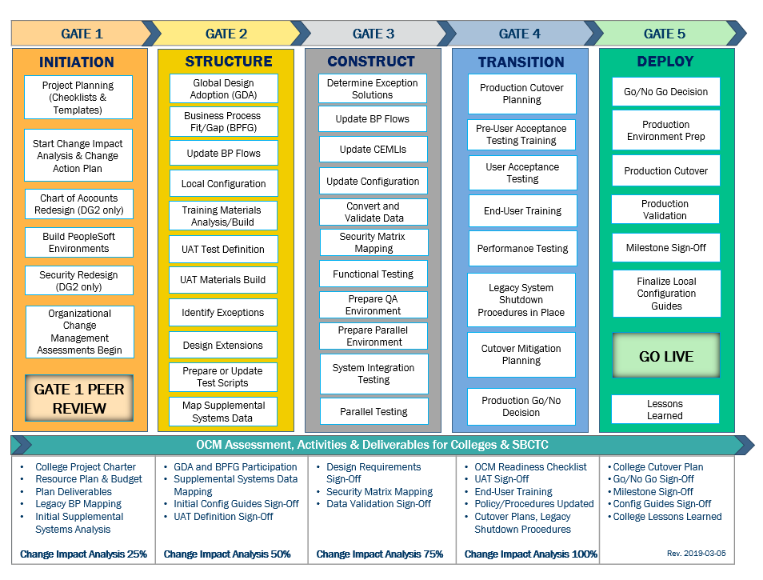
CTCLINK QUALITY GATES & MILESTONES

Slide 6
DG6 readiness TIMELINE
end of Nov. -
Dec. 2021
DG6-A: Feb. 10, 2022
DG6-B: April 1, 2022
DG6-C: April 14, 2022
DG6-A: Feb. 15, 2022
DG6-B: April 5, 2022
DG6-C: April 19, 2022
DG6-A: Feb. 28, 2022
DG6-B: April 25, 2022
DG6-C: May 9, 2022
Starts in
Dec. 2021
College readiness spreadsheet reviewed and drafted by ctcLink PMO team and DG6 PMs
Meetings and discussion with
DG6 PMs
*focused on Group A
(Groups: B & C Optional)
Readiness documents due from DG6 colleges, ctcLink Project team and SBCTC Support/Org teams
ctcLink Steering Committee review, discussion
DG6 go live Dates
KEY ELEMENTS OF QUALITY COLLEGE READINESS ASSESSMENT
Accuracy: true measurement of go live readiness
Consistency: one tracking tool
Identification of Gaps (for college-specific items)
Establishment of Mitigation Plans
Collaborative Process: Involvement/Assessment by College PMs, ctcLink & SBCTC Support/Organization Teams
Transparency: Report Readiness to all levels of ctcLink Governance

Slide 7
DG6-b: CLOVER PARK technical college, COLUMBIA BASIN COLLEGE & WALLA WALLA community college
College Readiness Assessments
ctcLink Project Team Recommendation
Steering Committee Decision & Approval of April 25, 2022 go live Date

Slide 8
COLLEGE READINESS STATUS: current
 | COLLEGE | DATA | SECURITY | TESTING | TRAINING | COLLEGE SUPPORT PLAN | TRANSITION | COMMS & OCM
 | CLOVER PARK | G | G | G | G | Y | Y | G
 | COLUMBIA BASIN | Y | G | Y | G | G | Y | Y
 | WALLA WALLA | G | G | G | G | Y | Y | G
STATUS LEGEND
R | RED - Critical system or organization issue, no mitigation available
O | ORANGE - System or organizational issue with workaround (mitigation plan)
Y | YELLOW - Somewhat ready for go live, small issues unresolved, doesn't impact go live
G | GREEN - Ready for go live

Slide 9
College readiness status: ESTIMATED at go live
 | COLLEGE | DATA | SECURITY | TESTING | TRAINING | COLLEGE SUPPORT PLAN | TRANSITION | COMMS & OCM
 | CLOVER PARK | G | G | G | G | G | G | G
 | COLUMBIA BASIN | Y | G | G | G | G | G | G
 | WALLA WALLA | G | G | G | G | G | G | G
STATUS LEGEND
R | RED - Critical system or organization issue, no mitigation available
O | ORANGE - System or organizational issue with workaround (mitigation plan)
Y | YELLOW - Somewhat ready for go live, small issues unresolved, doesn't impact go live
G | GREEN - Ready for go live

Slide 10
DG6-b: Clover Park Technical College presenters
Dr. Brian Lee, Project Manager
Lisa Wolcott, Executive Sponsor
Dr. Joyce Loveday, President

Slide 11
clover park technical COLLEGE READINESS
College Overview | Current Completion of Readiness Criteria | Current Go/No-Go Status | Estimated Go/ No-Go Status at go live
Data | 3 of 3 | G | G
Security | 3 of 3 | G | G
Testing | 8 of 8 | G | G
Training | 7 of 7 | G | G
College Support Plan | 4 of 5 | Y | G
Transition | 13 of 15 | Y | G
Comms & OCM | 7 of 8 | G | G
STATUS LEGEND
R | RED - Critical system or organization issue, no mitigation available
O | ORANGE - System or organizational issue with workaround (mitigation plan)
Y | YELLOW - Somewhat ready for go live, small issues unresolved, doesn't impact go live
G | GREEN - Ready for go live

Slide 12
clover park comments & MITIGATION plan
CATEGORY | COMMENTS | MITIGATION PLAN
Data | Production course fees seem to have some mismatches. | About 100 courses need to be fixed and we are currently working on it, to be completed before go live.
Security | Workbook submitted and Security Plan complete. | Planning to audit SVL prior to go live, especially with employees who have had changes required in test environments. Implementing SVL changes noted from Mock go live.
Testing | We have some refund configuration issues (Finance). | We will need to reconfiguration some of our FIN approval workflows (they work as designed in the system) but need to reflect our campus processes.
Training | End-user training started in January. In person classes and self-paced are currently running, will continue through July. | The campus will shift to lab and side-by-side training activities post go live.
College Support Plan | Elements of the College Support plan are being developed. Knowledge base completed, Ticketing System rolled out with ctcLink modification 03/31/2022. | Will develop the 30-, 60-, 90-day plan after readiness, but prior to go live.
Transition | Spring Class Schedule is complete, but Summer is outstanding, and fees have yet to be completely configured. AAR Reports and Transfer Credit Rules will not be completed by go live. We expect these to be complete by August. | FWL issues are expected not to be completed until after go live (some subject errors). Supplemental systems will have varying degrees of downtime but are preliminarily scheduled. Active Vendors/ suppliers will be updated Post go live.
Comms & OCM | Comms planning was completed, but is being continuously reformulated as we run them. Website and Policy Review is in process. | The campus needs to develop OCM Sustainability Plans based on Post go live evaluation of the user base.

Slide 13
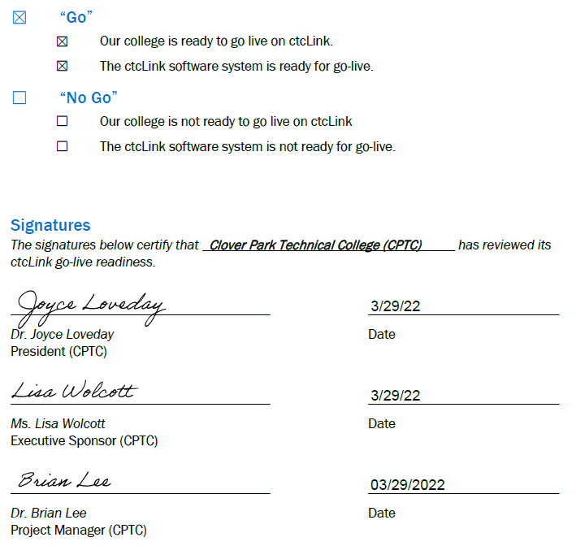
clover park go-live deployment recommendation form

Slide 14
DG6-b: Columbia Basin College presenters
Jeff Angus, Project Manager
Dr. Rebekah Woods, President & Executive Sponsor

Slide 15
COLUMBIA BASIN COLLEGE READINESS
College Overview | Current Completion of Readiness Criteria | Current Go/No-Go Status | Estimated Go/ No-Go Status at go live
Data | 2 of 3 | Y | Y
Security | 3 of 3 | G | G
Testing | 4 of 8 | Y | G
Training | 6 of 7 | G | G
College Support Plan | 3 of 5 | G | G
Transition | 10 of 15 | Y | G
Comms & OCM | 7 of 8 | Y | G
STATUS LEGEND
R | RED - Critical system or organization issue, no mitigation available
O | ORANGE - System or organizational issue with workaround (mitigation plan)
Y | YELLOW - Somewhat ready for go live, small issues unresolved, doesn't impact go live
G | GREEN - Ready for go live

Slide 16
COLUMBIA BASIN comments & MITIGATION plan
CATEGORY | COMMENTS | MITIGATION PLAN
Data | CS & HCM are all clear. In FIN: GL done, but not Refunds and a small subset of Acct Receivable. Continue through go live. | Pausing purchasing until July so we can focus more on everything else. Some clean-up will be post go live.
Security | Updating some scenarios to incorporate Data Governance protocols.
Testing | Haven't closed out about a dozen Waiver types for Student Financials (SF). Treasury completed 4/1/2022. | Time for testing and approval workflow corrections. Waivers are still an issue in UAT environment. Will formulate plan if not completely fixed by 4/1/2022.
Training | End-user training continues through July (Purchasing).
College Support Plan | Internal ticketing method, documentation and training delivered. Design for escalation built and communicated as far as supervisors. Plan to share with all April 20. | Designs to deflect activation and most-frequent security issues aimed to free up time to work on the less-expected issues.
Transition | Transfer Credit, Enrollment Reqs and AAR: None at 100%, but "good enough for go live." Working w/SBCTC HCM on some individual Time & Leave Work schedules. | Go live Weekend list done by 4/8/2022.
Comms & OCM | Comms/OCM timing shifts from recent legacy shutdown session, so continual evolution. Good shape.

Slide 17
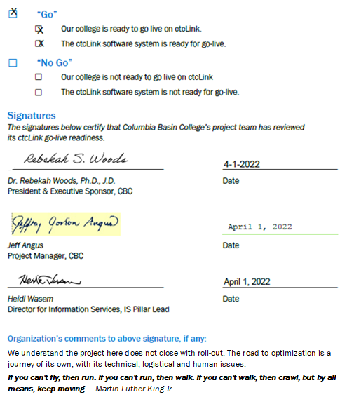
COLUMBIA BASIN go live deployment recommendation form

Slide 18
DG6-b: Walla Walla Community College presenters
Dr. Lisa Chamberlin, Project Manager
Dr. Chad Hickox, President & Executive Sponsor

Slide 19
Walla Walla Community College READINESS
College Overview | Current Completion of Readiness Criteria | Current Go/No-Go Status | Estimated Go/ No-Go Status at go live
Data | 3 of 3 | G | G
Security | 3 of 3 | G | G
Testing | 8 of 8 | G | G
Training | 7 of 7 | G | G
College Support Plan | 4 of 5 | Y | G
Transition | 14 of 15 | Y | G
Comms & OCM | 7 of 8 | G | G
STATUS LEGEND
R | RED - Critical system or organization issue, no mitigation available
O | ORANGE - System or organizational issue with workaround (mitigation plan)
Y | YELLOW - Somewhat ready for go live, small issues unresolved, doesn't impact go live
G | GREEN - Ready for go live

Slide 20
WALLA WALLA comments & MITIGATION plan
CATEGORY | COMMENTS | MITIGATION PLAN
Data | Continued clean up until go live. | SF Fees continue to be fine-tuned with Charles and Spencer and FIN SME.
Security | Security role management post go live plan is complete (policy and process).
Testing |  | AWE will continue to require refinement as impact to business processes is better understood post go live by end-users.
Training | End-user training continues through June ILT. 1331 Canvas courses completed by college employees. | Campus will shift to functional area workshops and onboarding training of new employees in production. Functional desktop guides will be developed throughout the first 365 days post go live.
College Support Plan | - Most resource support training occurring post Dry Run-->Pre go live. - Tier 1 support is currently completing Canvas training. - Escalation plan for Solar Winds complete. | - IT PM managing IT capacity, focus, and engagement on Tier 1 helpdesk activities. - 30-365 day plan for helpdesk/security role management complete. - Pillar plans in development.
Transition | Initial Course/Class build 100%, 42 AARs completed - set goal for 54/68 highest priority prior to GL. Transfer Rules/Vendors good. Concern over impact of faculty negotiations timing on summer quarter FWL. | 1099 entry will continue through go live. February/ March need to be completed. TLR mass upload will need modification post go live. Supplemental systems delayed until post go live to determine which are really necessary and which duplicate services in PS.
Comms & OCM | Data Oversight Group will manage formal policy/procedure changes (vetting for impact). Stabilizing temporary staff positions for sustainability. Building OCM momentum for strong adoption post go live. | OCM stability will depend on Pillar Leads/college leadership maintaining positive stance on working toward long-term benefit realization.

Slide 21
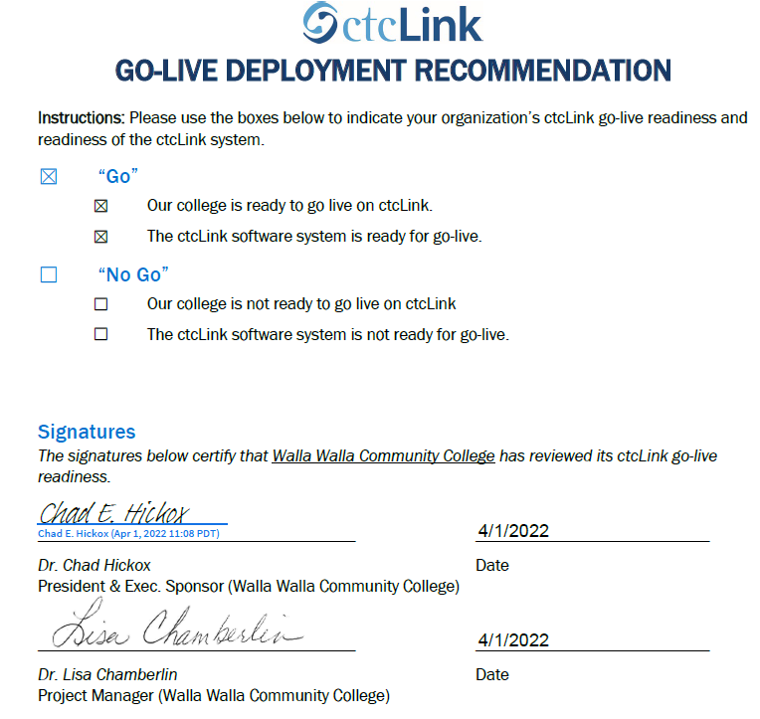
WALLA WALLA go live deployment recommendation form

Slide 22
Additional perspective
ctcLink Project Team Readiness
SBCTC Agency: Support/Organizations Team Readiness
Quality Assurance (Moran Technology Consulting)

Slide 23
ctcLink Project team: dg6-B Readiness concerns
STATUS: | G | → | G
Activities | Risks /Concerns | Target Completion Date/ Mitigation
Technical | No Technical concerns for DG6-B. | N/A
Testing (UAT stats as of 4/2/2022) | No Testing concerns for DG6-B, stats are below: Clover Park TC: Currently at 95% completed Columbia Basin: Currently at 96% completed Walla Walla: 100% completed | N/A
Security | No Security concerns for DG6-B. | N/A
PMO | Significant turnover in college resources. | During the onboarding of newly hired resources, there should be a detailed plan that includes ctcLink training materials.
Legacy | No Legacy concerns for DG6-B.

Slide 24
ctcLink Project team: dg6-B Readiness concerns
STATUS: | G | → | G
Activities | Risks /Concerns | Target Completion Date/ Mitigation
Financial Aid | No Financial Aid concerns for DG6-B. | N/A
Campus Solutions Core | Clover Park TC, Columbia Basin & Walla Walla: Colleges need to focus on Cleanup files from Cycle 5 prior to go live. | Final PRD lockout is 4/18/2022.
Human Capital Management | Clover Park TC, Columbia Basin & Walla Walla: Colleges need to focus on HCM PPMS system updates based on the dry run error files prior to go-live. | Target date is 4/20/2022.
Finance | No Finance concerns for go-live. | N/A
Student Financials | Clover Park TC, Columbia Basin & Walla Walla: Item Type GL final adjustment files. | Target date is 4/6/2022. If these files are not received, there are time constraint impacts below: Limited time to update the system with Item Type GL changes or added values Little to no time to report out of the system back to the college prior to go live Reduces feedback loop for colleges and team

Slide 25
SBCTC Agency: Support Organization Team DG6-B go live Readiness Criteria
DG6-B Readiness Assessment
Resources (functional) to support DG6-B colleges
Resources (technical) to support DG6-B colleges
Resources to support security
Access to documentation to ctcLink Project Team (homework & local/configuration)
dataLink set up and ready for DG6-B colleges
Mobile set up and ready for DG6-B colleges
Participation in transition (cutover, go live post support)

Slide 26
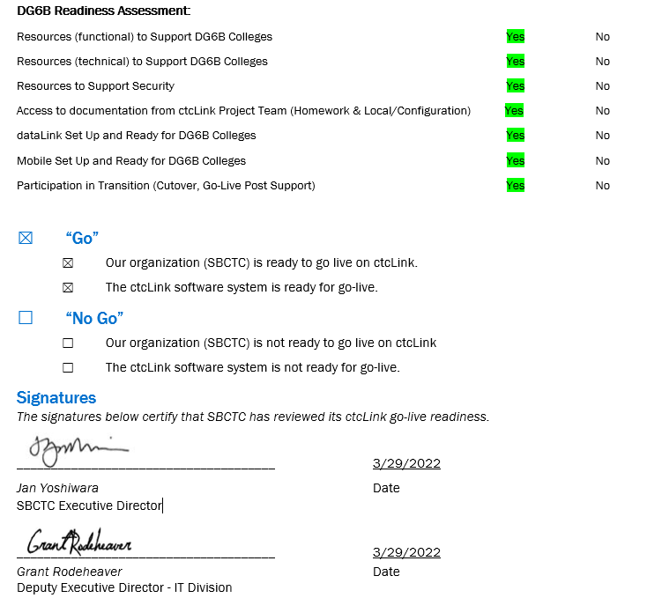
Sbctc support organization go live READINESS ASSESSMENT & recommendation form

Slide 27
Moran technology perspective
Paul Giebel, Quality Assurance (Moran Technology Consulting)

Slide 28
Recommendation to Steering committee
The ctcLink Project team recommends the ctcLink Steering Committee approve DG6-B colleges (Clover Park Technical College, Columbia Basin College, and Walla Walla Community College) to go live on ctcLink on April 25, 2022.

