Slide 1
DG6-C gate 5: college readiness
DISCUSSION & APPROVAL
ctcLink Project Steering Committee
April 19, 2022

Slide 2
agenda
Item | Description | Time | Facilitator
1 | Welcome, Introduction of Guests & Committee Members | 10 | Tim Wrye, Christy Campbell, All
2 | Review DG6-C Go-Live Readiness Status College Readiness ctcLink Project Team Readiness SBCTC/Customer Support Readiness Quality Assurance (Moran Technology Consulting) Action Item Vote on DG6-C readiness for May 9, 2022, go-live | 60 | Reuth Kim, College PMs, Executive Sponsors, Presidents Christy Campbell Grant Rodeheaver Paul Giebel Steering Committee
3 | Next Steps & Transition to Regular Steering Committee meeting | 5 | Christy

Slide 3
dg6-c college leadership
Yakima Valley College
Clarissa Wolfe, Project Manager
Dr. Teresa Rich, Executive Sponsor
Dr. Linda Kaminski, President
South Puget Sound Community College
Missy Yates, Project Manager
Rip Heminway, Executive Sponsor
Dr. Timothy Stokes, President
Bates Technical College
Nick Lutes, Executive Sponsor
Dr. Lin Zhou, President

Slide 4
CTCLINK PROJECT STEERING COMMITTEE
VOTING MEMBERS | NON-VOTING
College Executive Sponsors Tim Wrye, Highline, ctcLink Project Steering Committee Chair Reagan Bellamy, Wenatchee Valley Kurt Buttleman, Seattle Rodger Harrison, Bellevue Carolyn Tucker, Skagit Valley Chad Stiteler, Bellingham SBCTC Deputy Executive Directors Grant Rodeheaver, Information Technology Choi Halladay, Business Operations Carli Schiffner, Education | Members Christy Campbell, Chief Technology Officer–ctcLink Paul Giebel, Moran Technology Consulting, External QA Rich Tomsinski, OCIO Consultant Chris McLain, LWTech, Executive Sponsor Clay Krauss, Tacoma, PM Brian Lee, Clover Park, PM Commission Representatives Peter Lortz, North Seattle, Instruction Commission (IC) Ruby Hayden, LWTech, Washington State Student Services Commission (WSSSC)

Slide 5
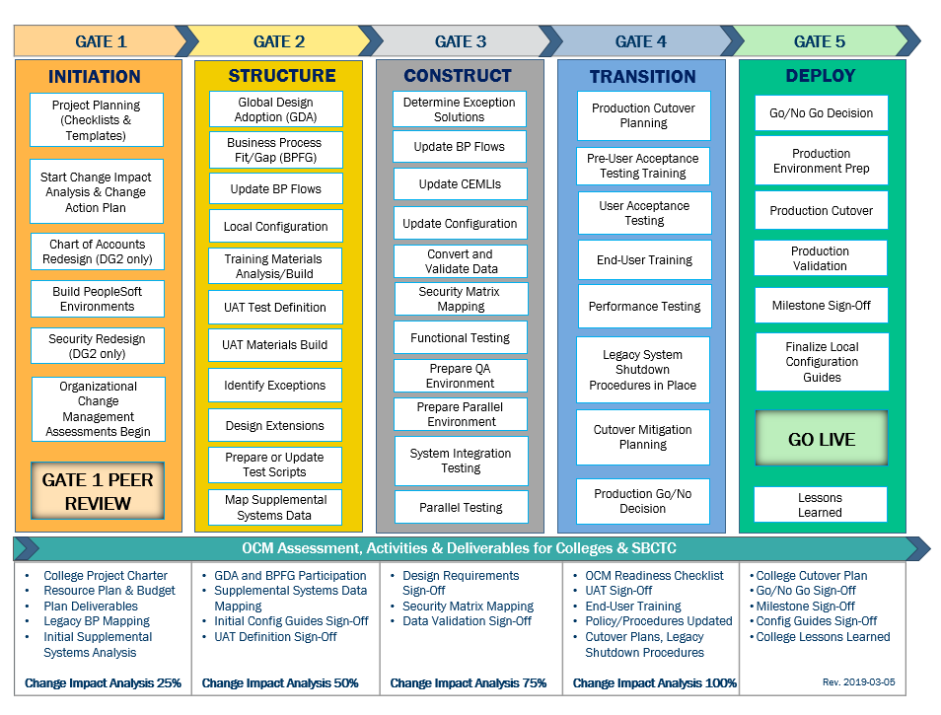
CTCLINK QUALITY GATES & MILESTONES

Slide 6
DG6 readiness TIMELINE
end of Nov. -
Dec. 2021
DG6-A: Feb. 10, 2022
DG6-B: April 1, 2022
DG6-C: April 14, 2022
DG6-A: Feb. 15, 2022
DG6-B: April 5, 2022
DG6-C: April 19, 2022
DG6-A: Feb. 28, 2022
DG6-B: April 25, 2022
DG6-C: May 9, 2022
Starts in
Dec. 2021
College readiness spreadsheet reviewed and drafted by ctcLink PMO team and DG6 PMs
Meetings and discussion with
DG6 PMs
*focused on Group A
(Groups: B & C Optional)
Readiness documents due from DG6 colleges, ctcLink Project team and SBCTC Support/Org teams
ctcLink Steering Committee review, discussion
DG6 Go-Live Dates
KEY ELEMENTS OF QUALITY COLLEGE READINESS ASSESSMENT
Accuracy: true measurement of go-live readiness
Consistency: one tracking tool
Identification of Gaps (for college-specific items)
Establishment of Mitigation Plans
Collaborative Process: Involvement/Assessment by College PMs, ctcLink & SBCTC Support/Organization Teams
Transparency: Report Readiness to all levels of ctcLink Governance

Slide 7
DG6-C: Yakima Valley College, South Puget Sound Community College, Bates Technical College
College Readiness Assessments
ctcLink Project Team Recommendation
Steering Committee Decision & Approval of May 9, 2022 Go-Live Date

Slide 8
COLLEGE READINESS STATUS: current status
 | COLLEGE | DATA | SECURITY | TESTING | TRAINING | COLLEGE SUPPORT PLAN | TRANSITION | COMMS & OCM
 | YAKIMA VALLEY | G | G | G | G | G | Y | G
 | SOUTH PUGET SOUND | G | G | G | G | G | Y | G
 | BATES | G | G | G | Y | Y | Y | Y
STATUS LEGEND
R | RED - Critical system or organization issue, no mitigation available
O | ORANGE - System or organizational issue with workaround (mitigation plan)
Y | YELLOW - Somewhat ready for Go-Live, small issues unresolved, doesn't impact Go-Live
G | GREEN - Ready for Go-Live

Slide 9
College readiness status: ESTIMATED at GO-Live
 | COLLEGE | DATA | SECURITY | TESTING | TRAINING | COLLEGE SUPPORT PLAN | TRANSITION | COMMS & OCM
 | YAKIMA VALLEY | G | G | G | G | G | G | G
 | SOUTH PUGET SOUND | G | G | G | G | G | G | G
 | BATES | G | G | G | G | G | G | G
STATUS LEGEND
R | RED - Critical system or organization issue, no mitigation available
O | ORANGE - System or organizational issue with workaround (mitigation plan)
Y | YELLOW - Somewhat ready for Go-Live, small issues unresolved, doesn't impact Go-Live
G | GREEN - Ready for Go-Live

Slide 10
DG6-C: Yakima Valley College presenters
Clarissa Wolfe, Project Manager
Dr. Teresa Rich, Executive Sponsor
Dr. Linda Kaminski, President

Slide 11
Yakima Valley College READINESS
College Overview | Current Completion of Readiness Criteria | Current Go/No-Go Status | Estimated Go/No-Go Status at Go-Live
Data | 3 of 3 | G | G
Security | 3 of 3 | G | G
Testing | 8 of 8 | G | G
Training | 7 of 7 | G | G
College Support Plan | 5 of 5 | G | G
Transition | 13 of 15 | Y | G
Comms & OCM | 8 of 8 | G | G
STATUS LEGEND
R | RED - Critical system or organization issue, no mitigation available
O | ORANGE - System or organizational issue with workaround (mitigation plan)
Y | YELLOW - Somewhat ready for Go-Live, small issues unresolved, doesn't impact Go-Live
G | GREEN - Ready for Go-Live

Slide 12
Yakima Valley College comments & MITIGATION plan
CATEGORY | COMMENTS | MITIGATION PLAN
Data | Data clean-up will continue up to go-live.
Security | Workbook submitted and security plan complete.
Testing | Parallel and UAT testing complete. Approval Workflows complete.
Training | End-user training continues through 2022.
College Support Plan | Will use local Helpdesk ticket system for ctcLink support. Will communicate support, escalation, and post go-live plans to Pillar Leads and college community.
Transition | Legacy shutdown planned. dataLink ready; supplemental systems integration planned. Classes for Spring/Summer/Fall ready 4/29/2022. For AAR, AA-DTA ready 4/29/2022. | AAR and Transfer Credit builds will be ongoing through Summer. Assignment Types to be added after Go-Live.
Comms & OCM | Strong leadership and support for ctcLink. Continue review/update of plans through go-live and after.

Slide 13
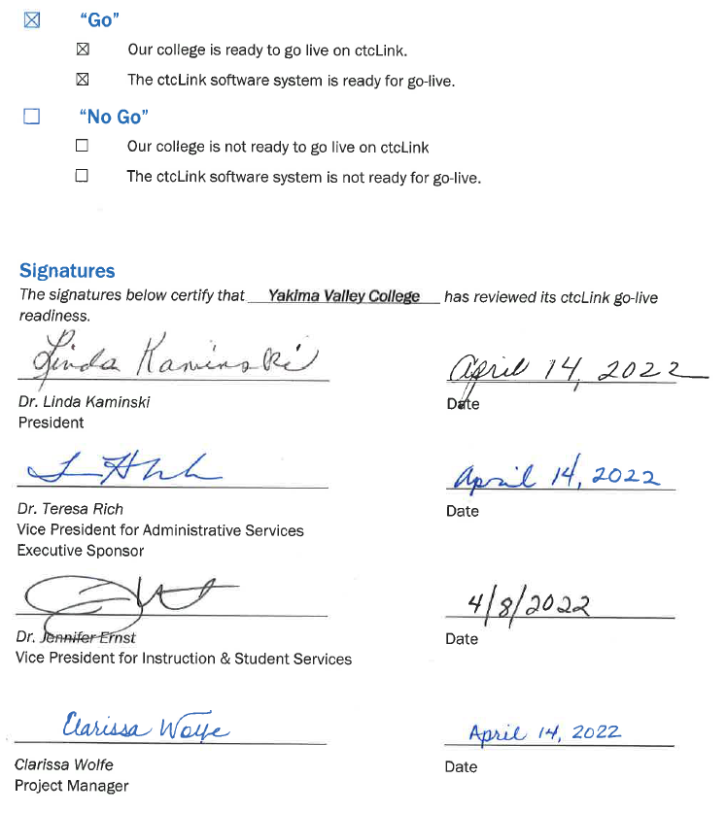
Yakima Valley go-live deployment recommendation form

Slide 14
DG6-C: South Puget Sound Community College presenters
Missy Yates, Project Manager
Rip Heminway, Executive Sponsor
Dr. Timothy Stokes, President

Slide 15
South Puget Sound CC READINESS
College Overview | Current Completion of Readiness Criteria | Current Go/No-Go Status | Estimated Go/No-Go Status at Go-Live
Data | 3 of 3 | G | G
Security | 3 of 3 | G | G
Testing | 6 of 8 | G | G
Training | 7 of 7 | G | G
College Support Plan | 5 of 5 | G | G
Transition | 13 of 15 | Y | G
Comms & OCM | 7 of 8 | G | G
STATUS LEGEND
R | RED - Critical system or organization issue, no mitigation available
O | ORANGE - System or organizational issue with workaround (mitigation plan)
Y | YELLOW - Somewhat ready for Go-Live, small issues unresolved, doesn't impact Go-Live
G | GREEN - Ready for Go-Live

Slide 16
South Puget Sound comments & MITIGATION plan
CATEGORY | COMMENTS | MITIGATION PLAN
Data | Validation and clean-up to continue through go-live.
Security | Audit of roles ongoing.
Testing | UAT expected completion is 4/18/2022.
Training | End-user training will continue through the end of academic / FY '23 to include just-in-time sessions throughout the year.
College Support Plan | Help Desk ticketing system used for tracking/escalating issues. Transition support team training in progress. Post go-live plan drafted as living document.
Transition | Class Schedule: Spring, Summer & Fall schedules complete by 4/22/2022; Vendor/Suppliers, Transfer Credit and AAR: ongoing through Summer. Supplemental Systems cannot be fully tested until after go-live. | Plan to use Pathways documentation and manual advising process for any AARs that are not yet complete; Supplemental Systems integrations tentatively scheduled; prioritized based on student impact.
Comms & OCM | Strong leadership and support; OCM activities ongoing, engaging staff with information, training and resources, focusing on the goal of benefits realization and monitoring levels of acceptance and adoption. | Post-implementation check-in discussions with users (meetings, surveys, etc.) will help monitor user adoption and benefits realization throughout transition and beyond.

Slide 17
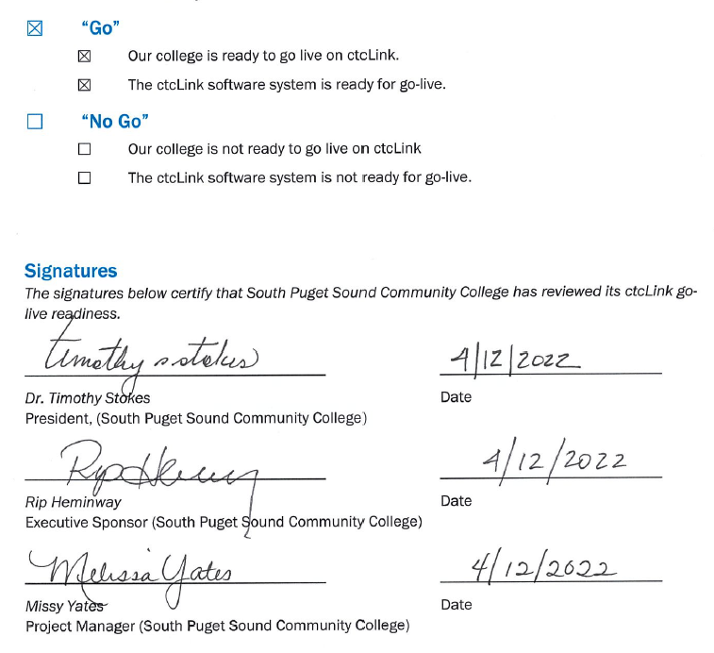
South Puget Sound go-live deployment recommendation form

Slide 18
DG6-C: Bates Technical College presenters
Nick Lutes, Executive Sponsor
Dr. Lin Zhou, President

Slide 19
Bates Technical College READINESS
College Overview | Current Completion of Readiness Criteria | Current Go/No-Go Status | Estimated Go/No-Go Status at Go-Live
Data | 2 of 3 | G | G
Security | 3 of 3 | G | G
Testing | 7 of 8 | G | G
Training | 4 of 7 | Y | G
College Support Plan | 3 of 5 | Y | G
Transition | 12 of 15 | Y | G
Comms & OCM | 5 of 8 | Y | G
STATUS LEGEND
R | RED - Critical system or organization issue, no mitigation available
O | ORANGE - System or organizational issue with workaround (mitigation plan)
Y | YELLOW - Somewhat ready for Go-Live, small issues unresolved, doesn't impact Go-Live
G | GREEN - Ready for Go-Live

Slide 20
BATES comments & MITIGATION plan
CATEGORY | COMMENTS | MITIGATION PLAN
Data | Duplicate students and correcting course/class is progressing well. Working on cleaning AR subledgers. | Continue: remove duplicate students; correct classes generating errors; clean AR.
Security | SME and CS pillar lead have been attending. Pillar LSAs have done training. Tara has met with newly identified security resources/staff. | Security Lead identified. Updating security plan to reflect recent staff changes and assignments. Working with IT staff on process and procedures for pre-production (SVL) and production environment security updates, to keep both aligned through May the fourth (be with you).
Testing | Bates is at 95% of UAT test completed. 100% completion is anticipated by 4/15/2022. | Must complete critical FIN UAT by 4/14/2022.
Training | Draft Help Guides and Tutorials web pages for students and employees are complete. PDFs and how-to docs in process. Information regarding SID to EMPLID crosswalk, activating user accounts have been communicated. Training plan is being updated to focus on the few weeks prior to and the first two weeks of go-live. | Confirm that training plan to support users for first time critical business process (such as completion of timesheets, purchasing and student registration) have needs addressed for go live training, such as: Identification of Trainers, establish a training the trainer session; access to training space to conduct training.
College Support Plan | College Support Plan is under development. Ticketing system is being updated to accommodate filter of ctcLink items to specifically constructed examination using SMEs and Business analyst position to triage/troubleshoot. | Will develop the 30-, 60-, 90-day plan after readiness but prior to go-live. Work with SBCTC to identify functions that would benefit from a "train the trainer" session.
Transition | Campus Solutions team has built 123 of 173 enrollment requirements. Prioritizing degrees, 84 Academic Advisement Requirements have been built. The AARs will be 'informational only' with contact information for students seeking information on AARs yet to be built. Fees are currently being linked to courses and classes for Summer and Fall Schedule. | Instructional Team will be building the Summer 2022 and Fall 2022 schedules on April 11-26 in the Downtown Campus computer lab. Instruction team is building Instructor/Advisor table. Vendor table will be built as allowed within balance of workload priorities (e.g., Legacy Data cleanup, priority Production data set construction) required for the college to go live.
Comms & OCM | Communications plan developed and communication deliverables are well-managed by Communications Lead. Crosswalk tools have been developed for Finance pillar. Student Financials crosswalk coding is under construction. | OCM items are pending. College needs to provide current assessment/status. Review college policies for incidents of overlap with Legacy and update to reflect ctcLink. Sustainability plans will be drafted post-go live after review of organizational impact.

Slide 21
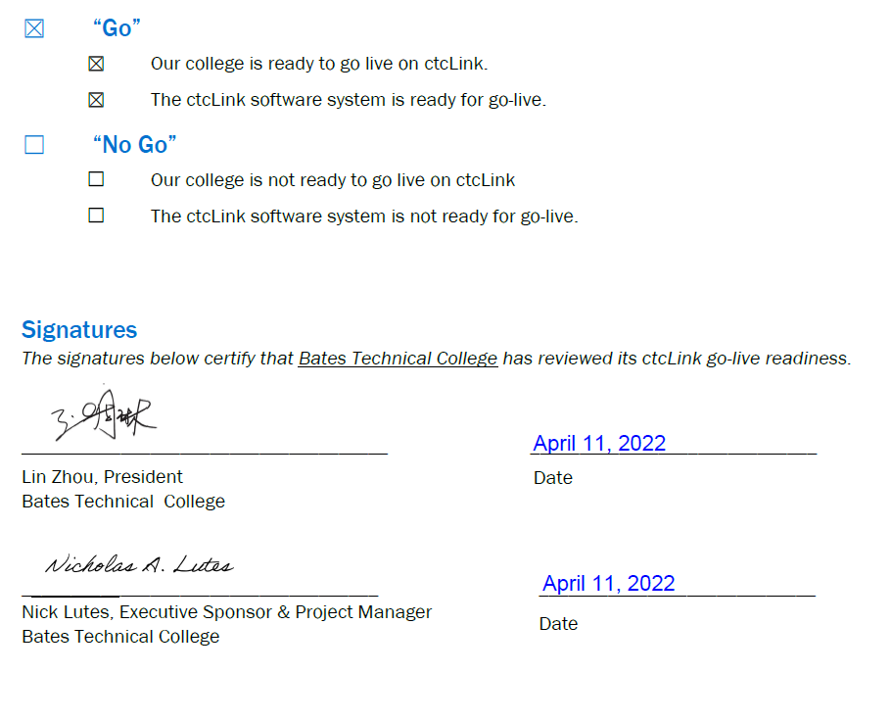
BATES TECHNICAL COLLEGE go-live deployment recommendation form

Slide 22
Additional perspective
ctcLink Project Team Readiness
SBCTC Agency: Support Organization Team Readiness
Quality Assurance (Moran Technology Consulting)

Slide 23
ctcLink Project team: dg6-C Readiness concerns
STATUS: | Y | → | G
Activities | Risks /Concerns | Target Completion Date/ Mitigation
Technical | No Technical concerns for DG6-C.
Testing (UAT stats as of 4/15/2022) | Yakima: 100% completed South Puget Sound: 96.9% completed 100% in all areas with the exception for FIN testing: 30.4% in Treasury Bates TC: 95.9% completed 100% in all areas except for FIN testing: 80% Procure to Pay, 75% Asset Management, 95.7% Treasury which totals 86.9% complete for FIN | *Treasury testing date is estimated to complete by 4/18/2022 end of day. College will continue to test until completion of FIN testing.
Security | Yakima: Training one additional new Local Security Administrator (LSA). Ready for go-live. South Puget Sound: No concerns ready for go-live. Bates TC: Training new LSA team, in progress. College will require assistance in SVL to ensure security meets implementation needs. | 5/4/2022
PMO | Significant turnover in college resources. | During onboarding of newly hired resources, there should be a detailed plan that includes ctcLink training materials.
Legacy | No Legacy concerns for DG6-C.

Slide 24
ctcLink Project team: dg6-C Readiness concerns
STATUS: | Y | → | G
Activities | Risks /Concerns | Target Completion Date/ Mitigation
Financial Aid | No Financial Aid concerns for DG6-C.
Campus Solutions Core | Yakima, South Puget Sound, Bates TC: Colleges need to focus on Cleanup files from Cycle 5 prior to go-live. | PS Course & Class Cleanup Due for Colleges: 4/29/2022. Legacy Cleanup Due for Colleges: 5/5/2022.
Human Capital Management | Yakima, South Puget Sound, Bates TC: Prior to go-live, colleges need to focus on HCM PPMS system updates based on dry run error files. | Legacy Cleanup Due for Colleges: 5/5/2022.
Finance | Bates: testing concerns as stated in testing section. *All DG6-C college resource concerns as stated in PMO section.
Student Financials | Yakima, South Puget Sound, Bates TC: Item Type GL final adjustment files. | Target date is 4/20/2022. If these files are not received, there are time constraint impacts below: Limited time to update the system with Item Type GL changes or added values Little to no time to report out of the system back to the college prior to go live Reduces feedback loop for colleges and team

Slide 25
SBCTC Agency: Support Organization Team DG6-c Go-Live Readiness Criteria
DG6-C Readiness Assessment
Resources (functional) to support DG6-C colleges
Resources (technical) to support DG6-C colleges
Resources to support security
Access to documentation to ctcLink Project Team (homework & local/configuration)
dataLink set up and ready for DG6-C colleges
Mobile set up and ready for DG6-C colleges
Participation in transition (cutover, go-live post support)

Slide 26
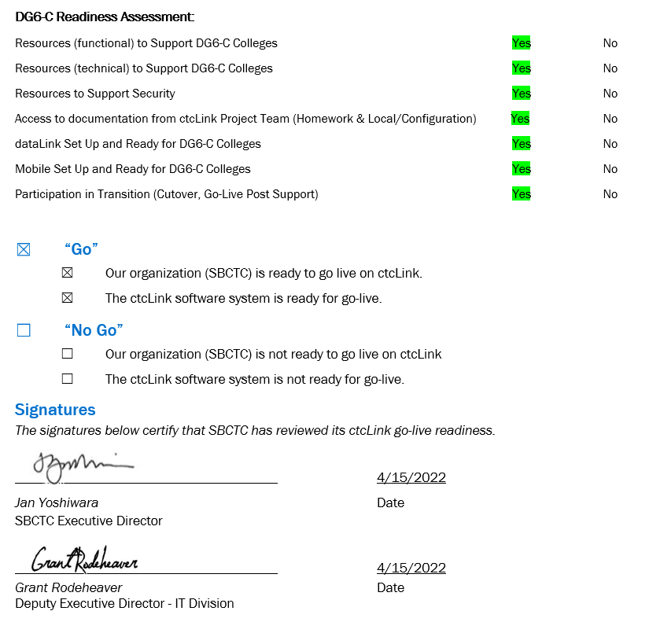
Sbctc support organization go-live READINESS ASSESSMENT & recommendation form

Slide 27
Moran technology perspective
Paul Giebel, Quality Assurance (Moran Technology Consulting)

Slide 28
Recommendation to Steering committee
The ctcLink Project team recommends the ctcLink Steering Committee approve DG6-C colleges (Bates Technical College, South Puget Sound Community College, and Yakima Valley College) to go live on ctcLink on May 9, 2022.

