Slide 1
2022 Production Release Dates – Pending Approval
Tuesday, March 29
Tax Update 22-A PRP
Thursday, June 23
FA Regulatory PRPs 2 & 3
Thursday, July 14
FA Regulatory PRP 4
Saturday, July 23
HCM Image 41 & Tax Update 22-B PRP
Saturday, October 8
HCM Image 43
Saturday, October 15
CS Image 26 & HCX Update
Saturday, October 29
FS Image 41
Saturday, December 10
HCM Image 44 & Tax Update 22-E PRP
Thursday, December 15
FS 1099 Update PRP
Saturday, December 17
CS Image 27 & HCX Update

Slide 2
2022 Production Release Dates by Pillar - Pending Approval
HCM
Tuesday, March 29
Tax Update 22-A PRP
Saturday, July 23
HCM Image 41 & Tax Update 22-B PRP
Saturday, October 8
HCM Image 43
Saturday, December 10
HCM Image 44 & Tax Update 22-E PRP
CS
Thursday, June 23
FA Regulatory PRPs 2 & 3
Thursday, July 14
FA Regulatory PRP 4
Saturday, October 15
CS Image 26 & HCX Update
Saturday, December 17
CS Image 27 & HCX Update
FSCM
Saturday, October 29
FS Image 41
Thursday, December 15
FS 1099 Update PRP

Slide 3
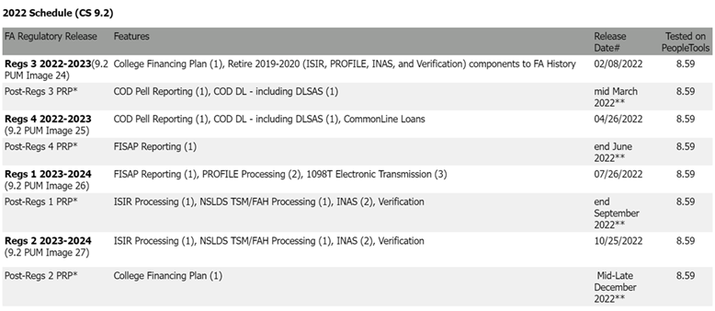
2022 Financial aid regulatory release schedule

