Slide 1
ctcLink DG5 LESSONS LEARNED
December 14, 2021
ctcLink Project Management Office

Slide 2
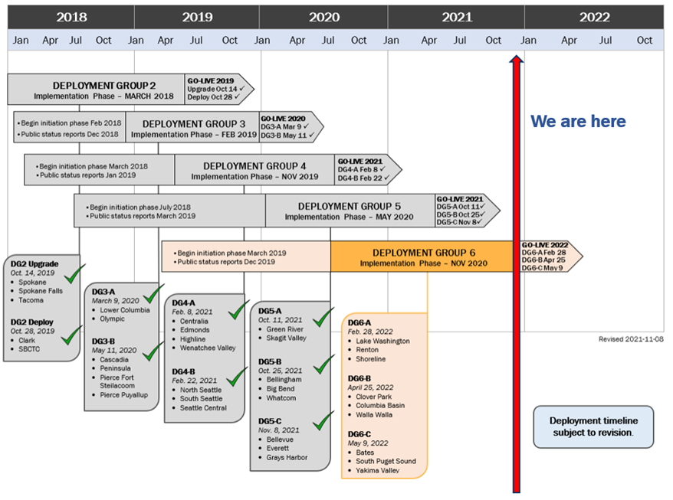
ctclink DEPLOYMENT GROUPS & TIMELINE

Slide 3
Ctclink quality gates & milestones
Ctclink quality gates & milestones
GATE 1 | GATE 2 | GATE 3 | GATE 4 | GATE 5
INITIATION
STRUCTURE
CONSTRUCT
TRANSITION
DEPLOY
Project Planning (Checklists & Templates)
Global Design Adoption (GDA)
Determine Exception
Solutions
Production Cutover Planning
Go/No Go Decision
Business Process Fit/Gap (BPFG)
Update BP Flows
Production Environment Prep
Start Change Impact Analysis & Change Action Plan
Pre-User Acceptance Testing Training
Update BP Flows
Update CEMLIs
User Acceptance Testing
Production Cutover
Local Configuration
Update Configuration
Chart of Accounts Redesign (DG2 only)
Training Materials
Analysis/Build
Convert and
Validate Data
End-User Training
Production Validation
Build PeopleSoft Environments
UAT Test Definition
Security Matrix
Mapping
Performance Testing
Milestone Sign-Off
Security Redesign (DG2 only)
UAT Materials Build
Functional Testing
Legacy System Shutdown Procedures in Place
Finalize Local Configuration Guides
Identify Exceptions
Prepare QA
Environment
Organizational Change Management Assessments Begin
Design Extensions
Prepare Parallel
Environment
Cutover Mitigation Planning
go-live
Prepare or Update
Test Scripts
System Integration Testing
GATE 1 PEER REVIEW
Map Supplemental Systems Data
Parallel Testing
Production Go/No Go Decision
Lessons
Learned
OCM Assessment, Activities & Deliverables for Colleges & SBCTC
College Project Charter Resource Plan & Budget Plan Deliverables Legacy BP Mapping Initial Supplemental Systems Analysis Change Impact Analysis 25% | GDA and BPFG Participation Supplemental Systems Data Mapping Initial Config Guides Sign-Off UAT Definition Sign-Off Change Impact Analysis 50% | Design Requirements Sign-Off Security Matrix Mapping Data Validation Sign-Off Change Impact Analysis 75% | OCM Readiness Checklist UAT Sign-Off End-User Training Policy/Procedures Updated Cutover Plans, Legacy Shutdown Procedures Change Impact Analysis 100% | College Cutover Plan Go/No Go Sign-Off Milestone Sign-Off Config Guides Sign-Off College Lessons Learned Rev. 2019-03-05

Slide 4
ctcLink is a people project
ctcLink Project Continuous Improvement Based on Prior Lessons Learned
Implementation methodology tested and refined over time
Conversion process works and is fine-tuned for each deployment
“Lessons Learned” Represents DG5 Collectively, not Individually
Expanded information-gathering
Common themes emerged from different stakeholder groups
Success is Borne of Local Efforts
Per Moran Technology Consulting, ctcLink Project Quality Assurance, Nov. 2020:
Successful experience of prior deployment does not ensure success for future colleges.
While ctcLink Project conversion and deployment methodology works, improving with each deployment, one aspect does not change: the amount of work required from each individual college for a successful implementation does not lessen.
College core business processes will substantially change, requiring a significant commitment, investment of time, and solid organizational change management practices by each college to implement ctcLink successfully.
Notes:
DG2 and DG3 were, by most accounts, successful implementations. There were hiccups that are being addressed but overall, the solution works. As the project has seen the deployments go smoother each time, there can be a belief that future deployment groups will have a much easier implementation.
However, while the solution and the conversion processes improve each time, there is one aspect that does not change – the amount of work necessary to be completed by each college in order to have a successful implementation.
There are a large number of college core business processes that will be substantially changing with ctcLink, requiring a significant commitment by each and every college in order to execute a successful implementation. (Moran Technology Consulting, ctcLink Project Quality Assurance, Monthly Report – November 2020.)

Slide 5
Significant changes from dg4 to dg5
New and improved strategies, training, and communication related to student financials
Increase in meetings with individual college project managers and teams
Guiding colleges through preparing for post go-live
Impact of the additional practice of final data validation activities during Cycle 4 data validation, Mock Go-Live Dry-Run
Significant improvements in learning and applying security
Substantially reduced conversion errors due to increased completion of User Acceptance Testing and data clean-up
DG5 colleges requested more “advanced” ctcLink post go-live support sessions

Slide 6
information gathering
During Implementation | Dates
Ongoing meetings with college PMs and SMEs | 2020 - 2021
DG5 PM meetings | 2020 – 2021
Executive Sponsor Meetings | December 2020 – 2021
Post Go-Live | Dates
Six focus groups, one with each of the sub-deployment project managers and executive sponsors | October and November 2021
ctcLink Project Team focus group | November 17, 2021
Key Informant interviews with ctcLink Project Leads | November 18, 2021

Slide 7
DG5 Lessons Learned Themes
Importance of College Leadership Engagement
Preparing for Go-Live
Resource Planning
Training
Security
Transition to Support

Slide 8
Importance of College Leadership
Executive sponsors need to have the resources and authority to mitigate barriers, including college culture resistant to change and financial/resource. (college)
Executive leadership needs to reach out to change-resistors and subject matter experts on their teams. (college)
PMs should meet regularly with President, Executive Sponsor, and executive leadership to provide the executive leaders with the necessary information to budget, allocate, and manage resources necessary to complete ctcLink activities. (college)
Executive sponsors should not hold another role in the ctcLink Project structure, e.g., pillar lead. (college)
Engage supervisors early and make sure they are knowledgeable about what to expect from the change to ctcLink; they will be key to communicating with and supporting the training of their teams. (college)
Frequently recognize people for the ctcLink work they do, including compensation, public recognition, and celebrations. (college)

Slide 9
Preparing for Go-Live
Prioritize Legacy data clean-up activities; it is one of the most important factors in a successful go-live experience. (college)
Map security roles for all employees prior to UAT. (college)
Make sure college offices are closed to finalize transactions in Legacy and for at least the first two weeks post go-live to fully participate in the ctcLink Support Webex Sessions. (college)
Plan for the budget tools that budget managers use after go-live, e.g., query access, commitment control budget reports, Tableau budget tool, etc.; connect with ctcLink-live colleges who have created budget tools. (college)
Capitalize on User Acceptance Testing (UAT) as an opportunity to practice cross-pillar work, especially financial aid and student financials; enrollment services, financial aid, and finance office; and work study, human resources, and payroll. (college and ctcLink project)

Slide 10
Preparing for Go-Live (CONT’d)
Reinforce how configuration decisions impact ctcLink during UAT. (college and ctcLink project)
Practice final data validation activities during Cycle 4 data validation, Mock Go-Live Dry-Run. (ctcLink project)

Slide 11
Resource Planning
Revisit and revise the college’s Resource Plan & Budget to ensure adequate resources are dedicated to complete the ctcLink activities prior to go-live and post go-live. Include the following items: (college)
Hire business analysts early; they are instrumental in preparing and stabilizing ctcLink.
Assign at least one person full-time, with back-up, as Local Security Administrators (LSA).
Hire faculty advocates to serve as points of contacts, liaisons, and lead-trainers. They are also great resources to lead other faculty to support students in the transition to ctcLink.
Revisit and revise the college’s Communication Plan; attend Communication Meetings and use the ctcLink Student Communication Resource Guide, ctcLink Executive Sponsor Guide (under Communications Planning Resources), and Post Go-Live Planning Guide. (college)

Slide 12
Training
Assign a local training lead and ensure the college community is engaged and taking the training; publicly track training for all employees. (college)
Offer college-sponsored post go-live open support session for each full day from when employees begin to activate their accounts through next quarter student registration. The sessions should be staffed by two to ten people to problem-solve account activation, security issues, reporting time and leave, enrollment processes, and other processes that non-SME people encounter. (college)
Hold Key Concepts training before the UAT relevant test cases. (ctcLink project)
Increase training prior on go-live on dual processing in financial aid. (ctcLink project and support)
Increase training to on how the sub-modules and payroll flow to general ledger. (ctcLink project and support)

Slide 13
Training (Cont’d)
Within the Quick Reference Guides (QRGs), indicate the order of operations (e.g. this is step 1, 2, 7 or step 18) for each business process’ component parts to give context within the overall business process described (ctcLink project and support)
Centralize the branding of the QRGs to become the colleges’ How-To Guides where appropriate. (ctcLink support)

Slide 14
Security
Engage college’s Legacy security leads in the security work prior to go-live so their knowledge and responsibility can be more aligned with ctcLink security requirements. (college)
Offer colleges Visio and other documentation to provide them the environment details they would need to work in the environment, including data snap-shots, corresponding security roles, and usage. (ctcLink project)
Develop more job aids to crosswalk job roles/duties to the necessary security roles (i.e., business operations by job descriptions that match to security roles). (ctcLink project)
Provide a link for LSAs in the QRGs that identify which security role(s) is needed for each business operation explained in the QRG. (ctcLink project and support)

Slide 15
Transition to Support
Make sure the right people are present and actively engaged in the Webex Support Sessions. (college)
Partner with another ctcLink-live college and use the relevant ctcLink listserv to receive mentorship and learn best practices; these actions will enhance go-live support. (college)
Engage ctcLink Support team throughout the implementation activities prior to go-live for an easier transition. (ctcLink project and support)
Ensure the scheduled post go-live Webex Support Sessions are in alignment with the time of go-live and sequences of business processes. (ctcLink support)

Slide 16
Next Steps & reference links
DG5 LESSONS LEARNED MEETINGS | DATE
Moran Technology Consultants review draft DG5 Lessons Learned report | December 2021
Present Lessons Learned to ctcLink Steering Committee | December 14, 2021
Distribute to DG5 PMs and Executive Sponsors | December 14, 2021
Post Final Report | December 14, 2021
DG5 Lessons Learned ctcLink Connect blog post | December 17, 2021
Present Lessons Learned to DG6 Executive Sponsors | December 20, 2021
Post Lessons Learned report deliverable to OCIO website | January 5, 2022
Present Lessons Learned to All-PM Meeting | January 5, 2022
Present Lessons Learned to cELC | January 26, 2022

