Slide 1
SBCTC
PeopleSoft Load Testing Results Review
DG2, DG3 & DG4
Prepared by
Kastech Software Solutions Group

Slide 2
Agenda
Scope
Approach
Assumptions
Findings
Results based on Recommendations
Key Takeaways

Slide 3
Scope of the Project
Perform load testing on the technical components of ctcLink (App, Web, database and network) and ensure that Application works as expected under heavy loads
Obtain baseline performance profile for all the SBCTC PeopleSoft systems hosted on AWS environment
Perform the tests on Production like environment with respect to architecture and capacity and configuration of the servers
Ensure the PeopleSoft Applications have adequate capacity to support anticipated User loads
Identify the bottle necks in the system (Application, Web, Database and network) and ensure that Application works as expected under predefined loads.
Determine application limitations under maximum number of active users performing common transactions.
Provide documentation on any changes recommended to improve service and delivery for students/employees using the PeopleSoft environment.

Slide 4
Approach
Utilize most frequently used transactions that may have potential impact to the load on the system and user experience
Test system with 30% of the current production population anticipated for DG2, DG3 & DG4
Include Fluid User Interface transactions
Execute multiple user type scripts (Student, Faculty, Staff, Employee and Manager)
Follow an incremental/Iterative approach and identify the break points for predefined load
Managed Services/Burgundy team to monitor the servers/infrastructure on AWS and make changes according to the load
Number of Load users by Application & User Type
CS | Student | 24000
CS | Faculty | 4000
CS | Staff | 4000
HR | Employee | 12000
HR | Manager | 1500
FIN | Procurement Finance Accountant | 300
Code | College | Student count | DG
WA171 | Spokane CC | 13279 | DG2
WA172 | Spokane Falls CC | 10061 | DG2
WA220 | Tacoma CC | 14582 | DG2
WA140 | Clark | 7749 | DG2
WA110 | Pierce | 9228 | DG3
WA300 | Cascadia | 3119 | DG3
WA010 | Peninsula | 2158 | DG3
WA030 | Olympic College | 6828 | DG3
WA130 | Lower Columbia | 3309 | DG3
WA062 | Seattle Central | TBF | DG4
WA063 | North Seattle | TBF | DG4
WA064 | South Seattle | TBF | DG4
WA090 | Highline | TBF | DG4
WA120 | Centralia | TBF | DG4
WA130 | Wenatchee Valley | TBF | DG4
WA150 | Edmonds | TBF | DG4

Slide 5
Assumptions
Testing to be performed on SBCTC AWS production like environment to meet the loads of students and staff
All the tests were executed through Interaction HUB portal (ctcLink Portal)
Recommendations provided based on the Deployment Group 2, Deployment Group 3 & Deployment Group 4 load.
Recommended changes will be made to the infrastructure, should be relative the future state anticipated loads

Slide 6
CS Transaction Scope & Results – Before & After
S.No | Transaction Name | Error % Before | Error % After
1 | Login into CS | 74.10 | 0.17
2 | Course Search with 2 criteria | 72 | 0.1
3 | Register for Four (4) Classes | 76.12 | 0.01
4 | View Grades | 0.67 | NA
5 | View Financial Aid | 1.45 | 0.25
6 | Add 4 Courses | 80.12 | 1.23
7 | Ad hoc add course | 73.89 (8k Students) | 0.21
8 | Add a Course | 71.25 (8k Students) | 0.24
10 | Drop Class | NA | NA
11 | Swap Class | NA | NA
12 | Calendar Inquiry | 0.27 | NA
13 | Modify Personal Data | 0.61 | NA
15 | Account Inquiry (SF) | 0.84 | NA
16 | View Class Schedule | 0.91 | NA
Details (Key Takeaway: Average percentage of errors for these transaction went down by 97.17%)
Student transactions were tested for 24000 users with a ramp up of 0.1 seconds.
Current Production average user load is around 1500 in an hour
Note: Two transactions in BOLD were successful when we tested it with 64 servers for 8000 students equivalent to 128 servers for 24000 students. 128 Servers’ scenarios will likely not happen until we go live with all 34 colleges

Slide 7
CS Results – Faculty Transactions
S.No | Transaction Name | Error % Before | Error % After
1 | Track Attendance | 63.76 | 0.19
2 | Lookup teaching schedule | 73.24 | 0.64
3 | Lookup advisee schedule | 76.33 | 1.05
4 | Lookup advisee grades | 68.84 | 0.32
5 | Modify Bio/Demo | 62.89 | 0.32
6 | Search Classes | 71.75 | 0.20
7 | View Student Account | 72.63 | 0.17
8 | Lookup Class Roster | 62.89 | 0.32
Details (Key Takeaway: Average percentage of errors for these transaction went down by 99.43%)
All scripts were executed through iHUB portal
Faculty and staff tested for 4000 users with a ramp up of 0.1 seconds.

Slide 8
CS - Current Production vs Recommended Configuration
Pillar | User Type | Count
CS | Student | 24000
CS | Faculty | 4000
CS | Staff | 4000
Parameter | Portal |  | Campus
 | Current | Recommended Config | Current | Recommended Config
Number of Application server Instances | 2 | 48 | 6 | 128
Number of Webserver Instances | 2 | 48 | 6 | 128
Number of Application server processes | 8 | 48 | 8 | 128
DB instance Size | m5.large | m5.8xlarge | m5.2xlarge | db.m5.12xlarge
Jolt min handlers | 8 | 50 | 8 | 50
Jolt max handlers | 12 | 70 | 12 | 70
Recycle count | 4000 | 2500 | 4000 | 2500

Slide 9
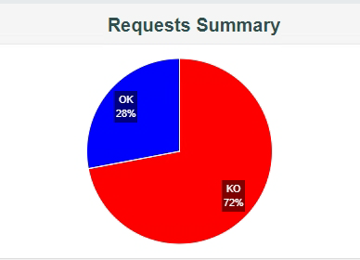
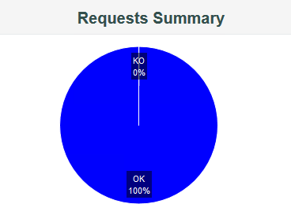
CS - Key Takeaways - Course Search using Elastic Search
Before implementing the recommended settings
28% of student transactions were executed successfully
72% of student transactions failed.
After implementing the recommended settings
99.99% of the student transactions were executed successfully
Only 0.01% of the student transactions failed.

Slide 10
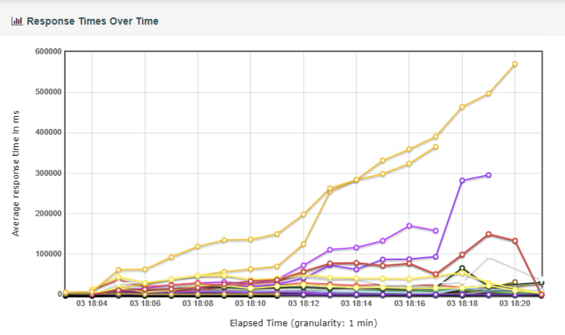
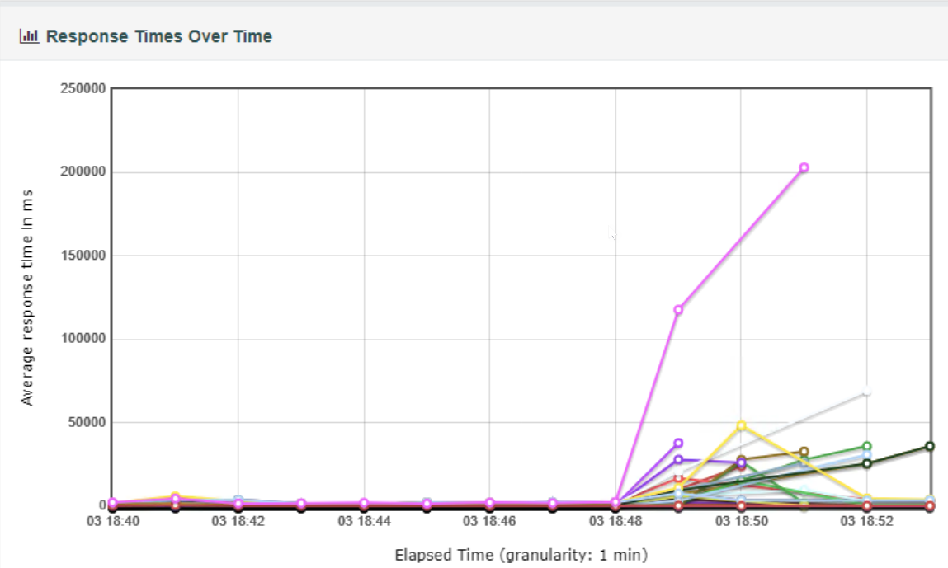
Current Configuration Vs New Configuration
CS (Course search with 2 criteria)
Response time got decreased drastically after suggested configuration changes from
Key Takeaway: Avg: 10 Mins response time vs Avg: 3 Secs of response time

Slide 11
Financial Aid/Student Financials Scope – New Configuration
S.No | Managers Transactions | Error %
1 | Fluid UI-Payment History | 0.00%
2 | Fluid UI-Account SummaryPage | 0.02%
3 | SS-Fluid-1098T | 0.43%
5 | Charges Due Page | 0.53%
6 | SS-Fluid-Make a Payment | 0.67%
8 | Fluid UI-College Financing Plan | 0.00%
9 | Fluid UI | 0.00%
11 | Fluid UI-Inquiry Data Page | 0.00%
12 | Fluid UI-FA Landing Page | 0.00%
13 | Fluid UI-Disbursements | 1.28%
Details:
Key Takeaway: 0.29% average errors were found using recommended settings on a smaller load of 300 users
These are the results for FS SF module
Test script was executed through iHub for 24000 users with a ramp up of 0.1 seconds.
Since environment was sized already with CS tower, all the scripts were executed successfully with < 1% errors.

Slide 12
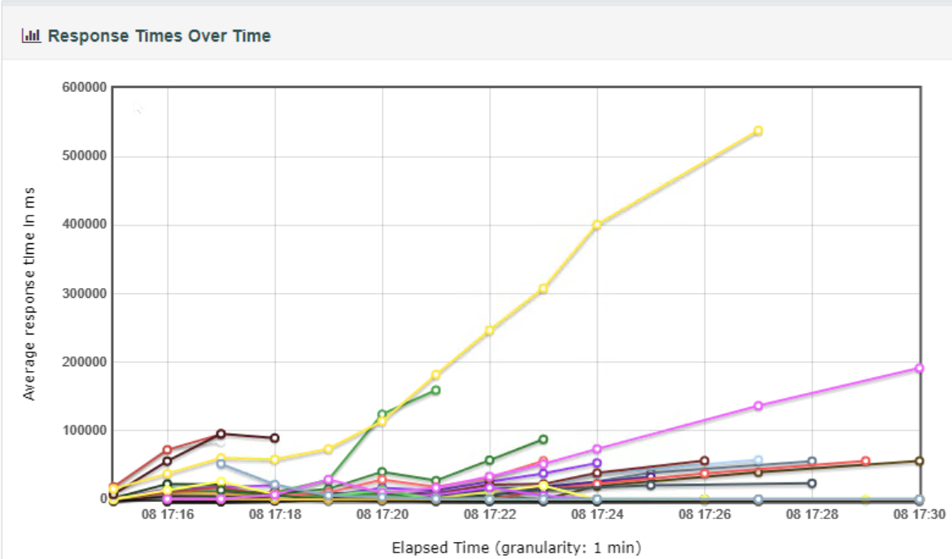
With New Configuration
Financial Aid / Student Financial -(Account Inquiry)
Response time decreased drastically after suggested configuration changes from 1300 sec to 7 sec
Key Takeaway: Avg: 22 Mins response time vs Avg: 7 Secs of response time

Slide 13
FINANCE Scope - Current vs New Configuration Results
User Type | Count
Procurement/Finance/Accountant | 300
Scope: S.No | Transaction Name | Load | Error %
1 | Create PO | 300 | 0.00%
2 | Enter Change Order to PO | 300 | 0.00%
3 | Create Voucher | 300 | 0.37%
4 | Create Journal | 300 | 0.94%
5 | Enter Suppliers | 300 | 0.00%
6 | Update Supplier | 300 | 0.00%
7 | Delete Supplier | 300 | 0.00%
Results: Parameter | FSCM (Current Prod) | FSCM (Suggested Config)
Number of Application server Instances | 2 | 48
Number of Webserver Instances | 2 | 48
DB instance Size | m5.2xlarge | m5.8xlarge
Jolt min handlers | 8 | 50
Jolt max handlers | 12 | 70
No. of Application server processes | 8 | 40
Recycle count | 4000 | 2500
Key Takeaway: 0.19% average errors were found using recommended settings on a smaller load of 300 users

Slide 14
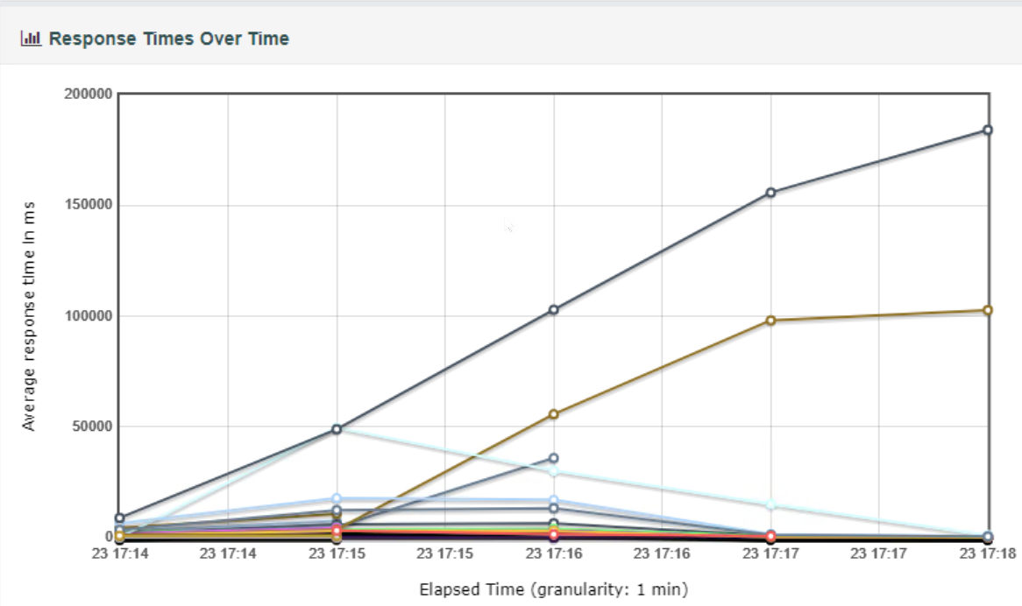
FINANCE (Create Journal)
With New Configuration
Response time got decreased drastically after suggested configuration changes from
Key Takeaway: Avg: 6 Mins response time vs Avg: 15 Secs of response time

Slide 15
HCM Scope - Current vs New Configuration Results
Parameter | HCM (Current Production) | HCM (Recommended Configuration)
Number of Application server Instances | 24 | 48
Number of Webserver Instances | 24 | 48
DB instance Size | m5.xlarge | m5.4xlarge
Jolt min handlers | 8 | 50
Jolt max handlers | 12 | 70
No. of Application server processes | 8 | 40
Recycle count | 4000 | 2500
Employee Transactions – 12000 Employees
Manager Transactions – 1500 Managers
S.No | Employee Transactions | Error %
1 | View Paycheck | 1.33%
2 | View W2 | 1.02%
3 | W2 Consent | 1.16%
4 | Submit W4 Tax | 0.71%
5 | View Dependent Beneficiaries | 0.91%
6 | View Benefits summary | 0.71%
S.No | Managers Transactions | Error %
1 | Job Data Inquiry | 0.80%
2 | Promotions | 0.61%
3 | Terminations | 0.81%
4 | Transfer | 0.38%
5 | Address Change | 0.31%
Key Takeaways:
0.97% average errors were found using recommended settings on Employee transactions
0.97% average errors were found using recommended settings on Manager transactions

Slide 16
Key Takeaways - Summary
On an average, errors went down by 95% based on our findings & recommended settings
Assumed recommended configuration is maintained 24/7 to meet the anticipated load by managed services
Load balancer server was not distributing the load among multiple servers equally, and the issue has been addressed
Based on our findings, the current infrastructure hosted on AWS needs to be ramped up from fewer times of the current infrastructure
Kastech recommends to turn on the autoscaling feature on AWS
If SBCTC thinks the overall cost to maintain the recommended configuration is too high, data analysis can be carried out after 6 months or 1 year to identify the total load on the system and configuration can be modified accordingly

Slide 17
Addendum Slides

Slide 18
Kastech Findings from Phase-1
Load handling ability of an application depends on multiple components within Application.
It has been identified that the current SBCTC production configuration cannot handle the anticipated load.
Fine-tuning of below items is suggested:
Application server
Number of Web server
DB instance Size
Jolt min handlers
Jolt max handlers
No. of Application server processes
Recycle count

Slide 19
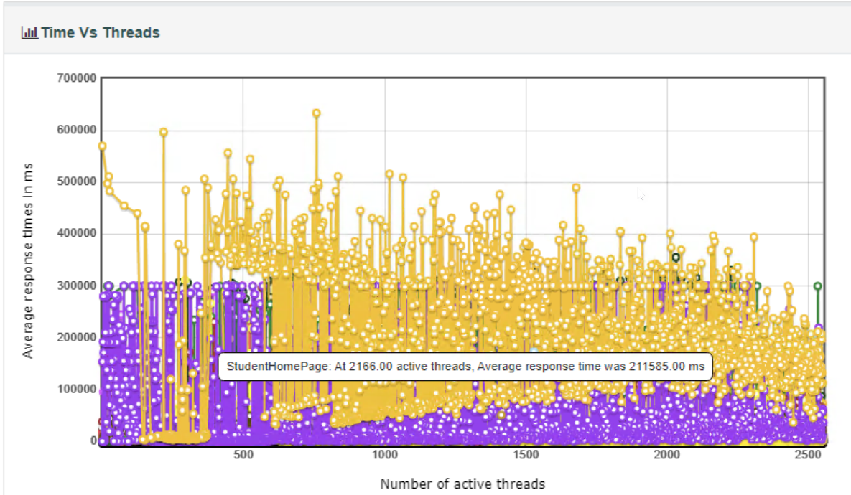
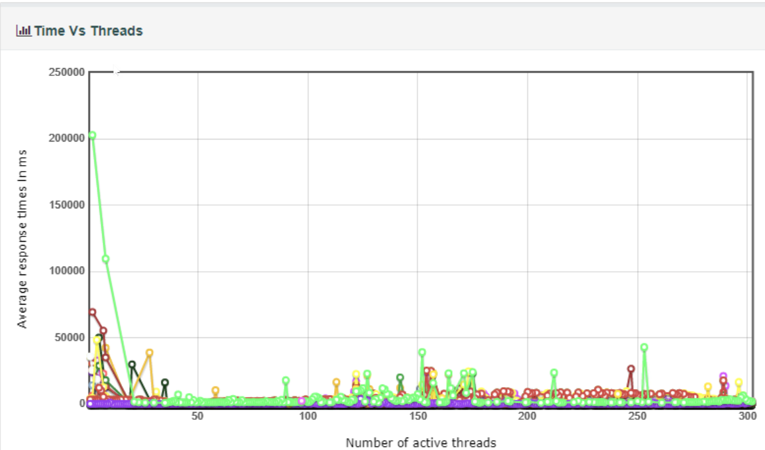
Current Configuration Vs New Configuration
CS (Course search with 2criteria)
Number of active threads per sec and response time got reduced
Avg: 13 Mins/600 users vs Avg: 5 Secs/50 users

Slide 20
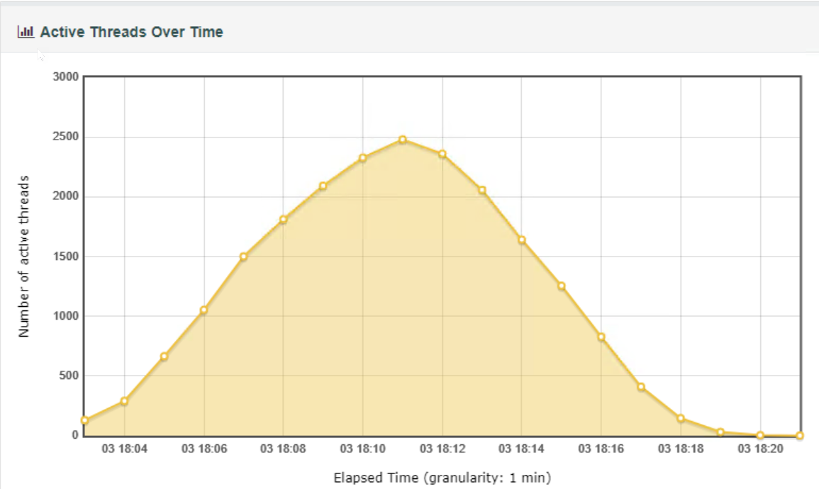
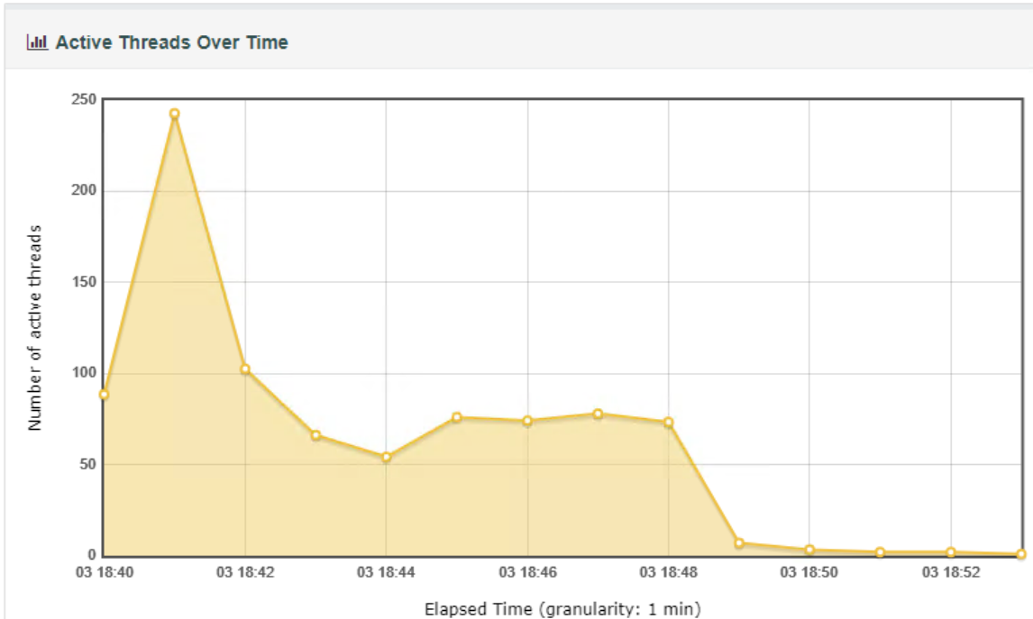
Current Configuration Vs New Configuration
CS (Course search with 2 criteria)
Active Threads Over Time showing number of active threads as time elapses
Avg: 800 Active Threads vs Avg: 50 Active Threads

Slide 21
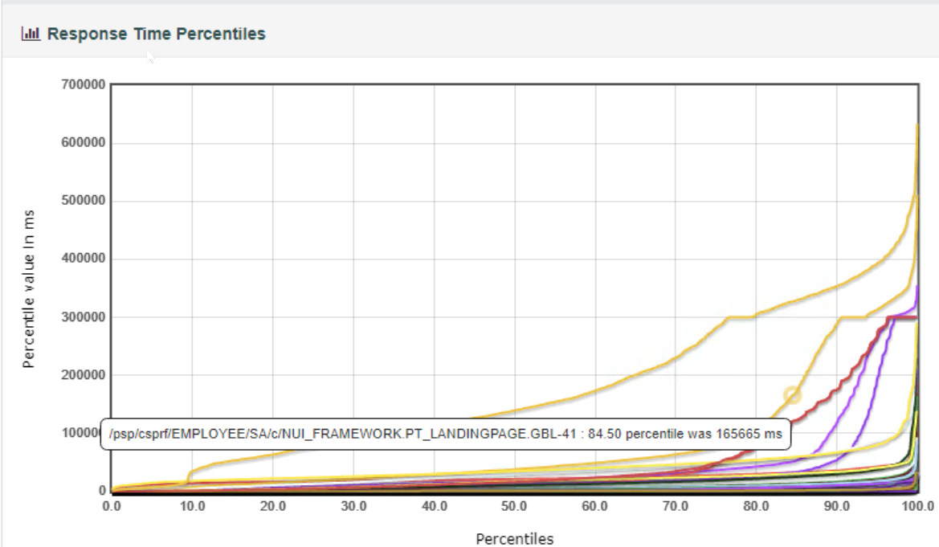
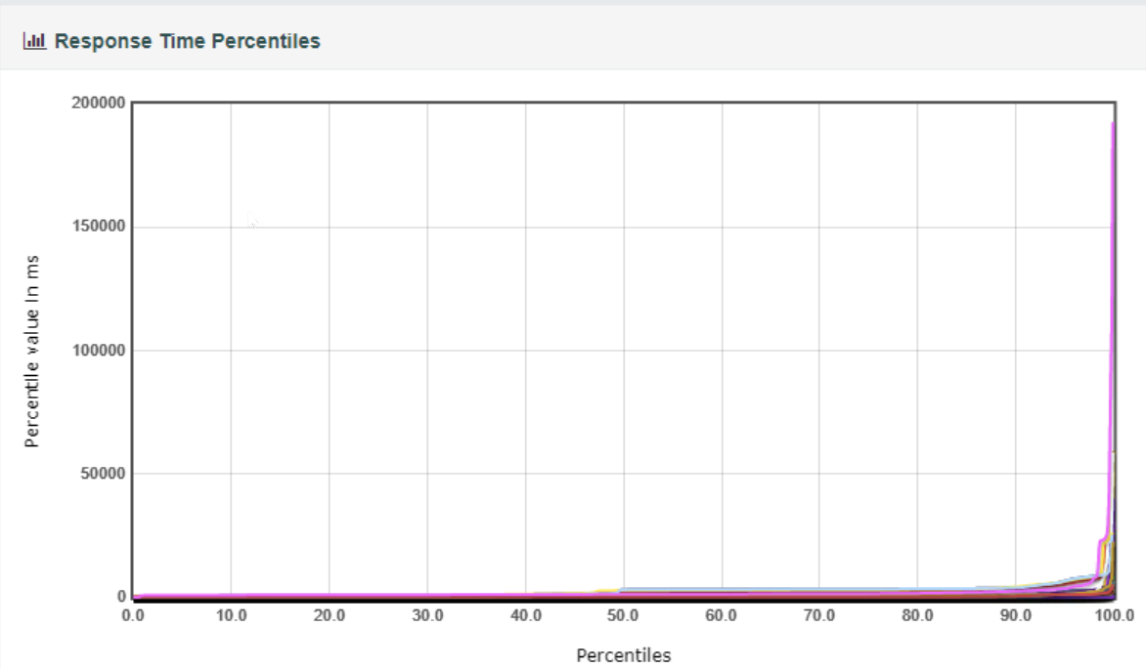
Current Configuration Vs New Configuration
CS (Course search with 2 criteria)
Response time is too low compared to initial configuration
At 100% Response time is: 13+ Mins Vs 6 Secs

Slide 22
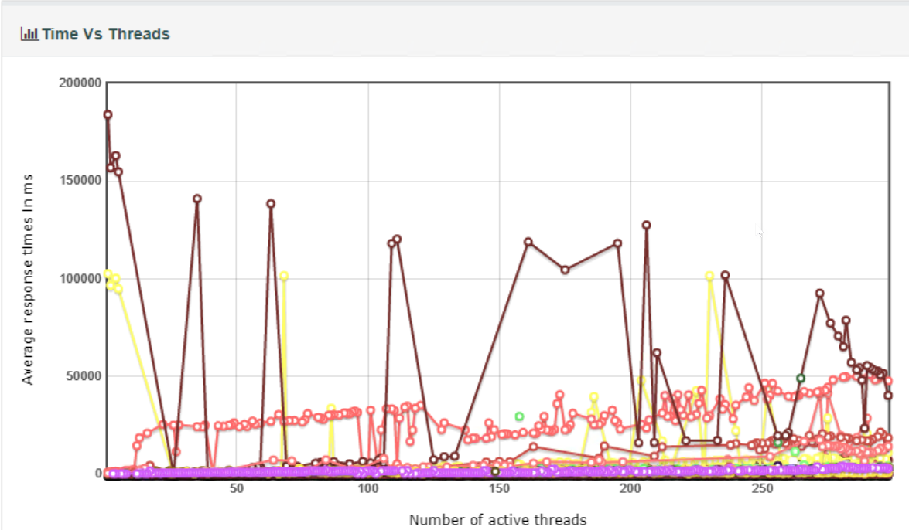
FSCM (Create Journal)
With New Configuration
Number of active threads per sec and response time got reduced
Avg: 5 Mins/70 users vs Avg: 15 Secs/80 users

Slide 23
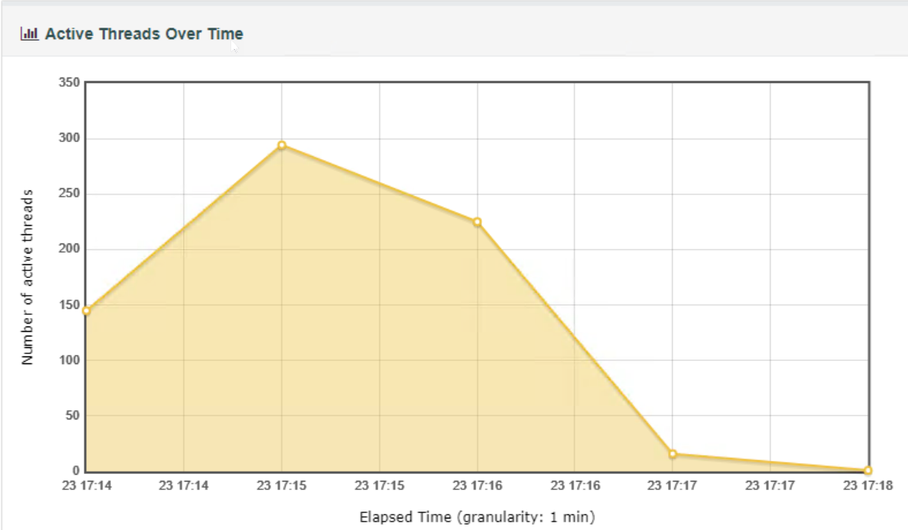
FSCM (Create Journal)
With New Configuration
Active Threads Over Time showing number of active threads as time elapses
Avg: 130 Active Threads vs Avg: 120 Active Threads

Slide 24
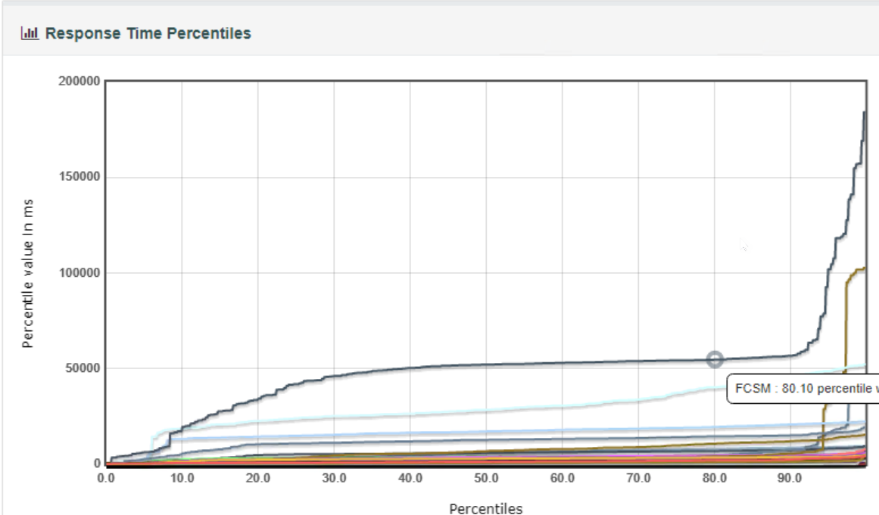
FSCM (Create Journal)
With New Configuration
Response time is too low compared to initial configuration
At 100% Response time is: 5+ Mins Vs 50 Secs

Slide 25
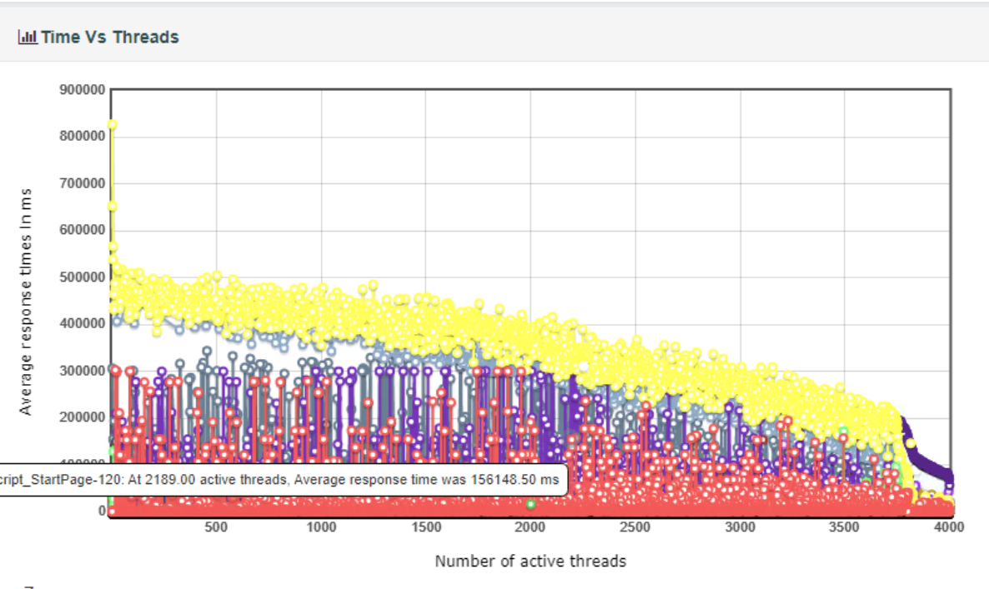
With New Configuration
FA-SF(Account Inquiry)
Number of active threads per sec and response time got reduced
Avg: 8 Mins/600 users vs Avg: 12 Secs/100 users

Slide 26
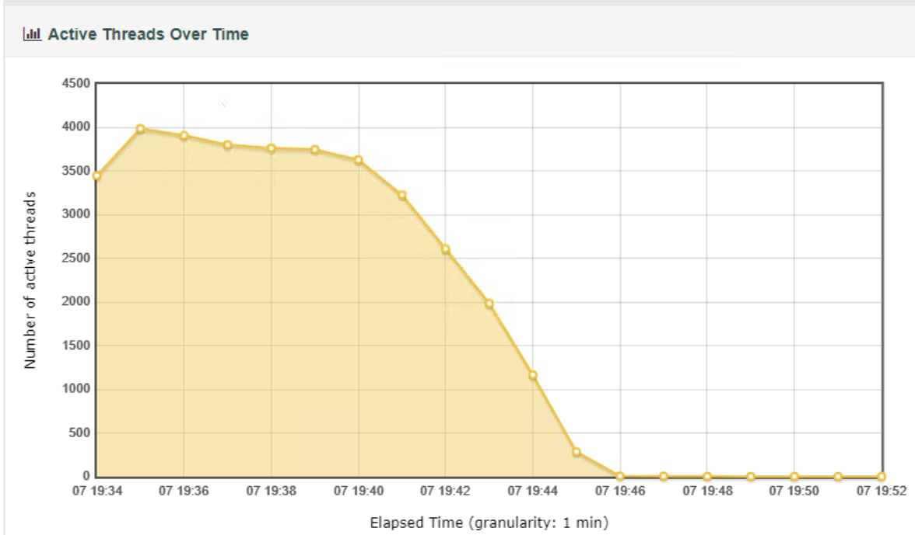
With New Configuration
FA-SF(Account Inquiry)
Active Threads Over Time showing number of active threads as time elapses
Avg: 1000 Active Threads vs Avg: 130 Active Threads

Slide 27
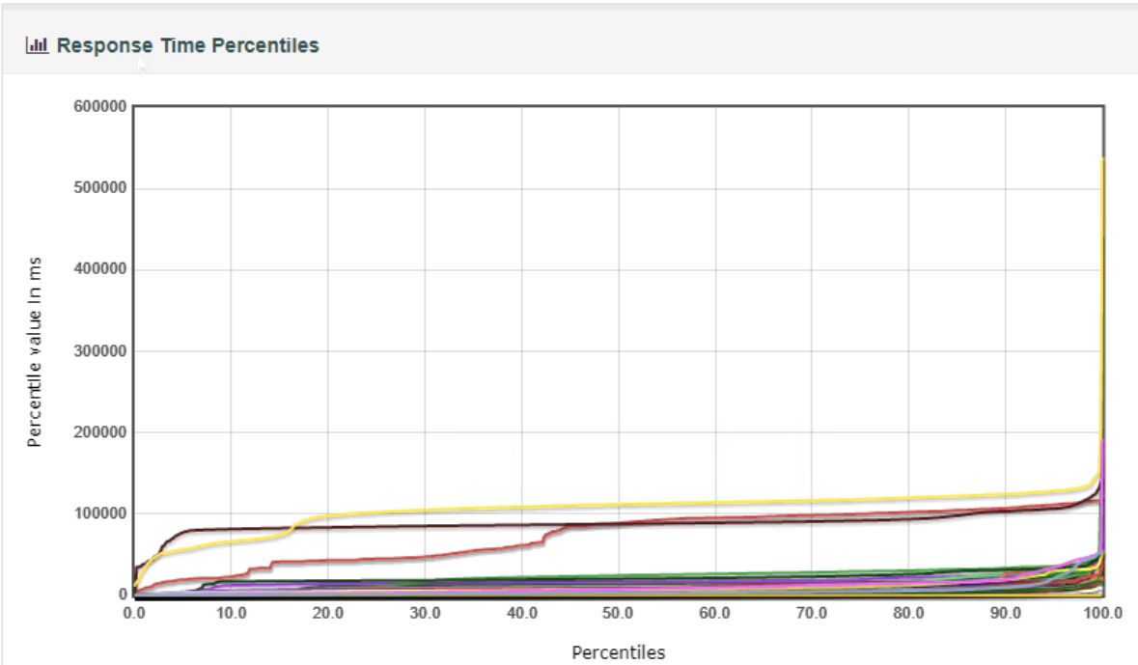
With New Configuration
FA-SF(Account Inquiry)
Response time is too low compared to initial configuration
At 100% Response time is: 9+ Mins Vs 15 Secs

