Slide 1
SBCTC
PeopleSoft Load Testing Results Review
Final Run
Prepared by
Kastech Software Solutions Group
Edited Feb. 8, 2022

Slide 2
Agenda
Scope
Approach
Assumptions
Findings
Results Based on Recommendations
Key Takeaways
2

Slide 3
Scope of the Project
Perform load testing on the technical components of ctcLink (App, Web, database and network) and ensure application works as expected under heavy loads.
Verify prior recommendations provided during DG2/3 and confirmed with DG5.
Perform the test in Production-like environment, with infrastructure scaled to prior recommendation state at the commencement of the load test.
Ensure the PeopleSoft applications have adequate capacity to support anticipated user loads at DG6 deployment.
Identify any new bottlenecks in the system (application, web, database and network) and ensure that application works as expected under predefined loads.
Determine application limitations under maximum number of active users performing common transactions.
Provide documentation on any changes recommended to improve service and delivery for students/employees using the PeopleSoft environment.
3

Slide 4
Approach
Include most frequently used transactions that might have potential impact to the load on the system.
Test system with 30% above the current production population anticipated for DG2, DG3, DG4, DG5 & DG6.
25% Student Population/50% Employee Population of All Colleges are being considered for Final Load Testing.
Include Fluid User Interface transactions which includes FA and SF transactions.
Execute multiple user type scripts (Student, Faculty, Staff, Employee and Manager).
Follow an incremental/Iterative approach and identify the break points for predefined load.
Burgundy team to monitor the servers/infrastructure on AWS and make changes according to the load.
Number of Load users by Application & User Type
CS | Student | 35,000
CS | Faculty | 4,000
CS | Staff | 4,000
HR | Employee | 12,000
HR | Manager | 1,500
FIN | Procurement Finance Accountant | 300
4

Slide 5
Assumptions
Testing to be performed on SBCTC AWS production-like environment to meet the loads of students and staff.
All tests were executed through Interaction HUB portal.
Recommendations were provided based on the Final Load.
Changes to infrastructure in the future should be relative to the future state anticipated loads.
5

Slide 6
Current Production vs Recommended Configuration
Pillar | User Type | DG5 Round Count | Final Round Count
CS | Student | 24,000 | 35,000
CS | Faculty | 4,000 | 4,000
CS | Staff | 4,000 | 4,000
Parameter | Portal |  | Campus
 | Current | Recommended Config* | Current | Recommended Config*
Number of Application server Instances | 2 | 48 | 6 | 128
Number of Webserver Instances | 2 | 48 | 6 | 128
Number of Application server processes | 8 | 48 | 8 | 128
DB instance Size | m5.large | m5.8xlarge | m5.2xlarge | db.m5.12xlarge
Jolt min handlers | 8 | 50 | 8 | 50
Jolt max handlers | 12 | 70 | 12 | 70
Recycle count | 4,000 | 2,500 | 4,000 | 2,500
6
* Recommendations from DG5 round remain confirmed.

Slide 7
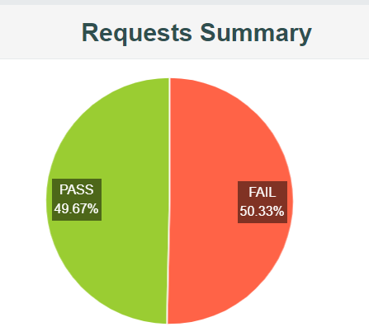
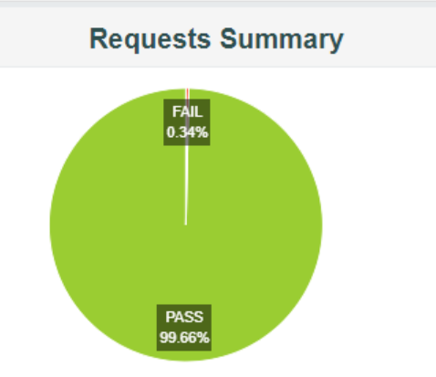
Key Takeaways – Search for Open Class using Elastic Search
Run With Recommended Settings At Original Ramp-Up Time
(Ramp-up time is 0.01 sec)
Load Testing with 10,000 student increment:
49.67% of student transactions were executed successfully.
50.33% of student transactions failed.
After Adjusting Ramp-Up Time
(Ramp-up time is 0.10* sec)
Load Testing with 35,000 students:
99.66% of the student transactions were executed successfully
Only 0.34% of the student transactions failed.
* Recommended Ramp-up Time by Managed Services
7

Slide 8
Results – Before and after implementing Suggestions
Below are the results for “Search for Open Class” transaction. This is with Elastic Search.
Test script was executed through iHub for 35,000 users with a ramp-up of 0.1 seconds.
Managed Services team reiterated no config change is needed to fix failure when we tested with ramp-up of 0.01 sec per user, since this is not a real-time scenario. So we changed ramp-up to 0.1 sec
With Recommended Config
49.67% students were able to perform the transaction successfully.
50.33% students were dropped out at multiple stages of transaction.
Reasons for failure:
Web server not available/not responding.
Gateway timeout
Bad Gateway
99.66% students were able to complete the transaction successfully.
0.34% students were dropped out.
8

Slide 9
CS Results – Student Scripts
S.No | Transaction Name | Error %
1 | Login into CS | 1.22
2 | Course Search with 2 criteria | 1.05
3 | Register for Four (4) Classes | NA
4 | View Grades | 0.14
5 | View Financial Aid | 0.09
6 | Add 4 Courses | NA
7 | Ad hoc add course* | NA
8 | Ad hoc* | NA
10 | Drop Class | NA
11 | Swap Class | NA
12 | Calendar Inquiry | NA
13 | Modify Personal Data | 0.53
15 | Account Inquiry (SF) | 0.00
16 | View Class Schedule | 0.30
17 | Search for Open Class | 0.34
Key Takeaway: Current Production environment set to handle 8K student load and positioned to scale to handle 35K student load.
Details
All scripts were executed through iHUB portal
Student transactions were tested for 35,000 users with a ramp-up of 0.01 seconds
Current Production average user load is around 1500 in an hour
* Note: Two transactions in BOLD were successful when tested with 64 servers for 8,000 students; equivalent to 128 servers for 35,000 students. 128 Servers scenarios will likely not happen until we go live with all 34 colleges.
9

Slide 10
CS Results – Faculty Transactions
S.No | Transaction Name | Error %
1 | Lookup teaching schedule | 0.44
2 | Lookup advisee schedule | 0.00
3 | Lookup advisee grades | 0.38
4 | Modify Bio/Demo | 0.37
5 | Search Classes | 0.46
6 | View Student Account | 0.28
7 | Lookup Class Roster | 0.15
Key Takeaway: Current Production environment sized to handle the 4K load
Details
All scripts were executed through Interaction HUB portal
Faculty and staff tested for 4,000 users with a ramp-up of 0.1 seconds
10

Slide 11
FSCM (FIN) New Configuration Results
User Type | Count
Procurement/Finance/Accountant | 300
Parameter | FSCM (Current Prod) | FSCM (Recommended Config)
Number of Application server Instances | 2 | 48
Number of Webserver Instances | 2 | 48
DB instance Size | m5.2xlarge | m5.8xlarge
Jolt min handlers | 8 | 50
Jolt max handlers | 12 | 70
No. of Application server processes | 8 | 40
Recycle count | 4000 | 2500
S.No | Transaction Name | Load | Error %
1 | Create PO | 300 | 0.48
2 | Enter Change Order to PO | 300 | 0.00
3 | Create Voucher | 300 | 0.29
4 | Create Journal | 300 | 1.09
5 | Enter Suppliers | 300 | 0.00
6 | Update Supplier | 300 | 0.00
7 | Delete Supplier | 300 | 0.30
8 | Journal Edit | 300 | 0.33
9 | Journal Post | 300 | 0.51
10 | Create Requisitions | 300 | 0.00
Key Takeaway: Recommended Settings confirmed to handle the FSCM Load
11

Slide 12
HCM Load Testing
All the tests are done through Interaction HUB portal.
Tests were performed on 12,000 employees and 1,500 Managers with ramp-up period of 0.1 seconds.
Pillar | User Type | Counts
HCM | Employee | 12,000
HCM | Manager | 1,500
12

Slide 13
HCM - On Recommended Configuration
Parameter | HCM (Current Production) | HCM (Recommended Configuration)
Number of Application server Instances | 24 | 48
Number of Webserver Instances | 24 | 48
DB instance Size | m5.xlarge | m5.4xlarge
Jolt min handlers | 8 | 50
Jolt max handlers | 12 | 70
No. of Application server processes | 8 | 40
Recycle count | 4,000 | 2,500
Employee Transactions
Manager Transactions
S.No | Employee Transactions | Error %
1 | View Paycheck | 0.21
2 | View W2 | 0.12
3 | W2 Consent | 0.23
4 | Submit W4 Tax | 0.13
5 | View Dependent Beneficiaries | 0.06
6 | View Benefits summary | 0.08
S.No | Managers Transactions | Error %
1 | Job Data Inquiry | 0.07
2 | Promotions | 0.12
3 | Terminations | 0.03
4 | Transfer | 0.02
5 | Address Change | 0.68
Key Takeaway: Recommended Settings confirmed to handle the Manager and Employee Self-service Load
13

Slide 14
FA/SF – Results Using New Configuration
S.No | Managers Transactions | Error %
1 | Fluid UI-Payment History | 0.00
2 | Fluid UI-Account Summary Page | 0.00
3 | SS-Fluid-1098T | 0.05
4 | Charges Due Page | 0.06
5 | SS-Fluid-Make a Payment | 0.09
6 | Fluid UI-College Financing Plan | 0.05
7 | Fluid UI | 0.01
8 | Fluid UI-Inquiry Data Page | 0.87
9 | Fluid UI-FA Landing Page | 0.87
10 | Fluid UI-Disbursements | 0.27
These are the results for FA/SF module.
Test script was executed through iHub for 35,000 users with a ramp up of 0.01 seconds.
Since environment was sized already with CS tower, all the scripts were executed successfully with < 1% errors.
Key Takeaway: Recommended settings confirmed to handle 35,000 Student load
14

Slide 15
Key Takeaways - Summary
On an average, errors went down by 95% based on our findings and recommended settings (from prior test round).
Kastech recommends scaling up to the recommended settings in advance of peak periods. A key outcome of Load testing is proactively monitoring Load and working with Managed Services to request changes to settings. Because SBCTC is not currently using AWS autoscaling, the Managed Services team must intentionally scale up before the increased Load hits so the Load can be managed.
Kastech recommends to maintain recommended setting whenever there is an anticipated load increase to avoid any disruption of application.
Load-balancer server prior to recommendation was not distributing the load among multiple servers equally. The issue has been addressed.
If SBCTC thinks the overall cost to maintain the recommended configuration is too high, data analysis can be carried out after six months or one year to identify the total load on the system and configuration can be modified accordingly.
Kastech recommends to turn on the autoscaling feature on AWS.
15

