Slide 1
Accessibility & ctcLink Open Forum
December 10, 2024

Slide 2
Agenda
Welcome
ER 232 - Adding Custom Self-Service Questions in Campus Solutions
Service desk tickets/Oracle service requests
College sharing
Terms and Definitions

Slide 3
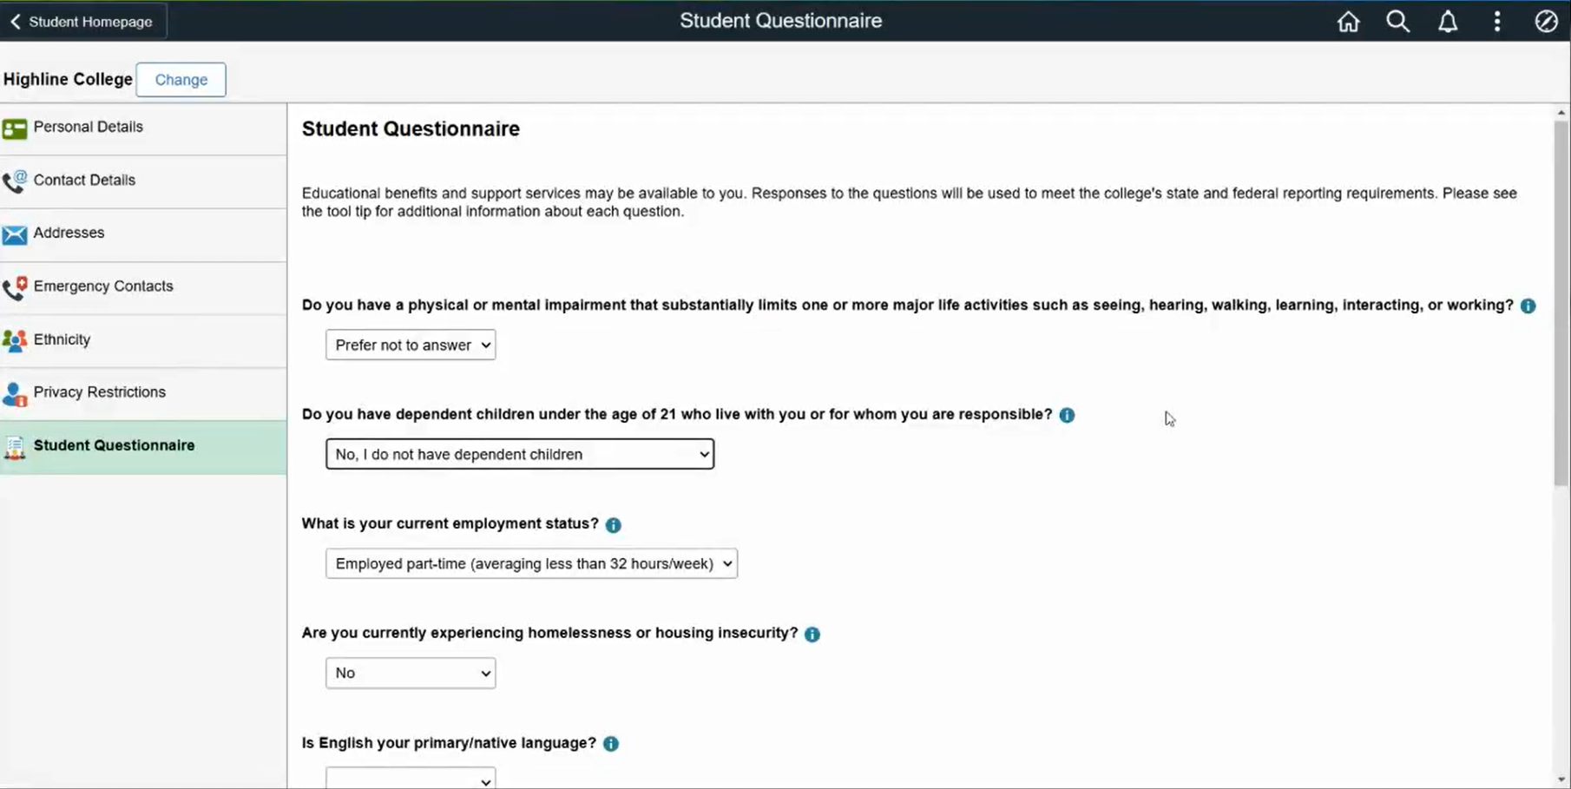
ER 232 - Adding Custom Self-Service Questions in Campus Solutions
ER 232 Enhancement Request details

Slide 4
College Sharing
Submit ideas for future forum meetings through our online submission form

Slide 5
ctcLink Accessibility Web Page
ctcLink Accessibility web page
Accessibility reviews
Image overview documents
PeopleSoft Update Manager (PUM) images are released periodically to update and add new features
Oracle VPATs and third-party VPATs
Glossary of terms

Slide 6
Forum Information
Accessibility and ctcLink Open Forum
Next meeting –January 14th, 2025 11:00 am to Noon.

Slide 7
End of Presentation
Expanded details from previous slides are provided following this page.

Slide 8
Service Desk Tickets/Oracle Service Requests – Campus Solutions
CS Make a Payment Page
Enhancement request approved to change from classic to fluid page.
CS Academic Advisement Report – incorrect PDF tags
Fix was supposed to be delivered in CS Image 26. There was a duplicate CSS declaration on the HTML academic progress fluid page and that was corrected. They did not make any updates to the PDF though, so we pushed back and asked that to be done.
Mark-up for 'Add' button incorrect creating WCAG violation
Oracle has accepted this as a bug and development is working on it now.
Select Button on Quick Enrollment Search Page
It was reported that on the Quick Enrollment Search results page, the Select button is buried and challenging to navigate to with keyboard-only navigation. Further investigation showed that the focus was going to the right place and the page is keyboard navigation friendly. Resolved.

Slide 9
Service Desk Tickets/Oracle Service Requests – Human Capital Management
HCM Report time page (PJV – Fixed.)
After previous button, focus goes to calendar button and Date in the edit box does not get read in NVDA. Does not happen with JAWS.
Opened an SR for this issue.
Provisional fix given by Oracle tested successfully. This will be coming in HCM 49.
HCM Enter Time Page. (PJV – No change. Will be able to test after we get PT8.60)
For the focus issue when switching between elapsed time and punch time, Oracle has agreed that it is a bug and will begin working on a resolution
Fix will be available in PeopleTools 8.60.
HCM Configurable headers (PJV – Fix is available, but Supervisor Name is not displaying on header – So opened SR 3-38808754274 : Issues with TL configurable page header.)
Oracle has accepted our enhancement request and development is currently underway to address this issue. Once this fix becomes available, we will be able to resolve the issue of Multiple jobs being indistinguishable while reporting time.

Slide 10
Service Desk Tickets/Oracle Service Requests – Human Capital Management
HCM W-2 PDF (PJV – No change. Developers are still working.)
JAWS reads "colon Y" after cell header in Box 13
SR is open for this issue.
HCM Configurable header labels (PJV – Fixed)
In the queue to be tested with different scenarios with using the configurable headers since we got some related fixes with HCM Image 49.
In Firefox browser Calendar button is announced as "button" (PJV – Added)
SR is open for this issue.

Slide 11
Service Desk Tickets/Oracle Service Requests – Finance
FIN Travel Authorizations (PJV – Fixed)
The attachment button on the grid does not have a label.
Continuing to review bug fixes provided by Oracle.
Finance - Express Bill Entry Template page.
The screen reader user cannot access any of the checkboxes on the Charge Details tab of the Configure Bill Line Grid Area. On the other tabs in the Configure Bill Line Grid Area, the checkboxes are accessed by the screen reader but the labels are not read by the screen reader so the user does not know what to check.
Oracle is developing a fix that is planned to be delivered in Finance Image 48.
Cash Advance Screen Reading Order is Incorrect
The reading order has been corrected, but User Default, Import ATM Advances, View Printable Version, Notes, and Attachment items are read twice by the screen reader. Service requested opened with Oracle. A defect has been submitted to the engineering team for review.

Slide 12
Service Desk Tickets/Oracle Service Requests – All Pillars
Combo Box drop down displays one blank row and list items order is not top to bottom (PJV – No ETA for this. SR 3-27290185731/Doc ID 2922397.1)
Oracle development is targeting PeopleTools 8.60 for the fix. (PJV –strike out)
(PJV- added) The developers are still reviewing.

Slide 13
Third Party Vendors
OAAP SSN Entry
For OAAP SSN entry, to be accessible there should be clear instructions on the format desired so you’d ask something like “Birthdate (mm/dd/yyyy)” or in the case of social security number it should say something like “###-##-####” but on having those dashes it seemed to get rejected. On putting the number in as ######### it then took it and let them proceed.
This issue was brought to our attention, and we will be working with Kastech soon on this.

Slide 14
Terms and Definitions
Oracle vs. HighPoint
Oracle is the company that makes PeopleSoft. Highpoint is a third-party vendor that provides the integrated HCX mobile solution.
ctcLink vs. HCX
ctcLink is the centralized PeopleSoft implementation that all the WA community and technical colleges use. HCX is the integrated mobile solution provided by HighPoint.
OAAP and Kastech
Kastech is the third-party company that provides the Online Admission Application Portal (OAAP) that is integrated with ctcLink.
IOVD (Image Overview Document)
A document that explains in detail all the new features, bug fixes, and accessibility fixes that come with the image.
SIT vs. UAT
In SIT, State Board staff test the fix. In UAT, the college user that reported the issue tests the fix.
Testing teams vs. functional teams at SBCTC
The testing team coordinates the testing and reviews the results. The functional teams have the functional knowledge and are the ones that complete the SIT testing. There are lots more that both those teams do, that’s just a brief summary of some of their work as it related to testing.
PeopleSoft Release Patchset (PRP) or Proof-of-Concept (POC)
A PRP is an official Oracle fix to a bug that we can apply outside of an image as a one-off. A POC is code Oracle gives us to apply ourselves before they have finalized it. It may solve the problem or may not and it is likely to change and be replaced in a future image.

Slide 15
Terms and Definitions (Continued)
PUM or Image
PeopleSoft Update Manager. The software our Managed Services uses to apply change packages, such as PRPs or images. The term is sometimes used interchangeably with the term image, like HCM image 40 or HCM PUM 40.
Conformance versus functional accessibility testing
Conformance focuses on code compliance with WCAG guidelines. Functional accessibility testing is focused on testing with all the assistive technologies and how they interact with the software.

