Slide 1
Accessibility & ctcLink Open Forum
June 10, 2024

Slide 2
Agenda
Welcome
Dynamic Page Headers on Time Pages
Make a payment
Student Questionnaire
Title II
Service desk tickets/Oracle service requests
College sharing
Terms and Definitions

Slide 3
Dynamic Page Headers on Time Pages
This will help employees who have multiple jobs with the same title.
Going to production tonight, 6/10.
Adding job information to these pages:
  Time Summary
  Enter Time
  Absence Balances
  Cancel Absence
  View Requests
  Manage Absence

Slide 4
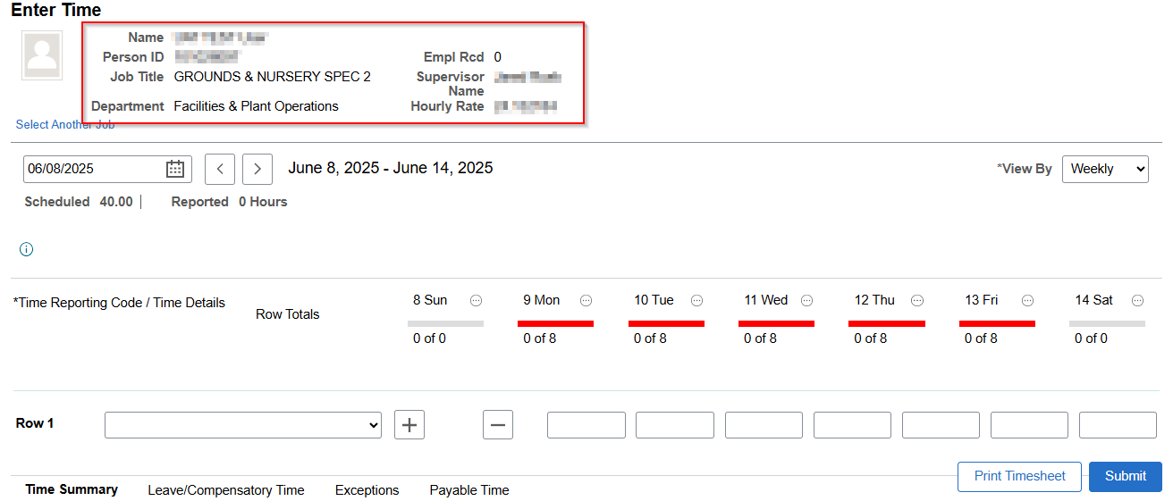
Enter Time

Slide 5
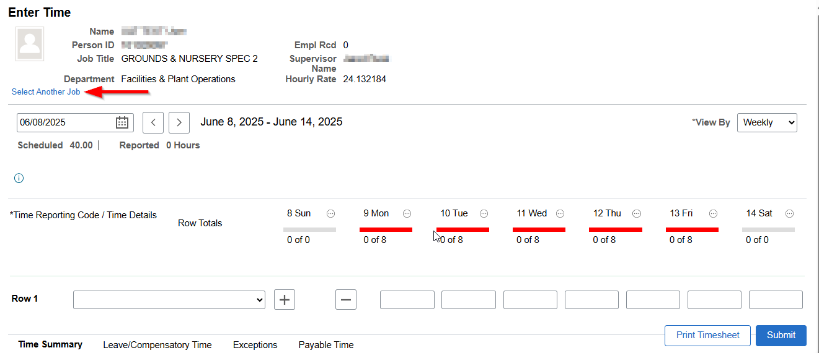
Enter Time – Select Another Job

Slide 6
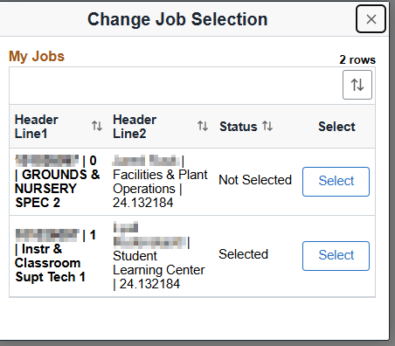
Enter Time – Select Another Job Pop-up

Slide 7
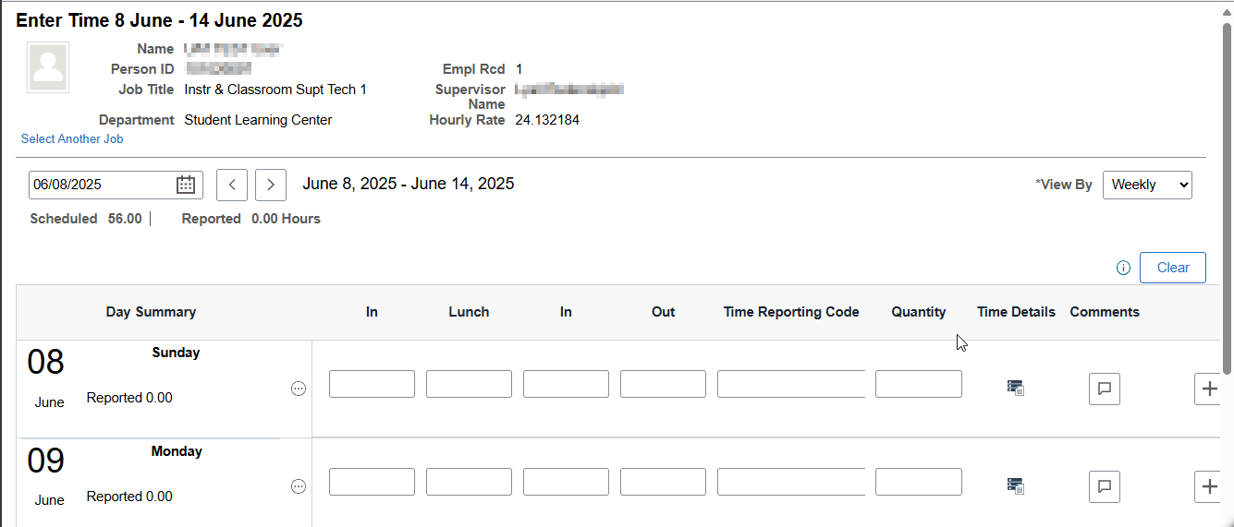
Enter Time after changing job

Slide 8
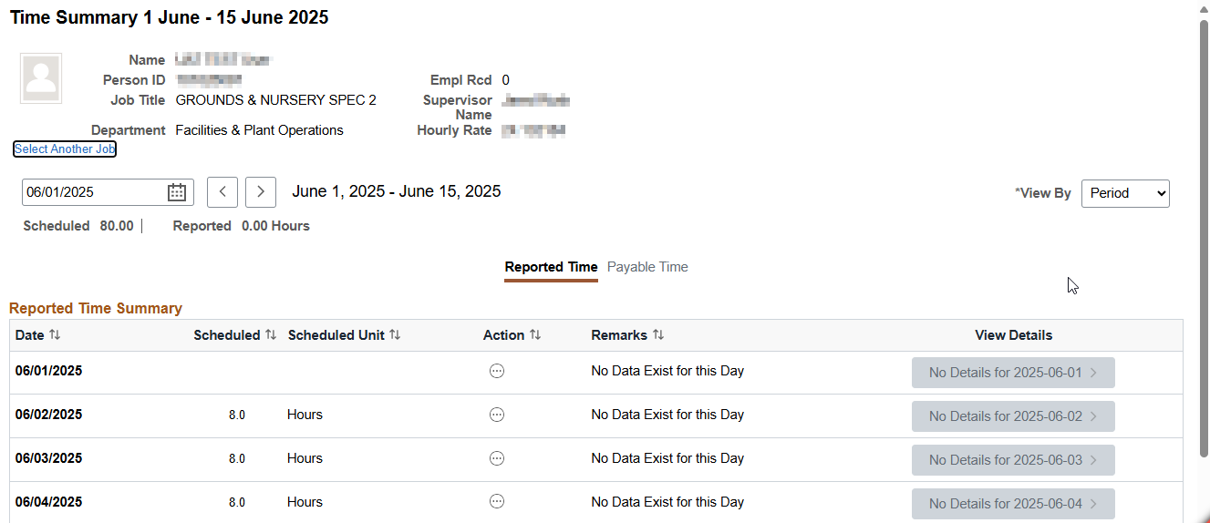
Time Summary

Slide 9
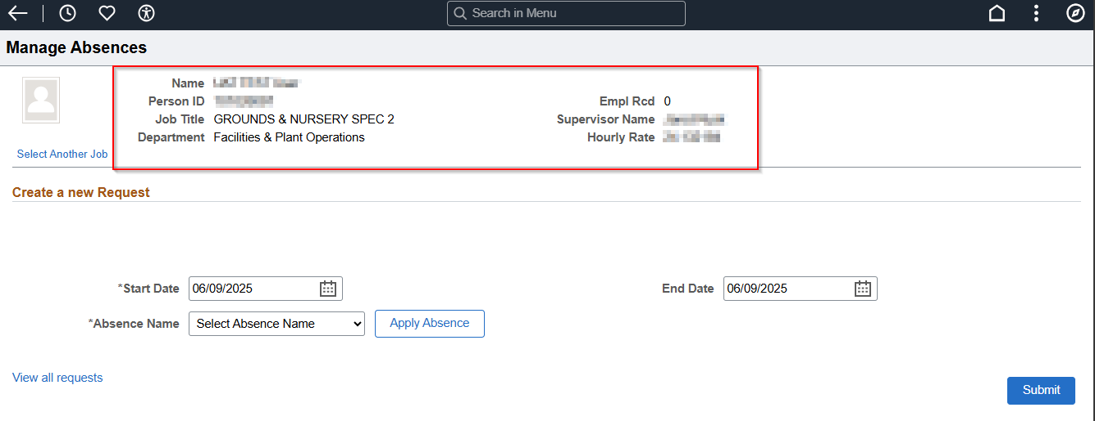
Manage Absence

Slide 10
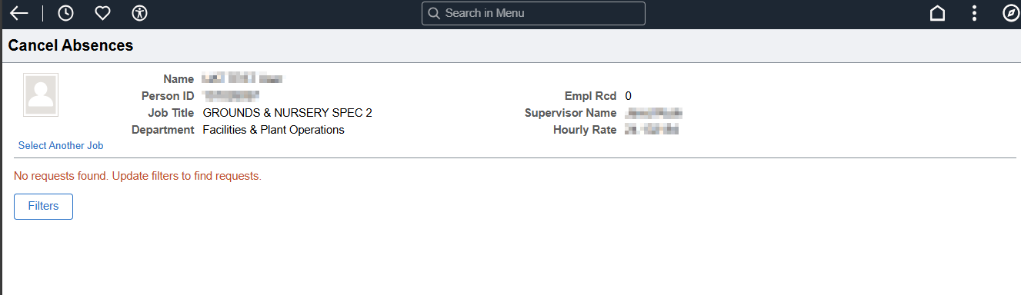
Cancel Absence

Slide 11
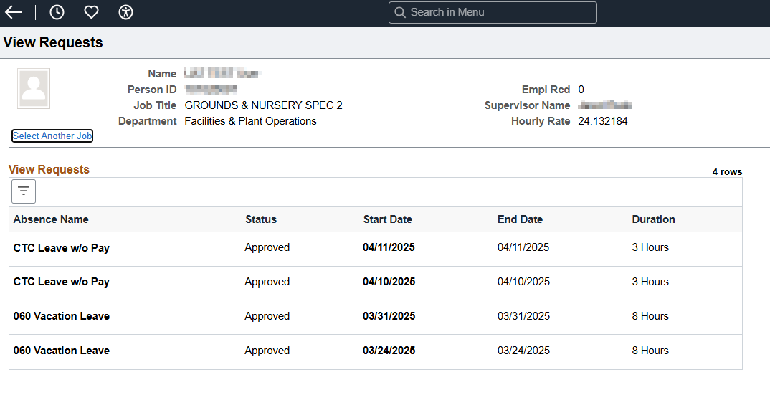
View Request

Slide 12
ER 253 - Make a Payment Page Classic to Fluid
The "Make a Payment" page is classic and cannot be resized. Not having the entire page display in small form factor is an accessibility violation as a user needs to be able to view and access all elements on the page. WCAG 2.1 Success Criterion 1.4.10: Reflow (Level AA) objective is that content can be enlarged without requiring horizontal scrolling. We need to make the text reflow within the width of the viewport. Success criterion 1.4.4 is to ensure that visually rendered text, including text-based controls can be scaled successfully so that it can be read directly by people with mild visual disabilities, without requiring the use of assistive technology such as a screen magnifier. Users may benefit from scaling all content on the Web page, but text is most critical. The classic version of this page is particularly a problem on mobile and with HCX, which has a link to it in the ctcLink mobile app. You must do horizontal scrolling to access the elements on the page and the visually rendered text is not scaled. Going to the fluid version of the page will resolve this. The fluid version of the page is responsive for all form factors, including Small Form Factor for mobile use.

Slide 13
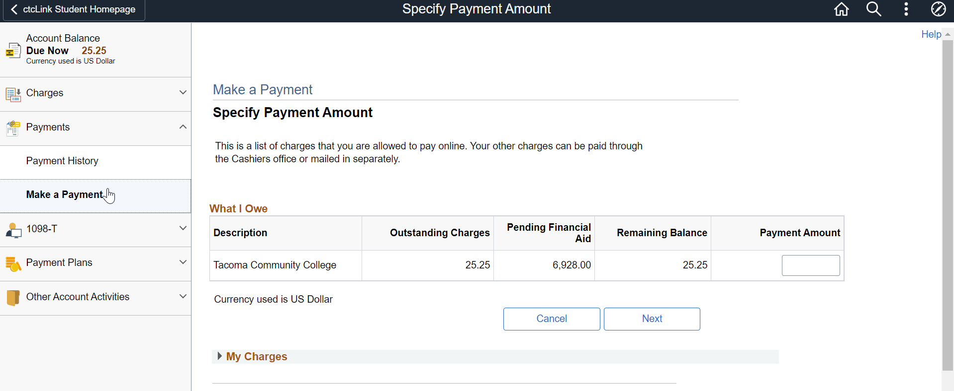
Make a Payment Current Classic Page

Slide 14
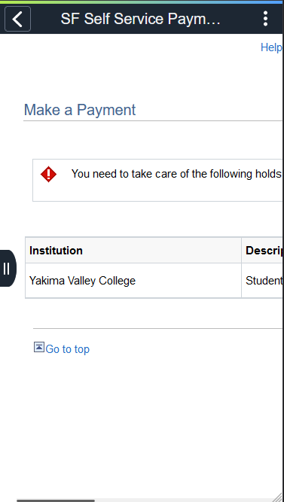
Make a Payment Classic – Side Scrolling

Slide 15
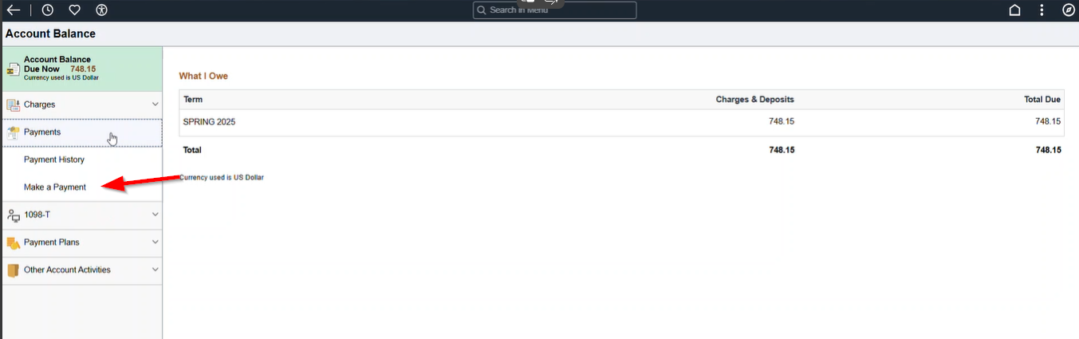
Make a Payment

Slide 16
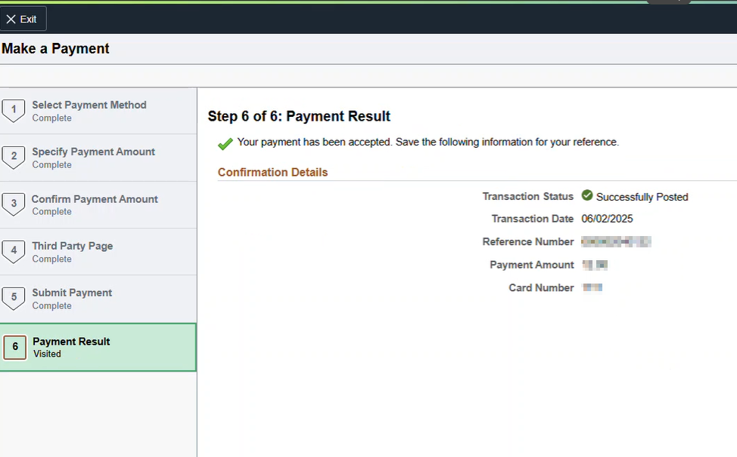
Make a Payment – Fluid Pages

Slide 17
Make a Payment
These changes will be deployed to production on June 24th, 2025.

Slide 18
ER 232 - Adding Custom Self-Service Questions in Campus Solutions
Josh and Vicki are working on another accessibility review.

Slide 19
Title II April 2026
Meeting work Oracle reps on June 16th to discuss Title II compliance.

Slide 20
College Sharing
Submit ideas for future forum meetings through our online submission form

Slide 21
ctcLink Accessibility Web Page
ctcLink Accessibility web page
Accessibility reviews
Image overview documents
  PeopleSoft Update Manager (PUM) images are released periodically to update and add new features
Oracle VPATs and third-party VPATs
Glossary of terms

Slide 22
Forum Information
Accessibility and ctcLink Open Forum
Next meeting – July 8, 2025 11:00 am to Noon.

Slide 23
End of Presentation
The following slides have the status of the open accessibility issues that we are working with vendors on resolving.

Slide 24
Service Desk Tickets/Oracle Service Requests – Campus Solutions
CS Make a Payment Page
  Enhancement request approved to change from classic to fluid page. Coming to production on 6/24.
CS Academic Advisement Report – incorrect PDF tags
  Fix was supposed to be delivered in CS Image 26. There was a duplicate CSS declaration on the HTML academic progress fluid page and that was corrected. They did not make any updates to the PDF though, so we pushed back and asked that to be done.
Mark-up for 'Add' button incorrect creating WCAG violation
  Oracle has accepted this as a bug and development is working on it now.

Slide 25
Service Desk Tickets/Oracle Service Requests – Human Capital Management
HCM Enter Time Page.
For the focus issue when switching between elapsed time and punch time, Oracle has agreed that it is a bug and will begin working on a resolution
Fix will be available in PeopleTools 8.60.
HCM Configurable headers
Development is complete to use configurable headers to resolve the problem of users not being able to distinguish between two jobs with the same job title on the time pages. Going to production on 6/10/25.

Slide 26
Service Desk Tickets/Oracle Service Requests – Human Capital Management
HCM W-2 PDF
  JAWS reads "colon Y" after cell header in Box 13
  SR is open for this issue.
  Oracle development is still working on a fix.
In Firefox browser Calendar button is announced as "button"
  SR is open for this issue.

Slide 27
Service Desk Tickets/Oracle Service Requests – Finance
Finance - Express Bill Entry Template page.
  The screen reader user cannot access any of the checkboxes on the Charge Details tab of the Configure Bill Line Grid Area. On the other tabs in the Configure Bill Line Grid Area, the checkboxes are accessed by the screen reader but the labels are not read by the screen reader so the user does not know what to check.
  Oracle is developing a fix that is planned to be delivered in Finance Image 48.
Cash Advance Screen Reading Order is Incorrect
  The reading order has been corrected, but User Default, Import ATM Advances, View Printable Version, Notes, and Attachment items are read twice by the screen reader. Service requested opened with Oracle. A defect has been submitted to the engineering team for review.

Slide 28
Service Desk Tickets/Oracle Service Requests – All Pillars
Combo Box drop down displays one blank row and list items order is not top to bottom
The developers at Oracle are still reviewing. No ETA for this. SR 3-27290185731/Doc ID 2922397.1

Slide 29
Third Party Vendors
OAAP SSN Entry
  For OAAP SSN entry, to be accessible there should be clear instructions on the format desired so you’d ask something like “Birthdate (mm/dd/yyyy)” or in the case of social security number it should say something like “###-##-####” but on having those dashes it seemed to get rejected. On putting the number in as ######### it then took it and let them proceed.
  This issue was brought to our attention, and we will be working with Kastech on this.

Slide 30
Terms and Definitions
Oracle vs. HighPoint
  Oracle is the company that makes PeopleSoft. Highpoint is a third-party vendor that provides the integrated HCX mobile solution.
ctcLink vs. HCX
  ctcLink is the centralized PeopleSoft implementation that all the WA community and technical colleges use. HCX is the integrated mobile solution provided by HighPoint.
OAAP and Kastech
  Kastech is the third-party company that provides the Online Admission Application Portal (OAAP) that is integrated with ctcLink.
IOVD (Image Overview Document)
  A document that explains in detail all the new features, bug fixes, and accessibility fixes that come with the image.
SIT vs. UAT
  In SIT, State Board staff test the fix. In UAT, the college user that reported the issue tests the fix.
Testing teams vs. functional teams at SBCTC
  The testing team coordinates the testing and reviews the results. The functional teams have the functional knowledge and are the ones that complete the SIT testing. There are lots more that both those teams do, that’s just a brief summary of some of their work as it related to testing.
PeopleSoft Release Patchset (PRP) or Proof-of-Concept (POC)
  A PRP is an official Oracle fix to a bug that we can apply outside of an image as a one-off. A POC is code Oracle gives us to apply ourselves before they have finalized it. It may solve the problem or may not and it is likely to change and be replaced in a future image.

Slide 31
Terms and Definitions (Continued)
PUM or Image
  PeopleSoft Update Manager. The software our Managed Services uses to apply change packages, such as PRPs or images. The term is sometimes used interchangeably with the term image, like HCM image 40 or HCM PUM 40.
Conformance versus functional accessibility testing
  Conformance focuses on code compliance with WCAG guidelines. Functional accessibility testing is focused on testing with all the assistive technologies and how they interact with the software.

