Slide 1
DRS BALANCING
Presented by DuAnn Kenney, Centralia College

Slide 2
TOPICS
Balancing Reports
Correcting Errors
Monitoring ERA

Slide 3
Balancing Reports
Use the following queries to balance DRS for each payroll:
1. CTC_AP_EXTRACT_SUMMARY
2. QHC_BA_DRS_TRANSMITTAL
3. QHC_PY_PAY_CHECK_DED
Print off a copy of the CTC_AP_EXTRACT_SUMMARY. This will be used to verify that the amounts sent via ACH match the amounts on the DRS transmittal and the paycheck deduction query.
Sort the query QHC_BA_DRS_TRANSMITTAL by retirement groups – P1, P2, P3 WSIB and SELF and print off the information for each group. Do the same for TRS.

Slide 4
Balancing Reports
Sort the query QHC_PY_PAY_CHECK_DED by retirement groups and print.
Use the DRS Transmittal query and paycheck deductions to match what was remitted via ACH on the AP Extract report. The DRS transmittal is the report that is submitted to DRS. The paycheck deduction query is what is deducted from the employee. The total of the employee and employer deductions should match what was remitted via ACH to DRS and what was reported on the DRS transmittal. If they don’t then there will be a discrepancy which will need to be researched.

Slide 5
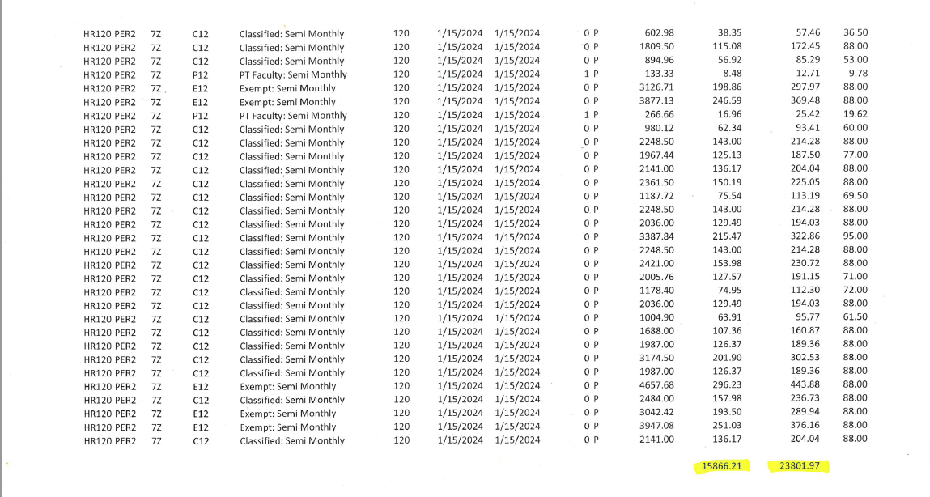
DRS Transmittal-01A

Slide 6
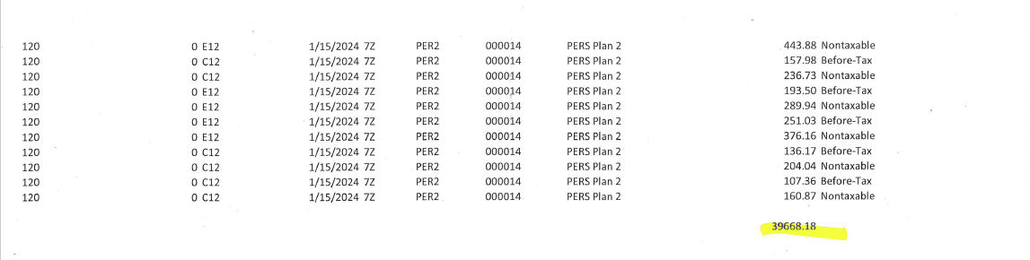
Paycheck Deductions-01A

Slide 7
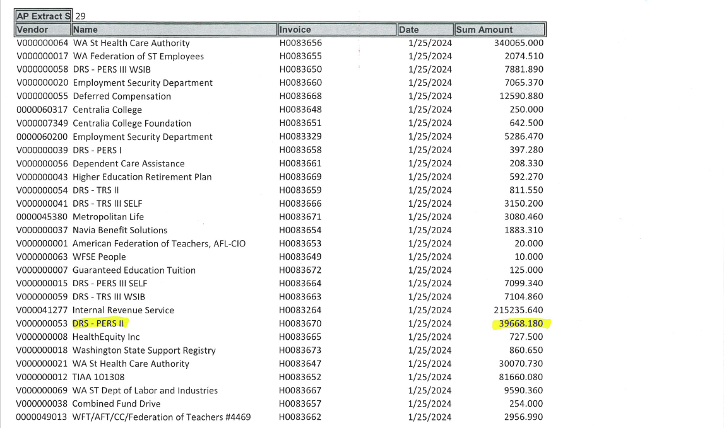
01A AP Extract

Slide 8
Correcting Errors
Errors can occur in various situations. For example:
If a new employee’s DRS information is not entered in ERA before reports are submitted to DRS, then the employee’s information on the DRS transmittal will reject. This will cause a credit in the college account and must be corrected by resubmitting the rejected information manually in ERA.
Sending missed retirement deductions for a prior payroll will require a manual adjustment in ERA.
Anytime that I am making corrections, I always wait until the funds have posted to verify that the amount off in the account is the amount expected. Once that is determined, then I proceed with the manual correction.

Slide 9
Correcting Errors
If I need to take additional retirement for a missed payroll, I will use ERA to verify that the amount missed is correct. It is easy to go into Employer reporting and enter the information regarding the missed gross wages. ERA will compute the amount for both employee and employer. Once I have the needed information, I cancel the report.
The best way to research any errors is by using the DRS transmittal and paycheck deductions. The DRS transmittal is always what DRS will be expecting. If the paycheck deductions are over or under it will result in a credit or debit on the college account. Any amounts owed, DRS will charge interest.

Slide 10
Scenario
Employee overpaid in error on 07B payroll due to supervisor error. Recovered overpayment before 8/9/23 pay day. Processed overpayment reversal for 8/9/23 pay day on 08A payroll. Employee on total LWOP for 08A payroll. Overpayment recovery created a negative entry for DRS, which needed to be corrected with the correct earn date in ERA.

Slide 11
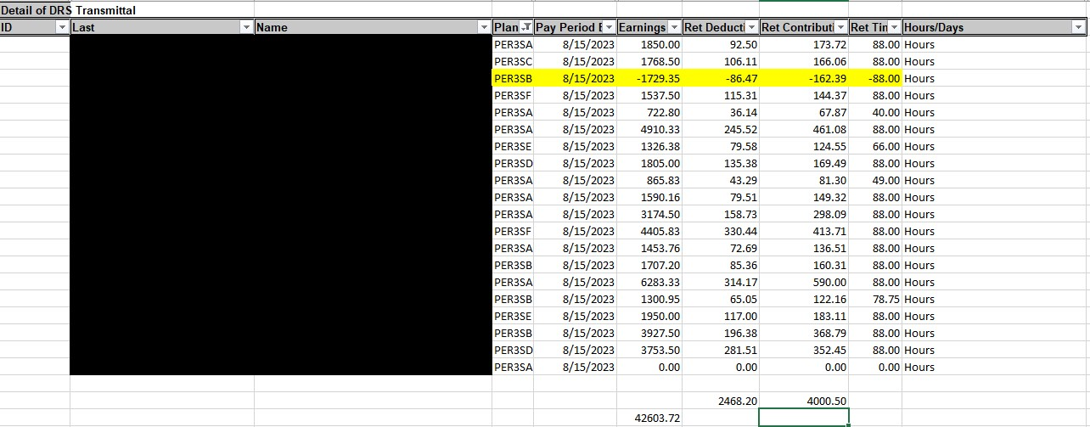
DRS Transmittal

Slide 12
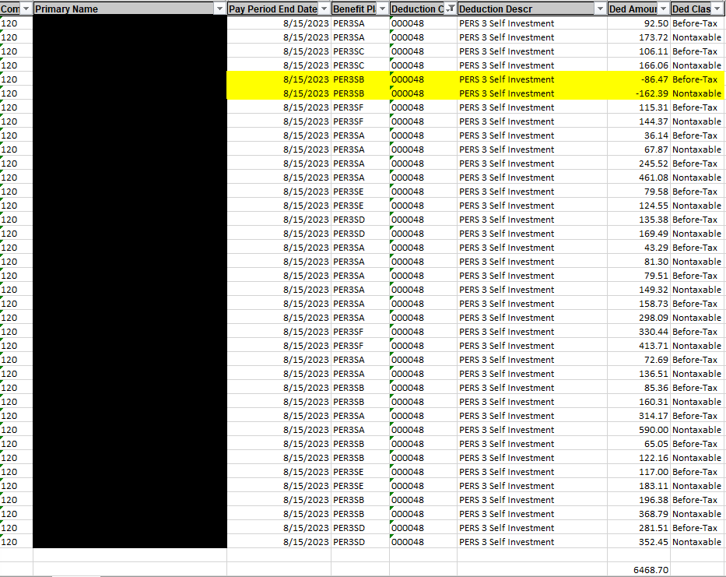
Paycheck Deductions

Slide 13
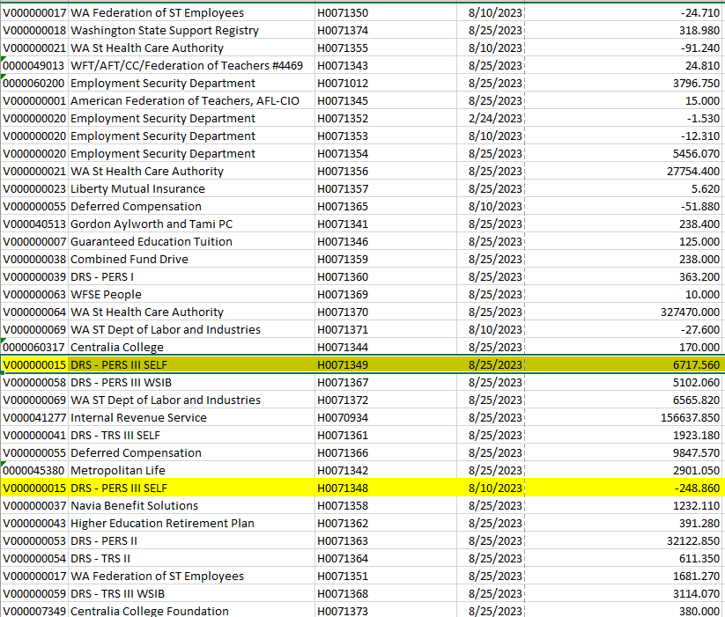
AP Extract

Slide 14
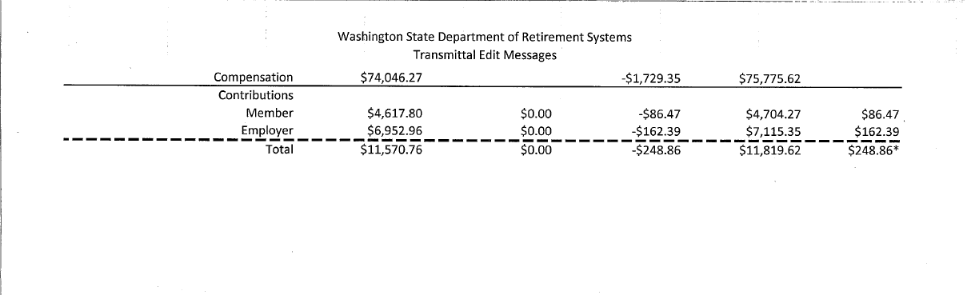
DRS Transmittal Edit Message

Slide 15
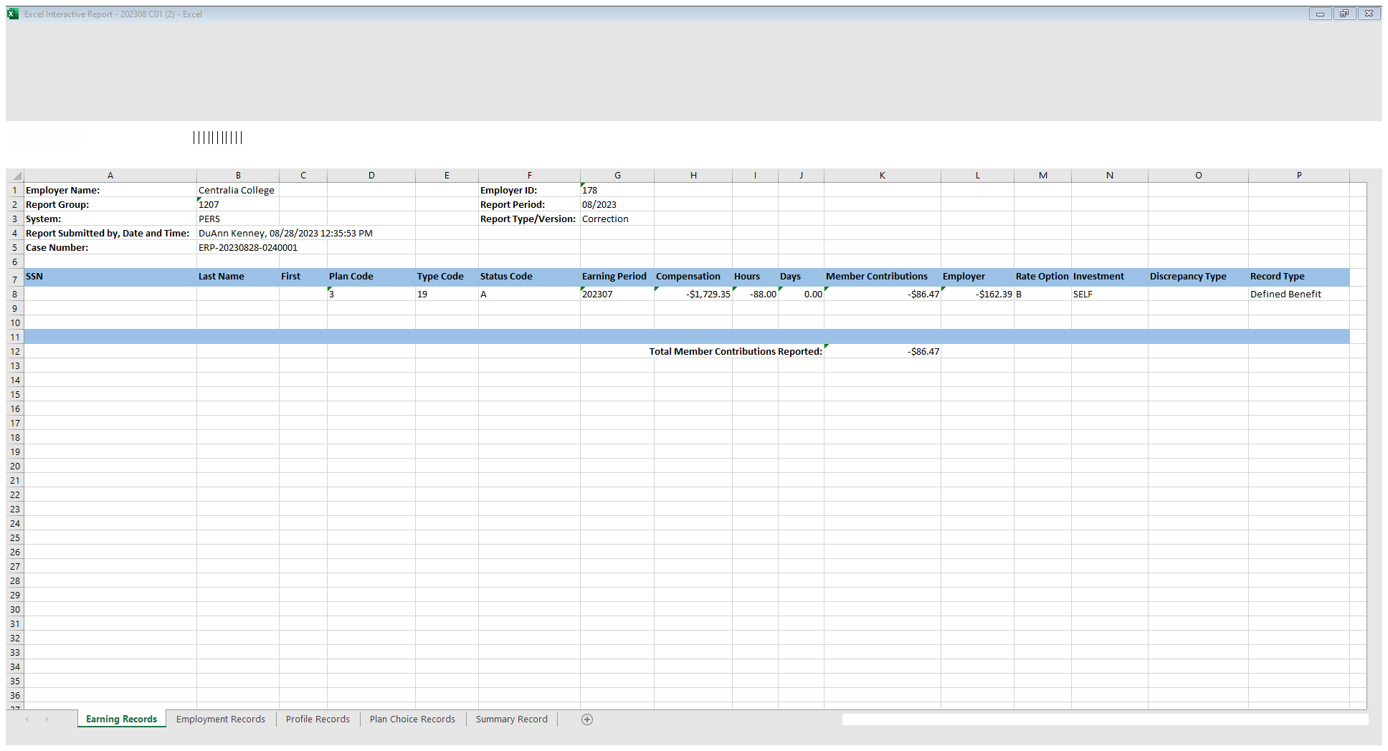
Entry to correct regular payment to employee on 07B paid in error.

Slide 16
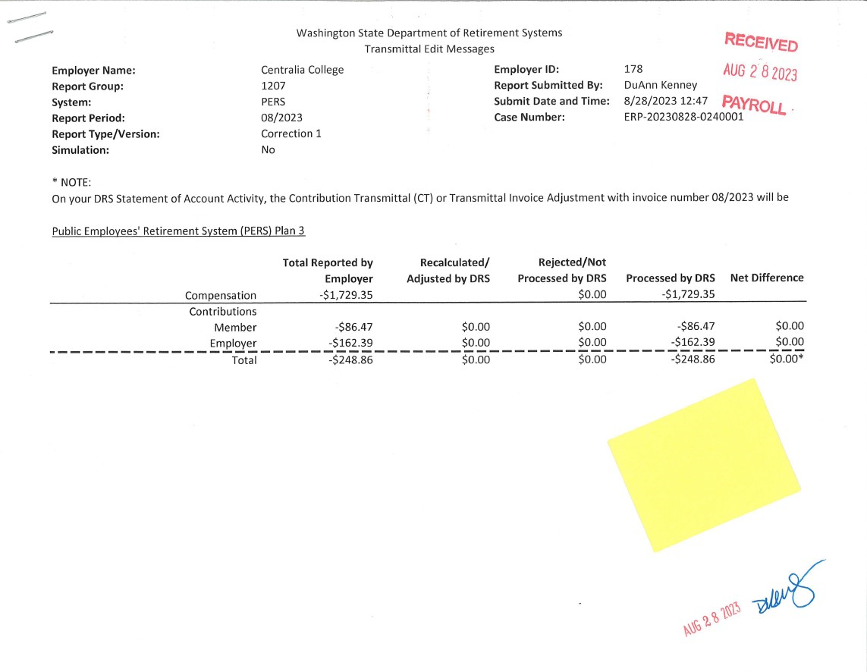
ERA Correction

Slide 17
Correcting P3 errors in ERA
When correcting P3 errors in ERA, only the Employer amounts are used for the correction entry.
If the employee amount is used as well, then your account will either have a credit or debit depending on the correction.

Slide 18
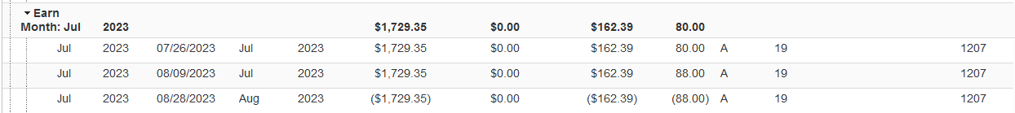
Verify the Correction in ERA processed as Expected.

Slide 19
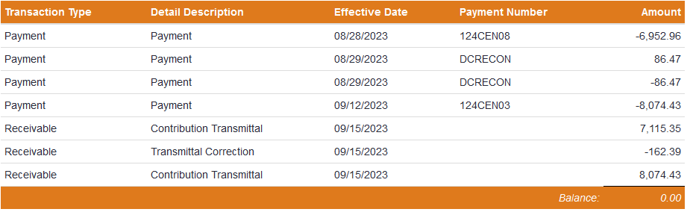
Always check your Account Balance to verify there is no outstanding balance.

Slide 20
Questions

