Slide 1
Early Return to Work Consultation (ERTWC)
Presenters: Lauri Cousineau, CDMS Region 5
Mindy Jackson, CRC Region 5
Notes:
Welcome! Thank you for the opportunity to meet with you and share how we can help the employer. Our goal is our to present what we do then f/u with an in-person consultation AT NO ADDED COST to the employer!
Introductions -
Happy to answer any questions you may have so feel free to raise your hand or comment in the chat box. We look forward to discussing your company needs and how we can best provide services.

Slide 2
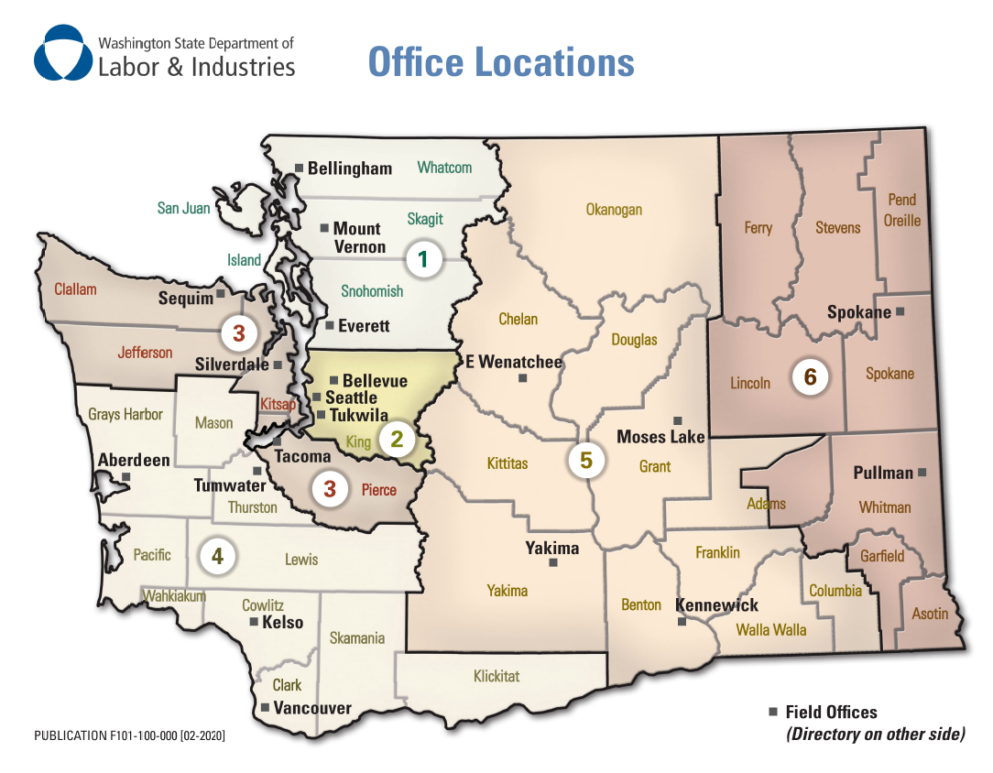
ERTWC Team
6 Regional Supervisors
- CRC and/or CDMS certification
- Credentialed Ergonomic Specialists
13 Vocational Service Specialists
- CRC and/or CDMS certification
- Credentialed Ergonomic Specialists
Notes:
First, I want to provide a quick overview of our regions.
We have six regions throughout the state, each with ERTWC Staff to assist employers in that location. Our staff hold certs in either CRC (Certified Rehab Counselor) or CDMS (Certified Disability Management Specialist) and many have Ergonomic certification as well.
Our preference is meeting Employers in person. It allows us to provide a better service, however we know that isn’t always possible. During Covid we expanded our services to meet virtual via Microsoft Teams or Zoom. We can assist via telephone however it is hard to give you the full meal deal, so to speak, over the phone.

Slide 3
ERTWC’s Focus
Assist employers in developing a Return to Work Culture
Providing vocational expertise to employers.
Removing return to work barriers by providing education, support, tools, and systems for a stable workforce.
Notes:
As I mentioned, our goal today is to provide an overview of the services we offer. We would like to provide some “selling points” regarding our program and what we can do for you.
We know consulting services may be a time commitment, but it will save time/money. Also, we are as efficient and effective as possible. Ultimately, our goal is to provide support for a healthy return to work culture and share tips/best practices.
Our focus is to :
share the benefits of developing a Return to Work Culture
Share our knowledge and best practices, assist your ability to navigate L&I to manage claims
Remove barriers to maintain a stable workforce.
Within this slide deck is valuable information and we want to share it with you all.
The most important thing is to have a firm foundation…..next slide please

Slide 4
Notes:
Based on statistics from our Claims dept. their numbers have shown injured workers who are off work longer than 12 weeks have only a 50% chance of ever returning to work!
This is why LNI and our ERTWC team wants to help you be prepared. When people never return to work, no one wins. We hope you will utilize our free services and programs to help prevent injuries and reduce the time off work.

Slide 5
Trivia Time!
How much money was spent on back injuries in Washington State in 2022?
Answer: $129,579,294

Slide 6
Job Modifications
Job Offer Planning
Light Duty Job Descriptions (Job Bank)
Navigate the L&I System
Return to Work Culture / Return to Work Program Development
ERTWC Services
Job Analyses (Job Bank)
Help Identify Light Duty Job Tasks
Washington Stay at Work (WSAW) Preparation
Ergonomic
Evaluations
Notes:
Our ERTWC services have focused on providing services and education from a pre-claim standpoint. These services include…..
Developing a Return to Work Culture
Light Duty Job Descriptions (Job Bank)
Job Offer Plans
Job Analyses (Job Bank)
Ergonomic Evaluations
Job Modifications and basically how to
Navigate through the L&I System
While we are no longer able to provide services on ACCEPTED claims, we do welcome Employers to reach out to us anytime as we are able to provide GENERAL information and assistance. We truly want to establish a good working relationships with all Employers so that they have a contact at LNI to address their concerns when they have them.

Slide 7
ERTWC Tools:
Light Duty Job Descriptions
Job Offer Letter Templates
Job Analyses Banks
RTW Checklist
RTW Toolkit (An Employer’s Guide to Return to Work)
Internal Referrals—SAW, Risk Management, DOSH
Access to My L&I
Other L&I Resources (posters, forms, etc.)
Notes:
With a complete Return to work Plan developed, We want the Employer to leave with
Light Duty Job Descriptions
Job Offer Letter Templates (temporary and permanent)
Step by Step Checklist to ensure that each job offer is valid
Return to Work Toolkit (An Employer’s Guide to Return to Work)
CAC Access and Instructions
Stay at Work Reimbursement Plan
Access to My L&I (CAC) w/ Education
Other L&I Resources (posters, forms, etc.)
AND A return to work professional that is familiar with their company who they can reach out to with questions.

Slide 8
Why Create a Job Analysis Bank?
Documents essential functions & demands of the position.
Assists L&I with occupational disease claims.
Medical providers review job tasks and demands for capacities to assist with full/light duty release.
Helps identify job modifications.
Hiring practices.
Notes:
Let’s start with what a Job analysis is; it’s an evaluation of the tasks performed in a job and the competencies required to perform the job. ONLY credentialed Vocational Counselors or Vocational Rehabilitation Counselors may compose these documents. They are similar to the job description form, however much greater in detail.
Why are these needed: the purpose of the JA is that often occupational disease claims require evaluation by the Occupational Nurse Consultant or an Independent Medical examiner. Medical providers uses this form to review and make recommendations for temporary or permanent job modifications. These forms are also great tools to utilize in your hiring practices for specific questions that may be posed by potential candidates.

Slide 9
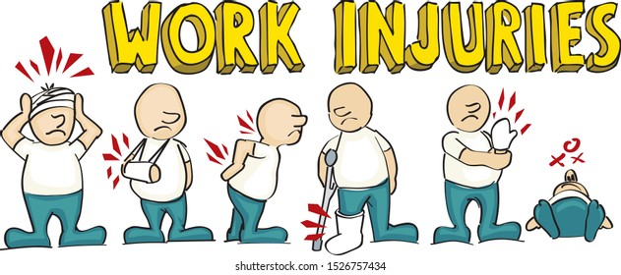
What Happens Now?
Notes:
What happens when you have an on the job injury?

Slide 10
Trivia Time!
Does HIPPA apply to L&I claims?
Answer: No. The employer has a legal right to access all medical records related to the claim.

Slide 11
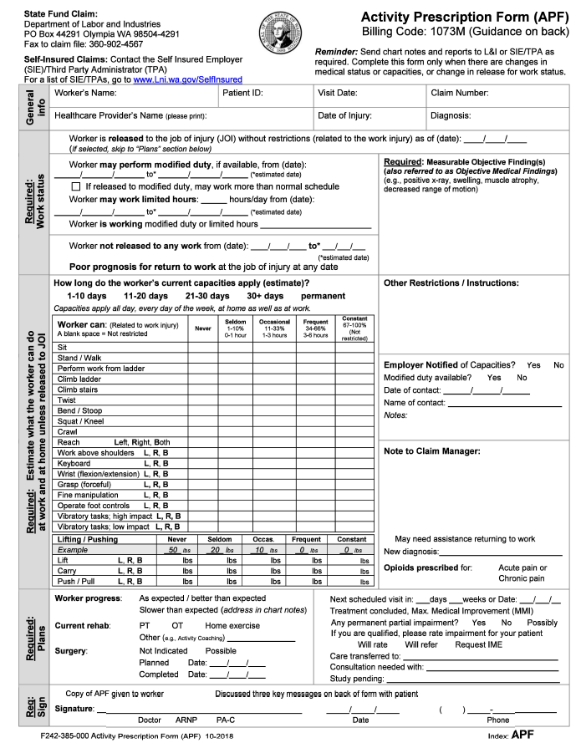
What is the Activity Prescription Form (APF)?
The APF helps medical providers communicate the worker’s:
Ability to work
Functional capacities
Physical restrictions
Treatment plan
Notes:
If you don’t have a good return to work culture, this may be the first thing you see to alert you that a claim has been filed!
An APF is based on what the worker can/cannot do in a 24 hour period
Functional capacities describe what tasks/activities workers can perform
APFs are also used to help:
Employers develop modified work plans while their worker is recovering.
Workers understand what they can do. It can be used as a motivator in their healing process.
L&I claim managers understand the worker’s ongoing treatment and medical progress, and to authorize time-loss benefits. *

Slide 12
Light Duty Job Descriptions
Explore light duty RTW options
Help complete light duty descriptions
Provide light duty education
Discuss light duty RTW policy

Slide 13
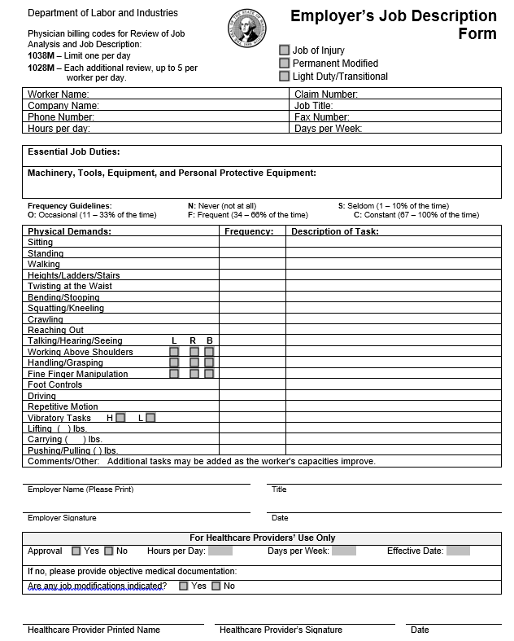
Employer’s Job Description Form
This form can be used to develop:
Job of Injury Job Description
Permanent Modified New Job
Transitional Light Duty Job
Notes:
Read the slide
Needed if you plan to apply for WSAW

Slide 14
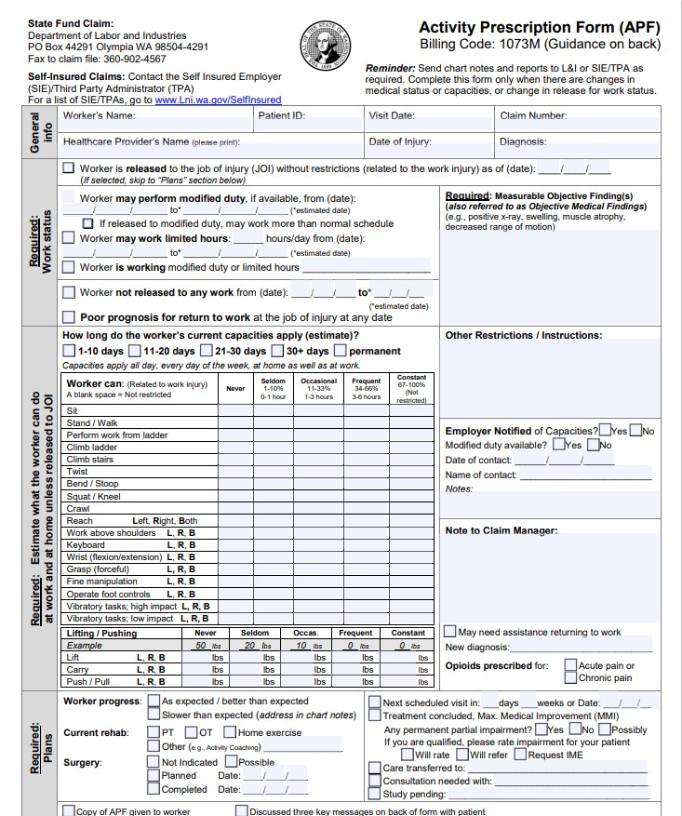
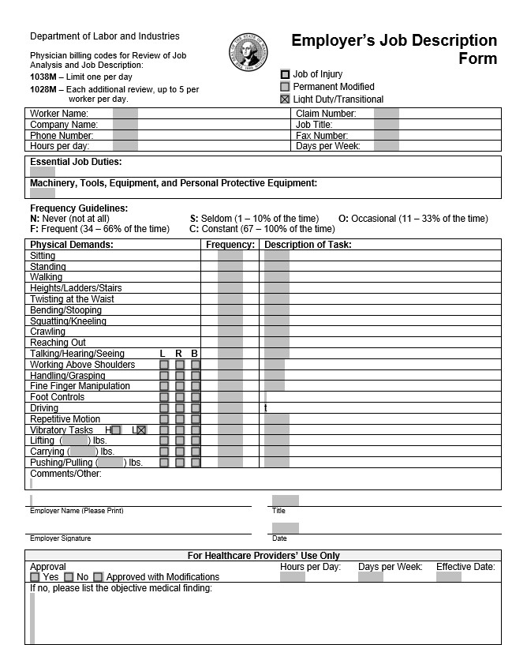
Turn the APF into a Employer’s Job Description
Restrictions
Light duty
Notes:
Pass out APF & LD

Slide 15
Develop a Return-to-Work Culture
What is It?
A collective mindset within the organization that focuses on returning an injured employee to work as soon as possible.
Notes:
A RTW culture is key AND a foundation for safety.
We define it as … Everyone in the organization focusing on RTW ASAP.
To create a RTW culture, it takes these steps:
Introduce the RTW culture to your company.
Share that everyone is important and valuable – workers and supervision.
Ensure everyone knows their role when an injury happens.
Share that their injury is priority and appropriate light duty will be available
Actively work with the medical provider *HIPAA does not apply to employers for industrial injuries
Encourage the development of a RTW coordinator (can be anyone within the company—upcoming manager or lead trainers, foreman, safety guru etc…) so there is a knowledgeable person to keep the RTW culture healthy
It improves morale
Everyone knows what to expect and their role in it
Employees can be part of the LD process
Everyone is treated the same
Employer cares about employee wellbeing
Quicker recovery when working
Worker engagement – when an employer has light duty, the worker gets up, showers, RTW with their friends and colleagues and keeps their normal schedule as best they can. This has been said it makes for better healing abilities. Stress is one of the worst healers.
Less potential for mental health concerns down the road
Cost savings
Limits time off work
The worker can report to the medical provider at the first visit that there is LD and a release can be given
LD approval facilitates light duty wage reimbursement which we address later
Monitoring a claim and progress or lack thereof
Assisting an employer to develop a Return to Work Culture is what I consider, our GOLD STAR service. We would be glad to schedule with the employer to map out a timeframe that works for them.
Now Stacy will cover a few more points…

Slide 16
Benefits of a RTW Culture
Boosts Morale and Employee Engagement
Quicker Recovery
Improved Overall Health & Well Being
Improves Claims Management

Slide 17
Job Offer
ERTW Best Practices
Documentation
Worker makes informed decision
Claims Manager informed
Rate impacts = Cost Savings
Notes:
Job Offers are an important part of the claim process. It protects the Worker and the Employer.
You will document medically approved job description, ensure the work hours and wages are listed. Include detailed schedule---where, who to report to, what time etc…
Delivery of the Job Offer
In person at work or hand deliver
Regular mail/Certified mail
Make sure to send to all parties—including attorneys
Ensure copies of job offer are sent to the claims manager to support job offer.
Using the job offer process is another way to manage your claims. If the worker declines, time loss may be stopped. Also it helps protect the Employer when the Worker is let go to cause.
Company policy trumps an injury.
A light duty job offer is temporary transitional employment. Temporary through the rehabilitation process.

Slide 18
Job Offer Tools
ERTWC provides consultation on Tools:
Formal temporary light duty Job Offer template
Formal permanent new Job Offer template
Step by Step Checklist to ensure that each job offer is valid
Employer’s Light Duty Job Description (F252-040-000)
CAC Access Instructions
Notes:
After working with an employer they will have a
Formal temporary light duty Job Offer template
Formal permanent new Job Offer template
A Step by Step Checklist to ensure that each job offer is valid
A copy of an Employer’s Light Duty Job Description (F252-040-000)
Set up on the claim and account center and Instructions how to find useful information and medical records.

Slide 19
L&I Education
Claim and Account Center:
Education
Sign Up
Navigate the L&I System
Claim Process
Services/Programs
L&I Partners (Education/Coordination)
Stay at Work / Preferred Worker
Risk Management Consultation
Safety and Health Consultation
Ergonomic Consultation
Notes:
We aim to assist at employers where they are. We have some employers how are brand new and have no knowledge of the L&I system, while others just need general reminders here and there. I mentioned several these education pieces a bit earlier and if desired can be provided individually.
Claim and Account Center:
Education
Sign Up
Navigate the L&I System
Claim Process
Services/Programs
An Overview of our L&I Partners and how their services are available:
Safety and Health Consultation
Safety or Industrial Hygiene consultants provide assistance with building your safety program, training, identifying and controlling hazards, and following applicable safety rules. No fines or penalties will result from issues uncovered during a consultation. However, consultants will ask you to correct any serious issues and offer assistance.
Risk Management Consultation Risk management consultants can review your workplace injury history and provide a step-by-step plan to help you prevent injuries and control industrial insurance costs.
Ergonomic Consultation Ergonomic specialists can help you find solutions to prevent sprain and strain injuries. These injuries are associated with high worker’s compensation costs.

Slide 20
Ergonomic Evaluations/Job Modifications
What will an Employer Get from ERTWC?
Ergonomic evaluation of an affected individual(s).
Education/pamphlets on work safety.
After completion of ergonomic consult, if approved for job modification, job modification form for reimbursement and owner agreement.
Notes:
As Lauri noted previously, all our team members have been trained in ergonomics and are available to provide ergonomic evaluations on individual employees.
If we deem that the ergonomic concerns are more job site specific and/or we need additional assistance, we can team up with our in house Ergonomist to complete the requested evaluation(s).
Review possible L&I benefits that the Employer may qualify.
Explore cost effective solutions.
Coordinate ordering, delivery and set up of equipment.
Assist with the completion and submission of paperwork.

Slide 21
Benefits of an ERTW Consultation
ERTWC and associated services/resources are available at no additional cost.
Maintain a consulting relationship with
your Regional Vocational Specialist
Notes:
Hopefully, I provided some reasons an Employer would want to work with us as I went through some of our services. BASICALLY we want to save the Employer (and help them earn MONEY back at the same time)
L&I Financial Incentives
We want them to have knowledge of the Stay at Work and Preferred Worker programs and have a system in place to take full advantage of these reimbursement programs!
Help with potential saving on L&I insurance rates and maintain or earn claim-free discount.
Maintaining Workforce Productivity
Employee Engagement
Positive workplace culture – employees feel cared for by the company
Employees who are out for a long time are less likely to return at all.
Once you have worked with us we are always available to help answer questions.

Slide 22
Financial Benefits of RTW Culture
Cost Savings on Time Loss
Retention and Retraining Cost Savings
L&I Incentives and Benefits
Return to Work is our Gold Star Service

Slide 23
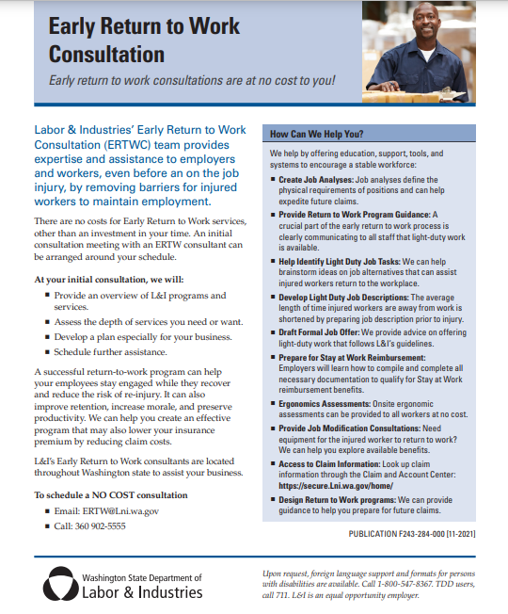
ERTWC Information for Employers
Resources
One Page Informational Sheet
Tri-fold Brochure
Call and Ask Us Questions
(360) 902-5555
Notes:
If you would like more information about our program before engaging, we would be happy to provide them one of our brochures or information sheets. We are represented on the L&I website. You can email at just call and speak with us! We have a direct ERTW phone line which is maned by at least one team member from 8am to 5pm.

Slide 24
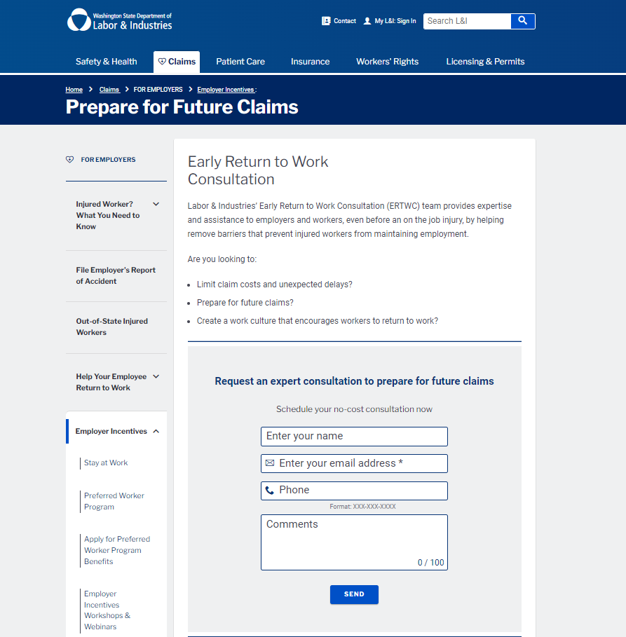
How to Request ERTWC Services
Via the L&I Website
Prepare for Future Claims (wa.gov)
Via Email
ERTW@lni.wa.gov
Request for services can come directly from the Employer or from their Representative.
Notes:
We are always available to help!
Referrals can be sent to us in two ways – via the Website or via direct email.

Slide 25
Time Frames
The ERTW mailbox is checked daily. Our goal is to assign a referral to an ERTWC VSS in the appropriate region within one business day.
ERTWC goal is to reach out to the Employer 1-2 days upon receipt of a referral.
We will provide services as quickly as possible.
Notes:
Time Frames!
Employers are busy and they don’t often have the time for L&I or worker’s compensation until they need the help! We get that! That’s why we are happy to work with the Employer on their time line.
Our goal is to reach out to the employer within 1-2 days of receiving the referral. During that initial contact or first meeting we will discuss anticipated timeframes. Right now, I believe our ERTWC staff would be able to schedule an onsite visit within 1-2 weeks, if not sooner.

Slide 26
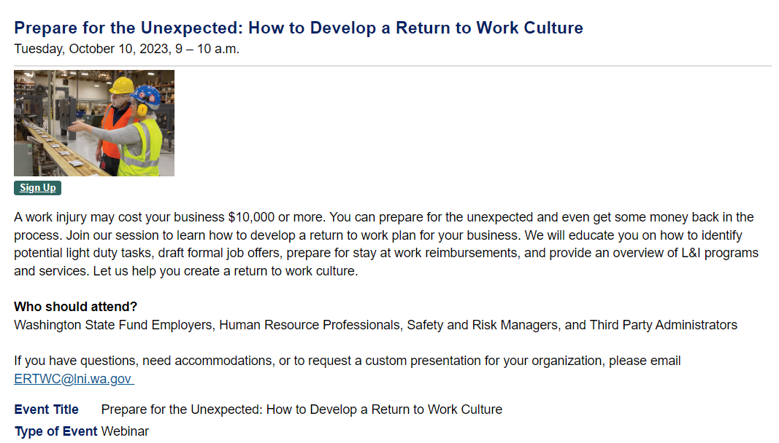
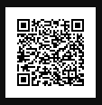
Join Us for an Upcoming Webinar
To Sign Up:
Upcoming Dates and Times
Usually the second Tuesday of each month
May 14, 2024
June 11th 2024
Notes:
To sign up you can scan the QR code which will take you directly to our sign up page.
Or you can search for Prepare for the Unexpected at L&I’s Workshops and Training Center webpage.
We currently have 6 webinars scheduled starting October 10th. They will be held the second Tuesday of the month, starting at 9am.

Slide 27
Questions?
How can ERTWC Best
Meet Your Employer’s Needs?
Notes:
Thank you for allowing me to share this information. I happy to answer any questions you may have!

Slide 28
Contact us at:
360-902-5555
ERTW@Lni.wa.gov
Website:
https://lni.wa.gov/EarlyReturnToWork

