Slide 1
HCA Discrepancy Auditing
Presented By:
Gretchen Bird
Benefits & Leave Administrator

Slide 2

Objectives
Disclaimers
How to run report
Moving through the names/data
Questions/Discussion

Slide 3
**Disclaimers**
Feedback wanted!! I’ve kind of blundered my way through this since we went live 2 years ago.
I have been doing this each month for years, so we haven’t ever gotten super behind, but we do sometimes find old problems.
A second pair of eyes in Payroll helps!
  I do my piece and if needed, turn it over to PR to make adjustments
Who is best to run/audit this?
  The people doing your enrollments/SOE changes!
  Reviewing old emails helps to remember the situation
  I use a combo of memory, Pay1, emails, pending folders for new hire forms, and CTC health records & prior paychecks

Slide 4
Discrepancies Aren’t Always Errors!
  New hires with HCA Avg Cost set up but they haven’t enrolled yet
  People with SOE changes – won’t collect on B payroll (10th) because Pay1 sends over record dated on the 1st (exception regular OE changes come over with 12/16 date
      ie. Adding Spouse 11/1/23 – when Pay1 comes over, before 10B processes, go to Health screen & Correct History to change Ded Beg Date (only) to 10/16/23. Viola! No payroll adjustment.
  People on 100% LWOP
  People with some LWOP (small check) who had a partial amount collect
  Payroll missed an adjustment I sent over
  Payroll adjustments crossing months
  Faculty with SOE during the summer, so prepay is over/under
  Sometimes it’s my error ☺

Slide 5
Running the Query
Run after A payroll confirm
Benefits > CTC Custom > HCA Benefits Data
  Parameters =
    Company
    Coverage Year
    Coverage Month
    Click Search
  3 Tabs show – I look at “Discrepancies”
QRG = “Viewing HCA Benefits Data”, last updated 8/2022
https://ctclinkreferencecenter.ctclink.us/m/79717/l/1074851-9-2-viewing-hca-benefits-data

Slide 6
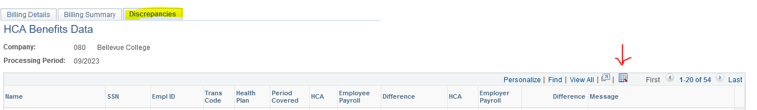
Downloading & Clean Up
Under Discrepancy Tab, click on the button to download to Excel.
I do a bit of clean up after it downloads to make it easier to look at
  I remove ‘Totals’ rows, add a ‘Comments’ column, and shorten up HCA Messages and Column Titles so it all fits better & is easier to review

Slide 7
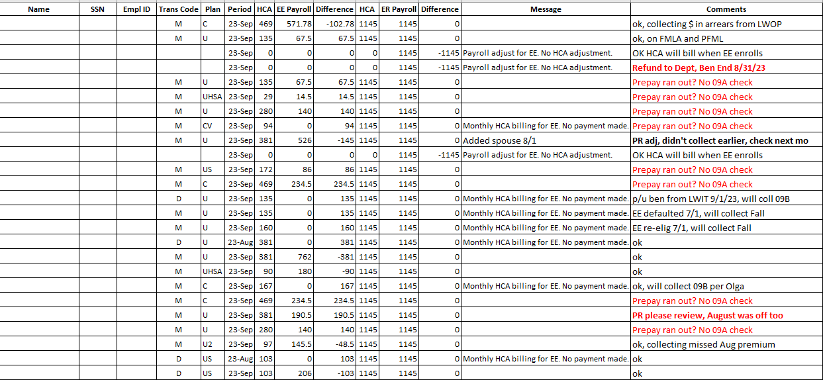

Slide 8
Messages Decoded
  Monthly HCA billing for employee. No payment made.
  (HCA billed and nothing was deducted)
  Payroll adjustment for employee. No HCA adjustment. (This means that you did something to the person’s deduction, not HCA. Ex: collected new hire’s retro premium owed, refunds after the fact, HCA Average Cost collected on time but before HCA billed you)
  No message = they billed, you collected part of it

Slide 9
What I Do to Audit
Go one by one to determine why the person is on there, what happened, any action needed?
Months that are out of whack are listed, so even if you run it for September, you may see someone listed with a August row (ex. bottom 2 rows)
  But sometimes they don’t show up – I have last month’s report out for reference
Anything I’m not sure about, I bold and look at next month to see if it dropped off.
Anything Payroll needs to adjust, (maybe they missed an adjustment I sent through) I put in Red and send to our Payroll Director.
  Sometimes PR runs a Paycheck Deductions query to sort it out
Prepay questions – I send to Payroll to review

Slide 10
Questions for YOU
I know some of you have told me you’re months and months behind on this –
  I’ve run this for prior months to test and it seems like everyone is still showing up on that month’s report even though it’s now been corrected/fallen off – is this right?
  Has anyone else cleaned this up this way running month by month?
  If something on here is not corrected, does it show up the following month?
  Any further info you can share with the group?
    Tips, tricks?

