Slide 1


HCM Mentor List
February 9th, 2024
Walla Walla Community College

Slide 2

Why mentor?
You’re great at your job. Share what you’ve learned!
Learn and grow together
Share your successes
Make new friends
Expand your quick response network

Slide 3

What will mentoring involve?
Be available to answer questions
Share links, forms, processes, vendor information
Informal or formal

Slide 4

Examples of HCM areas
New hires
Separations
General Deductions
Reconciling (DRS, HCA, payroll to AP vouchers)
Benefits (Retirement, PEBB, FSA/HSA/DCAP, etc)
Absence Entitlements
Faculty Work Load
PSHUP
And many others

Slide 5
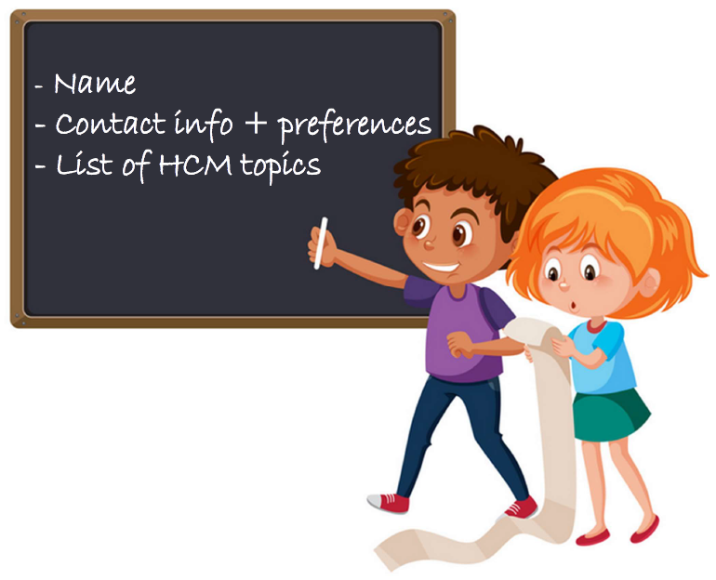
Email Payroll@wwcc.edu

Slide 6

Questions?

