Slide 1
Public Records Introduction and File Maintenance Best Practices
Hannah Shea
Public Records and Compliance Manager Hannah.Shea@seattlecolleges.edu

Slide 2
Public Records Act (RCW 42.56)
The Public Records Act is a Washington State law that was enacted for better transparency in government in 1972. It stipulates that we as public servants do not have "the right to decide what is good for the people to know and what is not good for them to know.“
The public has an inherent interest in the conduct of local and state government and has a right to the information produced in the conduct of business.

Slide 3
What are public records?
RCW 42.56.010 defines Public Records as "any writing containing information relating to the conduct of government or the performance of any governmental or proprietary function prepared, owned, used, or retained by any state or local agency regardless of physical form or characteristics“
It goes on to expand the definition of writing to include, "handwriting, typewriting, printing, photostating, photographing, and every other means of recording any form of communication or representation."

Slide 4
Three Elements of a Public Record
Relating to the conduct of government or proprietary function
Prepared, Owned, Used, or Retained
Writing
= Public Record!

Slide 5
Common Public Records
Syllabi
Emails
Teams Messages
Voicemails
Recordings
Personnel Records
Contracts
Loose Paper
Evaluations
Complaints
Investigations
Policies
Budgets
Word Documents
PowerPoints
Sticky Notes

Slide 6
Exemptions
Just because a record is public, does not mean all the information contained in the document is. The state and federal legislator acknowledges there are some documents and information that are not of legitimate interest to the public or may compromise the security of an employee or agency. Exemptions are to be applied narrowly in the interest of broad disclosure!

Slide 7
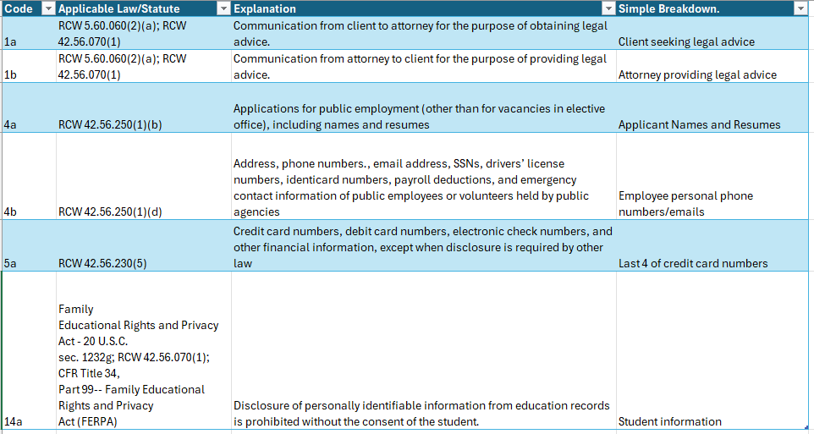
Example Image of an Exemption Log

Slide 8
Common Exemptions
Employee Personal Information (RCW 42.56.250(1)(d)): personal cell phone numbers, SSNs, personal emails, home addresses maintained for employment purposes.
Investigative Records (RCW 42.56.250(1)(f)): Investigative records are exempt while the events are ongoing, but disclosable upon conclusion. Victims and witnesses are redacted in when the case involves violations or policy or law.
Financial Information ((RCW 42.56.230(5)): information where release may compromise account, Credit card numbers, account numbers, check numbers
Student Educational Records (FERPA) – Assignments, homework, class schedule, email communication
Whistleblower Protection (RCW 42.40.070) – Identifying information for a person who brings a whistleblower investigation forward.

Slide 9
Communication is not private unless it is privileged!
Emails, Voicemails, Chats, and letters are all public record with very few exceptions.
Exceptions:
Communications between attorneys and clients seeking legal advice.
Communications between patients and healthcare professionals
Communication of persons seeking advice under an informal process to ascertain rights concerning a possible unfair practice under RCW 49.60

Slide 10
Use of state resources for personal use
Title 292 WAC: Ethics in Public Service
WAC 292-110-010 (3) does allow for employees to use state issued resources for personal use so long as
There is little or no cost to the state
Any use is brief and occurs infrequently
The use does not interfere with the employee’s duties or compromise security
The use is not for the purpose of conducting an outside business or private financial gain nor for promoting an outside organization
WAC 292-110-010 (4) goes on to clarify that there is NO expectation of privacy on these uses and that they may be subject to public disclosure or audit.

Slide 11
Use of personal devices
Employees are able to use their personal devices in the conduct of business so long as it does not present a security or safety risk, but this is not considered best practice.
Use of your personal cell-phone or laptop means public records are likely to be stored on these devices.
In the event of subpoenas, you may be opening yourself up to having your personal devices as part of the discovery
You may be forfeiting the privacy of your personal accounts when you use them for business.

Slide 12
If you choose to use your personal device or account for the conduct of work
It is your responsibility to maintain the files and emails for the appropriate retention time.
You are still responsible for submitted destruction logs for files that are not transitory in nature
Be mindful that the use of your personal email for business makes it publicly available.
Search your device when we receive public records requests or subpoenas
Maintain appropriate security locks on your devices.

Slide 13
Remember: As a state employee, any documents produced in the course of your work may be subject to public disclosure.

Slide 14
Lifecycle of a Public Records Request
Requests may be submitted in any format (verbally, on paper, email, fax, etc).
Requests should be forwarded to the school’s Public Records Officer/Designee/Manager.
Within 5 days of receipt, records must either be provided or acknowledged with an estimated completion date.
Records are gathered from the appropriate departments
The records are reviewed for applicable exemptions and redacted
The records are released and the request is closed.

Slide 15
File Maintenance Best Practices

Slide 16
Retention
The “retention” of a record is the length of time the institution must maintain a record prior to destroying it. We have a legal obligation to keep a record safe until it reaches the minimum retention.
The two retention schedules most schools will follow are:
General State Government Agencies Retention Schedule
Community and Technical Colleges Retention Schedule
Notes:
Note: Your school may have it’s own retention schedule on top of these! Make sure you are following your school specific policies as well.

Slide 17
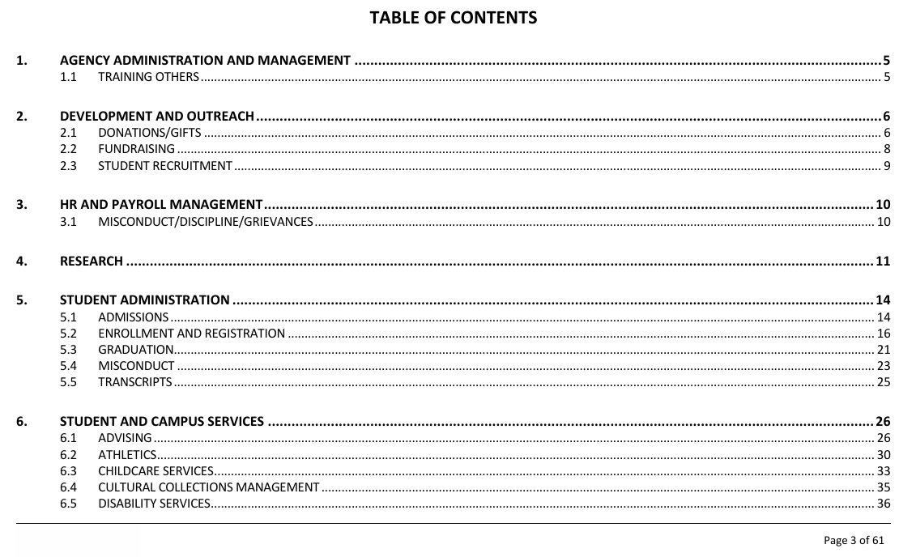
Example Screenshot of Retention Schedule Table of Contents

Slide 18
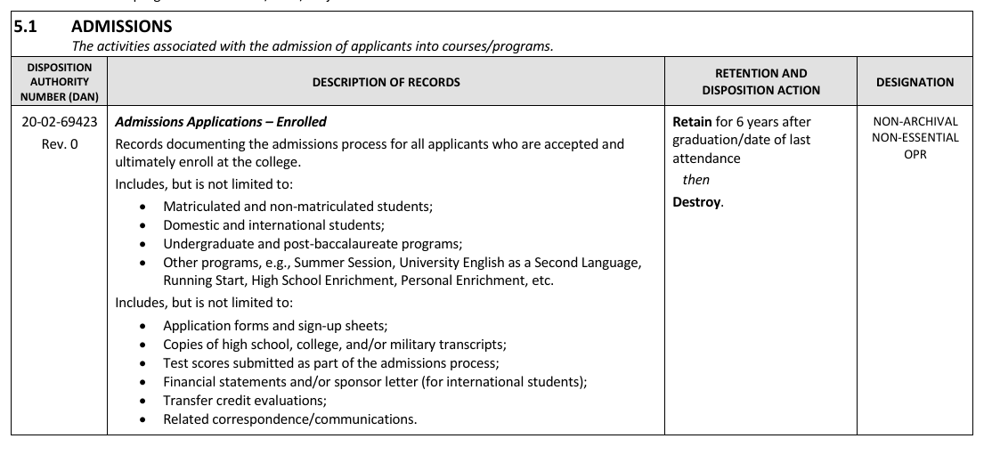
Example Image of Retention Schedule Category

Slide 19
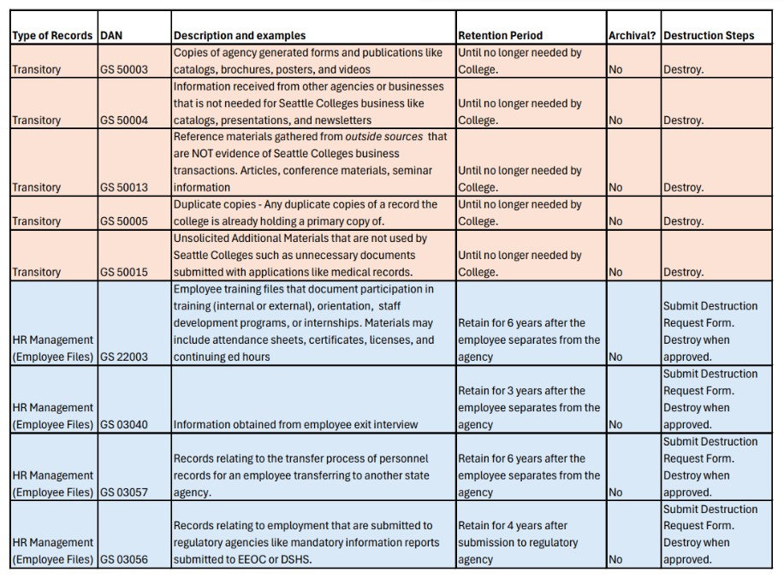
Example Image of Retention Cheat Sheet

Slide 20
Transitory Records
Not all records need to be maintained for years.
Transitory records are records that can be purged after they are no longer needed for agency business.
Some examples of transitory records are:
Blank Forms
Brainstorming notepads
Business Cards
Spam letters
Scheduling invites
Secondary copies
To-do Lists

Slide 21
Why should we delete records?
Space is limited
Save time
Cost effective
As long as records exist, they are subject to subpoenas and public records requests even if they are well beyond their intended destruction date.

Slide 22
Records eligible for destruction
If the records are beyond their retention period AND are labeled as non-archival, then the destruction process can begin!

Slide 23
Destruction
Once a record is eligible for destruction:
Fill out your agency’s destruction log!
Follow the destruction approval process your college has laid out.
When approved, destroy the records (via shredding, contractor, burning, or deletion) within 60 days and store the destruction log.

Slide 24
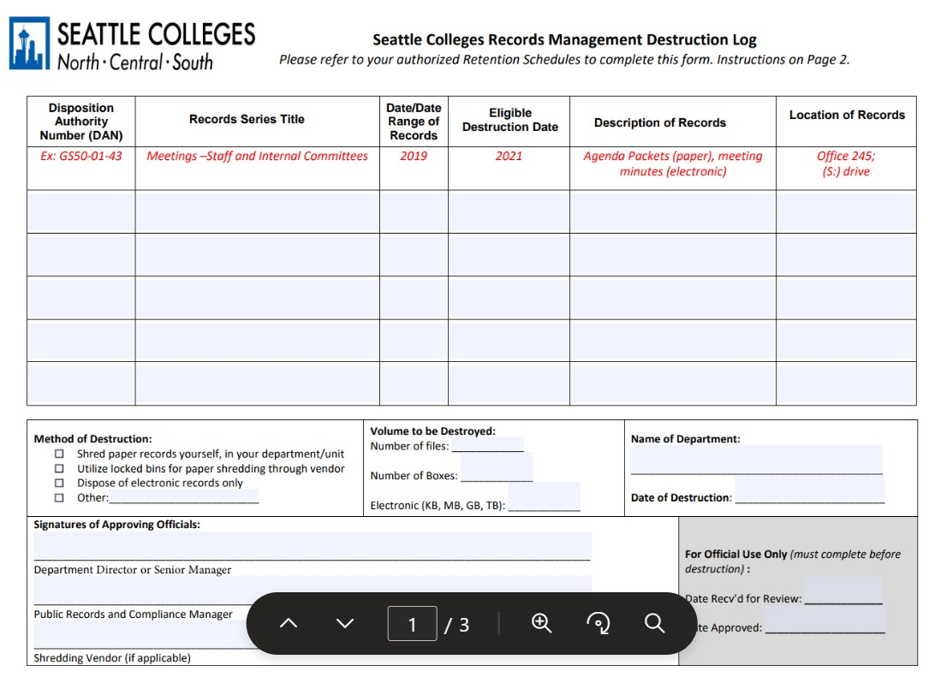
Example Image of Destruction Log used by Seattle Colleges

Slide 25
Records eligible for Archival
If the records are beyond their retention period AND are labeled as ARCHIVAL, the records cannot be destroyed. They should be archived according to your school’s policy.
Notes:
This typically entails working closely with your records manager to send the Records to the Washington State Archives. Heavily dependent on your school policy and the type of record.
Seattle Colleges Specific: Upon receiving approval, prepare and send the records to the Washington State Archives following their current protocol outlined on their website.
Our contact is the Puget Sound Branch and they can be reached for information and assistance with the archiving process at 425-564-3940

Slide 26
Records not eligible for destruction or archival
If the records are still within their retention period, we must ensure they are safely maintained.

Slide 27
Maintaining Records
If the record is still within the mandated retention period, it must be maintained.
Consider if the records should be re-labeled or organized. Does the current system make sense?
Label the box or folder with the appropriate destruction date to and Disposition Authority Number.
Consider digitizing the records.

Slide 28
Digitizing Records
Not all records need to be kept in their physical form.
Non-archival documents can be shredded before their retention period IF there is a complete and accurate digital copy.

Slide 29
Why would I digitize records?
Digital Records can be easier to search and file
Digital records take up less physical space
Digitizing records can save time in the future if there is a subpoena or records request that requires the records to be scanned
Digital records are not subject to the same dangers as physical records
Water Damage
Fire
Fading with Age

Slide 30
Considerations for Digitizing Records.
Records must be scanned in an accessible format.
For records with a retention span of six years of less:
TIFF, PNG
PDF, PDF/A
JPEG, JPEG 2000
For records with a retention span of longer than six years:
TIFF
PNK
PDF/A

Slide 31
Scanning Records
Set the scanner density to at least a DPI of
300. If the document has a lot of fine detail, consider setting the density higher.
Scan the document as accurately as possible.
Scan in color if applicable
Scan double-sided if applicable.
Scan with AND without sticky notes if they are crucial to the paperwork. Ensure there are no obstructions in your scan.

Slide 32
Quality Control
After scanning the document, check the original against the scan and look for the following:
Distortions
Missing pages
Obscured text
Incorrect color
Slanted pages
Speckling

Slide 33
Digitizing Records cont.
Once you have verified the digital record is a true and accurate copy…
Label and file the digital record accordingly.
Make a note of the original creation date and the destruction date. Either in your titling or filing system.
When filing, use appropriate security measures.
If the data is sensitive, set restriction on who may view or delete the data.
Establish back-up copies and institute disaster preparedness measures if necessary.
Receive approval from your department and destroy the physical copy.

Slide 34
Resources
General State Government Agencies Retention Schedule
Community and Technical Colleges Retention Schedule
Transitory Records Cheat Sheet
Sample Destruction Log
Washington State Archives Resource Page
Washington Archival Guidance
Public Records Act
WAC 292-110-010

Slide 35
Thank you!
Hannah Shea
Public Records and Compliance Manager 206-934-4436
Hannah.Shea@SeattleColleges.edu PRecords@SeattleColleges.edu

