Slide 1

Payroll Reconciliation from the Finance Side
Presented by: SBCTC System Accounting staff

Slide 2

How does the data get into the General Ledger?
Finance receives PAY journal
Payroll is entered / processed in HCM
Finance receives AP Vouchers
Voucher entered/
processed in FIN
Net Pay voucher is created

Slide 3
The PAY journal will:
Debit Credit
Salary Expense Liability Payable
(5000003 – 5000190) (2011004 – 2011710)
Benefit Expense
(5010003 – 5010160)

Slide 4
The AP Journals (includes Net Pay) will:
Debit Credit
Liability Payable Liability Payable
(2011004 – 2011710) (2000010)
Debit Credit
Liability Payable Cash
(2000010) (1000070)
When Voucher is Built
When Voucher is Paid

Slide 5
So what goes wrong?
Manual payments
Payment cancellations
Errors in the PAY or AP Vouchers that require intervention
Incorrect Combo Codes
Debit values where “statement of fact” must be submitted to vendor (such as TIAA)
Items sent to Payroll Suspense account (5010170)
Timing

Slide 6
Ways to mitigate potential issues:
Double check your combo codes for accuracy
Try not to correct anything in either your PAY journal or AP vouchers
If you do have to correct something, be sure to change both the PAY journal and AP vouchers the same
Note: if you modify a state fund, you will be messing up your VPA
Adjustments to AP vouchers are expensed
Payments received from suppliers are posted to Liability accounts with adjustments to interest/fees to recognize gain/loss to investments
Manual payments should not be expensed – should hit account 2011015
Make sure all AP vouchers are built from HCM – If a deduction doesn’t have a corresponding vendor attached, no voucher will be built

Slide 7
How do I know I don’t balance?
Timing is everything. Make sure you don’t pull these reports until your PAY journal has been posted and your AP vouchers (including your Net Pay) have been built.
Pull a GL report from FIN – suggest query: QFS_GL_ACCOUNT_ANALYSIS
  Start with all of FY23. However, once you get these balances, you will only need to review by month.
  Pivot the query. You want to look at only the Liability accounts associated with the deductions (2011004 – 2011710) and Expense suspense account (5010170)
Start with looking by date rather than string. This will get you to overall variances by the payroll period. Once that is clear, then look at by string to be sure that the strings are clearing out as expected.

Slide 8
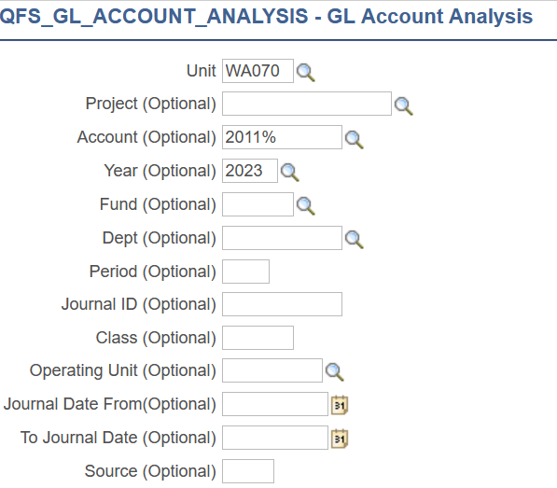
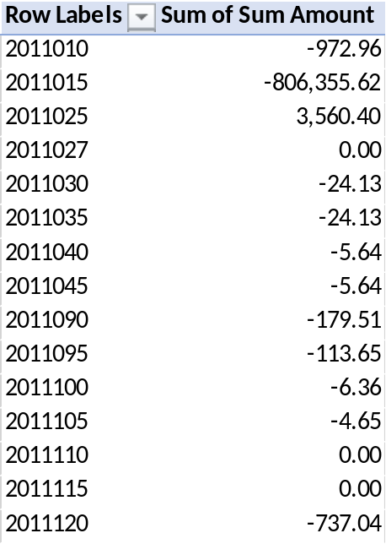
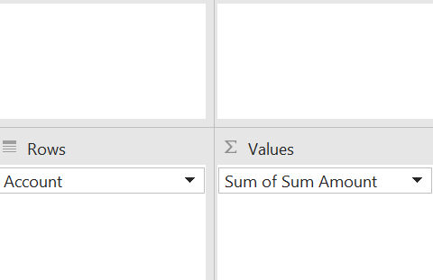
Query results & Pivot setup

Slide 9

How do I research / fix my issues?

Slide 10
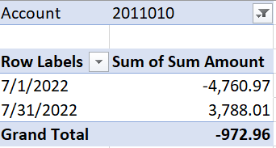
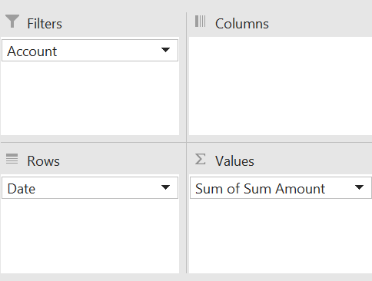
Review each account, first by Balance,

Slide 11
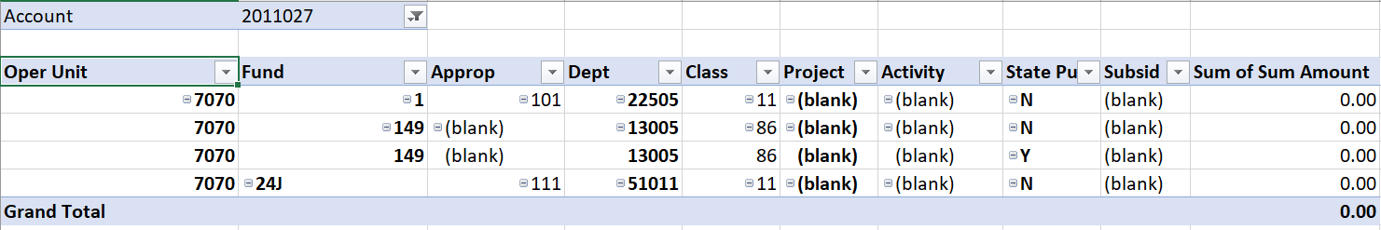
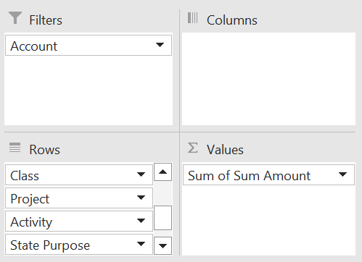
Then by string…

Slide 12
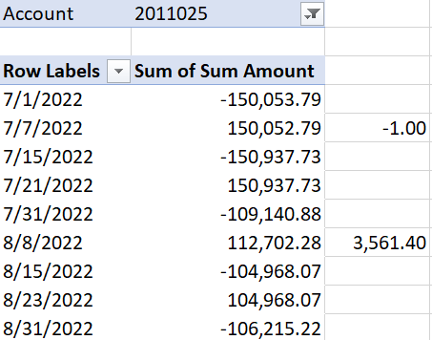
Researching issues…
Review the originating documents.
  The $1.00 variance came from the 6/30 payroll (It is dated 7/1 because it was outstanding at year-end, and we are only looking at FY23 (which would have a balance forward for the balance remaining in FY22)
Compare to the voucher.
  More than likely, an adjustment was requested by the HR department to the AP department. This adjustment was coded to the liability account rather than an expense account.

Slide 13
how does Reversed payments and manual payments effect my Net Pay voucher and GL Accounts?

Slide 14
Reversed Payments
If the employee doesn’t receive the funds, but we sent them (either by paper check or ACH), Central Payroll:
  1) If payment was made via ACH, the funds are requested back from the bank.
    If the funds are not returned, and the error was made by the college, the college will issue a new manual check to the employee and not enter the check into Payroll. This new manual check should be expensed (not put to 2011015).
    If the funds are returned, then a Reversal can be entered in Payroll and the manual check would be posted to 2011015, not an expense.
  2) If payment was made via check, then Central Payroll will cancel the payment at the bank and the college creates a Negative Manual Check in Payroll to reverse the payment. The college can either enter the earnings again on the next payroll or pay by manual payment. In this case the manual payment would need to be added back to the next payroll in order to keep the W-2 accurate.
Company | Company Name | Pay End Date | Pay Schedule | Form ID | Paycheck Number | Chk Option | Paycheck Status | Empl ID | Name | Net pay | Pay Check Issue Date | Cancellation | Void | Cancelled Total | Paid Total
220 | Tacoma Community College | 2023-01-31 | 01B |  | 1550 | Manual Check | Confirmed | 101034586 | Mears,Gina M | (302.77) | 2023-01-10 | N | N | - | (302.77)
220 | Tacoma Community College | 2023-01-31 | 01B | ADVICE | 1178853 | Advice | Confirmed | 101034586 | Mears,Gina M | 1,527.68 | 2023-02-10 | N | N | - | 1,527.68

Slide 15
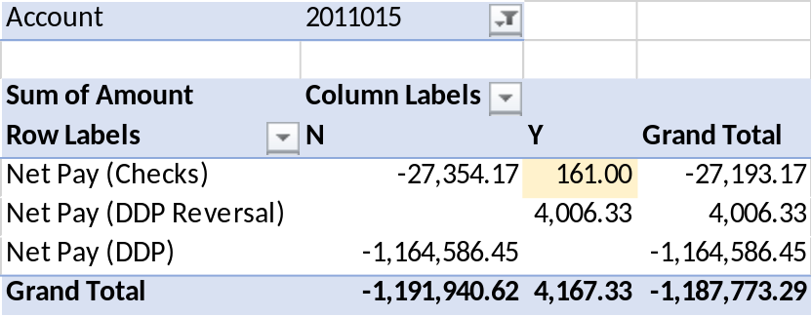
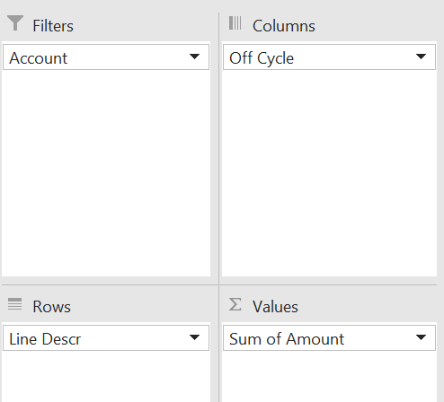
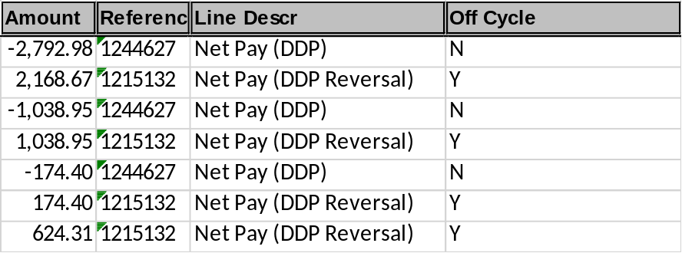
How does this tie to your Net Pay voucher?
CTC_HR_ACCTG_LINE_PAY_PERIOD
The $160.00 is an off-cycle Check (Manual) check. This is excluded from the pull for your Net Pay. The manual payment, done in AP, should have been coded to this GL Account (2011025).
The $4,006.33 is a payment reversal and is not excluded from the pull for your Net Pay.

Slide 16
Why does my PAY journal have entries for other operating units?
Please don’t delete these lines!
This happens when your Payroll department process payments to employees that have been terminated from your business unit. If your Payroll department does not follow the correct process, this results in you seeing incorrect detail. These expenses/liabilities are still yours. However, you will need to update your journal and the corresponding AP vouchers with the correct codes.
Issue: If the error or correction has a state fund, this will mess up your VPA. Suggest that you make the string postable without changing the state fund, then correct in a second journal so the changes to VPA will be picked up in your monthly report. Otherwise, you are going to have to manually adjust the monthly VPA report.
To figure out who the employee is, run the HCM query: HR Accounting Line by Pay Period, filter on the operating unit that is not yours. Then, go back to payroll and ask for their correct chartfields. They will need to get that by looking in combo code in the employee’s file.

Slide 17
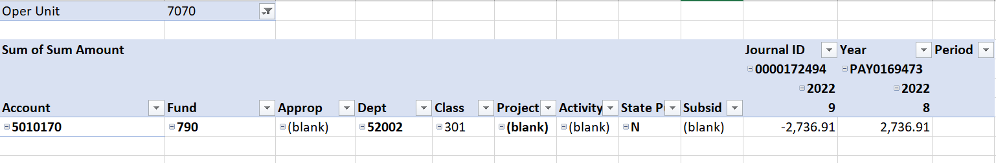
Why do amounts end up in the Payroll Suspense account?
Anytime an employee is paid without a valid combo code (which, by the way, is not a requirement in the HCM pillar to have in order to pay an employee), the system will assign this suspense account and string.

Slide 18
How do I clean these up?
This account is a “benefit” expense and needs to be reclassed to the appropriate salary account. There should be associated Staff Month value in the Stat field.
The adjusting journal must use the Source Type of “PTR” to be collected at year-end for reconciliation of reports being sent to SAO from the HCM pillar.
Make sure to go back to the employee’s job record and add a valid combo code.

Slide 19
If you need assistance, please create a ticket for the accounting department

