Slide 1
SBRP Supplemental Retirement Benefit
Calculation Overview and Steps
Pam Kelly & Julie Huss
February 2024

Slide 2
What is a Supplemental Benefit?
A defined benefit, formula-driven, lifetime income benefit.
Separately, but in connection with the SBRP, this benefit provides a “safety net” for eligible SBRP participants - assuring a minimum benefit from their state employment.
This benefit is managed and funded by the SBCTC.

Slide 3
Eligibility Requirements – Determined by District
Participation prior to July 1, 2011
At least age 62:
    Full benefit = age 65 or older.
    Reduced benefit = at least age 62.
At least 10 continuous YOS in the plan.
Disability retirement = must meet special SBRP disability retirement provisions at any age.

Slide 4
The calculation – Completed by SBCTC
Is complex and performed once for a qualifying retiree, based on retirement effective date.
Requires assistance from a professional actuary.
SBCTC cannot provide projected calculations.
SBRP (TIAA) account balances (as well as hardship withdrawals and division of assets due to a divorce) have no effect on the calculation.

Slide 5
What is the calculation based on?
Age at retirement.
Years of continuous service up to 25.
The calculation and comparison of the “goal income” and “assumed retirement income.”
The calculation also considers:
  The age of the beneficiary (up to 5 years difference).
  Benefit from another WA State Retirement Plan (TRS, PERS, SERS), if any.

Slide 6
Calculation Components
Goal Income includes:
  Years of service (up to 25),
  Salary (two highest fiscal years/averaged by month),
  Service factor - 2% per YOS, unless contributed less than 10% at age 50 (prior to 1/98, this was optional)
Assumed Retirement Income calculated by TIAA actuaries based upon actual contributions invested in TIAA Traditional and CREF Stock.

Slide 7
Overview and Steps
Part one:
District Eligibility Review
Notice of Intent to Retire
Benefit Options Selection and Beneficiary Designation
Part two:
Calculation Worksheet & Instructions

Slide 8
District Eligibility Review
Form should be completed for each employee who retires.
  Becomes the record of review and local determination on eligibility for a supplemental calculation.
  Completed forms should be retained on a similar schedule as payroll information.

Slide 10
Notice of Intent to Retire
This form begins the request for calculation.
Requires the retiree’s signature.
College must review for accuracy.

Slide 11
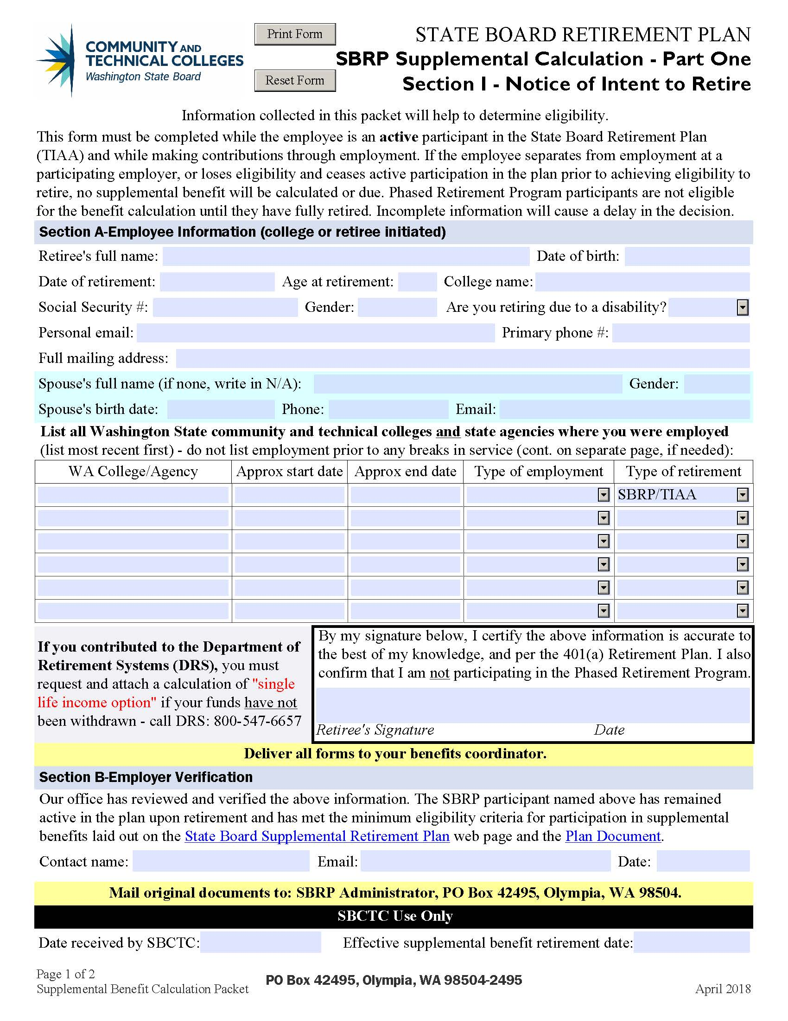

Slide 12
benefit Payment Option/beneficiary Designation
This form is required to complete calculation.
Requires the retiree, spouse (if applicable) and witness signature(s).

Slide 13
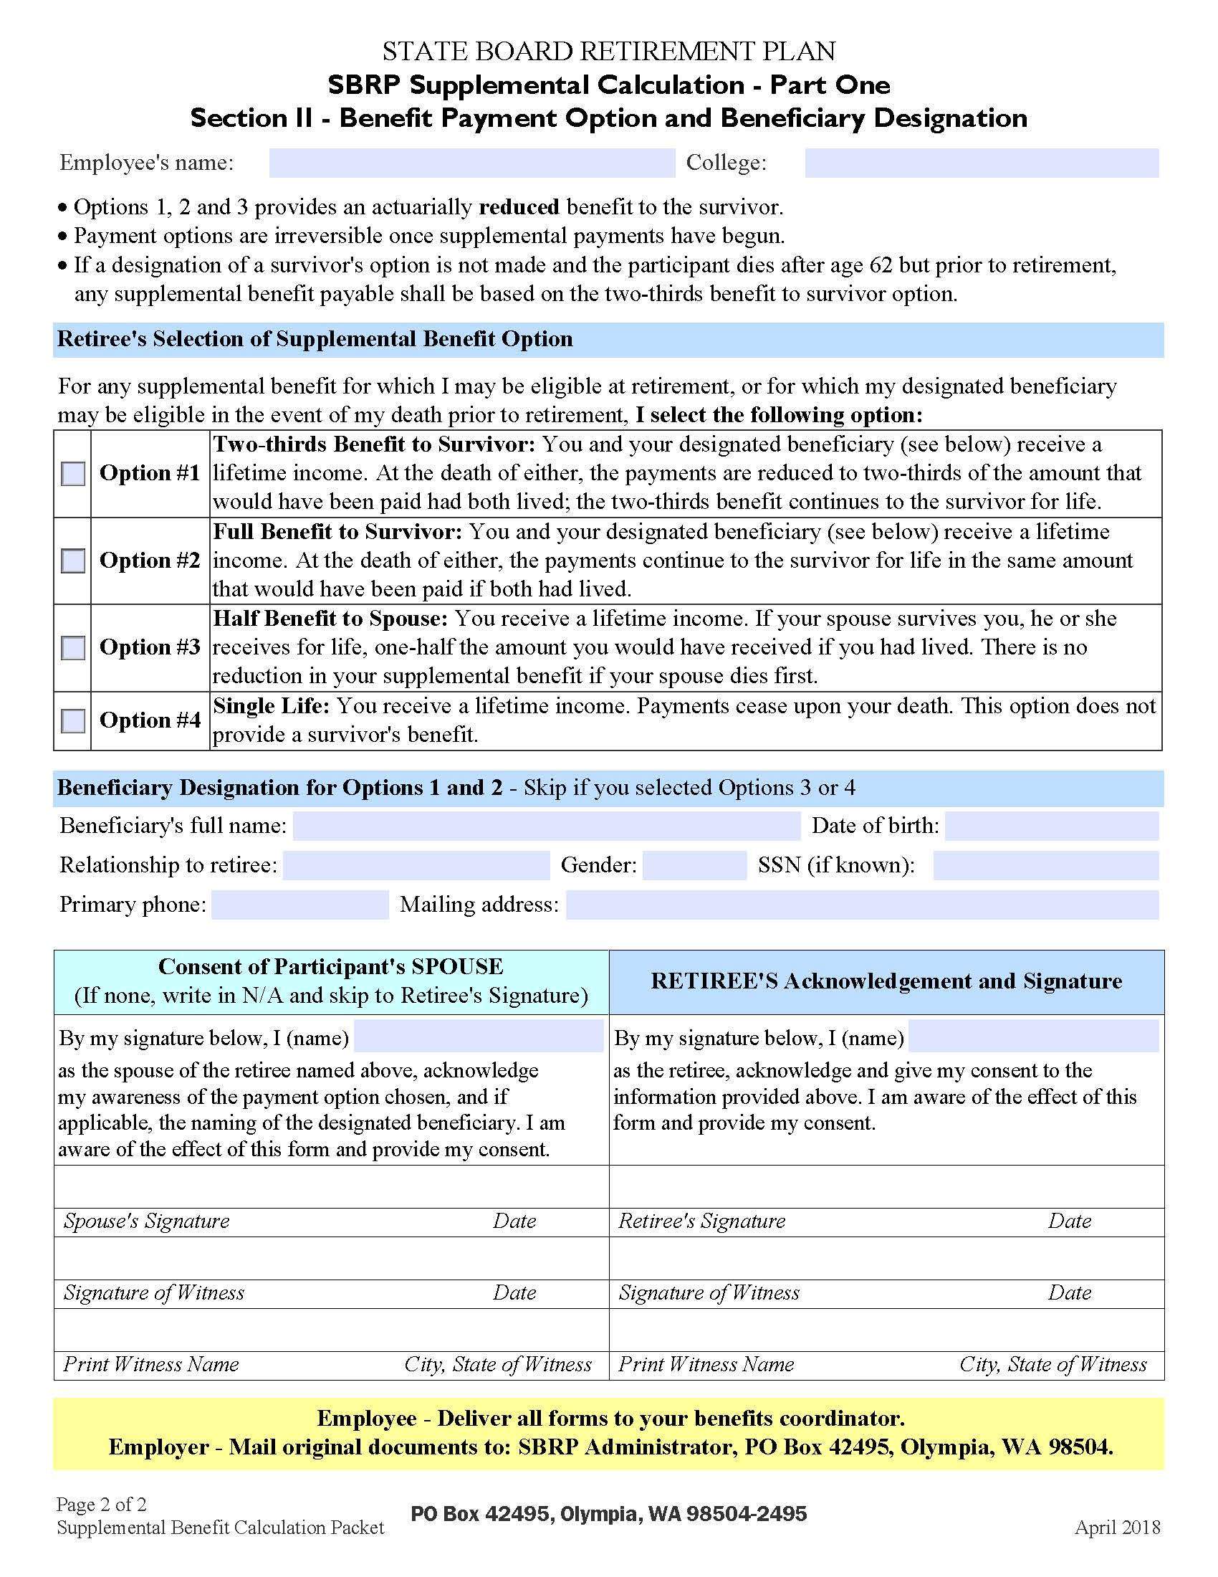

Slide 14
Calculation worksheet & Instructions
Fill in the information for the most recent (25) years of eligible service.
Using your own worksheet? Colleges have the option to use their locally developed worksheet. It must include all requested information and be reviewed and approved by SBCTC prior to its use.

Slide 15
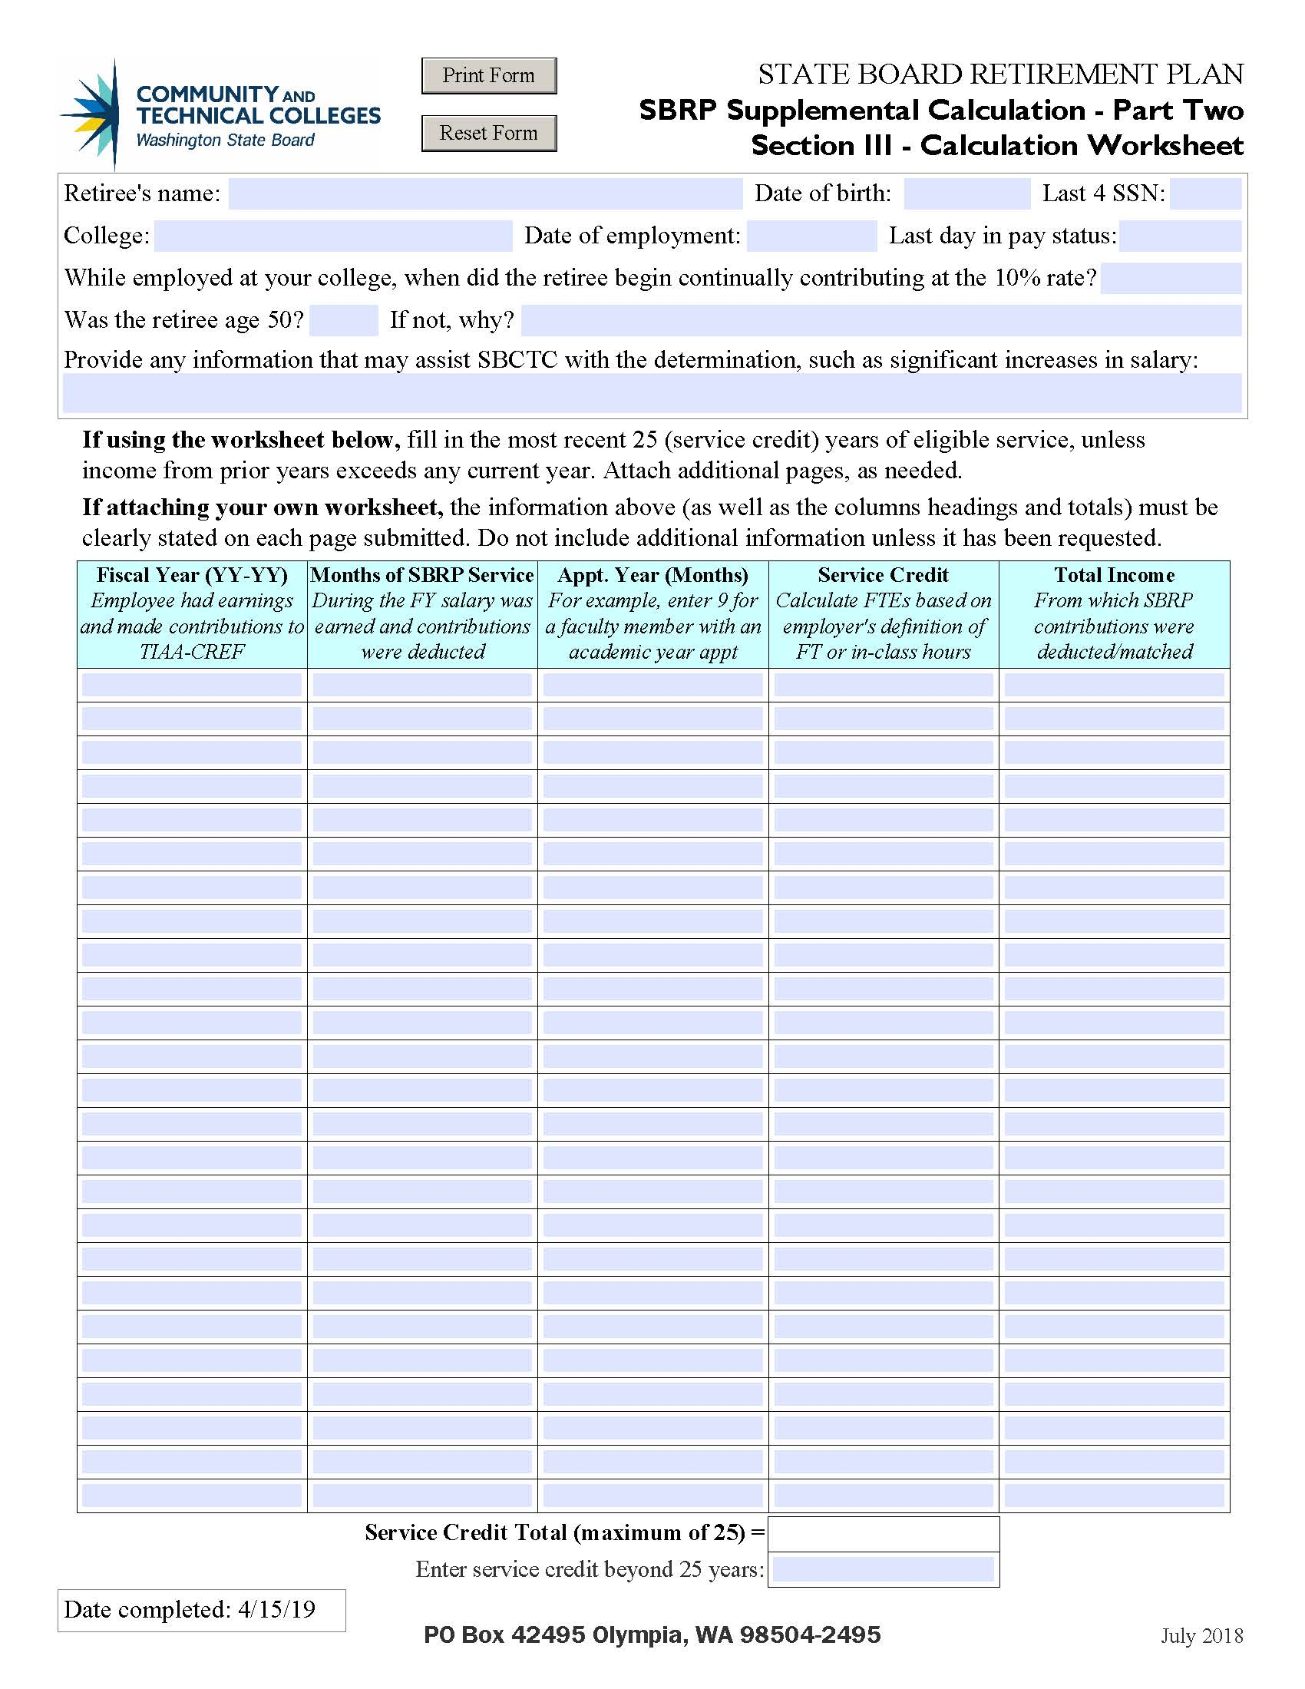

Slide 16
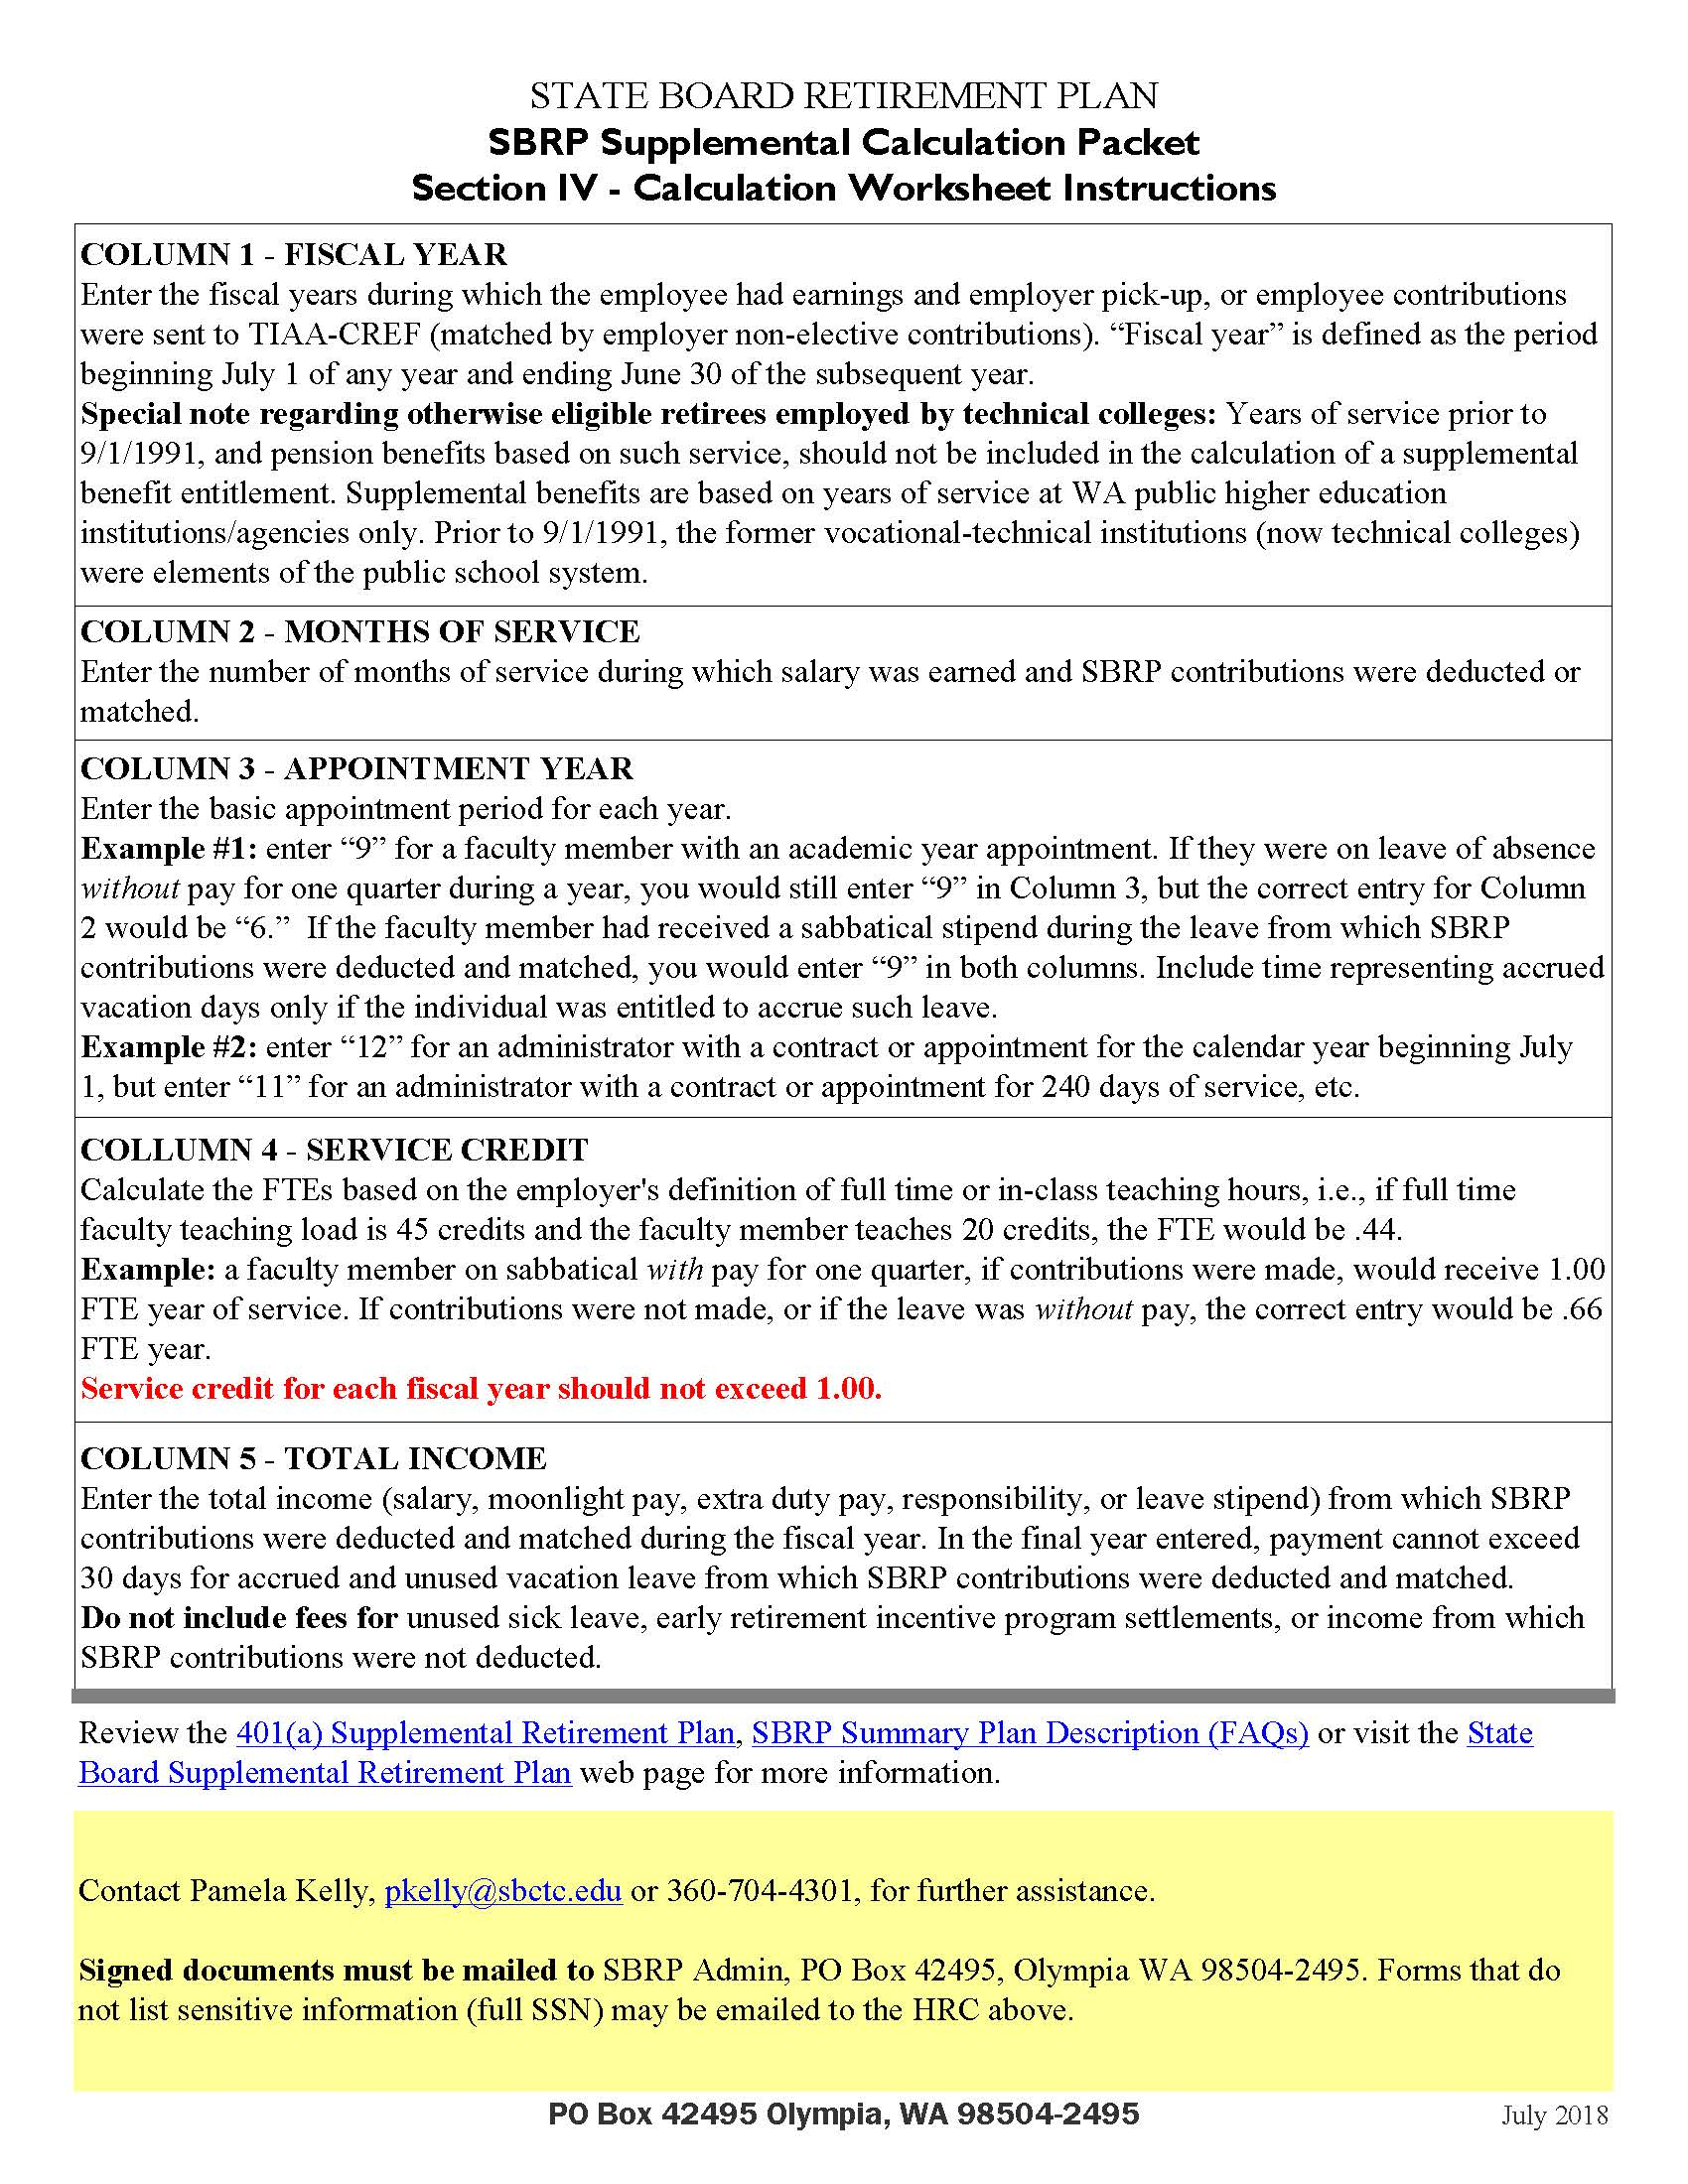

Slide 17
Column 1 – fiscal year
Enter the fiscal years (7/1 through 6/30) during which the employee had earnings and made contributions to SBRP/TIAA.
Technical Colleges:
    This benefit is based on years of service at WA public higher education institutions/agencies only.
      Years of service prior to 9/1/1991 (and pension benefits based on such service) should not be included in the calculation. (Prior to 9/1/1991, technical colleges were elements of the public school system.)

Slide 18
Column 2 – Months of Service
The number of months of service during which salary was earned and SBRP contributions were deducted and matched.
    May not be the same as seniority as defined in your faculty CBA.

Slide 19
Column 3 – Appointment Year
Enter the basic appointment period for each fiscal year.
Examples:
    #1 – Enter “9” for a faculty member with an academic year appointment. If leave of absence, without pay for one quarter during that year, you would still enter “9” but the enter for Column #2 would be “6.”
    #2 – Enter “12” for administrators with a contract appointment for the fiscal year (beginning July 1), but enter “11” for an administrator with an appointment for 240 days of service, etc.

Slide 20
Column 4 – Service Credit
Service credit for each fiscal year cannot exceed 1.0. Service credit is only provided for time in which contributions were made.
For part-time faculty, calculate FTEs based on RCW 28B.50.489 (your definition of full time and in-class teaching hours). For example:
    If full-time faculty teaching load is 45 credits and the faculty member teaches 20 credits, the FTE would be .44.
    A FT Faculty member on sabbatical with pay for one quarter (if contributions were made) would receive 1.0 FTE year of service credit. If contributions were not made, or they were on leave without pay for that quarter, the correct entry would be .66 FTE year of service credit.

Slide 21
Column 5 – Total Income
Enter total income from which contributions were deducted/matched during the FY.
In the final year – payment cannot exceed 30 days for accrued and unused vacation leave.
Do not include compensation for unused sick leave, early retirement incentives, settlements, or income from which contributions were not deducted.

Slide 22
Send Forms to
Send all forms (and if applicable, the DRS’ single life income option document) to – PO Box 42495, Olympia WA 98504-2495
    Attn: Pam Kelly
Forms with sensitive information should be mailed.
If e-mailing, cover the SSN and mail originals.
Calculation worksheet can be e-mailed.

Slide 23
What happens next?
Benefit offset calculation requested from TIAA.
    TIAA is working through the backlog, shifting to SBCTC.
Calculation worksheets sent to other colleges.
Information gathered, as needed.
SBRP supplemental calculation is completed.
Letter or e-mail of decision is sent.

Slide 24
More info…
State Board Supplemental Retirement Plan webpage
    Navigation: https://www.sbctc.edu/ → For Colleges & SBCTC Staff → My Employment → Retirement plans and planning tools → SBRP Supplemental Retirement Benefit
Benefit forms and plan documents
    Navigation: https://www.sbctc.edu/ → For Colleges & SBCTC Staff → My Employment → Benefit forms and plan documents

Slide 25
SBRP/SBSRP Contact INFO
Julie Huss, SBRP Administrator, jhuss@sbctc.edu 360-704-4303
Pamela Kelly, HR Consultant, pkelly@sbctc.edu 360-704-4301

Slide 26

Questions?

