Slide 1
Adjunct Faculty: 2 Year Averaging
Presented by: Gretchen Bird

Slide 2
Agenda
What is 2 Year Averaging (and Why Does it Give Me a Migraine)?
What do I have to do?
Samples for usage
Off Quarter/Summer
Questions!

Slide 3
What is 2 Year Averaging?
Can potentially help Adjuncts (PTF) keep their benefits during low quarters (<50%)
  There are requirements to keep protections in place – not a guarantee!
  Can stack loads with other eligible schools
Works with summer/off quarter protections from 1990’s Mader lawsuit
Notes:
Clarify available resources and reduce ad hoc requests.

Slide 4
But Wait.. There’s More!
WAC 182-12-131 (3)(d) – The Fine Print
(3)(d)Two-year averaging: All benefits-eligible faculty (eligible as described in WAC 182-12-114 (3)(a) and (b)) who worked an average of half-time or more in each of the two preceding academic years are potentially eligible to receive uninterrupted employer contribution toward PEBB benefits. "Academic year" means summer, fall, winter, and spring quarters or summer, fall, and spring semesters and begins with summer quarter/semester. In order to be eligible for the employer contribution through two-year averaging, the faculty must provide written notification of their potential eligibility to their employing agency or agencies within the deadlines established by the employing agency or agencies. Faculty continue to receive uninterrupted employer contribution for each academic year in which they:
(i) Are employed on a quarter/semester to quarter/semester basis and work at least two quarters or two semesters; and
(ii) Have an average workload of half-time or more for three quarters or two semesters.
Eligibility for the employer contribution under two-year averaging ceases immediately if the eligibility criteria is not met or if the eligibility criteria becomes impossible to meet.

Slide 5
Translation:
PTF must apply within your application deadline
  Late application? Do not accept, send them to HCA Appeals process
PTF must have averaged ½ time (50% or more) in each of the last 2 years to be approved
  Summer 24 – Spring 25 & Summer 25 – Spring 26
Once approved, PTF must teach 2 of the 4 available Qtrs in 26/27 AND average ½ time over 3 quarters
  If this is not met, or becomes impossible to meet, 2YA protections end and the PTF must have a 50%+ load to remain eligible

Slide 6
What Do BA’s Have to Do?
Send out application to all PTF and specify deadline
  Typically sent out early May for the following school year
  We set the deadline 4 weeks out, but this varies across SBCTC Colleges
  Send to any FTF electing SBRP Phased Retirement program next year
    Change deadline for these if needed
Review each application using B-3 worksheet
Send determination notification to each PTF who applies
Keep track of determinations to use during quarterly eligibility process

Slide 7
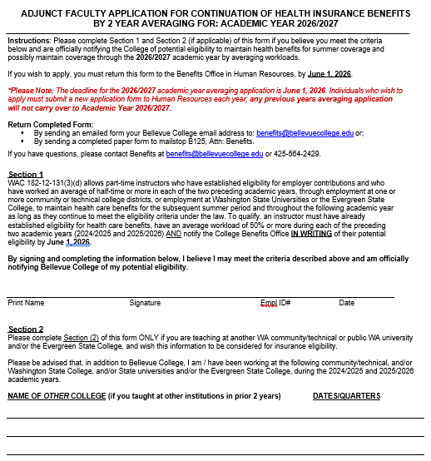
Application Sample
Clearly state your deadline
Confirm new application is needed each year
Ask for other college loads, can combine

Slide 8
Coordinating Applications
With Other Agencies
WAC 182-12-131 (3)(d):
“..faculty must provide written notification of their potential eligibility to their employing agency or agencies within the deadlines established by the employing agency or agencies.”
Realistically, the PTF just needs to apply with the school who carries their benefits.
If you do not carry their benefits, you can’t approve 2 year averaging if they apply with you. 2 options:
    Tell them to contact the carrying agency and apply there or,
    Forward their application to the other agency and ask them to process.
Have some grace, this is confusing to Faculty. If another school sends you the person’s application that went to them instead of you, and it’s outside your deadline, please process it.

Slide 9
Application Received, Now What?
There are 3 possible determinations:
Approved for 2 year averaging for the following year (includes Summer)
Not approved for 2 year averaging, but approved for Summer Qtr coverage
Not approved for 2 year averaging or Summer Qtr coverage

Slide 10
The Lovely B-3 Worksheet
Walks you through the determination BUT:
Be sure to only use highest 3 quarters of loads (Summer – Spring) – calculator only wants 3
Use 0 for one field if they only taught 2 quarters – if you don’t, the average will be wrong
Add in other school loads and use 3 highest totals only, delete others

Slide 11
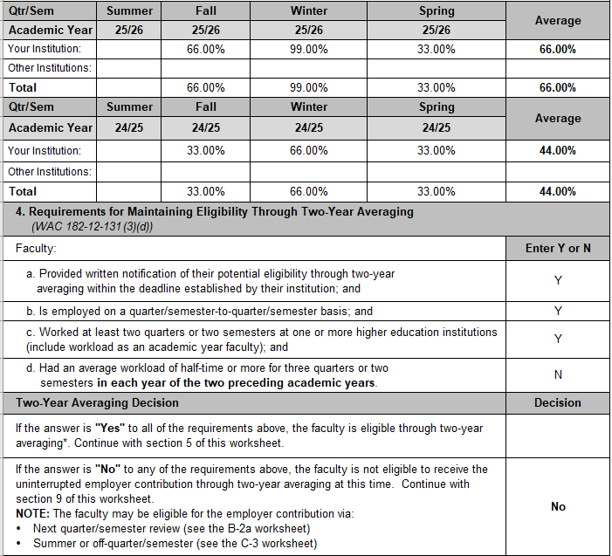

Sample #1: N/E for 2YA, Summer Only
Because both years don’t average out to 50%, this person would not be eligible for 2 YA.
Because they have averaged ½ time over 25/26, they would be eligible for Summer 26 coverage.
If they don’t have coverage for Spring, then they are re-eligible on the 1st of the month that Summer Qtr begins, whether they teach Summer or not.

Slide 12
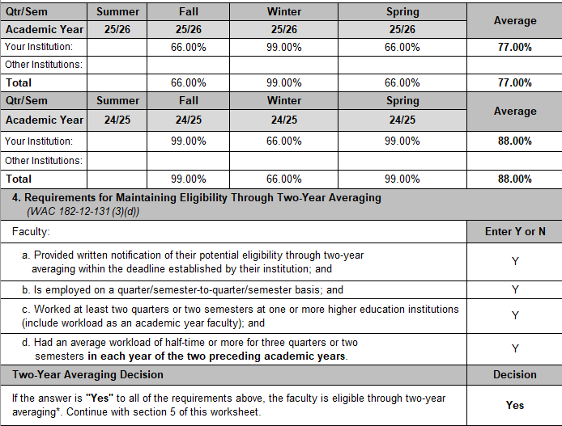

Sample #2: 2 YA Approved + Summer
Both years independently average out to ½ time, 2YA approved
Met Summer eligibility requirements

Slide 13
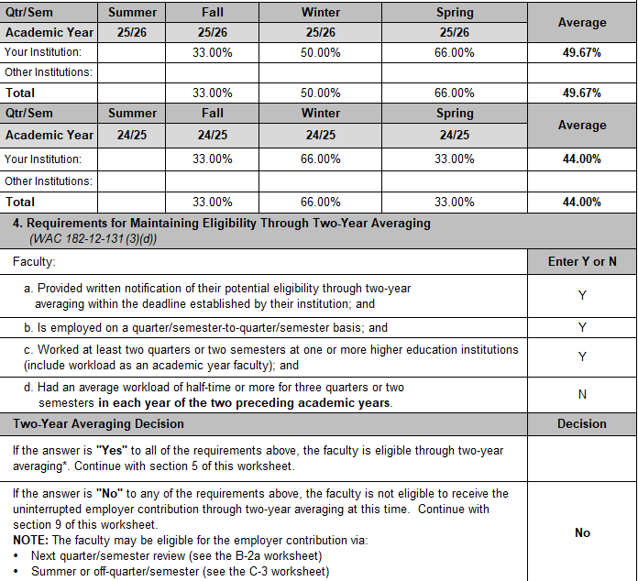

Sample #3: 2 YA Not Approved, No Summer
Neither years are above 50%, 2 YA not approved
This person was benefits-eligible Spring 26, but did not teach enough over 25/26 to ‘earn’ summer coverage so they must have a 50%+ summer contract
Notify Payroll to not pre-pay this person, if they remain eligible for Summer, they’ll pay as they go

Slide 14
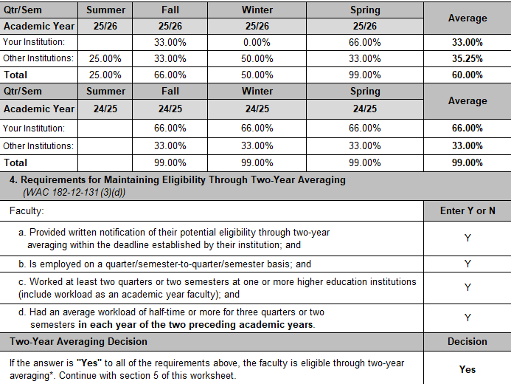
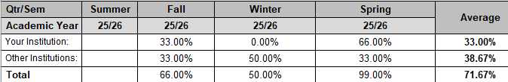





Sample #4: Using Other School Loads
Use 0 if they didn’t teach 3 quarters
Use 3 highest quarters, so remove 25% load, that changes average to:

Slide 15
Send Employee Your Determination
Write up an email template for each scenario: address eligibility requirements, determination for 2YA & Summer eligibility, summer prepay (if applicable)
Send out the determination email after processing each application, send before start of Summer Qtr
  Attach copy of B3 worksheet, ask for signed copy back
  Send all read receipt: HCA may audit and require proof the PTF received worksheet
Put application, B-3 worksheet and email determination in Benefits file
Email me at benefits@bellevuecollege.edu if you want a copy of BC email templates, happy to share!

Slide 16
Log Determination for Quarterly Checks
Log the result in your tracking sheet for anyone who applies & result.
Each quarter – before you cancel benefits for <50% teaching load check for:
1. Did they inform you they have loads at other colleges?
  EE notification to employer is required by WAC 182-12-114(3)(b)
2. Did they apply, and were they approved for 2YA?
  If yes, are protections still in place?
  Usage samples coming up..
3. Have they used an off quarter within the last 12 months?
  More info on slide 20

Slide 17
Using 2 Year Averaging – Sample 1-2
Example #1: Fall Qtr Eligibility Check
Summer 26 – 0% - ok
Fall 26 – 33% - ok
Benefits still ok for Fall because this PTF could still teach 2 of the 4 quarters & average ½ time over 3 quarters.
Example #2: Spring Qtr Eligiblity Check
Summer 26 – 0% - ok
Fall 26 – 66% - ok
Winter 27 – 66% - ok
Spring 27 – 33% - ok
Benefits ok for Spring because this PTF taught at least 2 qtrs. & averaged ½ time over 3 quarters. (66+66+33/3=55%)

Slide 18
Using 2 Year Averaging – Sample 3-4
Example #3: Spring Qtr Eligibility Check
Summer 26 – 0% - ok
Fall 26 – 33% - ok
Winter 27 – 33% - ok
Spring 27 – 66% - ok
PTF has not averaged ½ time over 3 quarters so 2YA protections end 3/31, but is teaching 50%+ Spring, so benefits still ok.
Would not be approved for 2YA next year because this year is low
Would not qualify for Summer 27 benefits automatically
Example #4: Winter Qtr Eligibility Check
Summer 26 – 0% - ok
Fall 26 – 0% - ok
Winter 27 – 33% - ok
Benefits still ok for Winter, because this PTF could still teach 2 quarters & average ½ time over 3 quarters.
No matter what Spring ends up being, they would not qualify automatically for Summer 27 benefits because Fall = 0% and Summer 26 was ‘off qtr’

Slide 19
Using 2 Year Averaging – Sample 5
Example #5: Spring Qtr Eligibility Check
Summer 26 – 0% - ok
Fall 26 – 50% - ok
Winter 27 – 50% - ok
Spring 27 – 33%
PTF has not averaged ½ time over 3 quarters so protections end 3/31, benefits end 3/31.
You can use the B-3(a) worksheet if you need help!

Slide 20
Off Quarter Coverage (a.k.a. “Mader”)
Usually Summer but.. maybe not (WAC 182-12-131 (3)(c)
PTF get 1 off quarter in a 12 month period
Must have taught in each of the immediate preceding 3 quarters, and averaged ½ time over those 3 quarters
If Summer is their off quarter, they don’t get another one for 12 months!
If you need to use another quarter as an off quarter (instead of Summer) to keep them eligible, best practice is to notify the PTF that they’ll either need to teach 50%+ that following Summer, or apply & be approved for 2 year averaging for that next year
Sample: Summer 25 = 66%, Fall 25 = 66%, Winter 26 = 66%, Spring 26 = 33%
Because they didn’t use Summer 25 as their off quarter, you can use Spring 26 as the off quarter and keep benefits on. BUT, now Summer 26 can’t be used as off quarter, must qualify by % or 2YA.

Slide 21

Rousing Discussion About How FUN This Is! ☺
Tylenol is on sale at Safeway…

