Slide 1


Administering VEBA Plan
Notes:
Thank you for joining this presentation intended to assist you with the administration of the VEBA plan. We hope that regardless of your level of experience with VEBA you are able to take away something that will help make your life a little easier. Whether you could use a quick refresher on different options enrolling new employees or haven’t used our secure messaging feature within your employer portal, we hope there is something for you to learn today.

Slide 2

Agenda
What is an HRA?
Key Plan Features
Employer Portal
  Enrollment
  Contributions
  Participant status changes
  Reports
  Secure messaging
Notes:
Today’s agenda includes a quick review of what an HRA is, the key features of the plan, and then some time focused on tips and best practices when using your employer portal.

Slide 3

What is the VEBA Plan?
Health Reimbursement Arrangement
HRA
Tax-free money for out-of-pocket medical costs
  Can be used for spouse and dependents, too
Eligibility and funding sources vary by employer and by employee group
  Sick leave cash out is most common
No individual choice (IRS rule)
  Group decision; all employees defined as eligible must participate
Notes:
So what is the VEBA Plan? VEBA is a health reimbursement arrangement. It is an account-based group health plan that is funded by you, the employer, with tax free dollars for your employees to use for reimbursement or payment of qualified medical, dental, and vision expenses.
Eligibility and funding are decided at the group level, the IRS doesn’t permit individuals to make personal elections in participation or funding amounts. Eligibility criteria and funding vary from employer to employer, and can even vary group to group within one employer. We’ll get into more detail on this in a few slides.

Slide 4

Key Benefits
Tax Free
Pay no tax (federal income or FICA)
Use anytime
Account can be used anytime (once claims eligible)
Investments
Choose from available portfolios or funds
No HDHP
No high-deductible health plan required
Carries over
Unused balance carries over
(no “use-it-or-lose-it” carryover limitations)
Beneficiaries
Account can transfer to spouse, children, beneficiaries, or other eligible survivors
Notes:
Now that you know more about what an HRA is and what it can be used on lets review a few VEBA plan features
There is no tax paid on the contributions- for employees that is roughly a 30% savings as they don’t pay federal income tax or FICA and the district saves FICA (7.65%)
Employees can start to use their HRA once they become claims eligible. For most employers that is when the first contribution is applied to the employees account
Employees can choose how they want to invest their funds. Employees will automatically be enrolled in the default investment, our conservative pre-mixed portfolio. Employees can make changes to their investment allocation once per calendar month and can choose from among 4 pre-mixed portfolios and 6 individual asset classes.
Employees do not need to be covered under a HDHP because VEBA is NOT a Health Savings Account. Employees can have any type of health plan and have a VEBA account along side that plan.
HRA account balances carry over year over year. Unlike the Flexible Spending Account, there is no use-it-or lose it provision. Employees can have both an FSA and HRA, but they should use their FSA funds before their HRA funds since FSA dollars are time sensitive.
While we hope no one passes away with funds still in their HRA, should it happen the HRA can transfer to the spouse, children or other beneficiaries. The ability to designate a beneficiary is unique to the VEBA plan.

Slide 5

Compliance Reminders
No individual choice
Non-discrimination rules – IRC § 105(h)
  Employees cannot choose whether to participate or have control over how much is contributed
  Eligibility and funding should not favor your top 25%
  Flat-dollar contributions are recommended; percent-of-pay may be considered discriminatory
  Please discuss any new funding or funding changes with your Gallagher Representative before implementing. Submit Plan Design Change form.
Notes:
Whenever your groups are considering a funding change or adding funds, or if you’re adding new groups, it’s important to speak with your client consultant so we can review the proposed information for compliance. The IRS has two main rules we all need to work within when creating and reviewing funding. First, there is no individual choice – meaning individual employees cannot choose whether or not they’re going to participate and cannot choose what amount is contributed. The group makes the decision and all eligible employees within the group participate at the same level. The second rule is that eligibility criteria and funding cannot favor your top 25% most highly compensated employees. For non-represented groups, it is especially important to avoid percent-of-pay contributions as they could be deemed discriminatory.

Slide 6


Paid Family and Medical Leave and
WA Cares Act (WA)
Contact the Employment Security Department (ESD) for any specific questions about “wages” subject to the PFML and WA Cares premiums
  “Gross Wages” are defined in RCW 50A.05.010
  The ESD has provided direction that leave cash outs to VEBA are subject to PFML premium while direct employer contributions are not
  It is believed the same “Gross Wages” definition will be applied to WA Cares premiums
Notes:
Paid Family Medical Leave is a premium assessment on wages and the PFML premium may apply to the VEBA contribution. At this time the Employment Security Department has provided direction that leave cash-outs to VEBA are subject to the PFML premium while direct employer contributions are not. We have not received specific guidance on the WA Cares Act premium but it is likely the same definition of Gross Wages will be applied. Of course if you have any questions regarding a contribution your district is making it is best to contact the Employment Security Department directly.

Slide 7


Common Medical Care Expenses
  Deductibles
  Copays
  Prescription drugs
  Vision
  Dental/Orthodontia
Internal Revenue Code § 213(d) defines qualified expenses, in part, as “medical care” amounts paid for insurance or “for the diagnosis, cure, mitigation, treatment, or prevention of disease, or for the purpose of affecting any structure or function of the body…” Expenses solely for cosmetic reasons generally are not considered expenses for medical care (e.g. facelifts, hair transplants, hair removal (electrolysis). Expenses that are merely beneficial to your general health, such as gym memberships, are not medical care expenses.
  Retiree medical premiums*
    *Before and after age 65. Includes medical, dental, vision, COBRA, Medicare supplement, Medicare Part B and Part D, and qualified long-term care insurance premiums. Premiums deducted pre-tax by an employer through a Section 125 cafeteria plan are not eligible for reimbursement.
Notes:
Once claims-eligible, employees can use their accounts to be reimbursed for their qualified out-of-pocket medical, dental, and vision expenses. That includes their deductibles, copays, prescriptions, orthodontia regardless of age, and even their retiree premiums. That includes premiums through PEBB, Medicare, and Medicare supplement plans.

Slide 8


Enroll Employees
Enroll all eligible employees before making contributions.
Only enroll employees who do not already have an account under your Plan.
Avoid upload errors: Don’t change tab names, column titles, or preset cell formatting.
From your online portal, you can securely:
  Upload Enrollment Spreadsheets or
  Manually enter employee enrollment information
The default investment allocation will apply until the participant makes a change
Notes:
Now let’s take a look at how to enroll employees.
The best way to enroll employees is through the online employer portal. With enrollment through the portal, there’s no longer any need to have employees complete an enrollment form.
You can either upload enrollment spreadsheets or manually enter enrollment data. Be sure to enroll employees before making contributions. You can always check your roster to see if an employee is already enrolled.
To help ensure a spreadsheet can upload, please don’t make any adjustments to the tabs or the pre-set formatting.

Slide 9
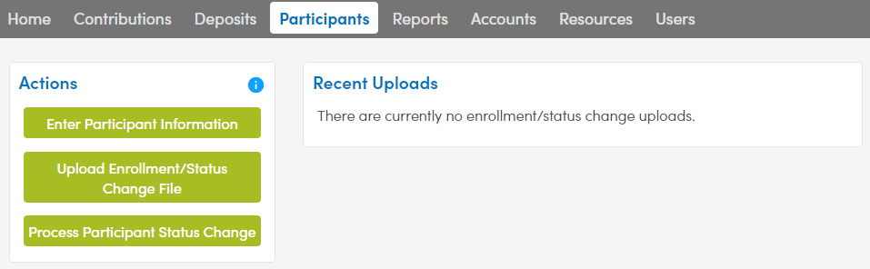
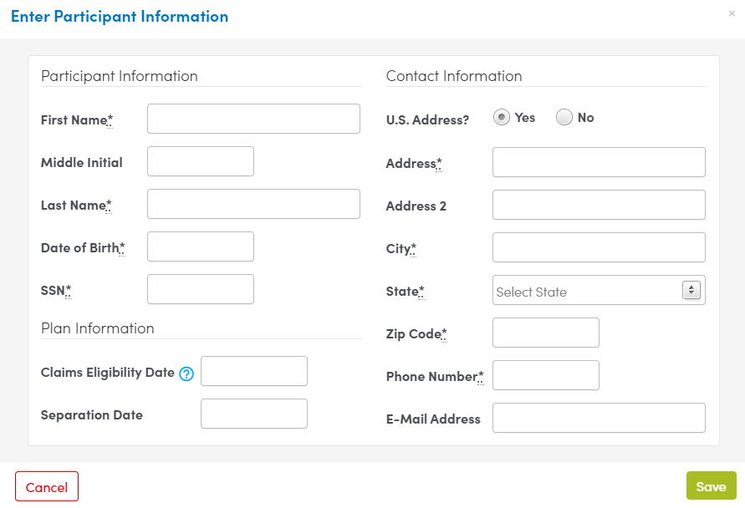
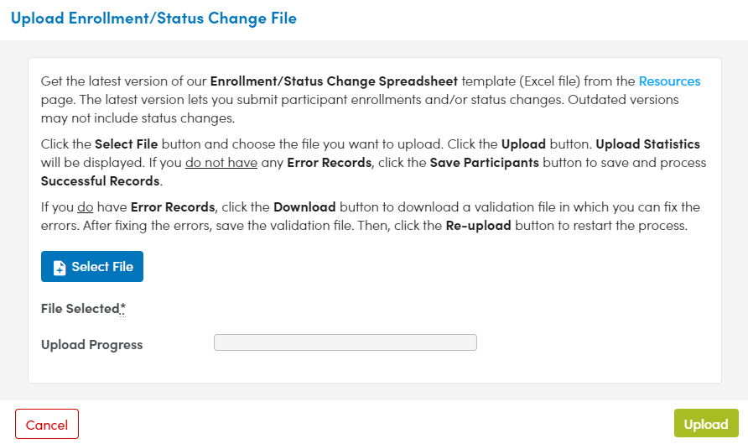
Enrollment Options
Notes:
On your employer portal, go to the Participants tab. You can upload the completed enrollment file we just reviewed by clicking the Upload Enrollment/Status Change button. Or you can manually key in employee data by selecting the Enter Participant Information button. The required items are indicated with an asterisk. This is a nice option if you are enrolling just a few people.
Now that you know how to enroll employees, let’s talk about submitting contribution reports.

Slide 10

Contribution Reports
All eligible employees should be enrolled
before
receiving a contribution
From your online portal,
you can securely:
  Upload Contribution Spreadsheets;
  Copy and update previous reports; or
  Build new reports from your Participant Roster
Notes:
The contribution report tells us how much to deposit in each participant’s account. You have a few options here: you can upload a contribution spreadsheet, copy a previous report, or build a new report from your participant roster. Employees must be enrolled before you send a contribution report or funds for them. And of course, mistakes happen from time to time, so if you ever discover an error, just contact customer care and we can get it fixed.

Slide 11

Required Contribution Data
Required information:
Employer ID number
Division code
Participant account number or Social Security number
Participant first and last name
Contribution amount
Please send funds within FIVE BUSINESS DAYS of submitting contribution reports.
Notes:
When you upload a contribution report, we’ll need: your employer ID # (this is the # we have assigned to you), division code, PT acct # or SSN, first and last name and contribution amount. Regarding division codes, take a moment to ask yourself if you know what those two codes are and when to use those codes. We’ll cover division codes on the next slide.

Slide 12

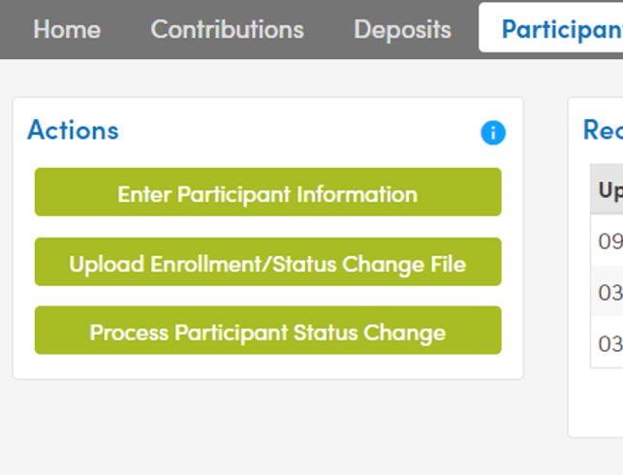
Submit Participant Status Changes
From your online portal, notify us when enrolled employees/participants:
Are voluntarily or involuntarily terminated (separation, retirement, etc.)
Experience a position change or hours reduction affecting eligibility for ongoing contributions (monthly, quarterly, etc.)
Are rehired
Pass away
Notes:
It is very important to accurately report status changes to us so we can update the participant’s account accordingly. It’s especially important to let us know when a participant separates from service so they don’t run into issues with their Medicare benefits.
Other instances when you might need to do a status update are:
-If the employee is no longer eligible for an ongoing contribution due to a reduction of hours
-If an employee is rehired.
-And lastly, hopefully you won’t have to encounter this, but if person passes away you can report that too

Slide 13
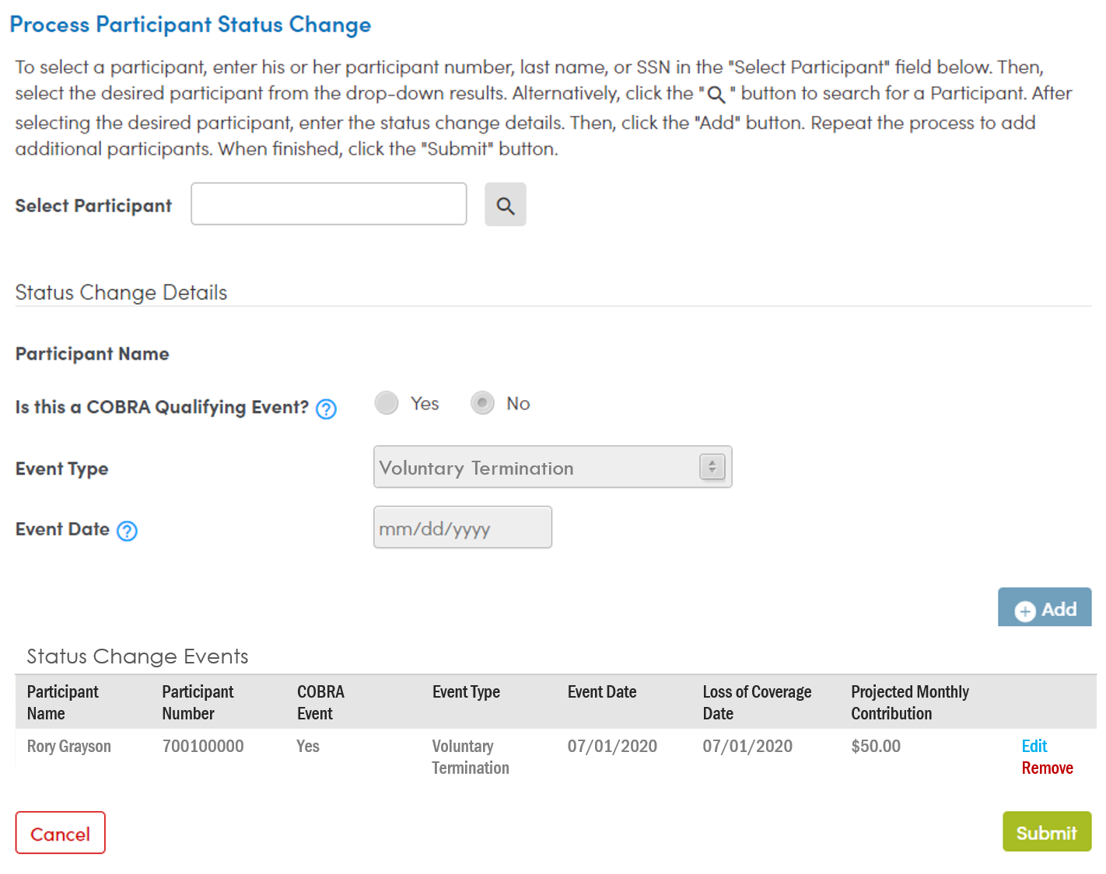
Participant Status Change Options
Notes:
A newer feature that is available is you can upload a status change file if you have a number of separation dates to enter. The Excel file you use to enroll employees has two pages to use for status changes. After choosing the “upload enrollment/status change file” button, select the file and upload it using the buttons indicated here.
Another option to process a status change online is to click “process a participant status change” button. Then you can search for a specific employee and enter their status change details.

Slide 14
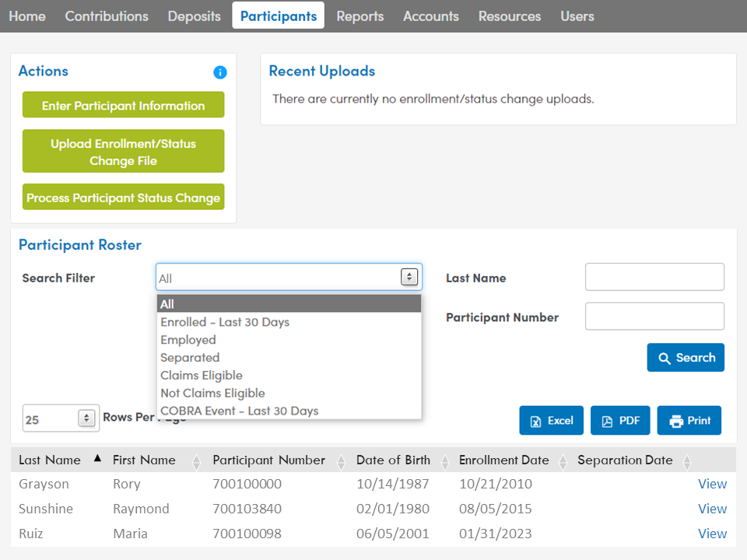
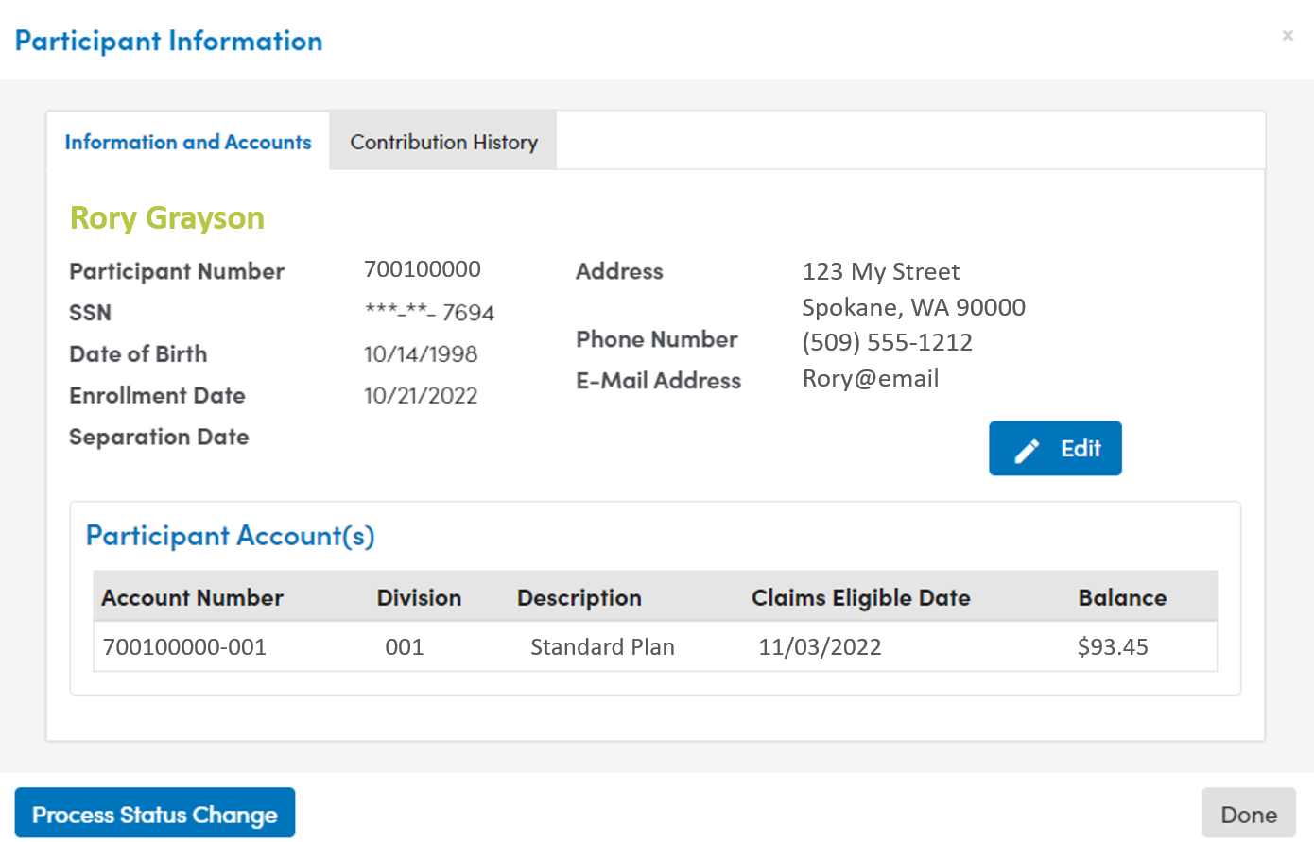
Participant Roster
Process a status change
Update participant information
View contribution history
Notes:
From the participant roster you are able to process a status change, update participant information, and view contribution history. Use the search filter or enter other identifying information and then select the View hyperlink once you find the participant you’re looking for. If you click the Edit button, you can update the person’s contact information. Or you can report separation information by clicking the Participant Status Change button. You can also review their past contributions by selecting the Contribution History tab.

Slide 15

When Might COBRA Apply?
COBRA may apply when qualifying events cause participants to stop receiving contributions to which they would have otherwise been entitled.
Example: Ongoing monthly contributions
You provide the projected monthly contribution when reporting the status change
VEBA Plan sends COBRA Election Notice to the participant
  Can elect COBRA and make after-tax contributions
Participants do not have to elect COBRA to maintain access to their accounts.
Notes:
When processing a status change here are some tips about when COBRA might apply
-is an employee no longer going to be able to receive a contribution they would have otherwise been entitled - example- the district is making an ongoing monthly contribution
-once you have reported the event to us we will send out the COBRA paperwork
Participants can access their accounts with out completing the COBRA paperwork, the COBRA paperwork would allow them to continue to make contributions to the plan

Slide 16
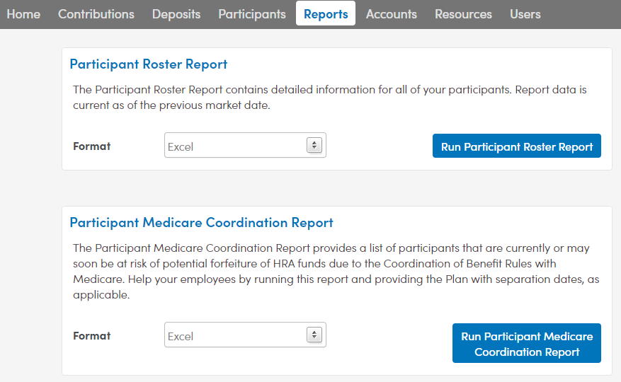
Reports
Find account numbers
Check separation dates
Check for limited coverage
Notes:
Some employers like to use the participant roster to help ensure that all separation dates have been captured. You can run a report, add any filters to it that you’d like, and look for any missing separation dates.
Again, if you find people who should be separated, you can either update that in the portal or send a list to the customer care team, which can be done safely through our secure messaging.

Slide 17
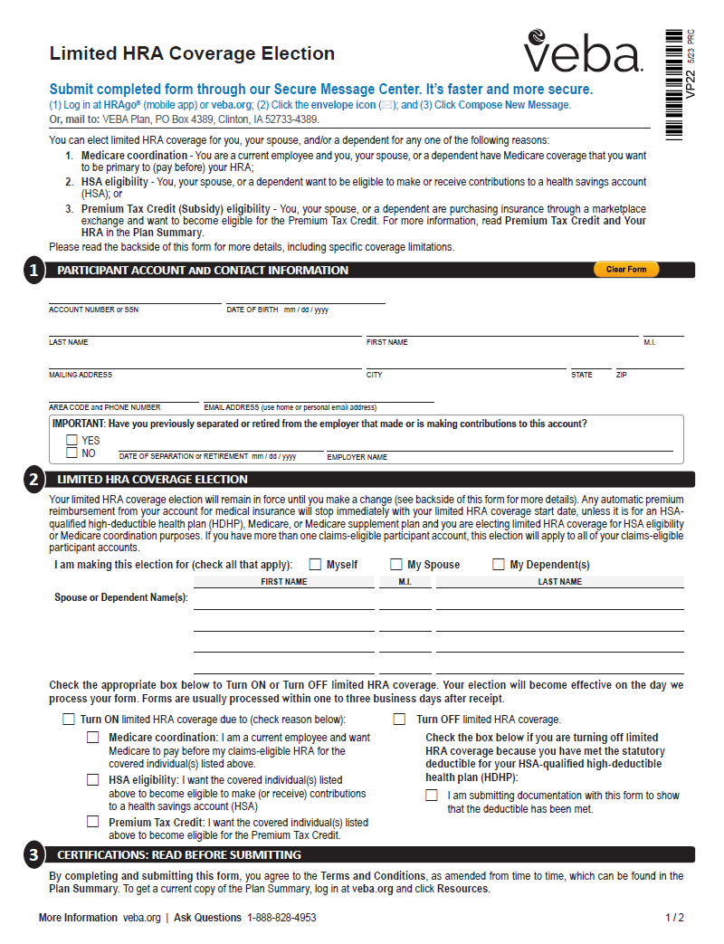
Limited Coverage
When might a participant need to elect limited HRA coverage?
1 Medicare coordination
    If working and participant and/or a covered individual are on Medicare
2 HSA eligibility
    If making or receiving contributions to an HSA
3 Premium Tax Credit eligibility
    To qualify for the Premium Tax Credit (subsidy)
Notes:
There are times when your employees may need to or want to limit their VEBA account. If employees are working past 65 or their spouse goes on Medicare, they may want to limit their account to protect their balance from Medicare’s coordination rules. Or if the employee has an HSA in addition to their VEBA, they’ll need to limit VEBA in order to make or receive contributions into their HSA. If something on screen applies to one of your employees, please provide them with the Limited HRA Coverage Election form and let them know our customer care center is available by phone and secure message to answer questions about their situation.

Slide 18
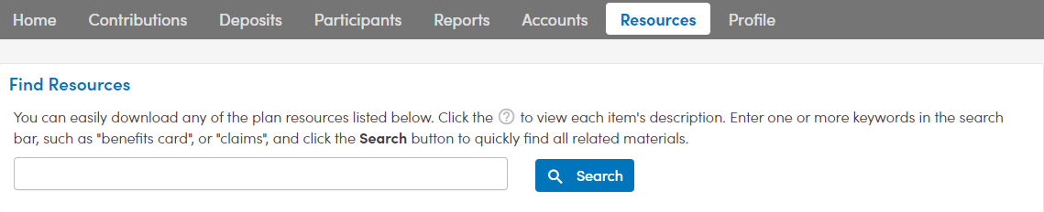
Resources Tab
Contributions Automatic funding Available Now Case Studies Contribution Instructions Contribution Spreadsheet HRA Funding Sources HRA Non-discrimination Information Which Division code Should I Use? Enrollment/Status Change Enrollment/Status Change Instructions Enrollment/Status Change Spreadsheet HRA Enrollment (for new participants) Welcome Letter and HRA Dashboard Sample | Plan Administration Ballot Sample COBRA Reporting Requirements Contact Us (Employers) Employer Policy Sample Group Voting Guide HRA Funding Reminder Statutory Hold Harmless Agreement Legal References Memorandum of Understanding Sample Plan Administration Guide Resolution Sample Separation Date Reporting Investments Choosing Your Investment Allocation Investment Fund Overview Newsletters HRAtoday Employer Edition HRAtoday Participant Edition | Forms Employer Automatic Funding Authorization Forfeiture Reallocation Mistake of Fact Participant Status Change Plan Design Change Participant Account Change Automatic Premium Reimbursement Benefits Card Supporting Documents Claim Form COBRA Event Notice Direct Deposit Enrollment HIPAA Authorization Investment Change Limited HRA Coverage Election Repayment Form Survivor Benefit Elections Packet/Form | Benefits Card Benefits Card FAQ Online Repayment Available Now Claims How to File a Claim Medical Care Expense Table Medical Care Expenses Proper Documentation What is a Letter of Medical Necessity? Coordination with Other benefits Don’t risk Losing Your HRA Funds HSA Contribution Eligibility and Your HRA Medicare coordination and Your HRA Premium Tax Credit and Your HRA Privacy and Security Multifactor Authentication for Your Protection Privacy Notice Your Privacy and Security Matter | Plan Information Plan Benefits Guide Check Out Our New Videos Contact Us (Participants) Coverage Type Descriptions Definition of Dependent HRA Basics HRA, HSA, FSA Comparison HRAs and Other Reimbursement Accounts Participant Statement Sample Plan Summary Standard vs. Post-separation HRA Plan Designs Summary of Benefits and Coverage Understanding IRS Form 1095-B What Happens If I Pass Away? HRA Plan Brochure What is a Qualified Group Health Plan
Notes:
The resources page is a buffet of helpful tools and information. You can get blank Excel templates to build enrollment files and contribution reports, there are educational documents, participant and employer forms, and copies of recent newsletters. If you haven’t visited this section of the portal in a while, we recommend taking a look through the available items.

Slide 19


Reminders
1
Always enroll employees before sending contributions
Notify us when enrolled employees separate from service, or retire
2
If you discover a mistake, contact our Customer Care Center right away at 1-888-828-4953 or through secure message.
Notes:
Just a few reminders- be sure to always enroll employees before sending in contributions and please notify us when employees separate from service. You can always contact customer care if you discover any mistakes.

Slide 20


Thank You!
Want to learn more?
Gallagher Representative
1-800-888-8322
Employer Help Desk
1-888-828-4953
Customer Care Center
1-888-828-4953

