Slide 1
Legacy transcripts
Planning Meeting
March 7, 2019

Slide 2
Objective
To make sure the solution is right for everyone and that it fits.

Slide 3
Iterative development
Iterative development is a way of breaking down the software development of a large application into smaller chunks. In iterative development, feature code is designed, developed and tested in repeated cycles. With each iteration, additional features can be designed, developed and tested until there is a fully functional software application ready to be deployed to customers.¹
¹Rouse, Margaret, and Yvette Francino. “What Is Iterative Development? - Definition from WhatIs.com.” SearchSoftwareQuality, 2011, searchsoftwarequality.techtarget.com/definition/iterative-development.

Slide 4
elicit requirements
SBCTC facilitates online or in-person workshop(s)
Workgroup shares their ideas and expectations
SBCTC records feedback
Topics
Define what we are trying to solve
Discover impacted users, external systems
Discover user interactions and goals
Discover features and design
Discover the sequence of activities
Discover data that users rely on
Discuss decisions that the system will make

Slide 5
Analysis and documentation
SBCTC performs analysis of requirements and prepares design document
Topics | Design Document
Define what we are trying to solve | Project scope/overview
Discover impacted users, external systems | Context diagram Process flows User stories
Discover user interactions and goals | Context diagram Process flows User stories Story maps
Discover features and design | Context diagram Process flow User stories
Discover the sequence of activities | Process flow Story maps
Discover data that users rely on | Data flow diagrams
Discuss decisions that the system will make | Decision tables

Slide 6
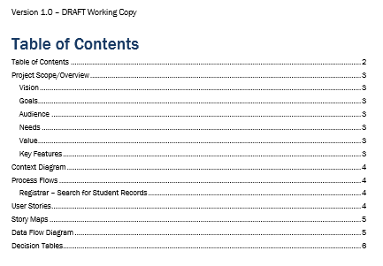
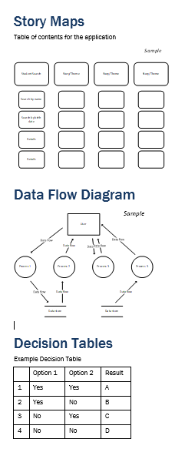
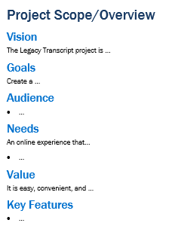
Review requirements and design
Workgroup reviews and approves design document

Slide 7
implement
SBCTC develops web-based application based on design document
SBCTC pulls data from legacy systems
SBCTC develops test scenarios based on user stories
Meets OCIO standards on security, accessibility
Responsive design

Slide 8
Test application and evaluate
Workgroup validates user stories by executing test scenarios
SBCTC and workgroup evaluates results from testing
Iterative development process repeats if testing produces errors or missing design elements

Slide 9
deploy
OTHER DUTIES
SBCTC deploys application
Workgroups assists with developing system communication
SBCTC maintains project web site
SBCTC monitors and reports on project activities and timelines

Slide 10
Workgroup make-up / schedule
Suggest 5-7 individuals from colleges representing diverse size and locations
3 - 4 work sessions
Online via WebEx or in-person
First meeting will last 3-4 hours
Subsequent meetings 1-2 hours
Quick check-in meetings as needed
30 minutes via WebEx
Project / time commitment depends on overall project scope

Slide 11
Any questions?
Sandy Main
Director, Application Services
Washington State Board for Community and Technical Colleges
smain@sbctc.edu • o: 360-704-4373 • f: 360-704-4414 • c: 360-280-8038
sbctc.edu • Twitter: @SBCTCWashington • Facebook: @WASBCTC

