Slide 1
Peoplesoft Campus Solutions
Page and Field Configuration Changes

Slide 2
Upcoming Changes
Disable Entry Campus_ID Field
Hide View/Download Sample Data File – 9/14/2023
Disable Entry Change Data Source Link -9/14/2023
Disable Entry Tuition Group Field – 9/14/2023

Slide 3
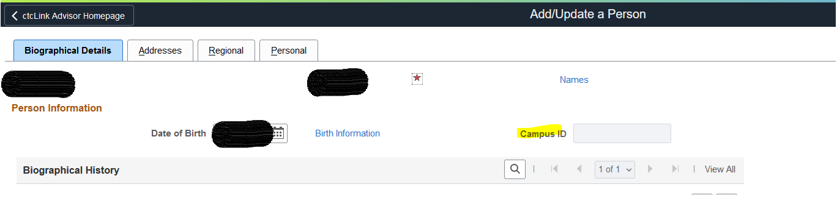
  Disable Entry Campus_ID Field
  This field is not used and visible on many pages.

Slide 4
19 different Navigation
Campus Community > Personal Information > Add/Update a Person
Campus Community > Personal Information (Student) > Add/Update a Person
Campus Community > SEVIS > Personal Information > Add/Update a Person
Campus Community > Campus Event Planning > Add/Update a Person
Student Recruiting > Prospect/Admissions Data Mgmt > Add/Update a Person
Student Recruiting > External Test Score Processing > Add/Update a Person
Student Admissions > Application Maintenance > Add/Update a Person
Student Admissions > External Test Score Processing > Add/Update a Person
Student Recruiting > Student Recruiters > Add/Update a Person
Contributor Relations > Constituent Information > People > Add/Update a Person
Student Admissions > Application Evaluation > Application Decisions > Maintain Applications
Student Admissions > Application Maintenance > Maintain Applications
Student Admissions > Application Entry > Add Application
Student Recruiting > Maintain Prospects > Create/Update Prospects
Records and Enrollment > Enroll Students > Quick Admit a Student
Campus Community > Service Indicators > Person > Audit Service Indicators
Campus Community > Service Indicators (Student) > Audit Service Indicators
Contributor Relations > Constituent Information > People > Service Indicators > Audit Service Indicators
Records and Enrollment > Graduation > Graduation Tracking Search

Slide 5
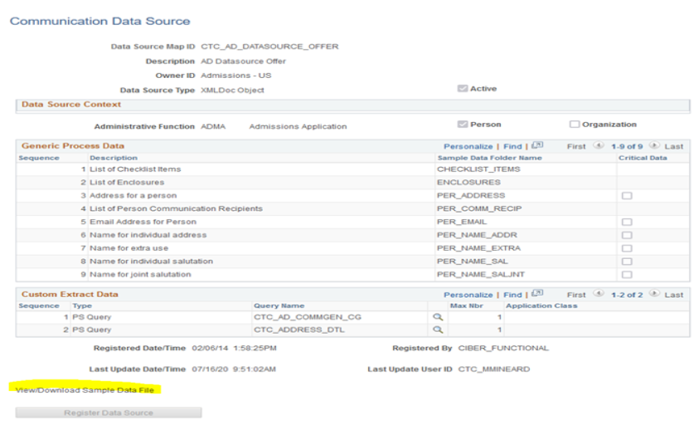
Hide View/Download Sample Data File Link
Campus Community > Communications > Set Up Communications > Communication Datasource page
Edit Access was removed on the Communication Datasource Page, this change is to prevent users and LSAs from trying to troubleshoot why the link is "broken."
Before

Slide 6
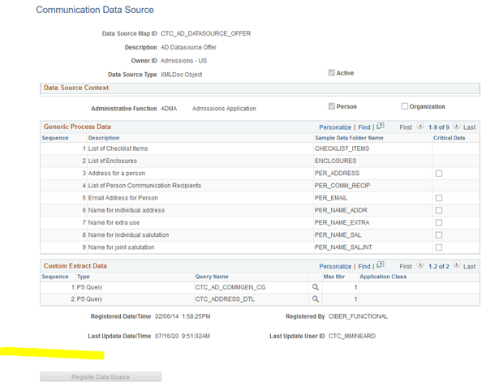
After Change

Slide 7
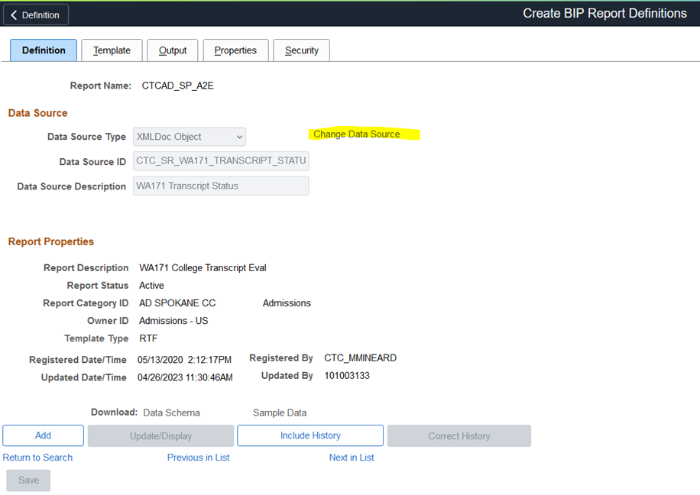
Disable Entry Change Data Source Link
Reporting Tools > BI Publisher > Create BIP Report Definitions
Changing the Data Source ID after a Report Definition is already in use can have significant negative impacts to 3C Communication records and current report templates.

Slide 8
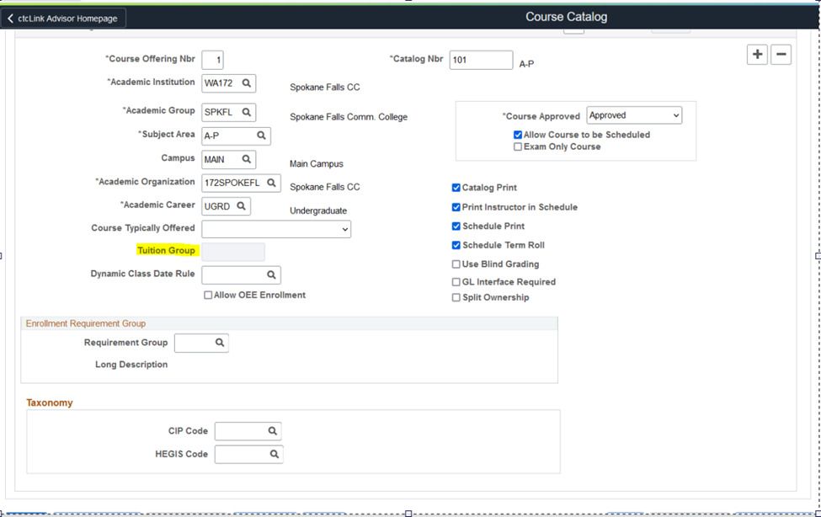
Disable Entry Tuition Group Field
Curriculum Management > Course Catalog > Course Catalog
When the Tuition Group is populated in Course Catalog, it causes a conflict which results in incorrect tuition calculation.

