Slide 1
Peoplesoft Campus Solutions
Report Definition Security
Content Library Security

Slide 2
Background – Current Production
Currently, users at any campus can update other campuses Report Definitions.
Reporting Tools > BI Publisher > Create BIP Report Definitions
Currently, Local college users do not have access to Content Libraries.
Reporting Tools > BI Publisher > Maintain BIP Sub-templates

Slide 3
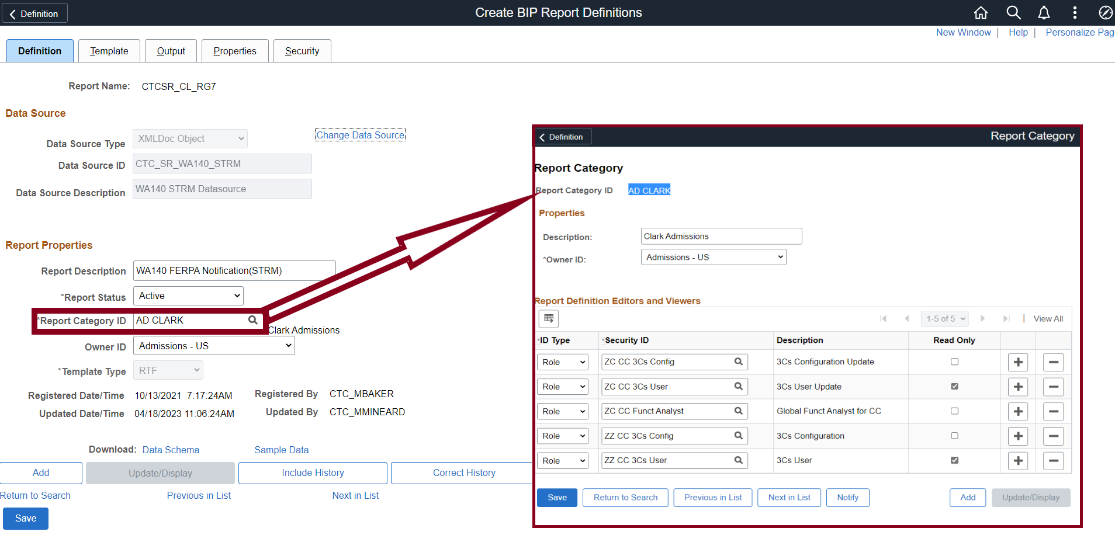
Upcoming Changes
Report Definition:
Each Report Definition is tied to a Report Category ID. The Report Category ID determines which security roles grant the user access to the Report Definition. These pages do not tie to Institution Code.

Slide 4
How to Secure Report Definitions
Created 5 new empty shell roles for each college.
ZZ Rpt Category (Institution) ALL
ZZ Rpt Category (Institution) AD
ZZ Rpt Category (Institution) FA
ZZ Rpt Category (Institution) SF
ZZ Rpt Category (Institution) SR
Only the users that need to access/edit Report Definition templates for your college will need one of these roles.
Having the 5 roles for each college gives the flexibility to get very granular with (AD, FA, SF and SR) or use the high level All role.

Slide 5
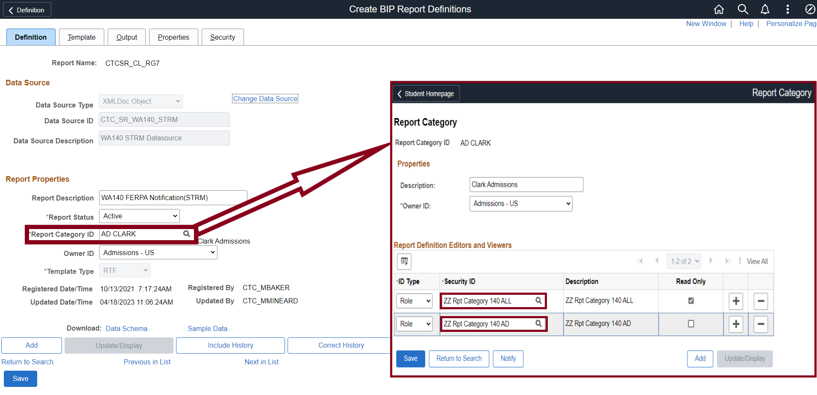
Add new college specific Roles to Report Category Setup Navigation: Reporting Tools > BI Publisher > Set Up > BIP Report Categories The Report Category security is updated by the CS Core Support team

Slide 6
Content Libraries
Update existing Content Libraries/ library files
Reporting Tools > BI Publisher > Maintain BIP Sub-templates
New Role - ZZ CC Content Library
Access to this page should be limited to college users who need to interact with the Content Library page (which will likely be only a couple of users at each institution).
While this role can be assigned to college users, we are asking to have those users/ their supervisors specifically request the role assignment with a ticket. The CS Core Support team will then meet with the user(s) to train them on how to correctly use and update the page before the role is assigned.

Slide 7
Questions and feedback
Questions?
Feedback?

