Slide 1
Peoplesoft Security
Secure in Security - HCM
Shelia Sloan
June 15, 2022

Slide 2
Agenda
What is Security
User ID Creation/Basic User ID and Role Administration
Time and Labor Security
Global Payroll User Profile
Security Processes
IT Audits/Offboarding / Onboarding
Working with Security Admins
Q&A

Slide 3
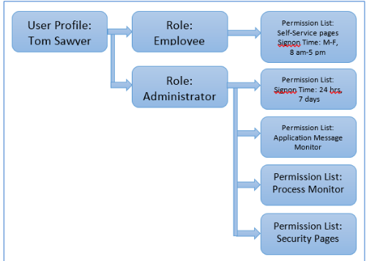
What is Security?
Security controls access to pages/data
Each User has a single User Profile
Profiles are attached to one to many roles
Roles have zero to many permission lists
Permission list contain page access required to perform business processes

Slide 4
What is Security
Security roles should be business process based
Navigator > Workforce Administration> Job Information> Job Data
Roles should contain the access needed to perform the business process
Sometimes they are bundled with several business processes that should be performed by the same type of individual
Roles Should not be built based on Job Titles

Slide 5
What is Security
Security is a way of protecting PII data
Personally Identifiable Information
HCM will implement masking for level four data elements in the future. We are piloting a new tool in CS.
Users should have the least amount of security possible to do their jobs
Security should be audited regularly
Offboarding
Job Changes
Segregation of Duties

Slide 6
What does ZC/ZZ/ZD Mean
Latest Role Re-Design implemented Roles/Permission Lists that begin with ZC/ZZ/ZD
ZC roles contain Correct History Access and should be limited to higher level users that understand downstream impacts
ZZ roles grant update access to pages and processes without correct history (Not sure why ZZ – Maybe zupdate? ☺ )
ZD roles are read only/inquiry roles that do not allow any updates

Slide 7
User id creation
New User Ids are Created in HCM upon Hire via the CIB_USRPFL process.
User ID is Created with a Base Set of Roles from Template User ID
CTC_UN_HCM
EOPP_USER
NA Payroll WH Form User
PAPP_USER
ZZ_EMPLOYEE
ZZ PeopleSoft User
The CTC_%_DISTR role is dynamically added based on Institution. This role gives access to the college tile in Portal. (i.e. CLK for Clark, OP for Olympic,etc)
User ID Syncs to Financials Using Integration Broker
Base Manager Access is dynamically assigned for those with reports to. Typically a base employee and base manager do not need the Navigation Bar. The majority of their work is within the tiles.

Slide 8
Basic User ID and Role Administration
User ID Administration General Tab
PeopleTools > Security > User Profiles > Distributed User Profiles
Always ensure the account is unlocked for new and current accounts;
Ensure the EMAIL ID is correct
The Process profile should be set for users to CTC_PT_PRCSPRFL_STAFF
Select your institutions row/primary permission lists on the user profile.
Ensure the symbolic ID is set to SYSAMD1

Slide 9
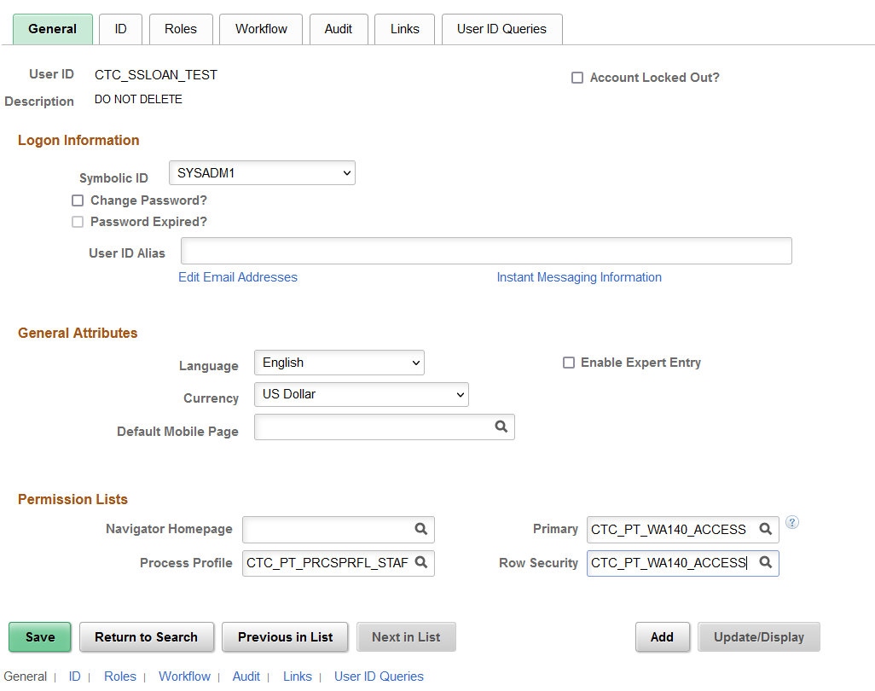
General Tab

Slide 10
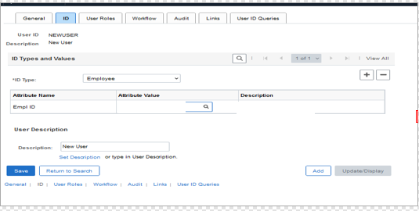
Basic User ID and Role Administration
User ID Administration ID Tab
The ID Type should be Employee and the EMPLID in the Attribute Value box. Should default in upon Creation

Slide 11
Basic User ID and Role Administration
User ID Administration User Roles Tab
Add the Appropriate Security Roles; If they are a core user provide additional role access as appropriate.
HR Access is highly dependent on keeping job and personal data current and up to date.
For terminated users, update the users access first in HCM, so that base roles will sync.
Then ensure that for terminated users ensure the following role set is left:
EOPP_USER
PAPP_USER
NA Payroll WH Form User
ZZ_EMPLOYEE
ZZ FORMER EMPLOYEE
The CTC_%_DISTR role will have to be manually added back based on Institution. This role gives access to the college tile in Portal. (i.e. CLK for Clark, OP for Olympic,etc) However it should sync from HCM as it should manually be added back there.

Slide 12
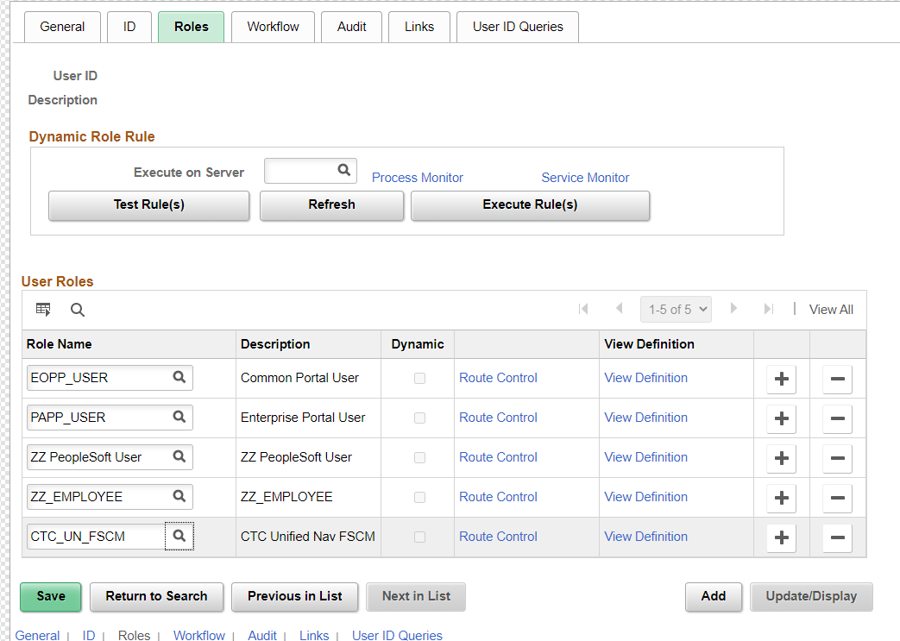
User ID Administration User Roles Tab

Slide 13
Basic User ID and Role Administration
User ID Administration Workflow Tab
Ensure the routing Preferences boxes are selected for Worklist and Email User
Alternate User ID is used if the user is an approver and will be out of office
Transactions will route to the User ID here while the employee is out on leave.
Once the date range has expired, it is best practice to remove the User ID and date range from the user profile.
This is typically not used any longer as we use delegation instead.
Reassign Work can be used to move ALL transactions waiting on the users approval, to a new approver (be careful with this)

Slide 14
User ID Administration Workflow Tab

Slide 15
Time and Labor Security
TL Permission List Security is used to define what Time Reporting Groups a Row Security Permission List can access in Time and Labor as well as the range of time in which they can alter information on the timesheets of those groups.
Group Access defines time reporters for whom Row Security Users can view, update, and delete time reporting data .
Each college has a row level security for Time and Labor: CTC_XXX_TL_SUPERUSER. This is assigned to your Time and Labor Administrators.
https://ctclinkreferencecenter.ctclink.us/m/79733/l/928754-9-2-understanding-time-and-labor-security

Slide 16
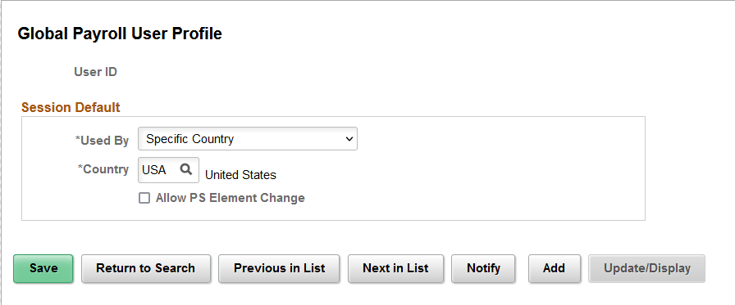
Global Payroll user profile
The Global Payroll User Profile page defines the default values that users see in the Used By and Country fields when adding an element.
Security refers to the ability to restrict users from viewing or updating certain data or payees. In Global Payroll, there are two levels of security:

Slide 17
Security Processes
PeopleSoft stores security data in user and transaction Security Join Tables. There are a set of processes that are run in our batch jobs that are required for user access to work. Once a new user is created, these processes must run in order for the user to function properly.

Slide 18
Security Processes
SJT_OPR_CLS: Contains the User IDs with their data permission lists. SJT_CLASS_ALL: Contains the data permission information for all the data permission lists that are given data access on the ‘Security by Dept Tree’ page or ‘Security by Permission List’ page. Transaction SJTs are: SJT_PERSON: Contains transaction data for the people (employees, contingent workers, Person of Interest). It has row level security attributes (SetID, DeptID etc) for all the employees. SJT refresh processes have to be run to keep security data (in user and transaction SJTs) up to date so that the system enforces data permission using the most current information.

Slide 19
IT Audits
Why are Audits Important?
Decreases Risk Associated with IT
Enhances Internal Control Environment
Improves Internal Operations
Identifies Potential Vulnerabilities
Areas we will focus on today
New User Access
Current User Access
Terminated User Access
Segregation of Duties
Tools

Slide 20
New User Access
Document Procedures and Follow them
Always Document the Request, Gain Approvals and Save
Be able to Show that What was Requested was granted
Never accept Phone Calls as a form of authorization.
Store for Auditors
Ensure Access is Appropriate and limited to only what they need.

Slide 21
New User Access
For Users that Transfer from Another Institution, work with the Local Security Admin from the Other Institution to properly offboard from there and properly onboard at the new institution.
Check Row /Primary Permissions, Email Addresses, User Preferences, SACR and other secondary types of security for these users to update to new institution.

Slide 22
Current User Access
Periodically Review Current Users Access, at least twice a year.
This is really recertification of user access
If job duties change, so should their access in the application.
Document the changes, gain authorization.
Ensure no segregation of duties issues are in place.

Slide 23
Terminated User Access
This should be handled on demand as users terminate but at least weekly.
Review Terminated users and confirm with HR that they are in fact terminated.
Coordinate with Security Administrator in HCM if Different to update roles to match the offboarding recommendations.
9.2 Employee HR Status System-wide (ctclink.us)

Slide 24
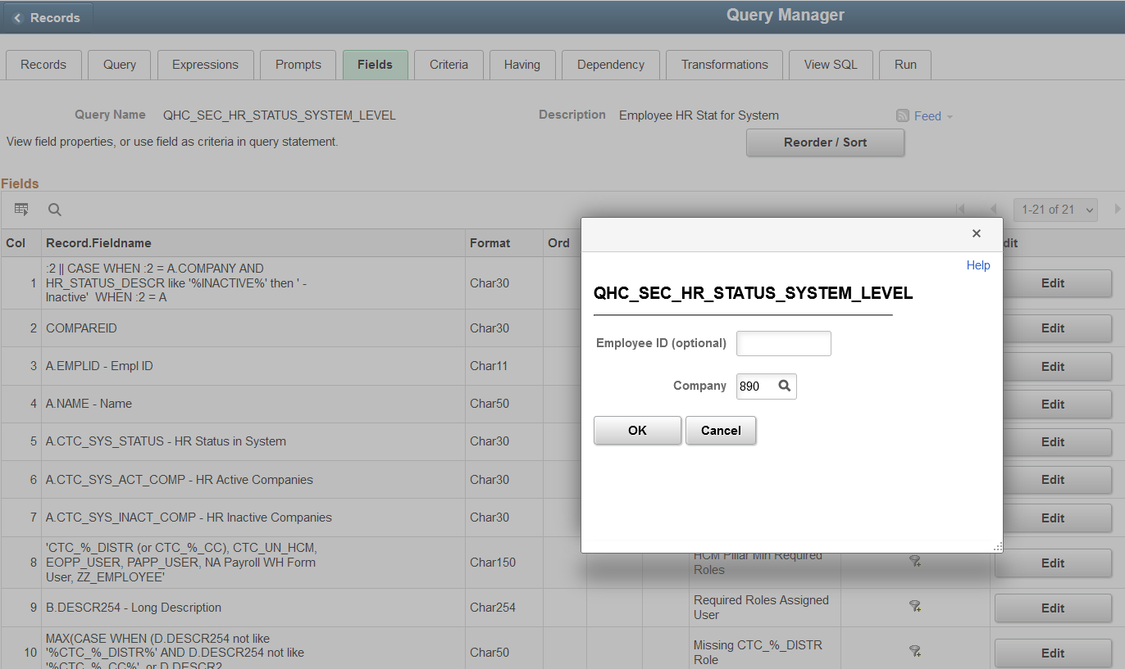
Offboarding
In HCM, Run Query: QHC_SEC_HR_STATUS_SYSTEM_LEVEL
Prompt for your Company ID.

Slide 25
Offboarding
Download results to Excel; Sort by Company Query Prompt. This will sort by the employees that are inactive at your school and active. Then you can pull out the active ones.
For the inactive ones, you will then need to sort by HR Active Companies.
If there are NO active companies, proceed with offboarding.
If they are active at a different institution, work with the local security admin there to properly offboard.

Slide 26
offboarding

Slide 27
Segregation of Duties
Segregation of duties is the concept of having more than one person required to complete a task. It is an administrative control to prevent fraud, theft misuse of information, or other security compromises.
For example, the person responsible for entering job data, should not be involved in the payroll process. You don’t want someone hiring someone and being able to pay that person as well.
Typically whoever enters the transaction should not be the one approving it.
When onboarding a new hire, it is critical to consider any segregation of duties issues while assigning roles.
It is also critical to review Segregation of duties issues twice a year for audit purposes as well.
QHC_SEC_SEGREGATION_OF_DUTIES query is available to use.

Slide 28
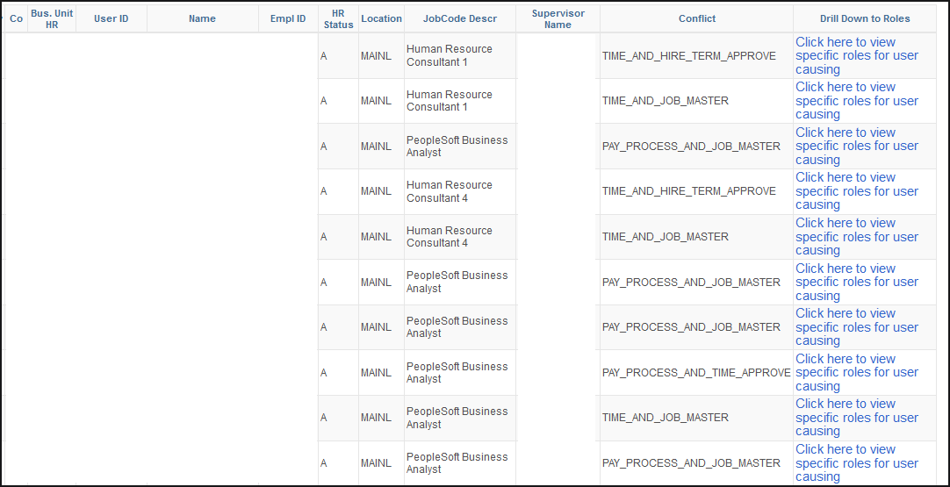
Segregation of Duties
QHC_SEC_SEGREGATION_OF_DUTIES query

Slide 29
Helpful queries
https://www.sbctc.edu/resources/documents/colleges-staff/data-services/peoplesoft-ctclink/report-catalog.pdf
There are queries listed by pillar here with descriptions

Slide 30
Security records

Slide 31
Working with security admins
Provide as Much information as possible
Navigation to Access Needed
Functional description of Business Process
Screen Shots of Errors
Employee ID of users with Issues
If it is a random issue, try to provide timings if available
Remember least access needed to do a job is critical; do not give more security than needed, it is an audit issue.

Slide 32
Requesting changes to security
There are times where roles may have too much access/not enough access, or are mislabeled, etc.
SBCTC has a process for New Role Requests or Role Modification Requests
Submit a service desk ticket to the Security Team by pillar
SBCTC will review the request and log it in our change tracking system
Review and gather support from SBCTC ctcLink production support teams. Then it goes through development and testing cycles.

Slide 33
Questions and feedback
Questions?
Feedback?
Any Parking Lot issues
THANK YOU FOR ATTENDING

