Slide 1
Peoplesoft Security
Making Sense of Security
Shelia Sloan
May 16, 2022

Slide 2

Agenda
What is Security
What does ZC/ZZ/ZD Mean
SACR Security
Helpful Queries
Working with Security Admins
Requesting Changes to Security
Q&A

Slide 3
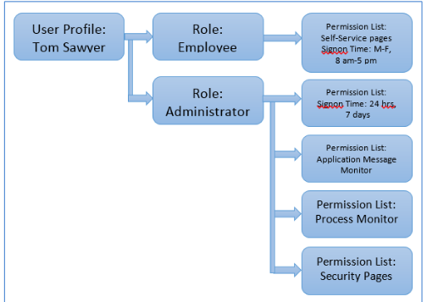
What is Security?
Security controls access to pages/data
Each User has a single User Profile
Profiles are attached to one to many roles
Roles have zero to many permission lists
Permission list contain page access required to perform business processes

Slide 4
What is Security
Security roles should be business process based
  Navigator > Curriculum Management > Course Catalog > Course Catalog
  Roles should contain the access needed to perform the business process
  Sometimes they are bundled with several business processes that should be performed by the same type of individual
  Roles Should not be built based on Job Titles

Slide 5
What is Security
Security is a way of protecting PII data
  Personally Identifiable Information
Campus Solutions uses Masking via the primary/row permission list on each user profile
  Looking at implementing new controls for masking soon!
Users should have the least amount of security possible to do their jobs
Security should be audited regularly
  Offboarding
  Job Changes
  Segregation of Duties

Slide 6
What does ZC/ZZ/ZD Mean
Latest Role Re-Design implemented Roles/Permission Lists that begin with ZC/ZZ/ZD
  ZC roles contain Correct History Access and should be limited to higher level users that understand downstream impacts
  ZZ roles grant update access to pages and processes without correct history (Not sure why ZZ – Maybe zupdate? ☺ )
  ZD roles are read only/inquiry roles that do not allow any updates

Slide 7
Sacr security
In ctcLink component security is used to restrict access to student data for specific User IDs by institution, campus, career, program, and plan.
SACR Security is a secondary type level of security
  This security doesn’t necessarily grant page access
  This security is more like what action you can take once you get to the page and what data you can see based on your institution

Slide 8
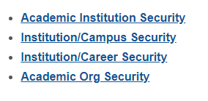
Sacr security
All administrative system users with 'Z' security roles in the Campus Solution pillar will require this basic SACR Security setup to define their institution, set their campus(es), careers (undergraduate/continuing education) and academic organizations they need access to in order for page/components in the CS to properly function.

Slide 9
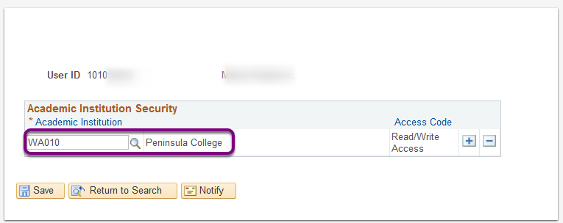
Sacr security
Academic Institution
  Ties User to one/more Institution
  Limits the data they see to those Institutions

Slide 10
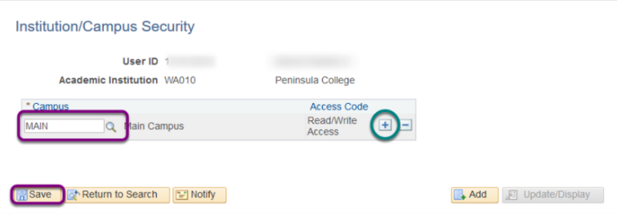
Sacr security
Institution/Campus Security
  Ties a User to an Institution and Campus(s)

Slide 11
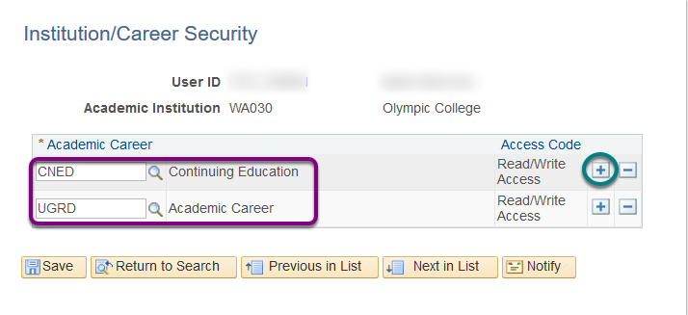
Sacr security
Institution/Career Security
  Institutions that never offered Continuing Ed will only see UGRD
  If previously offered it, but now don’t, still configure it in case you need access to student transcript information

Slide 12
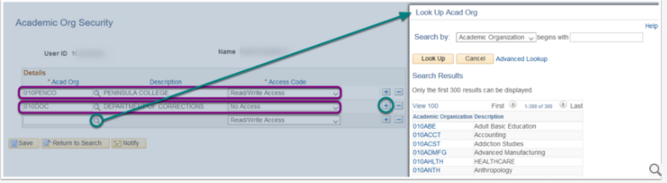
Sacr security
Academic Organization Security
  Grants access to academic organizations
  The system automatically grants access to data in any academic organization that reports directly or indirectly to that academic organization unless you specifically restrict access to a specific organization
  Uses Academic organization Security tree (hierarchies of organizational units at an institution)

Slide 13
Sacr security
Many areas in SACR - See below reference center for full list
  PeopleSoft Security | ctcLink Reference Center
Examples of Other areas – We will cover these today
  Service Indicator Security
  Student Groups
  Academic Program
  Test ID Security
  Milestone Security
  Enrollment Security
  Student Financials
  Program Action Security

Slide 14
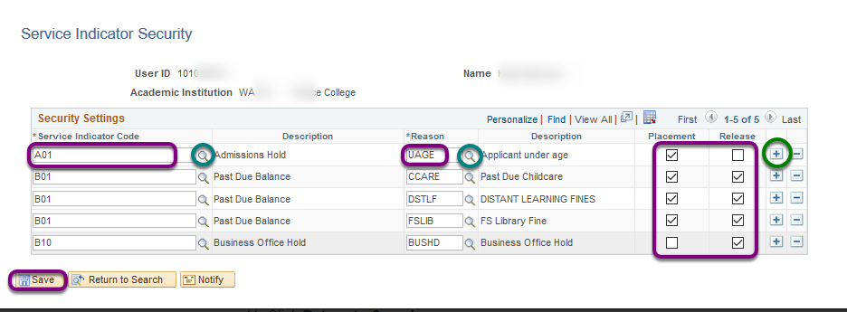
SACR Security
Service Indicators with their associated Reason Codes can be holds that prevent a student from receiving certain services or positive indicators that designate special services to be provided.
Service Indicator Security controls whether a user has the ability place a Service Indicator on a student record or Release a Service Indicator from a student record.

Slide 15
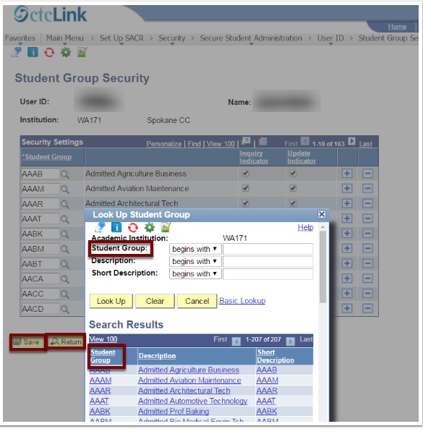
Sacr Security
Users need Student Group Security access for student groups in the Student Group Table

Slide 16
Sacr Security
Academic Program security allows colleges to limit the programs the user is allowed to view, and therefore the student information they can see attributable to that allowed program.
Academic Program Security is granted by colleges for each Academic Career, the Undergraduate (UGRD) Academic Career and the Continuing Education (CNED) career.
  https://ctclinkreferencecenter.ctclink.us/m/56084/l/560728-cs-9-2-sacr-security-academic-program-security
  The above QRG lists Key security roles requiring Academic Program Security

Slide 17
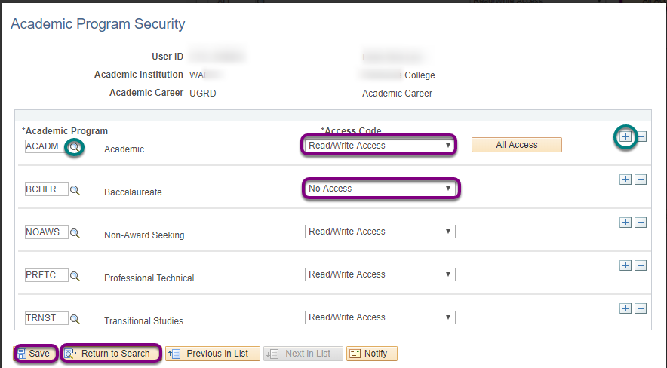
SACR – Academic Program SEcurity

Slide 18
Sacr Test ID security
User ID based security for test IDs ensures users access and process only the test data for which they have permission. Users attempting to view, enter or update test scores for a student must have the ZZ CS Test Processing (view/update) or ZD CS Test Processing (view only) role for access to the Test Results page.
There are Test IDs that are Global and Test IDs that are local to individual colleges. Due to this, the ALL option is not permissible for colleges, as this grants access to Test IDs outside their institution.

Slide 19
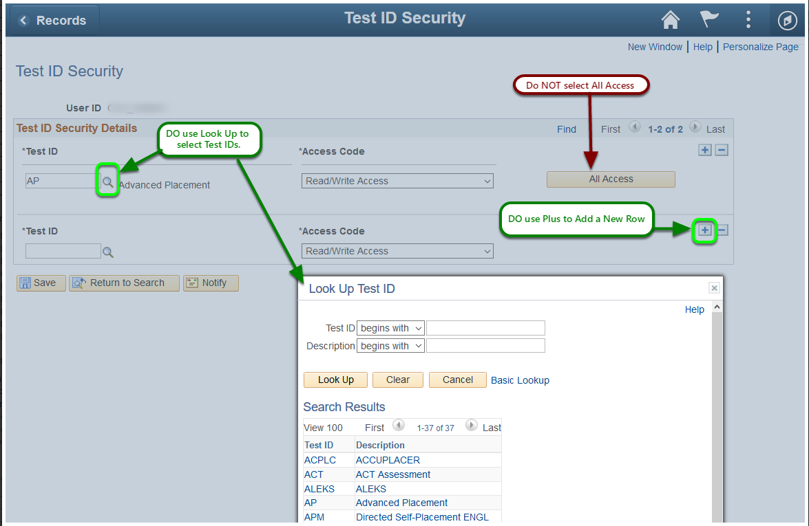
SACR TEST ID Security
Select the test IDs for which a user has Read/Write security on the Test ID Security page. The system enforces test ID security on the following components:
Test Results component.
  Role Name: ZZ CS Test Processing or ZD CS Test Processing (View Only)
Academic Test Summary component.
  Role Name: ZZ CS Test Score Loads
External Test Score Load component (only applies to AccuPlacer).
  Role Name: ZZ CS Test Score Loads
External Test Score Suspense component (only applies to AccuPlacer).
  Role Name: ZZ CS Test Score Loads
Search/Match/Post Test Scores component (only applies to AccuPlacer).
  Role Name: ZZ CS Test Score Loads

Slide 20
Sacr MILESTONE security
Milestones are non-course related but vital requirements that a student must complete toward degree progress to graduate. Colleges may choose to establish milestones for undergraduate student progress. After milestones are defined they can be assigned by advisors to a student, as well as being recorded to show the student's completions of milestones and attempts to fulfill them, by using the Student Milestones component. After configuring milestones, a user must have the Milestone Security established in SACR Security in order to assign configured milestones to a student.
The role name needed to configure milestones is: ZZ SACR Milestone Config
The role name(s) for processing milestones are: ZZ SR Milestones or ZC SR Milestones
The role name(s) for viewing student milestones is: ZD SR Milestones or ZD SR Super User
The role name for updating student milestones is: ZZ SR Milestones

Slide 21
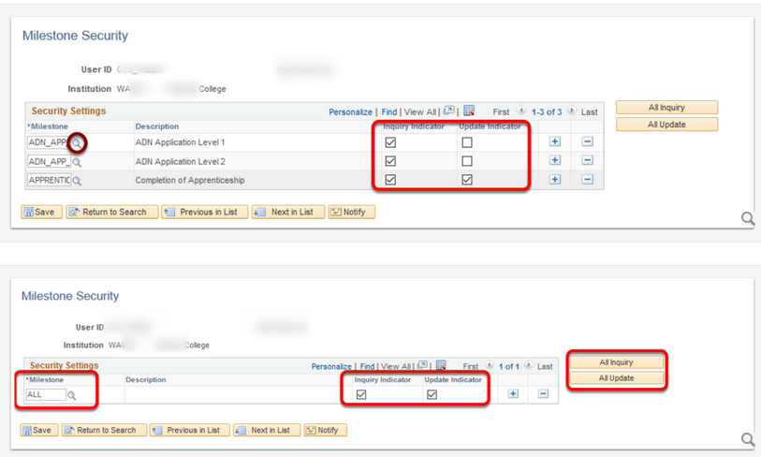
SACR Milestone security

Slide 22
Sacr ENROLLMENT security
Enrollment security is required for all staff engaged in enrollment activities and transactions. At the time of configuring security for an individual user colleges may choose how much power to grant that user in enrollment activities.
The college CS Security roles that will require Enrollment Security to be assigned are:
  ZD SR Enroll Students Inquiry
  ZD SR End of Term Processing
  ZD SR High Lev Enroll Inquiry
  ZD SR Super User
  ZZ SR Enroll Students
  ZZ SR Enroll Term Processing
  ZZ SR High Level Enrollment
  ZZ SR Mass Change
  ZZ SR Mass Enrollment
  ZZ SR Term Activation
  ZZ SR Withdraw
  ZC SR High Level Enrollment

Slide 23
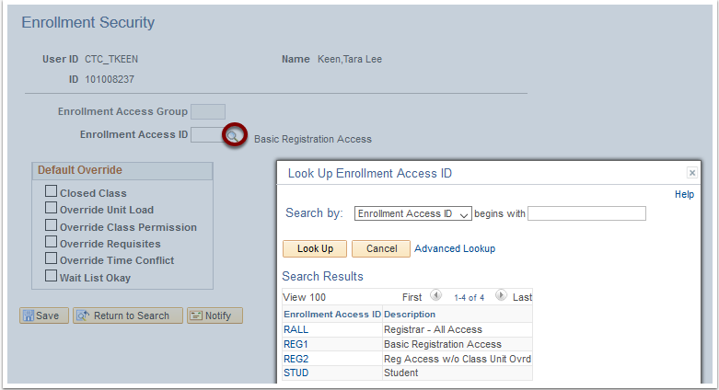
Sacr ENROLLMENT security
The institution that the enrollment security applies to is defined in the SACR User Defaults page. For multi-campus districts that intend to grant access to district level employee ability to enroll students at multiple campuses, the user must reset their default institution (e.g. WA062, WA063, WA064) to the institution for which they want to manage the student's enrollment.
https://ctclinkreferencecenter.ctclink.us/m/56084/l/1196588-cs-9-2-sacr-security-enrollment-security This QRG defines the ACCESS ID types

Slide 24
Sacr student financials security
Access to a properly functioning Student Financials module is governed by 4 key SACR Security for Student Financials security controls:
Business Unit
Institution Set
Origin IDs
SetID
Warning: When a user is attempting to establish their User Defaults (Setup SACR > User Defaults) on the second tab, if the Business Unit and SetID are not set, the system will turn the SetID field red and will throw an error that the user has entered an invalid value. Local Security Administrators (LSA) must FIRST set themselves with these values before they can assign it to another user. LSAs cannot access another user's User Defaults page, only the user can update these values for themself.

Slide 25
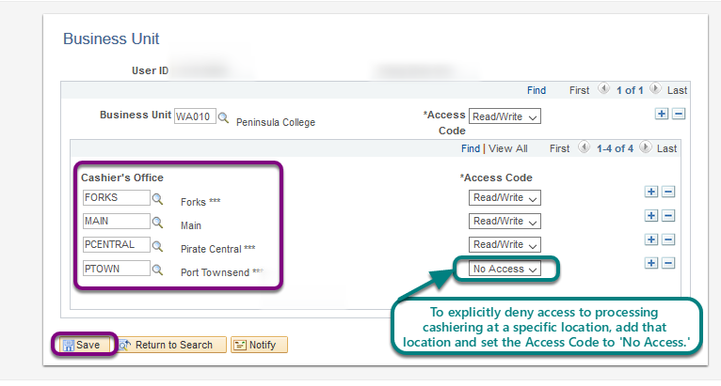
SACR – Business Unit
Set Up SACR > Security > Secure Student Financials > User ID > Business Unit
To explicitly restrict a cashier from processing transactions for a specific location, add the Cashier's Office and set the Access code to 'No Access.'

Slide 26
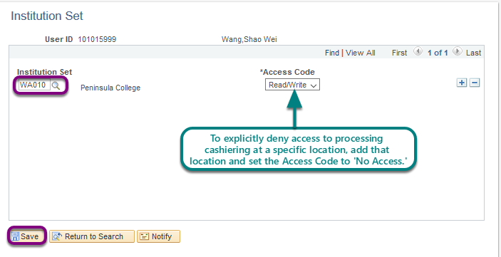
SACR – Institution Set
Set Up SACR > Security > Secure Student Financials > User ID > Institution Set

Slide 27
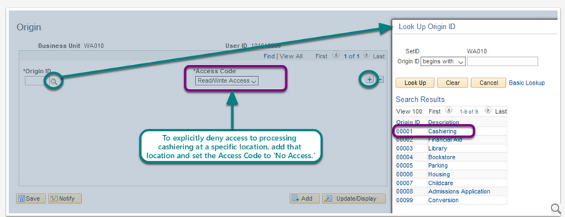
SACR – origin ids
Set Up SACR > Security > Secure Student Financials > User ID > Origin IDs
Valid Values for Origin IDs are displayed below. These values are global in the ctcLink system.
Origin ID | Description
00001 | Cashiering
00002 | Financial Aid
00003 | Library
00004 | Bookstore
00005 | Parking
00006 | Housing
00007 | Childcare
00008 | Admissions Application
00099 | Conversion

Slide 28
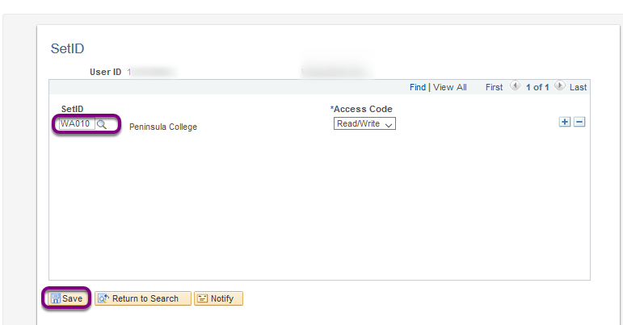
SACR – SETID
Set Up SACR > Security > Secure Student Financials > User ID > SetID

Slide 29
Additional cashiering SEcurity
In addition to SACR Security for Student Financials cashiers will need to be added as a New Cashier and Assigned to a Valid Tender.
  https://ctclinkreferencecenter.ctclink.us/m/92555/l/949144-9-2-add-a-new-cashier-and-assign-to-a-valid-tender
  Navigator > Setup SACR > Product Related > Student Financials > Cashiering > Valid Cashiers
    Note: Before opening a cashiering office and register with a cashier, the cashier and tender keys must be added. You MUST have the role ZZ SACR SF Cashiering Config assigned in the CS Pillar to access the Valid Cashiers page.
  NavBar > Navigator > Setup SACR > Product Related > Student Financials > Cashiering > Tender Keys
    Note: You MUST have the role ZZ SF Head Cashier assigned in the CS Pillar to access the Tender Keys page.
  NavBar > Navigator > Student Financials > Cashiering > Cash Management > Open Offices
    Note: You MUST have the role ZZ SF Head Cashier assigned in the CS Pillar to access the Open Offices page. Also, here is QRG for Opening a Cashier's Office

Slide 30
SACR – Program Action Security
Set Up SACR> Security> Secure Student Administration> User ID> Program Action Security.
All students in ctcLink must be active in an academic program and plan to later be activated into a term for that academic program and plan. Staff activate students into academic programs and plans by running a process or entering students' academic program and plan data manually in the Student Program/Plan component. Students' academic program and plan data rows are stored in the academic program table. The collection of student's rows in the academic program table are called the student's program stack.
Users who are also granted access to update a student's Program/Plan stack will require the granting of specific access in order for Student Program/Plan component to properly function. Only a Registrar should be granted 'ALL' access. Other administrative system users will need their supervisor to define what specific actions they are permitted to take and those actions must be predefined in the system.

Slide 31
SACR – Program Action Security
When staff execute program actions to change a student's program data, the corresponding program action status often changes. Below are program actions relevant to Student Records:
  ACTV (Activate) - Active in Program
  WADM (Administrative Withdrawal) - A student is withdrawn for administrative reasons.
  COMP (Completion of Program) - A student has completed the program.
  DEFR (Defer Enrollment) - This action lets you change the admit term for the applicant and record that they are deferring enrollment.
  DATA (Data Change), PRGC (Program Change), PLNC (Plan Change) - Data relative to a student's program, plan, or career status was changed.
  DISM (Dismissal) - A student is dismissed from the academic institution.
  DISC (Discontinuation) - A student discontinues attendance.
  LEAV (Leave of Absence) - A student takes a leave of absence from his program.
  RADM (Readmit) A person has applied to reenter a student career and academic program for which they already have a student record.
  RLOA (Return from Leave of Absence) - A student returns from a leave of absence.
  REVK (Revoke Degree) - Revoke a student's degree.
  SPND (Suspension) - A student is suspended from your academic institution.
  TRAN (Transfer to Other Career) - A student makes an inter-career transfer.
  ADRV (Admission Revocation) - A person was admitted into an academic program, but it was later determined that the person did not qualify for admission.
  MATR (Matriculation) - A person has completed all necessary steps to become an active student in an academic program.

Slide 32
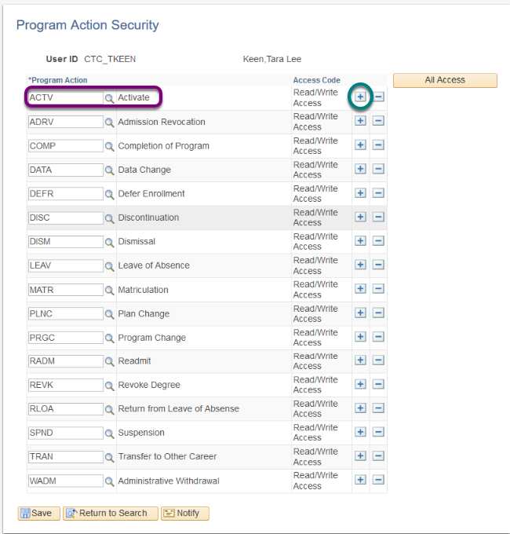
SACR – Program Action Security

Slide 33
Working with security admins
Provide as Much information as possible
  Navigation to Access Needed
  Functional description of Business Process
  Screen Shots of Errors
  Employee ID of users with Issues
  If it is a random issue, try to provide timings if available
  Remember least access needed to do a job is critical; do not give more security than needed, it is an audit issue.

Slide 34
Requesting changes to security
There are times where roles may have too much access/not enough access, or are mislabeled, etc.
SBCTC has a process for New Role Requests or Role Modification Requests
  Submit a service desk ticket to the Security Team by pillar
  SBCTC will review the request and log it in our change tracking system
  Gain Functional approval, CMB approval, and then it goes through development and testing cycles.

Slide 35
Helpful queries
https://www.sbctc.edu/resources/documents/colleges-staff/data-services/peoplesoft-ctclink/report-catalog.pdf
There are queries listed by pillar here with descriptions

Slide 36
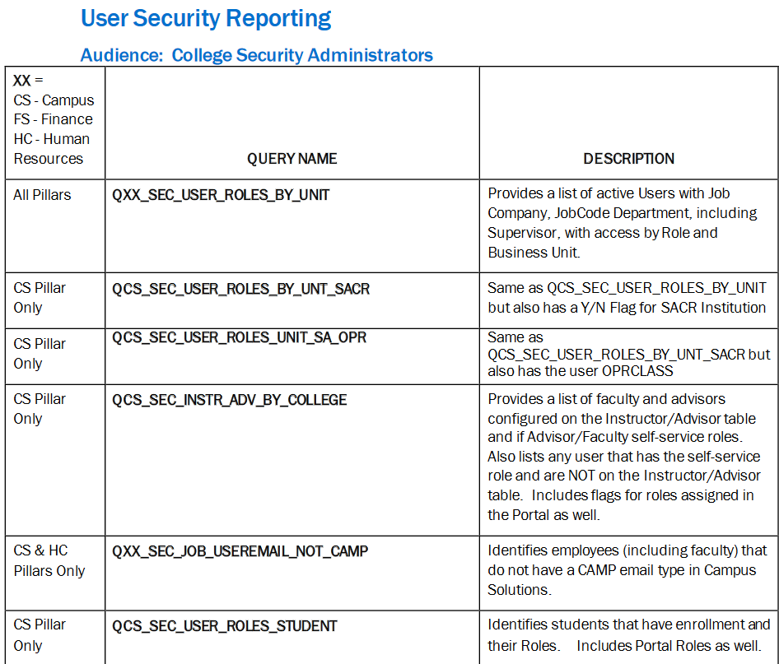
Helpful Queries

Slide 37
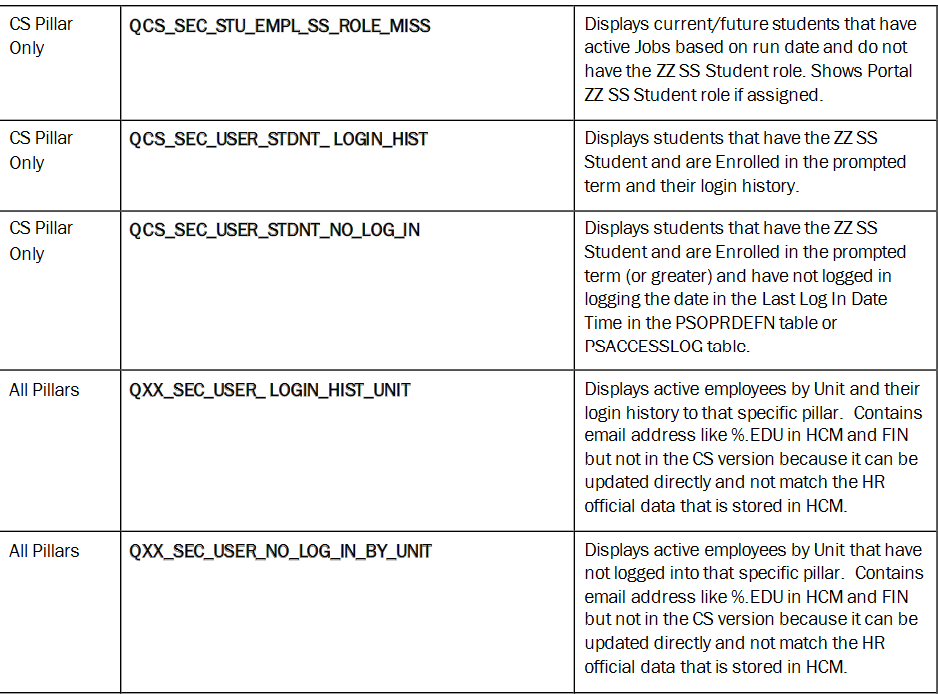
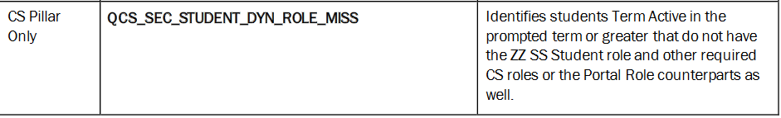
Helpful queries

Slide 38
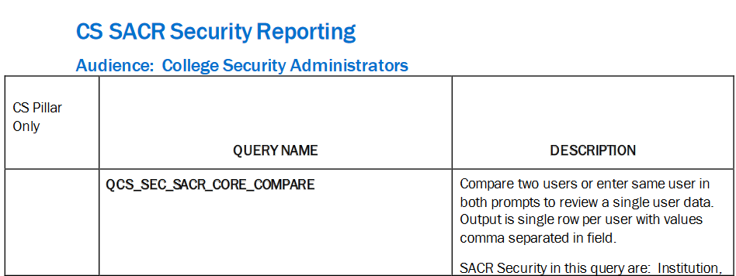
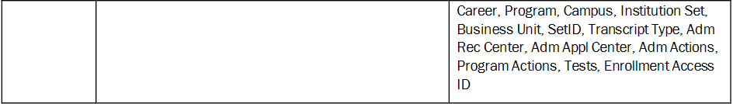
Helpful queries

Slide 39
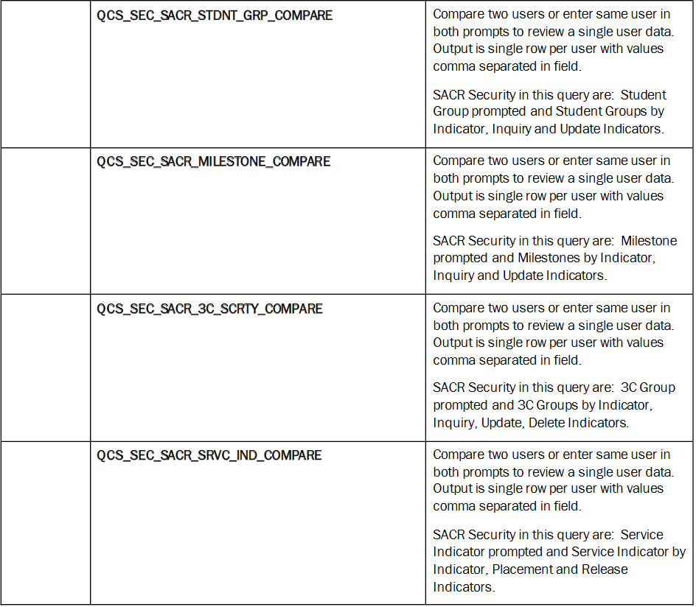
Helpful queries

Slide 40
DEMO OF QUERIES

Slide 41
Questions and feedback
Questions?
Feedback?
Any Parking Lot issues
THANK YOU FOR ATTENDING

