Slide 1
Peoplesoft Security
Masking UAT
Shelia Sloan
July 2022

Slide 2

Agenda
Background
Masking Changes on 4/24/22
New Masking Changes July 2022
Demo
Q&A

Slide 3
Background
Masking as Delivered by Oracle traditionally is controlled by the Primary permission list of the user.
  CTC_PT_MASK_NONE
  CTC_PT_MASK_ALL
  CTC_PT_MASK_PARTIAL
  CTC_PT_MASK_SSN
This delivered method only masks social security number and date of birth, and doesn’t consider other level 4 data elements.
This method also only works on the search look up pages, not on the main pages themselves.
Once the user is drilled down to the main page, oracle doesn’t mask the SSN/DOB unless the user has read only access via a security role to enforce masking.
  This can be an interruption to daily business processes as some users need to update the data, but not be able to see the SSN.

Slide 4
Background (continued)
Prior to April, here were the settings for the Primary Permission Lists.
  CTC_PT_MASK_NONE – Could See FULL SSN and DOB on look up pages
  CTC_PT_MASK_ALL – SSN and DOB Fully Masked on look up pages
  CTC_PT_MASK_PARTIAL – Partial SSN and Partial DOB displayed on look up pages
  CTC_PT_MASK_SSN – SSN Fully masked and DOB unmasked on look up pages.
Also once they drilled down to the page itself if they had a ZZ or ZC role, the SSN and DOB was fully unmasked even with Mask All.
If they had a ZD role, the SSN/DOB was masked.

Slide 5
Masking Changes 4-24-22
In April the settings for the Primary Permission Lists were changed.
  CTC_PT_MASK_NONE – SSN Fully Masked/ DOB visible on look up pages
  CTC_PT_MASK_ALL – SSN and DOB Fully Masked on look up pages
  CTC_PT_MASK_PARTIAL – SSN Fully Masked and Partial DOB displayed on look up pages
  CTC_PT_MASK_SSN – SSN Fully masked and DOB visible on look up pages.
Still once they drilled down to the page itself, if they had a ZZ or ZC role, the SSN and DOB were fully unmasked.
If they had a ZD role, the SSN/DOB were masked.

Slide 6
Why the change in April
Not all pages are delivered to be secured by business unit. SBCTC has enhanced this feature by introducing security views on the pages to secure them by business unit/institution. There were many out of the box that were not, and SBCTC has made tremendous progress over the years updating them and enhancing data protection. We are narrowing down the list released 50 more in the month of March. Our next batch has been developed and should be released in late July, early August.
The Masking Changes that went in during April, help protect SSN/DOB information on the lookup pages themselves.

Slide 7
Where we are going
The out-of-box delivered masking solution is not adequate. Oracle delivered a new tool for masking that will allow us to not only mask SSN/DOB on the lookup pages, but it also will allow masking for ALL data 4 level elements on the drill down pages themselves, not matter what type of role the user has.
Users will then be able to have update roles to change data if they need to, and have the SSN/DOB masking in effect as well as the other elements. This will significantly enhance the protection of PII data and not interrupt business processes.
We will release this in batches. The first batch of navigations have passed the development phase and system integration testing(SIT).
Welcome to UAT

Slide 8
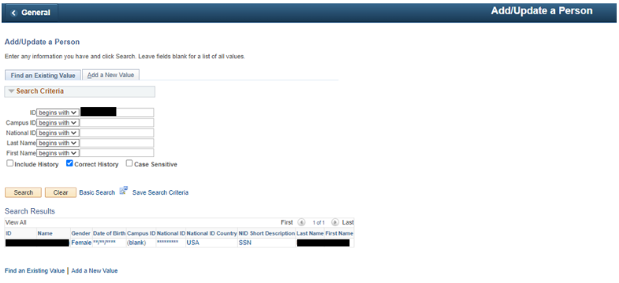
Add/Update a Person Search Page - Example of User with CTC_PT_MASK_ALL Permission List

Slide 9
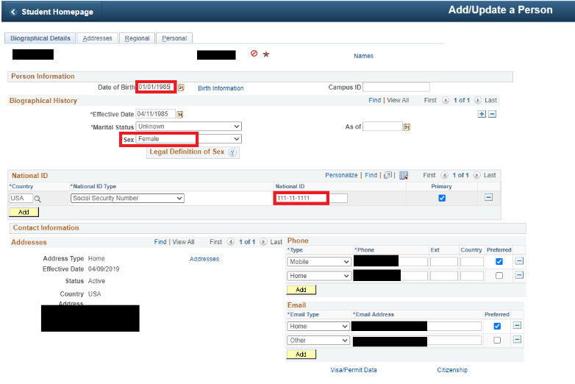
Add/Update a Person Page - Example of before masking solution changes
User with ZZ/ZC role: Once the land on the drill down page, even with MASK ALL, they can still see PII Data.

Slide 10
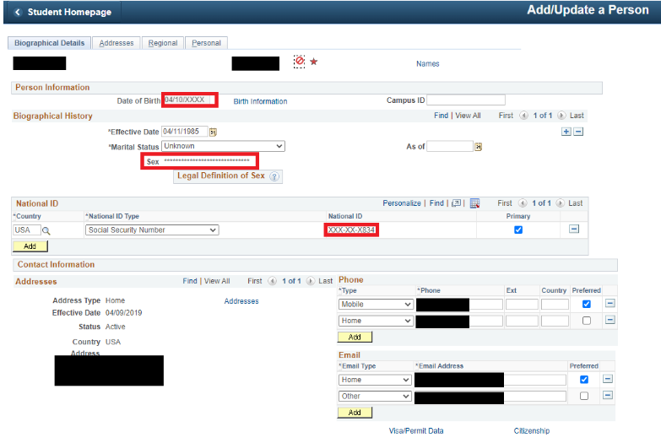
Add/Update a Person Page - Example of After masking solution changes
User with ZZ/ZC role: Once the land on the drill down page, Now with MASK ALL, Mask SSN and Mask Partial, they can see masked PII Data.

Slide 11
What are the level Four Elements
Social Security Number
Date of Birth
Bank Account
Drivers License
Visa Work Permit Number
Net Pay
Garnishments
Accommodations
Disability
Password
Credit Card Number
Sexual Orientation
Gender Identity
Immunization Information

Slide 12
Demo

Slide 13
Questions and feedback
Questions?
Feedback?
Any Parking Lot issues
THANK YOU FOR ATTENDING

