Slide 1
PeopleSoft Financials SECONDARY Security
Presenter: Laurel Anderson
08/16/2022
Notes:
Welcome! Today we’re going to discuss the secondary security settings that are in the Finance pillar.

Slide 2
Agenda
User Role Administration
Module Specific Security Setup
Define User Preferences
Security Admin Tools
Q&A
Notes:
Today we are discussing security setup that is in addition to assigning roles that are relative to specific business processes in the Finance pillar.
Additional security setup includes defining User Preferences or setting up security access within a specific Finance module. We’ll also review security admin tools that are available to you, followed by Q&A time to discuss any questions that you may have.

Slide 3
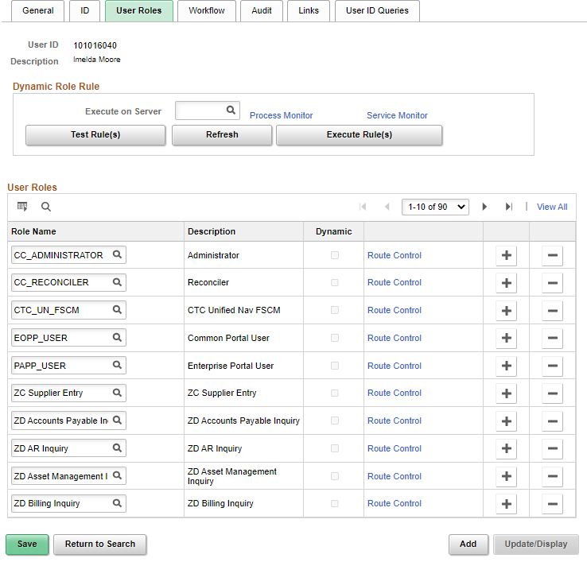
USER Role ADMINISTRATION
Distributed User Profile – User Roles tab
DG PowerPoints: Pillar Security Matrix Mapping by Module - Finance
  Security_Finance_Roles_-_Updated.pptx
  Finance_Approval_Process_Visual_Flows_-_Rea-1.pptx

Slide 4
USER Role ADMINISTRATION
  Finance Security Role Types
  ZZ roles grant add/update access to pages to perform the work.
  ZD roles grant read only access to pages to see, but not touch.
  ZC roles enable a key responsible individual or their backup to have access to Correct History functionality to pages where correct history could negatively impact the integrity of the data if not properly updated.
  The following QRG’s provide a list of common Finance roles with menu paths:
  FSCM 9.2 All 'ZZ' Security Roles
    FSCM 9.2 All 'ZD' Security Roles (View Only)
    FSCM 9.2 All 'ZC' Security Roles (Correct History)

Slide 5

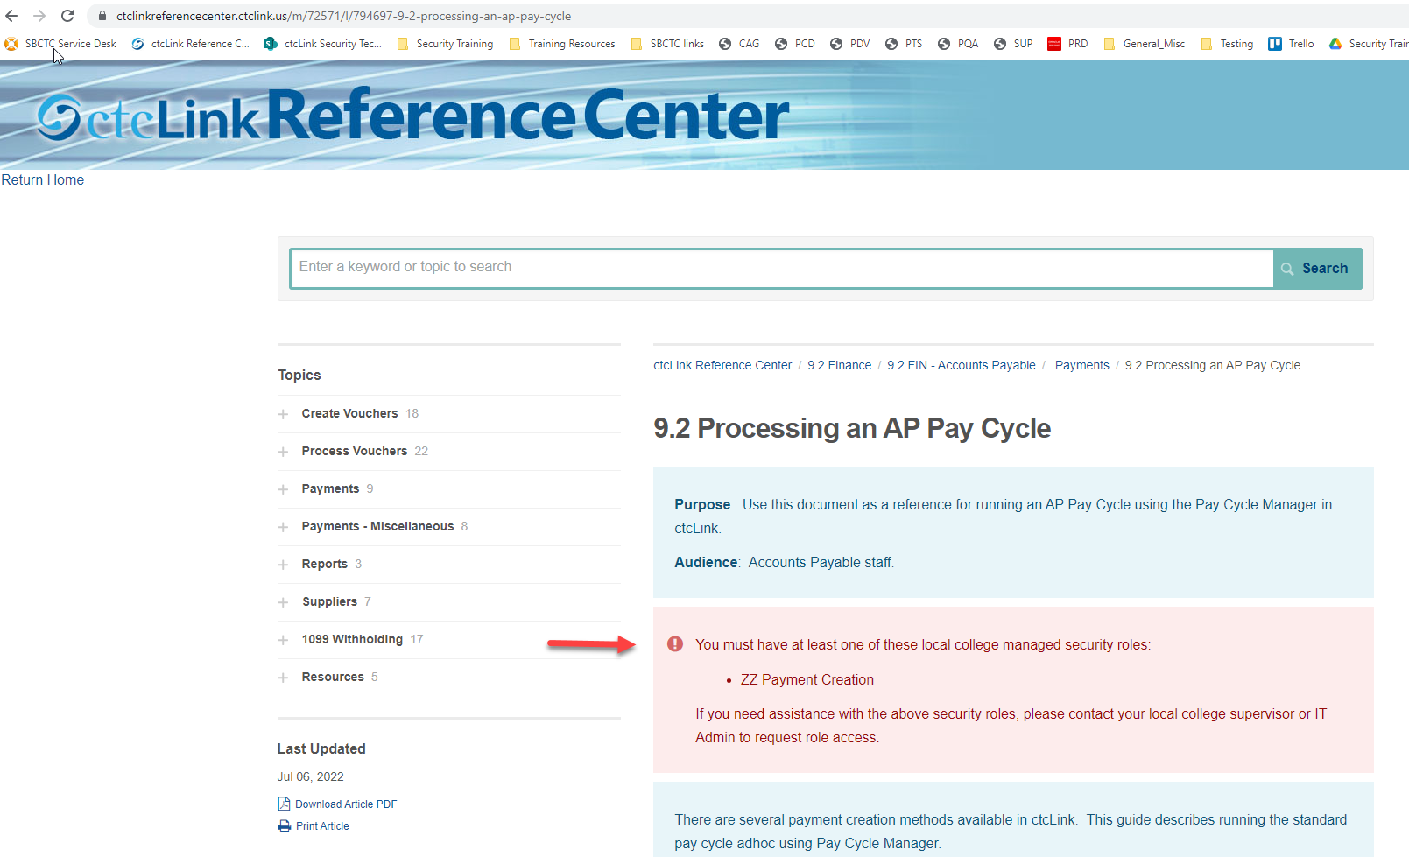
USER Role ADMINISTRATION
*New* Security Roles added to QRG’s

Slide 6
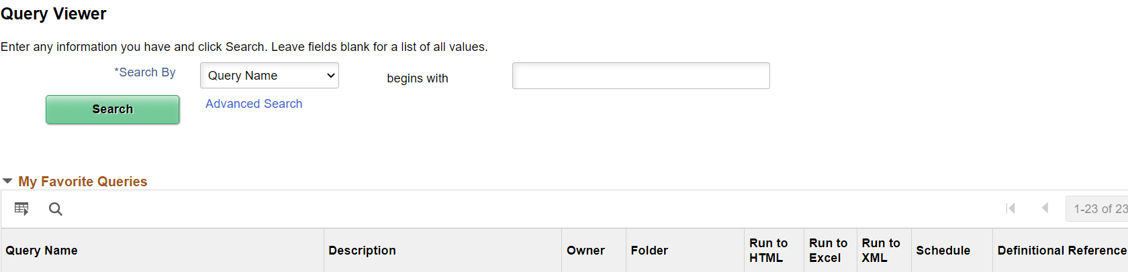
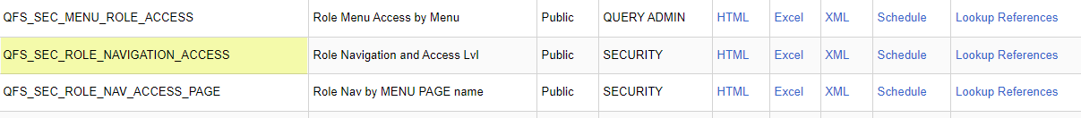
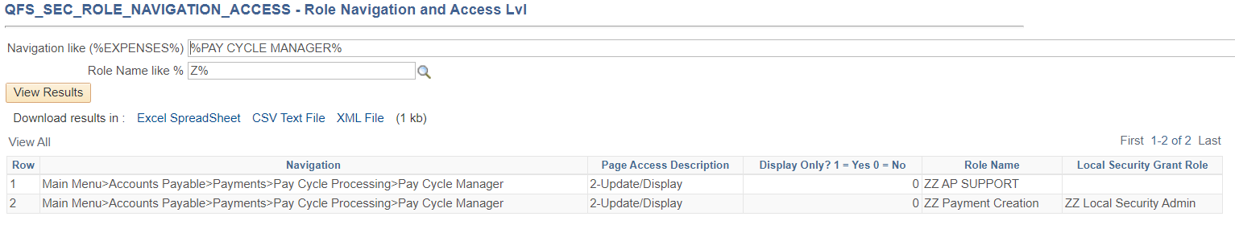
USER Role ADMINISTRATION – Query Nav Access
Determining the Role needed by the Navigation Path:
*Or lookup/enter the Role Name to see all menu paths for that role.

Slide 7
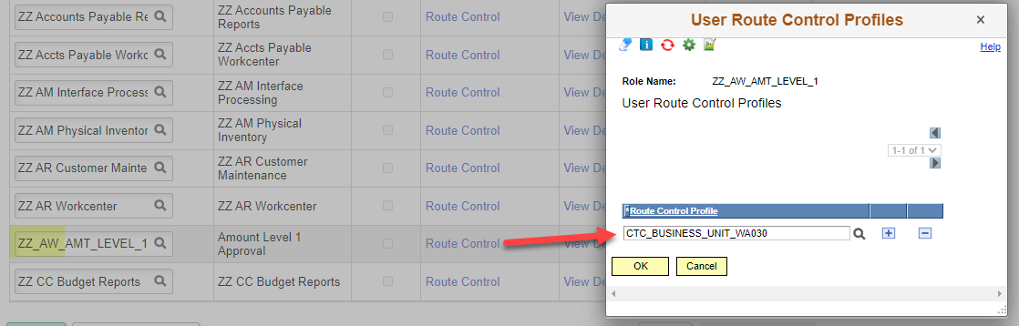
approval Roles and Route Controls
  Transactions that use workflow are routed for approval to users with approval roles that have route controls associated with them.
  The workflow roles are globally shared shell roles that do not provide page access.
  The roles names usually start with “ZZ_AW” (though there are some older roles starting with “CTC” or “CTC_AW” that will be phased out).
  The roles are linked to User Lists configured within the AWE Process Setup. The User List attributes are configured to require a route control by BU. Note: Workflow roles that are assigned without a route control will not route properly.

Slide 8
approval Roles and Route Controls
The following roles have permission lists and are used for workflow routing. When assigned, these roles require a route control (BU) in order to route properly:
  ZZ CC Budget Approval
  ZZ GL Journal Approval
  ZZ GL Jrnl Accountnt Approval
  ZZ_AW_BI_INV (AR Billing Approval)

Slide 9
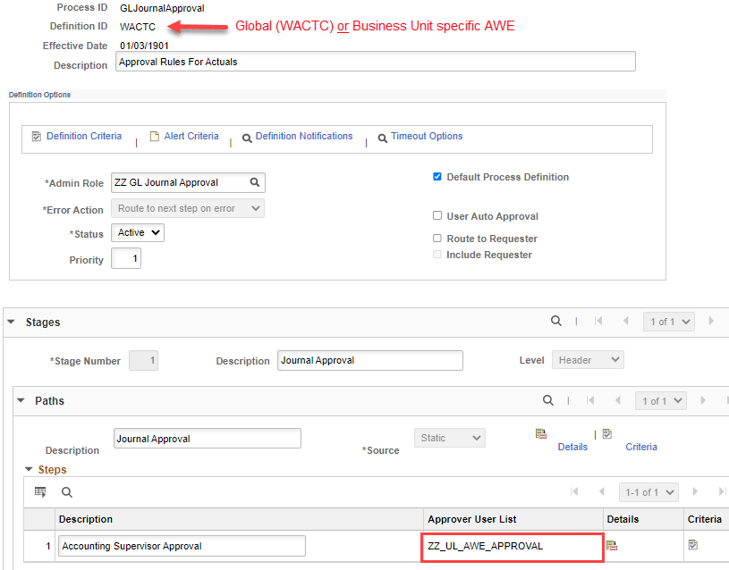
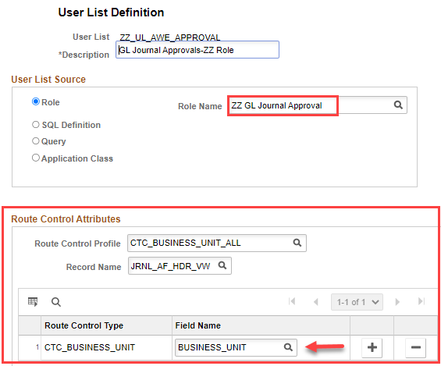
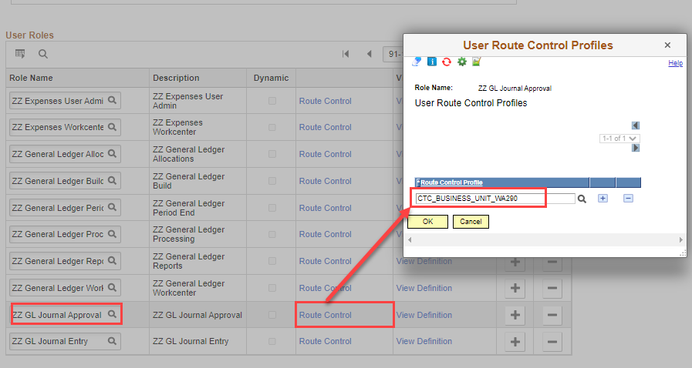
USER Role administration–route control

Slide 10

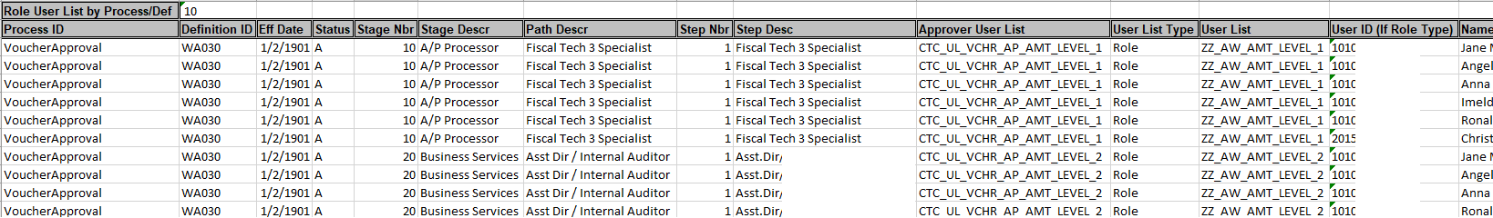
USER Role administration–route control
Workflow Roles/Route Controls
  The QFS_SEC_EOAW_USER_LIST query provides AWE Process setup details.
  The “User List” column has the approval role which requires a route control.
Query: QFS_SEC_USER_ROLES_NOT_LOCAL to view non-local grant “CTC” roles.
Distributed User Profile>User ID Queries tab>User ID’s Roles query

Slide 11
Segregation of Duties
Segregation of duties is the concept of having more than one person required to complete a task. It is an administrative control to prevent fraud, theft misuse of information, or other security compromises.
For example, the person responsible for adding a vendor, should not be able to approve the vendor. You don’t want someone entering a vendor, and vouchering against that vendor, and running a paycycle for example.
When onboarding a new hire, it is critical to consider any segregation of duties issues while assigning roles.
Typically whoever enters the transaction should not be the one approving it.
It is also critical to review Segregation of duties issues twice a year for audit purposes as well.
QFS_SEC_SEGREGATION_OF_DUTIES query is available to use.
Notes:
Since we are on the topic of assigning roles, I’ll mention the topic of Segregation of dutes…

Slide 12
Module specific security
Security Administration is more than assigning roles and maintaining the UserID.
There are other areas in the application that Security Administrators may be responsible for depending on how your institution is organized
User Preferences is most always the college security administrator’s responsibility and is included in the ZZ Local Security Admin role.

Slide 13
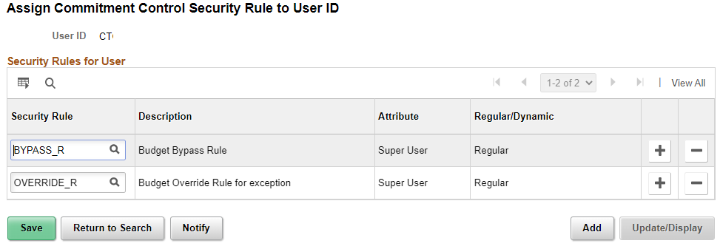
Commitment control
Commitment Control Rules
  Commitment Control, Define Budget Security, Assign Rule to User ID
Role needed: ZZ CC Local Config

Slide 14
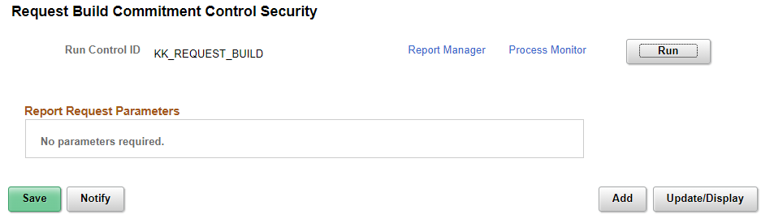
Commitment control
Once the rules are added for a User, the Request Build process has to be run for the changes to take effect.
  Commitment Control, Define Budget Security, Request Build

Slide 15
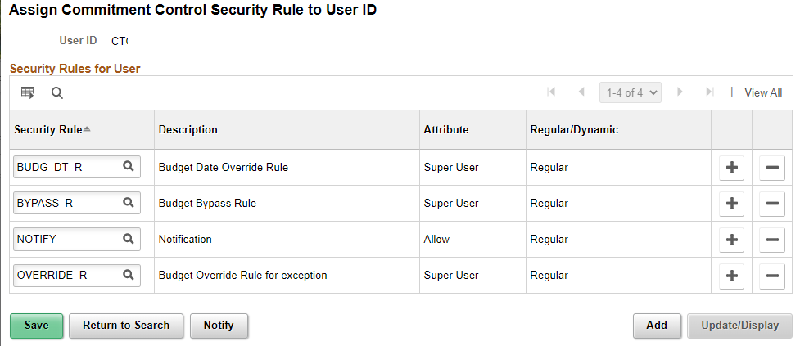
Commitment control rules
BUDG_DT_R: Allows Users to override the budget date on transactions that error due to the budget date on a transaction.
BYPASS_R: Allows a User to bypass budget checking entirely.(This function is reserved for occasions such as when a user needs to correct a suspense journal that was generated from within a source application like Purchasing and whose accounting entries have already been budget-checked.)
NOTIFY: Enables users to be notified by workflow when budget exceptions occur or when a specified percentage of the budget has been used.
OVERRIDE_R: Allows users to override budget checking exceptions for a new transaction or pass a transaction that has failed budget checking.

Slide 16
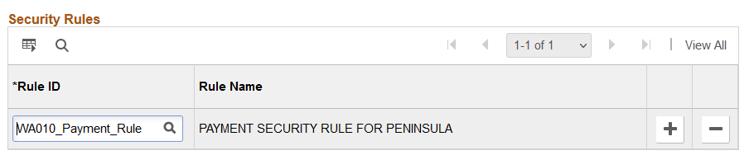
Treasury – Financial Gateway
Finance –Payment Security Rules
  The payment security functionality limits the list of prompt values for secured fields to only those that meet the defined security-rule criteria. The prompt values are determined based on the rule definitions that are assigned to a given user or role. For SBCTC it is the valid bank codes and bank accounts for each institution.
  Financial Gateway > Security > Security User Assignment
  Users with the Security User Assignment will be able to process the ACH/EFT payment dispatch, review payments, review payment files, override payment status, and override payment file status.
Role needed: ZZ Treasury Local Config

Slide 17
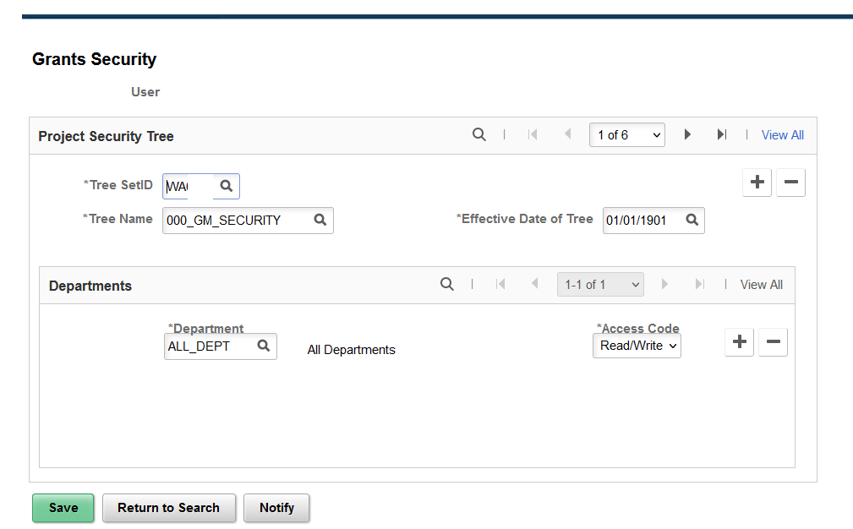
Grants Security
PeopleSoft Grants supports user security, which enables you to limit access to specific PeopleSoft Grants proposals based on the user and department. This is based off a Tree (for SBCTC it is ALL Depts currently)
  Setup Financials Supply Chain> Security > Grants Security > Grants Operator Security
    Role needed: ZZ Local Security Admin
    QRG: FSCM 9.2 - Grants Security
Notes:
You can create and save a proposal without this security but you won’t be able to see it after it has been created without this set up.

Slide 18
Purchasing
Requester/Buyer Setup
  The Requester and/or Buyer setup must be completed prior to configuring the User Preferences for Requisition & PO Authorizations.
  Setup Financials Supply Chain, Product Related, Procurement Options, Purchasing, Buyer Setup
  Setup Financials Supply Chain, Product Related, Procurement Options, Purchasing, Requester Setup
  Role needed: ZZ Local Security Admin or ZZ Purchasing Local Config role for both

Slide 19
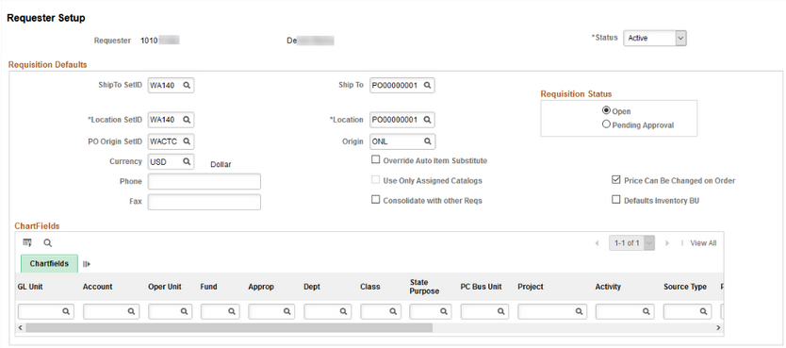
Purchasing
Requester Setup
  The Department/Ship To/Location SetID is the college Business Unit
  PO Origin SetID will always be WACTC
  Origin should be ONL
  Requisition Status: Open will save the requisition and not submit to workflow without an extra step; Pending Approval/Approved will submit the Requisition into workflow upon save if workflow is used;
  The Ship To and Location can be set here if they have defaults that they use all the time; Sometimes if they request for more than one dept, its best to leave that blank here.

Slide 20
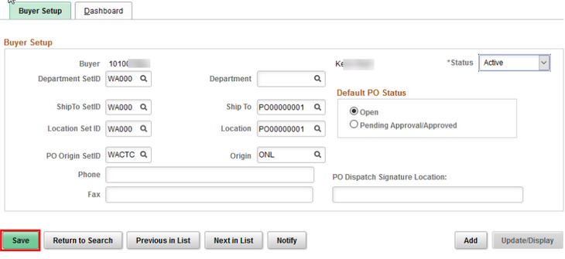
Purchasing
Buyer Setup
  The Department/Ship To/Location SetID is the college Business Unit
  PO Origin SetID will always be WACTC
  Origin should be ONL
  Default PO Status: Open will save the purchase order and not submit to workflow without an extra step; Pending Approval/Approved will submit the purchase order into workflow upon save.
  The Department/Ship To and Location can be set here if they have defaults that they use all the time; Sometimes if they purchase for more than one dept, its best to leave that blank here.

Slide 21
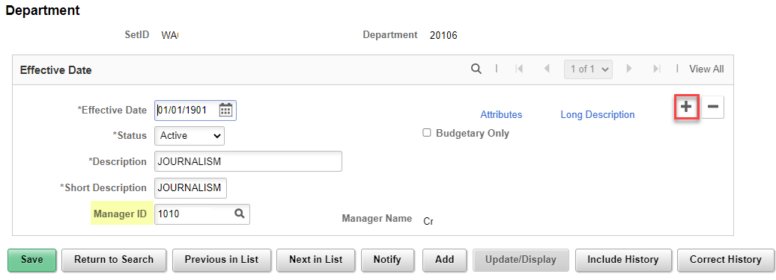
WORKFLOW – DEPARTMENT APPROVERS
Maintaining Department Approvers for Workflow
  Setup Financials Supply Chain, Common Definitions, Design Chartfields, Define Values, Chartfield Values, select Department. SetID is the college Business Unit
  Add a new record to update the Manager ID. The Effective Date can be back-dated as long as you don’t hit Save first. If help with editing an saved/existing record is needed, please submit a service ticket.
  Role needed: ZZ GL Local Configuration role
Notes:
Input ticket if not changing the effective date and correct history is needed.

Slide 22
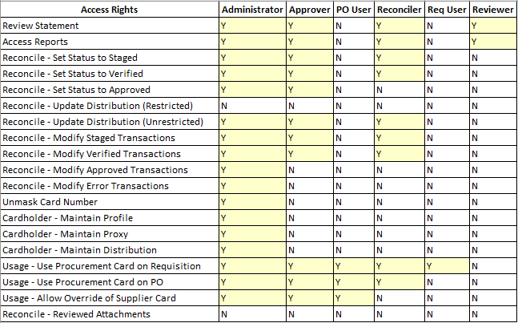
Purchasing
Procurement Card Security
With increased role security, you can control the level of information that is accessed by users, manage the assignments of different procurement cards, and setup proxies and default accounting distributions
  CC_ADMINISTRATOR
  CC_APPROVER
  CC_RECONCILER
  CC_REVIEWER
  CC_USER_PO
  CC_USER_REQ

Slide 23
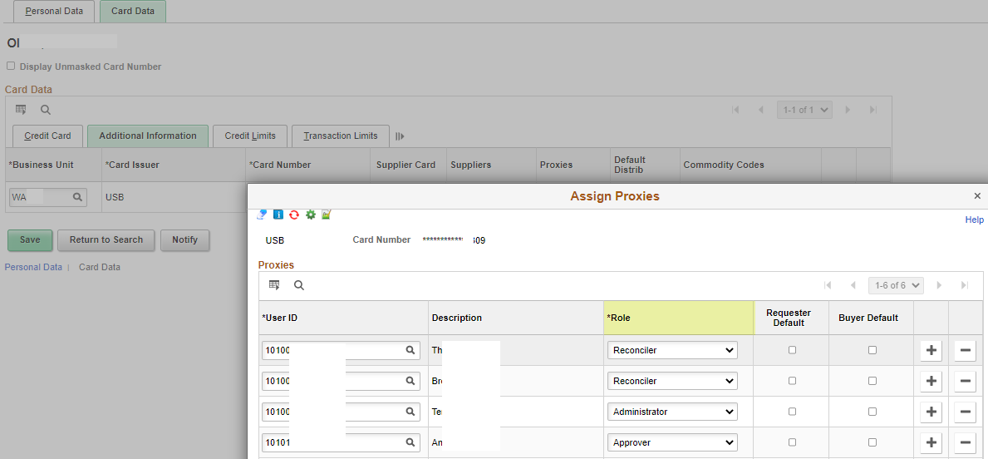
Purchasing
In the Cardholder Profile, on the Card Data tab, when pcards are added, the proxies can be assigned to the individual pcards.
  Purchasing, Procurement Cards, Definitions, Cardholder Profile
Role needed: ZZ Purchasing Local Config

Slide 24
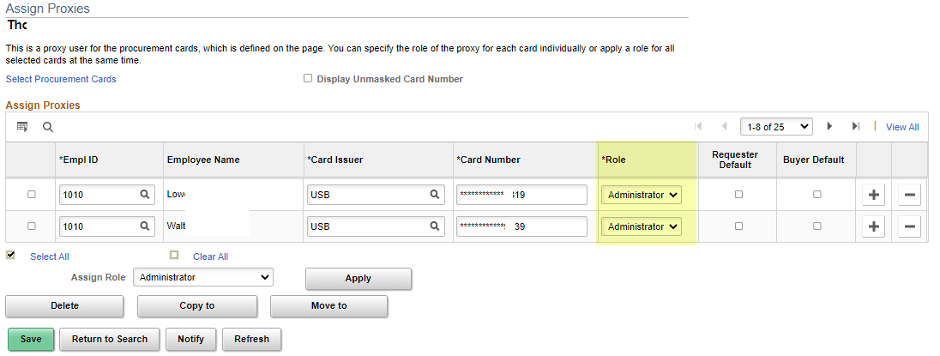
Purchasing
The Assign Proxies page can be used to assign a proxy to multiple pcards at the same time. Purchasing, Procurement Cards, Security, Assign Proxies
  The Requester Default box will only appear if the proxy user has also been setup as a requester using the requester setup page
  The Buyer Default will only appear if the proxy has been setup as a buyer on the buyer default page
  If the Requester or Buyer Default is checked, it will set the pcard as the default payment method for the user when new requisitions or purchase orders are created. It will also update the pcard as the default payment method in the user’s Requester or Buyer Setup screen.
Role needed: ZZ Purchasing Local Config

Slide 25
Travel & Expenses
Traveler Profile – a sync occurs at 8pm daily to load new employees and job record changes.
Travel And Expenses, Manage Employee Information, Update Profile
  The Organizational Data tab – is manually updated with a default chartfield string
  Transportation Information tab – a Transportation ID must be created for all new employees.
Role needed: ZZ Expenses User Admin role
This could be handled by the Expenses Administrator on your campus
QRG’s: 9.2 Editing Employee Organizational Data
9.2 Maintaining Employee Transportation Data
9.2 Recommendations for On and Off Boarding Employees for Expenses

Slide 26
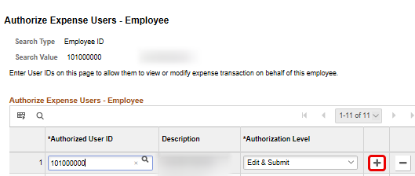
Travel & Expenses
Travel And Expenses, Manage Expenses Security, Authorize Expense Users
  If the campus business process includes having others create travel documents on behalf of the traveler, then the Authorized Expense User must be set up by the Travel Administrator or employee. (This process could be completed by the employee using their Employee Self Service user preferences - Delegate Entry Authority.)
Role needed: ZZ Expenses User Admin
This could be handled by the Expenses Administrator on your campus.
QRG: 9.2 Add Authorized Expense Users

Slide 27
Travel & Expenses
Setup Financials Supply Chain, Product Related, Expenses, Management, Approval Setup, Approver Assignments
This is where approvers for Expenses are defined by approval level.
Maintain approvers in the Expenses Approver Assignment tables in order to keep the T&E AWE functioning correctly.
Role needed: ZZ Expenses Local Config
This could be handled by the Expenses Administrator on your campus.
QRG: 9.2 Maintain Approver Assignments

Slide 28
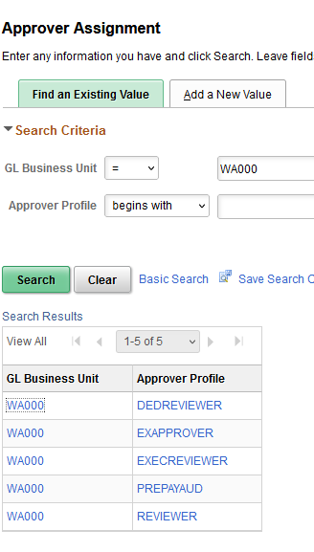
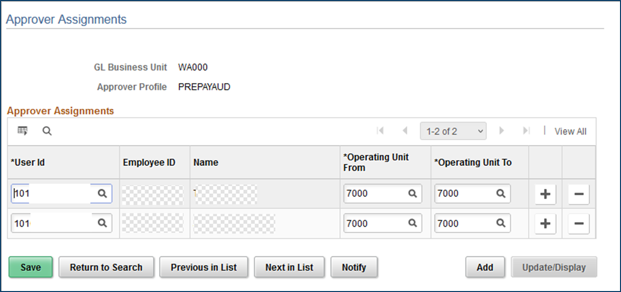
Travel & Expenses

Slide 29
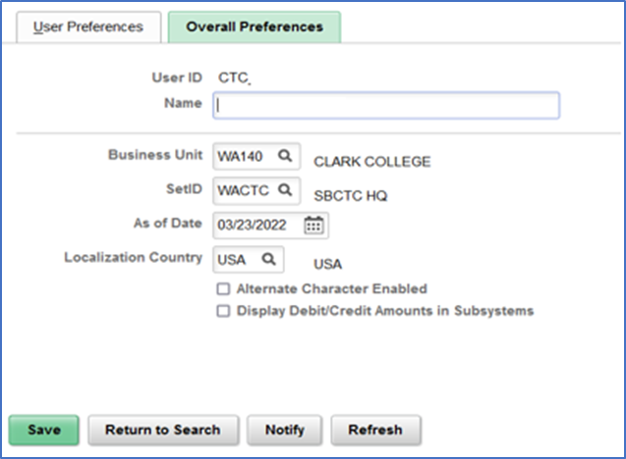
User preferences
User Preferences – Overall Preferences Tab
  Setup Financials Supply Chain, Common Definition, User Preferences, Define User Preferences.
  The Business Unit should be set to the college Business Unit and the SetID will always be WACTC
Notes:
In addition to the security roles that are assigned to users working in the Finance pillar, there are also User Preferences settings that have specific controls as to what the user can do on certain pages. In addition, user’s defaults can be set up in the User Preferences screens, saving the user from having to lookup information such as their Business Unit or Ship To location.
On the Overall Preferences tab, you can define the business unit and SetID that defaults for the user.
Before establishing the overall preferences, the primary and row permissions for the user’s institution should be assigned in their finance Security User Profile.
As of Date should reflect the start date of the user.
Localization Country defaults to USA.
Alternate Character Enabled checkbox will activate alternate description buttons or links which appear to the right of fields on many pages. Hover text.
Display Debit/Credit Amounts in Subsystems checkbox will enable displaying of debit and credit amounts of the business unit on journal entry or inquiry pages.

Slide 30
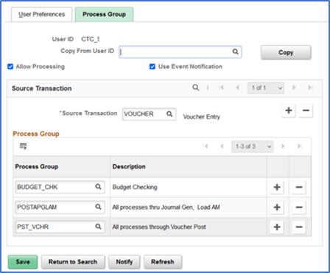
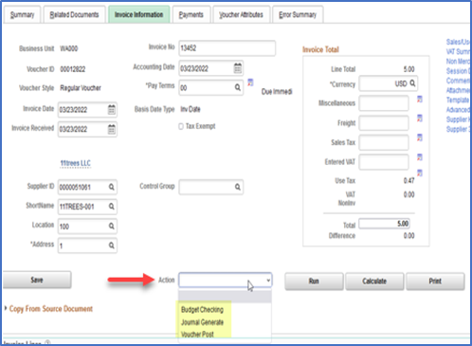
User preferences
Process Groups -There are several Finance process groups. These enable various actions available under the Action menu.
  An example is the VOUCHER process group; This enables a user to run processes directly on the voucher entry pages, such as budget checking, doc tolerance, etc. without having to wait on batch processing:
Notes:
In Finance there are several on-demand Process Groups that allow users to run processes directly from transaction entry pages.

Slide 31
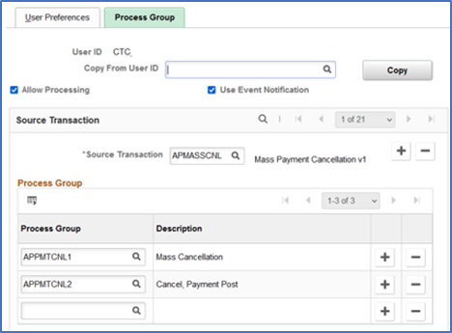
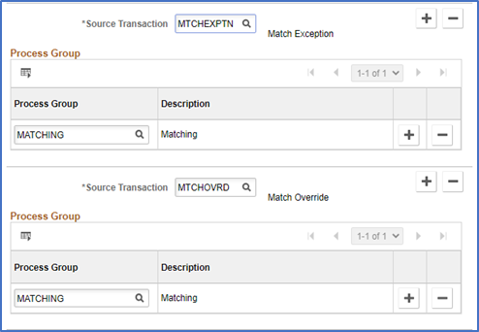
User preferences
User Preferences – Process Groups
The example below provides the user access to mass cancel AP payments and run Payment Post.
This example shows the process groups needed for unmatching AP vouchers.

Slide 32
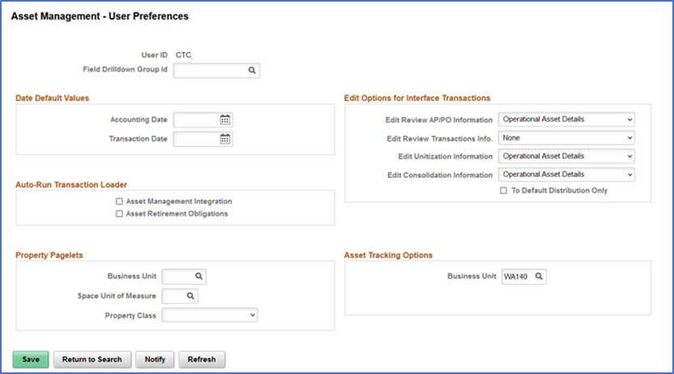
User preferences
User Preferences – Asset Management

Slide 33
User preferences
User Preferences – Asset Management
  Accounting Date: Supply a default date on which you want this transaction distributed to the general ledger. The accounting date is validated against the open periods that you establish for Asset Management in the FIN_OPEN_PERIOD table to determine to which period the system posts. The difference between the transaction date and the accounting date determines whether any prior period depreciation must be calculated. For example, suppose that a computer was acquired and placed in service on March 15, 2006 but was not entered in Asset Management until August 1, 2006. All general ledger periods prior to August are closed. In this case, Asset Management automatically calculates depreciation starting in March and posts it to the general ledger in August.
  Transaction Date: Supply a default date for asset transactions or leave this field blank to use the system date.

Slide 34
User preferences
User Preferences – Asset Management
  Edit Options for Interface Transactions
    Edit Review AP/PO Information:
      Select the options for this user for editing the Review AP/PO Information component. The available options are:
      All: Select this option to allow user to make edits to the following entries; Load Status, Asset ID, Dates Only fields and Operation Asset Details fields.
      Dates Only: Select this option to allow user to make edits to Load Status, Accounting Date and Transaction Date.
      Operational Asset Details: This is the default option. Select this option to allow user edits to asset operational fields only.
      None: Select this option to allow edits to only the Load Status.
    Edit Review Transactions Info
      Select the options for this user for editing the Review Transactions component. The available options are:
      All: Select this option to allow user to make edits to the following entries; Load Status, Auto Approval Status, Dates Only fields, Operation Asset Details fields and most fields in the Distribution and Cost Information section.
      Dates Only: Select this option to allow user to make edits to Load Status, Auto Approval Status, Acquisition Date, In-Service Date, Accounting Date and Transaction Date.
      Operational Asset Details: Select this option to allow user edits to asset operational fields only.
      None: This is the default option. Select this option to allow edits to only the Load Status and the Auto Approval Status.

Slide 35
User preferences
User Preferences – Asset Management
  Edit Options for Interface Transactions
    Edit Unitization Information
      Select All to allow user edits to all fields except for Interface ID and Interface Line Number.
      Select Operational Asset Details to allow user edits to asset operational fields only. Users granted this edit option cannot edit transaction amounts or distribution details.
      Select None to restrict user edits to all fields.
    Edit Consolidation Information
      Use this field to manage user editing privileges of the asset consolidation details on the Consolidate - TO Asset page.
      Select All to allow user edits to all fields except for Interface ID and Interface Line Number.
      Select Operational Asset Details to allow user edits to asset operational fields only. Users granted this edit option cannot edit transaction amounts or distribution details.
      Select None to restrict user edits to all fields.
    To Default Distribution Only
      Select this option to consolidate interface lines with different Chartfields to a single Chartfield distribution. If you do not select this option, interface lines with different Chartfields will be consolidated into a single asset ID with multiple ChartField distributions.

Slide 36
User preferences
User Preferences – Asset Management
  Auto-Run Transaction Loader
    Asset Management Integration: Select to add transactions from Maintenance Management to the transaction loader process (AMIF1000).
    Impairment/Revaluation Process: Select to always run impairment and revaluation processing when running the transaction loader process.
    Asset Retirement Obligations: Select this option to enable automatic always run Asset Retirement Obligation transaction processing when you click the Generate ARC button from either the ARO Measurement page or from the ARO Measurement in Mass – Process Parameters page when running the transaction loader process (AMIF1000).

Slide 37
User preferences
User Preferences – Asset Management
  Property Pagelets
    Business Unit - Select the business unit. This user will then have access to property assets from within the selected business unit.
    Space Unit of Measure - Select the default unit of measure to access when a user is working with space allocations. The available options are:
      Acres
      Feet
      Hectares
      Meters
    Property Class - Select the property class to be commonly used by default for this user ID when he or she is working with property assets. The available options are:
      Area
      Building
      Floor
      Site
      Space

Slide 38
User preferences
User Preferences – Asset Management
  Asset Tracking Options
    Business Unit
      Select a default business unit to use with the Scan Asset, Scan By Location, and Find Asset pages:
      The business unit you select here will appear in the search criteria for the Scan Asset and Find Asset pages.
      For the Scan By Location page, the business unit you select here controls the scan location prompt values.

Slide 39
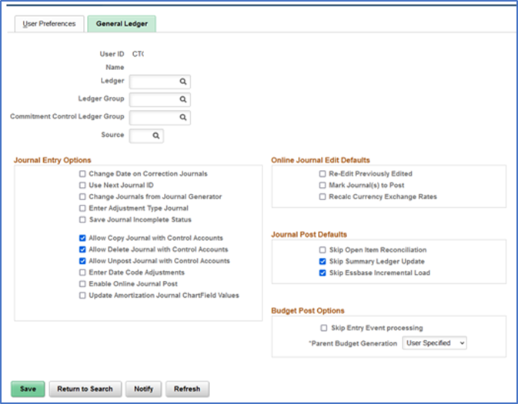
User preferences
User Preferences – General Ledger
QRG 9.2 Setting General Ledger User Preferences
Notes:
Some of the GL roles that require user preference definition include ZZ GL Journal Entry, ZZ General Ledger Processing & ZZ GL Journal Generation.

Slide 40
User preferences
General Ledger
Defaults
  Ledger – Local
  Ledger Group – Actuals
  KK Ledger Group - blank
  For the Source leave it blank so it doesn’t limit the types of journals you can work on.
  Journal Entry Options:
  Always check the Use Next Journal ID
  Until the issue with sub-journals is resolved, users will need the Change Journals from Journal Generator checked.
  If users need to post journals, select that box.
  The Ledger/Ledger Group and Commitment control ledger groups are just defaults so if you only enter journals for a specific ledger you can populate it here and it defaults to the transaction. If you enter for multiple, leave it blank.
Notes:
Ledger – Local
Ledger Group – Actuals
CC ledger group – blank
Source - blank

Slide 41
User preferences
General Ledger-Journal Entry Options
  Change Date on Correction Journals: Select to change the journal date in the corrections journal (which is on the Journal Suspense Correction page). (unchecked)
  Use Next Journal ID: Select to limit this user ID to the NEXT journal ID that is automatically entered by the system during online journal entry. If this option is selected, the Journal ID field becomes unavailable to this user ID, and the user cannot manually enter a journal ID.
  Change Journals from Journal Generator: Select to allow a specific user to update the ChartField and amounts on the Journal Entry page for a journal that was created by the Journal Generator process. (unchecked to avoid subsystem/GL variances)
  Enter Adjustment Type Journal: Select to allow a specific user to enter a Book Code adjustment type journal. (unchecked, unless managing Period 13 adjusting journals)
  Note: This option is used for the Book Code feature, not the Adjusting Entry feature.
  Save Journal Incomplete Status: When you select this option for a specific user and the user adds a new journal, the selected option appears on the Journal Header page of various journal entry options. This option enables the user to save journal entry transactions with an incomplete status and prevents them from being edited or posted until they are complete.
  Allow GL Entry Event Bypass: Select to enable the user to bypass selecting entry events in PeopleSoft General Ledger journal entry, even if they are required on the Installation Options - Entry Event page. (checked)

Slide 42
User preferences
General Ledger-Journal Entry Options
  Allow Copy Journal with Control Accounts: Select to allow journals that contain Control Accounts to be copied. This applies to online or batch journal copy.
  Allow Delete Journal with Control Accounts: Select to allow journals that contain Control Accounts to be deleted. This applies to online or batch journal delete.
  Allow Unpost Journal with Control Accounts: Select to allow journals that contain Control Accounts to be unposted.
  Enter Date Code Adjustments: Select to enable a user to enter date code adjustments for journal entries. The Date Code is displayed on journal lines only for users with the Enter Date Code Adjustments check box selected. (unchecked)
  Enabled Online Journal Post: Select this check box to indicate that the user can select the Post Journal option from the Process field on the Journal Entry - Lines Page. (unchecked)
  Update Amortization Journal ChartField Values: Select to enable a user to update ChartField values on the Amortization Journal – Stage Journal Page and the Journal Entry page for the actual amortization journals created.

Slide 43
User preferences
General Ledger – Online Journal Edit Defaults
  Re-Edit Previously Edited: Select to re-edit journals marked as valid. When this option is deselected, valid journals are not edited again when you run Journal Edit from the Journal Entry page by clicking the Edit button.
  Mark Journal(s) to Post: To mark valid journals with a process request status of Post. If this option is not selected, it prevents batch journals from being marked to post. (unchecked)
    To approve journal entries using PeopleSoft Workflow, you should deselect this option.
  Recalc Currency Exchange Rates: Select to reprocess foreign currency conversion at the journal line level.
Notes:
Online Journal Edit Defaults – Not used because staff need to intentionally choose their actions, as defaults may create issues.

Slide 44
User preferences
General Ledger – Journal Post Defaults
  Skip Open Item Reconciliation: Select to bypass open items for a specific user ID during the online journal post process, allowing the user to reconcile the open items at a later time by using the Open Item Maintenance page.
  Skip Summary Ledger Update: Select to bypass summary ledger updates for a specific user ID during the online journal post process.
  Skip Essbase Incremental Load: Select to bypass the Essbase Incremental Load for a specific user ID during the online journal post process.
Notes:
In this section, these features are not currently used.

Slide 45
User preferences
General Ledger – Budget Post Options
  Skip Entry Event Processing: Select to enable a specific user to post the budget that is associated with a journal entry or allocation without generating entry events through the Entry Event Processor. This may occur when an error occurs in a transaction; however, the entry event processing is correct.
  Parent Budget Generation: Select to enable a specific user to generate parent budget impacts when posting child budget journals. This option determines how the Generate Parent Budget(s) option on the Commitment Control - Budget Journals - Enter Budget Journals - Budget Header page acts. Available options are:
    Always Generate: Select this option to always generate parent budget impacts. When this option is selected, the Generate Parent Budget(s) option on the Budget Header page is also selected and the field is unavailable and cannot be changed.
    Never Generate: Select this option to not generate parent budget impacts. When you select this option, the Generate Parent Budget(s) option on the Budget Header page is deselected and the field is unavailable and cannot be changed.
    User Specified: Select this option to choose whether to generate parent budget impacts for each budget journal. When you select this option, the Generate Parent Budget(s) option on the Budget Header page is available for you to choose.
Notes:
Choose Always Generate to default on the Enter Budget Journal page – this will avoid unintentionally saving without it checked – then the system creates a child budget without a parent budget.

Slide 46
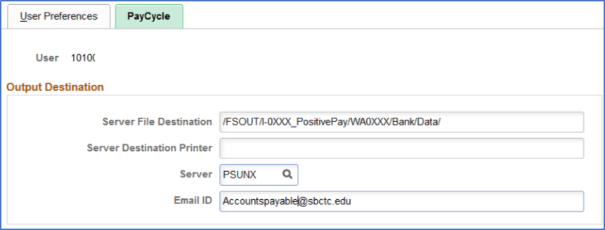
User preferences
User Preferences – PayCycle
  Server File Destination specifies the destination of bank files.
  Email ID is linked to the pay cycle criteria for an ACH pay cycle and is used to send out notifications. It can be set to a group email such as accountspayable@sbctc.edu or an individual email, however only ONE user in the system can be tied to this user preference.

Slide 47
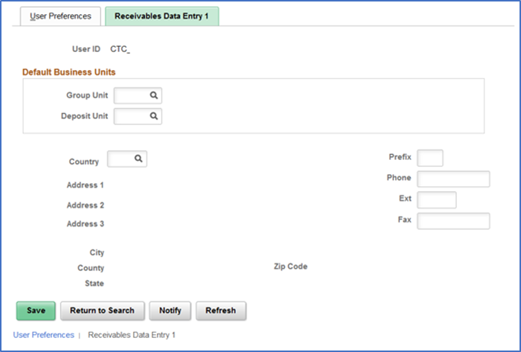
User preferences
User Preferences – Receivables Data Entry 1

Slide 48
User preferences
Receivables Data Entry 1
  Default Business Units: Used to define the default group unit, deposit unit, and address that is associated with a user.
    Group Unit and Deposit Unit : Enter values that become the user's default values for business units. Although the user can override these default values, you can minimize data entry by entering the user's most frequently used business unit. The system uses the group unit and deposit unit as the default business unit for online pending groups, deposits, and worksheets.
    Use the address fields to store addresses for follow up letters. The address information that you enter on this page is not validated against any table.

Slide 49
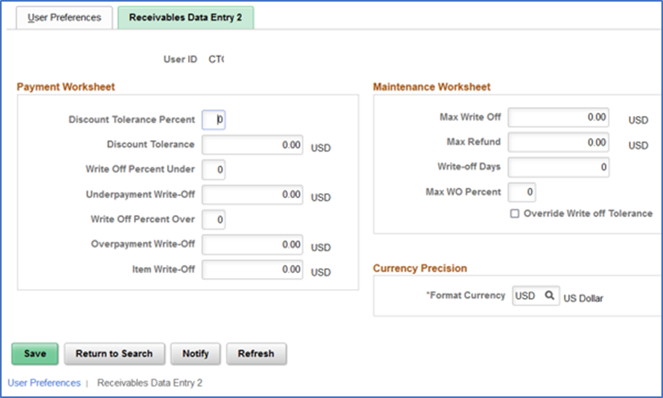
User preferences
Receivables Data Entry 2

Slide 50
User preferences
Receivables Data Entry 2
  Payment Worksheet - Used to specify write-off tolerances and discount tolerances.
    •Discount Tolerance Percent and Discount Tolerance: Enter the percent and amount to use to calculate the discount tolerance. These tolerances enable the user to enter an unearned discount amount that is less than or equal to the value that you enter. Enter the additional percentage that the user can add to the payment terms.
    For example, if an item is 700.00 and the discount terms are 2 percent for 10/Net30, the normal discount would be 14.00. If you enter 10 in the percent field, the user can take up to an additional 10 percent of the discount amount, which is 1.40. The total discount would be 15.40. However, the total discount can never be more than the value in the amount field.
    •Write-Off Percent Under, Underpayment Write-Off, Write-Off Percent Over and Overpayment Write-Off: Enter the percent and amount that define the maximum write-off for underpayments and overpayments. These values apply only to write-offs (such as Entry Types WAU and WAO). These values do not apply to adjustments or deductions associated with overpayments or underpayments (these are not write-offs). The user can enter a write-off amount as long as the amount does not exceed the specified write-off percentage of the payment.
    •Item Write-Off: Enter the highest amount that this user can write off when the user writes off an amount for an individual item on a payment worksheet.

Slide 51
User preferences
Receivables Data Entry 2
  Maintenance Worksheet
    Max Write Off (maximum write-off): Enter the maximum amount that the user can write off for either an individual item or for the remaining balance for a normal group or match group. The user can write off an amount below the maximum amount as long as it does not exceed the percentage of the original amount for the item. For example, if you enter an amount of 25.00, the user can write off amounts up to 25.00. However, if you enter a maximum write-off percentage of 10 percent, and the total original amount of an item is 240.00, the user cannot write off more than 24.00. For no limit, enter all 9s.
    Max Refund (maximum refund): Enter the maximum refund amount that a user can create.
    Write-off Days: Enter the minimum age of an item before a user can write it off on the maintenance worksheet. For no limit, enter 0.
    Max WO Percent (maximum write-off percent): Enter the maximum percentage of an item that this user can write off. For no limit, enter 100.
    Override Write off Tolerance: Select to enable the user to write off items or amounts that do not meet the write-off tolerances that are defined for the business unit, customer, or entry reason as long as the write-off meets the user's write-off tolerances. If the user's write-off action exceeds the tolerances in the business unit, customer, or entry reason levels, the system issues only a warning.

Slide 52
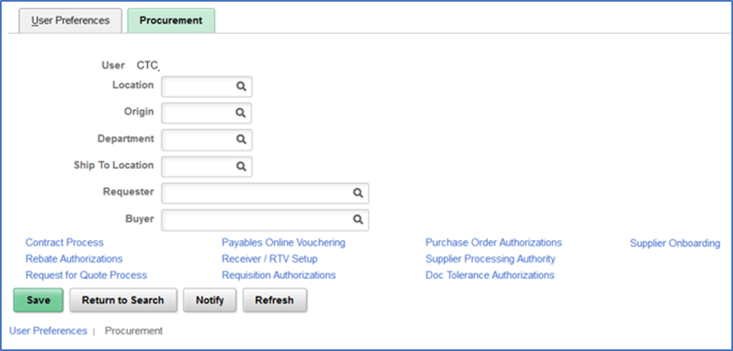
User preferences
Procurement

Slide 53
User preferences
Procurement
  For the Location/Origin/Dept/Ship To location: these are defaults that will default to transactions. You can leave them blank if you purchase for more than one dept/location.
  Requester: Enter the name of the person whom this user will be authorized to enter requisitions. So if this user enters requisitions, put their user id here; Requester Setup has to be done first
  Buyer: Enter the name of the buyer for whom this user will be authorized to enter POs. Buyer setup has to be completed first.

Slide 54
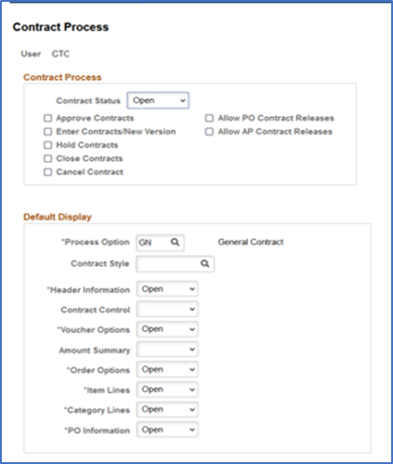
User preferences
Procurement - Contract Process

Slide 55
User preferences
Procurement - Contract Process
  Contract Process: Used to define contract process preferences by specifying the default contract status and authorized actions for a user.
  Contract Status: Select the status at which you want this user to open contracts. When the user creates a contract, the status appears by default based on the value you select.
  Approve Contracts: Select to provide the user the authority to approve procurement contracts.
  Enter Contracts/New Version: Select to provide the user the authority to create contracts and new contract versions.
  Hold Contracts: Select to provide the user the authority to place procurement contracts on hold.
  Close Contracts: Select to provide the user the authority to close procurement contracts.
  Cancel Contract: Select to provide the user the authority to cancel procurement contracts.
  Allow PO Contract Releases (allow purchase order contract releases): Select to provide the user the authority to release purchase order contracts.
  Allow AP Contract Releases (allow accounts payable contract releases): Select to provide the user the authority to release accounts payable contracts.

Slide 56
User preferences
Procurement - Contract Process – Default Display
  Process Option: Select a contract process option that you want to set up as default for the user. Contract process options enable you to determine a specific contract process for use throughout the contract's life cycle. You can use other process options, but the value you choose here defaults on the Contract Entry page (for the selected user).
      Values include:
      AP (Recurring Voucher)
      BRO (Release to Single PO Only)
      DST (Distributor)
      GN (General Contract)
      GRPM (Group Multi Supplier)
      GRPS (Group Single Supplier)
      MFG (Manufacturer)
      PADV (Prepaid Voucher with Advance PO)
      PO (Purchase Order)
      PPAY (Prepaid Voucher)
      RPOV (Recurring PO Voucher)
      SPP (Special Purpose)
      Contract Style: Select a contract style that you want to set up as the default style for this user. You can use other contract styles, but the value you choose here defaults on the Contract Entry page.
      Header Information, Contract Control, Voucher Options, Amount Summary, Order Options, Item Lines, Category Lines, and PO Information: Select a group box option that you want to apply for this user. The value you select controls how the group box initially appears on the Contract page. Valid values for the group boxes are:
      Collapsed: Select to collapse (hide) the group box when the user initially accesses the Contract page.
      Open: Select to expand (open) the group box when he user initially accesses the Contract page.

Slide 57
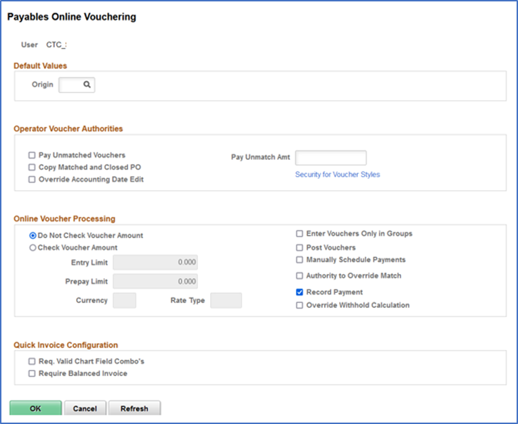
User preferences
Procurement - Payables Online Vouchering
Notes:
Roles that need user preferences definition are ZZ voucher entry & ZZ voucher processing.

Slide 58
User preferences
Procurement - Payables Online Vouchering
  Default Values:
    Origin: Such as ONL: Select the voucher origin for this user. The system tags all vouchers that are entered by this user with this origin, and uses the processing settings for this origin when it processes the voucher.
  Operator Voucher Attributes:
    Pay Unmatched Vouchers and Pay Unmatch Amt (pay unmatched amount): Select Pay Unmatched Vouchers to give users the authority to pay vouchers that have not been matched up to the maximum amount that is specified in the Pay Unmatch Amt field. Authorized users must select the Pay UnMatched Voucher check box on the Voucher Attributes page in the Voucher component (VCHR_EXPRESS) for the system to select the voucher during the Pay Cycle Application Engine process (AP_APY2015). Note: If you select the Pay Unmatched Voucher option, vouchers with the following match statuses (MATCH_STATUS_VCHR) are available for payment: T (ready), E (exception), D (dispute), O (overridden), and C (credit note). If you do not select the Pay Unmatched Voucher option, only vouchers with the match status of M (matched) or N (no match) are available for payment.
    Copy Matched and Closed PO (copy matched and closed purchase orders): Select to enable the user to copy matched and closed POs. Note: If this option is selected for your user preferences and you create a voucher that references a PO that has a matched line (because an earlier voucher also referenced the PO) and an unmatched line, then when you copy the PO to the voucher, the matched PO line copies with both the amount and the quantity at zero.
    Override Accounting Date Edit: Select to enable the user to override the accounting date edit option on the Procurement Control - General Controls page.
    Security for Voucher Styles: Click to access the Voucher Styles page, where you can define the user authority for each of the voucher styles by selecting the appropriate check boxes.

Slide 59
User preferences
Procurement - Payables Online Vouchering
  Online Voucher Processing
  Do Not Check Voucher Amount and Check Voucher Amount: Select one of these options to determine whether the system performs an edit during online voucher entry against the voucher gross amount. Voucher build will also perform an edit against the voucher gross amount based on the selected option.
  Entry Limit: If you selected Check Voucher Amount, specify the voucher entry limit amount for this user. When you specify the entry limit, you must also specify its currency and a rate type.
  Prepay Limit: If this user has the authority to prepay vouchers, you can specify a maximum amount for each prepayment that the user can enter. You must also specify a currency and a rate type for the prepayment.
  Currency: Specify a currency for the entry limit or prepay limit amount.
  Rate Type: Specify a rate type for conversion to the transaction currency that is entered on the voucher.
  Enter Vouchers Only in Groups: Select to enable the user to enter only vouchers that are attached to a control group ID as defined on the Control Group Information page.
  Post Vouchers: Select to enable the user to post approved vouchers.
  Manually Schedule Payments: Select to enable the user to schedule payments manually, overriding the system's automatic payment scheduling. If you do not select this option, the user is unable to modify any of the scheduled payment information on the Voucher - Payments page.

Slide 60
User preferences
Procurement - Payables Online Vouchering
  Authority to Override Match: Select to enable the user to override the match status of a voucher. If the voucher requires matching, the user has the authority to change the voucher match status to Not Applicable.In addition, if the Matching Application Engine process (AP_MATCH) has been run but the process encountered match exceptions or errors, the user can override the match exceptions. When the exceptions are overridden, the user can rerun the Matching process; the Matching process updates the voucher match status to Matched.
  Record Payment: Select to enable the user to manually record payments for a voucher. When this option is deselected, the user is unable to specify Record as a payment action on the Payments page of the Voucher component.
  Override Withhold Calculation: Select to enable the user to override the timing of the withholding calculation on the Withholding page of the Voucher component. Withholding calculation can be at payment time or voucher posting time based on the withholding entity setting.
  Req. Valid Chart Field Combo's (require valid ChartField combinations): Select this check box for the system to automatically validate ChartField combinations on Quick Invoice vouchers. If the ChartField combination is invalid, the system prevents the user from saving the voucher.
  Require Balanced Invoice: Select this check box for the system to automatically perform balancing algorithms on Quick Invoice vouchers. If the vouchers are out of balance, the system prevents the user from saving the voucher.

Slide 61
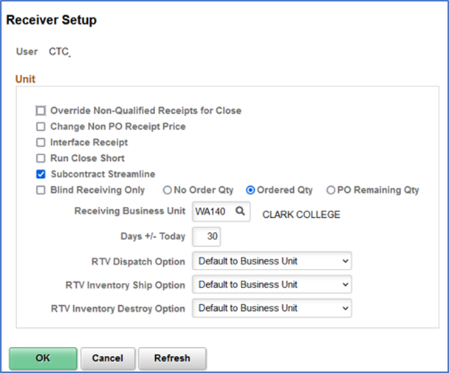
User preferences
Procurement – Receiver/RTV Setup
Notes:
The roles ZZ Receipt Entry and ZZ Receipt Processing do require user preferences setup.

Slide 62
User preferences
Procurement - Receiver/RTV Setup - Unit
  Override Non-Qualified Receipts for close: Select to enable the user to force close Non-Qualified receipts. (checked)
  Change Non PO Receipt Price (change non purchase order receipt price): Select to enable the user to change the receipt price for an item on a non-purchase order receipt. (checked)
  Interface Receipt: Select to automate the passing of inventory and asset information through the Receiver Interface Push process (PO_RECVPUSH). (checked)
  Run Close Short: Select to call the Close Short Process (PO_CLSSHORT) automatically during the Receiver Interface Push processing (PO_RECVPUSH).
  Subcontract Streamline: Select this check box if you want the Subcontract Streamline check box to appear selected by default for a subcontracted purchase order receipt for this user. The user will be able to override this field setting for a subcontracted purchase order receipt. The system determines whether to perform subcontract streamlining (purchase order receipt and production completion for the production ID in a single step) from the receipt. Streamline processing for subcontract RTVs enables you to process RTVs if completions have been performed on the associated receipt. The system includes negative production completion and production scrap for operations being returned against the subcontract. If this check box is deselected, the Subcontract Streamline check box will appear deselected for a subcontracted purchase order receipt for this user. The user will not be able to change this field setting for the subcontracted purchase order receipt. That is, this assumes subcontract streamlining is not enabled for this user

Slide 63
User preferences
Procurement - Receiver/RTV Setup
  Blind Receiving Only: Select to prevent the receiver from seeing the order quantity or the remaining quantity from the purchase order. The receiver needs to count the items before entering the quantity received. When you select this check box, the No Order Qty, Ordered Qty, and PO Remaining Qty check boxes are deselected.
  No Order Qty (no order quantity): Select to prevent the receiver from seeing the purchase order quantity. The receiver must specify the actual quantity that is received by doing a live count of the items.
  Ordered Qty (ordered quantity): Select to use the purchase order quantity as the default quantity received.
  PO Remaining Qty (purchase order remaining quantity): Select to use the remaining quantity (original order quantity minus previously received quantities) on the purchase order as the default quantity received.
  Receiving Business Unit: Select the user's default receiving business unit. This business unit can be overridden during the receiving process so that you can receive goods into any valid Purchasing business unit.
  Days +/- Today: Enter the number of days plus or minus the current system date to be used as default search criteria on receiving pages when you are selecting purchase order schedules against which to receive. *Optional, can be 30 or 60 days for example, determines how many are listed.

Slide 64
User preferences
Procurement - Receiver/RTV Setup
  RTV Dispatch Option (return to vendor dispatch option): Select the dispatch method as this user's preference for the return to vendor functionality. This functionality provides a default value for dispatching the RTV to the Supplier.
    RTV dispatch option values include:
    Default to Business Unit: Select to use the dispatch option that is defined at the business-unit level. You define the business unit RTV dispatch option value using the Business Unit Options tab on the Purchasing Definition page. When processing RTV options, the system initially checks the user preference and then the business unit when you select the Default to Business Unit option.
    Manual: Select to indicate that the Dispatch processing for the RTV must be performed manually.
    Often collaboration must take place between procurement personnel and another group before a RTV line can be dispatched. For example, you might have to verify the disposition of goods with warehouse personnel before dispatching the RTV.

Slide 65
User preferences
Procurement - Receiver/RTV Setup
  RTV Inventory Ship Option (return to vendor inventory ship option): Select the return to vendor ship option that you want to use as this user's default value for the Inventory Process field on the RTV line. This option will only be used by the RTV function when the disposition on the RTV line has a value of Ship. The system determines the ship option default value by first checking the user preference ship option value. If the user preference value is Manual, Express, or Fulfillment then the system uses the value as the default value. If the user preference value is Default to Business Unit, the system uses the ship option value defined at the business-unit level. Values are:
    Default to Business Unit: Select to use the inventory ship option that is defined at the business-unit level.
    Express: Select to use the RTV express option to process Purchasing and Inventory data collection transactions at the same time. This means that the user can perform Inventory issue (automatic issue) action from within the Purchasing RTV component. If the RTV line disposition is Ship, the system creates a material stock request with a status of Shipped to update inventory.
    Fulfillment: Select to set the user's preference to perform Inventory fulfillment processing for RTV transactions. This enables the user to create an Inventory material stock request transaction and to process it through Inventory fulfillment processing. The Fulfillment value is only valid for RTV processing when RTV line disposition is Ship.
    Manual: Select to indicate that the RTV ship transaction must be completed manually. This option requires that the inventory Express Issue function be used to ship the items to the supplier. When you use the Manual Inventory Ship option, the system does not perform RTV express functions. The user must use the Inventory Express Issue component to issue inventory returns that are being shipped to the vendor.

Slide 66
User preferences
Procurement - Receiver/RTV Setup
  RTV Inventory Destroy Option (return to vendor inventory destroy option): Select the return to vendor destroy option that you want to use as this user's default value for the Inventory Process field on the RTV line. This option is only used by the RTV function when the disposition on the RTV line has a value of Destroy. The system determines the destroy option default value first by checking the user preference destroy option. If the user preference value is Manual or Express then the system uses that default value. If the user preference value is Default to Business Unit, the system uses destroy option defined at the business-unit level.
    RTV Inventory destroy option values are:
      Default to Business Unit: Select to use the inventory destroy option setting at the business-unit level.
      Express: Select to use the RTV express option to process Purchasing and Inventory data collection transactions at the same time. This means that the user can perform Inventory adjustment (automatic adjustment) actions from within the Purchasing RTV component.
      Manual: Select to indicate that the RTV destroy transaction must be completed manually. This option requires that the Inventory Adjustment function be used to update inventory for the items being returned to the vendor.

Slide 67
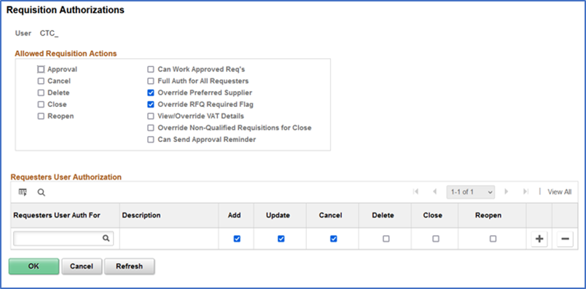
User preferences
Procurement - Requisition Authorizations

Slide 68
User preferences
Procurement - Requisition Authorizations
  Can Work Approved Reqs (can work approved requisitions): Select to enable a user to change a requisition that has already been approved.
  Full Auth for All Requesters (full authority for all requesters): Select to give the user authority to add, update, cancel, delete, and close requisitions for all requesters. If you select this option, you don't need to configure the rest of this page.
  Override Preferred Vendor: Select to enable a user to change the default vendor on a requisition line. If this authority is not selected, the user is unable to manually suggest a vendor.
  Override RFQ Required Rule Flag: Select to enable a user to override the RFQ Required Rule option that was previously specified for a requisition in the requisition component.
  View/Override VAT Details (view or override value-added tax details): Select to view and override VAT details within the requisition component.
  Override Non-Qualified Requisitions for Close: Select to enable a user to close requisitions that are nonqualified for close.
  Can Send Approval Reminder: Select to enable a user to send reminders to pending approvers of requisitions.
  Requesters User Auth For (requesters user authority for): Requesters for whom this user can work requisitions. Select the requester that you want to designate as the user's default requester by selecting the check box to the left of the requester's name. Add, Update, Cancel, Delete, Close, and Reopen :Select to enable the user to add, update, cancel, delete, close, and reopen requisitions for this requester.

Slide 69
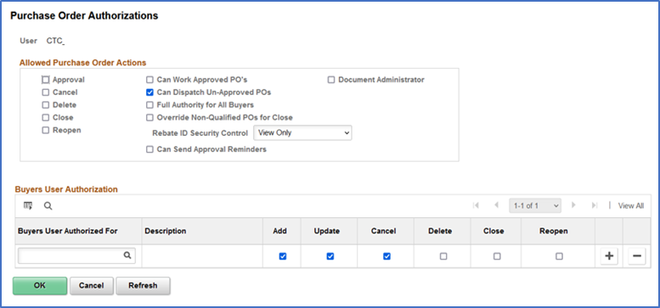
User preferences
Procurement– Purchase Order Authorizations

Slide 70
User preferences
Procurement - Purchase Order Authorizations
  Can Work Approved POs (can work approved purchase orders): Select to enable a user to change a purchase order that has already been approved or dispatched.
  Can Dispatch Un-Approved POs: Select to enable a user to dispatch purchase orders with a status of pending approval.
  Full Authority for All Buyers: Select to give the user authority to add, update, cancel, delete, and close purchase orders for all buyers. If you select this option, you don't need to configure the rest of the page.
  Override Non-Qualified POs for Close: Select to enable a user to close purchase orders that are nonqualified for close.
  Rebate ID Security Control: Select the vendor rebate agreement security control option for purchase orders. Options are:
    Hidden: Vendor rebate agreement fields are hidden from this user when he or she is maintaining purchase orders.
    Update: Vendor rebate agreement fields can be updated by this user when he or she is maintaining purchase orders.
    View Only: Vendor rebate agreement fields are only able to be viewed by this user when he or she is maintaining purchase orders.

Slide 71
User preferences
Procurement - Purchase Order Authorizations
  Can Send Approval Reminder: Select to enable a user to send reminders to pending approvers of purchase orders.
  Buyers User Authorized For: Select the buyers for whom this user can enter purchase orders. Add, Update, Cancel, Delete, Close, and Reopen Select to enable the user to add, update, cancel, delete, close, and reopen requisitions for this buyer.

Slide 72
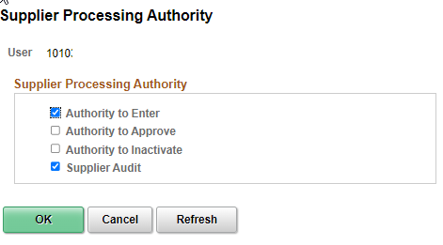
User preferences
Procurement - Supplier Processing Authority
For users needing to Enter Suppliers, select the Authority to Enter and the Bottom Supplier Audit is automatically Checked.
Note: These two are the only valid options for the institutions as the Authority to Approve or Inactivate is for SBCTC use only.

Slide 73
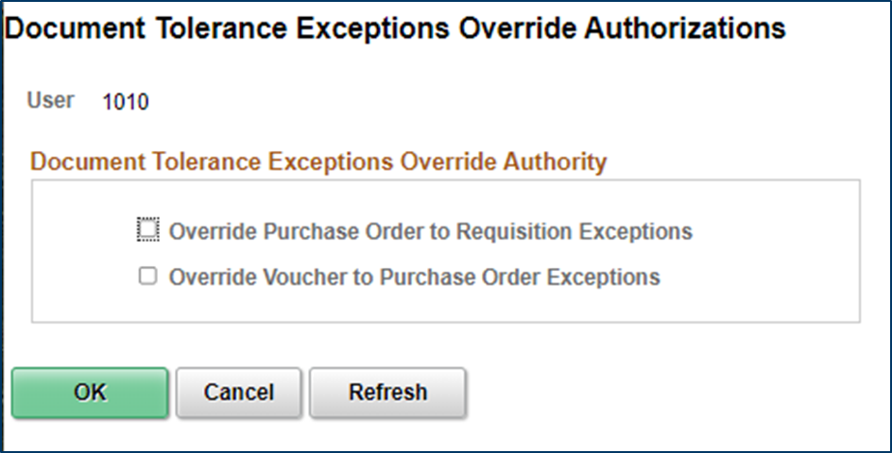
User preferences
Procurement – Doc Tolerance Authorizations
Override Purchase Order to Requisition Exceptions | Enables you to override document tolerance exceptions that are generated when an encumbrance exceeds the preencumbrance during document tolerance checking.
Override Voucher to Purchase Order Exceptions | Enables you to override document tolerance exceptions that are generated when an expenditure exceeds the encumbrance during document tolerance checking.

Slide 74
New User Access
Document Procedures and Follow them
Always Document the Request, Gain Approvals and Save
Be able to Show that What was Requested was granted
Never accept Phone Calls as a form of authorization.
Store for Auditors
Ensure Access is Appropriate and limited to only what they need.

Slide 75
Current User Access
Periodically Review Current Users Access, at least twice a year.
This is really recertification of user access
If job duties change, so should their access in the application.
Document the changes, gain authorization.
Ensure no segregation of duties issues are in place.

Slide 76
Terminated User Access
This should be handled on demand as users terminate but at least weekly.
Review Terminated users and confirm with HR that they are in fact terminated.
Coordinate with Security Administrator in HCM if Different to update roles to match the offboarding recommendations.
QRG: 9.2 Offboarding - Security Procedure

Slide 77
Tools
CTCLINK REPORT CATALOG
Security Queries
QFS_SEC_ROLE_NAVIGATION_ACCESS: Displays user friendly menu navigation by Role and Page Access
QFS_SEC_OPR_DEF_TBL_FS_OPRCLS: Displays the OPRCLASS by the Business Unit for Users in OPR_DEF_TBL_FS
QFS_SEC_USER_EMAIL_RTE_CNTRL: Displays the user’s roles and associated route controls
BI publisher report: BFS_SEC_OPDF
Reporting Tools > BI Publisher > Query Report Scheduler

Slide 78
Tools
User Preference Report
  Setup Financials Supply Chain, Common Definitions, User Preferences, User Preferences Report (Requires ZZ Local Security Admin role)
Security Report(Commitment Control)
  Commitment Control, Define Budget Security, Security Report (Requires either the ZZ CC Local Config role or the ZZ CC Budget Reports Role)

Slide 79

Q&A

