Slide 1
PeopleSoft Financials Security Offboarding areas
Presenter: Laurel Anderson
March 28, 2023

Slide 2
Agenda
What does offboarding have to do with me?
Security settings in various Functional areas
Tools for Offboarding
Q&A
Notes:
During this session, we will walk through the various areas in Finance that have security settings and talk about best practices from an offboarding perspective.

Slide 3
What does Offboarding have to do with me?
Offboarding User Access within ctcLink – What does this mean?
When an employee leaves an institution, their access within ctcLink must be updated to only have access to their old W-2’s or old pay stubs. Elevated access must be taken off the user account immediately.
Why is this important?
Removing elevated access within ctcLink is critical so that we protect our data and keep our system secure.
I’m not a Local Security Administrator so why do I need to know?
Protecting our data and system is EVERYONE’s responsibility. From end users, to local security admins, to central staff at SBCTC, everyone plays an important role in this process. Also as Finance Data owners, there are certain areas in Finance that need to be offboarded, that local security administrators are not responsible for.

Slide 4
Other Areas - offboarding
The Finance Pillar has many secondary security areas that are critical to consider and update when offboarding an employee. This responsibility is a joint responsibility between Finance functional data/area owners at the college, and the Local Security Administrators. Communication between the parties is CRITICAL.
We will walk through the various finance secondary security areas using our offboarding tools.

Slide 5
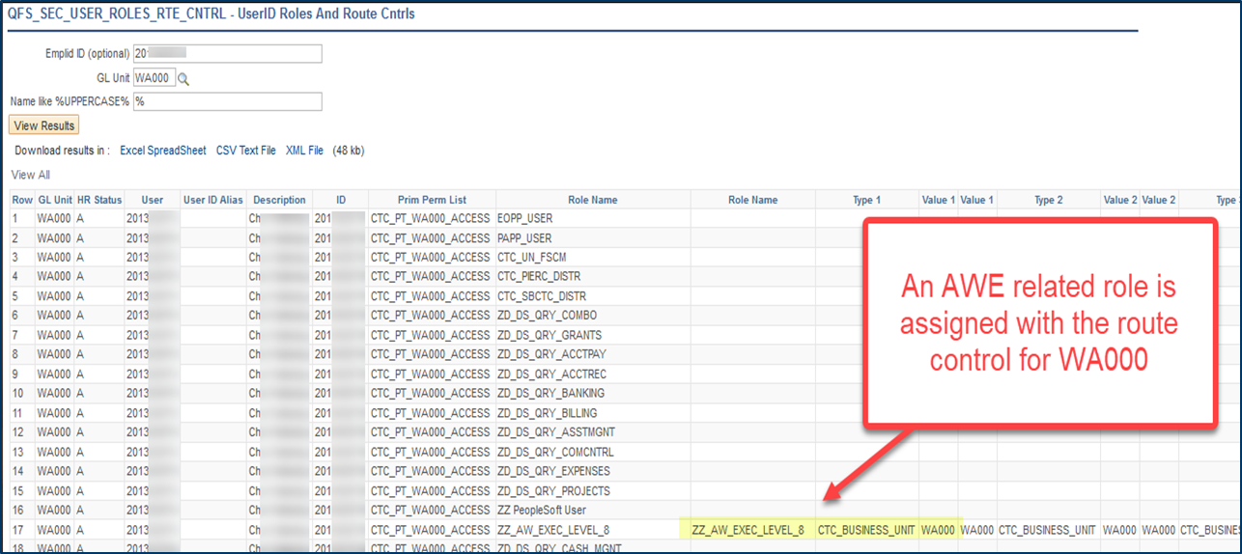
Finance Pillar Tools for offboarding
Finance query: QFS_SEC_USER_ROLES_RTE_CNTRL
Nav: Main Menu > Reporting Tools > Query > Query Viewer
This query lists all the roles assigned to a user and any corresponding route controls.
Role needed: ZD_DS_QRY_SECURITY_TABLES
Notes:
Local security administrators can run this query to see what roles a user has assigned and remove all but the base roles for a former employee.

Slide 6
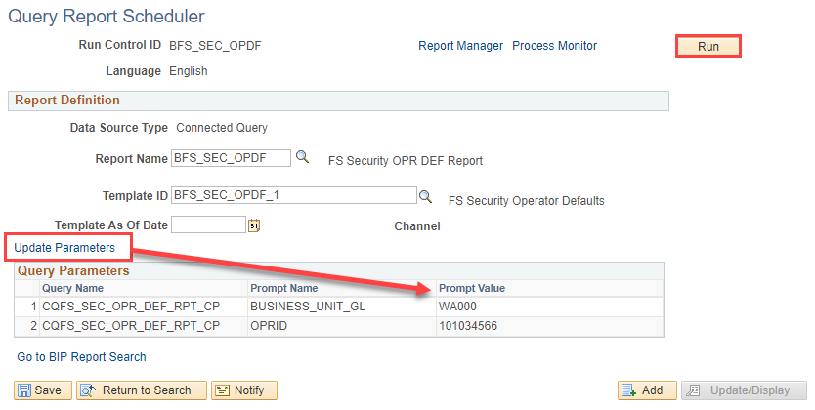
Finance Pillar Tools for offboarding
BI Publisher report: BFS_SEC_OPDF
Nav: Main Menu > Reporting Tools > BIP Publisher > Query Report Scheduler
Role needed: ZD_DS_QUERY_VIEWER
Notes:
Configure the Run Control ID to run the report, the search criteria can be updated by clicking on the Update Parameters hyperlink.

Slide 7
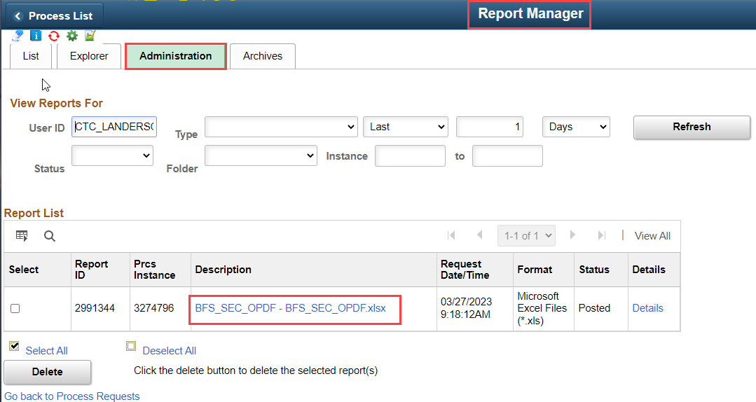
Bi Publisher report – bfs_sec_opdf
Notes:
The process scheduler request screen will open, click Ok. When the process instance runs to success, click on the Report Manager link>Administration tab, to open the file. It will download to Excel.

Slide 8
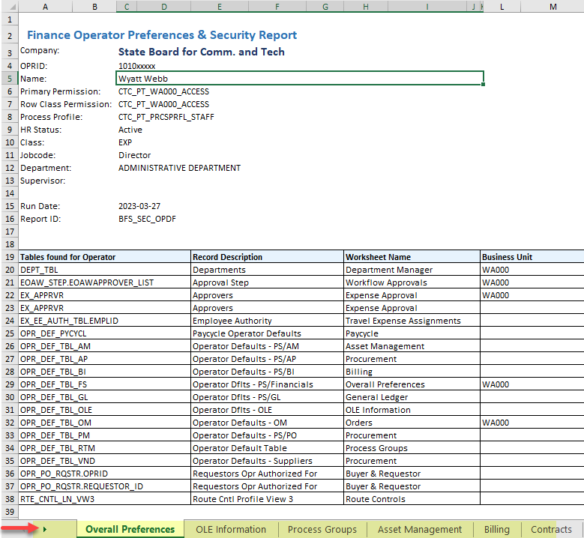
Bi Publisher report – bfs_sec_opdf
The report has 22 worksheet tabs.
Not all users will have data in all tabs and for base employees the data will be very limited.
We will walk through each tab in the spreadsheet and then look at corresponding pages in ctcLink.

Slide 9
Bi Publisher report – bfs_sec_opdf
Overall Preferences This first tab, upper portion of the report, has information from the General tab of the User’s profile listing basic user security information
Second part shows which tables were found with the Operator ID.
Notes:
The second part of this page is a data dump showing which tables include the user’s Empl ID.
Note on Line 20 of the report that the user is listed in the Dept_Tbl as a Department Manager.

Slide 10
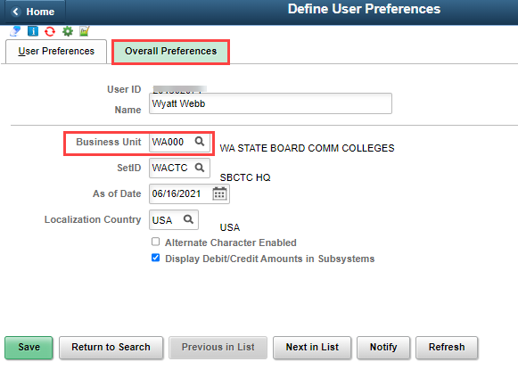
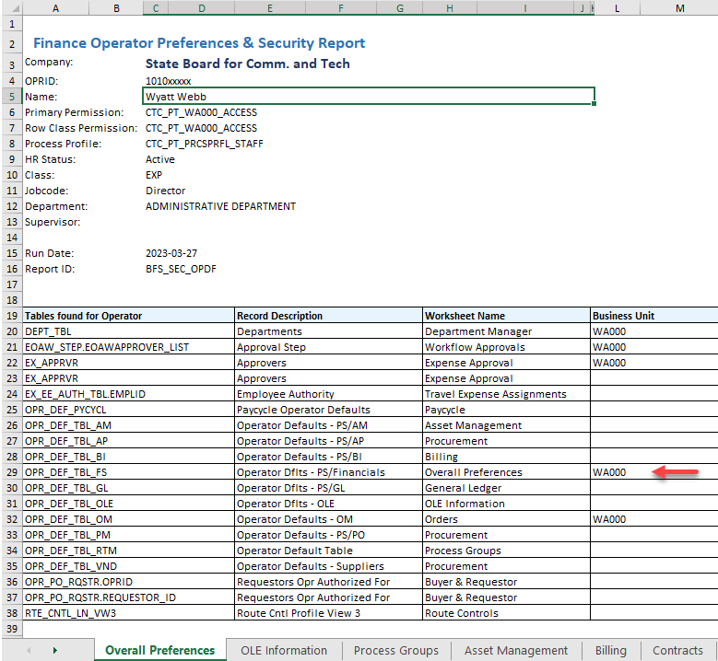
User preferences
Nav: Main Menu > Setup Financials Supply Chain > Common Definition > User Preferences > Define User Preferences
Overall Preferences - This is the first area in User Preferences that should be reviewed. The default business unit can be cleared. It is referenced on the report - table OPR_DEF_TBL_FS.
Notes:
On the Overall Preferences tab, you can clear the defaults for the user.
If you are onboarding an employee that is transferring from another ctcLink institution and they did not offboard their User Preferences, then you can update the user preferences as needed for their current position.

Slide 11
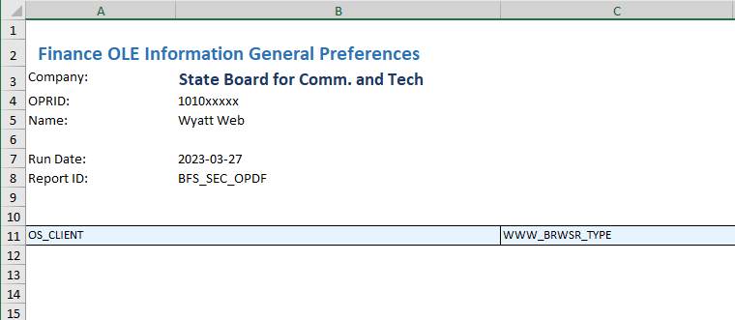
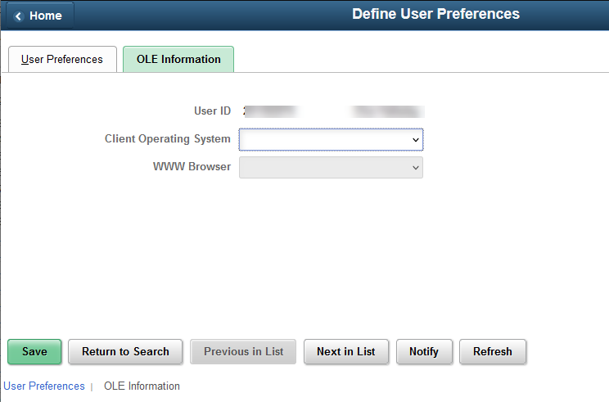
Bi Publisher report – bfs_sec_opdf
OLE Information tab – not configured
Object Linking and Embedding (OLE) information defining the users' web browser and client OS.
Notes:
The report has an OLE tab – this can be skipped as this data is not configured. As we walk through the tabs of the BI Publisher report, you’ll see that a few have the same data repeated.

Slide 12
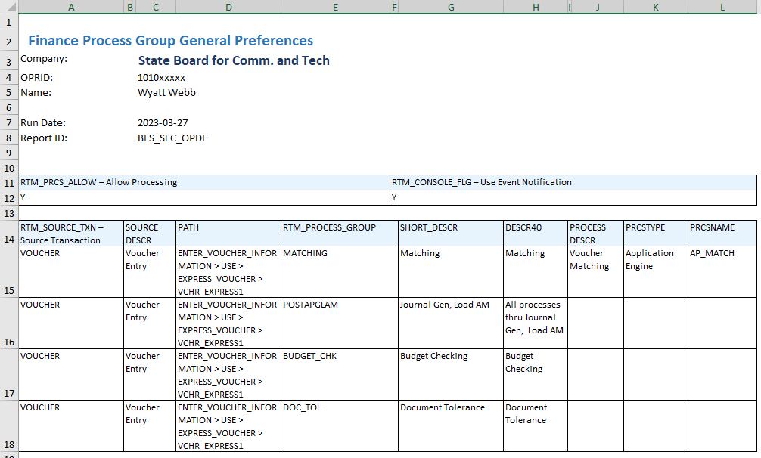
Bi Publisher report – bfs_sec_opdf
Process Groups tab

Slide 13
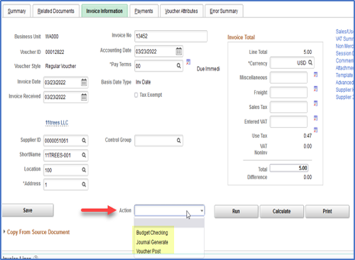
User preferences
Process Groups enable processes in the Action menu.
An example is the VOUCHER process group; This enables a user to run processes directly on the voucher entry pages, such as budget checking, doc tolerance, etc. - without having to wait on batch processing.
Notes:
In Finance there are several on-demand Process Groups that allow users to run processes directly from transaction entry pages.

Slide 14
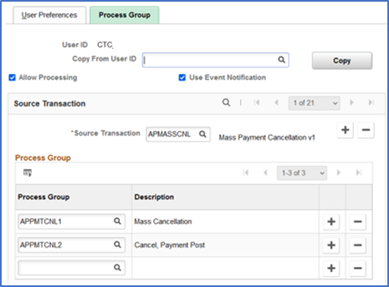
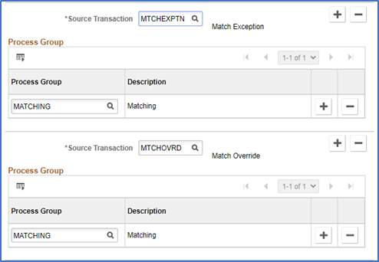
User preferences
Process Groups
The example below provides the user access to mass cancel AP payments and run Payment Post.
This example shows the process groups needed for unmatching AP vouchers.
Notes:
Examples of process groups for Accounts Payable.

Slide 15
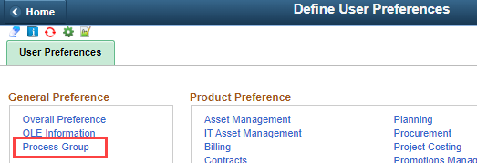
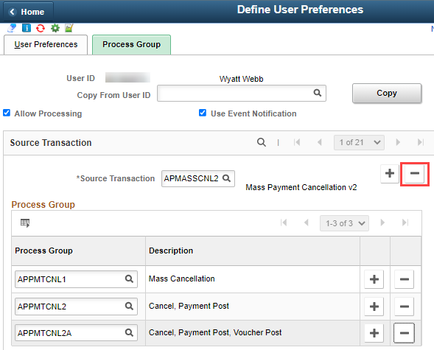
User preferences
Process Groups
Remove the assigned process groups by selecting the minus sign next to each Source Transaction record.
Notes:
A quick way to remove process groups is to find a user who does not have any and use the “copy from” feature.

Slide 16
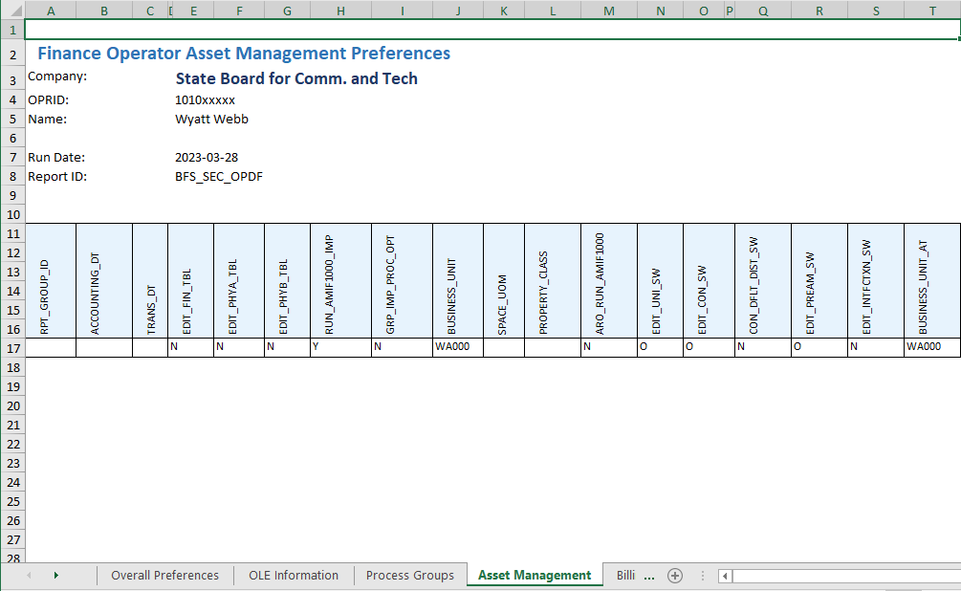
Bi Publisher report – bfs_sec_opdf
Asset Management tab

Slide 17
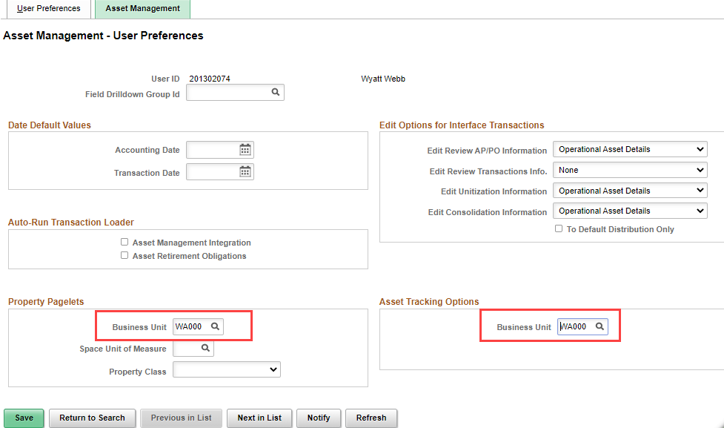
User preferences
Asset Management
Notes:
Business unit should be cleared if populated.

Slide 18
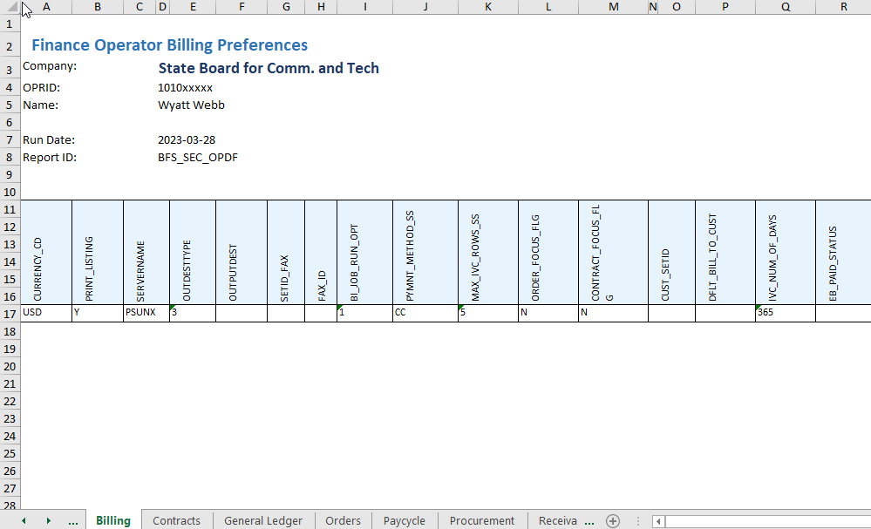
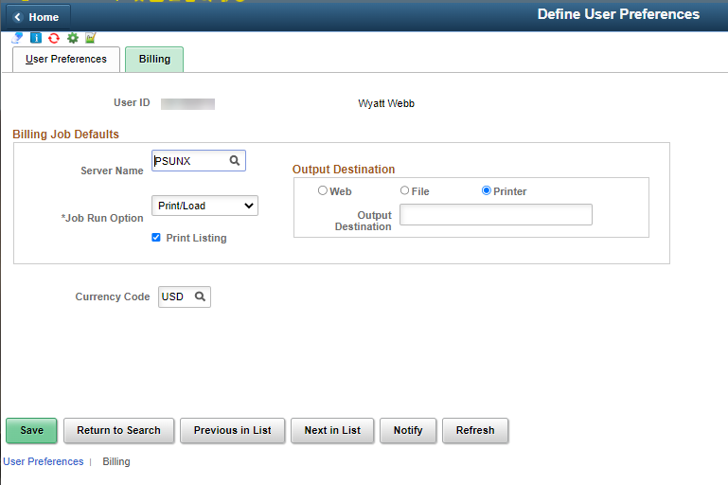
Bi Publisher report – bfs_sec_opdf
Billing tab
Notes:
Clear billing job defaults if populated.

Slide 19
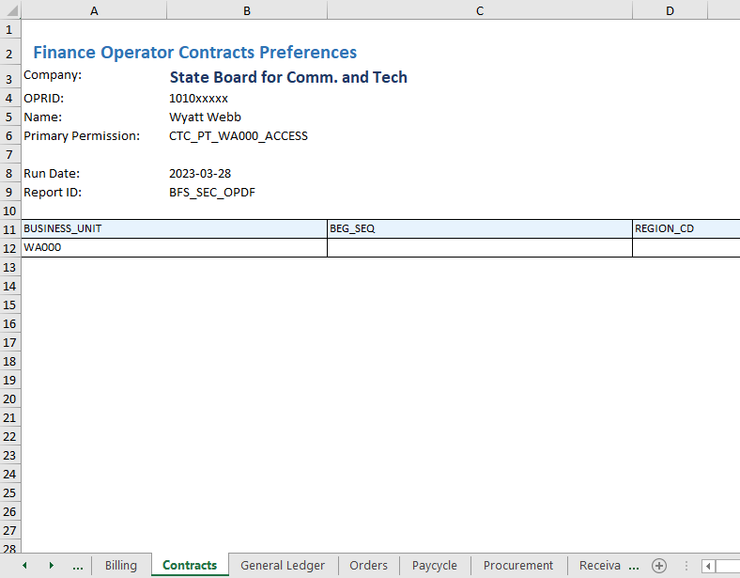
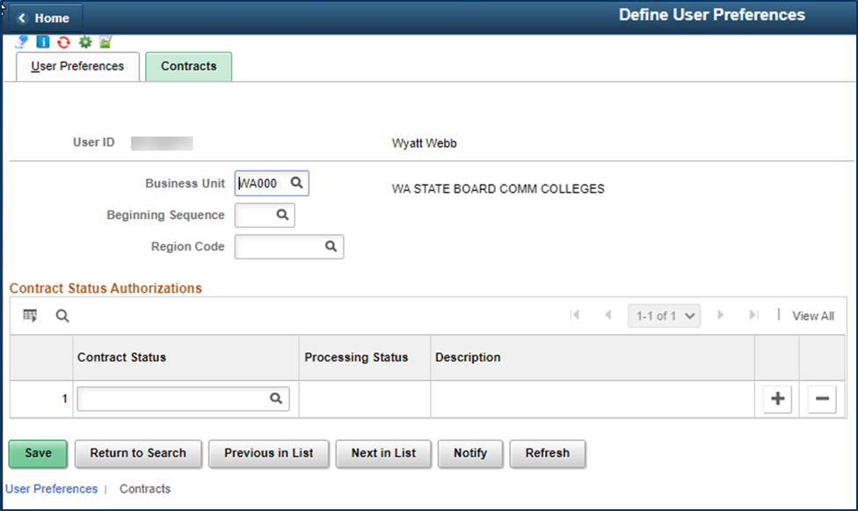
Bi Publisher report – bfs_sec_opdf
Contracts tab
Notes:
Clear Contracts fields if populated.

Slide 20
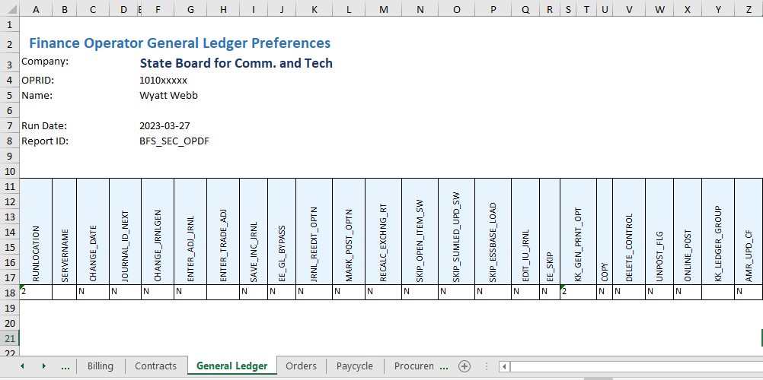
Bi Publisher report – bfs_sec_opdf
General Ledger tab

Slide 21
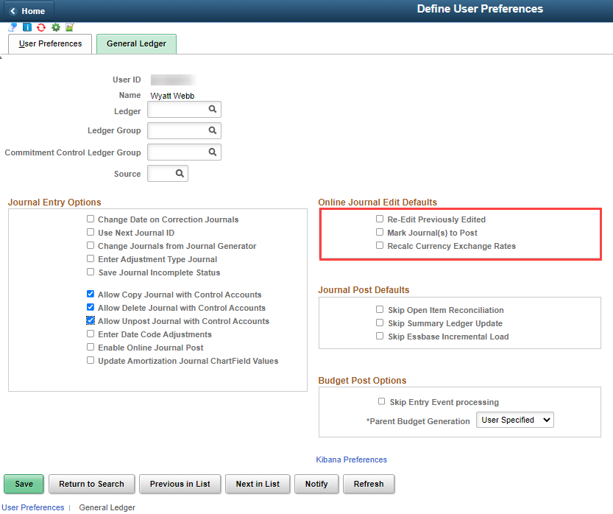
User preferences
General Ledger
Notes:
Clear the top part as needed, uncheck the options in Online Journal Edit Defaults section. “Mark journal to post” should never be checked.

Slide 22
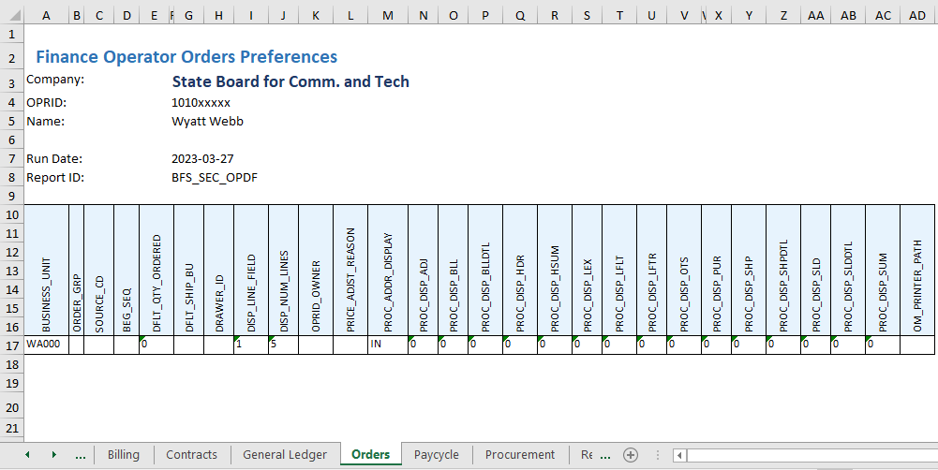
Bi Publisher report – bfs_sec_opdf
Orders tab
Notes:
Not in use

Slide 23
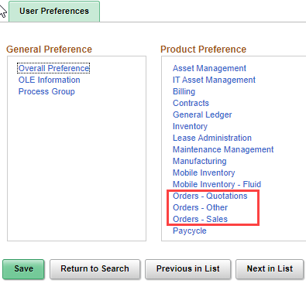
User preferences
Orders tabs
Notes:
The Orders tab are not usually populated.

Slide 24
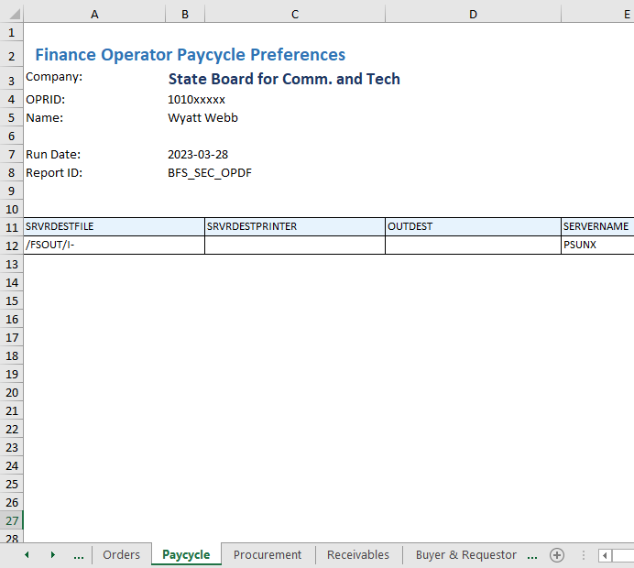
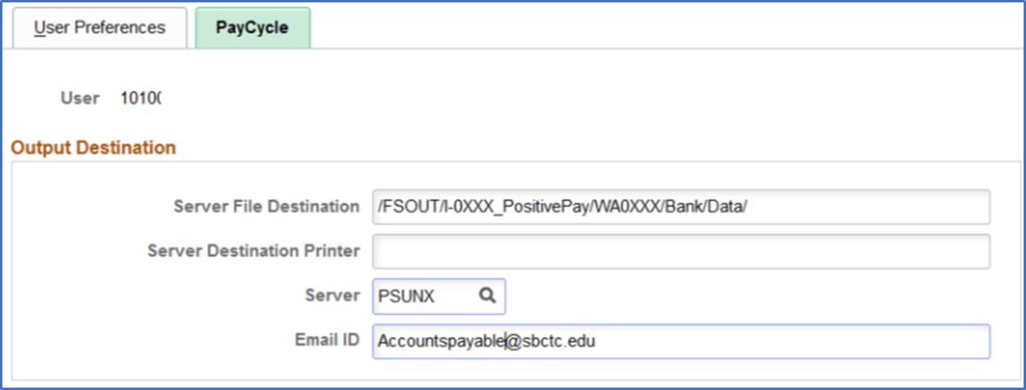
Bi Publisher report – bfs_sec_opdf
Paycycle tab
Notes:
Clear the fields if populated.

Slide 25
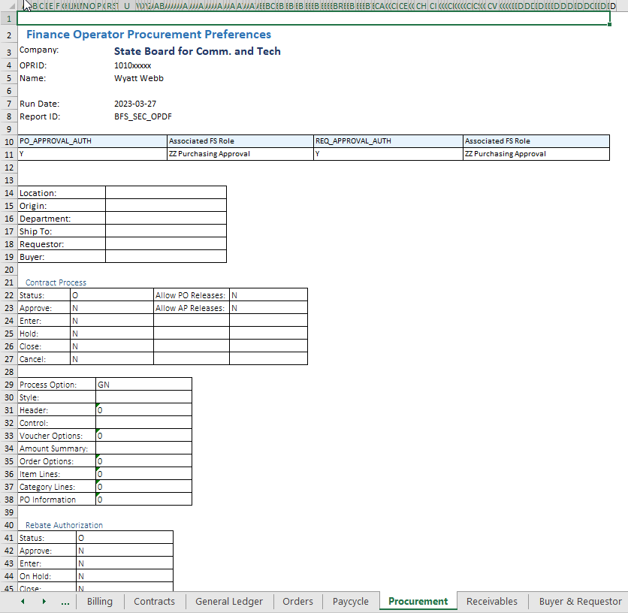
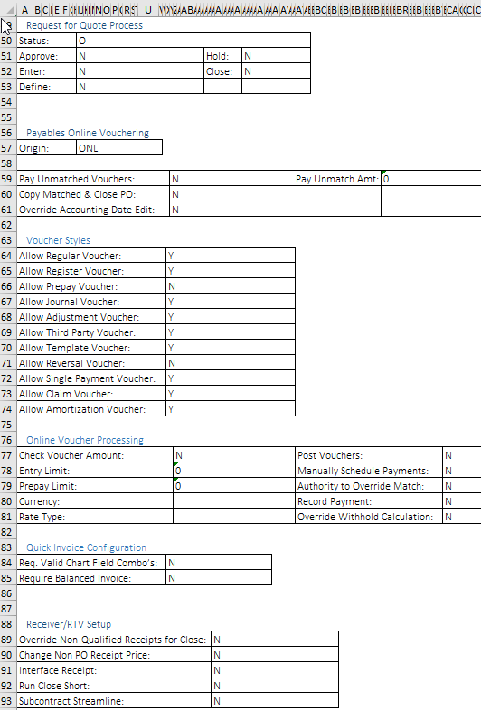
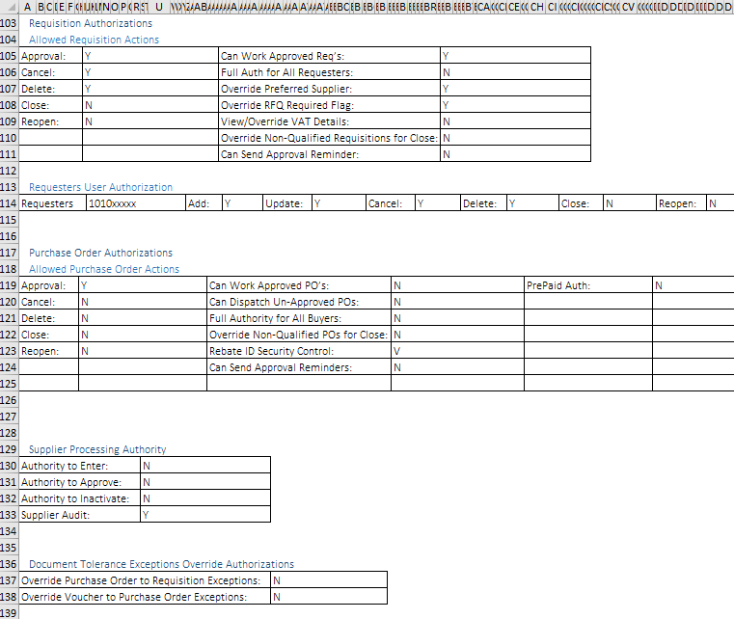
Bi Publisher report – bfs_sec_opdf
Procurement tab
Notes:
The Procurement tab of the reports shows all of the purchasing defaults.

Slide 26
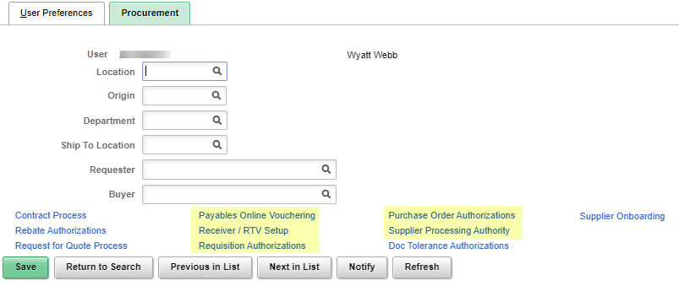
User preferences
Procurement
Note: Some areas are not usually configured, but can be checked.
Notes:
In User Preferences on the Procurement tab, the default settings can be cleared at the top of the page, then there are several hyperlinks to select.
I’ve highlighted the links that are a priority. Some areas are not usually configured for use do not have corresponding tabs in the BI publisher report, so I won’t go over those screens.

Slide 27
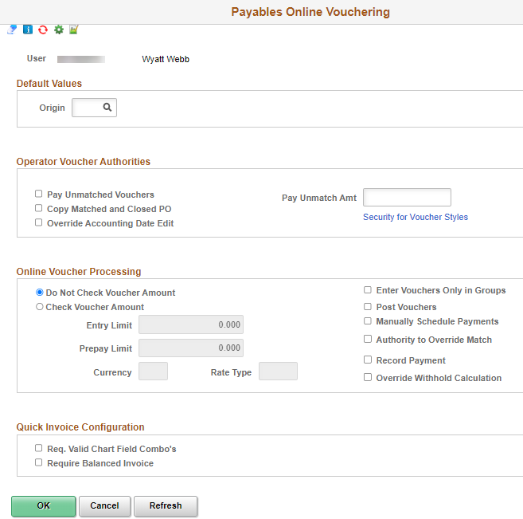
User preferences
Procurement > Payables Online Vouchering
Notes:
Clear the origin field and check boxes – especially the Post Vouchers box.

Slide 28
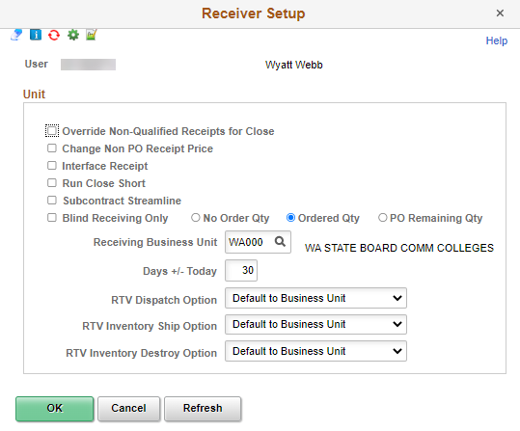
User preferences
Procurement > Receiver/RTV Setup
Notes:
Clear default business unit

Slide 29
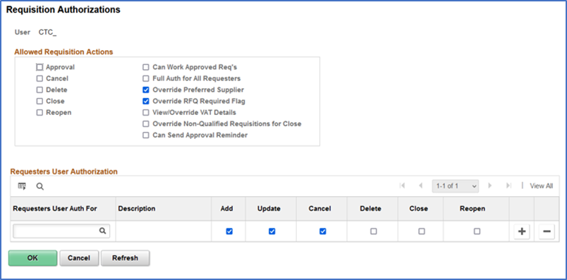
User preferences
Procurement > Requisition Authorizations
Notes:
The allowed requisition actions can be unchecked and the requesters user authorization section can be cleared.

Slide 30
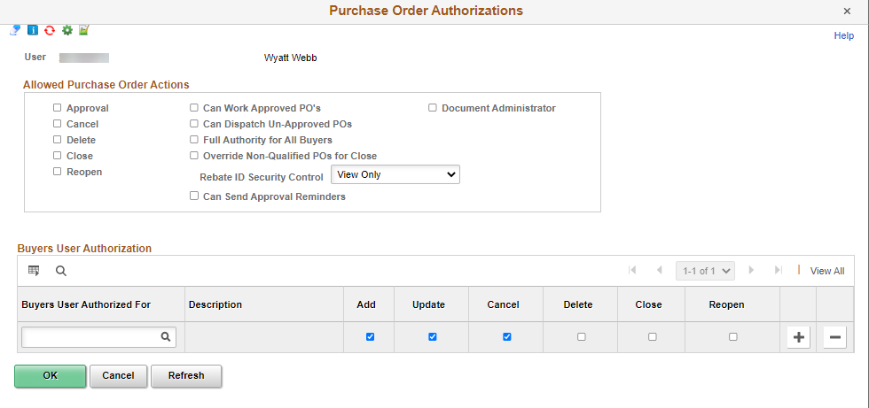
User preferences
Procurement > Purchase Order Authorizations
Notes:
Clear the allowed actions and the buyer user authorized for section. The Full Authority for All Buyers should not be checked.

Slide 31
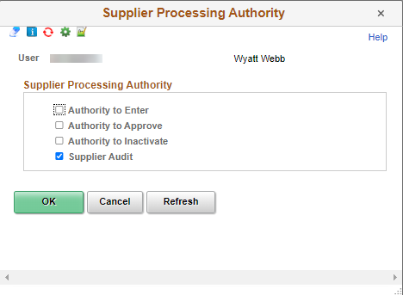
User preferences
Procurement - Supplier Processing Authority
Notes:
Uncheck the Authority to Enter setting.

Slide 32
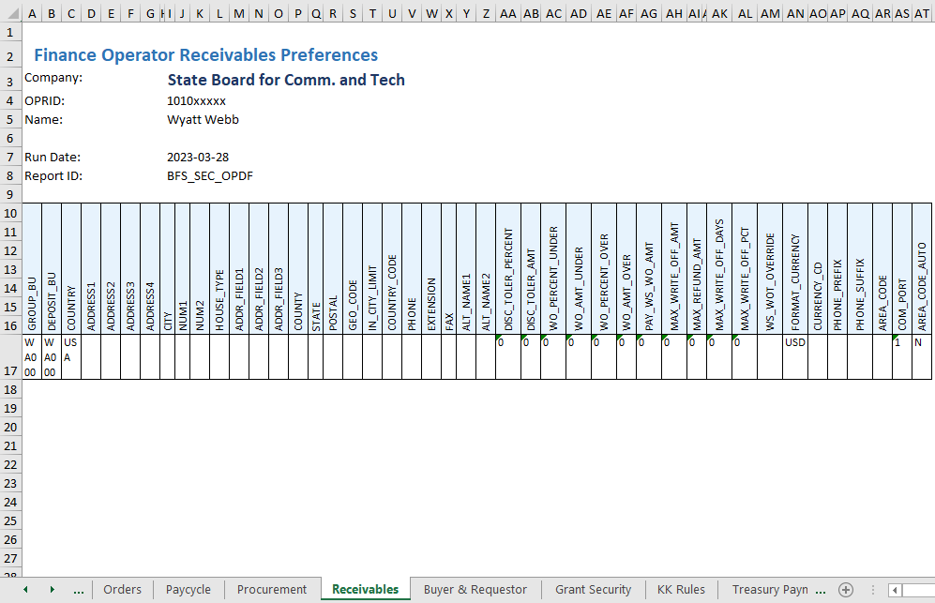
Bi Publisher report – bfs_sec_opdf
Receivables tab

Slide 33
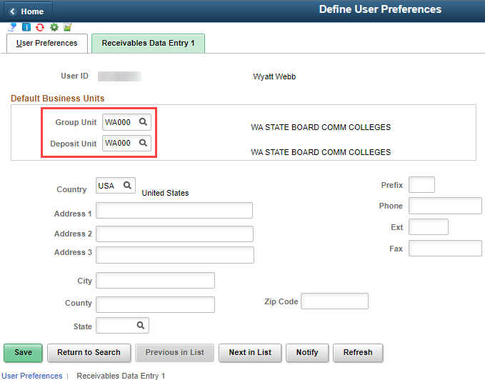
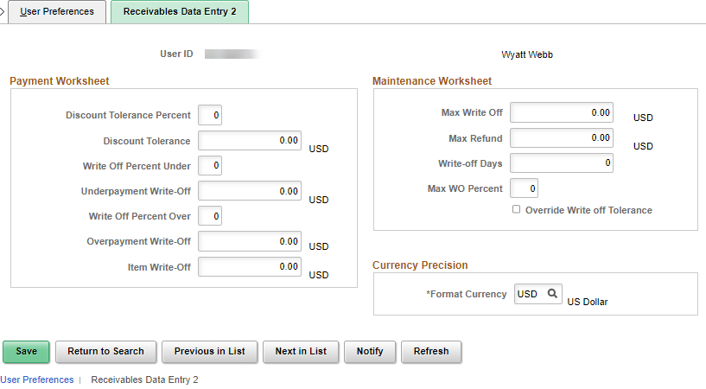
User preferences
User Preferences – Receivables Data Entry 1 & 2
Notes:
Clear configured fields as needed in the Receivables Data Entry 1 and 2 screens.

Slide 34
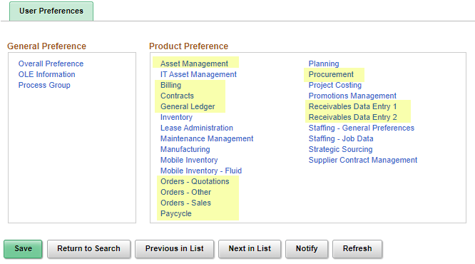
User preferences
There are other areas in the User Preferences menu that usually do not have configured values – however these can be optionally checked.
Notes:
While working through the tabs of the BI Publisher Reports, we’ve covered these highlighted items. The other settings can also be reviewed, but usually are not configured. This will complete review of the User Preferences settings.
Next, we continue to walk through the tabs of the BI publisher reports that pertain to module specific – or secondary security settings.

Slide 35
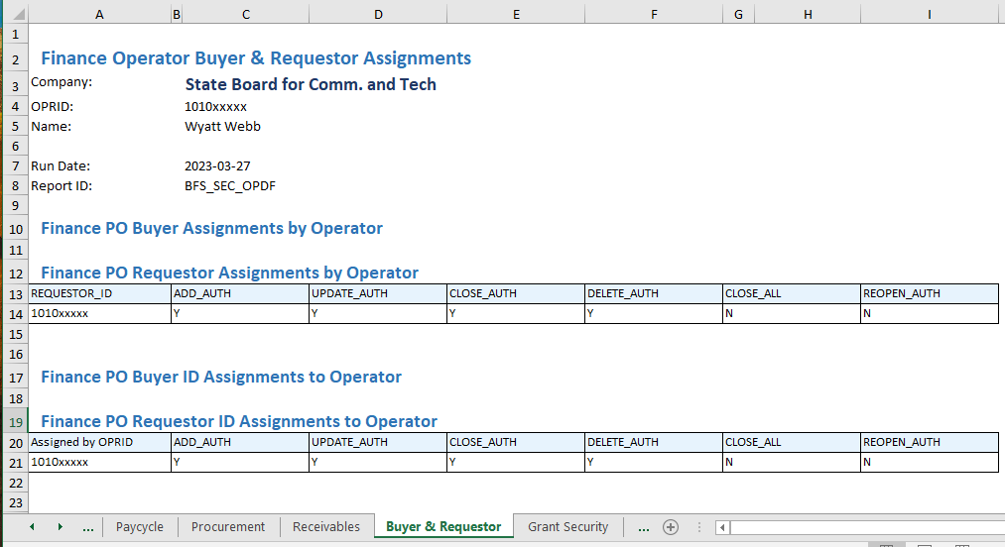
Bi Publisher report – bfs_sec_opdf
Buyer & Requestor tab

Slide 36
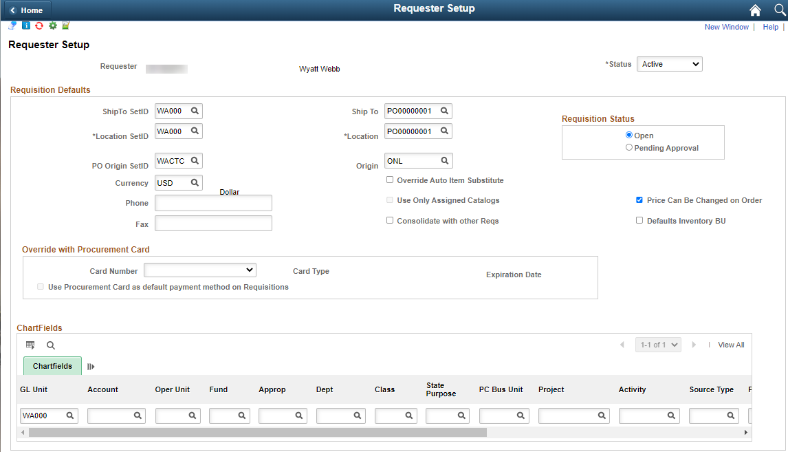
Purchasing
Requester Setup – clear defaults
Nav: Main Menu > Set Up Financials/Supply Chain > Product Related > Procurement Options > Purchasing > Requester Setup
Role needed: ZZ Purchasing Local Config or ZZ Setup Fin No Install - WA
Notes:
The Status can be changed to Inactive after all transactions for the user are completed.

Slide 37
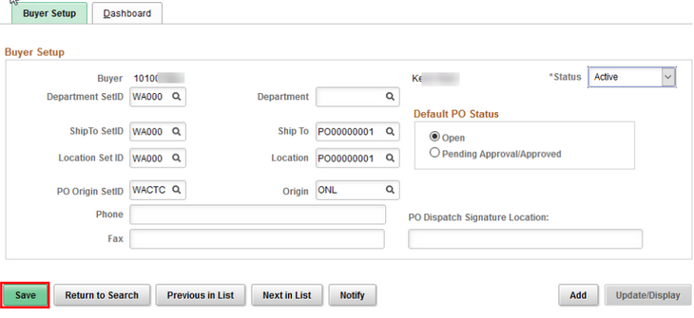
Purchasing
Buyer Setup – clear defaults
Nav: Main Menu > Set Up Financials/Supply Chain > Product Related > Procurement Options > Purchasing > Buyer Setup
Notes:
The status can be changed to Inactive after all transactions for the user are completed.

Slide 38
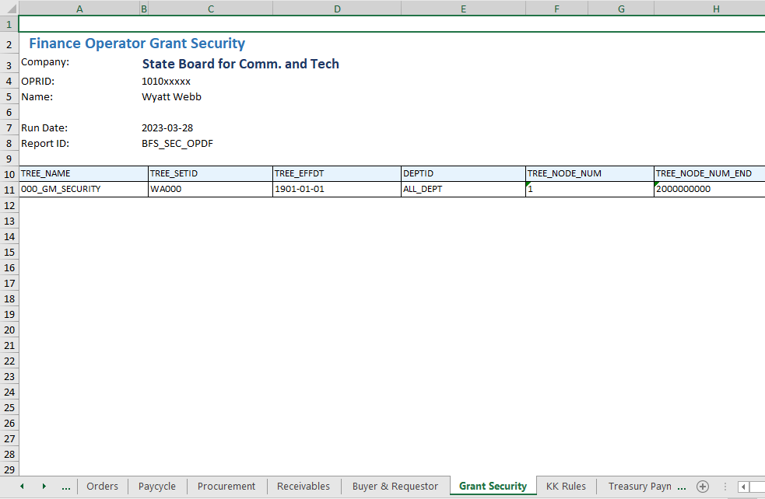
Bi Publisher report – bfs_sec_opdf
Grant Security tab

Slide 39
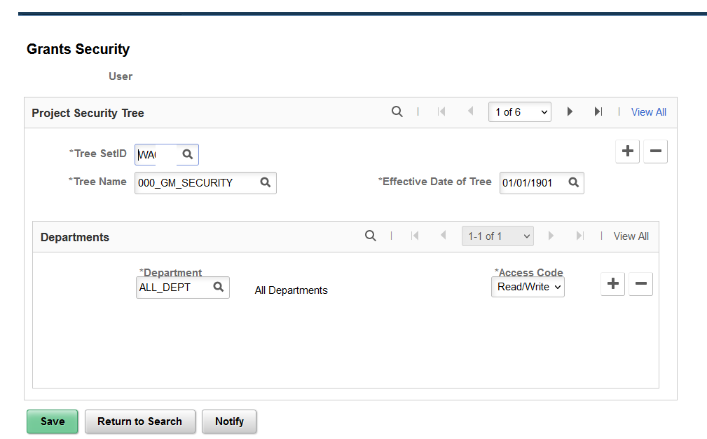
Grants Security
Nav: Main Menu > Setup Financials/Supply Chain> Security > Grants Security
PeopleSoft Grants supports user security, which enables you to limit access to specific grant proposals based on the user and department. The record can be removed by clicking on the minus sign.
Role needed: ZZ Setup Fin No Install _ WA or ZZ Local Security Admin
Notes:
You can create and save a proposal without this security but you won’t be able to see it after it has been created without this set up.

Slide 40
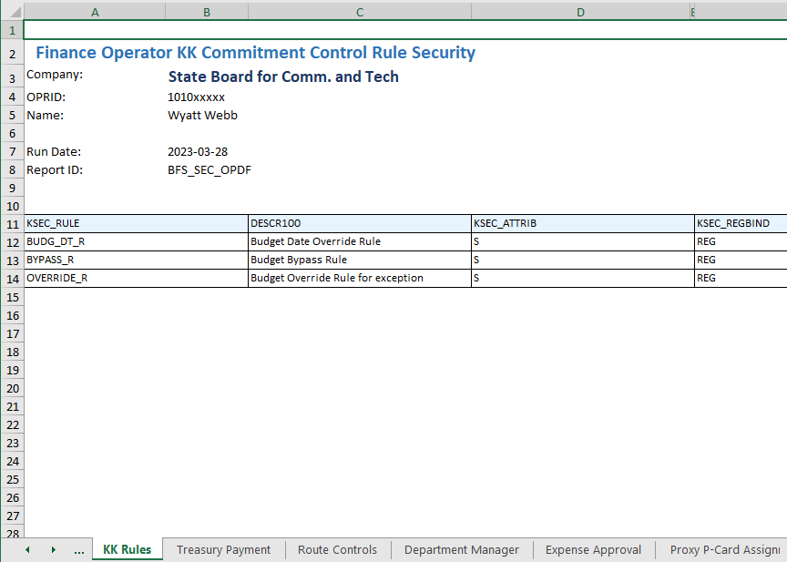
Bi Publisher report – bfs_sec_opdf
KK Rules tab

Slide 41
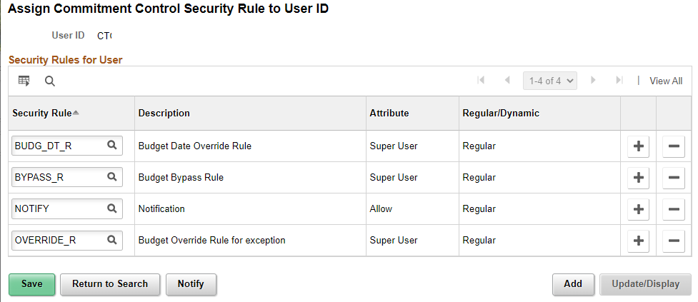
Commitment control rules
Nav: Main Menu > Commitment Control > Define Budget Security > Assign Rule to User ID
BUDG_DT_R: Allows Users to override the budget date on transactions that error due to the budget date on a transaction.
BYPASS_R: Allows a User to bypass budget checking entirely.(This function is reserved for occasions such as when a user needs to correct a suspense journal that was generated from within a source application like Purchasing and whose accounting entries have already been budget-checked.)
NOTIFY: Enables users to be notified by workflow when budget exceptions occur or when a specified percentage of the budget has been used.
OVERRIDE_R: Allows users to override budget checking exceptions for a new transaction or pass a transaction that has failed budget checking.
Clear the rules by clicking on the minus sign for each record.
Role needed: ZZ CC Local Config
Notes:
The commitment control rules provide various elevated securities and it’s important to remove them for the user.

Slide 42
Commitment control
Nav: Main Menu > Commitment Control > Define Budget Security > Request Build
Once the rules are removed for a User, the Request Build process needs to run for the changes to take effect. The process runs nightly, but can also be ran immediately as needed.

Slide 43
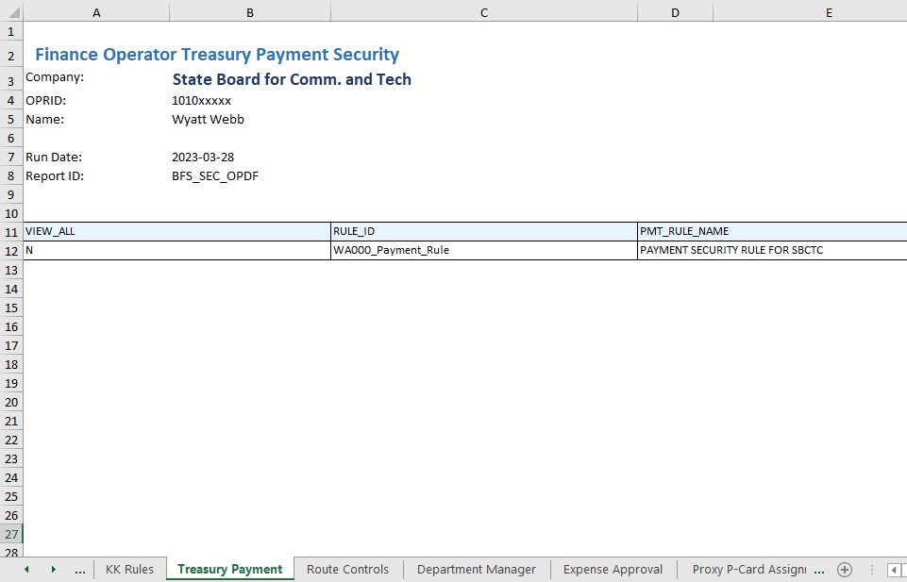
Bi Publisher report – bfs_sec_opdf
Treasury Payment tab

Slide 44
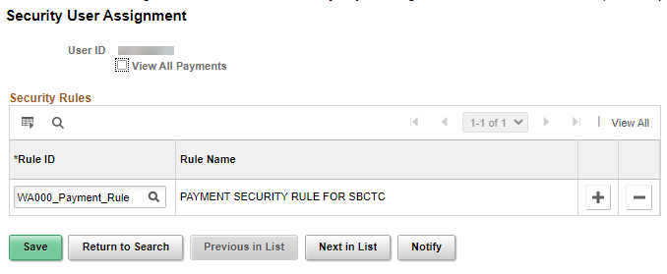
Treasury – Financial Gateway
Payment Security Rules
Nav: Main menu > Financial Gateway > Security > Security User Assignment
The payment security rule functionality limits the list of prompt values for secured fields to only those that meet the defined security rule criteria. The prompt values are determined based on the rule definitions that are assigned to a given user or role and include bank codes and bank accounts for each institution.
Rules should be removed (click on the minus sign) and the option to View all Payments should not be checked.
Role needed: ZZ Treasury Local Config

Slide 45
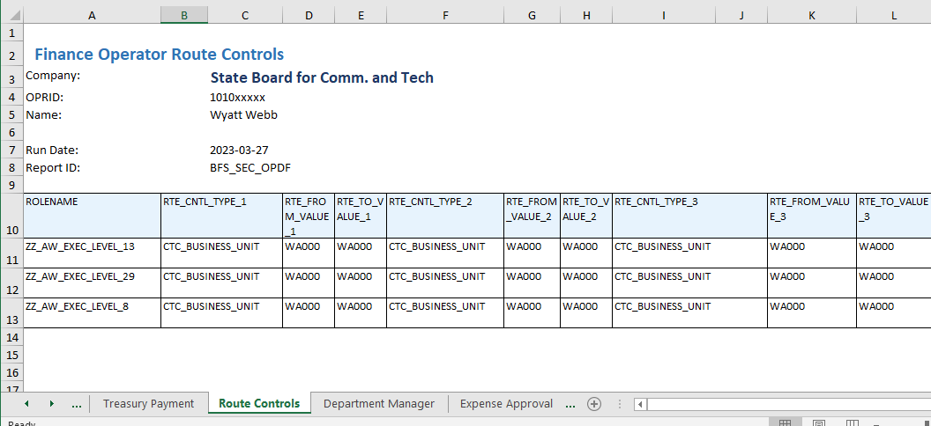
Bi Publisher report – bfs_sec_opdf
Route Controls tab
Notes:
Removing AWE related roles will also clear the route controls configured for them. If roles aren’t removed when a user transfers the incorrect route control may remain on the role resulting in workflow routing errors.

Slide 46
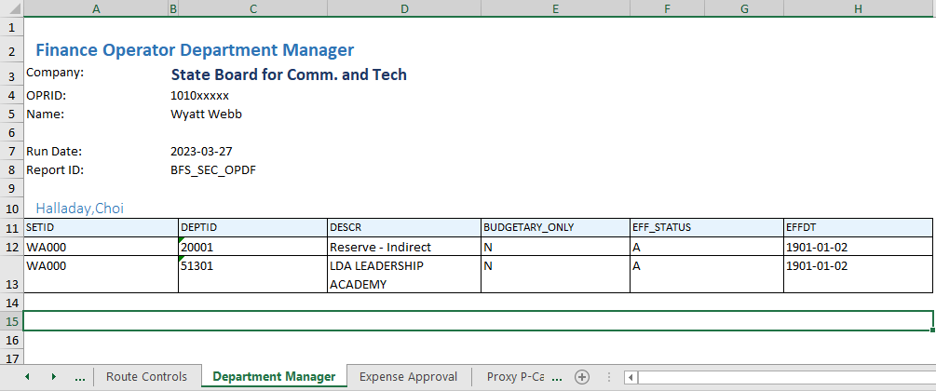
Bi Publisher report – bfs_sec_opdf
Department Manager tab

Slide 47
WORKFLOW – DEPARTMENT APPROVERS
Nav: Main menu > Setup Financials/Supply Chain > Common Definitions > Design Chartfields > Define Values > Chartfield Values. Click on the “Department” link.
Search using the college’s Business Unit, then a list of all departments will display. Click View All. Sort by clicking on the column header “Manager Name”.
Identify the Dept ID, add a record (plus sign), and update the Manager ID. The Effective Date will be the current date, however it can be back-dated as long as you don’t hit Save first. If help with editing a saved/existing record is needed, please submit a service ticket.
Role needed: ZZ GL Local Configuration role
Role needed: ZZ GL Local Configuration or ZZ Setup Fin No Install – WA
Notes:
Input ticket if not changing the effective date and correct history is needed.

Slide 48
Bi Publisher report – bfs_sec_opdf
Expense Approval tab

Slide 49
Travel & Expenses
Nav: Main menu > Setup Financials/Supply Chain > Product Related > Expenses > Management > Approval Setup > Approver Assignment
The Approver Assignment tables are where approvers for Expenses are defined by approval level. Search by BU, then by Approver Profile type. When the table opens, locate the approver assignment and update the User ID.
Role needed: ZZ Expenses Local Config or ZZ Setup Fin No Install - WA
Notes:
Update with the replacement Approver.

Slide 50
Bi Publisher report – bfs_sec_opdf
Proxy P-Card Assignments tab

Slide 51
Purchasing
Nav: Main menu > Purchasing > Procurement Cards > Definitions > Cardholder Profile
In the Cardholder Profile, on the Card Data tab > Credit Card tab, a pcard can be inactivated. The pcard can then be reassigned to another user. See QRG 9.2 Inactivating and Reassigning a Procurement Card for more details.
Click on the Card Data tab > Add’l Information tab to locate the Proxies link to manage assigned proxies.
Role needed: ZZ Purchasing Local Config
Notes:
Reassign cards as needed, inactivate on term’d user profile

Slide 52
Purchasing
Nav: Main Menu > Purchasing > Procurement Cards > Security > Assign Proxies
If the user is a proxy for many Pcards, the Assign Proxies page can be used to remove or reassign multiple proxy assignments at the same time.
Role needed: ZZ Purchasing Local Config

Slide 53
Bi Publisher report – bfs_sec_opdf
Travel Expense Assignments tab

Slide 54
Travel & Expenses
Nav: Main menu >Travel And Expenses > Manage Expenses Security > Authorize Expense Users
If others are allowed to create travel documents on behalf of the traveler, then the Authorized Expense User is set up by the Travel Administrator or employee. The authorized user record should be removed (minus sign).
Role needed: ZZ Expenses User Admin

Slide 55
Bi Publisher report – bfs_sec_opdf
Workflow Approvers tab
Notes:
This information is also on the “Route Controls” tab of the report.

Slide 56
Bi Publisher report – bfs_sec_opdf
FIN Roles Assigned tab
Notes:
The final tab on the BI Publisher reports shows a list of all roles assigned to the user.

Slide 57
Terminated User Access
Offboarding tasks should be handled on demand as users terminate, but at least weekly.
Review terminated users and confirm with HR that they are in fact terminated before proceeding.
Local Security Admin and Finance admin have separate offboarding responsibilities. Working together will ensure that user security updates are correct.
QRG 9.2 Offboarding - Security Procedure lists offboarding steps and has been updated to note the corresponding tabs on the BI publisher report.
Notes:
Audits

Slide 58
QUESTIONS?

