Slide 1
Peoplesoft Security
Security for Business Analysts
Bill Ramirez
October 12, 2022

Slide 2
Agenda
Why is Security Important
Accessing ctcLink
Understanding Security Access
Delegation and Vacation
Working with Security Admins
Requesting Changes to Security
Helpful Queries
Useful Links
Q&A

Slide 3
Why is security important
Protects PII(Personally Identifiable Information) – See slide 55
Masking in CS
Roles with PII data broken out
Never Share PII data, especially in Email – train your end users
Reduces Risk in the Organization
Flexible security roles can prevent SOD(Segregation of Duties) Issues
Allows for User audits to see who has access to each area in system
SSO(Single Sign on) and upcoming MFA (Multi Factor Authentication) protects user access and makes it harder for cybercriminals to gain access to your account.
Provides Access for Job Duties
Security Roles and Secondary Security Privileges allow you to access the necessary areas in ctcLink to perform your job functions.
Roles are built based on Business Process and Not Job Titles to be more flexible.

Slide 4
Accessing ctclink
Student User Profiles are created in CS (Campus Solutions) when a person is matriculated
Employee User Profiles are created in HCM (Human Capital Management) when a employee’s job record is entered for Hire.
These new User profiles are created by copying a Template User profile with base roles.
If a person was an employee first, then becomes a Student, the Student role (ZZ SS Student) will need to be assigned manually in CS, as the user id would already exist and can’t copy from the template.

Slide 5
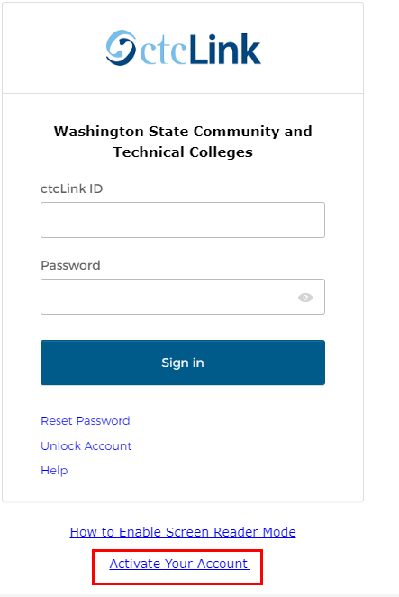
Accessing ctcLink
First Time User Process
Navigate to the ctcLink Sign In page (https://myaccount.ctclink.us/ or https://gateway.ctclink.us) or the Activate Your Account page from your college’s website. (If you select Activate Your Account, start with Step 3 below).
Select the Activate Your Account link toward the bottom of the page.

Slide 6
Accessing ctcLink
First Time User Process Cont’d
Select the OK button when the redirection pop up message displays.
The Activate Your Account page displays.
Enter your First Name and Last Name. Please make sure you have entered your name correctly. (If your legal name is a single name—such as Pran, Madonna or Nani - you must enter a hyphen (-) in the First Name field and enter your single name in the Last Name field.)
Enter your Date of Birth (MM/DD/YYYY) as shown or use the calendar icon.
From the drop-down menu select:
ctcLink ID (new) if you are a new student or employee.
Enter your ctcLink ID.
Select the Submit button.

Slide 7
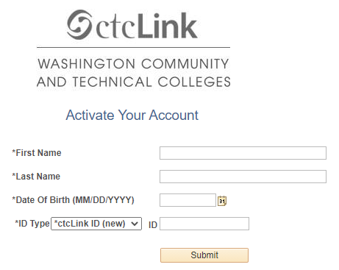
Accessing ctcLink
First Time User Process Cont’d

Slide 8
Accessing ctcLink
First Time User Process Cont’d
The Set Your Password page displays. This page is used to set up your password and your account recovery options. Enter your preferred Email address.
Select the Security Question from the drop-down menu.
Provide the Answer to your security question. (No Spaces in Answer)
Additional Account Recovery options located in the Account Recovery box.
Enter Phone Number for text (SMS) option.
Enter Phone Number for voice option.

Slide 9
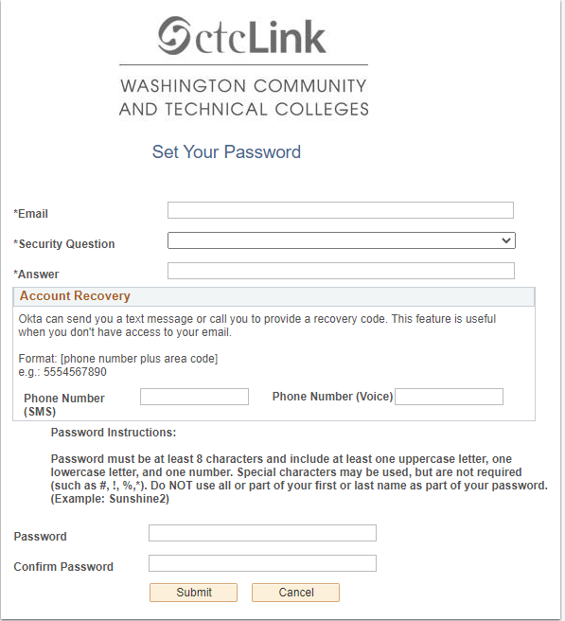
Accessing ctcLink
First Time User Process Cont’d
Create your Password. (At least 8 characters, including at least one uppercase letter, one lowercase letter and one number. Special characters may be used but are not required. Do NOT use all or part of your first or last name as part of your password.)
Confirm your Password.
Select the Submit button.

Slide 10
Accessing ctcLink
First Time User Process Cont’d
A pop-up message displays.
Make note of your ctcLink ID.
Select the OK button.
The Account Activation confirmation message displays.
Close the browser tab.

Slide 11
Understanding security access
Gaining Access within ctcLink to perform your job duties may require more than security roles to be assign to your user profile
Secondary Security also allows certain actions to be performed by business analysts and are necessary to complete job functions
Access to Query Viewer and Query records may be needed for certain job functions
Time and Labor admins may require different primary/row permission lists than other users to be able to approve time.

Slide 12
Understanding security access
Tips to figure out what security roles you need to do your job function
Query: QXX_SEC_ROLE_NAVIGATION_ACCESS – identify role needed by menu path or search by role to view menu path access
This query exists in all three pillars QFS, QHC, QCS prefix
User can enter part of the page name and put Z% in role and run the query to identify navigations and roles needed for that navigation
See Next Slide for example

Slide 13
Understanding security access
As an analyst, if you need Voucher Regular Entry, and the ability to Enter Vouchers, use this query, scroll to Regular Entry and use the columns to right to determine which role is needed and give that to the local security admin. Only roles that have ZZ Local Security Admin in the last column can be given to college users. The Page Access Description will let you know if the role can add transactions, update existing transactions or if it is display only.

Slide 14
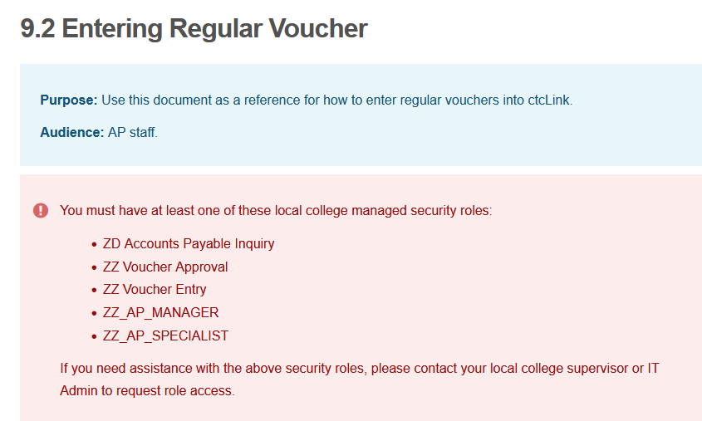
Understanding security access
Tips to figure out what security roles you need to do your job function
QRG’s now have role names associated
Example Entering a Regular Voucher
https://ctclinkreferencecenter.ctclink.us/m/72571/l/1064740-9-2-entering-regular-voucher

Slide 15
Understanding security access
Tips to figure out what security roles you need to do your job function
Query Access requires certain roles
ZD_DS_QUERY_VIEWER provides access to Query Viewer
Users need other roles that contain the record access to See and Run Queries.
Run Query QFS(CS, HC)_DS_QUERY_RECORD_USER_RPT– view which roles are needed for a query (only one role per record is required) This query is intended to be used to troubleshoot query access issues by Users. This query prompts for theQuery Name and Username and will identify each record in the query and flag whether or not the User has access to each record and which Role(s) provides access.
Example, user John Smith needs access to query QFS_AP_EX_PYMNT_ADVICE; what query roles do they need?

Slide 16
Understanding security access
Tips to figure out what security roles you need to do your job function
Workflow Approval Roles in Finance
Transactions that use workflow are routed for approval to users with roles that have route controls associated with them.
The workflow roles are globally shared shell roles that do not provide page access.
The roles names usually start with “ZZ_AW” (though there are some older roles starting with “CTC” or “CTC_AW” that will be phased out).
Note: Workflow roles that are assigned without a route control will not route properly.

Slide 17
Understanding security access
Tips to figure out what security roles you need to do your job function
Workflow Approval Roles in Finance
The QFS_SEC_EOAW_USER_LIST query provides AWE Process setup details.
The “User List” column has the approval role which requires a route control
Query: QFS_SEC_USER_ROLES_NOT_LOCAL to view non-local grant “CTC” roles.
Distributed User Profile>User ID Queries tab>User ID’s Roles query

Slide 18
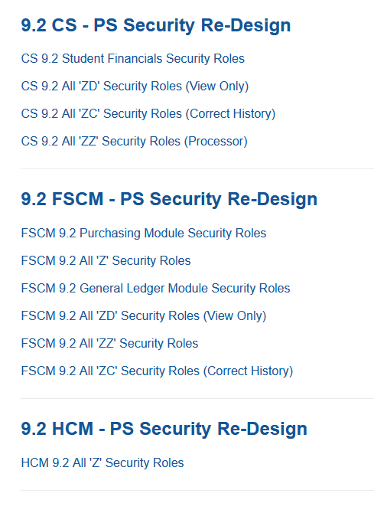
Understanding security access
https://ctclinkreferencecenter.ctclink.us/m/56084

Slide 19
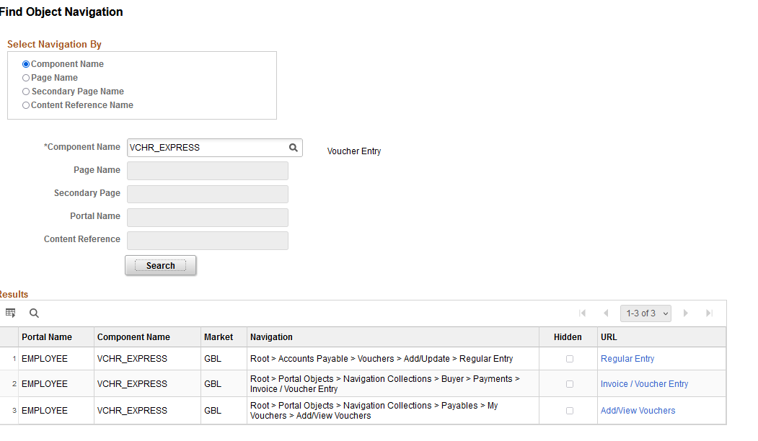
Understanding security access
Tips to figure out what security roles you need to do your job function
For Security Administrators on Campus: If a User gives you a Page Name/Component Name Use the following to track the navigation, then use the query to find the role.
Enterprise Components > Find Object Navigation

Slide 20
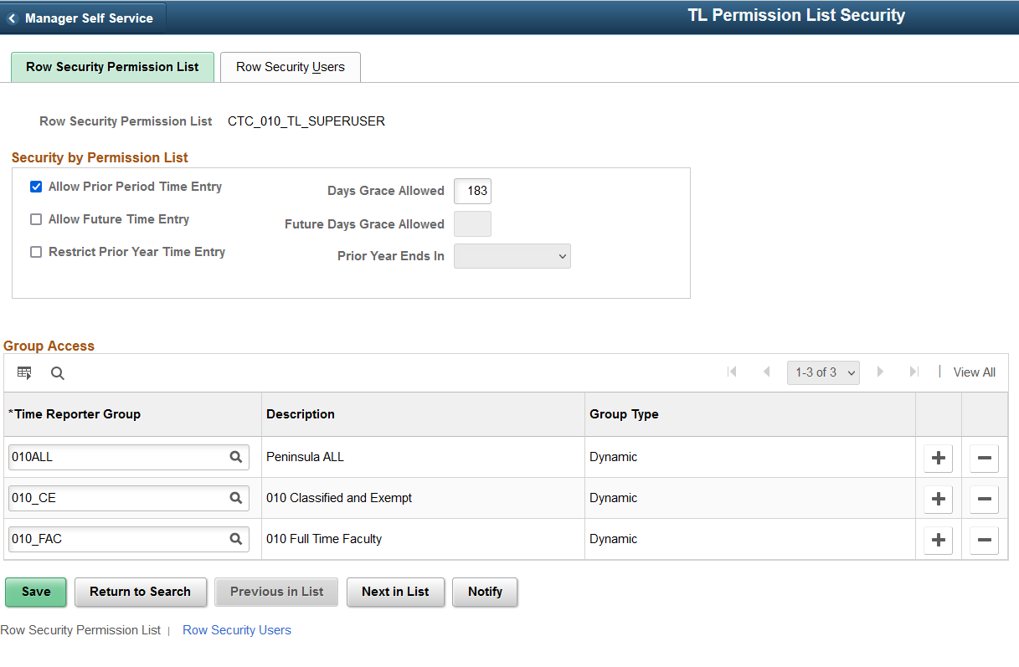
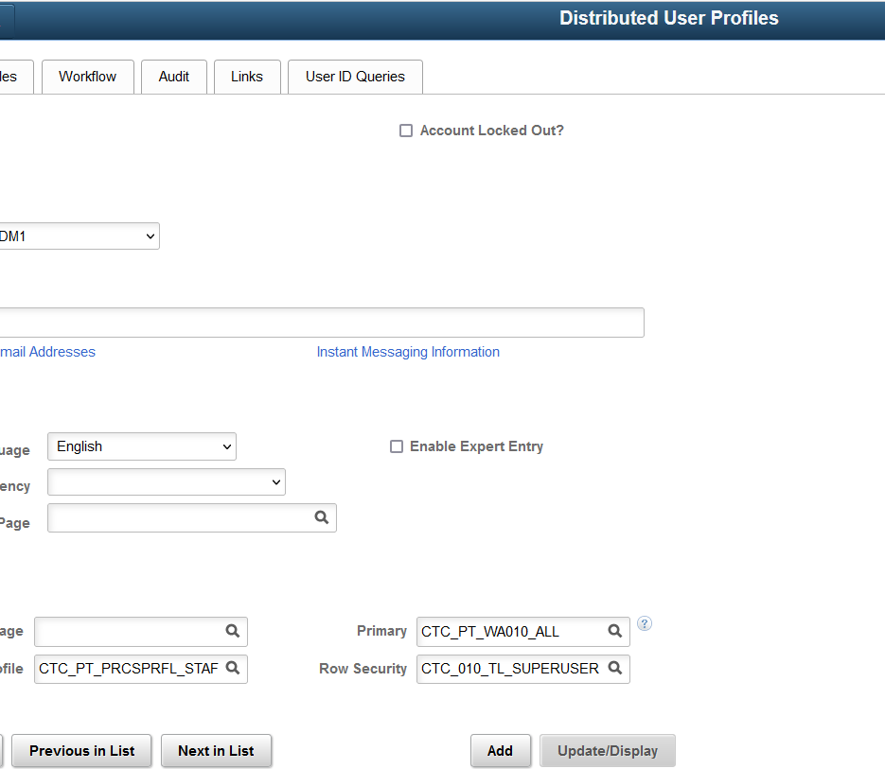
Understanding security access
Secondary Security is often the hardest part of security
HCM is really limited on Secondary Security
Time and Labor Administrators need a special row level permission list to See time reporter groups to approve time.
There is a unique one per college

Slide 21
Understanding security access
Finance has Many Areas of Secondary Security
https://www.sbctc.edu/colleges-staff/it-support/security/documentation.aspx Click on Documentation and Training, Security Training Presentations, Finance and there is a presentation from 8/16/2022 with the recording.

Slide 22
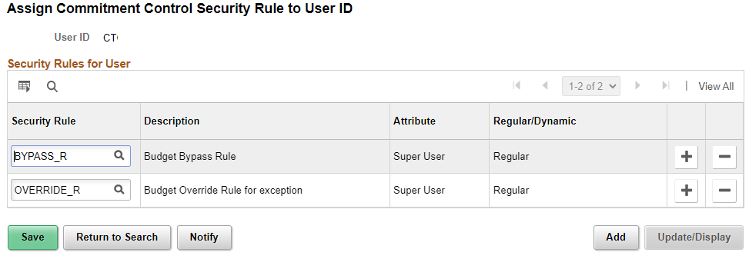
Understanding security access
Commitment Control Rules
Commitment Control, Define Budget Security, Assign Rule to User ID
Role needed: ZZ CC Local Config

Slide 23
Understanding security access
Once the rules are added for a User, the Request Build process has to be run for the changes to take effect.
Commitment Control, Define Budget Security, Request Build

Slide 24
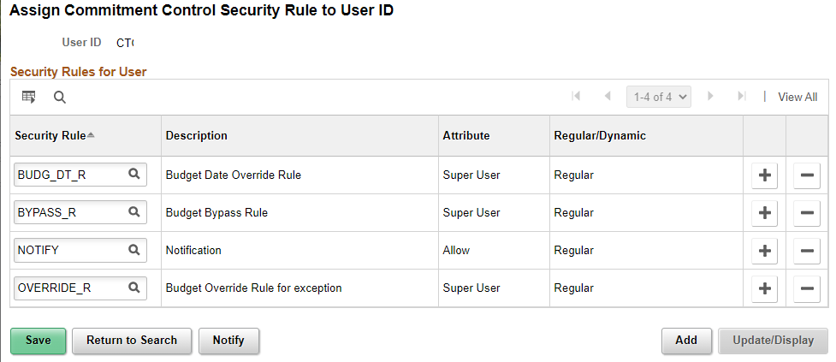
Understanding security access
BUDG_DT_R: Allows Users to override the budget date on transactions that error due to the budget date on a transaction.
BYPASS_R: Allows a User to bypass budget checking entirely.(This function is reserved for occasions such as when a user needs to correct a suspense journal that was generated from within a source application like Purchasing and whose accounting entries have already been budget-checked.)
NOTIFY: Enables users to be notified by workflow when budget exceptions occur or when a specified percentage of the budget has been used.
OVERRIDE_R: Allows users to override budget checking exceptions for a new transaction or pass a transaction that has failed budget checking.

Slide 25
Understanding security access
Treasury- Financial Gateway: Finance –Payment Security Rules
The payment security functionality limits the list of prompt values for secured fields to only those that meet the defined security-rule criteria. The prompt values are determined based on the rule definitions that are assigned to a given user or role. For SBCTC it is the valid bank codes and bank accounts for each institution.
Financial Gateway > Security > Security User Assignment
Users with the Security User Assignment will be able to process the ACH/EFT payment dispatch, review payments, review payment files, override payment status, and override payment file status.
Role needed: ZZ Treasury Local Config

Slide 26
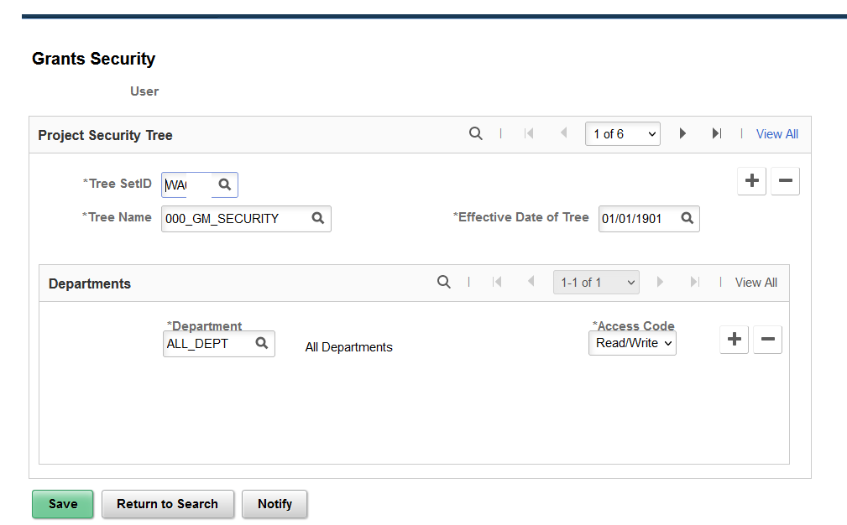
Understanding security access
GRANTS SECURITY: PeopleSoft Grants supports user security, which enables you to limit access to specific PeopleSoft Grants proposals based on the user and department. This is based off a Tree (for SBCTC it is ALL Depts currently)
Setup Financials Supply Chain> Security > Grants Security > Grants Operator Security
Role needed: ZZ Local Security Admin
QRG: FSCM 9.2 - Grants Security
Notes:
You can create and save a proposal without this security but you won’t be able to see it after it has been created without this set up.

Slide 27
Understanding security access
PURCHASING: Requester/Buyer Setup
The Requester and/or Buyer setup must be completed prior to configuring the User Preferences for Requisition & PO Authorizations.
Setup Financials Supply Chain, Product Related, Procurement Options, Purchasing, Buyer Setup
Setup Financials Supply Chain, Product Related, Procurement Options, Purchasing, Requester Setup
Role needed: ZZ Local Security Admin or ZZ Purchasing Local Config role for both

Slide 28
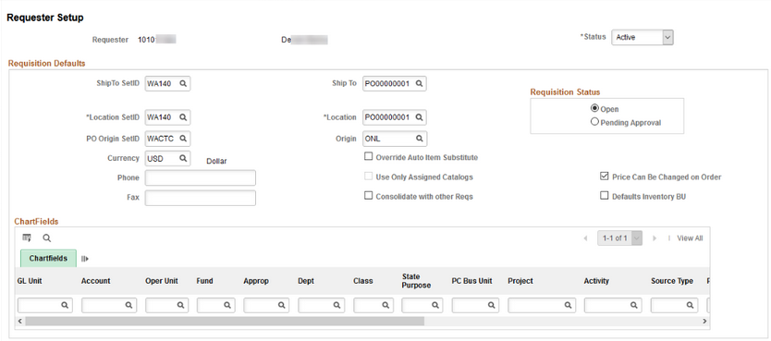
Understanding security access
Requester Setup
The Department/Ship To/Location SetID is the college Business Unit
PO Origin SetID will always be WACTC
Origin should be ONL
Requisition Status: Open will save the requisition and not submit to workflow without an extra step; Pending Approval/Approved will submit the Requisition into workflow upon save if workflow is used;
The Ship To and Location can be set here if they have defaults that they use all the time; Sometimes if they request for more than one dept, its best to leave that blank here.

Slide 29
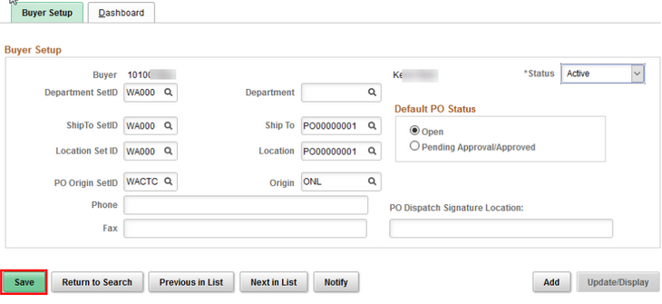
Understanding security access
Buyer Setup
The Department/Ship To/Location SetID is the college Business Unit
PO Origin SetID will always be WACTC
Origin should be ONL
Default PO Status: Open will save the purchase order and not submit to workflow without an extra step; Pending Approval/Approved will submit the purchase order into workflow upon save.
The Department/Ship To and Location can be set here if they have defaults that they use all the time; Sometimes if they purchase for more than one dept, its best to leave that blank here.

Slide 30
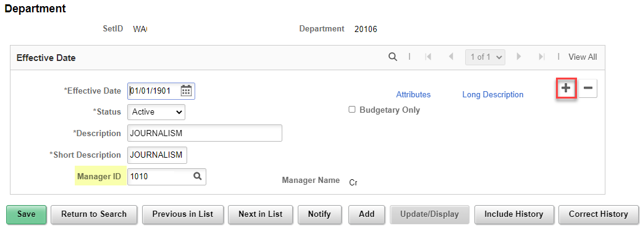
Understanding security access
Maintaining Department Approvers for Workflow
Setup Financials Supply Chain, Common Definitions, Design Chartfields, Define Values, Chartfield Values, select Department. SetID is the college Business Unit
Add a new record to update the Manager ID. The Effective Date can be back-dated as long as you don’t hit Save first. If help with editing an saved/existing record is needed, please submit a service ticket.
Role needed: ZZ GL Local Configuration role
Notes:
Input ticket if not changing the effective date and correct history is needed.

Slide 31
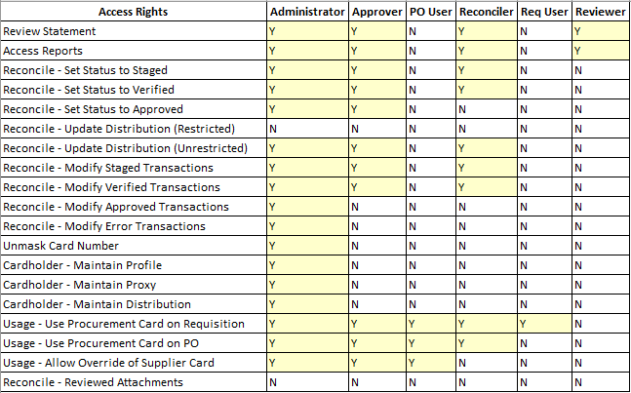
Understanding security access
Procurement Card Security
With increased role security, you can control the level of information that is accessed by users, manage the assignments of different procurement cards, and setup proxies and default accounting distributions
CC_ADMINISTRATOR
CC_APPROVER
CC_RECONCILER
CC_REVIEWER
CC_USER_PO
CC_USER_REQ

Slide 32
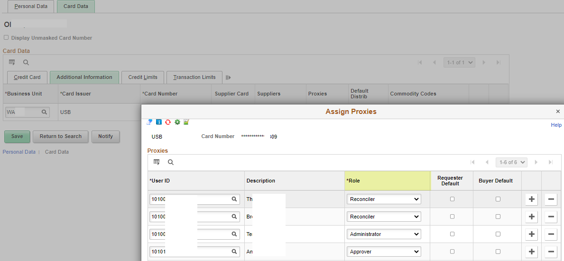
Understanding security access
In the Cardholder Profile, on the Card Data tab, when pcards are added, the proxies can be assigned to the individual pcards.
Purchasing, Procurement Cards, Definitions, Cardholder Profile
Role needed: ZZ Purchasing Local Config

Slide 33
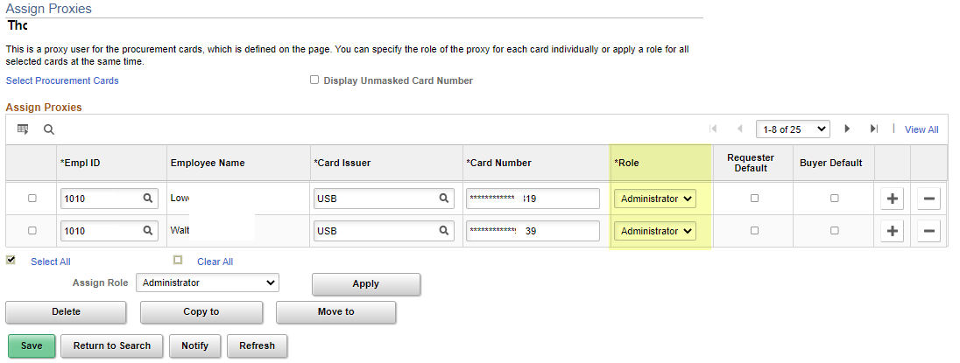
Understanding security access
The Assign Proxies page can be used to assign a proxy to multiple pcards at the same time. Purchasing, Procurement Cards, Security, Assign Proxies
The Requester Default box will only appear if the proxy user has also been setup as a requester using the requester setup page
The Buyer Default will only appear if the proxy has been setup as a buyer on the buyer default page
If the Requester or Buyer Default is checked, it will set the pcard as the default payment method for the user when new requisitions or purchase orders are created. It will also update the pcard as the default payment method in the user’s Requester or Buyer Setup screen.
Role needed: ZZ Purchasing Local Config

Slide 34
Understanding security access
TRAVEL AND EXPENSES: Traveler Profile – a sync occurs at 8pm daily to load new employees and job record changes.
Travel And Expenses, Manage Employee Information, Update Profile
The Organizational Data tab – is manually updated with a default chartfield string
Transportation Information tab – a Transportation ID must be created for all new employees.
Role needed: ZZ Expenses User Admin role
This could be handled by the Expenses Administrator on your campus
QRG’s: 9.2 Editing Employee Organizational Data
9.2 Maintaining Employee Transportation Data
9.2 Recommendations for On and Off Boarding Employees for Expenses

Slide 35
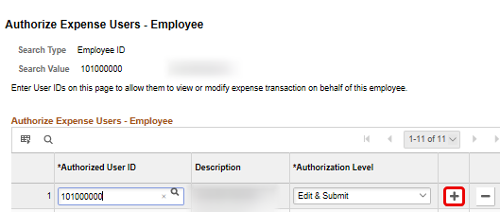
Understanding security access
Travel And Expenses, Manage Expenses Security, Authorize Expense Users
If the campus business process includes having others create travel documents on behalf of the traveler, then the Authorized Expense User must be set up by the Travel Administrator or employee. (This process could be completed by the employee using their Employee Self Service user preferences - Delegate Entry Authority.)
Role needed: ZZ Expenses User Admin
This could be handled by the Expenses Administrator on your campus.
QRG: 9.2 Add Authorized Expense Users

Slide 36
Understanding security access
Setup Financials Supply Chain, Product Related, Expenses, Management, Approval Setup, Approver Assignments
This is where approvers for Expenses are defined by approval level.
Maintain approvers in the Expenses Approver Assignment tables in order to keep the T&E AWE functioning correctly.
Role needed: ZZ Expenses Local Config
This could be handled by the Expenses Administrator on your campus.
QRG: 9.2 Maintain Approver Assignments

Slide 37
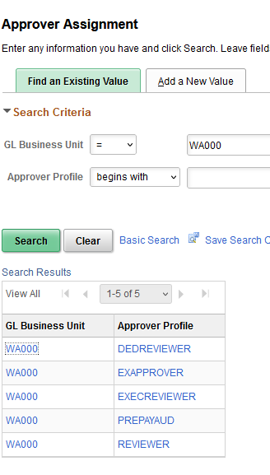
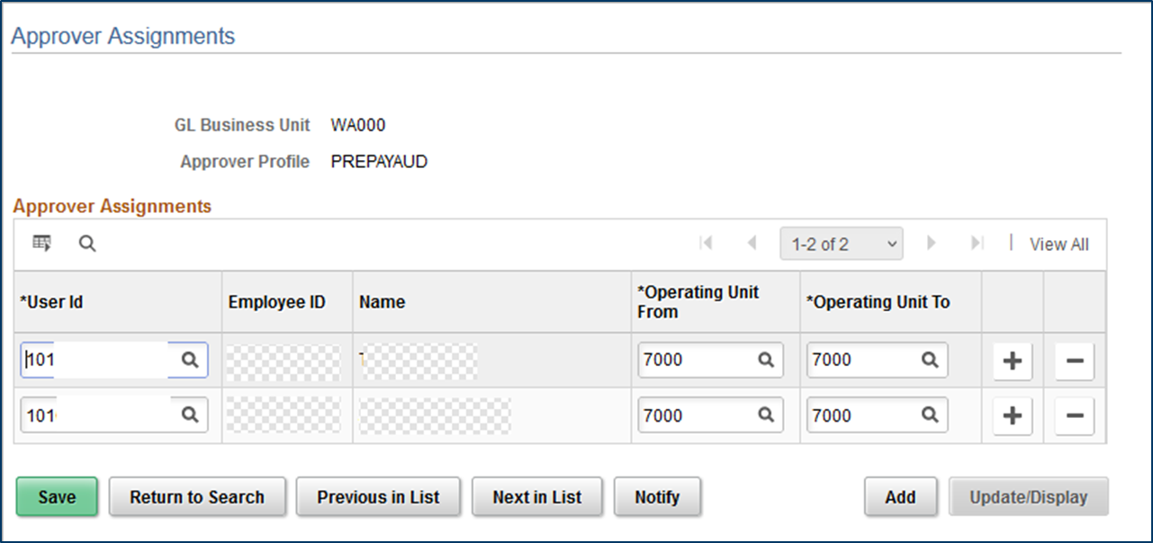
Understanding security access

Slide 38
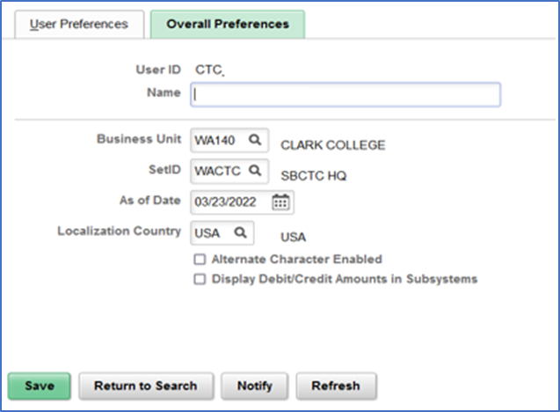
Understanding security access
User Preferences – Overall Preferences Tab
Setup Financials Supply Chain, Common Definition, User Preferences, Define User Preferences.
The Business Unit should be set to the college Business Unit and the SetID will always be WACTC
Notes:
In addition to the security roles that are assigned to users working in the Finance pillar, there are also User Preferences settings that have specific controls as to what the user can do on certain pages. In addition, user’s defaults can be set up in the User Preferences screens, saving the user from having to lookup information such as their Business Unit or Ship To location.
On the Overall Preferences tab, you can define the business unit and SetID that defaults for the user.
Before establishing the overall preferences, the primary and row permissions for the user’s institution should be assigned in their finance Security User Profile.
As of Date should reflect the start date of the user.
Localization Country defaults to USA.
Alternate Character Enabled checkbox will activate alternate description buttons or links which appear to the right of fields on many pages. Hover text.
Display Debit/Credit Amounts in Subsystems checkbox will enable displaying of debit and credit amounts of the business unit on journal entry or inquiry pages.

Slide 39
Understanding security access
User Preferences – Overall Preferences Tab
https://ctclinkreferencecenter.ctclink.us/m/56084/l/1176969-fscm-security-user-preference-definition-in-finance
https://ctclinkreferencecenter.ctclink.us/m/56084/l/1591955-9-2-finance-security-guide
https://ctclinkreferencecenter.ctclink.us/m/56084/l/1603308-9-2-fscm-security-process-groups
https://www.sbctc.edu/colleges-staff/it-support/security/documentation.aspx (Click on Documentation and Training, Security Training Presentations, Finance and there is a presentation from 8/16/2022 with the recording.)
Notes:
In addition to the security roles that are assigned to users working in the Finance pillar, there are also User Preferences settings that have specific controls as to what the user can do on certain pages. In addition, user’s defaults can be set up in the User Preferences screens, saving the user from having to lookup information such as their Business Unit or Ship To location.
On the Overall Preferences tab, you can define the business unit and SetID that defaults for the user.
Before establishing the overall preferences, the primary and row permissions for the user’s institution should be assigned in their finance Security User Profile.
As of Date should reflect the start date of the user.
Localization Country defaults to USA.
Alternate Character Enabled checkbox will activate alternate description buttons or links which appear to the right of fields on many pages. Hover text.
Display Debit/Credit Amounts in Subsystems checkbox will enable displaying of debit and credit amounts of the business unit on journal entry or inquiry pages.

Slide 40
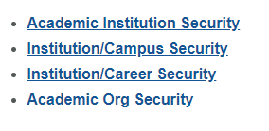
Understanding security access
SACR Security:
In ctcLink component security is used to restrict access to student data for specific User IDs by institution, campus, career, program, and plan.
SACR Security is a secondary type level of security
This security doesn’t necessarily grant page access
This security is more like what action you can take once you get to the page and what data you can see based on your institution
All administrative system users with 'Z' security roles in the Campus Solution pillar will require this basic SACR Security setup to define their institution, set their campus(es), careers (undergraduate/continuing education) and academic organizations they need access to in order for page/components in the CS to properly function
Notes:
In addition to the security roles that are assigned to users working in the Finance pillar, there are also User Preferences settings that have specific controls as to what the user can do on certain pages. In addition, user’s defaults can be set up in the User Preferences screens, saving the user from having to lookup information such as their Business Unit or Ship To location.
On the Overall Preferences tab, you can define the business unit and SetID that defaults for the user.
Before establishing the overall preferences, the primary and row permissions for the user’s institution should be assigned in their finance Security User Profile.
As of Date should reflect the start date of the user.
Localization Country defaults to USA.
Alternate Character Enabled checkbox will activate alternate description buttons or links which appear to the right of fields on many pages. Hover text.
Display Debit/Credit Amounts in Subsystems checkbox will enable displaying of debit and credit amounts of the business unit on journal entry or inquiry pages.

Slide 41
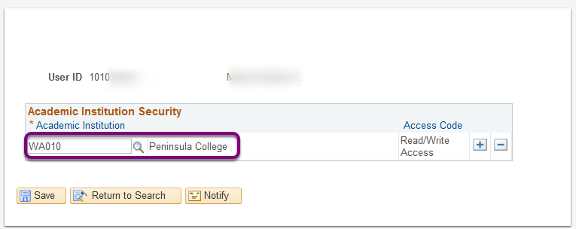
Understanding security access
Academic Institution
Ties User to one/more Institution
Limits the data they see to those Institutions

Slide 42
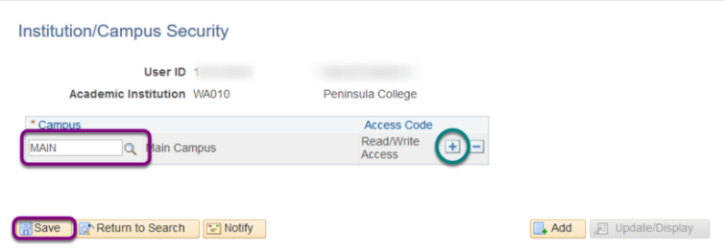
Understanding security access
Institution/Campus Security
Ties a User to an Institution and Campus(s)

Slide 43
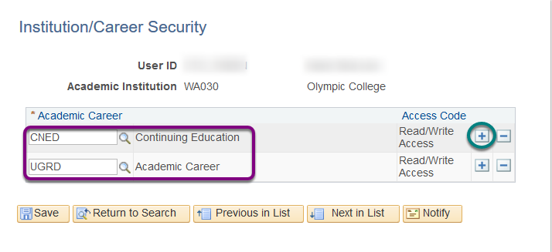
Understanding security access
Institution/Career Security
Institutions that never offered Continuing Ed will only see UGRD
If previously offered it, but now don’t, still configure it in case you need access to student transcript information

Slide 44
Understanding security access
Academic Organization Security
Grants access to academic organizations
The system automatically grants access to data in any academic organization that reports directly or indirectly to that academic organization unless you specifically restrict access to a specific organization
Uses Academic organization Security tree (hierarchies of organizational units at an institution)

Slide 45
Understanding security access
Many areas in SACR - See below reference center for full list
PeopleSoft Security | ctcLink Reference Center
Examples of Other areas –
Service Indicator Security
Student Groups
Academic Program
Test ID Security
Milestone Security
Enrollment Security
Student Financials
Program Action Security

Slide 46
Understanding security access
Access to a properly functioning Student Financials module is governed by 4 key SACR Security for Student Financials security controls:
Business Unit
Institution Set
Origin IDs
SetID
Warning: When a user is attempting to establish their User Defaults (Setup SACR > User Defaults) on the second tab, if the Business Unit and SetID are not set, the system will turn the SetID field red and will throw an error that the user has entered an invalid value. Local Security Administrators (LSA) must FIRST set themselves with these values before they can assign it to another user. LSAs cannot access another user's User Defaults page, only the user can update these values for themself.

Slide 47
Understanding security access
Set Up SACR > Security > Secure Student Financials > User ID > Business Unit
To explicitly restrict a cashier from processing transactions for a specific location, add the Cashier's Office and set the Access code to 'No Access.'

Slide 48
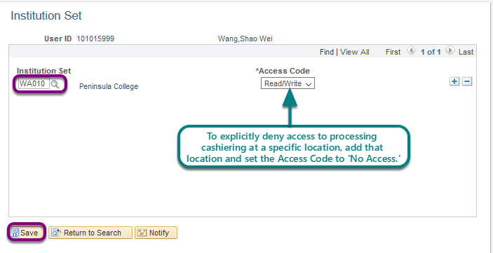
Understanding security access
Set Up SACR > Security > Secure Student Financials > User ID > Institution Set

Slide 49
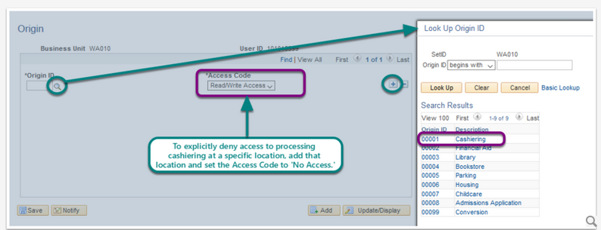
Understanding security access
Set Up SACR > Security > Secure Student Financials > User ID > Origin IDs
Valid Values for Origin IDs are displayed below. These values are global in the ctcLink system.
Origin ID | Description
00001 | Cashiering
00002 | Financial Aid
00003 | Library
00004 | Bookstore
00005 | Parking
00006 | Housing
00007 | Childcare
00008 | Admissions Application
00099 | Conversion

Slide 50
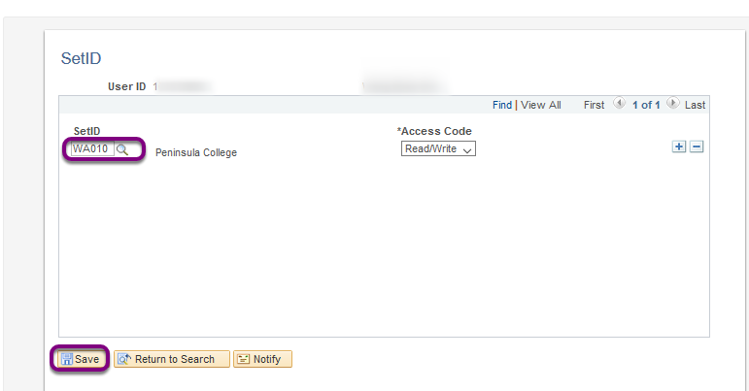
Understanding security access
Set Up SACR > Security > Secure Student Financials > User ID > SetID

Slide 51
Understanding security access
Additional Cashiering Security: In addition to SACR Security for Student Financials cashiers will need to be added as a New Cashier and Assigned to a Valid Tender.
https://ctclinkreferencecenter.ctclink.us/m/92555/l/949144-9-2-add-a-new-cashier-and-assign-to-a-valid-tender
Navigator > Setup SACR > Product Related > Student Financials > Cashiering > Valid Cashiers
Note: Before opening a cashiering office and register with a cashier, the cashier and tender keys must be added. You MUST have the role ZZ SACR SF Cashiering Config assigned in the CS Pillar to access the Valid Cashiers page.
NavBar > Navigator > Setup SACR > Product Related > Student Financials > Cashiering > Tender Keys
Note: You MUST have the role ZZ SF Head Cashier assigned in the CS Pillar to access the Tender Keys page.
NavBar > Navigator > Student Financials > Cashiering > Cash Management > Open Offices
Note: You MUST have the role ZZ SF Head Cashier assigned in the CS Pillar to access the Open Offices page. Also, here is QRG for Opening a Cashier's Office

Slide 52
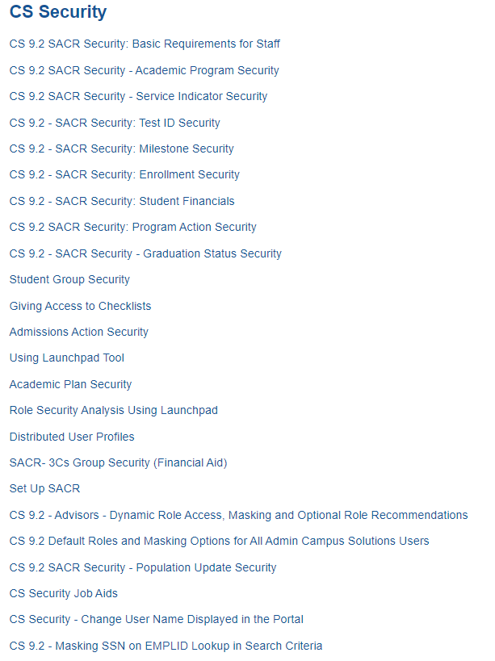
Understanding security access
SACR information:
https://ctclinkreferencecenter.ctclink.us/m/56084

Slide 53
Understanding security access
MASKING:
https://www.sbctc.edu/colleges-staff/it-support/security/documentation.aspx (Under Documentation &Training, Security Training Presentations, Campus Solutions 4/27/22 powerpoint and under All Pillars, Masking UAT overview Presentation.)

Slide 54
Understanding security access
Masking as Delivered by Oracle traditionally is controlled by the Primary permission list of the user.
CTC_PT_MASK_NONE
CTC_PT_MASK_ALL
CTC_PT_MASK_PARTIAL
CTC_PT_MASK_SSN
This delivered method only masks social security number and date of birth, and doesn’t consider other level 4 data elements.
This method also only works on the search look up pages, not on the main pages themselves.
Once the user is drilled down to the main page, oracle doesn’t mask the SSN/DOB unless the user has read only access via a security role to enforce masking.
This can be an interruption to daily business processes as some users need to update the data, but not be able to see the SSN.

Slide 55
Understanding security access
The out-of-box delivered masking solution alone is not adequate. Oracle delivered a new tool for masking that will allow us to not only mask SSN/DOB on the lookup pages, but it also will allow masking for ALL data 4 level elements on the drill down pages themselves, no matter what type of role the user has.
Users will then be able to have update roles to change data if they need to, and have the SSN/DOB masking in effect as well as the other elements. This will significantly enhance the protection of PII data and not interrupt business processes. Level 4 elements:
Social Security Number
Date of Birth
Bank Account
Drivers License
Visa Work Permit Number
Net Pay
Garnishments
Accommodations
Disability
Password
Credit Card Number
Sexual Orientation
Gender Identity
Immunization Information

Slide 56
Delegation and Vacation
For users with approval authorities that will be going on vacation or extended leave and need other employees to initiate and approve their transactions, Delegation is the tool for this in HCM/ FS.
https://ctclinkreferencecenter.ctclink.us/m/79748/l/1265034-9-2-creating-and-accepting-absence-mgmt-and-t-l-delegation-using-fluid-tile
https://ctclinkreferencecenter.ctclink.us/m/79738/l/1314338-9-2-fin-create-delegation-request
There are other QRG’s in ctclinkreferencecenter.ctcLink.us

Slide 57
Working with security admins
Provide as Much information as possible
Navigation to Access Needed
Functional description of Business Process
Screen Shots of Errors
Employee ID of users with Issues
If it is a random issue, try to provide timings if available
Remember least access needed to do a job is critical; do not give more security than needed, it is an audit issue.

Slide 58
Requesting changes to security
There are times where roles may have too much access/not enough access, or are mislabeled, etc.
SBCTC has a process for New Role Requests or Role Modification Requests
Submit a service desk ticket to the Security Team by pillar
SBCTC will review the request and log it in our change tracking system
Gain Functional approval, Production Support Group approval, and then it goes through development and testing cycles.

Slide 59
Helpful queries
https://www.sbctc.edu/resources/documents/colleges-staff/data-services/peoplesoft-ctclink/report-catalog.pdf
There are queries listed by pillar here with descriptions

Slide 60
Useful links
https://www.sbctc.edu/colleges-staff/it-support/erp-support/submit-ticket.aspx (How to get ctcLink Support)
https://www.sbctc.edu/colleges-staff/it-support/security/default.aspx (ctcLink Security)
https://www.sbctc.edu/colleges-staff/it-support/erp-support/ctclink-training/default.aspx (ctcLink Training)
https://ctclinkreferencecenter.ctclink.us/ (ctcLink Reference Center)

Slide 61
Questions and feedback
Questions?
Feedback?
Any Parking Lot issues
THANK YOU FOR ATTENDING

