Slide 1
Shared User Account
Shelia Sloan
April 19, 2022

Slide 2

Agenda
Purpose of Shared account
Process for Requesting shared account
Auditing
Q&A

Slide 3
Purpose of shared user account
Allows Colleges to schedule processes to run at predefined times.
Allows for notifications to be sent to group email addresses for monitoring purposes.
Ensures more than one individual can resolve issues if the process fails, if someone happens to be out of office.

Slide 4
Process for Requesting shared user account
Submit a ticket to SBCTC.
List Detail business requirements for the use of the shared account.
List name of Security Administrator that will be responsible for the shared account and the process.
List email address that should be used for notification purposes.
Submit process by which you will monitor the account and how often you will be changing password

Slide 5
Process for Requesting shared user account
List access requirements, processes that will be run, recurrence information, SACR needed and any other useful details.
SBCTC will then create the user id and assign roles/Sacr.
This allows us to maintain a standard naming convention.

Slide 6
Auditing
  Colleges should document their internal process for audit purposes.
    Who the security admin is that will be responsible for the account (as far as sharing password information with others)
    Monitoring procedures/Access recertifications/error handling
  SBCTC will be also conducting biannual recertifications on these accounts, and auditing role assignments. Only SBCTC should be adding/removing roles from these accounts.

Slide 7
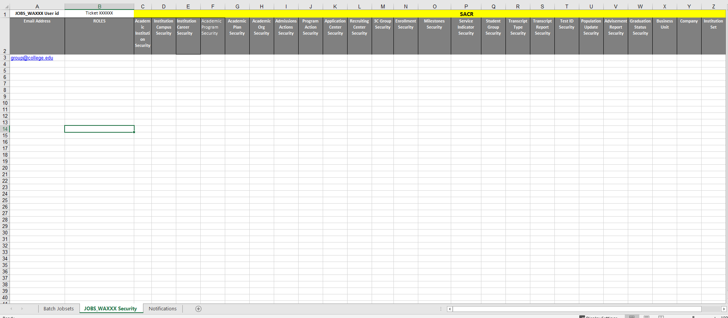
Access

Slide 8
Questions and feedback
Questions?
Feedback?
Any Parking Lot issues
THANK YOU FOR ATTENDING

