Slide 1

Internal cash
- reconciliation tips
Jackie Thoms
PeopleSoft Business Analyst – SF/Finance
May 9, 2024

Slide 2

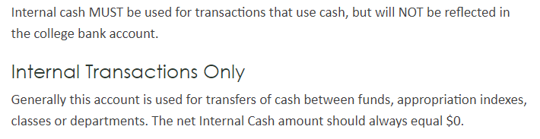
What is internal cash?
  Per the CLAM Manual:
  https://www.sbctc.edu/colleges-staff/programs-services/accounting-business/clam/accounting-for-cash-and-equivalents/internal-cash

Slide 3
Where is internal cash used?
    When moving items like expenses and revenues from one chart string to another
    In Student Finance with the following item types:
      Financial Aid (9*) – Second Journal Sets
      Departmental Payments (75*) – Second Journal Sets

Slide 4
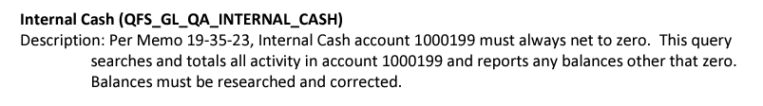
How do tell if internal cash is out of balance?
  https://www.sbctc.edu/resources/documents/colleges-staff/programs-services/accounting/smarter-query-descriptions-instructions-updated-6-7-23.pdf

Slide 5
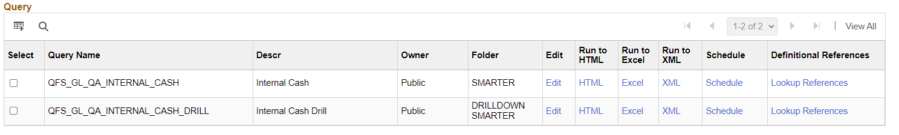
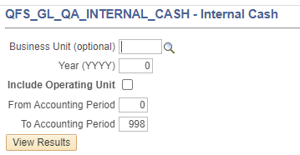
SMARTER Query to monitor 1000199
Notes:
You can run this for the whole year or for single months by entering data in the accounting period fields.

Slide 6
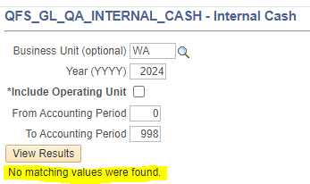
Query results:
In Balance:

Slide 7
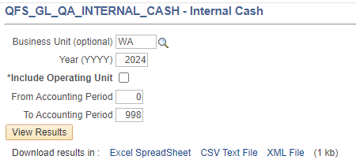
Query results:
Out of Balance:

Slide 8
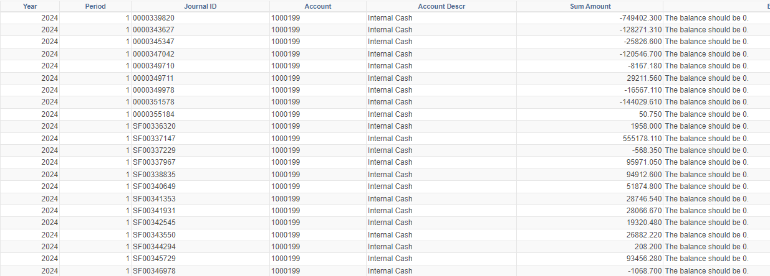
Drill down option:
Notes:
This will give you all of the journals that make up the out of balance amount.

Slide 9
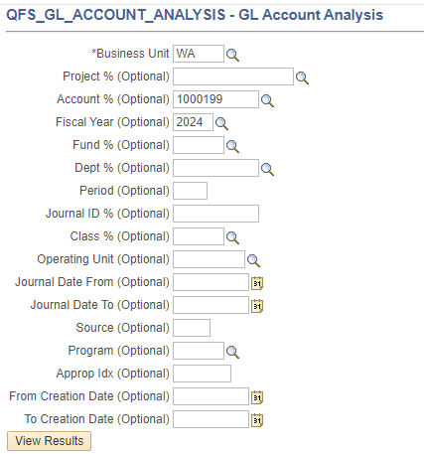
Option 2
– QFS_GL_ACCOUNT_ANALYSIS

Slide 10

Review all 1000199 data

Slide 11

I’ve identified Out-of-balance amounts.
Now what?
Notes:
Once I know I have an out of balance between SF and SJS, I start researching to find out what item types caused the issue.
SF query – E214

Slide 12
Ways 1000199 can get out of balance:
Manual journals with only one 1000199 leg
32* and 62* - Third Party Payments
38* and 68* - Payment Plans
FARC/FARP – 496100000000 and 709610000000
Conversion item types (e.g. Conv: FA Refund, Conv: FA Adjust)
Missing or incorrect chart strings from SF item types
Missing or incorrect chart stings from SJS item types
Notes:
Items types that are designed to work together – 2rd party, payment plans, FARC/ FARP
Item types that are designed to be used with Second Journal Sets
Manual Journals that do not have internal cash in balance within the journal

Slide 13
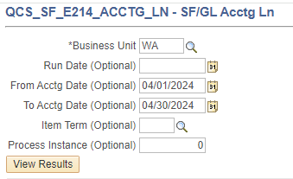
What queries should I use?
SF FIRST JOURNAL SET TRANSACTIONS:
QCS_SF_E214_ACCTNG_LN
Notes:
Once I know I have an out of balance between SF and SJS, I start researching to find out what item types caused the issue.
SF query – E214

Slide 14
Second journal set transactions:
For months BEFORE February 1, 2024:
Open and pivot the SJS files you received from SF ERP
For months ON or AFTER February 1, 2024:
QCS_SF_ACCTNG_LN_W_PROMPTS_SJS
Notes:
(This does not require scheduling – it runs quickly as an ad hoc report).

Slide 15
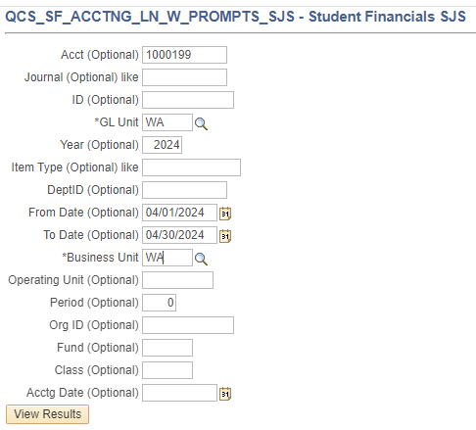
Notes:
Sample SJS with prompts criteria

Slide 16
Sf Transaction Details:
CTC_SF_ACCTNG_LN_WITH_PROMPTS
By EMPLID
By Item Type
By Date Range
By so many options…

Slide 17
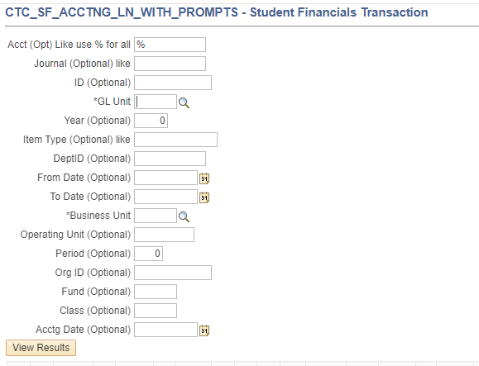
Notes:
Sample SF with prompts criteria

Slide 18

Review query data
Notes:
Refer to Excel
Spreadsheet 2 – do demo of pivoting, formatting and analysis.
Spreadsheet 3 – 38* 68*
Spreadsheet 4 – FARC FARP
Spreadsheet 5 – Conversion payment
Spreadsheet 6 – Error with item type

Slide 19
Queries USEFUL for reconciling:
QCS_SF_ACCTNG_LN_W_PROMPTS_SJS
QCS_SF_E214_ACCTG_LN
QCS_SF_E214 ITEM_NOT_GEN
QCS_SF_E218_ITEM_NOT_GEN
QCS_SF_ITEM_1ST_2ND_ACCOUNTS
CTC_SF_ACCTNG_LN_WITH_PROMPTS
QFS_GL_JRNL_ANALYSIS_ALLSTAT
QFS_GL_ACCOUNT_ANALYSIS

Slide 20

Need help?
Log a ticket with Accounting Support --> Campus Solutions
Include as much information as you can

Slide 21

Any Questions?

