Slide 1

Payroll Reconciliation from the Finance Side
Presented by: SBCTC System Accounting staff

Slide 2

How does the data get into the General Ledger?
Finance receives PAY journal
Payroll is entered / processed in HCM
Finance receives AP Vouchers
Voucher entered/
processed in FIN
Net Pay voucher is created

Slide 3
PAY Journal Entries
The PAY journal will:
Debit
Salary Expense
(5000003 – 5000190)
Benefit Expense
(5010003 – 5010160)
Credit
Liability Payable
(2011004 – 2011710)

Slide 4
AP Journals
The AP Journals (includes Net Pay) will:
Debit
Liability Payable
(2011004 – 2011710)
Credit
Liability Payable
(2000010)
When Voucher is Built
Debit
Liability Payable
(2000010)
Credit
Cash In Bank
(1000070)
When Voucher is Paid

Slide 5
So what goes wrong?
Manual payments
Payment cancellations
Errors in the PAY or AP Vouchers that require intervention
Incorrect Combo Codes
Debit values where “statement of fact” must be submitted to vendor (such as TIAA)
Items sent to Payroll Suspense account (5010170)
Timing

Slide 6
Ways to mitigate potential issues
1. Double check combo codes for accuracy
2. Avoid correcting anything in either the PAY journal or AP vouchers
3. If something must be corrected, be sure to modify both the PAY journal and AP vouchers.
Note: if a state fund is modified, it will affect the college state reimbursements.
4. Ensure adjustments to AP vouchers are expensed
5. Payments received from suppliers are posted to Liability accounts with adjustments to interest/fees to recognize gain/loss to investments
6. Manual payments should not be expensed – should use account 2011015
7. Ensure all AP vouchers are built from HCM – If a deduction doesn’t have a corresponding vendor attached, a voucher will not be created.

Slide 7
How do I know I don’t balance?
Timing is everything. DO NOT pull these reports until the PAY journal has been posted and the AP vouchers (including Net Pay) have been built.
Pull a GL report from FIN – suggest query: QFS_GL_ACCOUNT_ANALYSIS
  Start with all of FY23. However, once these are balanced, only monthly reviews will be needed.
  Pivot the query. It is only necessary to look at the Liability accounts associated with the deductions (2011004 – 2011710) and Expense suspense account (5010170)
Start with looking by date rather than chartstring. This should reveal overall variances by the payroll period. Once that is clear, then look at by string to be sure that the strings are clearing out as expected.

Slide 8
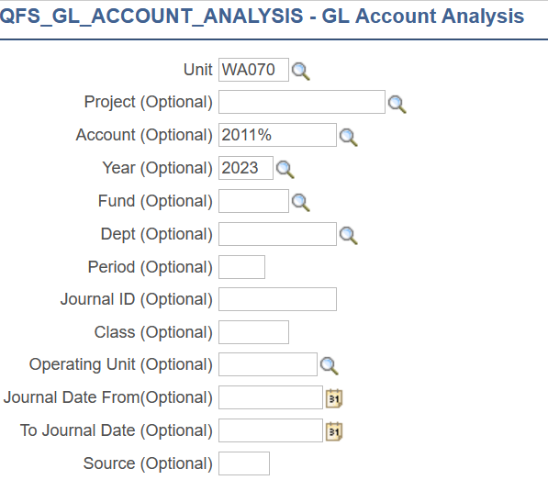
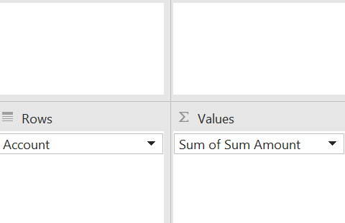
Payroll AP Query
QFS GL Account Analysis Parameters
Pivot Setup
Query Results

Slide 9

How do I research / fix my issues?

Slide 10
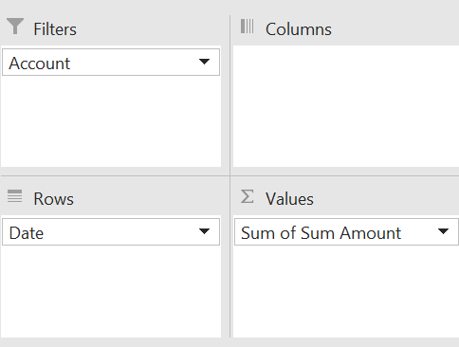
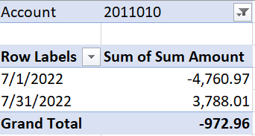
Review each account, first by Balance,
Pivot Setup
Query Results

Slide 11
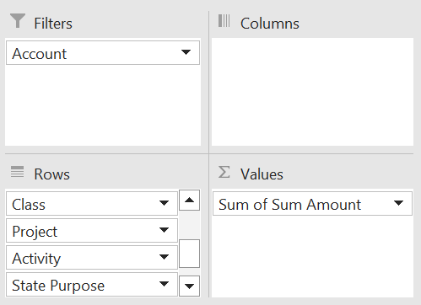
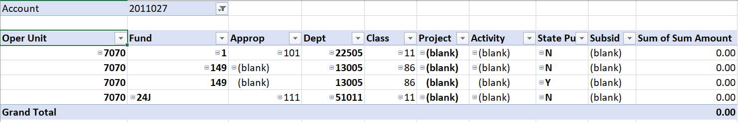
Then by chartstring…
Pivot Setup
Pivot Results

Slide 12
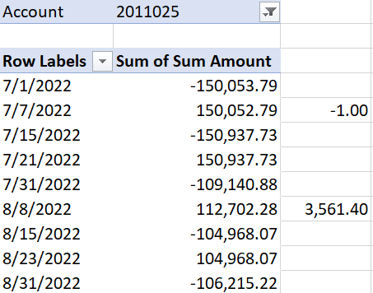
Researching issues…
Review the originating documents
  The $1.00 variance came from the 6/30 payroll (It is dated 7/1 because it was outstanding at year-end, and we are only looking at FY23 (which would have a balance forward for the balance remaining in FY22)
Compare to the voucher
  More than likely, an adjustment was requested by the HR department to the AP department. This adjustment was coded to the liability account rather than an expense account.

Slide 13
how does Reversed payments and manual payments effect my Net Pay voucher and GL Accounts?

Slide 14
Reversed Payments
  If the employee doesn’t receive the funds, but the college sent the funds (either by paper check or ACH), Central Payroll:
  1) If payment was made via ACH, the funds are requested back from the bank.
    If the funds are not returned, and the error was made by the college, the college will issue a new manual check to the employee and not enter the check into Payroll. This new manual check should be expensed (not put to 2011015).
    If the funds are returned, then a Reversal can be entered in Payroll and the manual check would be posted to 2011015, not an expense.
  2) If payment was made via check, then Central Payroll will cancel the payment at the bank and the college creates a Negative Manual Check in Payroll to reverse the payment. The college can either enter the earnings again on the next payroll or pay by manual payment. In this case the manual payment would need to be added back to the next payroll in order to keep the W-2 accurate.

Slide 15
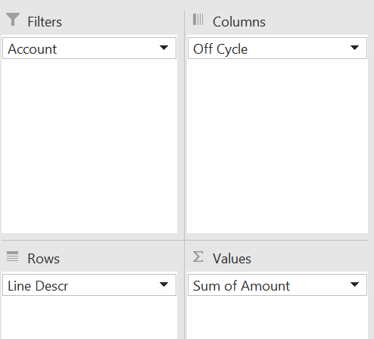
How does this tie to the Net Pay voucher?
Run the query: CTC_HR_ACCTG_LINE_PAY_PERIOD
Pivot Setup
Pivot Results
Query Results
The $161.00 is an off-cycle Check (Manual) check. This is excluded from the pull for your Net Pay. The manual payment, done in AP, should have been coded to this GL Account (2011025).
The $4,006.33 is a payment reversal and is not excluded from the pull for Net Pay.

Slide 16
Why does the PAY journal have entries for other operating units?
Please don’t delete these lines!
This happens when the Payroll department process payments to employees that have been terminated from the business unit. If the Payroll department does not follow the correct process, its results in incorrect detail entries. These expenses/liabilities still belong to the college. However, it will be necessary to update the journal and the corresponding AP vouchers with the correct codes.
Issue: If the error or correction has a state fund, this create a discrepancy in the college VPA. If possible, correct the transaction to make the string postable without changing the state fund. Then correct the transaction in a second journal so the changes to VPA will be picked up in the VPA monthly report. Otherwise, the college will need to manually adjust the monthly VPA report.
To determine who the employee is, run the HCM query: HR Accounting Line by Pay Period, filter on the operating unit that is not correct. Then, ask payroll for the correct chartfields for the employee in question. Payroll can find it by looking at the combo code(s) in the employee’s file.

Slide 17
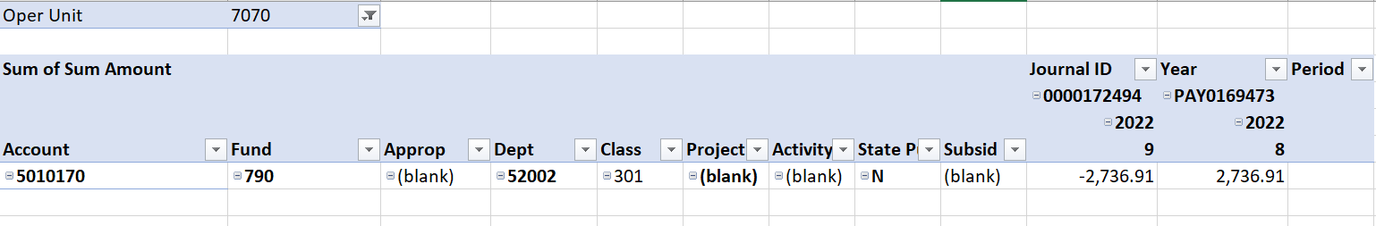
Why do amounts end up in the Payroll Suspense account?
Pivot Results
Query Results
Whenever an employee is paid without a valid combo code (which is not a requirement in the HCM pillar to have to pay an employee), the system will assign this suspense account and string. Colleges should review these transactions each pay period and make all the necessary adjustments.

Slide 18
How do I clean these up?
This account is a “benefit” expense and needs to be reclassed to the appropriate salary account. There should be associated Staff Month value in the Stat field.
The adjusting journal must use the Source Type of “PTR” to be collected at year-end for reconciliation of reports being sent to SAO from the HCM pillar.
Make sure to go back to the employee’s job record and add a valid combo code.

Slide 19
If you need assistance, please create a ticket for the accounting department

