Slide 1
ANTI-RACIST COORDINATED CARE
BEdA Biennial Conference
Claudia Avendano-Ibarra MSW
July 24, 2024

Slide 2
INTRODUCTION
Name
College/Employer
Position
Pronouns
My level of experience providing coordinated care/case management is..
My experience with anti-racist initiatives is..

Slide 3
WHEN WORKING WITH STRUGGLING STUDENTS, WHAT SKILLS OR STRATEGIES WORK FOR YOU?

Slide 4
ROADMAP
Definitions
Elements of Anti-Racist Education
Oppression as a Catalyst
Equity Detours
Equity Literacy
Anti-Oppressive Values
Intersectional Analysis

Slide 5
COORDINATED CARE
A client-centered approach to deliberately organize care activities and the sharing of information among all participants to achieve safety and more effective care.
Requires the ability to listen and accurately assess to offer a range of diverse and innovative interventions.
Involves the follow-up of progress towards goals set by the client.
Summers, 2015

Slide 6
LEVELS OF COORDINATED CARE
Administrative
Resource coordination
Intensive
Targeted or blended

Slide 7
ETHICS AND BOUNDARIES
In relationship within
Our scope of practice
Law and agency policy & procedure
Limits to confidentiality
Empowering - Helping them help themselves

Slide 8
SEPARATING FROM THERAPY
Does require a set of skills that is nonetheless therapeutic.
As we uncover deep-seated problems and issues, they become the basis of a plan developed to resolve and we refer to experts.
We apply good listening skills and focus on helping the person with a plan until more is attained.
Summers, 2016

Slide 9
ANTI-RACISM
The practice of actively identifying and opposing racism. The goal of anti-racism is to actively change policies, behaviors, and beliefs that perpetuate racist ideas and actions.
Boston University Community Service Center
A transformative concept that reorients and reenergizes the conversation about racism. It is not a destination but a journey requiring deliberate and consistent work.
Dr. Ibram X Kendi

Slide 10
9 IMPORTANT ELEMENTS OF ANTI-RACIST EDUCATION
By the National Museum of African American History and Culture

Slide 11
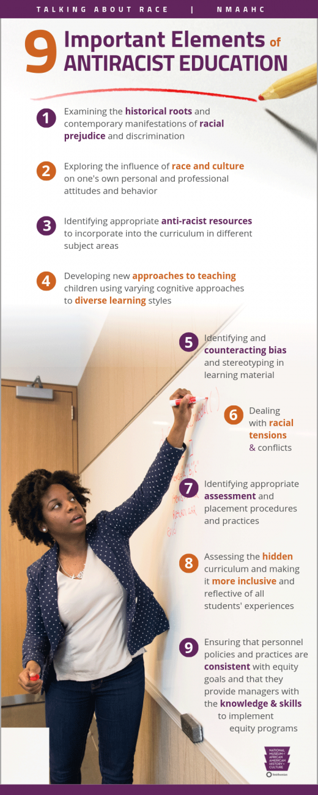
Important Elements of Antiracist Education

Slide 12
Additional Elements
Examining the historical roots and contemporary manifestations of racial prejudice and discrimination
Exploring the influence of race and culture on one’s own personal and professional attitudes and behavior
Identifying appropriate anti-racist resources to incorporate into the curriculum in different subject areas.

Slide 13
13
Developing new approaches to teaching using varying cognitive approaches to diverse learning styles
Identifying and counteracting bias and stereotypes in learning material
Dealing with racial tensions and conflicts

Slide 14
14
Identifying appropriate assessment and placement procedures and practices
Assessing the hidden curriculum and making it more inclusive and reflective of all students’ experiences
Ensuring that personnel policies and practices are consistent with equity goals and that they provide managers with the knowledge and skills to implement equity programs

Slide 15
OPPRESSION AS A CATALYST
Systematic mistreatment of particular individuals. Oppression is not just an isolated incident. Rather, it is a complex system of power, sustained and pervasive beliefs, laws or policies, behaviors, and feelings.

Slide 16
“Oppression refers to a combination of prejudice and institutional power that creates a system that regularly and severely discriminates against some groups and benefits other groups.”
National Museum of African American History and Culture in Talk About Race

Slide 17
Intersecting Forms of Oppression

Slide 18
Levels of Oppression and Change
Levels of Oppression & Change
Personal | Interpersonal | Institutional | Cultural
Values Beliefs Feelings Attitudes Opinions | Actions Treatment Relationships Behaviors Communications | Policies Practices Rules Procedures Systems | Worldview Stories Climate Shared Values Unwritten Rules Media Public Opinion Symbolic/Ritual Group Dynamics Norms
Adapted from Dr. Valerie Batt, “Is Reconciliation Possible? Lessons from Combating Modern Racism”

Slide 19
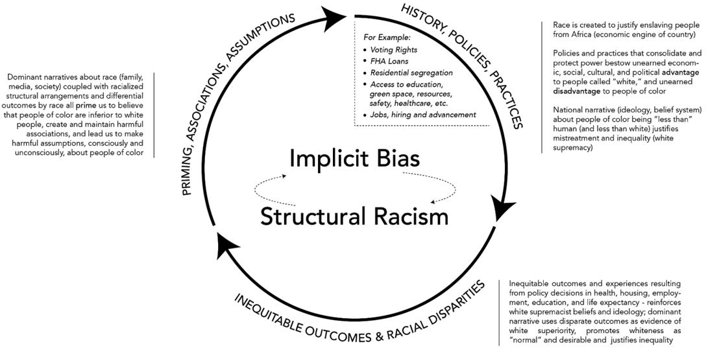
Implicit Bias
Source: Implicit Bias and Structural Racialization by the National Equity Project

Slide 20
PAUL GORSKI, AN ADVOCATE FOR SCHOOL-BASED EQUITY, IDENTIFIES FOUR COMMON RACIAL EQUITY DETOURS

Slide 21
AVOIDING RACIAL EQUITY DETOURS
Racial equity detours are actions and approaches that schools and organizations might adopt in the name of equity, but which ultimately create only the illusion of progress without truly cultivating more equity.
These detours can sometimes be based on misunderstandings about what equity means or the level of transformation needed to achieve it.
Source: Equity Literacy Institute – Common Racial Equity Detours

Slide 22
Barriers
Pacing for Privilege: Prioritizing the comfort of those threatened by equity issues over the need to make rapid progress.
Poverty of Culture: Discussing racist actions and inequities connected to racism only as “cultural” issues.
Adopting a Deficit Ideology: Viewing people from marginalized groups as deficient based on cultural stereotypes.
Celebrating Diversity: Focusing on celebrations that help privileged students learn about other cultures and races without confronting racism.

Slide 23
GUIDING QUESTIONS
Do you think your school engages in any equity detours?
Do you agree with Gorki’s point that schools “must prioritize equity over the comfort of reluctant educators”? What would this mean in your school?

Slide 24
“What is it you want me to reconcile myself to? You always told me it takes time. It has taken my father’s time, my mother’s time, my uncle’s time, my brothers’ and my sisters’ time, my nieces’ and my nephews’ time. How much time do you want for your ‘progress’?”
James Baldwin

Slide 25
ENGAGE EQUITY LITERACY PRINCIPLES

Slide 26
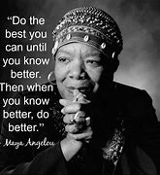
TO COUNTER DETOURS
Equity Literacy
Equity Response
Redressing Inequities
Cultivating Equity
Sustaining Equity
Designed to help educators and organizations develop a deeper understanding and commitment to equity.

Slide 27
GUIDING QUESTIONS
How can educators incorporate the equity literacy principles into their practice?
What are some examples of schools successfully implementing equity literacy?

Slide 28
INTERSECTIONALITY

Slide 29
29
“Intersectionality is a lens through which you can see where power comes and collides, where it interlocks and intersects. It’s not simply that there’s a race problem here, a gender problem here, and a class or LBGTQ problem there. Many times, that framework erases what happens to people who are subject to all these things.” Kimberly Crenshaw

Slide 30
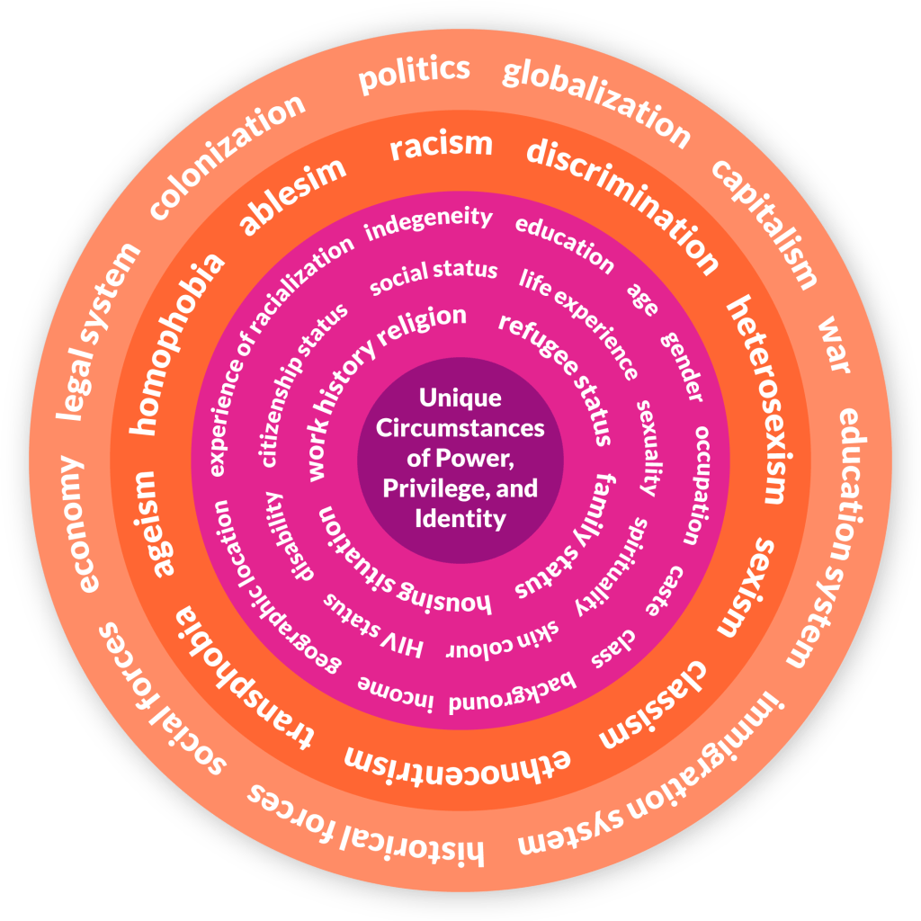
Intersectionality
The innermost circle = represents a person’s unique circumstances The second circle = aspects of individual identity The third circle = different types of discrimination and attitudes that impact identity The outermost circle = larger forces and structures that work together to reinforce exclusion.
Intersectionality Displayed in a Wheel Diagram, (adapted from the Canadian Research Institute for the Advancement of Women, 2009)

Slide 31
INTERSECTIONAL ANALYSIS TO ASSESS AND RESPOND
Are we considering how multiple identities and experiences converge and interact in order to unveil the ways systems or privilege, power, and oppression affect our students within the school?
Are we applying equity vs equality?
Are we engaging in bias disruption

Slide 32
ANTI-OPPRESSIVE VALUES

Slide 33
ANTI-OPPRESSIVE VALUES
Passion
Awareness
Knowledge
Honestly
Skills
A look at positionalities, identity, intersectionality, and privilege. Michigan Online. Retrieved 06/03/24

Slide 34
WE WANT BELONGING

Slide 35
“To remedy institutional racism, we must identify policies and practices that perpetuate racial disparities even inadvertently, and change them. To counter structural racism, however, we must pursue policies that PROMOTE racial equity and advance equal opportunity for all.
Otherwise, structural racism will continue and when systems and structures reinforce inequality and exclusion, BELONGING cannot take root and bloom. Ultimately, to build a world were all people feel a sense of belonging, we must understand and work together to end racism in all its forms.”
Structural Racism Explained by the UC Berkeley Othering and Belonging Institute

Slide 36
SUMMARY
Anti-racist coordinated care is a way of being. We cannot be antiracist oriented with our students if we are not this all the time.
Cultural humility is the foundation. It is about being aware of who we are and what our limitations are and being other oriented.

Slide 37
37
Anti-racist coordinated care involves:
Work within our scope of practice and boundaries to uncover the inequities that become the basis of the plan we develop.
Recognizing oppression as systematic mistreatment of particular individuals sustained by pervasive beliefs, laws or policies, behaviors, and feelings.
Validating students’ experience, seeing culture as an opportunity, and being willing to be vulnerable so we can gain knowledge about systems and how they perpetuate marginalization and offer privilege.

Slide 38
38
A commitment to anti-racist practice as a journey requiring deliberate and consistent work (individual, interpersonal, institutional, and systemic/cultural).
The active practice of identifying and opposing policies, behaviors, and beliefs that perpetuate all forms of oppression.
The active practice of creating policies and initiatives that create and foster equitable outcomes.

Slide 39
39
Addressing racial equity detours and engagement of equity literacy principles.
The use of intersectional analysis to guide our equitable practice.

Slide 40
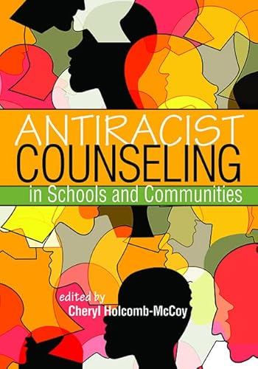
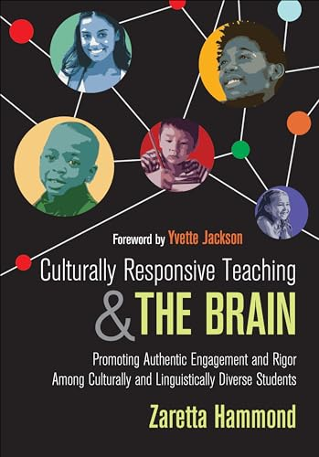
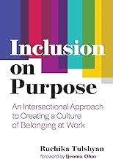
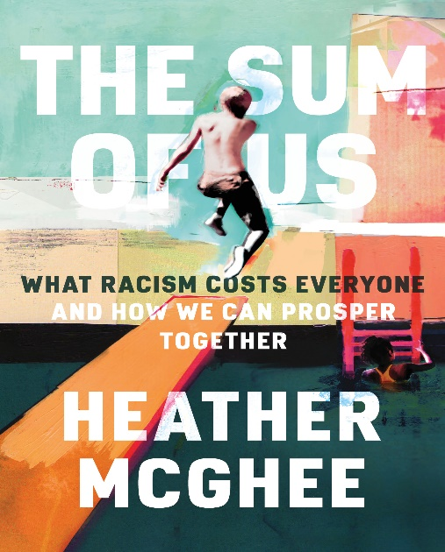
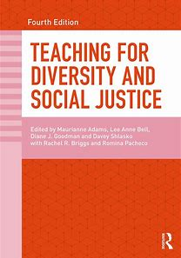
40

Slide 41
RESOURCES
Summers: Fundamentals of Case Management Practice: Skills for Human Services – 5th Edition – 2015
Culturally Responsive Teaching and the Brain: Promoting Authentic Engagement and Rigor Among Culturally and Linguistically Diverse Students. 2014
Structural Racism Explained by the UC Berkeley Othering and Belonging Institute
A look at positionalities, identity, intersectionality, and privilege. Michigan Online. Retrieved 06/03/24
U.S. Department of Treasury – Post 56: Racial Differences in Educational Experiences & Attainment – Retrieved 6/3/24
FactSheet-Oppression: Oppression Without Bigots by Abby L. Ferber, PhD and Dena R. Samuels, PhD
Syracuse University – FYS 101: Intersectional Self - Retrieved 6/3/24

Slide 42
References
National Equity Project – Culturally responsive Teaching – Retrieved 6/3/24
Boston University Community Service Center – What is Racism - Retrieved 7/15/24
Implicit Bias and Structural Racialization by the National Equity Project – Retrieved 7/15/24
Adams, M., Bell, L. A., & Griffin, P. (Eds.). (2007). Teaching for diversity and social justice (2nd ed.). Routledge/Taylor & Francis Group. https://doi.org/10.4324/9780203940822
Avoiding Racial Equity Detours
Equity Literacy Institute – Common Racial Equity Detours
Gorski, P. (2019). Avoiding Racial Equity Detours. Educational Leadership, 76(7), 56-61.
Dr. Valerie Batt, “Is Reconciliation Possible? Lessons from Combating Modern Racism”

Slide 43
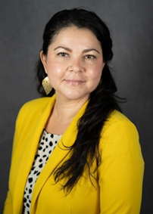
Contact Information
Claudia Avendaño-Ibarra MSW
She, her, ella
Claudia.avendano-ibarra@skagit.edu
Human Services Department Chair

Slide 44
TERMS YOU SHOULD KNOW
Courtesy of
The Boston University Community Service Center
What is Anti-Racism

Slide 45
Glossary
Race: False classification of people that is not based on any real or accurate biological or scientific truth. The concept of race was created as a classification of human being with the purpose to legitimize the dominance of white people over non-white people.
Ethnicity: Refers to the social characteristics that people may have in common, such as language, religion, regional background, culture, foods, etc., revealed by the traditions one follows.
Racism: Prejudice, discrimination, or antagonism directed against a person or people on the basis of their membership in a particular racial or ethnic group. A group that is typically a minority or is marginalized.
Systemic Racism: System or structures that have procedures or processes that disadvantage marginalized groups.
Structural Racism: Inequalities rooted in the system-wide operation of a society that excludes substantial numbers of members or particular groups from significant participation in major social institutions.

Slide 46
Glossary Cont’d
Institutional Racism: Refers to the policies and practices within and across institutions that, intentionally or not, produce outcomes that chronically favor, or put a racial group at a disadvantage.
Anti-racism: The practice of actively identifying and opposing racism. The goal of anti-racism is to actively change policies, behaviors, and beliefs that perpetuate racist ideas and actions.
Colorism: Prejudice or discrimination against individuals with a dark skin tone. Typically among people of the same ethnic or racial group.
Discrimination: Actions or thoughts based on conscious or unconscious bias that favors one group over others.
Diversity: Having a variety of racial, sexual, gender, class, religious, ethnic, abled, and other social identities represented in a space, community, institution, or society.
Prejudice: Feeling favorable or unfavorable, towards a person or thing, prior to, or not based on actual experience.

Slide 47
Glossary Continued
Microaggression: The everyday verbal, nonverbal, and environmental slights or insults, ether intentional or unintentional, which communicate hostile, derogatory, or negative messages to target persons based solely upon their marginalized group membership.
Racial Profiling: The use of race or ethnicity as grounds for suspecting someone of having committed an offense.
Racial Justice: The systematic fair treatment of people of all races, resulting in equitable opportunities and outcomes for all.
Stereotype: An attitude, belief, feeling or assumption about a person or group of people that are widespread and socially sanctioned. Although stereotypes can be positive and negative, they all have negative effects because they support institutionalized oppression by validating oversimplified beliefs that are often bot based on facts.

Slide 48
Final Glossary
Unconscious Bias: Negative stereotypes regarding a person or group of people. These biases influence individuals’ thoughts and actions without their conscious Knowle. We all have uncurious biases.
BIPOC: An acronym standing for Black, Indigenous, and People of Color. The term has become more popular as a way to highlight the divergent or shared needs and concerns of these distinct communities.
Boston University Community Service Center – What is Anti-Racism - Retrieved 7/15/24

