Slide 1
Increase Financial Literacy Through
Ability to Benefit
July 24th, 2024
Nicole Daughtry

Slide 2
Ability to Benefit Defined
Ability to Benefit (ATB) allows a student without a high school diploma or equivalency to receive Title IV student financial aid to pay for postsecondary education and training if they are enrolled in an eligible career pathway program.

Slide 3
Ability to Benefit Criteria
Students must be 16 years or older
Student must be co-enrolled in an eligible college program of study and a high school completion program at any of our 34 community and technical colleges.

Slide 4
Ability to Benefit Qualification
Three ways in Washington state to qualify for ATB
Achieve a cut score on an approved test (ACCUPLACER)
Earn six college credits
Co-enroll in I-BEST and High School + (the state approved process)

Slide 5
Ability to Benefit in WA State
Washington state's process allows students co-enrolled in I-BEST and our competency-based High School Plus (HS+) program to meet the core ATB student eligibility requirement and bypass the testing/credit options.
This new option saves time and money for people looking to more quickly gain the skills and credentials needed for living wage careers.

Slide 6
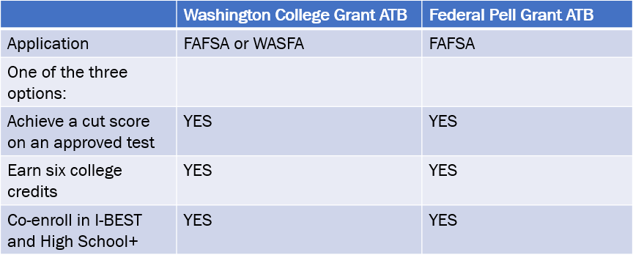
State and Federal ATB

Slide 7
Ability to Benefit Data
48 Students
51 Students
79 Students
Spring 2023
Fall 2023
Winter 2024
13 Colleges reported in Data Warehouse
13 Colleges reported in College Desk Audit
12 Colleges reported in Data Warehouse
9 Colleges reported in College Desk Audit
16 colleges reported in Data Warehouse
15 Colleges reported in College Desk Audit

Slide 8
Ability to Benefit Equity & Access
ATB aligns with BEdA goals and priorities, which aim to provide equitable access to financial resources that support students with achieving their goals.
ATB Students are in many cases I-BEST students and bring enhance FTE to the program.
ATB Allows students to access the full range of Financial Aid funding to stay on the path toward completion.

Slide 9
Ability to Benefit: Getting Started or Growing
Identify Students
Choose Eligible Career Pathways
Identify the best ATB options for your college
Connect with Stakeholders

Slide 10
Think, Pair & Share
Is your college currently offering ATB? Or Is your college planning to offer ATB in the future?
What is working well? What areas could use innovation?
What questions do you have about ATB implementation, sustainability, impact or benefit?

Slide 11
Questions?
Nicole Daughtry
Policy Associate, I-BEST | ATB | IELCE
Washington State Board for Community & Technical Colleges
ndaughtry@sbctc.edu | 360.704.4368

