Slide 1
Authentic Teaching:
Creating a Bridge Between our Core Beliefs and Culturally Responsive Teaching

Slide 2
Agenda
Welcome
Getting to know you
Meditation
Beliefs and practices in culturally responsive teaching
Creating a bridge between your heart and culturally responsive classroom practice
Reflection
Art project

Slide 3
Welcome – Getting to know you
Chat with the people sitting close to you for 5 minutes or so....
The basics (name, school, work situation)
Why did you become a teacher?
What brought you here today?
Do you have an interesting hobby or creative practice? How do you like to spend your free time?
Make your own questions!

Slide 4
Welcome – Body Scan Meditation
Feel present in this time and location

Slide 5
Welcome – Energizing Breaths
Breath sharply in through your nose and raise your arms above your head
Breath sharply out through your nose and quickly pull your arms down into fists
Repeat 10 X
Thank you Brinda Sivaramkrishnan for teaching me the energizing breaths!

Slide 6
Why Culturally Responsive Teaching is Necessary
Historically, institutions of higher education have played a role in upholding oppression and assimilation.
Indian residential schools
Racial segregation and discrimination
Unjust admission policies/ legacy admissions
Unequal funding and resources
Lack of representation of faculty of color
Eurocentric curriculum, assessment, and policy

Slide 7
Why Culturally Responsive Teaching is Necessary
Colonialism - The domination of one group of people by another.
Coloniality – The way that colonialism survives maintained in books, criteria for academic performance, in cultural patterns, aspirations of self, values placed on certain works of art, literature, accents, and pedagogies.
(Race, Empire, and English Language Teaching by Suhanthie Motha)

Slide 8
Culturally Responsive Teaching - Terms
culturally responsive teaching
culturally relevant teaching
culturally sustaining teaching
*Varying frameworks, but all focus on the strengths and assets of students of color

Slide 9
Culturally Responsive Teaching - Beliefs
Culturally responsive teaching is assets-based (focusing on what students bring to the classroom instead of what they lack)
Culturally responsive teaching is student centered
Culturally responsive teaching values students’ languages, cultures, and backgrounds.
Culturally responsive teaching both challenges and supports students.
Culturally responsive teaching = Decentering traditional education as a tool to uphold White and European standards.

Slide 10
Culturally Responsive Teaching - Actions
Let students generate topics for the curriculum.
Building curriculum based on students' interests and engagement
Create space for student input to unfold
Connecting outcomes to real-life experience
Keeping a critical eye on negative stereotypes and curating counter-narratives to combat them.
Recognizing that creativity, mindfulness, and reflection are an essential part of rigor
Creating inclusive classroom environments by centering multicultural perspectives and explicitly teaching strategies for respectful conversations.
Placement and assessment practices should embrace multicultural knowledge and avoid comparing students to Eurocentric norms
Listening to students and letting curriculum emerge instead of rigidly adhering to plans.
Prioritizing humanity and relationships over outcomes and production
Challenge white supremacy culture by shifting power to students.

Slide 11
Culturally Responsive Teaching - Beliefs
Central to culturally responsive teaching are guiding beliefs and values that prioritize equity, justice, and empathy.
These beliefs about humanity are generally already in our heart!
We just have a lot to unlearn to connect these beliefs to our actions at work.

Slide 12
Reflection
Reflection and mindfulness can be one of our greatest tools in developing and maintaining a teaching practice that values and uplifts all students

Slide 13
Reflection
Reflection and mindfulness can help us to connect with our core beliefs and unlearn and dismantle harmful practices in education that are often upheld as the norm.

Slide 14
Reflection
10 minutes freewriting
What beliefs and values do you hold about how to treat people?
What beliefs do you hold about teaching and learning?
Does your teaching practice align with your beliefs?
In what ways do you want to change as a teacher?
What are you feeling in your heart?

Slide 15
Reflection
10 minutes freewriting
What beliefs and values do you hold about how to treat people?
What beliefs do you hold about teaching and learning?
Does your teaching practice align with your beliefs?
In what ways do you want to change as a teacher?
What are you feeling in your heart?

Slide 16
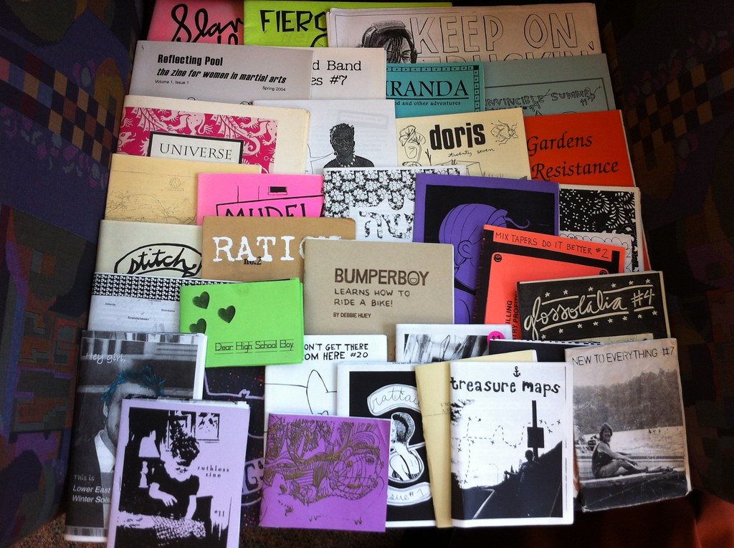
Art Project – Making Zines
Thank you Olli Toppeta (Brilliant TCC Librarian)!!!!!
Lots of resources for making zines with your students
https://tacomacc.libguides.com/zines
This Photo by Unknown author is licensed under CC BY-SA-NC.

Slide 17
Art Project – Making Zines
Directions:
Watch the video on how to fold your paper into a small book
For each page of the book – write one of your beliefs about teaching.
Feel free to take ideas from your freewriting or look on your phone for poems or quotes.
Decorate your book however you like
Read it as needed for guidance in decisions and to remember who you are at heart.

Slide 18
Art Project – Making Zines

Slide 19
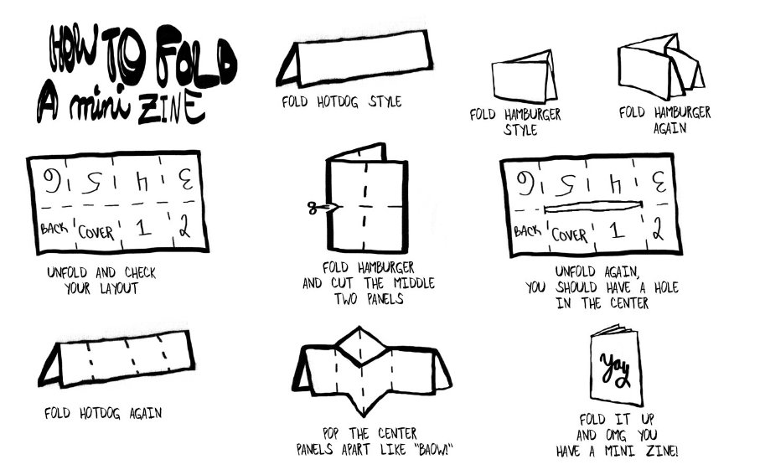
Art Project – Making Zines

Slide 20
Thank you!

