Slide 1
The Role of Public Libraries in Supporting Adult Basic Education
Enhancing Literacy, Skills and Community Connection
BEdA Biennial Conference
July 24, 2024

Slide 2
Speakers
Elissa Burnley, MLIS
Associate Director
Planning & Evaluation
Sara Schwan
Associate Director
Advocacy & Development

Slide 3
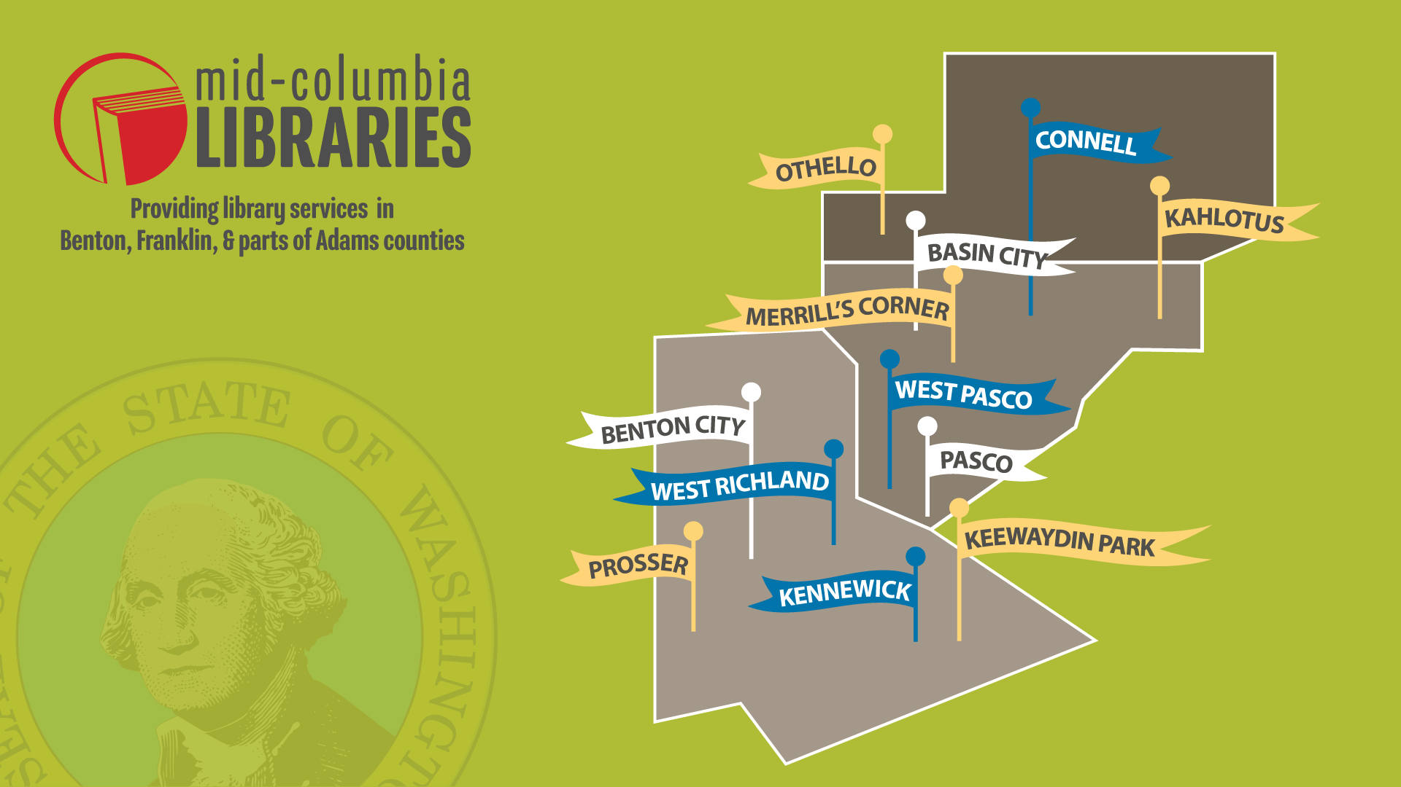
Service Area
Notes:
MCL is a special purpose district – serving Benton and Franklin Counties as well as the City of Othello.
We have 12 branches, employ approx. 110 people and are governed by a seven-member Board of Trustees appointed jointly by the Benton and Franklin County Commissioners.
Mission
Mid-Columbia Libraries empowers people, supports learning, and strengthens community through literacy, enrichment, and connection.
MCL performed a community needs assessment survey in 2022. Using that direct data from our residents, we formulated a new strategic plan and strategic foci – literacy, enrichment and connection.
This presentation will highlight the public libraries, Washington State Library, other library systems in the state and the system we know best – MCL.

Slide 4
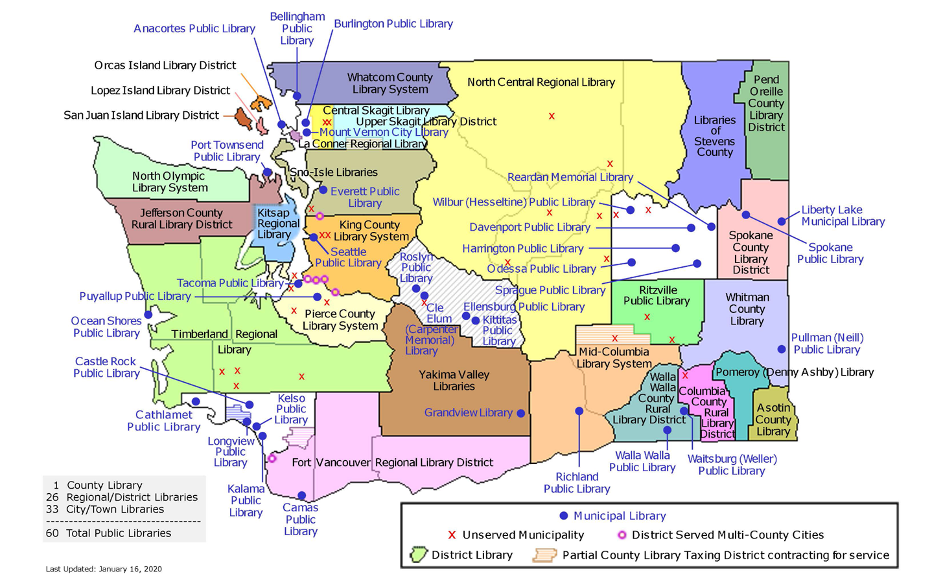
Map of Public Libraries
Notes:
This is a map from the Washington State Library. We’re going to start with an overview of public libraries in Washington state. Everyone is aware of how diverse our state is, whether red or blue, east or west, urban or rural, city blocks or corn stalks. Each of these regions or blue dots has their own personality, values and opinions.
Our library district is in peach here. The City of Richland is a municipal library, a donut hole in the middle of our district, and serves Richland residents.

Slide 5
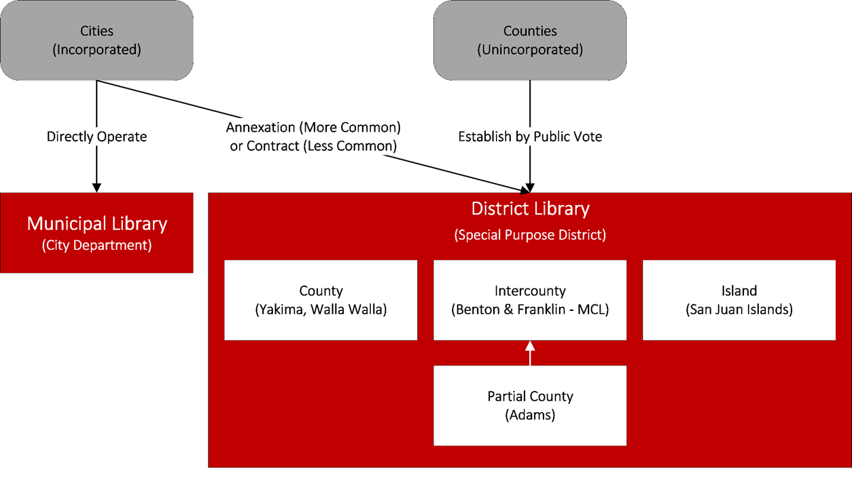
RCW Public Libraries
Notes:
As mentioned, MCL is a library special purpose district, established by a public vote in 1948 and began serving residents of Kennewick, Benton County and Franklin County in 1949. We are celebrating our 75th year of service this year.
Municipal (City): part of city government, serving city residents; funded by city council appropriation. Those are those blue dots on the map and the donut hole of Richland in our district.
Districts, whether a county, partial-county, island or regional. MCL, as a special purpose district is not part of county or city government serving affiliated residents. We are funded by dedicated property taxes and contract fees.

Slide 6
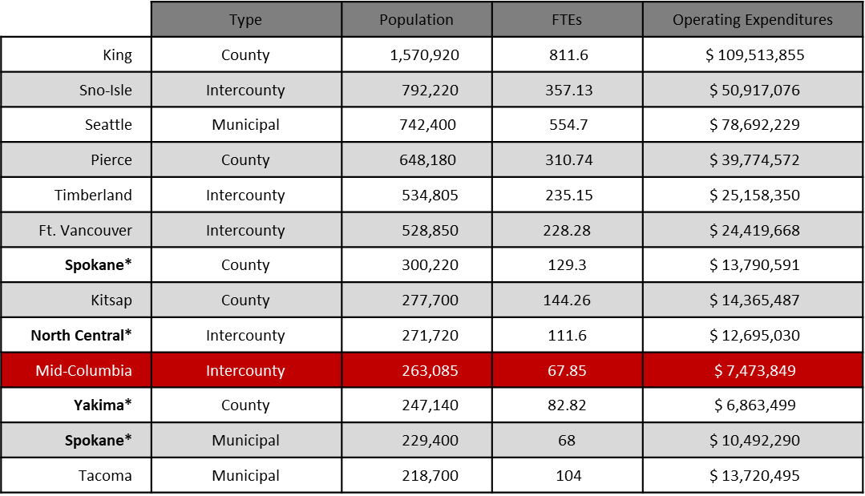
Largest Library Systems in Washington State
Notes:
You can see here a chart of the 13 largest library systems in the state. MCL is #10.
The previous slide illustrated the different types of library systems shown in the first column. The following columns show population, number of full time employees, and the total operating expenditures of the 13 largest library systems in our state.
There are many ways in which public libraries differ, so many more beyond this slide. Take a look at Sno-Isle, an intercounty district serving Island and Snohomish counties just to the north of Seattle, and Seattle Public, a municipal library. The populations are pretty similar. Seattle Public has 27 branches and Sno Isle 23 branches.
Seattle’s budget, provided by a city council appropriation, is 50% more than Sno-Isles’. And Seattle has about 55% more staff than Sno-Isle. For the sake of time, we will stop here but the differences between the services, collections and programs of these two libraries are vast.

Slide 7
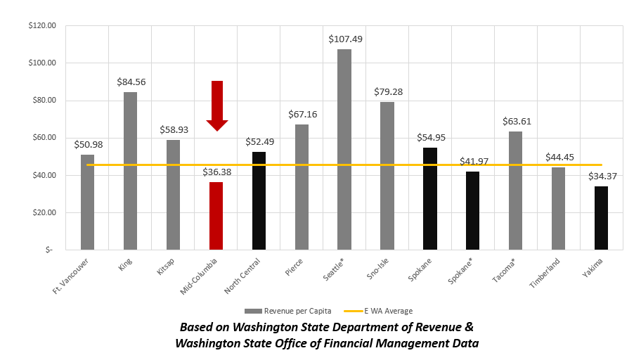
Revenue Per Capita - Largest Library Systems in Washington
Notes:
Of the thirteen largest library systems in the state, MCL has the lowest revenue per capita.
Impacting the budgets of these different systems are our levy rates which are unique to each system. Also impacting these systems, and may entities across the state is the a 1% limit on property tax increases that voters passed 2001.

Slide 8
The More You Know
City of Kennewick Assessed Valuations
2023: $9.6 Million
2024: $11.6 Million
MCL Levy Rate
2014: $0.37/thousand
2019: $0.34/thousand
2023: $0.26/thousand
2024: $0.22/thousand
1 % Property Tax Limit on Tax Levies Annually
MCL’s Revenue From Property Taxes Increased by
Approximately $190,000 in 2024.
Notes:
Here in the Tri-Cities area, we are seeing a tremendous amount of growth, lots of housing being created for all the new residents moving to the area and our property values are also going up. Just in Kennewick alone our assessed valuations went from $9.6 million in 2023 to $11.6 million in 2024. So one would think libraries and other government entities are collecting more money and we are! You multiple that levy rate by the assessed values. YES! But not by much.
So 1% is added to MCL’s revenue from the previous year and then from there calculates the levy rate. Here you can see how this negatively impacts our levy rate and revenue.
Property Tax Revenue:
2024 $5,460,000
2023 $5,270,000
2022 $5,178,000
So yes, our revenue from property taxes did go up. In 2023 it went up by $82,000. But you can imagine how it would make it challenging to continue to provide high quality library services and access to materials to more people with this increase. We won’t talk about publishing and inflation.
And this is not what we were invited here to talk about but in the words of LaVar Burton, the more you know…

Slide 9
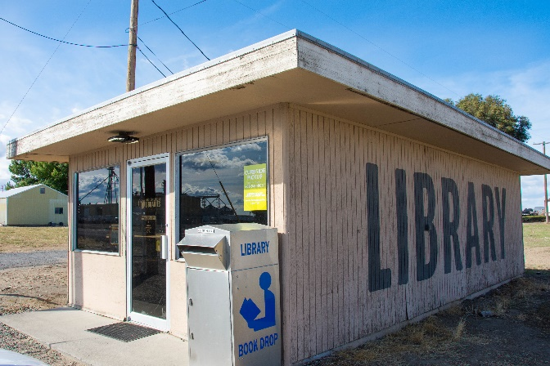
Audience Poll
Audience Poll
How many branches of public libraries are there in the
state of Washington?
Less than 260
Between 260 and 320
More than 320
Notes:
Alright, back to libraries…. How many branches of public libraries are there in the state of Washington? Less than 260?
Between 260 and 320?
More than 320?

Slide 10
Map of Public Library System
Notes:
This is a map from the WSL that shoes the 60 Public library systems in Washington. Within those 60 systems are 324 branches. Over 17,000 public libraries in the US (more libraries than McDonalds).
Every public library serves their community and is a reflection of their community. A great public library is listening to their community and using that feedback to determine their library services. Their mission, values, goals, programming and services are different. Their boards of trustees as well as their policies and procedures… those are all unique to each library system. Just as each elected official serves their constituents, libraries serve theirs and we are all unique.
As mentioned, MCL did a community needs assessment survey in 2022, ensuring that we are in alignment with our community needs, whether it be the programs we offer, the services we provide, it is important to MCL that we are providing value to our community. Our strategic focuses are literacy, enrichment and connection. With our very low levy rate, we have to be very strategic with our budget. Every thing we do has to be in alignment with our strategic plan in order to make an impact, be good stewards of our tax payer dollars and to provide value to our community. And for this reason, our literacy focus is geared towards young and school aged children. As we looked at post Covid reading scores, what our community said was most important to them, we had to narrow our focus. We would love to be everything to all people but we know that isn’t 1. realistic or 2. feasible with our funding levels.
We encourage you to reach out to your library, get to know your library staff, programs and services, and also be vocal about how you can partner, share resources and help one another with the communities you serve.

Slide 11
Strategic Goals
The State Library: connecting Washington through the power of libraries.
The Washington State Library builds prosperous and informed communities by providing technology, access to information, resources, and professional support.
Foster civic engagement
Preserve and share Washington’s stories
Serve all who cannot read standard print
Support the incarcerated and hospitalized with their recovery and release
Promote economic growth, education and life-long learning
Build and maintain a federal and state depository program
Develop professional skills and build capacity among all libraries
Notes:
The WA State Library, under the Secretary of State, provides vast resources to residents, libraries, agencies and governments. Here is the vison, mission and strategic goals of the Washington State Library.
And while MCL’s strategic plan focuses on youth literacy, we are still able to provide great resources to adult learners through the WSL.

Slide 12
Library Card
Audio & Braille Books
Digital Collections Including Historic Newspapers, Books, Washington Rural Heritage Federal Government Publications
Genealogy
Maps
Newspapers of Washington State
Northwest Collection of Books, Journals, DVD's and more.
Special Collections of Manuscripts, Maps, Rare & Territorial Collections
State Government Publications
Notes:
Here is a redacted copy of my WSL e-library card. It was very easy to obtain. Just like public library cards, these are free to all WA residents. I submitted an online application, a copy of my WA state drivers license and a day later it was in my inbox.
Here are some of the collections that one can check out with their library card.

Slide 13
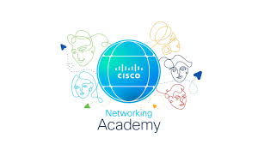
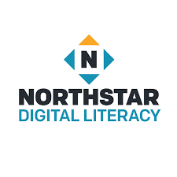
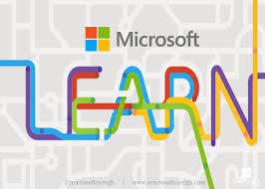
Training Resources
https://washstatelib.libguides.com/Digital-skills-resources/home
Notes:
In addition to providing training, supports and grants to libraries across the state, the WSL has a license agreement to provide the following training resources. That license states that you first access these through your public library whenever possible.

Slide 14
Courses
Networking:
​Networking Basics (22 hours; beginning)
Networking Devices and Initial Configuration (22 hours; beginning)
Network Addressing and Basic Troubleshooting (14 hours; beginning)
Network Support & Security (12 hours; beginning)
Programmable Infrastructure:
Python Essentials 1 (30 hours; beginning)
Python Essentials 2 (40 hours; intermediate)
Cybersecurity:
Ethical Hacker (70 hours; intermediate)
Endpoint Security (27 hours; intermediate)
Network Defense (27 hours; intermediate)
Cyber Threat Management (16 hours; intermediate)
Data Science:
Introduction to Data Science (6 hours; beginning)
Data Analytics Essentials (30 hours; beginning)
Notes:
You can select from hundreds of certificate aligned courses in areas like cybersecurity, networking, and Python.
I recently read an article in Fortune magazine that said the world is in need of 3.4 million cybersecurity experts. Cisco Networking Academy is one of Cisco’s efforts to meet those needs.
Here are some of the courses, with levels and hours involved.
Free of charge with the WSL, which highlights two pathways – the Certified Support Technician (CCST) Networking Pathway (Help desk positions, entry level IT support) and the Certified Support Technician (CCST) Cyber Pathway (cybersecurity)

Slide 15
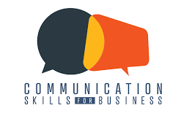
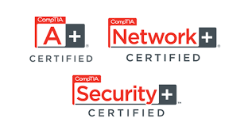
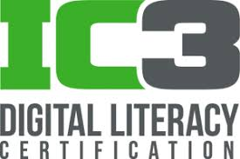
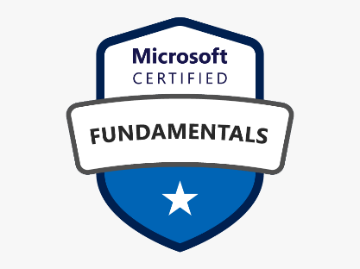
Additional Services
Notes:
Gmetrix helps people prepare for software certification exams as well as IT skills. Users are able to test their proficiency with Gmetrix’s simulated testing environment.
If your library does not offer Gmetrix, you can receive access through your state library card. Remember those are free to any WA state resident.
LearnKey Self-Paced Courses
Practice Tests
Certification Vouchers
The exams WSL offers include:
ACP Adobe Certified Professional
CompTia A+ , Network +, Security +
CSB - Communication Skills for Business
ESB - Entrepreneurship & Small Business
IC3 Digital Literacy
ITS - IT Specialist
MOS - Microsoft Office Specialist – which includes all the Office programs like Word, Outlook, SharePoint
MCF - Microsoft Certified Fundamentals

Slide 16
Digital Literacy
Essential Computer Skills Basic Computer Skills
Internet Basics
Using Email
Windows
Essential Software Skills
Basic Computer Skills
Internet Basics
Using Email
Windows
MAC OS
Using Technology in Daily Life
Social Media
Information Literacy
Career Search Skills
Accessing Telehealth Appointments
Your Digital Footprint
Supporting K-12 Distance Learning
Notes:
These are the 14 focus areas of Northstar. Every library in Washington is eligible for a free Northstar account including public, tribal, education and special libraries. This curriculum is currently available in English and Latin American Spanish.
Assessment feedback is strengths-based, showing learners where they already have foundational skills as well as directing them to areas for practice.
Test takers can receive certificates or digital badges when they pass Northstar assessments in a proctored environment.

Slide 17
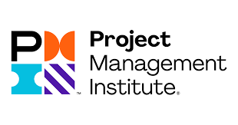
Logos
Notes:
Access from your local libraries is very wide spread with Linkedin Learning. Formerly Lynda.com
LinkedIn Learning offers courses and learning paths taught by experts in their fields to prepare you to take technical and business certification exams from CompTIA, Microsoft, AWS, (ISC)2, Six Sigma, and other leading providers. Some of these
Access to standalone video tutorials, courses, and full learning paths that prepare learners for a wide variety of professional, technical, and creative skillsets.
From gaming, to human resources, project management, social media, you can find it on LinkedIn Learning.

Slide 18
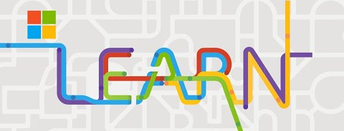
Training
.NET
Azure
Bing
Clarity
Consumer
Dynamics 365
Flip
GitHub
HoloLens
Industry Solutions
Internet Explorer
Microsoft 365
Microsoft Authentication Library
Microsoft Copilot
Microsoft Defender
Microsoft Edge
Microsoft Endpoint Manager
Microsoft Entra
Microsoft Fabric
Microsoft Graph
Microsoft Intune
Microsoft MakeCode
Microsoft Power Platform
Microsoft Priva
Microsoft Purview
Microsoft Teams
Microsoft Viva
Microsoft Website
Minecraft
Mixed Reality Toolkit
Nuance
Office 365
Playwright
Project Bonsai
Quantum Development
SQL Server
Surface
Sysinternals
Visual Studio
Windows
Xbox
Notes:
Microsoft LEARN provides up-to-date information and hands-on training materials for individuals and organizations looking to learn or enhance their skills and knowledge of Microsoft technologies.
The platform offers a wide range of free, self-paced courses, documentation, and tutorials, available to keep up-to-date with ever-changing products.
Over 4,700 trainings. You can sort by your role, whether it was business owner, educator, technical writer, as well as by levels or course type.

Slide 19
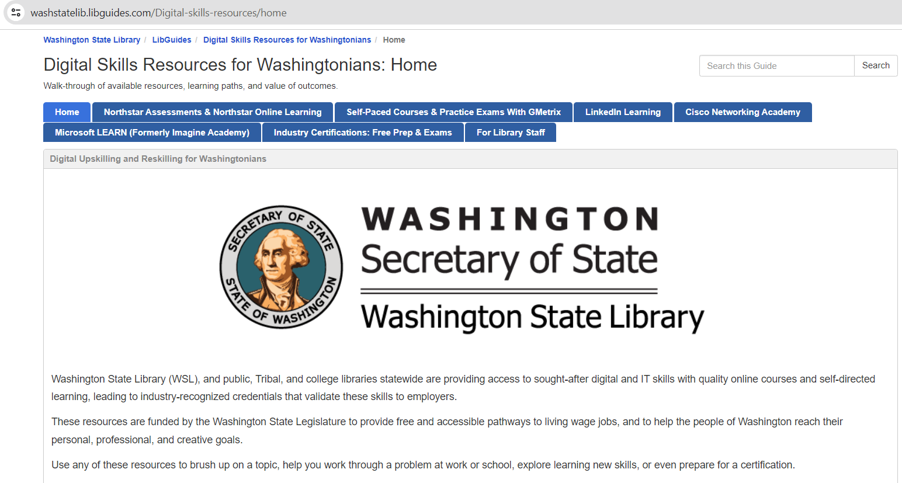
Digital Skills Home
Notes:
All of this information can be found on the WSL’s libguide for digital skills resources. You’ll notice a tab here on industry certificates.
According to a recent report from the National Skills Coalition;
Non-degree credentials (NDCs) are a key component in helping workers obtain better jobs and serving to reconnect them to further postsecondary education and training opportunities.
Non-degree credentials matter to workers and jobseekers because they have value in the labor market. Postsecondary certificate holders earn 30 percent more than individuals with a high school diploma alone, on average, and the wage premium for short term programs in certain fields is often comparable to or higher than associate’s degrees and even some bachelor’s degrees.¹

Slide 20
Audience Poll
Which of the WSL platforms do you feel will be of most use to your students?
1. Cisco Networking Academy
2. Gmetrix
3. Northstar Digital Literacy
4. LinkedIn Learning
5. Microsoft Learn
Notes:
Which of the WSL platforms do you feel will be of most use to your students?
1. Cisco Networking Academy
2. Gmetrix
3. Northstar Digital Literacy
4. LinkedIn Learning
5. Microsoft Learn

Slide 21
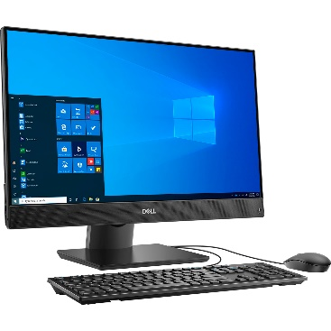
More than just books!
Importance of Libraries in Communities
Access to Information
Educational Support
Community Hub
Digital Inclusion
Resource for Continuing Education
Cultural and Recreational Value
Notes:
Importance of Libraries in Communities
Libraries are more than just book repositories.
Access to Information:
Libraries provide free access to books, e-books, research databases, and the internet.
They offer resources that might otherwise be unaffordable for many individuals.
Educational Support:
Libraries support lifelong learning and literacy development.
They offer educational programs, workshops, and classes for all age groups.
Community Hub:
Libraries serve as community centers, providing a safe and welcoming space for everyone.
They host community events, meetings, and social activities.
Digital Inclusion:
Libraries bridge the digital divide by offering access to computers and digital literacy training.
They help patrons develop essential digital skills for the modern world.
Resource for Continuing Education:
Libraries provide materials and resources for adult education and professional development.
They offer programs and support for career advancement and personal enrichment.
Cultural and Recreational Value:
Libraries promote cultural awareness through diverse collections and cultural events.
They offer recreational activities like book clubs, storytelling, and exhibitions.

Slide 22
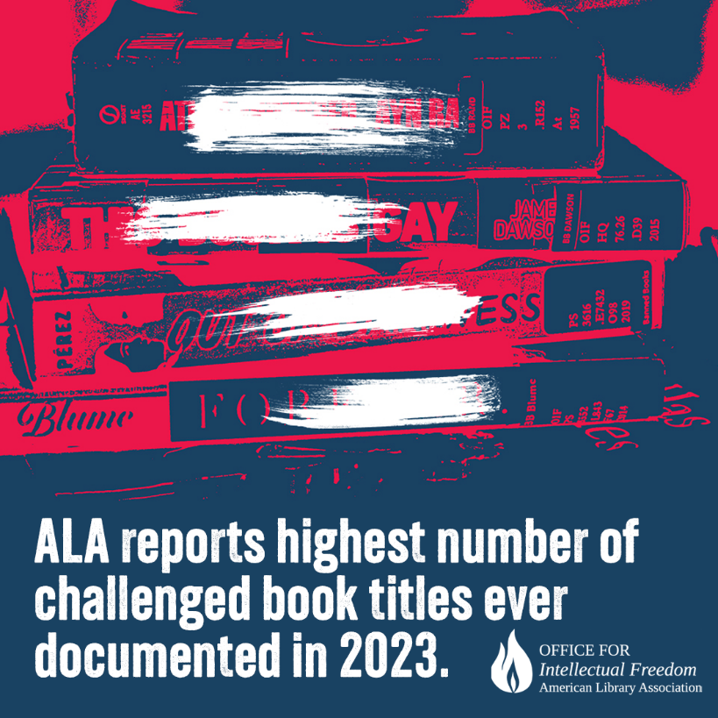
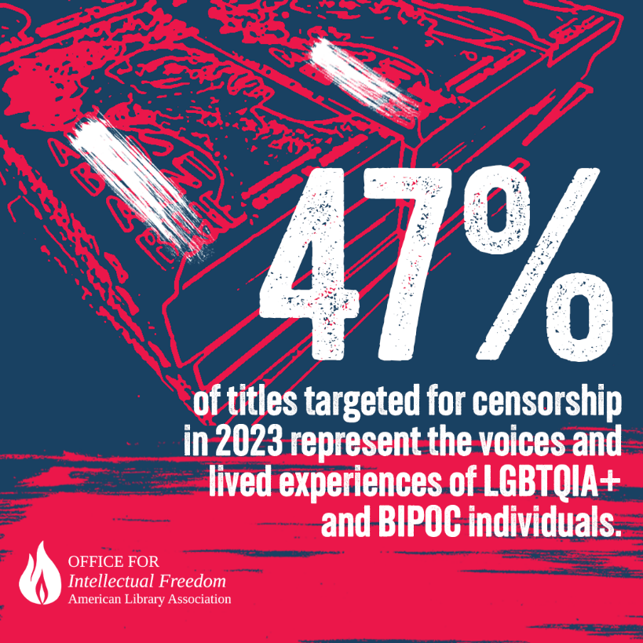
Libraries and Equity: Promoting Social Justice
Notes:
Libraries and Equity: Promoting Social Justice
Libraries protect the ability of individuals to access whatever materials they deem appropriate for themselves and their families, they attempt to keep all materials on the shelves and not let a single ideology determine what is in the collection.

Slide 23
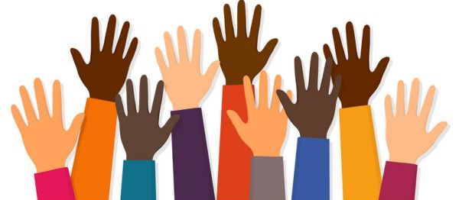
Libraries and Equity: Promoting Social Justice
Access for all
Inclusive Programs and Services
Safe Spaces
Advocacy and Awareness
Digital Equity
Empowering Communities
Notes:
Libraries and Equity: Promoting Social Justice
Public libraries are pivotal in fostering equity and social justice within communities. They strive to provide equal access to information, resources, and opportunities for all individuals, regardless of their socioeconomic status, race, gender, or background. By offering inclusive programs and creating safe, welcoming spaces, libraries work to address systemic inequalities and support the empowerment and upliftment of marginalized and underserved populations.
Access for All:
Libraries provide equal access to information and resources, regardless of socioeconomic status, race, or background.
They ensure everyone has the opportunity to learn and grow.
Inclusive Programs and Services:
Libraries offer programs specifically designed to meet the needs of marginalized and underserved communities.
Examples include literacy programs, language learning resources, and support for individuals with disabilities.
Safe Spaces:
Libraries serve as safe, neutral spaces where all community members are welcome and respected.
They provide refuge and support for vulnerable populations, including the homeless and refugees.
Advocacy and Awareness:
Libraries actively promote awareness of social justice issues through collections, displays, and events.
They host discussions, workshops, and panels on topics such as racism, inequality, and human rights.
Digital Equity:
Libraries help bridge the digital divide by providing free access to technology and the internet.
They offer digital literacy training to ensure everyone can participate in the digital world.
Empowering Communities:
Libraries empower individuals by providing resources for education, employment, and personal development.
They foster community engagement and civic participation.

Slide 24
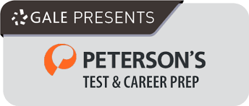
Key Programs for Adult Learners: Literacy
Adult Literacy Tutoring and Workshops
GED Preparation and Support
ESL Classes
Notes:
There are many resources available from libraries. Using our online platform LibbyRead along books on Libby
https://www.learningexpresshub.com/ProductEngine/LELIndex.html#/center/adult-learning-center/home
MANGO languages - A blend of the right content at the right time, with intelligent algorithms, high-quality audio, and powered by proven methodologies, Mango’s adaptive learning process evolves to your progress and unique learning behaviors, preparing you to start the conversation with confidence. They list 99 languages on their website but some are specialty…. Oktoberfest German, French – Wine & Cheese, St. Patrick’s Day Irish… Do you see a theme here for their specialty languages?
Peterson’s - Prepare for standardized tests with ebooks, online courses and full-length practice tests for GED, SAT, ACT, AP, PSAT, GRE, LSAT, MCAT, TOEFL, U.S. citizenship and more. Create your résumé, find your ideal career direction and search for your next job. Their prep also includes journeyman exam prep, cosmetology, real estate, social work.. And it also has resources for foundational skills in math, science, reading, writing.
There are literacy nonprofits in the state that focus on adults. Here are two that I found – one in Whatcom and one in the Seattle area. Nonprofits are amazing partners and collaborating can help lift both your organization and theirs.
Literacy Source – Offers to Seattle area residents ADULT BASIC EDUCATION (ABE), ENGLISH FOR SPEAKERS OF OTHER LANGUAGES (ESOL), CITIZENSHIP PREPARATION, DIGITAL LITERACY, GED PREPARATION and READY TO WORK

Slide 25
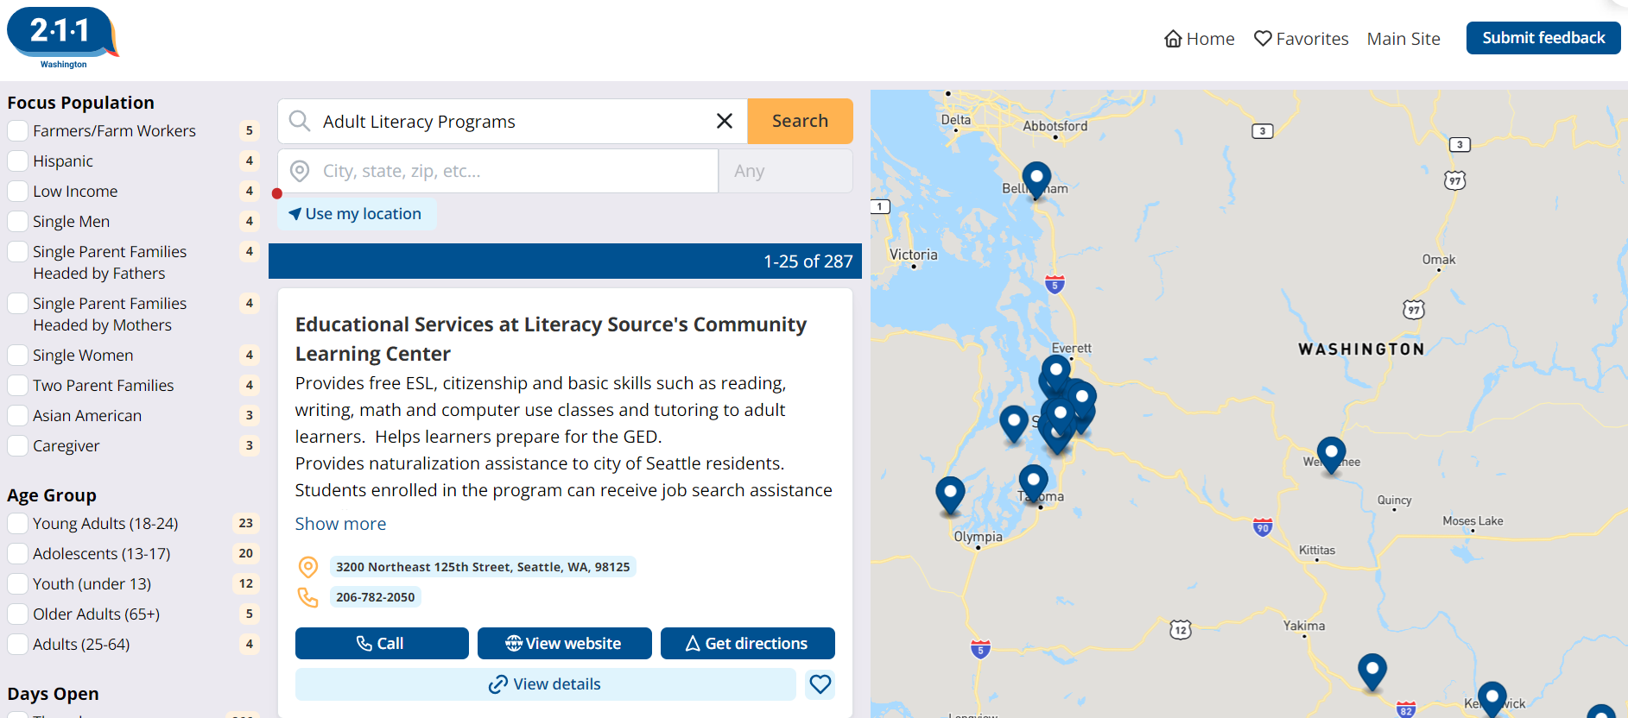
Key Programs for Adult Learners: Literacy
Notes:
2-1-1 has a wealth of information about resources across the state. Lots of investment was made into 2-1-1 during the pandemic. Here it found 287 resources related to adult literacy programs in the state. I used it to search for resume help, it brought up resources.
A quick online search found lots of resources for ESL, GED and adult literacy resources. Reaching out to your library to see if they are aware of other resources is also a great idea always.

Slide 26
Key Programs for Adult Learners: Technology & Digital Literacy
Computer and Internet Basics
Microsoft Office Software Proficiency
Online Safety and Cybersecurity
Notes:
Thanks to the WSL, so many of these are accessible through your local library.
Locally our local law enforcement agencies offer information about online safety and cyber security.
Goodwill Industries offers local digital literacy classes at our libraries and distributed laptops to the public.

Slide 27
Resources for Career Development: Job Search Assistance
Resume Writing and Interview Preparation
Job Search Assistance
Professional Skills Workshops
Notes:
WOW – Women of Wisdom Tri-Cities was awarded $375,000 under the Community Reinvestment Project to
provide no-cost financial coaching including homebuyer education, business coaching, retirement
planning, debt remediation, and more to help community members build a stable financial future. As
part of this program, WOW Tri-Cities also provides career development such as resume building, job
search, interview preparation, and continuing education.
WorkSource has been a tremendous partner for MCL and to our community. They provide us flashdrives with resources on them to help job seekers. We cross promote events, have them host events in our spaces and work together on projects. .
The Benton-Franklin Workforce Development Council (BFWDC) is the convener of regional workforce development efforts and they are working to put a connection site into our Benton City branch a work station, in conjunction with Worksource. Connection sites are publicly available computer(s) with Internet access, the ability to connect to job search services, unemployment, online learning, skills development, etc. They are accessible to the general public during regularly scheduled, posted days and hours. There will be a dedicated work station and computer for this effort.

Slide 28
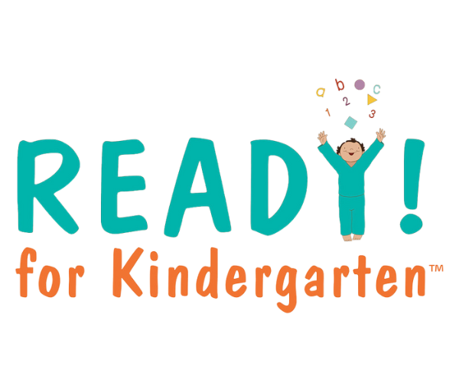
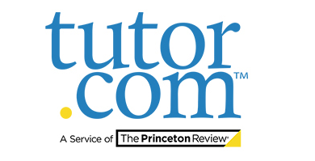
Family Literacy Programs: Supporting Whole Families
Family reading programs and story times
Homework help for children
Parenting resources and workshops
Notes:
Family Literacy Programs: Supporting Whole Families
Briefly introduce the concept of family literacy programs and their significance.
Promoting Intergenerational Learning:
Family literacy programs encourage parents and children to learn together.
They foster a culture of learning within the household, benefiting all family members.
Building Literacy Skills:
Programs are designed to improve reading, writing, and communication skills for both adults and children.
They provide resources and activities that cater to different literacy levels.
Enhancing Parent-Child Bonding:
Activities like storytime, reading clubs, and educational games strengthen the bond between parents and children.
Shared learning experiences create lasting positive memories.
Supporting Parental Involvement:
Programs empower parents to take an active role in their children’s education.
They offer workshops and resources to help parents support their children’s academic progress.
Providing Access to Resources:
Families gain access to books, educational materials, and technology.
Libraries often provide multilingual resources to cater to diverse communities.
Creating a Supportive Community:
Family literacy programs build a sense of community among participating families.
They offer opportunities for families to connect, share experiences, and support one another.

Slide 29
Future Directions: Innovation and Growth in Libraries
Expanding digital resources
Strengthening community partnerships
Advocating for public library funding and support
Notes:
Future Directions: Innovation and Growth in Libraries
Libraries do not exist in a vacuum – they are there to serve.
Through providing access to knowledge, as well as an open, welcoming public space, they help others help themselves.
But they are also dependent on external support. This isn’t just about the politicians, officials or senior management who decide on budgets, staffing, or laws. It’s also about those who influence the decision-makers, about public opinion itself.
Embracing Digital Transformation:
Expand digital collections and online resources.
Implement advanced technologies like AI and VR for interactive learning experiences.
Enhanced Community Engagement:
Develop more community-centered programs and services.
Increase partnerships with local organizations and schools.
Advocacy for Libraries:
Advocate for increased funding and resources to support library initiatives.
Raise public awareness about the vital role libraries play in communities.
Engage with policymakers and stakeholders to champion the importance of libraries.

Slide 30
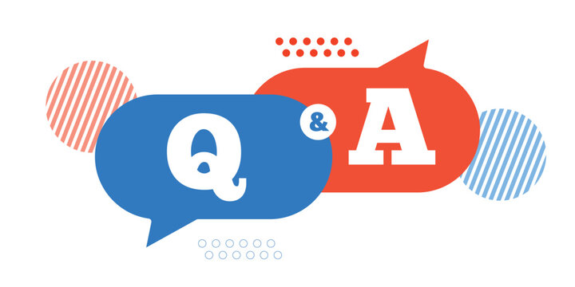
Questions?
Comments?
Cool library stories?
Something new you learned?

Slide 31
Contact
Contact Information
Elissa Burnley
eburnley@midcolumbialibraries.org
Sara Schwan
sschwan@midcolumbialibraries.org
Notes:
Contact Information

Slide 32
Contact

