Slide 1
Beyond Accommodations in Higher Education 2.0
Justice versus Equity Framework
Terry Watson, MS
Strategies For Justice, BWMP LLC
Penn State University, World Campus
Notes:
1- minutes
All:
Welcome remarks
Name
Strategies for Justice slogan
Penn State World Campus Accessibility Team

Slide 2
Agenda
Introduction
Who is in the room?
Rules of engagement.
Basic Information
Terminology
Four Corners
Anxiety, assumptions, and attachments
Break
Notes:
2- minutes
andrəˌɡäjē
All
Cover the Agenda
Review of relevant history and data:
Inclusive Learning Model (ILM)
Pedagogy Concepts
Eminent Knowledge
Cultural Task
Disability Personas
Process, Procedures, Resource Analysis (PPR)
Unique challenges and misconceptions
Cultural Task Redefined
Closing

Slide 3
Agenda, pg 2
What is disability equity? -Advantages and limitations
What is disability justice? -Advantages and limitations
Break
Go over the 10 principles of disability justice
Break
Disability Principle round table (Group activity)
Break
Tour of the round tables (Group activities)
Groups will share out
Wrap up and conclude
Notes:
2- minutes
andrəˌɡäjē
All
Cover the Agenda
Review of relevant history and data:
Inclusive Learning Model (ILM)
Pedagogy Concepts
Eminent Knowledge
Cultural Task
Disability Personas
Process, Procedures, Resource Analysis (PPR)
Unique challenges and misconceptions
Cultural Task Redefined
Closing

Slide 4
Learning objectives
Define the difference between the disability equity framework and the disability justice framework and why it makes a difference.
Explore the ten principles of disability justice concerning educational practices and theories.
Work through analyzing and preparing disability justice initiatives.
Work through evaluating and continuing disability justice work within your departments/units/institutions.
Notes:
2- minutes
All
Cover Learning objectives;
Apply UDL principles to your pedagogy and method/mode of teaching.,
Identify three ways to create/enhance teaching and learning environments to be more inclusive to individuals with disabilities.
Identify techniques to go from an equity to a liberation framework
Develop institutional competencies to engage in conversations inside and outside of the classroom setting.

Slide 5
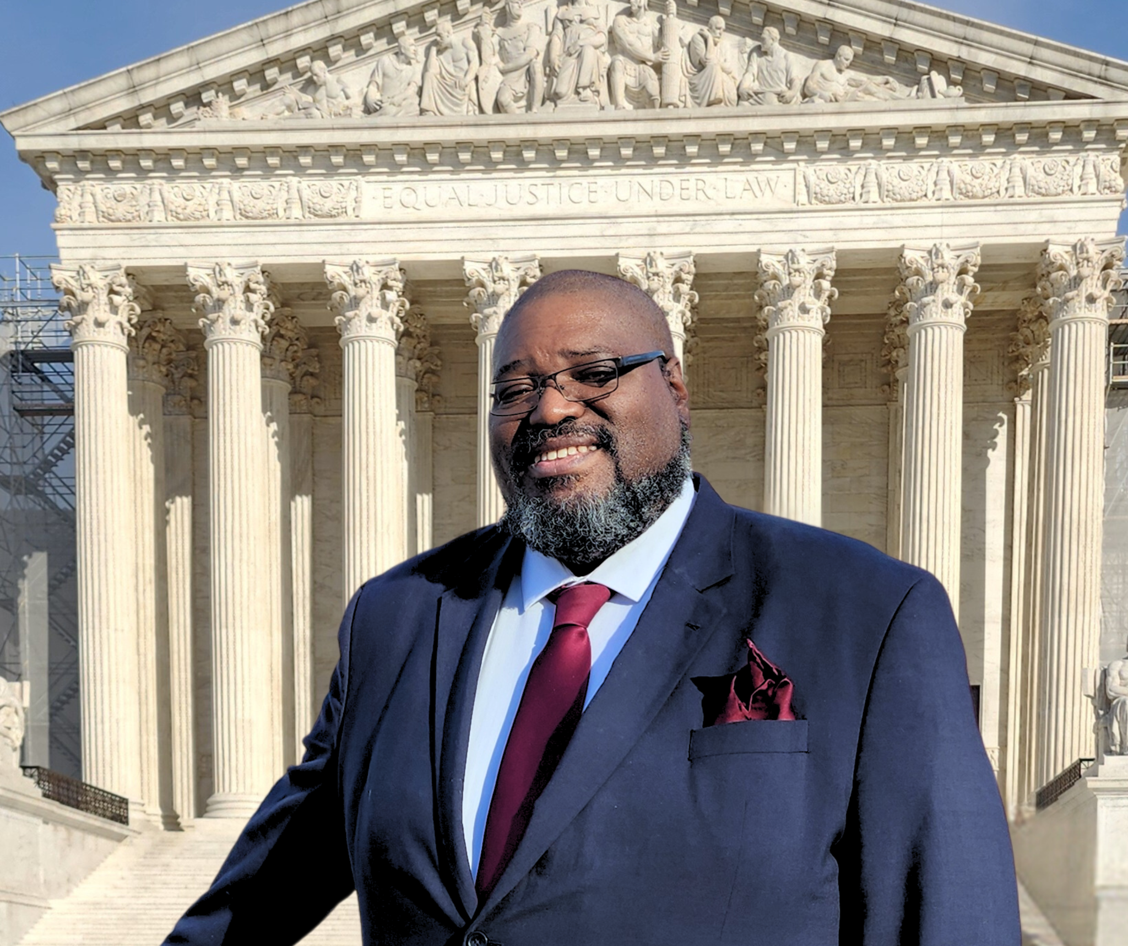
Who is presenting?
Terry Watson, M.S.
Disability Services [13]
Higher Ed [20]
Award winning Author
Artist
A person w. disability
Son w. a disability
Disability advocacy within government

Slide 6
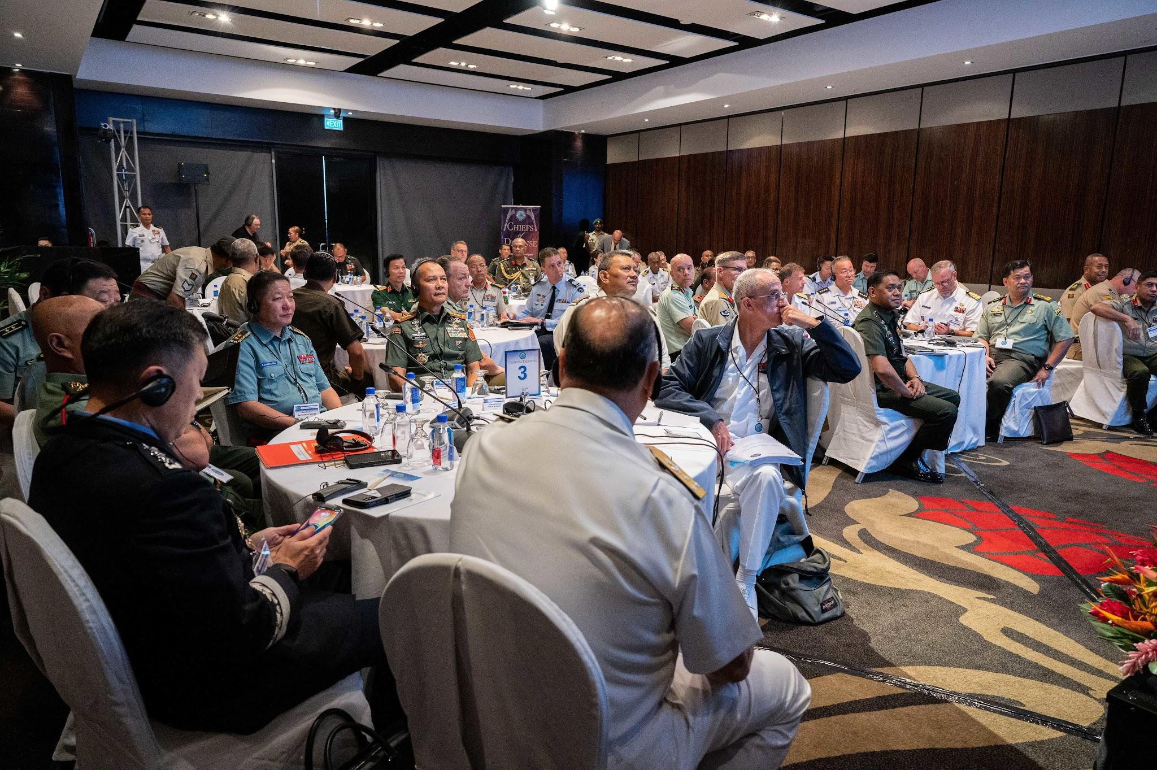
Who is in the room?
What do you wish to gain from this workshop?
Complete this statement:
When I think about disability equity, the first thing that comes to mind is…
When I think about disability justice, the first thing that comes to mind is…

Slide 7
Rules of engagement
Stay present: Embrace this moment and share this space.
Avoid Judgment: Our aim is to learn, grow, and nurture curiosity.
Silence is valuable; honor and respect it: Listen attentively to both spoken and unspoken words, recognizing that everyone's journey is unique.
Be mindful of anxieties, assumptions, and attachments: Strive for genuine interaction and address barriers hindering our ideal environment.
Express your truth and be open to others' perspectives: Draw from your own experiences, thoughts, and emotions while being receptive to others.
Invoke curiosity in challenging situations: When faced with complexity, explore the reasons behind it and its significance at that moment.

Slide 8
Rules of engagement continues
Is there anything you would like to contribute to the rules of engagement?

Slide 9
Cultural Task
The term Cultural Task is meant to identify a problem statement by examining the current culture and student experience.
The identification of the cultural task(s) happens when a unit, college, or department has identified potential barriers or tension within the UDL framework that is present in their academic unit. These potential barriers or gaps may prohibit a qualified student from gaining “Eminent Knowledge”
Notes:
2- minutes
Go over cultural task (read)

Slide 10
Cultural Task Statement
Student Needs
(Cultural Task)
“Providing a person using a screen reader with documents about registering for courses.”
Potential barriers or tension within the Universal Design Learning framework
Patterns of beliefs, behaviors, knowledge
Transmitting of eminent knowledge
Notes:
3- minutes
Preparing for next break out session.
Ok, now that you have your eminent knowledge, lets work on your cultural task.
Your eminent knowledge and mode/method will be in this statement, the one thing we have to do is identify your student need or the potential barriers or tension within the UDL framework (engagement, representation, action & expression).

Slide 11
Cultural Task Statement/Modality
Student Needs
(Cultural Task)
Providing information
“Providing [enter potential UDL barrier] with [enter pattern here] about [enter eminent knowledge.”
Receiving information
“Receiving [enter pattern here] regarding [enter eminent knowledge] from [enter potential UDL barrier]”
Notes:
10- minutes (3 minutes on personas and 7 on CTS)
Lets go to the whiteboard
Same Groups of no more than 5.
Lets create your cultural task statement.
Notice the difference between providing information and receiving information.
How do we select a potential barrier?
Take a look at personas. (Go over persona slides, then come back to this slide)
Questions:
Who did you chose to work with and why?
Advise:
If your modality has to do with websites, documents, forms,, consider using Sean
If your modality has anything to do with communicating, consider using Andy or Michael
If your modality comes with a deadline, consider using Phil or Sarah.

Slide 12
Institutional Competencies
Student Needs
(Cultural Task)
Unique Challenges
Misconceptions
Institutional Procedure, Processes, and Resources
Cultural Task Redefined

Slide 13
Approaches to Disability
Medical model
Moral model
Social model
Disability Justice
Gatekeeper vs. educator
Notes:
5- minutes
Medical model:
The Medical Model views disability as a defect within the individual. Disability is an aberration compared to normal traits and characteristics. In order to have a high quality of life, these defects must be cured, fixed, or completely eliminated. (https://odpc.ucsf.edu/clinical/patient-centered-care/medical-and-social-models-of-disability)
And in some cases, this is how we still do accommodation and academic adjustments in higher education.
Social model:
The social model of disability is a way of viewing the world, developed by disabled people. This is what we should strive for. (https://www.scope.org.uk/about-us/social-model-of-disability/)
Disability Justice: Disability Justice centers intersectionality and the ways diverse systems of oppression amplify and reinforce one another., https://static1.squarespace.com/static/5bed3674f8370ad8c02efd9a/t/5f1f0783916d8a179c46126d/1595869064521/10_Principles_of_DJ-2ndEd.pdf
Patty Berne 10 principles: Intersectionality, Leadership of Those Most Impacted, Anti-Capitalist Politic and a Commitment to Cross Movement Organizing, Recognizing Wholeness, Sustainability, Committment to Cross Disability Solidarity, Interdependence, Collective Access, Collective Liberation
What model (moral, social, medical) does your institution prescribe?
What do you hope to achieve from attending this workshop?
How we view disabilities also will dictate how we approach accommodations and students who receive accommodations.
The tone you set can impact a student from disclosing their accommodations.
Gatekeeper vs. educator
A person who controls access
Educate: “Bring up, rear” -Jane Elliott-

Slide 14
Four Corners
A
I am very experienced and comfortable distinguishing between disability equity vs. disability justice.
B
I am very experienced, but I am not comfortable distinguishing between disability equity vs. disability justice.
C
I have little-to-no experience but is comfortable distinguishing between disability equity vs. disability justice.
D
I have little-to-no experience and I am not comfortable distinguishing between disability equity vs. disability justice.
Notes:
20- minutes [15 minutes Group Discussion, 5 minutes to wrap up]
If using whiteboard, allow participants to move put their initials or name in the corner. They will be able to move around as well.
https://jamboard.google.com/d/1LJSPzMEBhKO8z4vqgqMZ3P8XEsMgELqLzAQEnS8M8GA/edit?usp=drive_link
Do first break out here::
I will read the statement and we will have four break out rooms (A, B, C, D). Please remember the letter you select. This group will get back together at the end.
Questions to addressed during the breakout rooms.
Talking points
What do you hope to gain from this experience?
What does it mean to be in the quadrant you selected?
How does it impact the student experience?
Come back as a group and discuss
Break if needed

Slide 15
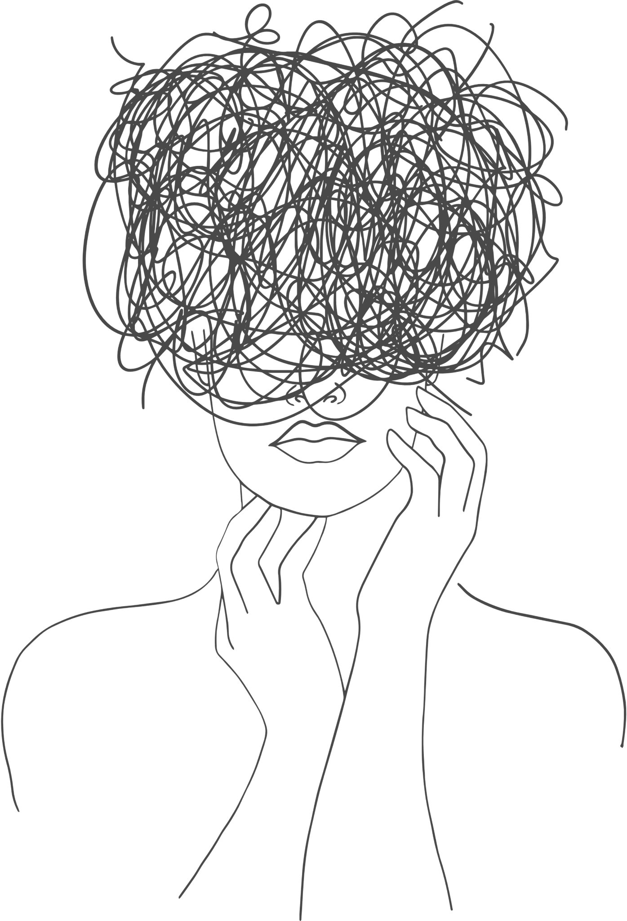
Anxieties, Attachments, and Assumptions
Assumptions
Anxieties
Attachments

Slide 16
Anxieties
Conservatism Bias
“Better safe than sorry.”
“Walking on eggshells.”

Slide 17
Assumptions
Unconscious Bias
“My way or the highway.”
Presents a barrier to critical reflection

Slide 18
Attachments
Confirmation Bias
Negative Bias
“This is outside of my control.”
“I am beginning to doubt myself.”
A combination of anxieties and assumptions

Slide 19
Break?

Slide 20
What is Disability Equity?
“Civil rights law …designed to ensure that people with disabilities have the same rights and opportunities as everyone else by prohibiting discrimination in employment, education, transportation and other aspects of public life.
“Equity involves providing resources according to the need to help diverse populations achieve their highest state of health and other functioning.”
American Psychological Association

Slide 21
Disability Equity: Advantages and limitations
What are the advantages?
What are the limitations?
Notes:
Advantages:
legislation that protects Americans with disabilities
DOJ, DOE, OCR – provide interpretation
Focuses on the civil rights of individuals with disabilities

Slide 22
What is Disability Justice
“Disabled people live at the intersection of all systems of oppression and social justice issues. There isn’t one issue or one intersection where you will not find disabled individuals advocating for or experiencing the effects of those issues.”
— Daphne Frias,
“If government is to serve the people, then disability justice must be a framework we bring to every policy discussion.”
(Pressley & Cokley, 2021)
Notes:
“Disabled people live at the intersection of all systems of oppression and social justice issues. There isn’t one issue or one intersection where you will not find disabled individuals advocating for or experiencing the effects of those issues.” — Daphne Frias, youth activist, organizer, storyteller, and peacebuilder.

Slide 23
Disability Justice: Advantages and limitations
What are the advantages?
What are the limitations?

Slide 24
DISABILITY JUSTICE PRINCIPLES (DJP)
INTERSECTIONALITY
LEADERSHIP OF THE MOST IMPACTED
ANTI-CAPITALIST POLITICS
CROSS-MOVEMENT SOLIDARITY
RECOGNIZING WHOLENESS
SUSTAINABILITY
COMMITMENT TO CROSS-DISABILITY SOLIDARITY
INTERDEPENDENCE
COLLECTIVE ACCESS
COLLECTIVE LIBERATION
Framework was developed by Sins Invalid
https://www.sinsinvalid.org/curriculum
Notes:
What does this principle mean to you?
If you were to bring one of these principles back to your classroom/institution/organization, what would it be and why?
What do you think would be the greatest barrier? Are there any educational practices or theories that you think would cause tension?
Who would need to be a part of this conversation at your institution/organization?

Slide 25
DJP: Intersectionality
“Simply put, this principle says that we are many things, and they all impact us.
We are not only disabled, we are also each coming from a specific experience
of race, class, sexuality, age, religious background, geographical location,
immigration status, and more.”
INTERSECTIONALITY
Framework was developed by Sins Invalid
https://www.sinsinvalid.org/curriculum
Notes:
1. INTERSECTIONALITY
Simply put, this principle says that we are many things, and they all impact us.
We are not only disabled, we are also each coming from a specific experience
of race, class, sexuality, age, religious background, geographical location,
immigration status, and more. Depending on context, we all have areas where we
experience privilege, as well as areas of oppression. The term “intersectionality”
was first introduced by feminist theorist Kimberlé Crenshaw in 1989 to describe the
experiences of Black women, who experience both racism and sexism in specific
ways. We gratefully embrace the nuance that this principle brings to our lived
experiences, and the ways it shapes the perspectives we offer.
What does this principle mean to you?
If you were to bring one of these principles back to your classroom/institution/organization, what would it be and why?
What do you think would be the greatest barrier? Are there any educational practices or theories that you think would cause tension?
Who would need to be a part of this conversation at your institution/organization?

Slide 26
DJP: LEADERSHIP OF THE MOST IMPACTED
“we are lifting up, listening to, reading, following, and highlighting the perspectives
of those who are most impacted by the systems we fight against. By centering the
leadership of those most impacted, we keep ourselves grounded in real-world
problems and find creative strategies for resistance.”
LEADERSHIP OF THE MOST IMPACTED
Framework was developed by Sins Invalid
https://www.sinsinvalid.org/curriculum
Notes:
2. LEADERSHIP OF THOSE MOST IMPACTED
When we talk about ableism, racism, sexism & transmisogyny, colonization, police
violence, etc., we are not looking to academics and experts to tell us what’s what —
we are lifting up, listening to, reading, following, and highlighting the perspectives
of those who are most impacted by the systems we fight against. By centering the
leadership of those most impacted, we keep ourselves grounded in real-world
problems and find creative strategies for resistance.
What does this principle mean to you?
If you were to bring one of these principles back to your classroom/institution/organization, what would it be and why?
What do you think would be the greatest barrier? Are there any educational practices or theories that you think would cause tension?
Who would need to be a part of this conversation at your institution/organization?

Slide 27
DJP: ANTI-CAPITALIST POLITICS
“Our worth is not dependent on what and how much we can produce.”
ANTI-CAPITALIST POLITICS
Framework was developed by Sins Invalid
https://www.sinsinvalid.org/curriculum
Notes:
3. ANTI-CAPITALIST POLITICS
Capitalism depends on wealth accumulation for some (the white ruling class), at the
expense of others, and encourages competition as a means of survival. The nature
of our disabled bodyminds means that we resist conforming to “normative” levels
of productivity in a capitalist culture, and our labor is often invisible to a system that
defines labor by able-bodied, white supremacist, gender normative standards. Our
worth is not dependent on what and how much we can produce.
What does this principle mean to you?
If you were to bring one of these principles back to your classroom/institution/organization, what would it be and why?
What do you think would be the greatest barrier? Are there any educational practices or theories that you think would cause tension?
Who would need to be a part of this conversation at your institution/organization?

Slide 28
DJP: CROSS-MOVEMENT SOLIDARITY
“Disability justice can only grow into its potential as a movement by aligning itself
with racial justice, reproductive justice, queer and trans liberation, prison abolition,
environmental justice, anti-police terror, Deaf activism, fat liberation, and other
movements working for justice and liberation.”
CROSS-MOVEMENT SOLIDARITY
Framework was developed by Sins Invalid
https://www.sinsinvalid.org/curriculum
Notes:
4. CROSS-MOVEMENT SOLIDARITY
Disability justice can only grow into its potential as a movement by aligning itself
with racial justice, reproductive justice, queer and trans liberation, prison abolition,
environmental justice, anti-police terror, Deaf activism, fat liberation, and other
movements working for justice and liberation. This means challenging white disability
communities around racism and challenging other movements to confront ableism.
Through cross-movement solidarity, we create a united front.
What does this principle mean to you?
If you were to bring one of these principles back to your classroom/institution/organization, what would it be and why?
What do you think would be the greatest barrier? Are there any educational practices or theories that you think would cause tension?
Who would need to be a part of this conversation at your institution/organization?

Slide 29
DJP: RECOGNIZING WHOLENESS
“Each person is full of history and life experience. Each person has an internal
experience composed of our own thoughts, sensations, emotions, sexual fantasies,
perceptions, and quirks. Disabled people are whole people.”
RECOGNIZING WHOLENESS
Framework was developed by Sins Invalid
https://www.sinsinvalid.org/curriculum
Notes:
5. RECOGNIZING WHOLENESS
Each person is full of history and life experience. Each person has an internal
experience composed of our own thoughts, sensations, emotions, sexual fantasies,
perceptions, and quirks. Disabled people are whole people.
What does this principle mean to you?
If you were to bring one of these principles back to your classroom/institution/organization, what would it be and why?
What do you think would be the greatest barrier? Are there any educational practices or theories that you think would cause tension?
Who would need to be a part of this conversation at your institution/organization?

Slide 30
DJP: SUSTAINABILITY
“We learn to pace ourselves, individually and collectively, to be sustained long-term.
We value the teachings of our bodies and experiences, and use them as a critical
guide and reference point to help us move away from urgency and into a deep,
slow, transformative, unstoppable wave of justice and liberation.”
SUSTAINABILITY
Framework was developed by Sins Invalid
https://www.sinsinvalid.org/curriculum
Notes:
6. SUSTAINABILITY
We learn to pace ourselves, individually and collectively, to be sustained long-term.
We value the teachings of our bodies and experiences, and use them as a critical
guide and reference point to help us move away from urgency and into a deep,
slow, transformative, unstoppable wave of justice and liberation.
What does this principle mean to you?
If you were to bring one of these principles back to your classroom/institution/organization, what would it be and why?
What do you think would be the greatest barrier? Are there any educational practices or theories that you think would cause tension?
Who would need to be a part of this conversation at your institution/organization?

Slide 31
DJP: COMMITMENT TO CROSS-DISABILITY SOLIDARITY
“we are lifting up, listening to, reading, following, and highlighting the perspectives
of those who are most impacted by the systems we fight against. By centering the
leadership of those most impacted, we keep ourselves grounded in real-world
problems and find creative strategies for resistance.
COMMITMENT TO CROSS-DISABILITY SOLIDARITY
Framework was developed by Sins Invalid
https://www.sinsinvalid.org/curriculum
Notes:
7. COMMITMENT TO CROSS-DISABILITY SOLIDARITY
We value and honor the insights and participation of all of our community members,
even and especially those who are most often left out of political conversations. We
are building a movement that breaks down isolation between people with physical
impairments, people who are sick or chronically ill, psych survivors and people
with mental health disabilities, neurodiverse people, people with intellectual or
developmental disabilities, Deaf people, Blind people, people with environmental
injuries and chemical sensitivities, and all others who experience ableism and
isolation that undermines our collective liberation.
What does this principle mean to you?
If you were to bring one of these principles back to your classroom/institution/organization, what would it be and why?
What do you think would be the greatest barrier? Are there any educational practices or theories that you think would cause tension?
Who would need to be a part of this conversation at your institution/organization?

Slide 32
DJP: INTERDEPENDENCE
“We work to meet each other’s needs as we build toward
liberation, without always reaching for state solutions which inevitably extend state
control further into our lives..
INTERDEPENDENCE
Framework was developed by Sins Invalid
https://www.sinsinvalid.org/curriculum
Notes:
8. INTERDEPENDENCE
Before the massive colonial project of Western European expansion, we understood
the nature of interdependence within our communities. We see the liberation of all
living systems and the land as integral to the liberation of our own communities, as
we all share one planet. We work to meet each other’s needs as we build toward
liberation, without always reaching for state solutions which inevitably extend state
control further into our lives.
What does this principle mean to you?
If you were to bring one of these principles back to your classroom/institution/organization, what would it be and why?
What do you think would be the greatest barrier? Are there any educational practices or theories that you think would cause tension?
Who would need to be a part of this conversation at your institution/organization?

Slide 33
DJP: COLLECTIVE ACCESS
“We can share responsibility for our access needs, we can ask that our needs be met without compromising our integrity, we can balance autonomy while being in community, we can be unafraid of our vulnerabilities, knowing our strengths are respected.”
COLLECTIVE ACCESS
Framework was developed by Sins Invalid
https://www.sinsinvalid.org/curriculum
Notes:
9. COLLECTIVE ACCESS
As Black and brown and queer crips, we bring flexibility and creative nuance to our
engagement with each other. We create and explore ways of doing things that go
beyond able-bodied and neurotypical norms. Access needs aren’t shameful — we
all function differently depending on context and environment. Access needs can
be articulated and met privately, through a collective, or in community, depending
upon an individual’s needs, desires, and the capacity of the group. We can share
responsibility for our access needs, we can ask that our needs be met without
compromising our integrity, we can balance autonomy while being in community, we
can be unafraid of our vulnerabilities, knowing our strengths are respected.
What does this principle mean to you?
If you were to bring one of these principles back to your classroom/institution/organization, what would it be and why?
What do you think would be the greatest barrier? Are there any educational practices or theories that you think would cause tension?
Who would need to be a part of this conversation at your institution/organization?

Slide 34
DJP: COLLECTIVE LIBERATION
“We move together as people with mixed abilities, multiracial, multi-gendered, mixed
class, across the sexual spectrum, with a vision that leaves no body or mind behind..”
COLLECTIVE LIBERATION
Framework was developed by Sins Invalid
https://www.sinsinvalid.org/curriculum
Notes:
10. COLLECTIVE LIBERATION
We move together as people with mixed abilities, multiracial, multi-gendered, mixed
class, across the sexual spectrum, with a vision that leaves no bodymind behind.
This is disability justice. We honor the longstanding legacies of resilience and
resistance which are the inheritance of all of us whose bodies and minds will not
conform. Disability justice is not yet a broad based popular movement. Disability
justice is a vision and practice of what is yet-to-be, a map that we create with our
ancestors and our great-grandchildren onward, in the width and depth of our
multiplicities and histories, a movement towards a world in which every body and
mind is known as beautiful.
What does this principle mean to you?
If you were to bring one of these principles back to your classroom/institution/organization, what would it be and why?
What do you think would be the greatest barrier? Are there any educational practices or theories that you think would cause tension?
Who would need to be a part of this conversation at your institution/organization?

Slide 35
Break 2?

Slide 36
Disability Justice Principles Round Tables Set up: Step 1
Break up into groups (pre-assigned)
Create a group name
Select a cultural task from the facilitator
Notes:
Break up into groups (pre-assigned) Should be 4-6 per group
Break up into groups (preferably 4-6/ pre-assigned) Each group will come up with a group name. Select a cultural task from the facilitator. This will be your cultural task, throughout this presentation.
NOTE: It is a good idea to select a designated write and speaker.

Slide 37
Disability Justice Principles Round Tables Set up: Step 2
Groups Name
At your group’s table, grab a Post-it Easel Pad Sheet
On the most top available space, write your groups name
Directly under your group name, write your group’s cultural task.
Draw a horizontal line under your cultural task then draw a vertical line underneath the horizontal line.
Groups Cultural Task

Slide 38
Disability Justice Principles Round Tables Set up: Step 3
Groups Name
Anonymously select two Disability Justice Principle cards from the envelope
On one side, write down one principle and on the other side write down the second principle.
Discuss what your cultural task look like through the lens of the principles you selected. Write it down underneath the principle.
Groups Cultural Task
DJP 1
DJP 2
Completing this cultural task under this principle means we should do or avoid the following
Completing this cultural task under this principle means we should do or avoid the following

Slide 39
DJP Roundtable: Anxiety, Assumptions, and Attachments. Step 4
Anxieties
Groups Name
Groups Cultural Task
DJP 1
DJP 2
Assumptions
Completing this cultural task under this principle means we should do or avoid the following
Completing this cultural task under this principle means we should do or avoid the following
1
2
3
4
5
6
1
2
3
4
5
6
Attachments
Notes:
In your group discuss what anxieties, attachments, and assumptions might come into play when addressing your cultural task through these two principles.
Organize your anxiety, assumption, or attachment from least to most impactful? Which would be the most difficult to address and why?
If time permits, select two new disability justice cards and repeat Steps 1-4
Place all used disability justice cards in the envelope

Slide 40
Break 3?

Slide 41
Tour of the round tables
Now visit other groups principles and read over the cultural task and the principles they worked with.
Using the pink sticky note. Write down ways you would deal with the listed anxieties, assumptions, or attachments.
Place it under the Blue, Green, and Yellow notes.
Groups Name
Groups Cultural Task
DJP 1
DJP 2
Completing this cultural task under this principle means we should do or avoid the following
Completing this cultural task under this principle means we should do or avoid the following
Notes:
Now visit other groups principles and read over the cultural task and the principles they worked with.
You should have a pink sticky note. Write down ways you would deal with the listed anxieties, assumptions, or attachments. Be as detailed as you like. Place it under the Blue, Green, and Yellow notes.
Do this for all other stations, time permitting
Go back to your groups table
Look at what others wrote.

Slide 42
Evaluate your DJP project
Look over what others left you (Pink post it notes)
As a group address the following questions:
Organize your feedback from least helpful to most helpful. Write down which feedback you found most helpful?
How and to whom would you present this cultural task to with this DJP in mind? How would you incorporate the feedback?
Groups Name
Groups Cultural Task
DJP 1
DJP 2
Completing this cultural task under this principle means we should do or avoid the following
Completing this cultural task under this principle means we should do or avoid the following
Notes:
Now visit other groups principles and read over the cultural task and the principles they worked with.
You should have a pink sticky note. Write down ways you would deal with the listed anxieties, assumptions, or attachments. Be as detailed as you like. Place it under the Blue, Green, and Yellow notes.
Do this for all other stations, time permitting
Go back to your groups table
Look at what others wrote.

Slide 43
Team report out
Tell us your team's name
Tell us your cultural task.
Tells us which disability justice principles you worked with today.
Tells us about your most impactful Anxieties, Assumptions, or Attachments. How would you address this?
Tell us about the feedback you received and which one you decided was most useful.
Demonstrate as a team, how would you use all this information.

Slide 44
Learning objective revisited
Define the difference between the disability equity framework and the disability justice framework and why it makes a difference.
Explore the ten principles of disability justice concerning educational practices and theories.
Work through analyzing and preparing disability justice initiatives.
Work through evaluating and continuing disability justice work within your departments/units/institutions.

Slide 45
Continue to plan
Timeline | What task are you working on? | Who will work on it? | What is needed?
Within a week…
Within 30 days…
Within a semester…
Within an academic year…
Ongoing…
Notes:
5- minutes
Lets discuss the power of cultural task redefined.
If you have a CTR, then you can start to open the door of education for all.
Feel free to use this format for any plan you have.
When we work with a team, we go in with a year commitment. We check in on their progress 3, 6, 9, and 12 months, however, we encourage teams to following the timeline above.
We want you to identify a task that you are going to work on.
Identify who is going to work on that task and what they will need. This can be part of a unit’s goals, or an individual goal.
With in the first week, you should meet with the ILW team to discuss what you are thinking and identify resources.
Within 30 days, you should take a look at those resources and determine what is needed (ie., time, funds, supports, technology, etc.)
By the end of the year, you should have updated your procedure or practice to include this inclusive pedogagy.

Slide 46
Questions

Slide 47
Resources
National Center for Education Statistics (NCES): The National Center for Education Statistics (NCES) is the primary federal entity for collecting and analyzing data related to education in the U.S. and other nations.
National Center for Education Statistics (NCES): The National Center for Education Statistics (NCES) is the primary federal entity for collecting and analyzing data related to education in the U.S. and other nations.
Universal Design with Personas: Open Educational resource managed by a team at Penn State World Campus, and its primary purpose is to host our personas of students with disabilities.

Slide 48
Reference P. 01
“UDL: The UDL Guidelines.” UDL: The UDL Guidelines, 2 Sept. 2022, udlguidelines.cast.org.
Berne. (2015, June 10). Disability Justice - a working draft by Patty Berne &mdash; Sins Invalid. Sins Invalid. Retrieved October 22, 2022, from https://www.sinsinvalid.org/blog/disability-justice-a-working-draft-by-patty-berne
Izzo, M. V., Murray, A., & Novak, J. (2008). The Faculty Perspective on Universal Design for Learning. Journal of Postsecondary Education and Disability, 21(2), 60-72.
Ladau, Emily. "Demystifying disability : what to know, what to say, and how to be an ally." Emeryville : Ten Speed Press, 2021.
Pedagogy, andragogy, & heutagogy. Pedagogy, Andragogy, & Heutagogy | University of Illinois Springfield. (n.d.). https://www.uis.edu/colrs/teaching-resources/foundations-good-teaching/pedagogy-andragogy-heutagogy
(2022). Section 504, Rehabilitation Act of 1973. U.S. Department Of Labor. https://www.dol.gov/agencies/oasam/centers-offices/civil-rights-center/statutes/section-504-rehabilitation-act-of-1973Links to an external site.
(2022). ADA@30: The Americans with Disabilities Act 1990-2020. U.S. Equal Employment Opportunity Commission. https://www.eeoc.gov/ada30-americans-disabilities-act-1990-202Links to an external site.0
(2022). The Americans with Disabilities Act Amendments Act of 2008. U.S. Equal Employment Opportunity Commission. https://www.eeoc.gov/statutes/americans-disabilities-act-amendments-act-2008

Slide 49
Reference P. 02
Pressley, A., & Cokley, R. (2021). There Is No Justice That Neglects Disability. Stanford Social Innovation Review, 20(1), 2–4. https://doi.org/10.48558/F3MT-ZT59
Pappas, S. (2020, November 1). Despite the ADA, equity is still out of reach. Monitor on Psychology, 51(8). https://www.apa.org/monitor/2020/11/feature-ada
Betts, et al.. UNDERSTANDING DISABILITIES & ONLINE STUDENT SUCCESS. The Online Learning Consortium, Oct. 2013, doi:10.24059/olj.v17i3.388.
Rothwell, W. J., Ealy, P. L., & Campbell, J. (2022). Rethinking Organizational Diversity, Equity, and Inclusion: A Step-by-Step Guide for Facilitating Effective Change. Taylor and Francis. https://doi.org/10.4324/9781003184935
Edgar H. Schein, & Peter A. Schein. (2021). Humble Inquiry, Second Edition : The Gentle Art of Asking Instead of Telling: Vol. Second edition, revised and expanded. Berrett-Koehler Publishers.
Beauchamp-Pryor, K. (2012). From absent to active voices: securing disability equality within higher education. International Journal of Inclusive Education, 16(3), 283–295. https://doi.org/10.1080/13603116.2010.489120

Slide 50
Questions & Comments
Terry L. Watson (He/Him)
Penn State University
Strategies for Justice
admin@strategiesjustice.com
tlw37@psu.edu
www.strategiesjustice.com
Notes:
10- minutes
Q&A

Slide 51
“The stories of ableism I’ve experienced in my lifetime could easily have filled every page of this book and then some.”
Emily Ladau- Demystifying Disability: What to know, What to Say, and How to be an Ally.
Notes:
1- minutes
The important aspect of collecting the narrative of individuals with disabilities is what this work shop is founded on.

