Slide 1
Contemporary Media Meets Culturally Responsive Instruction: A Roundtable for Educators
Facilitators: Troy Goracke & Nicole Daughtry

Slide 2
Facilitator Introductions
Troy Goracke
Policy Associate, Adult Secondary Completion, Compliance, State Legislative Priorities
Nicole Daughtry
Policy Associate, I-BEST, Ability to Benefit (ATB), Integrated English & Literacy Civics Education (IELCE)

Slide 3
Participant Introductions
Name
Role

Slide 4
Setting the Stage: Deficit vs Asset Language
Notes:
Troy

Slide 5
Deficit View
Focus on Where Students Fall Short
Low Expectations
Less Rigor

Slide 6
Asset Mindset
Capable of Learning
High Expectations
Using Student Strengths

Slide 7
Educator’s Responsibility
Know Your Students
Understand Strength & Knowledge
Set High Expectations

Slide 8
Quick Start Guide to Film Analysis
Semiotic Analysis
Narrative Analysis
Cultural/Historical Analysis
Mise-en-scène Analysis
Notes:
Nicole

Slide 9
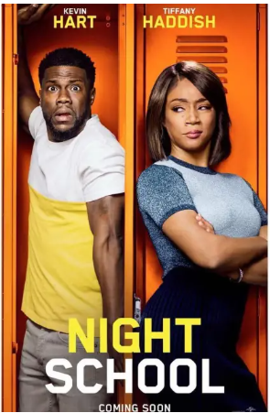
Film:
Night School
Released in 2018
Written & Produced by Kevin Hart
Director, Malcolm D Lee
Main Characters;
Teddy (Ted) Walker, Kevin Hart
Carrie, Tiffany Haddish
Stewart, Taran Killam

Slide 10
Scene Analysis Questions
What imagery did you observe in the scene?
What did you notice about the dialogue between the characters?
What narrative is the filmmaker trying to convey?

Slide 11
Resources
University of North Carolina at Chapel Hill
Writing Center: Film Analysis
https://writingcenter.unc.edu/tips-and-tools/film-analysis/

Slide 12
Thank you!!
Contact Info:
Nicole Daughtry
Policy Associate, I-BEST
Washington State Board for Community and Technical Colleges
ndaughtry@sbctc.edu | 360.704.4368
Troy Goracke
Policy Associate, State GED Administrator
Washington State Board for Community and Technical Colleges
tgoracke@sbctc.edu | 360.704.4361

