Slide 1
Best Practices for Creating Accessible Digital Content
Vicki Walton
July 24, 2024

Slide 2
AGENDA
Definitions
Understanding Accessibility's Significance
Universal Design for Learning (UDL)
Core Concepts for Accessible Content

Slide 3
DEFINITIONS

Slide 4
ACCESSIBLE, ACCESSIBILITY, and INCLUSION
Accessible: “Accessible” means that individuals with disabilities are able to independently acquire the same information, engage in the same interactions, and enjoy the same services within the same timeframe as individuals without disabilities, with substantially equivalent ease of use. (University of Montana 2014 OCR Resolution Agreement 10122118)
Accessibility: Accessibility is the design of products, devices, services, or environments for people with disabilities. The concept of accessible design and practice of accessible development ensures both "direct access" (i.e. unassisted) and "indirect access" meaning compatibility with a person's assistive technology (for example, computer screen readers).
Inclusion: is intricately linked to diversity, equity, accessibility, and belonging.
Notes:
Accessibility Source: https://en.wikipedia.org/wiki/Accessibility
Inclusion Source: https://digital.gov/resources/an-introduction-to-inclusion/

Slide 5
ASSISTIVE TECHNOLOGY and DIGITAL ACCESSIBILITY
Assistive Technology: Primarily, assistive technologies are either software or hardware that exist to enable people with permanent or temporary disabilities to use the computer or mobile device. For example, if you get carpal tunnel syndrome, you can use assistive technologies to accomplish your work without using your hands. Assistive technologies consist of voice interfaces, screen readers, alternate input devices, and much more.
Digital Accessibility: Digital accessibility is the practice of designing digital content and technologies in a way that they can be accessed, understood, and used by as many people as possible, including those with disabilities. It’s about removing barriers in the digital world, creating inclusive online spaces where everyone has equal access to information and digital resources.
Notes:
Digital Accessibility Source: https://userway.org/blog/digital-accessibility/#:~:text=Let's%20get%20started.,navigated%20by%20a%20screen%20reader?

Slide 6
USABILITY versus ACCESSIBLE
There is significant overlap between usability and accessibility, and not always a clear distinction between them.
  Usability is about making products [content] easy to use for all users to perform their intended tasks. [The more usable a digital experience is for everyone, the better their overall user experience will be.]
  Accessibility focuses on designing products so that people with disabilities can use them, making sure there are no barriers preventing equal access.
Notes:
Relationship Between Web Accessibility and Usability Source: https://www.w3.org/WAI/EO/Drafts/access-use/accessibility-n-usability2010-09Sep-09.html#:~:text=Usability%20is%20about%20making%20products,no%20barriers%20preventing%20equal%20access.

Slide 7
DISTINCTIONS and OVERLAPS
Accessibility: addresses discriminatory aspects related to equivalent user experience for people with disabilities. Web accessibility means that people with disabilities can equally perceive, understand, navigate, and interact with websites and tools. It also means that they can contribute equally without barriers. For more information, see the Accessibility introduction.
Usability: is about designing products to be effective, efficient, and satisfying. Usability includes user experience (UX) design. This may include general aspects that impact everyone and do not disproportionally impact people with disabilities. Usability practice and research often does not sufficiently address the needs of people with disabilities.
Inclusion: is about diversity and ensuring involvement of everyone to the greatest extent possible. In some regions this is also referred to as universal design and design for all.
Notes:
Accessibility, Usability, and Inclusion Source: https://www.w3.org/WAI/fundamentals/accessibility-usability-inclusion/

Slide 8
DISABILITY
A disability is any condition of the body or mind (impairment) that makes it more difficult for the person with the condition to do certain activities (activity limitation) and interact with the world around them (participation restrictions).
There are many types of disabilities:
Vision
Movement
Thinking
Remembering
Learning
Communicating
Hearing
Mental health
Social relationships
Notes:
What is Disability Source: https://www.cdc.gov/ncbddd/disabilityandhealth/disability.html#:~:text=What%20is%20disability%3F,around%20them%20(participation%20restrictions)

Slide 9
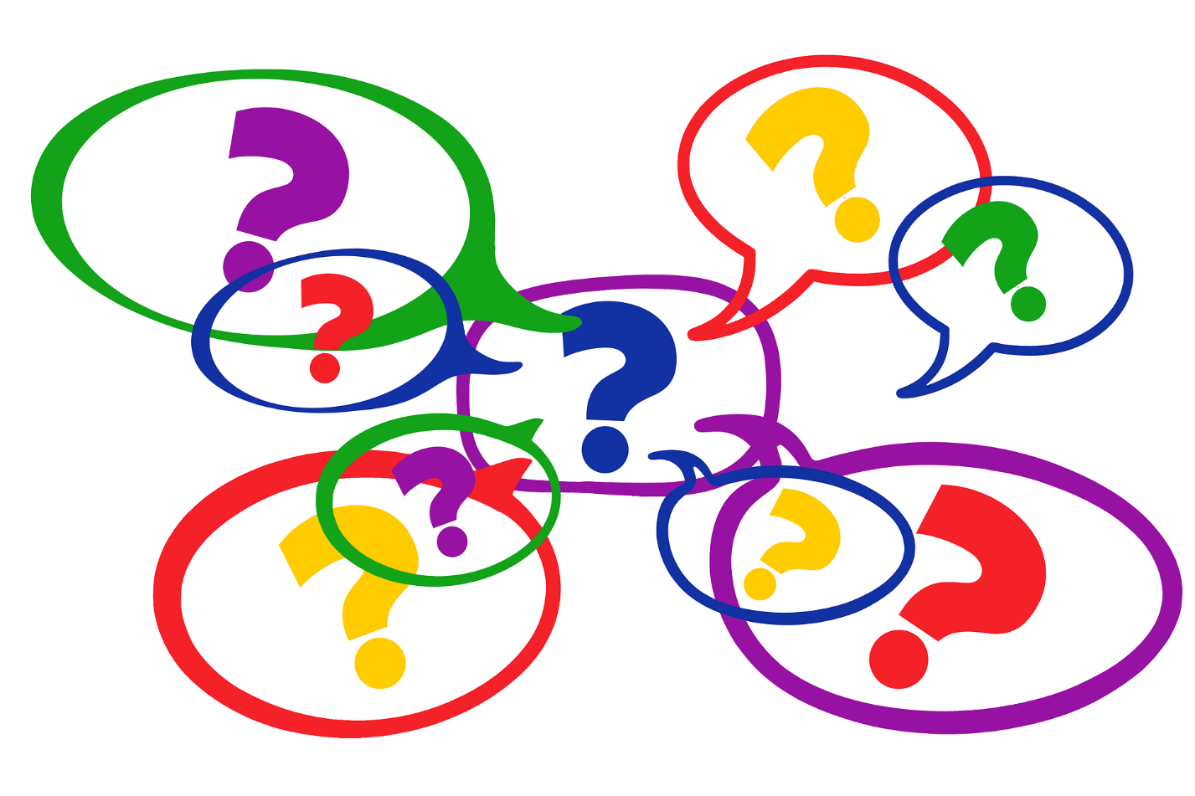
QUESTIONS ABOUT DEFINITIONS
Notes:
Image from: https://pixabay.com/illustrations/ai-generated-question-mark-balloon-8800026/

Slide 10
UNDERSTANDING ACCESSIBILITY'S SIGNIFICANCE

Slide 11
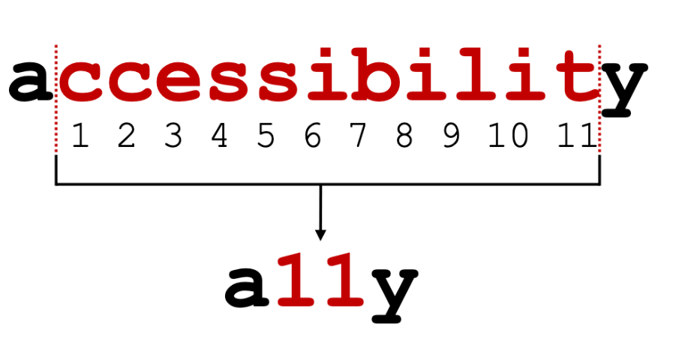
WHAT IS THE MEANING OF A11Y?
Notes:
What Is the Meaning of A11Y? Source: https://www.continualengine.com/blog/what-is-a11y/

Slide 12
WHY ACCESSIBILITY MATTERS
Digital accessibility is important because it ensures that everyone, including people with disabilities, can access and use digital content. It is a way to promote inclusion and diversity and to ensure that no one is excluded from accessing important information and services.
When producing or sharing documents, PowerPoint slides, web pages, images or videos, colleges have a legal obligation to make sure people with disabilities can access it.
Notes:
Digital Accessibility Source: https://www.grackledocs.com/en/why-digital-accessibility-is-a-must-in-todays-corporate-world/?ref=ad#:~:text=Digital%20accessibility%20is%20important%20because,accessing%20important%20information%20and%20services.

Slide 13
VOICE CONTROL with DRAGON NATURALLY SPEAKING
This type of speech recognition software is extremely valuable to anyone who needs to generate a lot of written content without a lot of manual typing. It is also useful for people with disabilities that make it difficult for them to use a keyboard and/or mouse.
Many individuals cannot use a keyboard and/or mouse so they can use voice commands to navigate their computer or compose text. I use Dragon NaturallySpeaking not only in my accessibility evaluations, but I also use it for work because I have some arthritis in my hands, and it gives me a break from having to use the mouse and keyboard all the time.
Video Demo [2 min]

Slide 14
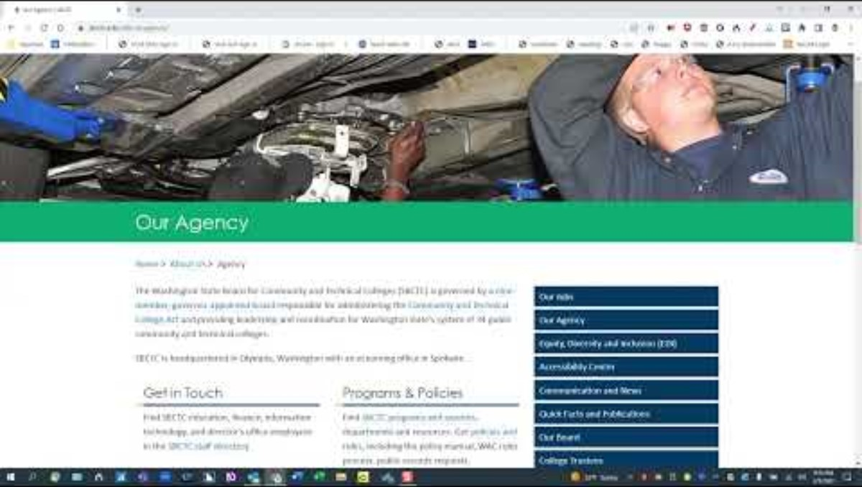
DEMO with DRAGON NATURALLY SPEAKING
Notes:
Voice Control Software Demonstration Dragon Naturally Speaking Source: https://www.youtube.com/watch?v=YH823aBAX3w
Real captions (rather than auto-captions) are available when turned on

Slide 15
SCREEN READER NAVIGATING A PDF
This PDF is accessible because proper tags have been added to the document. Tagging a PDF adds structure to the document and is what makes the content readable by screen readers or search engines, providing a logical and meaningful reading order.
By including tags that identify text, headings, lists, tables, and other elements, assistive technology can better understand and navigate the content of the document, making it easier for users with visual impairments to access the information they need. Without tags, none of these accessibility features are possible and the PDF will be inaccessible to individuals who need to use screen readers.
Video Demo [1:20 min]

Slide 16
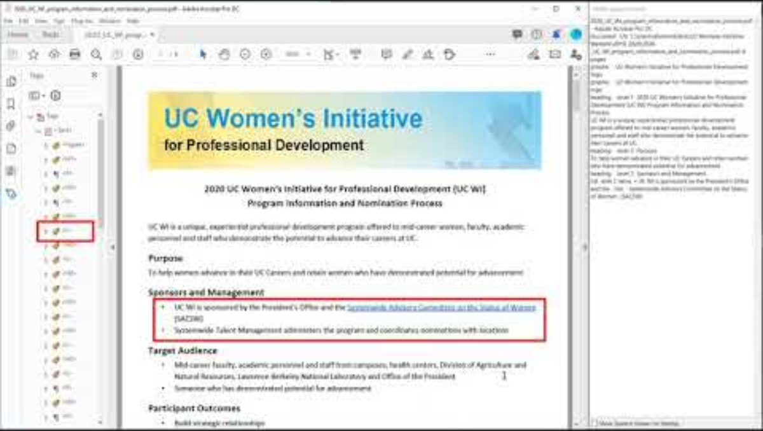
SCREEN READER DEMO
Notes:
Accessible PDF screen reader demo Source: https://www.youtube.com/watch?v=tEkZUlNfcZo&t=2s
Real captions (rather than auto-captions) are available when turned on

Slide 17
*LEGAL OBLIGATIONS*
We are legally mandated to procure accessible products and produce accessible content.
  Office of the Chief Information Officer (OCIO) Washington State Policy 188
  Section 504 of the Rehabilitation Act of 1973
  Section 508 Refresh
  ADA Title II
  On April 24, 2024, the Department of Justice’s Civil Rights Division (DOJ) issued a final rule revising Title II of the Americans with Disabilities Act (ADA)
Notes:
More on all five main points of Policy 188: Washington State Accessibility Legislation Source: https://www.upanup.com/article/washington-state-accessibility-legislation

Slide 18

QUESTIONS ABOUT UNDERSTANDING ACCESSIBILITY
Notes:
Image from: https://pixabay.com/illustrations/ai-generated-question-mark-balloon-8800026/

Slide 19
UNIVERSAL DESIGN FOR LEARNING (UDL)

Slide 20
UNIVERSAL DESIGN FOR LEARNING (UDL)- INTRO
Influenced by the Americans with Disabilities Act of 1990, the concept of Universal Design (UD) originated in the field of architecture, recognizing buildings with built-in accessibility for everyone was a superior approach to retrofitting buildings to accommodate diverse individual needs. The concept of Universal Design for Learning (UDL) emerged in the late 1990s, focusing on principles of UD but instead applied to schools, classrooms, and curricula.
Notes:
Universal Design for Learning: An Introduction Source: https://www.nea.org/professional-excellence/student-engagement/tools-tips/universal-design-learning-introduction

Slide 21
WHAT IS UNIVERSAL DESIGN FOR LEARNING (UDL)
A scientifically valid framework for guiding educational practice that — (A) provides flexibility in the ways information is presented, in the ways students respond or demonstrate knowledge and skills, and in the ways students are engaged; and (B) reduces barriers in instruction, provides appropriate accommodations, supports, and challenges, and maintains high achievement expectations for all students, including students with disabilities and students who are limited English proficient. (Source: Higher Education Opportunity Act of 2008)
Notes:
Additional Sources: UDL in the Every Student Succeeds Act (ESSA; 2016): https://www.cast.org/impact/udl-public-policy

Slide 22
THE THREE GUIDING PRINCIPLES OF UDL
Principle 1: Provide Multiple Means of Representation. Present information and content in different ways.
Principle 2: Provide Multiple Means of Action and Expression. Differentiate the ways that students can express what they know.
Principle 3: Provide Multiple Means of Engagement. Stimulate interest and motivation for learning.
Notes:
Overview of 3 UDL Principles Source: https://durhamcollege.ca/ctl/teaching/planning-to-teach/udl/3-udl-principles/

Slide 23
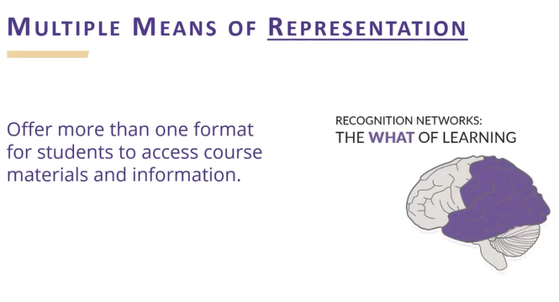
MULTIPLE MEANS OF REPRESENTATION: THE "WHAT" OF LEARNING
For resourceful, knowledgeable learners, present information and content in different ways
Notes:
The Day 1-Week 1 Approach: UDL from the start Source: https://www.washington.edu/doit/webinars/?webinar=udlstart#:~:text=In%20this%20webinar%2C%20we'll%20discuss%20using%20principles,1%20and%20Week%201%20of%20the%20term.

Slide 24
EXAMPLES OF MULTIPLE MEANS OF REPRESENTATION
How can I present information in ways that reach all learners?
Have I considered options for how printed texts, pictures, and charts are displayed?
What options do I provide for students who need support engaging with texts and/or with auditory learning?
Examples:
Make it easy for students to adjust font sizes and background colors through technology.
Provide options for engaging with texts, such as text-to-speech, audiobooks, or partner reading.

Slide 25
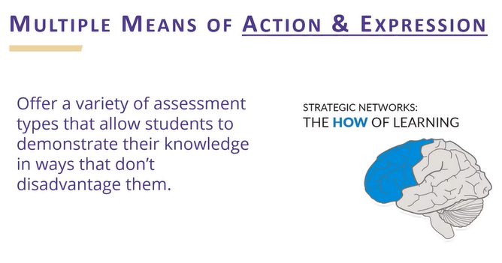
MULTIPLE MEANS OF ACTION & EXPRESSION: THE "HOW" OF LEARNING
For strategic, goal-directed listeners, differentiate the ways that students can express what they know.
Notes:
The Day 1-Week 1 Approach: UDL from the start Source: https://www.washington.edu/doit/webinars/?webinar=udlstart#:~:text=In%20this%20webinar%2C%20we'll%20discuss%20using%20principles,1%20and%20Week%201%20of%20the%20term.

Slide 26
EXAMPLES OF MULTIPLE MEANS OF ACTION & EXPRESSION
How can I offer purposeful options for students to show what they know?
When can I provide flexibility with timing and pacing?
Have I considered methods aside from paper-and-pencil tasks for students to show what they know?
Am I providing students access to assistive technology (AT)?
Examples:
Provide calendars and checklists to help students track the subtasks for meeting a learning goal.
Allow students to show what they know through a variety of formats, such as a poster presentation or a graphic organizer.
Provide students with access to common AT, such as speech-to-text and text-to-speech.

Slide 27
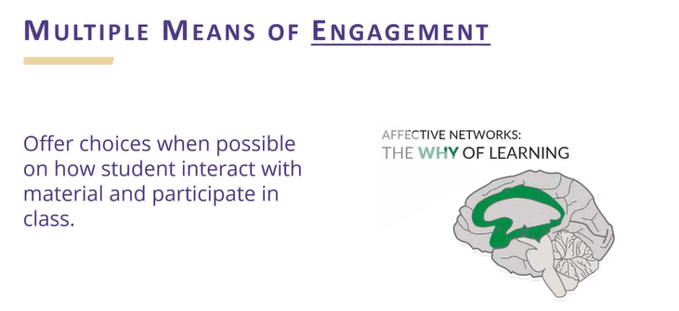
MULTIPLE MEANS OF ENGAGEMENT - THE "WHY" OF LEARNING
For purposeful, motivated learners, stimulate interest and motivation for learning.
Notes:
The Day 1-Week 1 Approach: UDL from the start Source: https://www.washington.edu/doit/webinars/?webinar=udlstart#:~:text=In%20this%20webinar%2C%20we'll%20discuss%20using%20principles,1%20and%20Week%201%20of%20the%20term.

Slide 28
EXAMPLES OF MULTIPLE MEANS OF ENGAGEMENT
How can I engage all students in my class?
In what ways do I give students choice and autonomy?
How do I make learning relevant to students’ needs and wants?
In what ways is my classroom accepting and supportive of all students?
Examples:
Survey students about their interests, strengths, and needs. Incorporate the findings into lessons.
Use choice menus for working toward goals.
State learning goals clearly and in a way that feels relevant to students

Slide 29
WHY USE UNIVERSAL DESIGN FOR LEARNING?
UDL may change how you think about what prevents students from learning. Instead of thinking that something needs to change about the students, UDL looks at the learning environment. The learning environment can include barriers to learning, like the design of the curricular goals, assessments, methods, and materials. In this way, the learning environment itself can be “abled” or “dis-abled.”
UDL gives you a framework to follow so you can reduce the barriers to learning. The main way to do this is to prepare a learning environment where students have what they need to flexibly meet learning goals.

Slide 30
WHAT DOES UDL LOOK LIKE IN THE CLASSROOM?
Universal Design for Learning looks different in every classroom. But there are commonalities. To start with, there’s always a focus on building expert learning for all. Other common elements of a UDL experience include:
  All learners knowing the goal
  Intentional, flexible options for all students to use
  Student access to resources from the start of a lesson
  Students building and internalizing their own learning
Notes:
Universal Design for Learning (UDL): A teacher’s guide Source: https://www.understood.org/en/articles/understanding-universal-design-for-learning#How_can_I_use_the_three_principles_of_UDL?

Slide 31
QUESTIONS ABOUT UDL
Notes:
Image from: https://pixabay.com/illustrations/ai-generated-question-mark-balloon-8800026/

Slide 32
CORE CONCEPTS FOR CREATING
ACCESSIBLE CONTENT

Slide 33
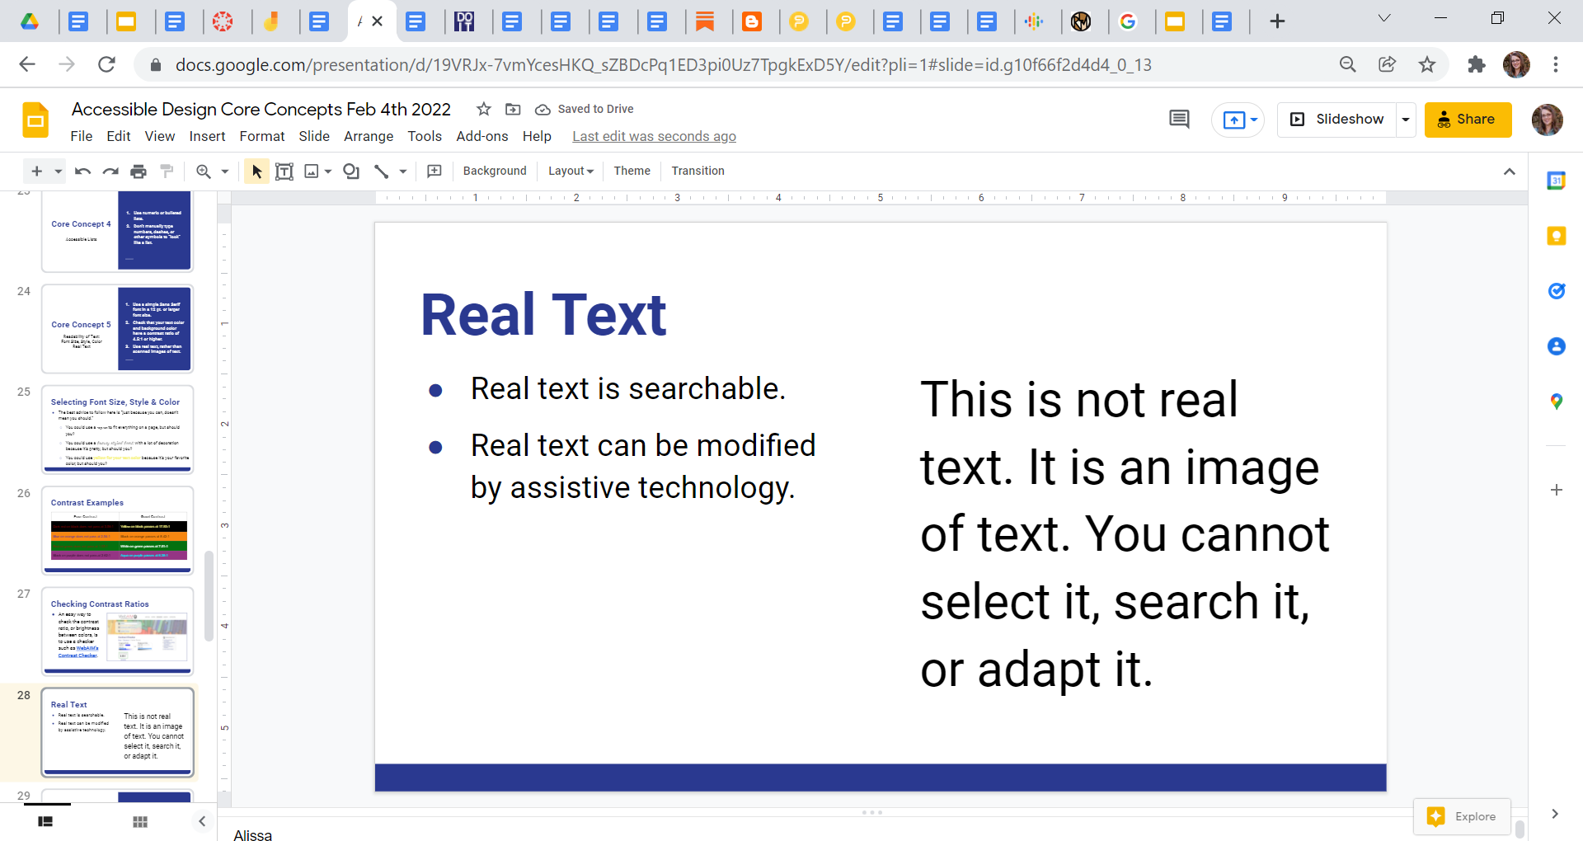
CORE CONCEPT 1: REAL TEXT
Real text is searchable.
Real text can be read by a screen reader.
Real text can be modified by assistive technology.
You can select the text with your mouse.

Slide 34
CORE CONCEPT 2: HEADING STRUCTURE
Using logical and sequential headings in your document provides the basis for good document structure (sections) and navigation.
The title of the document should be H1 and you do not want to repeat Heading level 1. After that, using Headings in sequential order, and don’t skip heading levels.

Slide 35
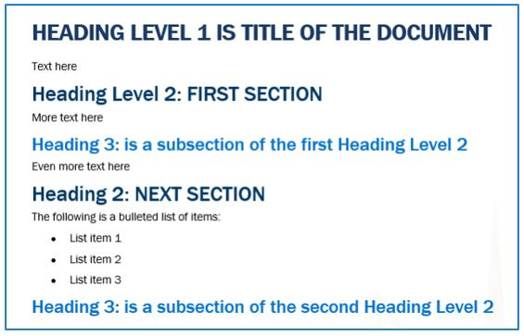
HEADING STRUCTURE EXAMPLE

Slide 36
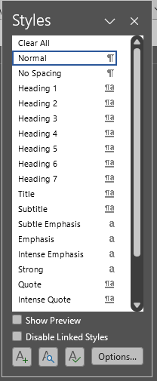

HOW TO CREATE HEADINGS
Headings are ranked <h1> through <h6>

Slide 37
CORE CONCEPT 3: ALT TEXT
Alt Text is short for Alternative Text
Alternative text is the back-end information added to an image. With the help of alt text, a screen reader can describe the image’s content to someone unable to see it.
Alternative text is a text substitute for non-text content like images, charts, graphs, etc.

Slide 38
HOW TO MAKE IMAGES ACCESSIBLE
By writing meaningful alternative text descriptions for images and pictures.
By adding Alt Text to images.
By marking decorative images as such.
Notes:
Meaningful Alternative Text Descriptions Source from WebAIM: https://webaim.org/techniques/alttext/
From SBCTC's Library of Accessibility Resources | Accessible Design concepts | Alt Text for Images Source: https://sbctc.instructure.com/courses/1578604/pages/alt-text-for-images?module_item_id=33185585

Slide 39
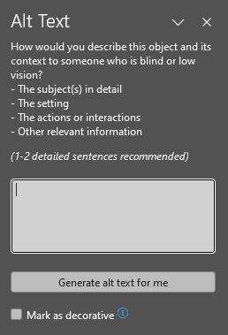
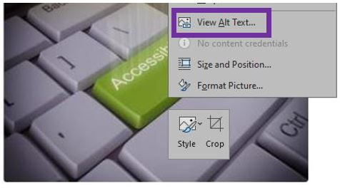
HOW TO ADD ALT TEXT

Slide 40
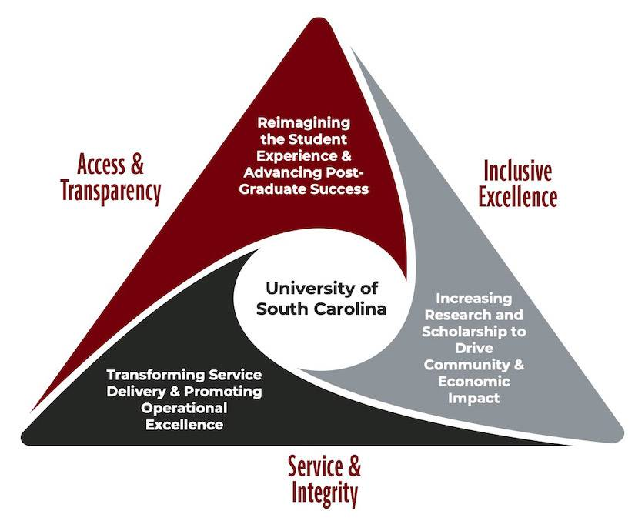
Alt Text Example
Short Description: A diagram of the Strategic Priorities for University of South Carolina.
Long Description: A triangle diagram with three sections, each labeled and coming together to the center that has the words University of South Carolina. The first section has the words Access and Transparency: reimagining the student experience and advancing post-graduate success. The second section has the words Inclusive Excellence: increasing research and scholarship to drive community and economic impact. The third section has the words Service and Integrity: transforming service delivery and promoting operational excellence.
Notes:
Context is key when writing good alt text!
Image Source: https://www.sc.edu/about/offices_and_divisions/digital-accessibility/toolbox/best_practices/alternative_text/charts-diagrams/index.php

Slide 41
CORE CONCEPT 4: DESCRIPTIVE HYPERLINKS
Hyperlinks, more commonly known as “links”, are used to navigate within a document or to external locations such as websites.
Hyperlinks that are embedded directly into meaningful and contextualized text describing where the link takes you will provide non-sighted and sighted readers with the most useful information.
Links are more useful when they make sense out of context. Authors should avoid non-informative link phrases such as:
  click here
  here
  more
  read more

Slide 42
TIPS FOR DESCRIPTIVE HYPERLINKS
DON’T:
DO:
Unlinked URL text
  https://sbctc.instructure.com/courses/1578604
Hyperlinked, full text URLs
  Visit SBCTC’s Library of Accessibility Resources https://sbctc.instructure.com/courses/1578604
Non-descriptive link text
  “Click Here” to visit SBCTC Library of Accessibility Resources
Embed links directly into meaningful text describing where the link takes you.
Visit SBCTC Library of Accessibility Resources to learn more about descriptive hyperlinks.

Slide 43
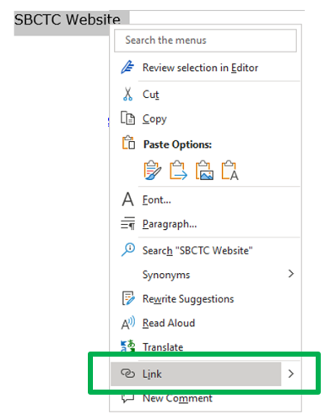
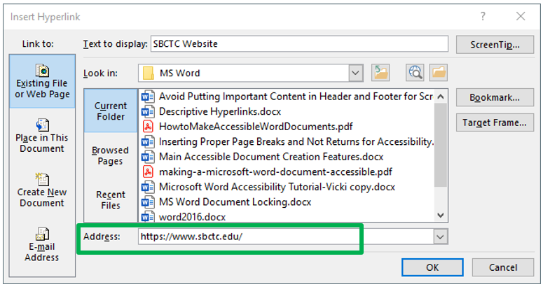
HOW TO ADD A DESCRIPTIVE HYPERLINK

Slide 44
CORE CONCEPT 5: ACCESSIBLE LISTS
There are two main types of lists:
  Ordered lists, which is a numeric list
  Unordered lists, which uses bullets or another symbol from the built-in list design
Don’t manually type numbers, dashes, or other symbols to “look” like a list.

Slide 45
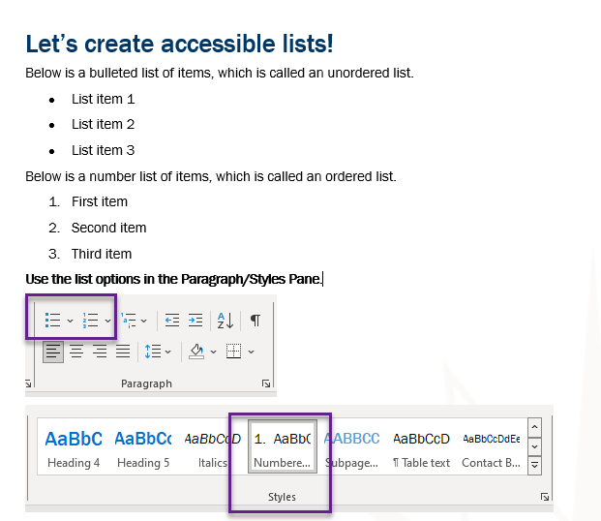
Tips for Accessible Lists

Slide 46
CORE CONCEPT 6: READABILITY, FONT SIZE, STYLE & COLOR CONTRAST
Use a simple Sans Serif font in a 12 pt. or larger font size.
Check that your text color and background color have a contrast ratio of 4.5:1 for 14pt or smaller.
3:1 for 18pt or larger.
Do not use color alone to indicate meaning.
Use real text, rather than scanned images of text.

Slide 47
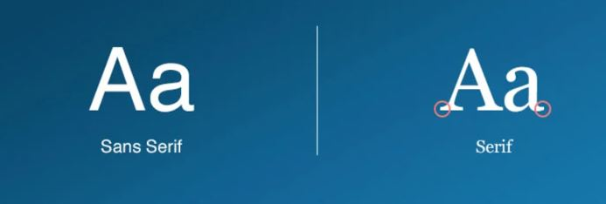
Sans Serif VS Serif: What’s the Difference?
The Sans Serif font on the left has clean and very precise ends while the Serif font on the right is more ornamental and has serifs extending from the ends.

Slide 48
EXAMPLE LIST
Amanita
Chanterelle
Porcini
Shiitake
Tylopilus
The mushrooms listed in red are poisonous. The ones in green are safe.

Slide 49
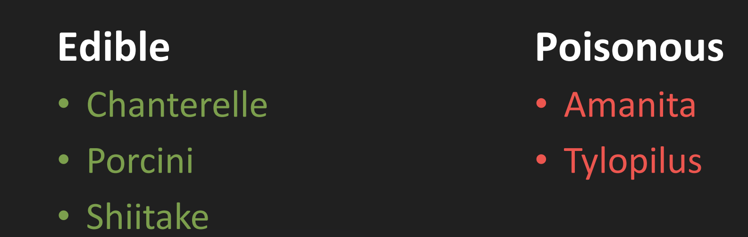
TWO SOLUTIONS…
Remember! Icons need Alt Text.
Create separate lists
Amanita ☠
Chanterelle
Porcini
Shiitake
Tylopilus ☠

Slide 50
SELECT FONT SIZE, STYLE AND COLOR
The best advice to follow here is “just because you can, doesn’t mean you should.”
  You could use a 10 pt. font to fit everything on a page, but should you?
  You could use a fancy styled font with a lot of decoration because it’s pretty, but should you?
  You could use yellow for your text color because it’s your favorite color, but should you?

Slide 51
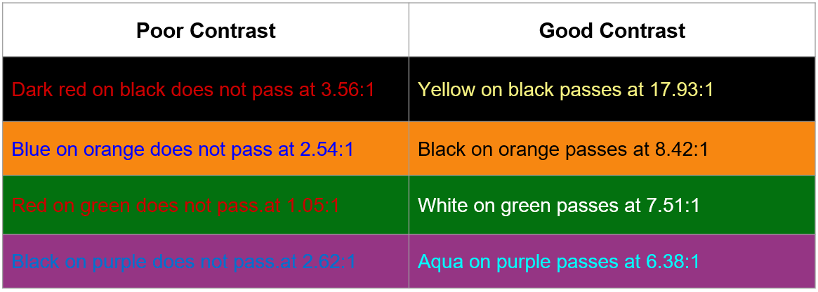
CONTRAST EXAMPLES

Slide 52
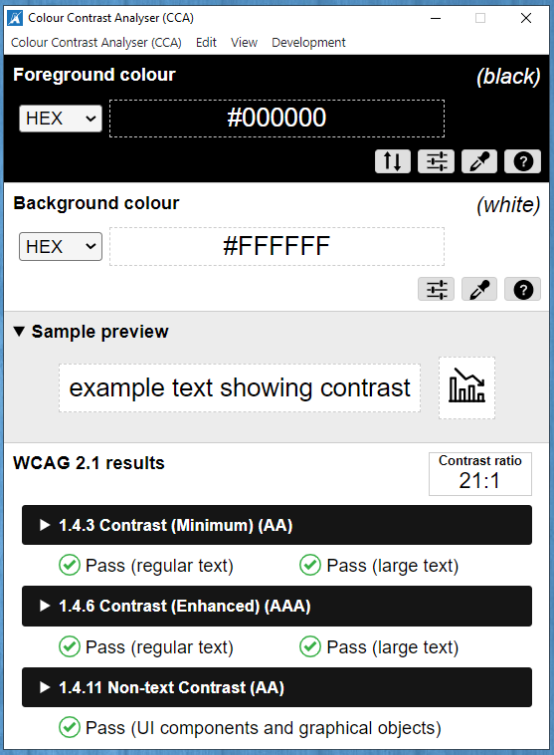
CHECKING CONTRAST RATIOS
An easy way to check the contrast ratio, or brightness between colors, is to use a checker such as Colour Contrast Analyzer (CCA)
Notes:
TPGi Colour Contrast Analyzer (CCA) Source: https://www.tpgi.com/color-contrast-checker/

Slide 53
CORE CONCEPT 7: TABLES
Tables are used to display data only.
Don’t use tables to control the layout or “look” of your document.
Always apply a Header Row and/or Header Column.

Slide 54
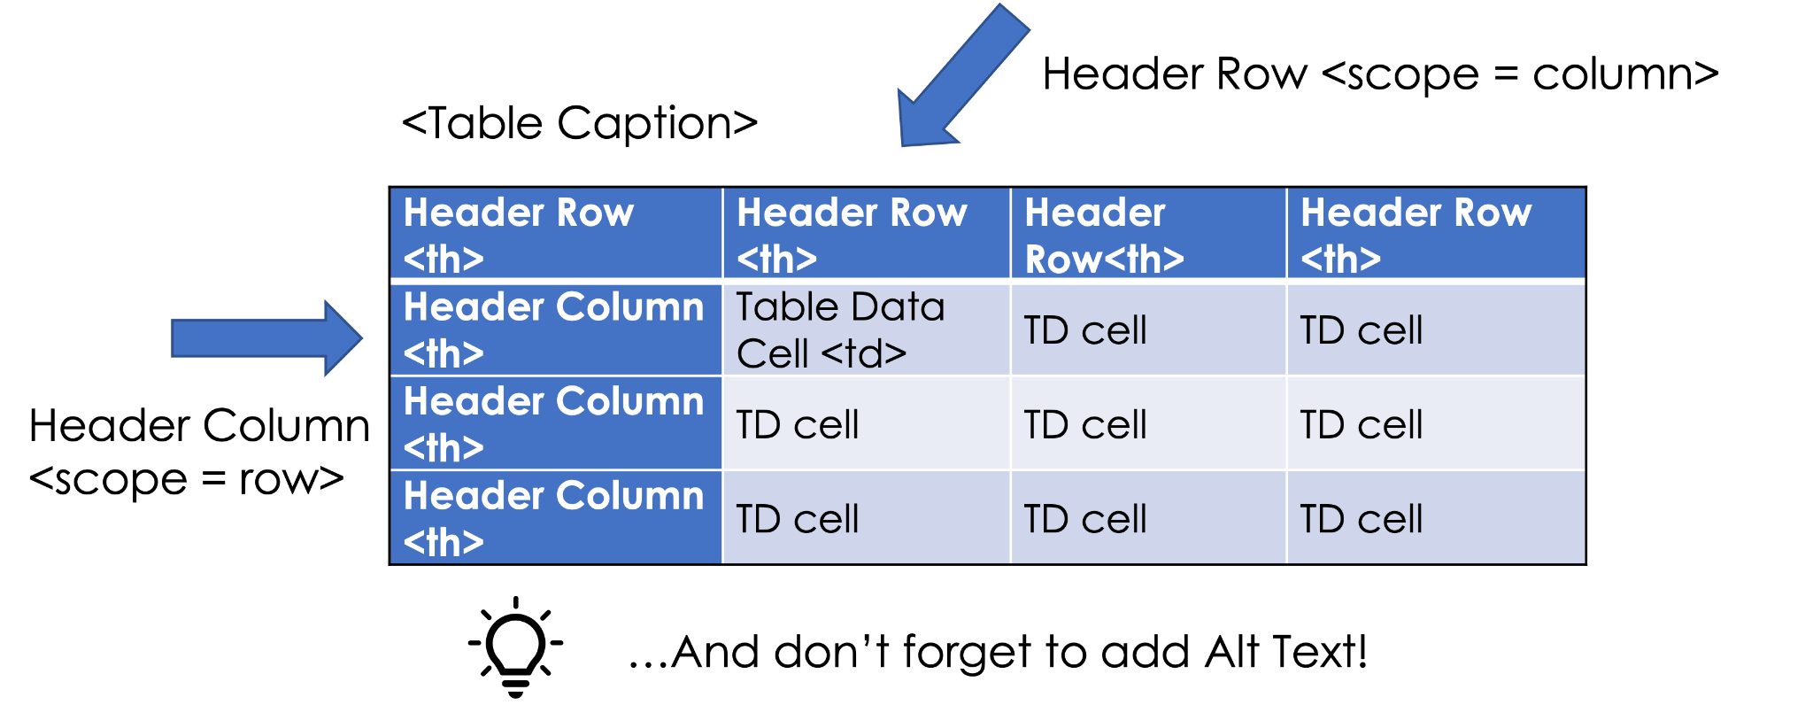
Anatomy of an accessible table
Create Tables in Word
Notes:
WebAIM accessible table article: https://webaim.org/techniques/tables/data
Tables in Word: https://webaim.org/techniques/word/word365win#tables

Slide 55
CORE CONCEPT 8: ACCESSIBILITY CHECKERS
Some content editing applications have a built-in Accessibility Checker.
Checkers help find and give advice on how to fix problems.
Manual checking is still required.

Slide 56
QUESTIONS ABOUT CORE CONCEPTS
Notes:
Image from: https://pixabay.com/illustrations/ai-generated-question-mark-balloon-8800026/

Slide 57
WHO TO CONTACT AT SBCTC
Monica Olsson: molsson@sbctc.edu
  Policy Associate, Accessible IT Coordinator
Vicki Walton: vwalton@sbctc.edu
  Web Accessibility Specialist and IT Quality

Slide 58
Resources
Relevant Laws and Policies
SBCTC Accessibility Micro Courses - a collection of micro-courses focused on how-to’s for creating accessible content (earn badges!)
SBCTC Library of Accessibility Resources - a public Canvas site containing learning resources for creating accessible content
Guide: Create Accessible Word documents
Checklist for Word
Checklist for PDF
Checklist for PPT
WebAIM: Accessible Word 365 and 2019 for Windows
Microsoft’s Rules for the Accessibility Checker

