Slide 1
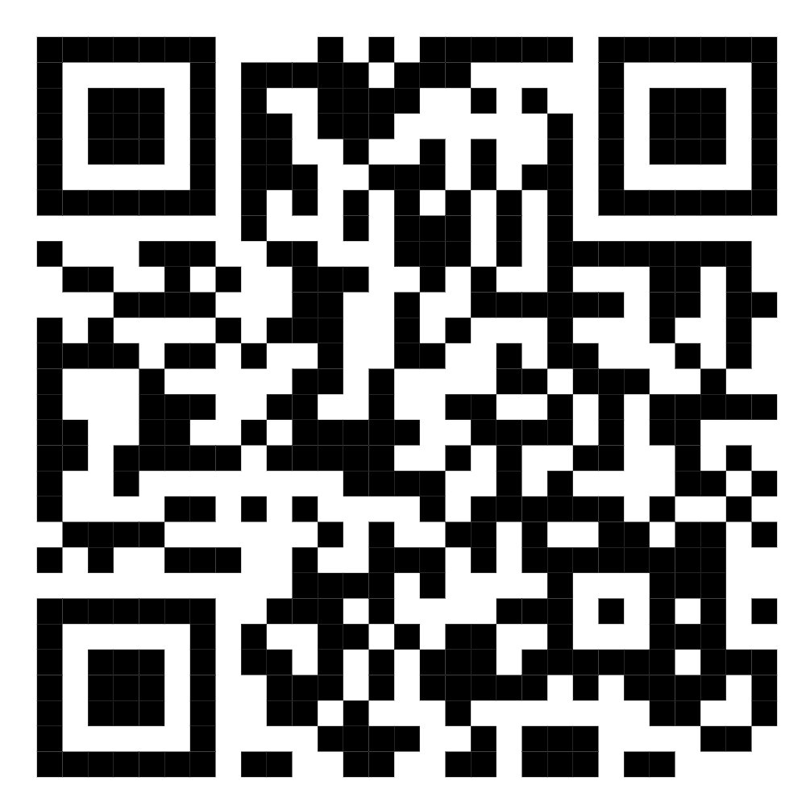
Against
Checking the Box
Scan code to open these slides:
Flexible Strategies for Practicing Culturally Sustaining Pedagogy

Slide 2
Session Agenda
9:40 | Welcome and Session Overview
9:45 | Connection: Grounding
9:50 | Why Culturally Sustaining Pedagogy?
10:05 | A Note About our Pathways
10:10 | The Culturally Responsive Scorecard: Collaborative Annotation
10:40 | Creating Your Mini-Assessment Plan
11:00 | Connection: Sharing

Slide 3
Connection: Grounding
Where and/or what are you teaching this academic year? OR
What is something that you’re looking forward to for the rest of this summer? OR
What might you take from this conference that you want to carry with you into the academic year ahead?

Slide 4
The Literature
Framework | Culturally Relevant Pedagogy | Culturally Responsive Pedagogy | Culturally Sustaining Pedagogy
Scholarship | Dr. Gloria Ladson-Billings, Dr. Luis Moll, et. al. | Geneva Gay, Zaretta Hammond, et. al. | Dr. Django Paris, H. Samy Alim, Dr. Tara Yosso, et. al.
Focus | Resists deficit thinking, activates critical self-consciousness, affirms cultural identities. | Promotes wider multiculturalism, emphasizes cognitive development. | Prioritizes ethnic and lingual pluralism, addresses systemic inequities and injustices.
Key Concepts | Resource Pedagogies, Funds of Knowledge. | Rigor, Neuroscience of Learning. | Cultural Connectedness, Community Cultural Wealth.

Slide 5
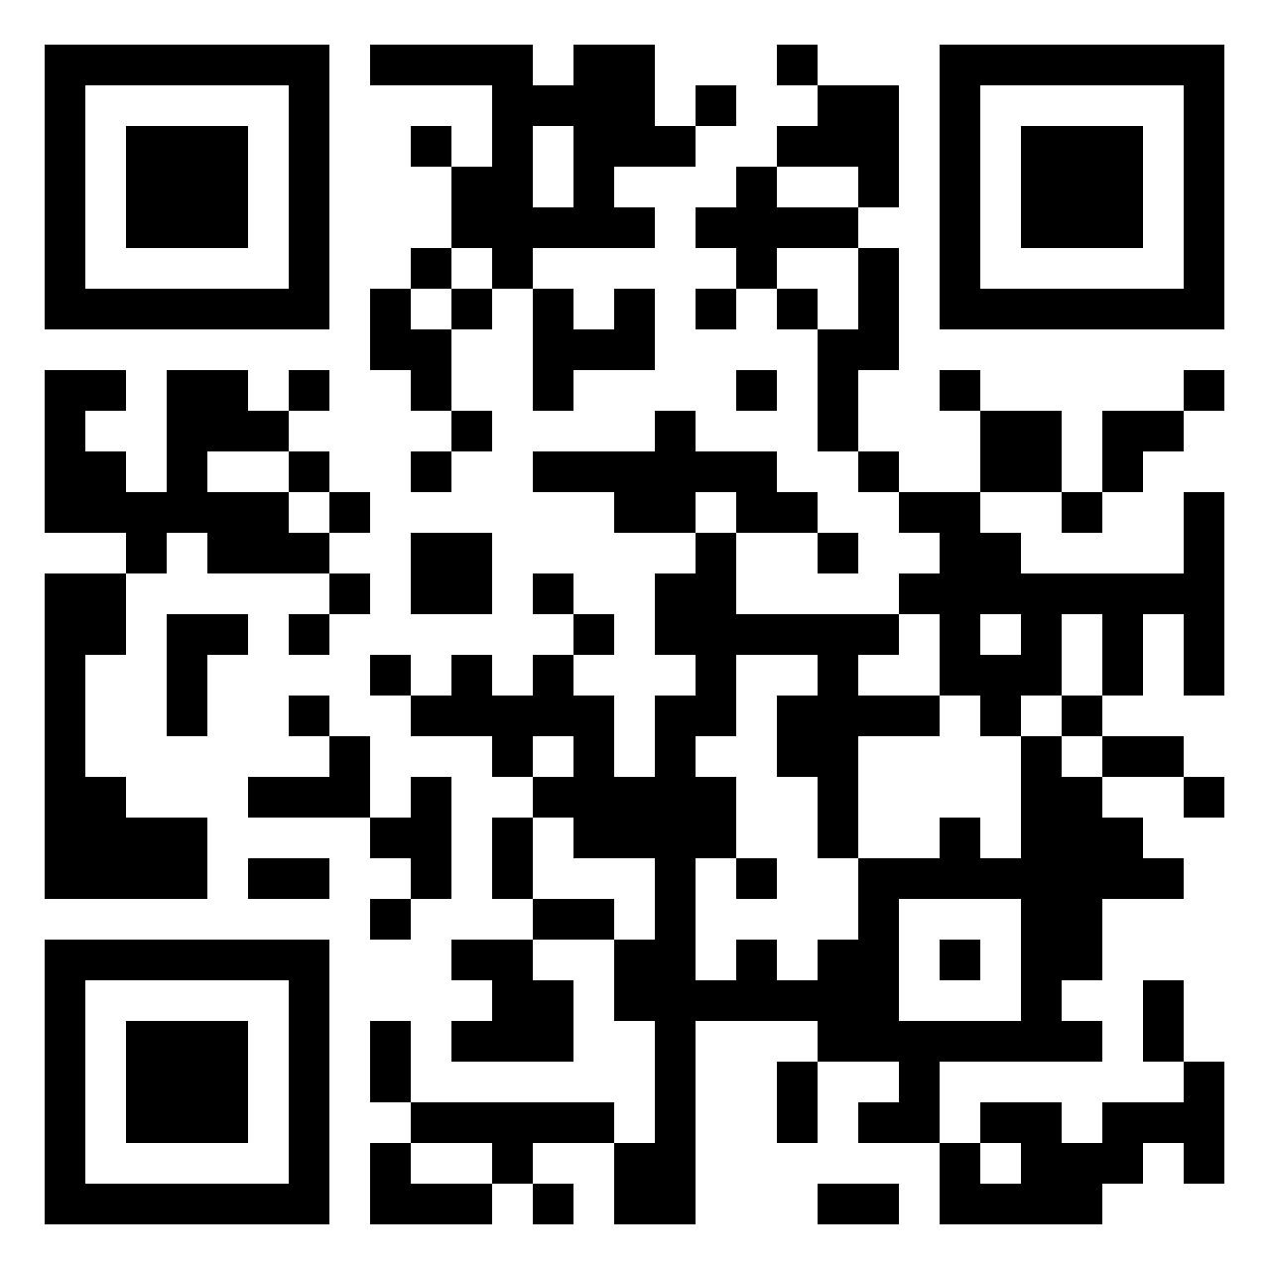
Culturally Sustaining Pedagogy
Answer any of these questions! Use what you already know or what you've learned from the quote.
-What feels important to you about culturally sustaining pedagogy?
-What do you already know about culturally sustaining pedagogy that you're excited to share with others?
-What questions, confusions, or clarifications do you have?
Add your thought to the Padlet
“Although it is clear that Ladson-Billings (1995) was laying out the ground for maintenance and cultural critique, the term and stance of “relevance” or “responsiveness” does little to explicitly support this goal.It is quite possible to be relevant to something or responsive to it without ensuring its continuing presence in a student’s repertoires of practice (Gutiérrez & Rogoff, 2003), and so its presence in our classrooms and communities.”
“I offer the term culturally sustaining pedagogy as an alternative that I believe embodies some of the best past and present research and practice in the resource pedagogy tradition and as a term that supports the value of our multiethnic and multilingual present and future. The term culturally sustaining requires that our pedagogies be more than responsive of or relevant to the cultural experiences and practices of young people—it requires that they support young people in sustaining the cultural and linguistic competence of their communities while simultaneously offering access to dominant cultural competence. Culturally sustaining pedagogy, then, has as its explicit goal supporting multilingualism and multiculturalism in practice and perspective for students and teachers. That is, culturally sustaining pedagogy seeks to perpetuate and foster—to sustain—linguistic, literate, and cultural pluralism as part of the democratic project of schooling.”
Paris, D. (2012). Culturally sustaining pedagogy: A needed change in stance, terminology, and practice. Educational Researcher, 41(3), 93–97.

Slide 6
A Note About Our Pathways
 | Get Good | Get Free
Frame | Binary | Liberated
Mode | Static | Active
Scope | Myopic | Forward-Thinking
Focus | Examining Privilege | Dismantling Power
Risk | Invulnerability | Courage and Vulnerability
Impact | Performative | Relational and Authentic
Scale | Individual | Collective

Slide 7
Culturally Responsive Scorecard (SBCTC)
Adapted from J. Bryan-Gooden, M. Hester, & L. Q. Peoples. (2023). Culturally Responsive ELA Curriculum Scorecard. New York: Metropolitan Center for Research on Equity and the Transformation of Schools, New York University.
 | Statements
Social Justice Orientation | Curriculum highlights non-dominant populations and their strengths and assets, so that students of diverse race, class, gender, ability, and sexual orientation can relate and participate fully.
 | The curriculum communicates an asset-based perspective by representing and valuing people of diverse races, classes, genders, abilities and sexual orientations through their strengths, talents and knowledge rather than their perceived flaws or deficiencies.
 | The curriculum does not communicate negativity or hostility toward people of marginalized backgrounds through verbal or nonverbal insults, slights or snubs.***
 | Curriculum and instructional activities promote or provoke critical questions about the societal status quo. They present points of view from marginalized and systemically non-dominant groups as equally worth valuing.
 | The curriculum recognizes the validity and integrity of knowledge systems based in communities of color, collectivist cultures, matriarchal societies, and non-Christian religions.
 | The curriculum leads with stories and perspectives of marginalized or systemically non-dominant groups and presents different points of view on the same event or experience.
 | The curriculum provides avenues for students to connect learning to social, political, or environmental concerns that affect them and their lives and contribute to change.
 | The curriculum encourages students by providing resources and/or connecting to organizations and movements in order to take actions on issues that affect them and their lives.

Slide 8
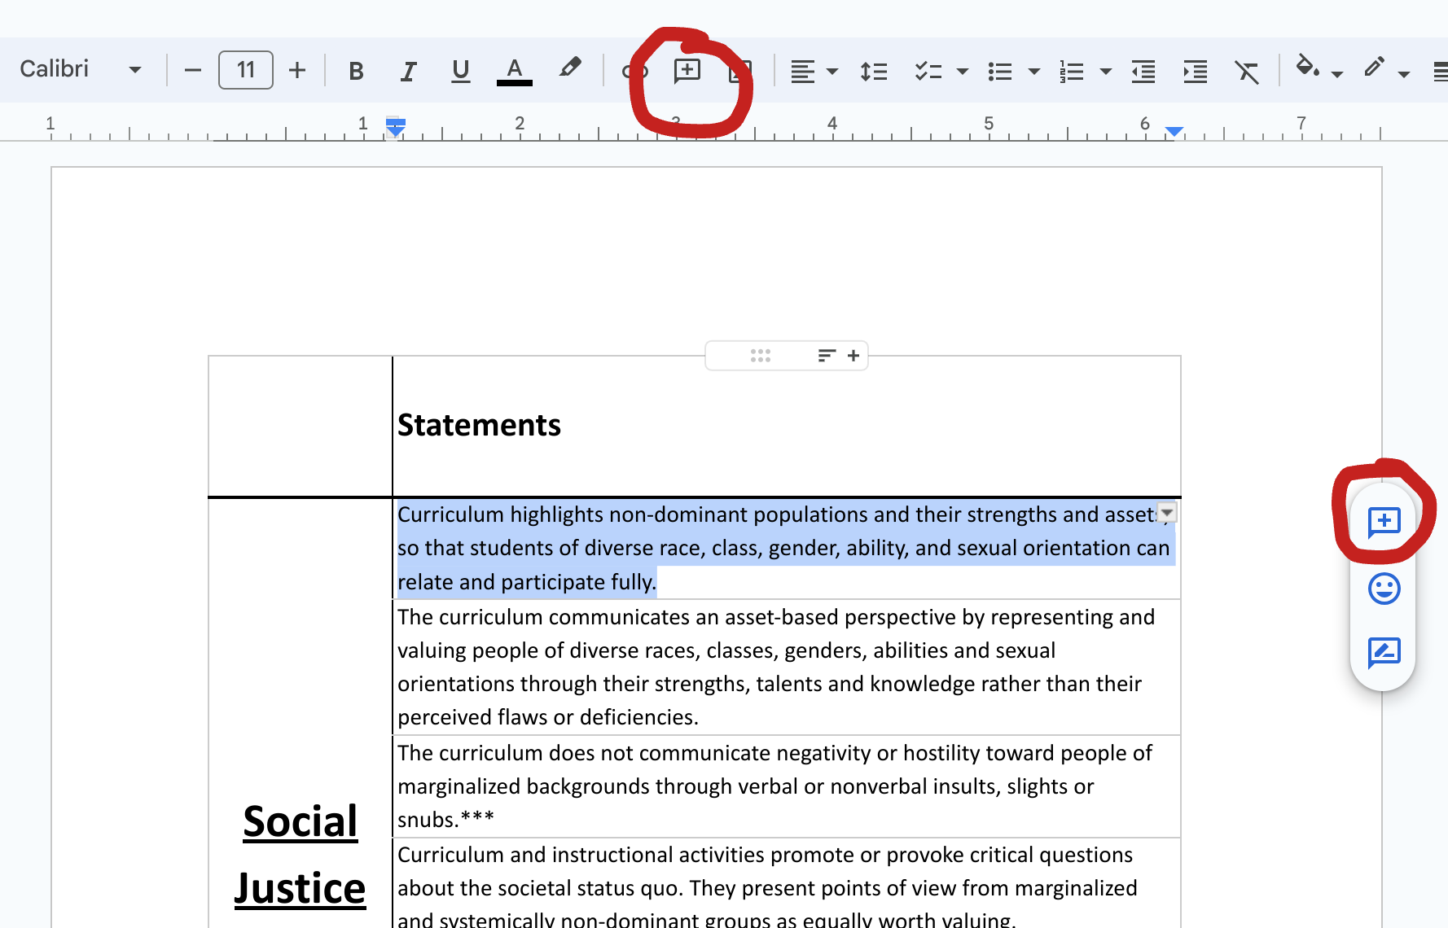
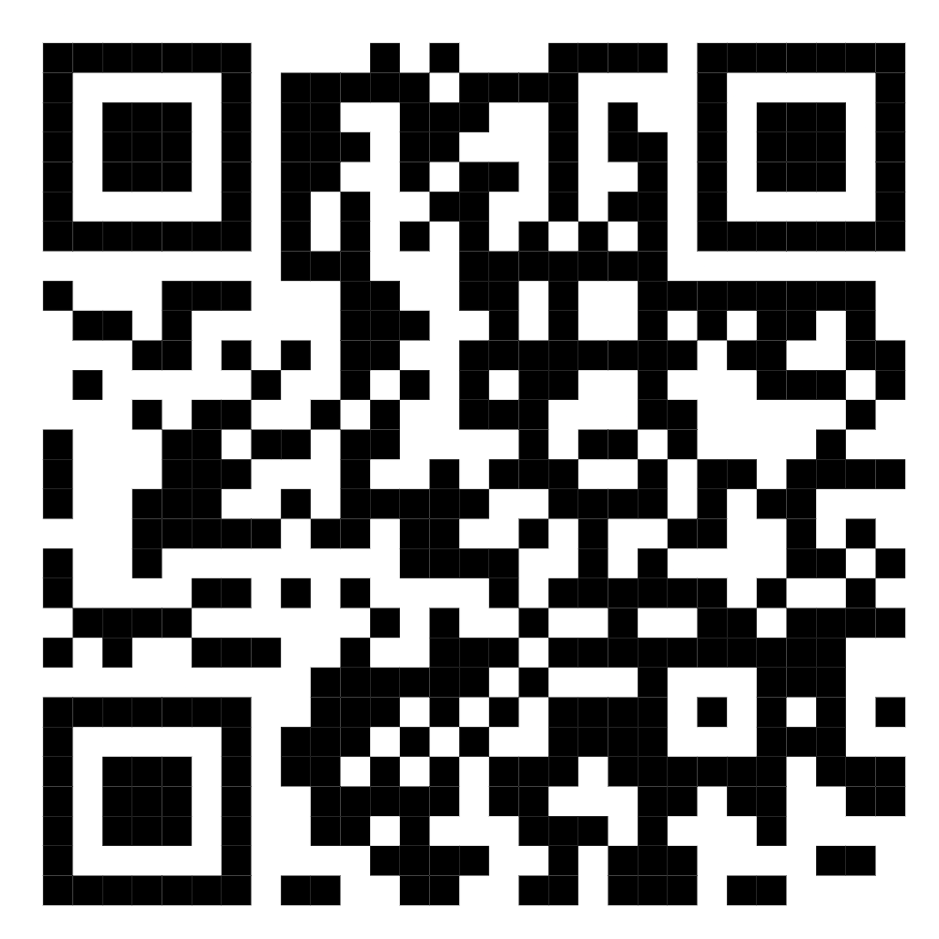
Collaborative Annotation
Instructions: Follow the link or QR code (see: below right) to access our collaborative Google Doc. Add your comment/s to the document by clicking either “Add Comment” button (see: below left). Refer to the Metacognitive Bookmark (see: below right) to help craft your comment/s.
Click Here to Access Culturally Responsive Scorecard
Click Here to Access the Metacognitive Bookmark

Slide 9
Creating Your Mini-Assessment Plan
Instructions: Open the Google Doc below and select “Make a copy” under the “File” tab. Create an assessment rubric that features what you have reflected on today and want to focus on this fall quarter. There is no wrong way to create your rubric; however, refer to the examples being handed out or at the links below if you like.
Click Here to Go to Some Sample Rubric Forms You Can Use to Make a Mini Assessment Plan
Two Examples of Mini-Assessment Plans We Created

Slide 10
Connection: Sharing
Please feel welcome and supported to share your mini-assessment plan.
Please feel welcome and supported to check in with us and/or each other this fall:
  morgan.owens@seattlecolleges.edu
  jacob.galfano@gmail.com

