Slide 1
Disrupting the Single Story: Centering Students’ Voices & Agency
Caro Forero
Faculty, Seattle Central College
BEDA Biannual Conference July 2024
Notes:
9-9:05

Slide 2
Agenda
01
Welcome & Grounding
02
Principles of CRT/CSP
03
Creating a CSP Classroom
04
Examples and Discussion
Notes:
9-9:05

Slide 3
What Will You Walk Away with Today?
Examples of activities and lessons that center student voices and agency
Understand the principles of culturally responsive/
sustaining pedagogy
Reflection prompts to continue your journey in CRT/CST
Strategies on creating a culturally responsive/
sustaining classroom
Ideas for your own classes
Notes:
9-9:05

Slide 4
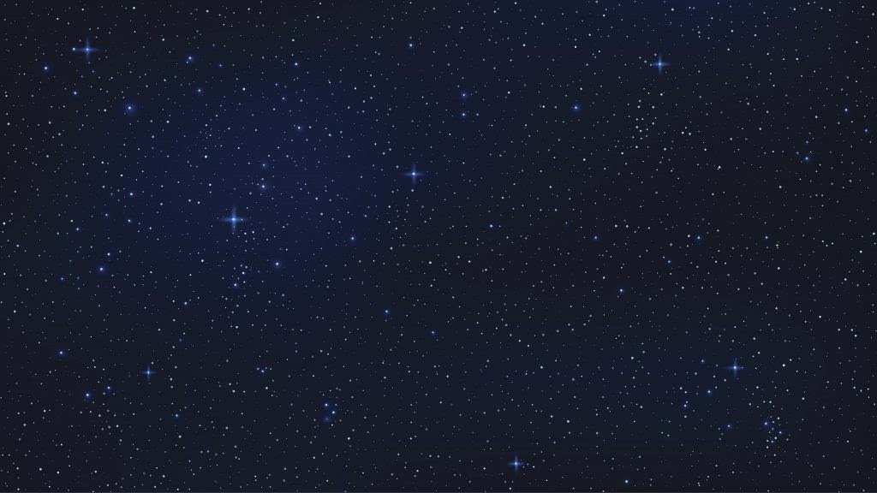
Ways of Knowing,
Seeing, Being, Doing and Loving
Knowledge Activation
Evoking Awareness
Strategic Application
Mind Body
Spirit
Community
Action | Kahulo
Collective Stewardship
Notes:
9:05-9:07

Slide 5
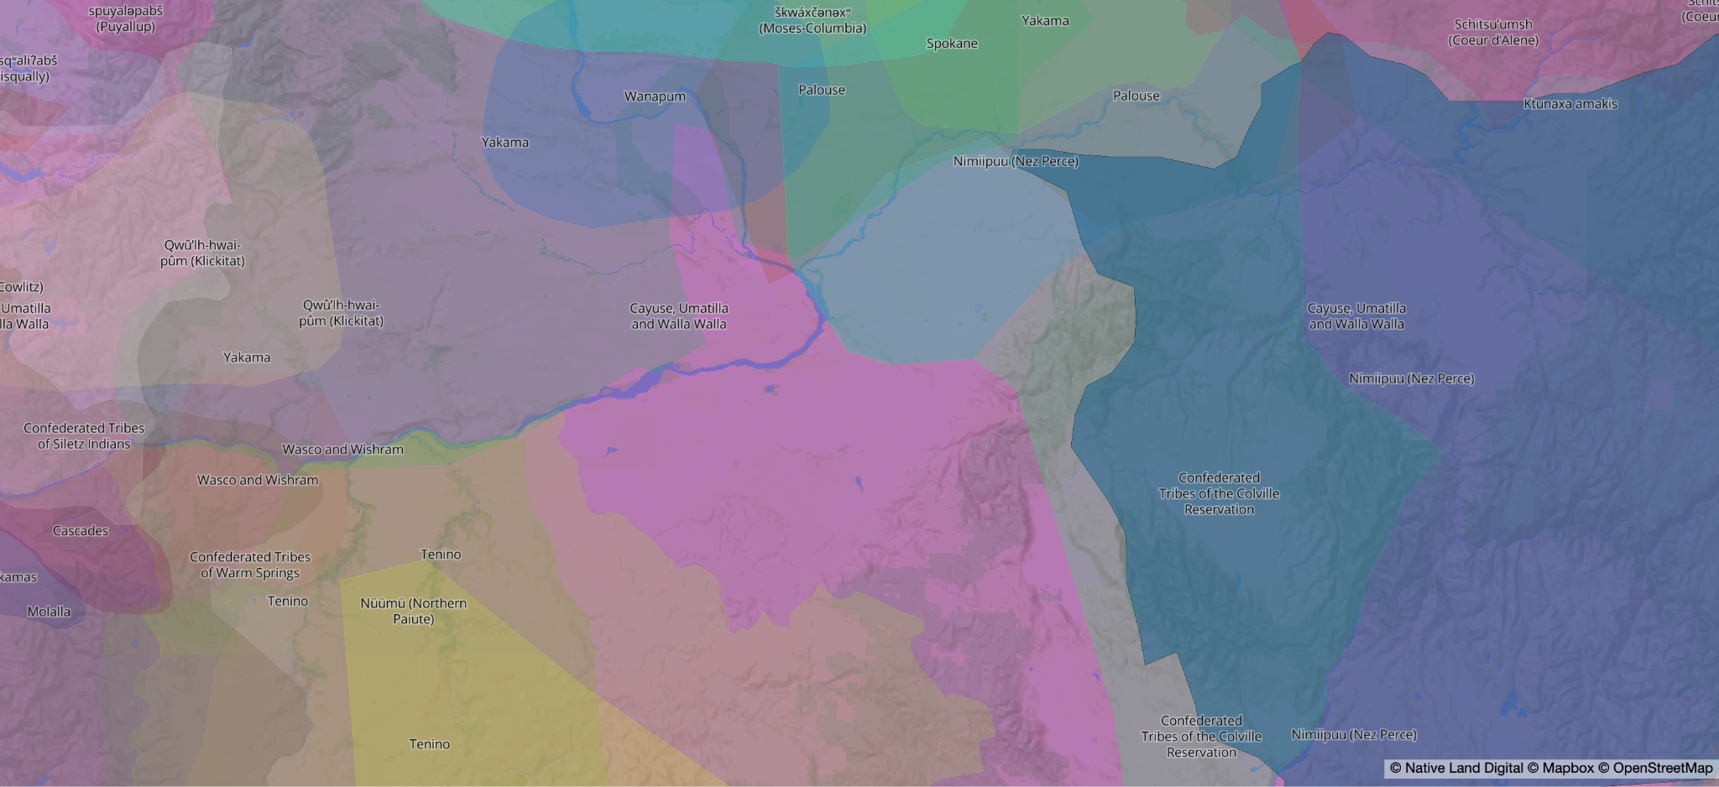
Whose Land Are We on Today?
Notes:
9:07-9:10
https://www.nbcrightnow.com/news/confederated-tribes-of-umatilla-recognized-with-city-of-kennewick-in-signing-memorandum-of-understanding/article_f852d3ba-aa0c-11eb-9274-539b25e6ded7.html

Slide 6
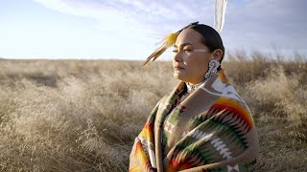
Movement Is Medicine
Notes:
9:10-9:16

Slide 7
Emergent Strategy Principles
Change is constant (be like water)
Small is good, small is all (The large is the reflection of the small)
There is always enough time for the right work
Less prep more presence
There is a conversation in the room that only the people these people at this moment can have. Find it!
Never a failure, always a lesson
Trust the people (If you trust the people, they will become trustworthy
What you pay attention to grows
Move at the speed of trust. Focus on critical connections more than critical mass-build resilience by building connections
Notes:
9:16-9:23

Slide 8
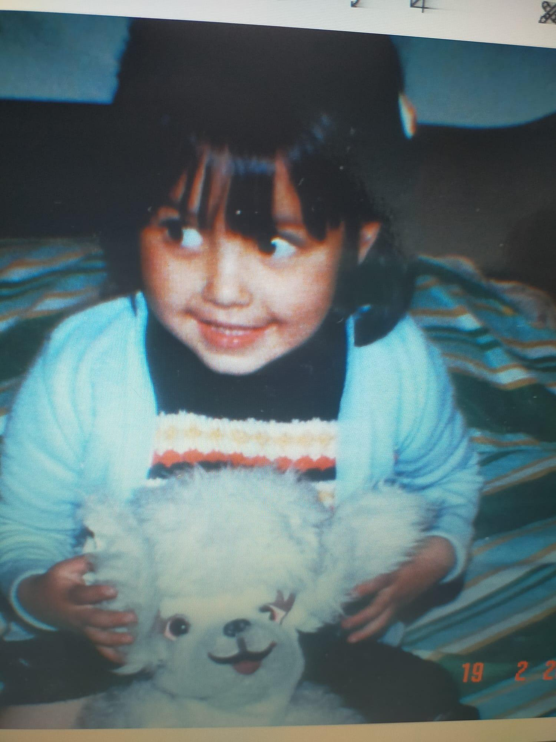
Identity & Positionality
Mother
immigrant
Anti-racist educator
indigenous latinx
Colombian
Cisgender woman
able bodied+neurodivergent
Middle-class
bilingual/bicultural
Learner (ever-evolving journey)
Notes:
9:23-9:25

Slide 9
What About you?
Notes:
9:25-9:30

Slide 10
Learning in Community
What can you bring to the community today?
What would you like to receive from your peers today?
Notes:
9:30-9:35

Slide 11
Principles of Culturally Responsive/Sustaining Teaching
Notes:
9:35-9:50

Slide 12
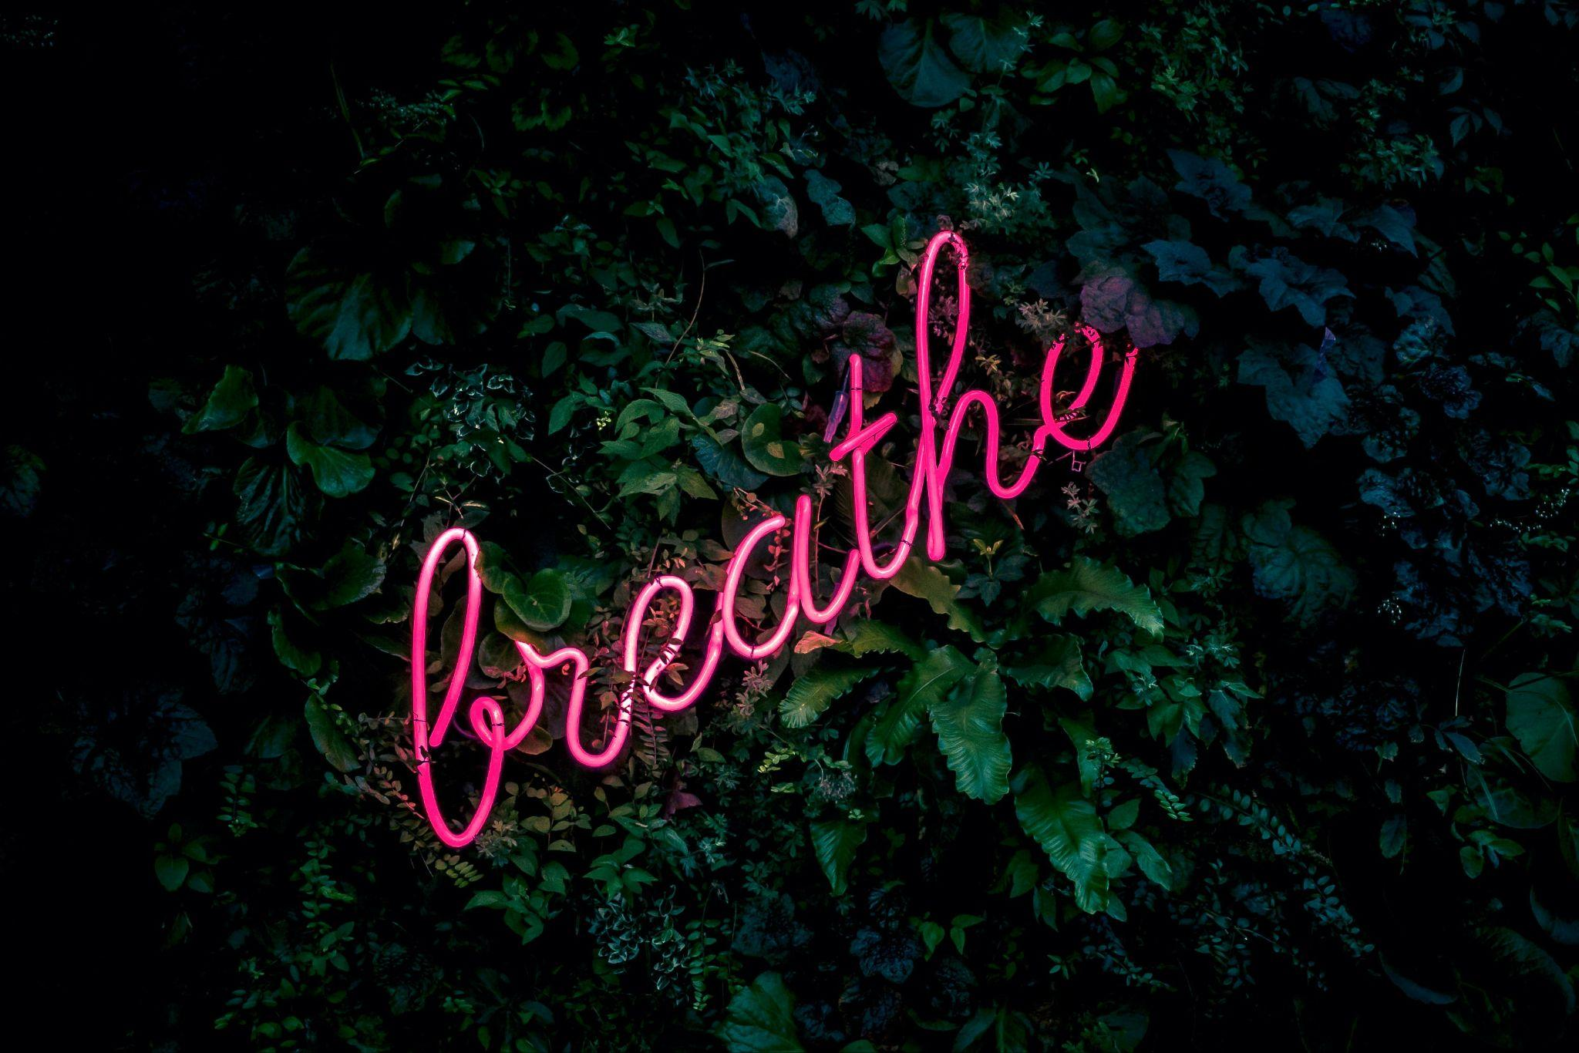
Breathe

Slide 13
Creating a Welcoming & Affirming Environment
How do you learn about your students’ cultures and backgrounds?
How do we build and sustain student relationships
How can our instructional materials reflect and affirm our students’ identities and lived experiences?
Notes:
Activity 9:50-10:10

Slide 14
Inclusive Curriculum & Assessment
How can our students participate in the design of our curriculum, instruction and assessment plans?
How do we co-create knowledge with our students?
How do we adapt our instructional strategies to the diverse learning needs of our students?
How do we incorporate resources that center racially, linguistically and culturally diverse perspectives?
Notes:
9:50-10:10

Slide 15
High Expectations and Rigor
How do we engage with our students in critical examinations of power structures.
What opportunities for student leadership and project based learning can we apply in our classroom? (pblworks.org)
Notes:
9:50-10:10

Slide 16
Ongoing Professional Development and Support
Where can we find opportunities for anti-racist and anti-bias training with opportunities to learn, practice and reflect?
How can we prioritize spaces and dialogues to ask questions and learn with others?
Where can we find support in aligning curriculum and instruction to the histories, languages and experiences of our students?
Notes:
9:50-10:10

Slide 17
Creating a Culturally Responsive/Sustaining Classroom
Vulnerability
Cultural humility
Authenticity
Student-centeredness
Flexibility
Responsive

Slide 18
Examples of Activities and Projects
Name Poster
This I Believe
Identity/Culture Box
StoryCorps Project
Notes:
10:10-10:15

Slide 19
Group Discussion & Questions
Notes:
10:15-10:30

Slide 20
Thank you!
Wishing you the best in this journey!

