Slide 1
BEdA Equitable Math Pathways & Practices
Michael Jenck
July 25, 2024 at 9:40 AM – 11:10 AM

Slide 2
Instructor Account
You will need an Instructor account to copy/create questions
If you don’t have one go to https://www.wamap.org/index.php
Choose Classroom tab or go directly to

Slide 3
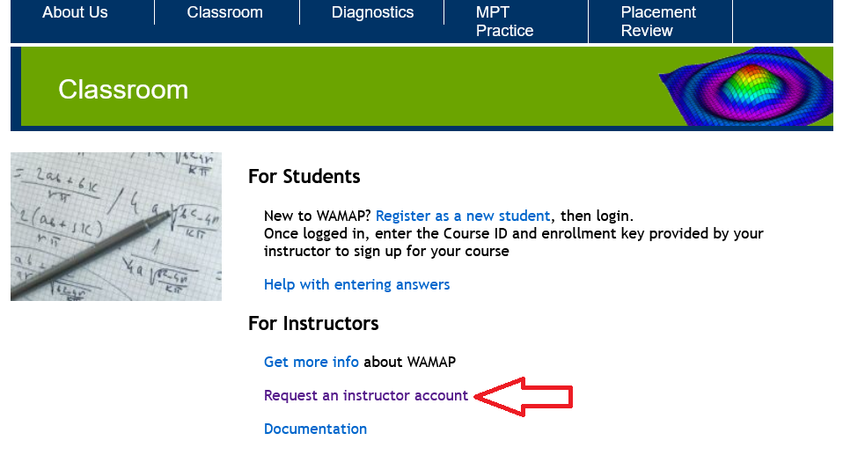
Click on the Request an instructor account
https://www.wamap.org/wamap/info/classroom.php

Slide 4
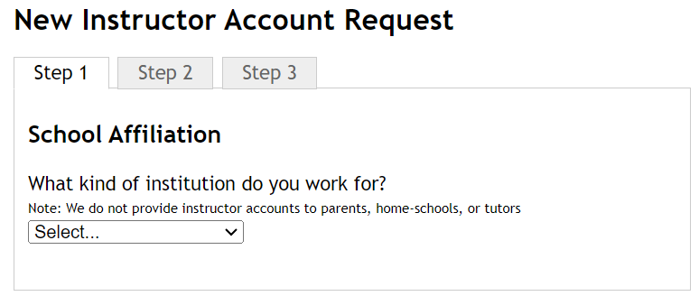
Click on the Request an instructor account

Slide 5
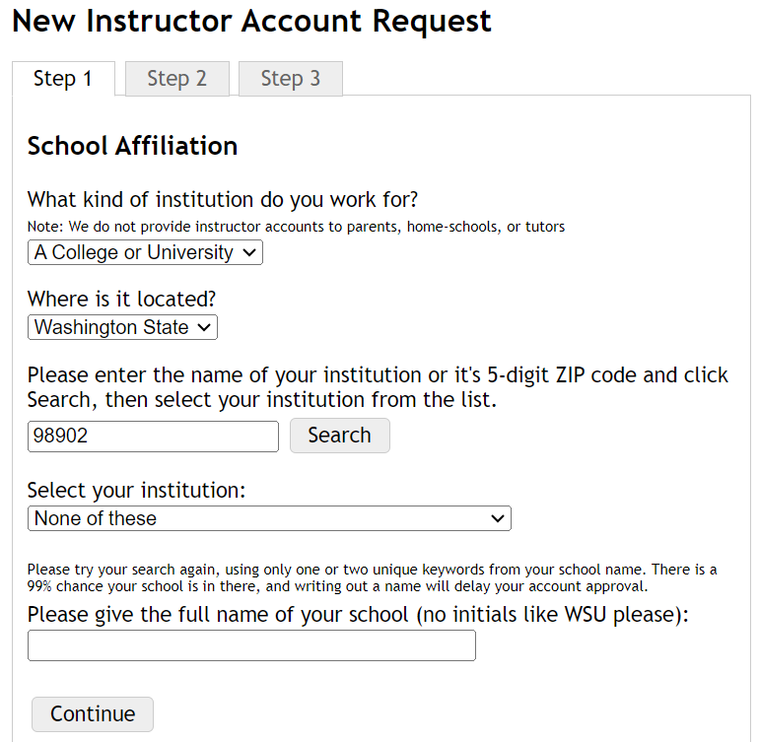
New instructor account request

Slide 6
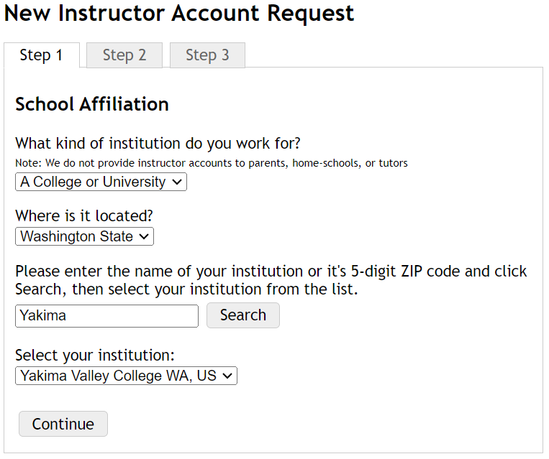
New instructor account request cont’d

Slide 7
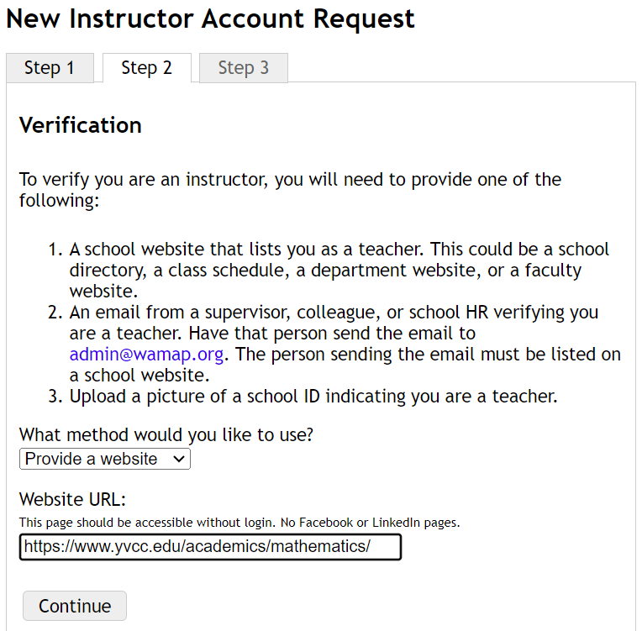
New instructor account request cont’d 2

Slide 8
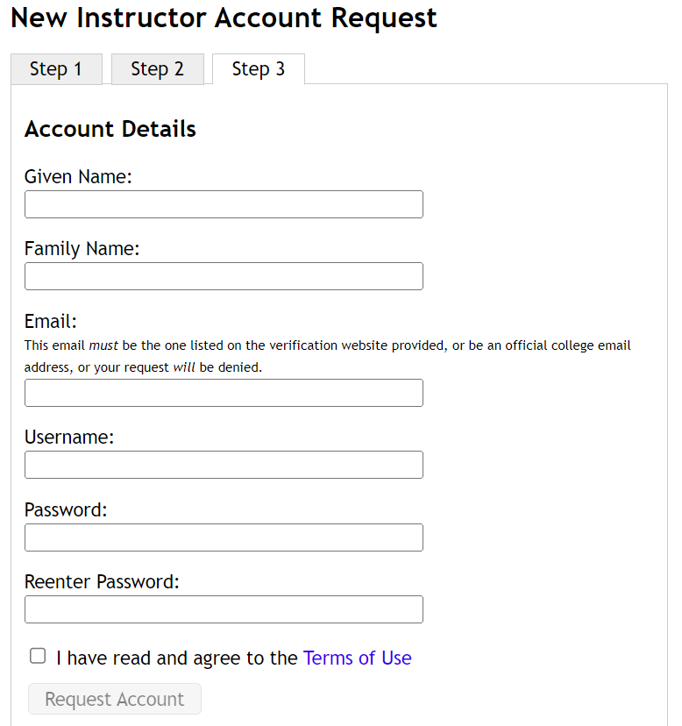
New instructor account request cont’d 3

Slide 9
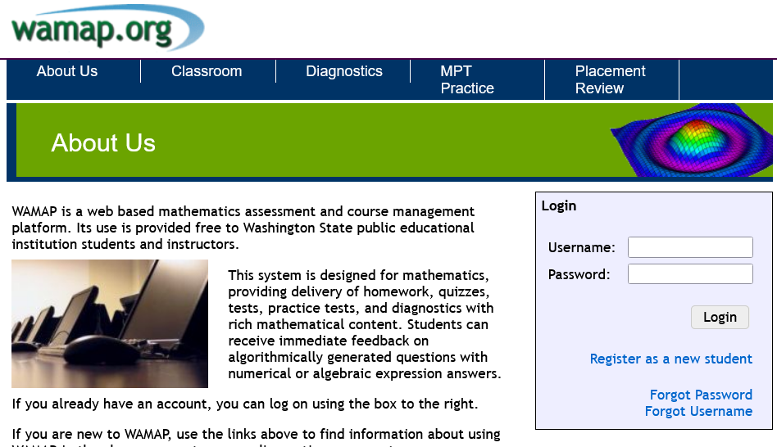
https://www.wamap.org/index.php

Slide 10
WAMAP
Click the Add New Course button
Now click
Use course ID: 36946
Enrollment key: math
On the next page click

Slide 11
MOM
Click the Add New Course button
Now click
Use course ID: 23858
Enrollment key: math
On the next page click

Slide 12
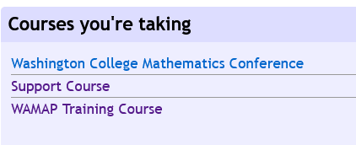
Support and Training

Slide 13
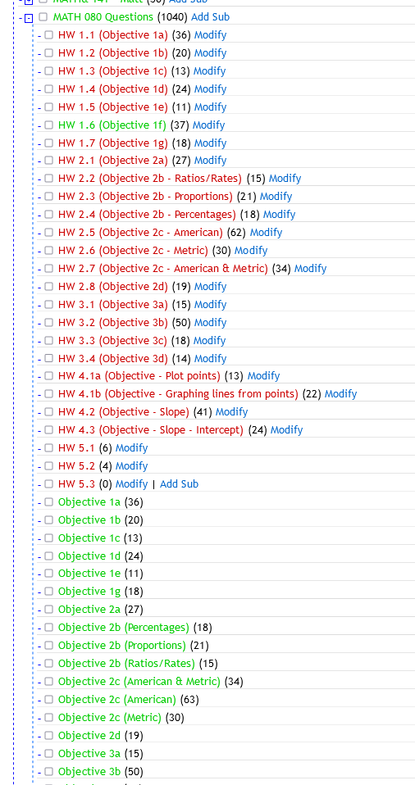
Library Structure
Now lets start writing/modifying questions.

Slide 14
Wrap-Up
I hope this workshop has helped your journey to OER questions on WAMAP.
Questions: email at mjenck@yvcc.edu

