Slide 1
Equity coaching for student success
BEdA Biennial Symposium
Monica Wilson Director Student Success Center & Strategic Initiatives SBCTC | Sophia Agtarap Director Equity, Diversity, and Inclusion SBCTC

Slide 2

Welcome
This symposium session is for all attendees, regardless of role or responsibility, and will ground attendees in an equity framework that is contextualized to students in programs in Basic Education for Adults programming, cultivate empathy and awareness for students and colleagues, and develop practical coaching techniques to advance understanding, belonging, and success within BEdA programs and across our system.
Drawn from a variety of coaching and equity resources, this symposium session will provide a space for curiosity, deep listening, self-reflection, connection building, and practices that can be used the moment the session ends.

Slide 3
Our Time together
Building community
Our Collective Why: Equity and Justice in the CTCs
Lens of Systemic Oppression
Equity Coaching as a lever for change
Building a Liberatory Mindset

Slide 4
Informal Introductions
Take 90 seconds to share about yourself, not including any information about your work or education, etc.
Family
Faith, spirituality
Background
Identities
Special talents or interests
Notes:
In small group/rounds

Slide 5
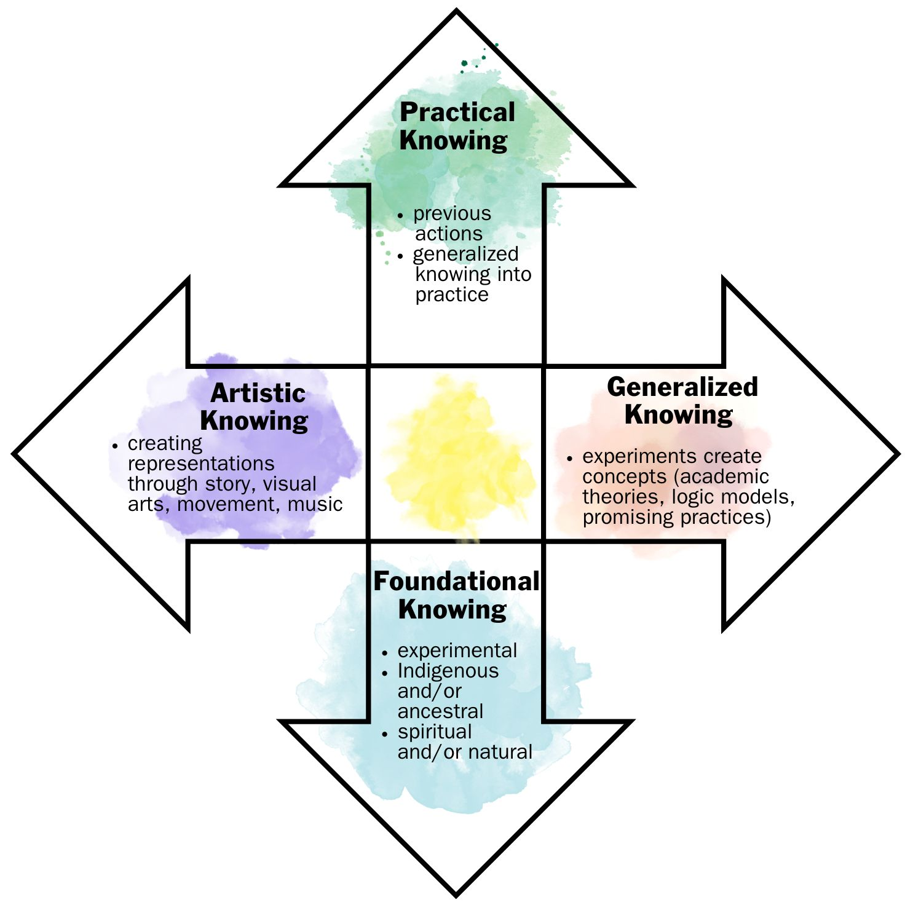
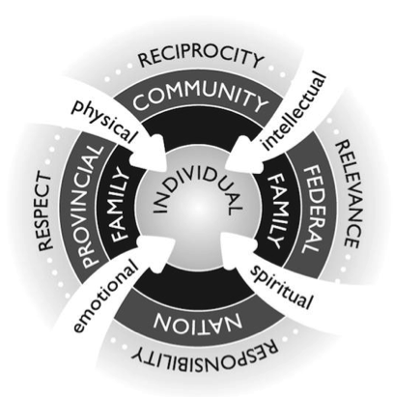
Some Ways of knowing
This Indigenous wholistic framework provides guiding principles to ensure post-secondary institutions become accessible, inclusive, safe, and successful places for Indigenous students. https://opentextbc.ca/indigenizationfrontlineworkers/chapter/indigenous-ways-of-knowing-and-being/
Multiple Ways of Knowing: Expanding How We Know. Nonprofit Quarterly. Elissa Sloane Perry and Aja Couchois Duncan

Slide 6
How do we want to be together?
Agreements
Expectations
Race conscious
Curious
Engaged
Care for our community
Unfinished business
"The devil needs no advocates"
Follow up for resources
BIPOC breakout spaces

Slide 7
Collective vision: equity & justice

Slide 8
OUR WHY: ADVANCNG EQUITY AND JUSTICE
SBCTC Vision
Leading with racial equity, our colleges maximize student potential and transform live within a culture of belonging that advances racial, social, and economic justice in service to our diverse communities.
BEdA Vision
To advance racial and economic justice, Basic Education for Adults provides equitable programming for all Washingtonians to realize their potential as they launch on a supported college and career pathway to living-wage employment and strengthen the vitality of their communities.
BEdA Mission
Basic Education for Adults works collaboratively to offer culturally responsive and equity focused college and career pathways that address barriers and enable students to obtain meaningful employment, meet workforce needs, and reduce economic disparities.
Notes:
Monica

Slide 9
BEdA Commitments
Basic Education for Adults’ work is guided and informed by our commitment to:
Students’ cultural capital: voice, experience, perspective
Diversity, equity, inclusion: racial, economic, and social justice
Quality: collaborative, evidence-based innovative pathways
Our success is measured by
the success of our students.
Notes:
Monica

Slide 10
Constructivist listening
Engaging in conversations that are both intellectually demanding and emotionally challenging.
Give full attention to another person to hold space for them to:
Reflect
Release emotion
Construct new meaning about challenges
Equal time.
No interruption.
Confidentiality.
No criticism.
Undivided attention.
Listening Prompts
What did you notice in the documents? Does anything need to be clarified?
What are you wondering?
Notes:
Monica

Slide 11
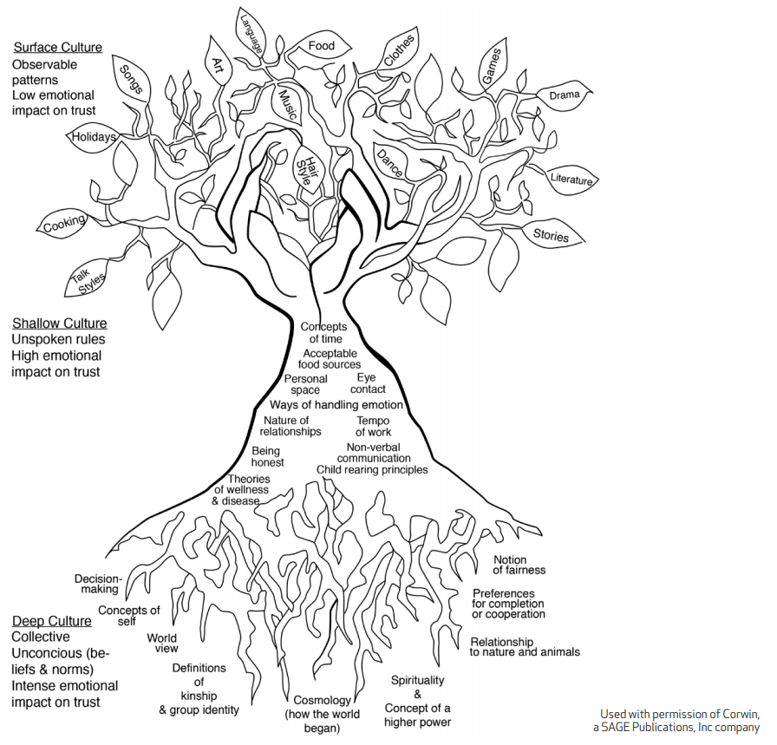
Surface culture: Observable and concrete elements of culture such as food, music, holidays, dress.
Culturally Responsive Teaching and the Brain, p. 24
Shallow/intermediate culture: Unspoken rules and norms that guide everyday social interactions, which could include attitudes toward elders, concepts of time, personal space, and nonverbal communication and eye contact.
Deep culture: Tacit knowledge and unconscious assumptions that guide how we move about the world, including religious and spiritual views. Deep culture governs how we learn new information and it is at this level that our brain makes sense of the world and forms our worldview that guides our thinking and behavior. If we were to think of culture as a tree, deep culture would be the root system.
Notes:
Sophia--Another model to consider based on Zaretta Hammond’s work in Culturally Responsive Teaching and the Brain.

Slide 12
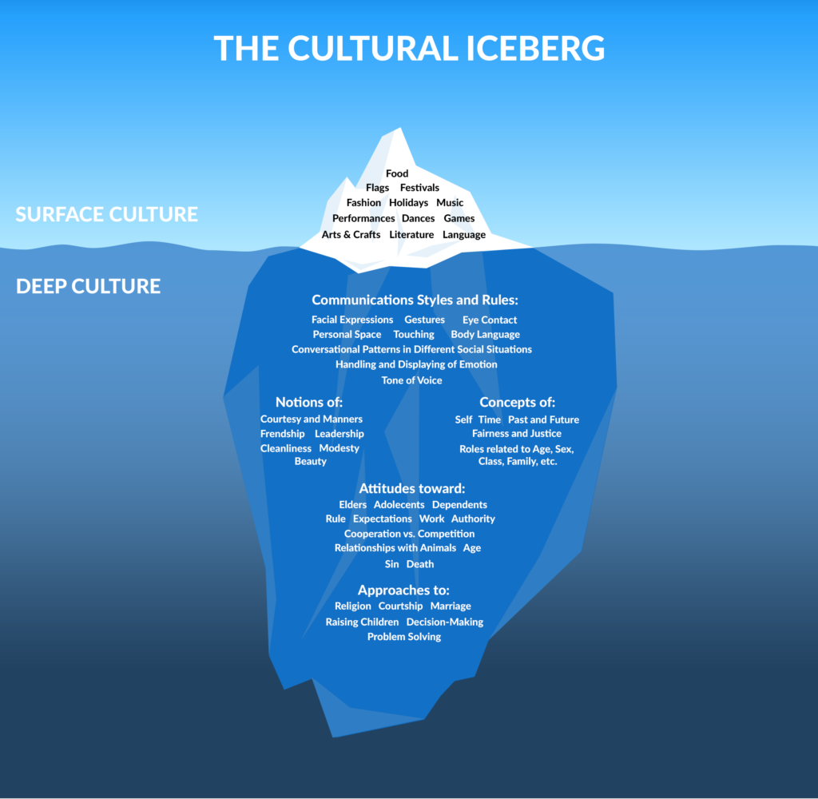
The Cultural Iceberg
ACTIONS
BELIEFS
MENTAL
MODELS
VALUES
MINDSETS
And the role culture plays in constructing beliefs.
Notes:
Sophia
Actions are like the tip of the iceberg.
Beneath the surface are the beliefs, mindsets, values, mental models, and mindsets.
In this work we are often talking about the relationship between beliefs and behaviors. Important to surface the underlying mental models from which we often act.

Slide 13
Constructivist listening
Engaging in conversations that are both intellectually demanding and emotionally challenging.
Give full attention to another person to hold space for them to:
Reflect
Release emotion
Construct new meaning about challenges
Equal time.
No interruption.
Confidentiality.
No criticism.
Undivided attention.
Listening Prompts
Describe the culture of the BEdA program at your institution.
  Surface
  Shallow
  Deep
Notes:
Sophia

Slide 14
Using a Lens of Systemic Oppression
A “lens” is a metaphor to communicate the idea of looking at an event, experience, and/or a set of data through a particular perspective.
Each of us views the world through a set of lenses everyday – it is how we read and make meaning of the world.
Name some of the ways that the layers of systemic oppression impact the BEdA student experience
Structural:
How these effects interact and accumulate across institutions—and across history
Institutional:
Policies and practices at the organization or sector level that perpetuate oppression
Interpersonal:
the interactions between people—both within and across difference
Individual:
A person’s beliefs & actions that serve to perpetuate oppression
Notes:
Monica
https://www.nationalequityproject.org/frameworks/lens-of-systemic-oppression

Slide 15
Liberatory design mindset: Recognize oppression
How:
Name identity-related patterns of inequity we see in this context.
Listen to the experiences of those most negatively impacted.
Identify what designs (structures, policies, processes, practices) over time have produced these - intentionally or unintentionally.
Notice how our own identities and positional power shape what we see and hear and how we frame challenges.
Learn to see how oppression, in its many forms, has shaped designs that lead to inequity.
Why: Inequities do not exist in a vacuum. They are shaped by oppression and design decisions made across history. Understanding oppression’s causes and more effectively design to catalyze liberation.
Notes:
Sophia

Slide 16

Coaching for Change

Slide 17
How Change Happens
Why?
Why change?
What?
What are we changing?
How?
How can we make change happen?
Pathway Design
Pathway Entry
Pathway Navigation
Teaching and Learning

Slide 18
THE CASE FOR COACHING
Coaching is a mechanism for transformational change and an active practice. Colleges can leverage the capacity and knowledge of coaches to make progress on institutional reform agendas to increase student success. Coaches are facilitators, data journeyers, capacity builders, advocates, connectors, & critical friends/partners.
SSCN Coaching Program: Facilitating Institutional Transformation
CCRI’s Lia Wetzstein and Katie Kovacich and our JFF partners, Tara Smith, Jessica Soja, Alexandra Waugh, and Hector Torres
Notes:
https://www.washington.edu/ccri/sscn_coaching_meta-fit_final/

Slide 19
What is coaching?
Leadership is about taking responsibility for what matters to you. It’s not about a title or position. Anyone can be a leader for equity.
Every leader is a coach, and every coach is a leader. We believe that a coaching stance allows for transformational change where you are faculty, administrators, staff, or a formal coach.

Slide 20
Coaches…
Believe others are as creative, resourceful, and whole—where the solutions live
Elicit solutions from those impacted
Focus on transformation
Focus on intentional action to fulfill mission
Brings out best in whole team – “collective intelligence”
Builds capacity to come up with best answers for the college
Sees college striving to be best self/college
Notes:
Inclusive solutions that bring people of identities and cultures that have not been a part of the design of our system.

Slide 21
A liberatory mindset
Mindsets are used to surface particular beliefs, values and stances
to ground and focus design practice.
Build relational trust
Work to transform power
Practice self-awareness
Seek liberatory collaboration
Exercise creative courage
Recognize oppression
Work with fear and discomfort
Take action to learn
Embrace complexity
Attend to healing
Share don’t sell
Focus on human values
Notes:
https://www.nationalequityproject.org/frameworks/lens-of-systemic-oppression

Slide 22
A liberatory mindset
Build relational trust
Practice transparency and non-attachment in sharing ideas with collaborators.
Focus on human values
Work to transform power
Practice self-awareness
Seek liberatory collaboration
Exercise creative courage
Recognize oppression
Work with fear and discomfort
Take action to learn
Embrace complexity
Attend to healing
Share don’t sell
Who we are determines how we design. Looking in the “mirror” reveals what we see, how we relate, and how our perspectives impact our practice.
Recognize differences in power and identity to design “with” instead of “for.” Design for belonging.
Every human is creative. Creative courage allows us to push through self-doubt and creative fragility so we can design bravely against oppression.
Learn to see how oppression, in its many forms, has shaped designs that lead to inequity.
Fear and discomfort are anticipated parts of equity design work. Identifying the sources of such feelings offers us a context to work through them and continue to design.
Explore structures and opportunities for interactions in which power is shared, not exercised.
In order to design for genuine shared power across communities, place relationships at the center of our work.
Invest in relationships with intention, especially across difference. Honor stories. Practice empathetic listening.
Recognize that equity challenges are complex and messy. Stay open to possibility. Powerful design emerges from the mess, not from avoiding it.
The effects of oppression are complex and often hinder our ability to take action. Integrate ongoing healing processes when designing for equity.
The complexity of oppression must be addressed with courageous ongoing action. Experiment as a way to think and learn – without attachment to outcome.
Notes:
https://www.nationalequityproject.org/frameworks/lens-of-systemic-oppression

Slide 23
Constructivist listening
Engaging in conversations that are both intellectually demanding and emotionally challenging.
Give full attention to another person to hold space for them to:
Reflect
Release emotion
Construct new meaning about challenges
Equal time.
No interruption.
Confidentiality.
No criticism.
Undivided attention.
Listening Prompts
What did you notice about liberatory mindset?
What are you wondering?

Slide 24
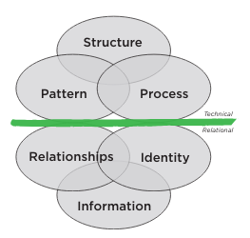
A systems View of Coaching for Equity
“The “hallucination” was that if you changed the structure of the organization – assigned people to have the primary responsibility for a key initiative – the organization would then respond to the change. Additionally, the thinking was that if you designed explicit processes that detailed out every step to of a change process, people would willingly respond and create the desired change.”
-Steve Zuieback and Tim Dalmau

Slide 25
Surface culture: Observable and concrete elements of culture such as food, music, holidays, dress.
Culturally Responsive Teaching and the Brain, p. 24
Shallow/intermediate culture: Unspoken rules and norms that guide everyday social interactions, which could include attitudes toward elders, concepts of time, personal space, and nonverbal communication and eye contact.
Deep culture: Tacit knowledge and unconscious assumptions that guide how we move about the world, including religious and spiritual views. Deep culture governs how we learn new information and it is at this level that our brain makes sense of the world and forms our worldview that guides our thinking and behavior. If we were to think of culture as a tree, deep culture would be the root system.
Notes:
Another model to consider based on Zaretta Hammond’s work in Culturally Responsive Teaching and the Brain.

Slide 26
Above the green line--Technical
Structure
Process
The way a system organizes itself to conduct its work.
The standard processes (operations) that are used to build consistency and efficiency.
Patterns &
Strategies
How a system focuses its key strategies to accomplish its mission and goals
Notes:
What is observable here What do patterns and strategies, structure, and process show up? How do we observe them? Where to we find them?

Slide 27
below the green line--relational
Relationships
Information
Identity
How a team or organization values its people -- Their emotional, physical and spiritual well-being
Abundant information focuses attention on what is important and enhances sense of security
Shared purposes and principles of people in teams motivates individuals to work together in organizations.
Notes:
How does this show up? What is observable? What is unspoken? What is unconsciously taken for granted?

Slide 28
Green line reflection
Consider a real time issue or problem of practice concerning student success in your program.
  What are the elements of the problem?
  Where would you locate the problem or issue, above or below the green line?
  What are the racial and social equity implications and dynamics of the issue or problem?
  What do you see as potential options for transformation?
Share with a partner

Slide 29
Coaching Strategies
Style | What It Is | When You Use It
Prescribing | Give directions, advice/or recommendations to the learner | If the client lacks confidence If the client is unable to direct their own learning yet If there are legal, safety, ethical, quality guidelines
Informing | Giving information and knowledge to the learner | Showing where to find extra help, information Supply missing facts Explaining what just happened Telling your own experiences
Confronting | Challenging the client’s assumptions: stimulating their awareness of their own behavior, attitudes or beliefs | To show consequences of the client’s actions To challenge the client to re- think assumptions To raise the client’s awareness of others perceptions To boost the client’s confidence by affirming success
Cathartic | Helping the client to release tension and to release or come to terms with emotions which are blocking their progress | If the client is afraid of risk or failure If the client feels incompetent If the client is frustrated, unmotivated
Catalytic | Helping the client to self-discovery, to self-directed learning, and to solving their own problems | To achieve a deeper level of understanding To encourage the learner to take responsibility To promote motivation and commitment
Supporting | Building the client’s self-esteem, self- confidence and self- respect | To build morale and self- confidence To encourage risk taking To reward success, promote further learning

Slide 30
Exploring Beliefs about equity
It is a coach’s responsibility to address inequities when they are observed
If there is not an expectation of equity conversation, the coach shouldn’t break that unspoken agreement.
If a coach is going to talk about educational inequity, they should have training in how to do this. They need to know what racism is, how to create antiracist spaces, and how to talk about inequity.
A coach doesn’t need to have extensive training in antiracism to address inequities that they observe
When a coach witnesses inequities, it’s their responsibility to tell administrators and let them deal with it.
Coaching around issues of race and other biases is uncomfortable and hard.
Coaching around issues of race and other biases can be healing for everyone.

Slide 31
Surfacing your beliefs
Use the sentence stems for further reflection
  When I think about coaching around issues of equity,
  I feel…
  When I think about having conversations about race and racism, I feel…
  I believe that coaching for equity is…
  I believe that talking about race and racism is…
  If a coach is going to talk about educational inequality, then I believe they should…

Slide 32
Cycle of an emotion
1. Prompting Event
2. Interpretation
3. Physical Response
4. Urge to Act
5. Action
6. After Effects
An emotion is a reaction to an event. They are physiological, cognitive, and behavioral experiences.
Something happens, and your body responds. You behave in accordance with your mind’s interpretation and your body’s response.
Knowing the cycle, you can intervene in your own experience or coach others.

Slide 33
Thank you
Questions? Comments? Feedback? Collaboration?
Monica Wilson mwilson@sbctc.edu | Sophia Agtarap sagtarap@sbctc.edu

