Slide 1
More Than Self-Care: The Systemic Roots of Professional Burnout & Re-envisioning the Status Quo
Melissa Williams, M.A.
Policy Associate for Equity, Diversity, and Inclusion
Washington State Board for Community and Technical Colleges
2024 BEdA Biennial Conference

Slide 2
GROUP AGREEMENT
Allow for brave learning space ​
Acknowledge the impact of your comments and behaviors ​
Discomfort is welcome ​
Respect each other’s perspectives ​
Practice graceful listening ​
Stay engaged ​
Make space, take space ​
Stories stay, knowledge leaves ​
Speak your truth ​
Expect and accept non-closure

Slide 3
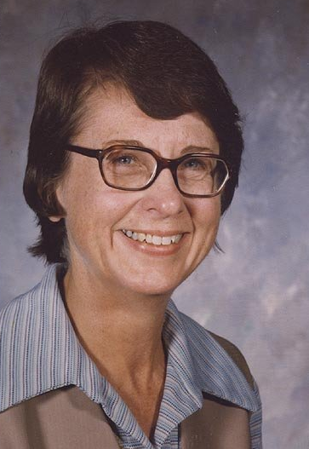
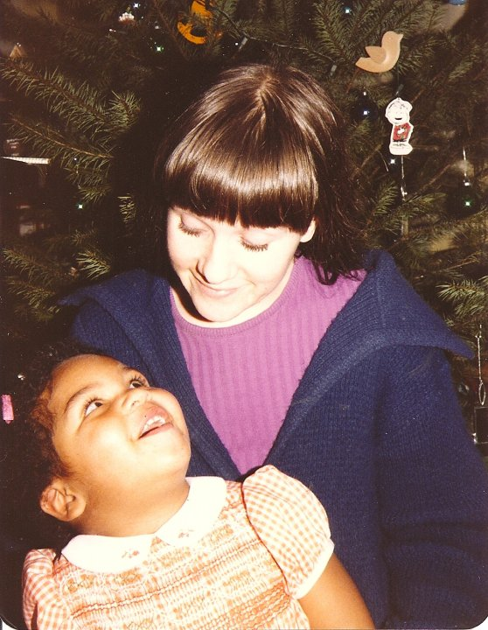
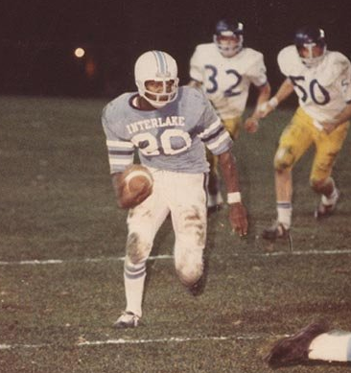
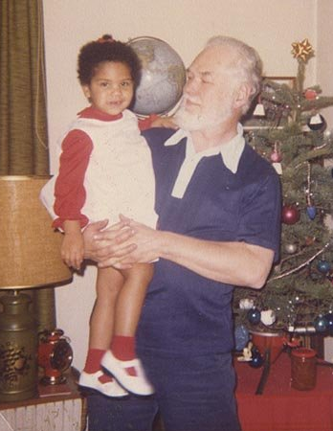
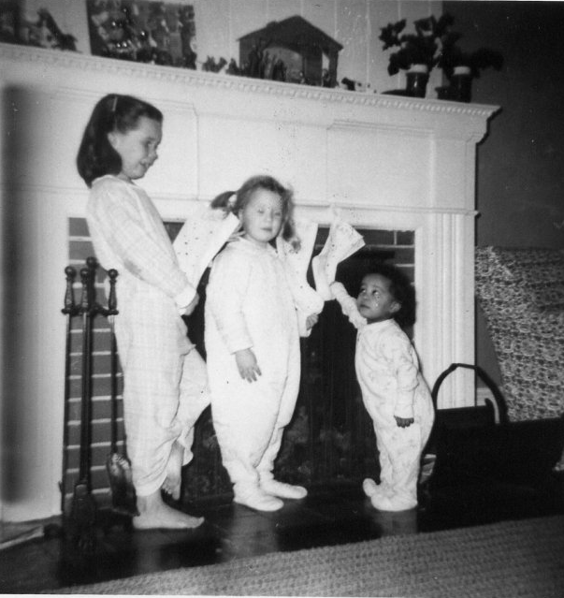
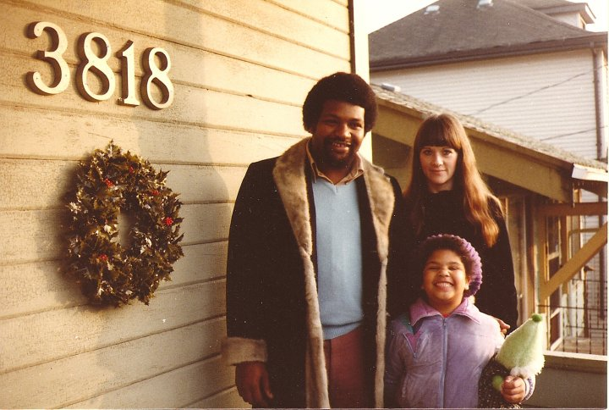
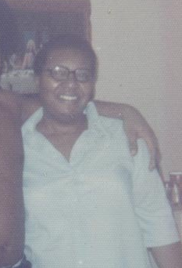
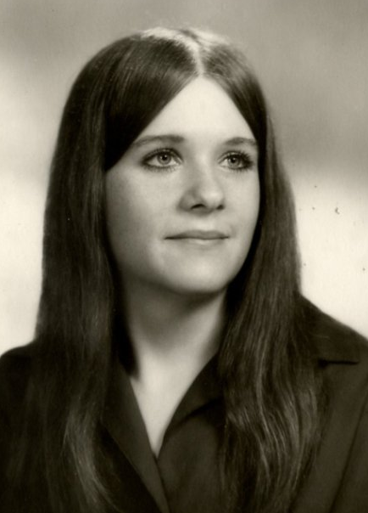
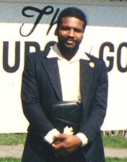
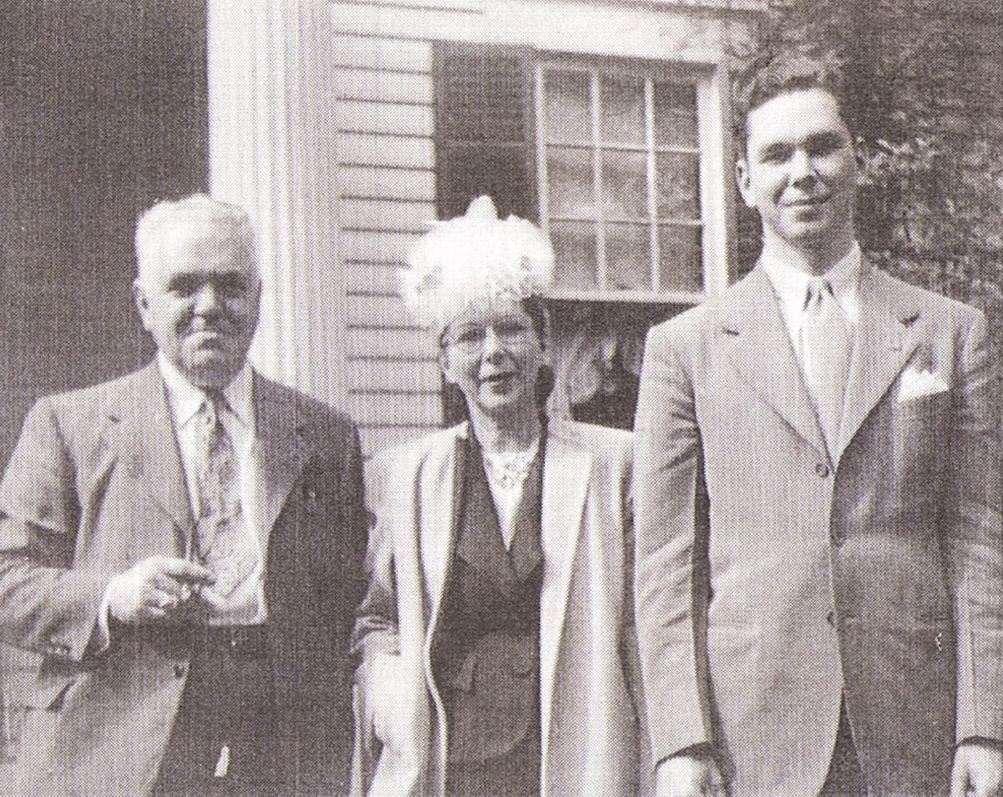

PRESENTER SNAPSHOT
Granddaughter of Willie & Leslie and Nancy & Ken​
  enslaved people and sharecroppers from TX​ from mid-1800s to 1930s
  educators and engineers from PA, OH, IL from early 1800s
Only child of Barbara and Ray
Born at Grandma’s house in Portland, OR
Raised in pre-gentrified Albina neighborhood of Portland (1980s)​
At age 9, moved to Vancouver, WA, where I live now
Attended Clark College, UW, WSU, and now PSU​
Friend of goats​

Slide 4
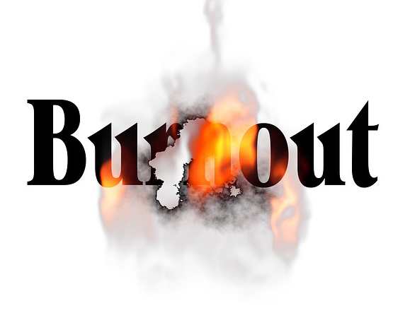
AGENDA
Terminology: What burns out?
Definition and symptoms
Society and systems
Work roles and work styles
Traditional wisdom
Your reflections
Resources
Recap
Session Outcomes/Objectives
Knowledge: Define workplace burnout and identify how it manifests.
Comprehension: Describe elements of a thriving workplace culture and how those elements support employees’ well-being.
Analysis: Compare and contrast mainstream American workstyles and concepts of self-care with traditional wisdom about work and rest from cultures around the world.
Synthesis: Generate ideas for a proposal (or draft a proposal) to address certain systemic causes of burnout in your workplace.

Slide 5

TERMINOLOGY: WHAT “BURNS OUT”?
Light bulbs
Candles
Matches
Stars
Electronics and electrical parts
Why do we use the word “burnout” to describe feeling chronically stressed and unrested?
What else does this experience feel like?

Slide 6
WORKPLACE BURNOUT AS A CONCEPT
World Health Organization (WHO) (2019)
“Burn-out is a syndrome conceptualized as resulting from chronic workplace stress that has not been successfully managed.”
Included in the 11th Revision of the International Classification of Diseases (ICD-11) handbook as an occupational phenomenon.
Not classified as a medical condition.
American Medical Association (AMA)
Adopted WHO’s categorization of burnout as a syndrome—a set of medical signs and symptoms that are correlated with each other and often associated with a particular disease or disorder.
American Psychological Association (AMA)
True workplace burnout is specific to one’s job or occupation and is more concerning and detrimental than the daily irritations that most workers experience and that most of us manage.
Excessive workloads, low levels of support, little say or control over workplace matters, lack of recognition/ reward for one’s efforts, interpersonally toxic and unfair work environments.
Notes:
https://www.who.int/news/item/28-05-2019-burn-out-an-occupational-phenomenon-international-classification-of-diseases
https://www.ama-assn.org/practice-management/physician-health/who-adds-burnout-icd-11-what-it-means-physicians
https://www.apa.org/topics/healthy-workplaces/workplace-burnout

Slide 7
SYMPTOMS
The World Health Organization (WHO) characterizes workplace burnout in three “dimensions”:
Feelings of energy depletion or exhaustion;
Increased mental distance from one’s job, or feelings of negativism or cynicism related to one’s job;
Reduced professional efficacy.
These dimensions are often continuous or last for long periods of time, and there is no fulfilling recovery from the stress.
Have you experienced these symptoms?
Notes:
https://www.hrdive.com/news/employee-burnout-productivity/703405/
https://www.gallup.com/workplace/288539/employee-burnout-biggest-myth.aspx

Slide 8
NUMBERS
In 2023, nearly 65% of employees polled said they suffered from burnout. (isolved Human Resource Management)
Other recent surveys indicate up to 75% of workers reporting feeling job burnout at least sometimes.
About 72% of employees said burnout impacted their job performance.
Employees who frequently experience work burnout are 63% more likely to take a sick day and 23% more likely to visit the emergency room.
According to the isolved report:
  88% of employees said it’s become more important to have a job they find personally fulfilling
  53% want their employer to provide more opportunities to develop their skills
  52% want a more flexible work environment
  19% want improved internal communications
Notes:
https://www.hrdive.com/news/employee-burnout-productivity/703405/
https://www.gallup.com/workplace/288539/employee-burnout-biggest-myth.aspx

Slide 9
AT ITS ROOT, BURNOUT IS STRESS
Stress: mental or emotional strain or tension resulting from adverse or very demanding circumstances
Evolutionary roots, normal and okay/beneficial
Unharmful if experienced in a full cycle of which recovery is a part
  Burnout skips recovery phase; often compounds if the causes of stress aren’t addressed
  Times of huge output in life and at work are okay but have recovery time
Mindset and stress
  Mindset is how we think about our own thoughts and feelings
  Mind and body trust each other
  How we choose to feel about our situations and relationships is important
But let’s not let culture, society, systems, and organizations off the hook…

Slide 10
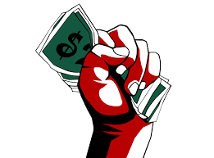
SYSTEMIC CONTEXT: CONNECTIONS
Capitalism and consumerism
Concept of productivity
  Linked to deservingness/deservedness
  Linked to achievement culture
Concept of individualism
Language plays a role in shaping our perceptions
  Aggressive language to describe the Western work ethic: hustle, grind, slay, nail it, kill it, burn the midnight oil, burn the wick at both ends, etc.
  Other phrases you know? Phrases from other cultures and languages?
Burnout can be more severe is one is experiencing situational stress, mental health challenges, or has cognitive or emotional disabilities that are not being well supported or treated

Slide 11
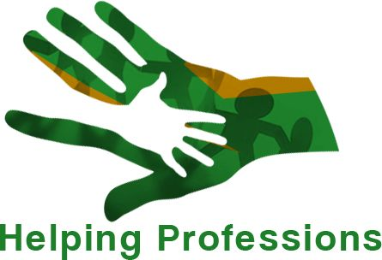
SYSTEMIC CONTEXT: ROLES & WORK STYLES
Some work roles and work styles allow for disproportionate burden on some people.
More common with specific roles and jobs
  Especially “helping” and “nurturing” positions such as the broad range of health care providers, childcare providers, and educators and trainers
  Isolated work in which people are siloed
  High expectations for individual success
  Positions and efforts that go unrecognized
Often those in “helping” and “nurturing” roles are:
  Cis and trans women, people of color, groups with a history of being colonized, immigrants, lowest wage earners to upper middle class
Note: Low-paid service provider positions and those with inconsistent work or gig work.

Slide 12
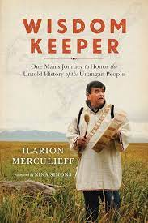
Heart-based living: “Such spiritual principles for living did not emanate from logic or thought, but from a much deeper source of wisdom, referred to in Unangan culture as the ‘heart.’ When Unangan elders speak of the ‘heart,’ they do not mean mere feelings (even positive and compassionate ones), but rather a deeper portal of profound interconnectedness and awareness that exists between humans and all living things. Listening to the heart gives us access to a deeper source of wisdom, ‘the Womb at the Center of the Universe.’”
FLIP THE SCRIPT: ANCESTRAL WISDOM
Ilarion Merculieff, Unangan (Aleut)
Collective work: “I had a fully traditional upbringing where the entire village raised me. I had to spend equal time with the men, the women, the elders, and my peers. I know that this traditional upbringing is why I have never experienced ‘burnout’ as it is known in western society. I used to work 17 hours a day, six days a week for some twenty years and what kept me centered and “in the flow” was what my people, the Unangan (Aleut) people gave to me.”
Notes:
https://transitionnetwork.org/news/what-indigenous-cultures-can-teach-us-about-burnout/

Slide 13

FLIP THE SCRIPT: ANCESTRAL WISDOM
Cora Tso, Navajo
Mental, emotional, and spiritual health: “I fought hard to overcome burnout with reflection, rest and prayer. Reflection was a huge factor in getting myself out of this funk. I took the time to meditate on who I was, who I am becoming and what I want out of life. This allowed me to let go of unnecessary, stressful thoughts and focus on what truly mattered to me.”
“When winter break arrived, I did the things I enjoyed: being with friends and family, watching movies, taking my dog to the park, going trail running and sleeping. I allowed myself to rest and have these breaks because I knew that was what I needed to return to my true self.”
Notes:
https://turningpointsmagazine.medium.com/burnout-83ba3dcfbf3e

Slide 14
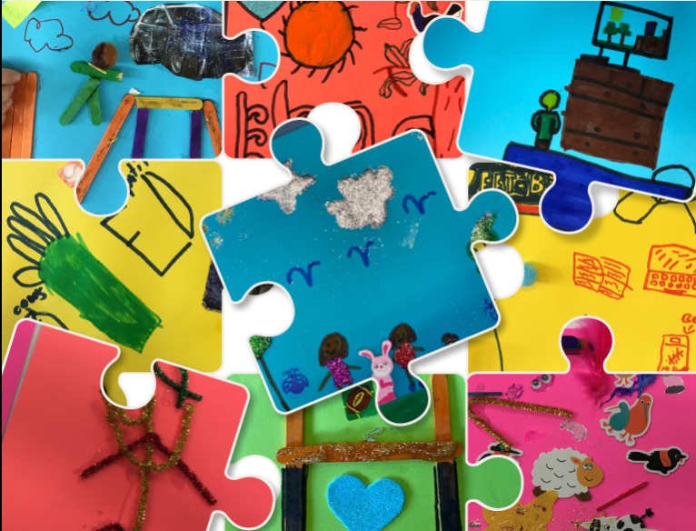
FLIP THE SCRIPT: ANCESTRAL WISDOM
Consider your thoughts on values, achievement, work ethic, stress, or rest.
From childhood to young adulthood, what did you learn about those concepts from your family, teachers, and others who influenced you?
What do you value about what you were taught?
What do you wish you had also been taught?
Notes:
https://turningpointsmagazine.medium.com/burnout-83ba3dcfbf3e

Slide 15
FLIP THE SCRIPT: MAKING CHANGE IN THE WORKPLACE
2021 Gallup poll revealed workers whose likelihood of experiencing burnout is essentially zero!
They are engaged at work.
  Have what they need to get their work done.
They have high wellbeing.
  Work-life integration rather than work-life balance
    = bringing our best self to work (because of home) and our best self to home (because of work)
They work in a culture that celebrates each person’s strengths.
  Using natural talents to build on what we do best for a “state of flow” in which time flies by, we find challenges exhilarating, and we achieve exceptional performance.
It’s not necessarily the hours we work but how we work.

Slide 16

FLIP THE SCRIPT: MAKING CHANGE IN THE WORKPLACE
Engagement at work
  Leaders help employees manage their workloads, collaborate effectively, and see a clear future.
Actions managers can take:
Focus me. Work with me to establish mutual expectations and priorities.
Free me from unnecessary stress. Help me get the resources I need and remove barriers for me.
Help me feel valued and supported. Ask my opinion and use it, recognize my contribution, and genuinely care about me.
When have you experienced engagement as an employee--how did it feel?
When have you fostered engagement as a leader—how did you do it?

Slide 17
FLIP THE SCRIPT: MAKING CHANGE IN THE WORKPLACE
High wellbeing
  Leaders who have authentic relationships with team members help employees make their work better fit their current life situations and adjust when challenges arise. Remote workers need particular care.
Actions managers can take:
See me. Check-in with employees with genuine care, and learn what each employee finds to be too much or too little checking-in.
Connect me. Facilitate connections between teammates and connections to the workplace’s purpose and vision/mission.
Teach me. Provide professional development opportunities.
When have you experienced high wellbeing as an employee--how did it feel?
When have you fostered high wellbeing as a leader—how did you do it?

Slide 18
FLIP THE SCRIPT: MAKING CHANGE IN THE WORKPLACE
Celebration
  Leaders recognize employees’ skills, talents, and interests and position each team member to spend a significant amount of time playing to their strengths.
Actions managers can take:
Tell me. Provide personalized feedback and set goals with (not for) team members considering their strengths in a way that is inspiring not daunting.
Include me. Reduce strain on each employee by encouraging a team to collaborate by leveraging individuals’ areas of expertise and interest.
Leave me be. Allow employees daily uninterrupted, focused time using their natural talents and building on what they do best.
When have you experienced being celebrated as an employee--how did it feel?
When have you fostered the celebration of others as a leader—how did you do it?

Slide 19
RESOURCES
Podcasts
Black Girl Burnout | Kelley Bonner
Burnout Recovery | Dex Randall
Disrupting Burnout | Dr. PBJ
Burnout | Connor Franta
Fried: The Burnout Podcast | Cait Donovan
Beyond Chronic Burnout | Carole Jean Whittington
The Burnout Doctor Podcast | Dr. Jessica Louie
Articles
“Job burnout: How to spot it and take action,” Mayo Clinic
“Burnout,” Psychology Today
“What is Burnout?” Cleveland Clinic
“How to Recognize Burnout Symptoms,” Very Well Mind
“A Guide to Burnout,” Healthline
Google Scholar for research articles
YouTube
Social Media

Slide 20

RECAP
We learned:
The definition of burnout and reviewed its symptoms;
Stress without recovery is harmful;
Our cultures, societies, systems, and organizations often perpetuate unhealthy work stress and burnout;
Ancestral or traditional wisdom can teach us different ways to think about values, achievement, work ethic, stress, and rest;
Workers who are least likely to experience burnout share common workplace characteristics and these characteristics can be shaped by leaders and others in an organization;
Many resources highlight how to make organizational changes to mitigate workplace burnout, and there are many more resources geared toward individual actions we can take for rest, recovery, and self-care.

Slide 21
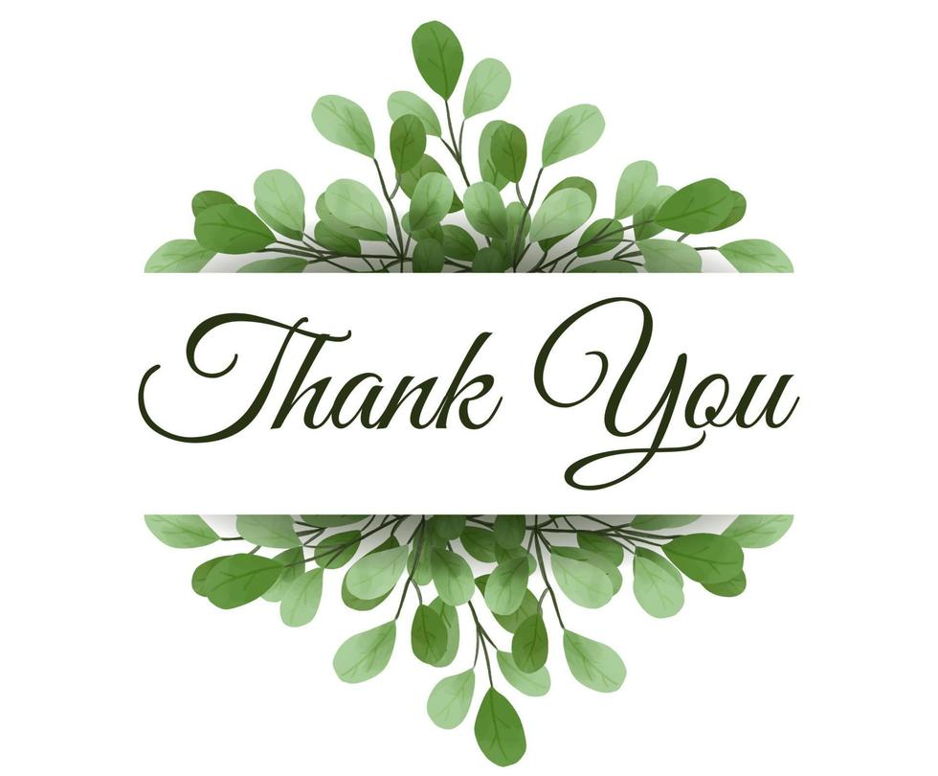
SHARING
Your thoughts, ideas, suggestions, questions.
Melissa Williams
mwilliams@sbctc.edu

