Slide 1
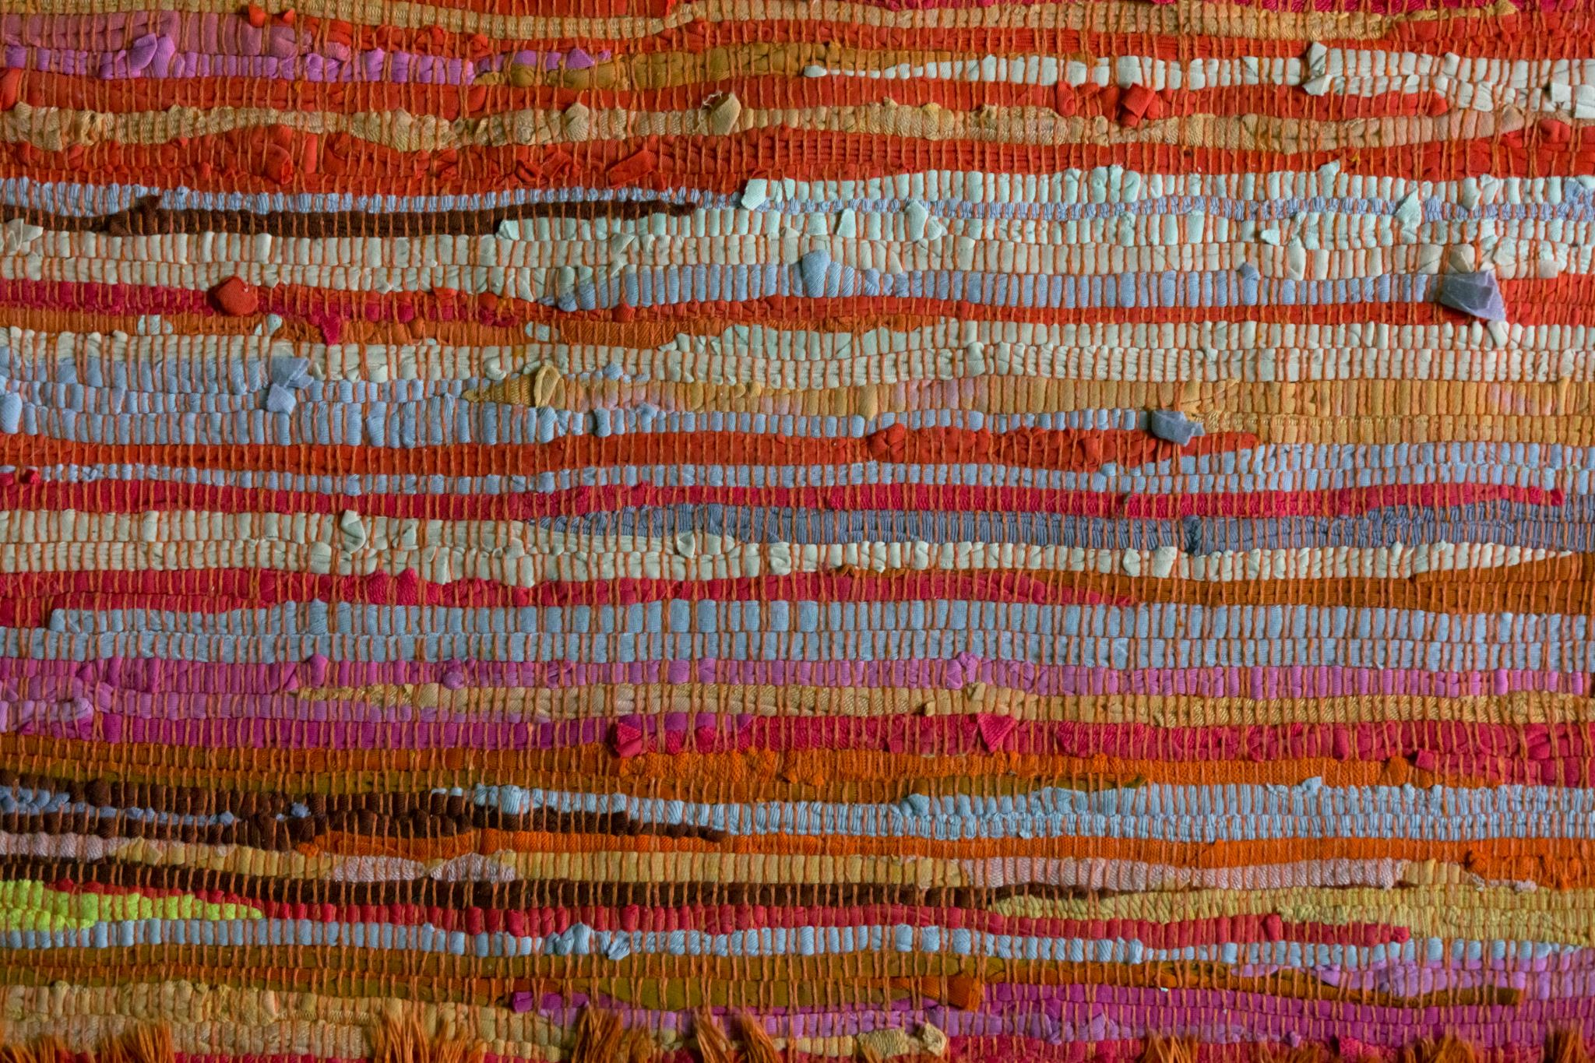
Native Erasure
Tokenizing Land Acknowledgments
Annette Woolley
Amy Gustafson
Notes:
This is why important, these are our outcomes
Hook:
Who are some Native people you know?
Mostly past or present?
(5 minutes)
intro selves, community agreements of taking care of self, LA
5 min – agenda + outcomes
15 min – historical (fill in the blank think pair share?)
20 minutes – steps
30 minutes - examples
10 min – questions

Slide 2
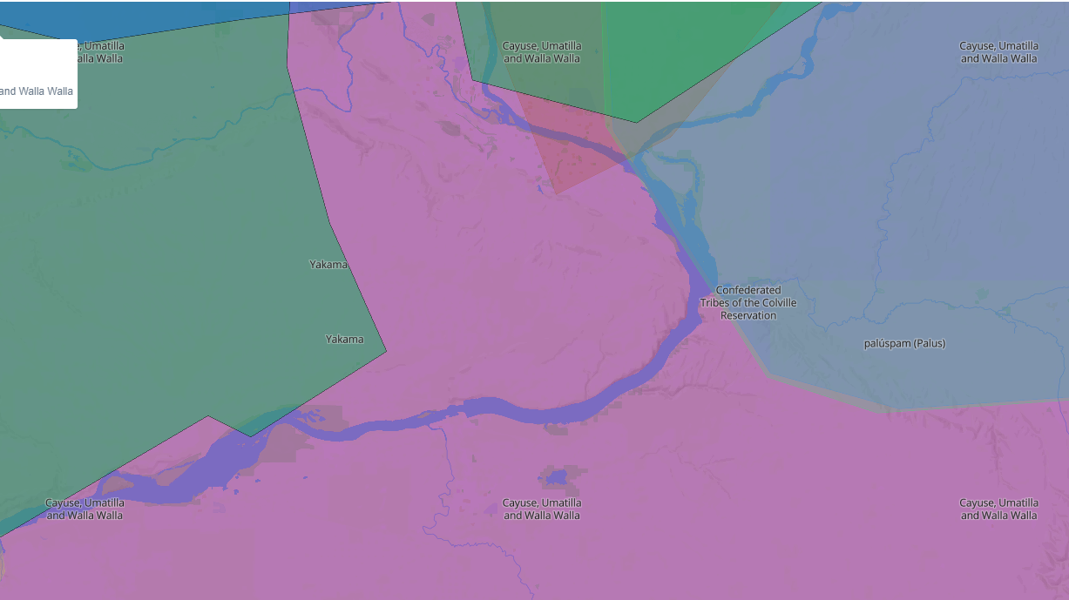
Map of overlapping local tribes
Notes:
Annette’s
Land acknowledgment:
Protocol – introduce selves and ask for permission to speak
If yes, give gift
If no, why is that (and give auntie the gift)
tee hee (not Kennewick)
Cayuse, Umatilla, and Walla Walla
History: their treaty included still fish, hunt, gather foods and medicine, and pasture.
First treaty of 1855, then ratified in 1859.
3 Tribes are confederation (all kinda together): Umatilla Indian Reservation
Columbia River is really important to them
Oregon Trail tried to go through their land, but they were strong and made it move south
1953 – won fight (damage from fishing and got settlement)
Connection:
Still today, non-Native farmers are trying to take their Land
Connect back to theme of Literacy and Justice for all – both strength in fighting for rights (still ongoing)

Slide 3
Outcomes
Connect individual positionality with purpose of a Land Acknowledgement
Identify components of authentic Land Acknowledgments
Honor relationships by identifying and choosing areas of Indigenous excellence to connect with
Understand structure of LA by comparing and contrasting contemporary examples
Notes:
Amy’s
Edits:
Know purpose of LA (education and action and work)
Honor relationships by identifying and choosing areas of Indigenous excellence to connect with
and use LA
What are protocols for using
Appropriate/inappropriate to ask/do
Understand structure of LA by comparing and contrasting contemporary examples

Slide 4



Content
Context
Positionality
Historical
Educational
Land acknowledgments
Examples
Making connection
Supporting Native creators
Native researchers
Notes:
Amy’s slide

Slide 5
Quote
"Owning our story can be hard, but not nearly as difficult as spending our lives running from it. Embracing our vulnerabilities is risky but not nearly as dangerous as giving up on love and belonging and joy, the experiences that make us most vulnerable. Only when we are brave enough to explore the darkness will we discover the infinite power of our light."
(Brown, 2020, p. 10)
Notes:
Annette’s
Asking folx to think about positionality – it is hard, but not as hard as being performative and fakey

Slide 6
Where did this happen?
"Our nation was born in genocide...We are perhaps the only nation which tried as a matter of national policy to wipe out its indigenous population. Moreover, we elevated that tragic experience into a noble crusade. Indeed, even today we have not permitted ourselves to reject or feel remorse for this shameful episode. -Martin Luther King, Jr." (In Dunbar-Ortiz, R., page 78).
Notes:
Annette – gotcha on genocide
Talk about emotional education and work here
Annette will read scenarios – audience will choose A or B

Slide 7
Historical
1492 – invaded
1819 – boarding schools
1871 – no more treaties
Hundreds of years of treaties
1883 – Court of Indian Offenses
1887 – Dawes Act
1934 – Blood Quantum
1954 - "relocation"
1978 - ICWA
Notes:
Amy
1492 – invaded; 1st steal
Hundreds of years of treaties and lies and harm and relocation – 2nd steal
1871 – no more treaties (discontinues recognizing tribal groups) 3rd steal
1819 – boarding schools (permit education of Native children off-reservation) (mass assimilation: 1819-1960 “Kill the Indian, Save the Man.” some STILL in operation today) 4th steal
1883 – Court of Indian Offenses (established Code of Indian Offenses – outlawed many traditional Native practices) 5th steal
1887 – Dawes Act (land held "in trust" until Natives could prove themselves competent to maintain; pay taxes on land, etc) (land went from 138 million acres to 48 million (1934) to 20 million) 6th steal
Umatilla Indian Reservation – land reduced by almost half (1939 – Lands restored to reservation (able to fight and try to get back some of the Land) but verrry small size
1934 – Blood Quantum (termination) but also some cultural practices allowed again (powwows but not for children) 7th steal
1954 - "relocation" lead to boom in Urban Indians (mass assimilation) 8th steal
1978 – ICWA (and return of all practices)

Slide 8
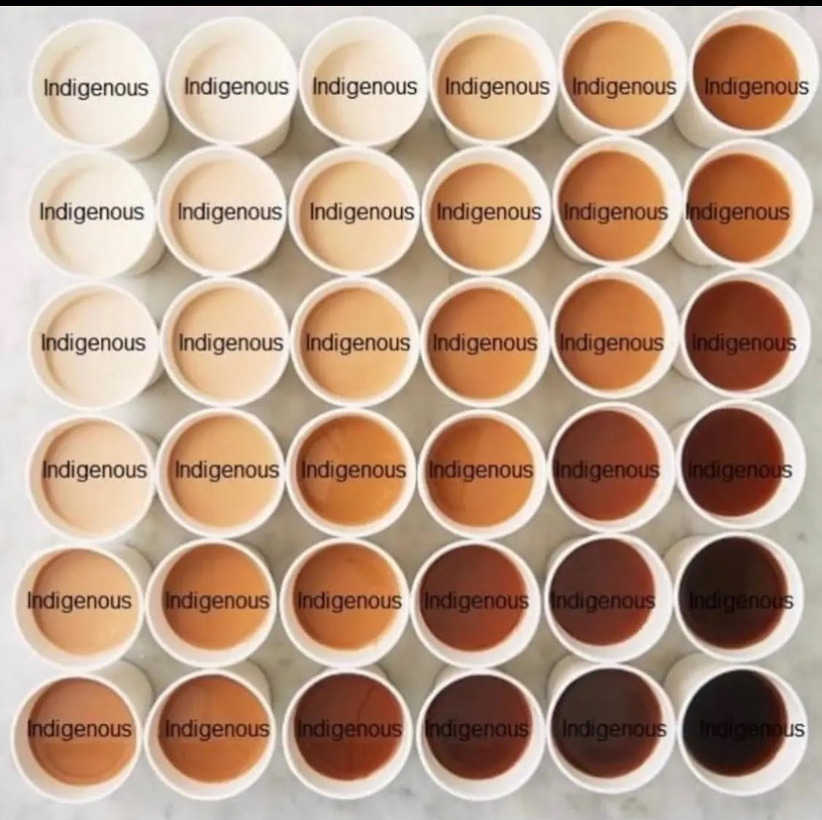
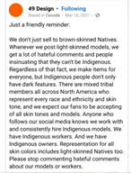
Educational
Lies
From invasion to treaties to whose land students are on
Not taught
Assumptions of what is Native
49 Design – social media post, 3/16/2021
Not all brown skin, brown hair, brown eyes
Notes:
Amy’s
Ties back to: not just race and ethnicity – political.
What part of me is Native – my head? My heart? My legs?
From political slide?
Not just Race and Ethnicity – Political
Our 500+ nations had treaties, rights, diplomacy
Different forms of government
Hereditary, Election, Senate, Chairman, Committee
Inform yourself of the nations whose lands you are on
Annette finish

Slide 9
Step 1 - Identifying
Names
  https://native-land.ca/
Notes:
Amy
History not taught
Names - https://native-land.ca/
History - https://birchbarkbooks.com/products/an-indigenous-peoples-history-of-the-united-states

Slide 10
Step 2 – Learn History
History
  https://birchbarkbooks.com/products/an-indigenous-peoples-history-of-the-united-states
Notes:
Amy start with Upper paddling and blocking
History not taught
History - https://birchbarkbooks.com/products/an-indigenous-peoples-history-of-the-united-states
Add more resources for them to click on later
Annette jump in

Slide 11
Step 3 –
Connect
Connect
  self
  interests
  challenges
Excellence
  art
  community
  science
  kinship
Topics
  Education
  MMIW
  Landback
  boarding schools
  Language Revitalization
Notes:
Annette start
Get Personal
Connect - self, interests, challenges
Shows reflection and learning of history 🡪 authentic!
Excellence - art, community, science, kinship…
Amy - topics - Education, MMIW, Land Back, boarding schools, language…
Support
Native creators
Artists
Painters
Musicians
Actors
Businesses
Big
Small
Local
Movements
Landback
MMIP
Ask them to do in the workshop – 5 min

Slide 12
Step 4 – Taking Action
Use positionality
  Identities
  Profession
  connection
Inform
  Need this information
Make change
  https://hackthegates.org/wp-content/uploads/2020/08/Redshirt-Shaw_Landback_HTGreport.pdf
Improve lives
  Do the work
Notes:
Take Action
Use positionality
Inform
Make change - https://hackthegates.org/wp-content/uploads/2020/08/Redshirt-Shaw_Landback_HTGreport.pdf
Improve lives
Support
Native creators
Artists
Painters
Musicians
Actors
Businesses
Big
Small
Local
Movements
Landback
MMIP
Ask them to do in the workshop – 5 min

Slide 13
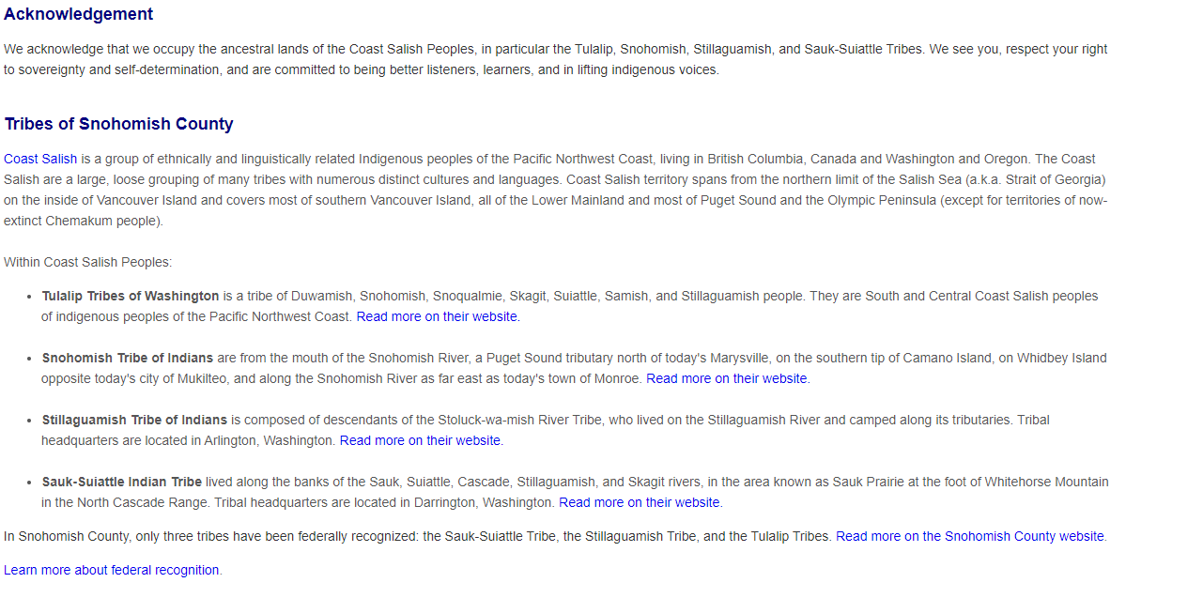
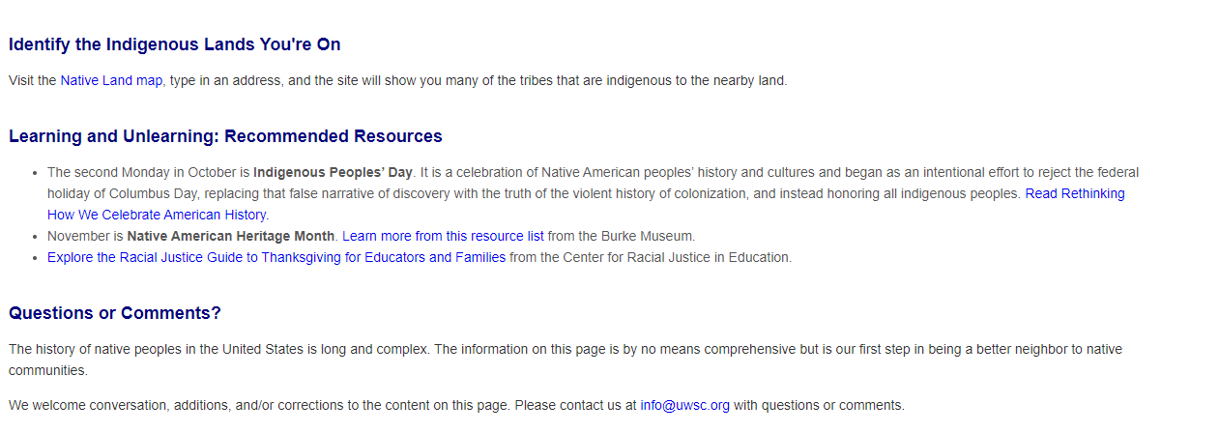
EXAMPLE 1
Notes:
Intro:
Recap 4 steps and then let’s use that lens to evaluate these examples
Evaluation:
Good but:
Specific – names
Recognizes sovereign + explains not recognized
Call to action – educate
Not enough – acknowledges that it is just a start

Slide 14
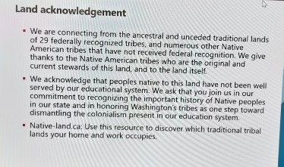
EXAMPLE 2
(SBCTC MEETING 9/2022)
Notes:
Not good bc not connected:
Specific
Not connected
Needs to use power to call to action

Slide 15
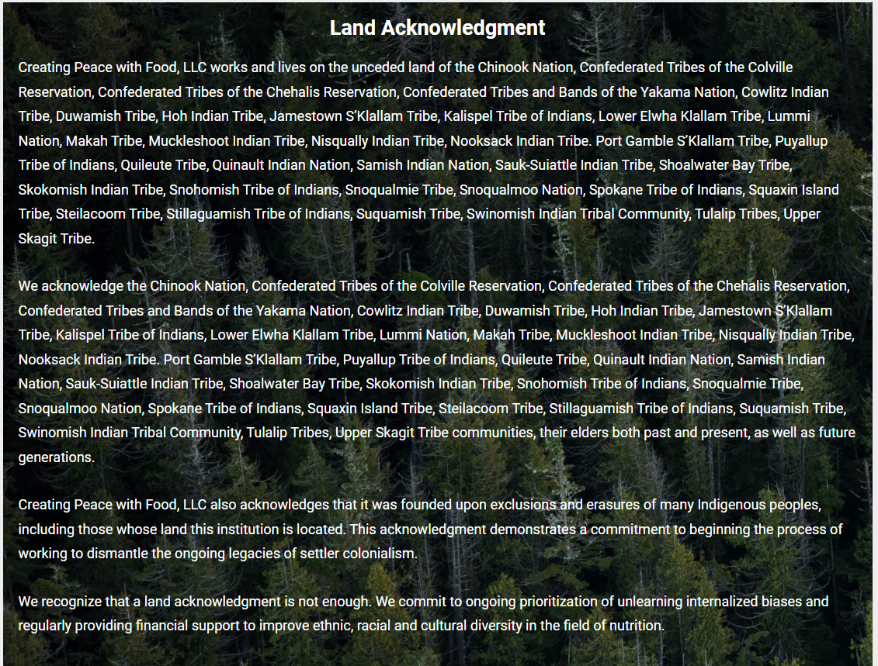
Example 3
Notes:
Very specific
Named elders, named erasure, named not enough
Call to action? Is it enough?

Slide 16
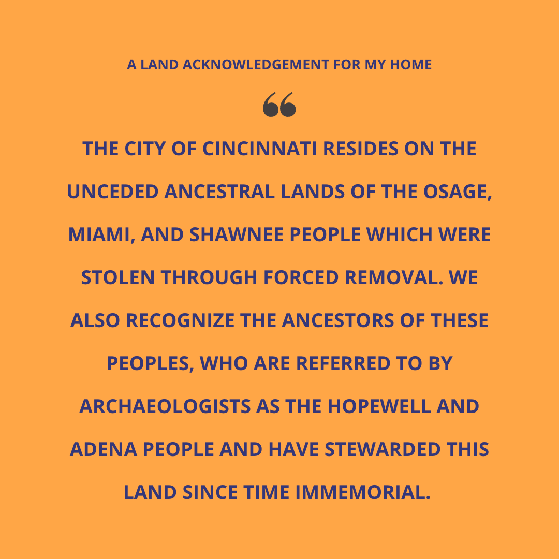
EXAMPLE 4
Notes:
Calls out forced removal
No action
Says "stewarded" as if that is all we are; archaeologists

Slide 17
Quote
We can’t talk about restoring relationship to land without talking about restoring it to the people from whom it was taken. As a phrase, Land Back started with a tweet, which became a hashtag, which became a rallying cry for a movement of land restoration and Indigenous sovereignty. The movement has been in existence for hundreds of years; it’s just that we now call it Land Back. For as long as colonists and their governments around the world have taken Indigenous land for themselves, we have sought to be restored to it. So, we cannot talk about restoring our relationship to the land without talking about resorting the relationship with the people from whom it was taken.
- Krawec, 2022, pp. 130-131

Slide 18
Additional Resources www.ctuir.org
Podcast
https://www.indigenousaction.org/podcast/
https://www.allmyrelationspodcast.com/
https://nativegov.org/resources/untying-knots-podcast-beyond-land-acknowledgment/
https://www.indigenousaction.org/indigenous-action-podcast-ep-1-acknowledge-this/
Video
Exterminate All the Brutes https://www.hbo.com/exterminate-all-the-brutes
Social Media
https://www.instagram.com/notoriouscree/?hl=en
https://www.instagram.com/dineaesthetics/
Written
Potlatch is Pedagogy
True Reconciliation
Government to Government – P. and G. James
https://www.redbudresourcegroup.org/resources
https://www.powwows.com/what-is-land-acknowledgement-why-are-land-acknowledgements-important/
Notes:
www.ctuir.org

Slide 19
Close
Circle it all back
How are we being erased?
Why do action?
historical, political, cultural, educational trauma

Slide 20
Additional Resources
https://www.redbudresourcegroup.org/resources​
https://www.powwows.com/what-is-land-acknowledgement-why-are-land-acknowledgements-important/​
https://nativegov.org/resources/untying-knots-podcast-beyond-land-acknowledgment/​
https://www.indigenousaction.org/indigenous-action-podcast-ep-1-acknowledge-this/
Notes:
Can you add from your quotes? - just a link to the resources for Brown, Krawec, Dunbar-Ortiz?
We can revamp this later to be more APA

Slide 21
References
Brown, B. (2022). The Gifts of Imperfection: Features a new foreword and brand-new tools. Simon and Schuster.
Dunbar-Ortiz, R. (2014). An indigenous peoples’ history of the United States. Beacon Press.
Krawec, P. (2022). Becoming kin: an Indigenous call to unforgetting the past and reimagining our future. Broadleaf Books.

