Slide 1
Nourishing the Frontline
A Self-Care Journey for Student Support Professionals
Dr. Inez Olive
July 25, 2024

Slide 2
Guidance for our time together
Understanding the importance of self-care
Identifying personal and professional boundaries
Building a supportive community
Self-Care Wheel reflection
Resources

Slide 3
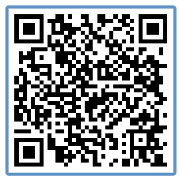
The unique challenges of Frontline Work

Slide 4
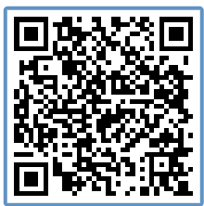
What is self-care?

Slide 5
Impact of self-care on students
Modeling healthy behaviors
Enhanced resilience
Improved interactions
Prevention of burnout
Promotion of student success

Slide 6
Navigating blurred lines
Extended Work Hours
Constant Connectivity
Emotional Carryover

Slide 7
Setting Healthy Boundaries
Prioritize self-care
Schedule downtime
Limit technology use
Delegate when possible
Saying “No”

Slide 8
Communicating Boundaries
Direct and honest statements
“I” statements
Providing explanations
Staying calm and respectful
Reiteration when necessary

Slide 9
The Power of Social Support
Social support provides:
Emotional support
Validation and recognition
Problem-solving and advice
Workplace culture and climate
Stress buffering
Professional development and growth
Health and well-being

Slide 10
Building a supportive community

Slide 11
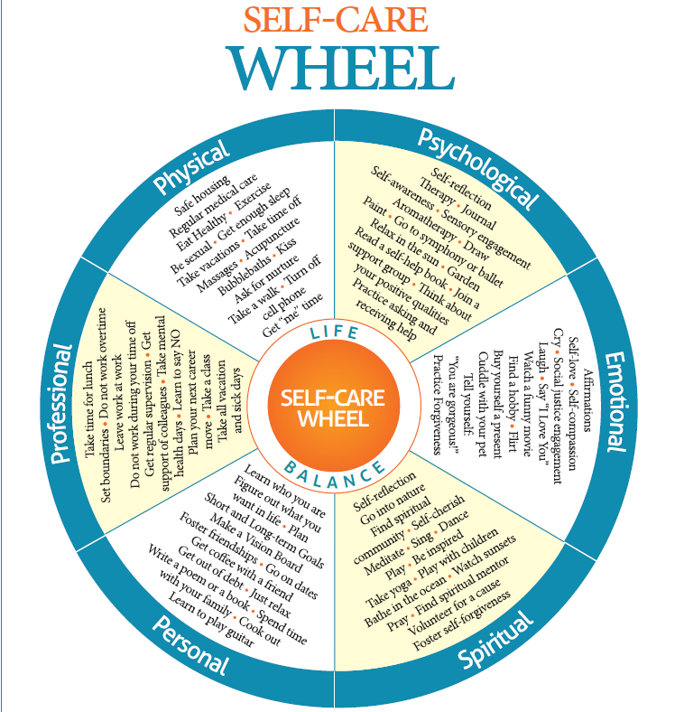
Reflection: Committing to self-care

Slide 12
Resources for support

Slide 13
Wrap up and questions

