Slide 1
NUMBER TALKS AND MULTILINGUAL LEARNERS
A foundation-building math-language routine
Jana Dean, M.Ed., Mathematics Education Collaborative
Heather Byington, M.Ed., Washington State University
July 24, 2024

Slide 2
GETTING STARTED
WITH THE NUMBER TALK ROUTINE
When you know how many dots there are without counting one-by-one, show us with a thumb up on your chest.
See how many different ways you can see the pattern.
When everyone has had a chance to think, we will ask you to share.

Slide 3
LET’S EXPERIENCE A DOT TALK

Slide 4
REFLECTION
What type of communication did you notice? (Consider all forms of communication.)
What teacher moves did you see/hear?
What indications did you see of engagement and/or understanding?

Slide 5
TEACHER MOVES
Accepting all forms communication
Encouraging gestures & heritage languages
Revoicing (paraphrasing without adding more)
Providing synonyms
Being aware and intentional about registers
Connecting students to each other as resource
Attending to gestures as pre-verbalizations
Purposefully selecting students to share (multilingual learners first)
Providing frequent opportunities for students to privately confer and set goals for future sharing.

Slide 6
How could you solve this if you didn’t already know the answer?
6 x 8

Slide 7
12 x 16

Slide 8
5 x 18

Slide 9
REFLECTION
What type of communication did you notice? (Consider all forms of communication.)
What teacher moves did you see/hear?
What indications did you see of engagement and/or understanding?

Slide 10
What are your thoughts about this routine and . . .
positive mathematical identities?
language development?
student choice and agency?

Slide 11
NUMBER TALKS AND THE RESEARCH
An inquiry-oriented divergent-strategy routine (Kazemi & Hintz, 2014)
Recommended for language acquisition for mathematics learning on the basis of design principles (Erath et al., 2021)
Relates register and representations across languages (Prediger and Wessels, 2011)

Slide 12
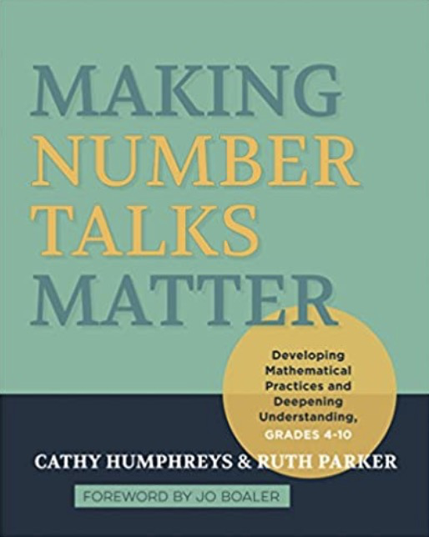
OUR VIEW OF LEARNING MATHEMATICS & LANGUAGE ACQUISITION
Conceptual, not procedural
Having more than one way to think about how quantities interact
Deep familiarity with symbolic representations
Visualization
Student choice in how to approach problems
Student Agency
Divergent Strategy
Meaning-making
Ambiguity as Resource

Slide 13
A NUMBER TALK DIFFERS FROM . . .
“Number String”
“Notice-and-Wonder”
“Which One Doesn’t Belong”
“Quick viewing”
Teacher-led front-loading
Core mathematics instruction

Slide 14
DESIGN PRINCIPLES
Situating authority in the student (including shared decision-making over aspects of the routine.)
Accepting all answers without judgement
Examining the symbolic representation before starting.
Examining co-created artifact at the end.
Visually representing students’ thinking.
Ensuring that models and tools are present in core math time.
Maintaining the regularity and structure of the routine.
Maintaining consistent language and prompts within the routine.
Incorporating pair-sharing

Slide 15
LET’S PRACTICE
How many do you see?
Am I seeing it the way you are seeing it?
Can you help me write an expression that matches the way you saw it?
What do we notice about what all of us saw?
Select dot talks.
Notes:
Place to talk about consistency in recording and teacher prompts.

Slide 16
REFLECTION
What are your thoughts?
Possible challenges?
A-ha moments?
Notes:
Participant or facilitator perspective. Questioning, recording, visualizing, verbalizing.

Slide 17
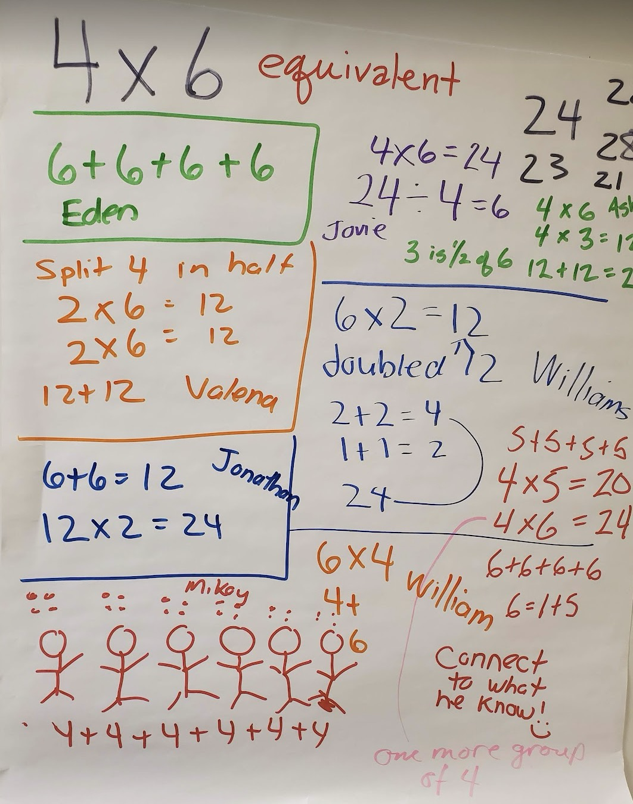
NUMBER TALK
FUNDAMENTALS TO GET STARTED
A whole-class 10-minute mathematics discourse routine.
The teacher poses a problem.
Students solve the problem without using a standard algorithm.
Teacher and student negotiate meaning until the student is convinced that the teacher has understood their strategy.

Slide 18
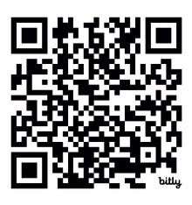
AND THANK YOU!
Please let us know how Number Talks develop in your classroom.
If you enjoyed this session, know that we are looking for partners to advance this work.
Mathematics Education Collaborative
Jana Dean, janad@mec-math.org

Slide 19
19

