Slide 1
NUMBER TALKS AND MULTILINGUAL LEARNERS
Everyday Algebraic Thinking
Jana Dean, M.Ed., Mathematics Education Collaborative
Heather Byington, M.Ed., Washington State University
July 24, 2024

Slide 2
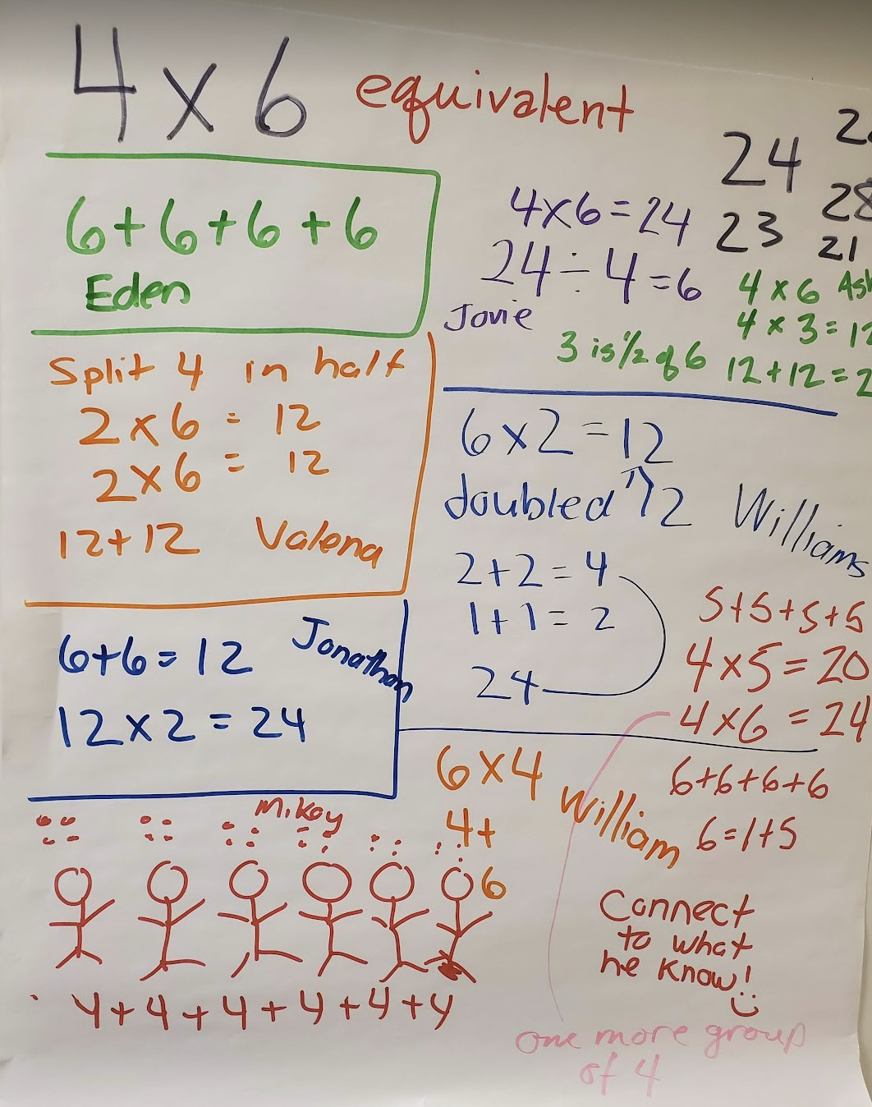
NUMBER TALK
FUNDAMENTALS
A whole-class 10-minute mathematics discourse routine.
The teacher poses a problem.
Students solve the problem without using a standard algorithm.
Teacher and student negotiate meaning until the student is convinced that the teacher has understood their strategy.

Slide 3
Dot Talk artifact from the previous session here.
What do you notice about what all of us saw here?

Slide 4
Number Talk artifact from the previous session here.
What do you notice about what all of us saw here?

Slide 5
Algebraic Thinking and Mental Math
Take some time to look at your copies of the dot talk and number talk from this morning.
You also have a document that illustrates algebraic properties of numbers.
What connections can you make between the properties of numbers and the dot talk and number talk?
Be ready to share your thoughts with the whole group.

Slide 6
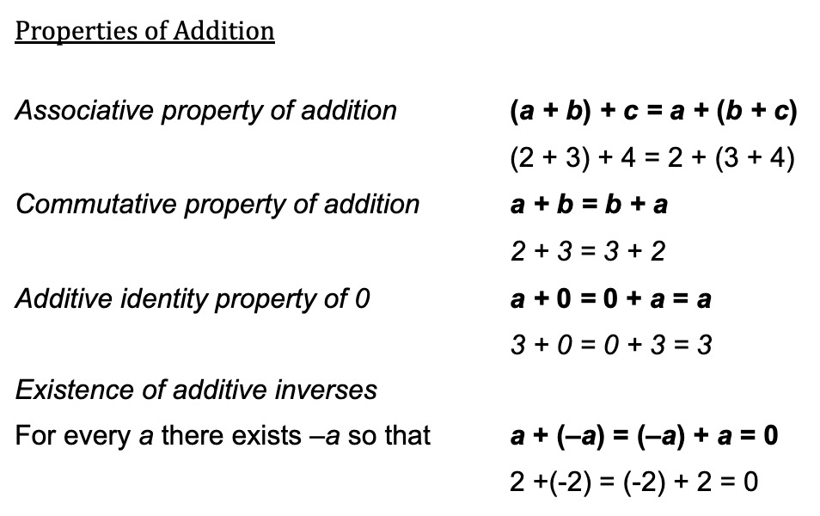
Annotated artifacts from the morning that illustrate the properties.

Slide 7
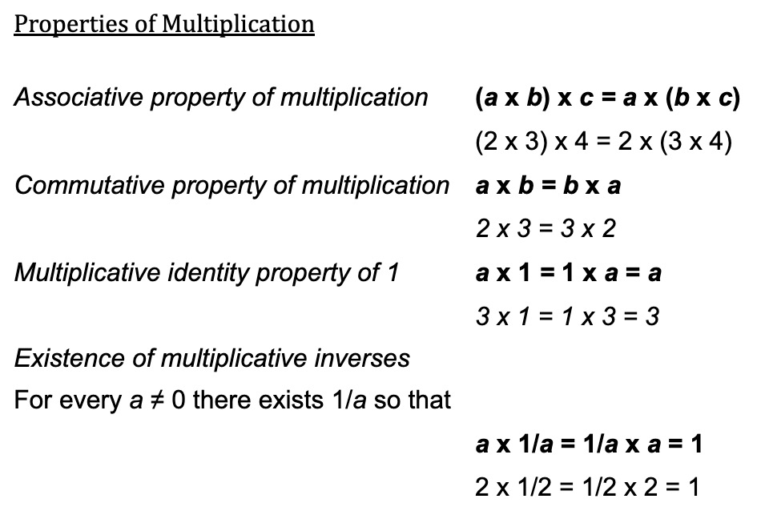
Annotated artifacts from the morning that illustrate the properties.

Slide 8
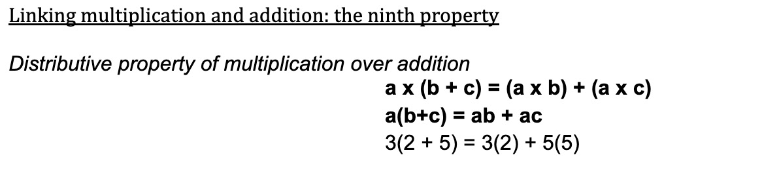
Annotated artifacts from the morning that illustrate the properties.

Slide 9
9
“You can’t do mental math without doing algebra.”
                Phil Daro

Slide 10
YOU CAN’T DO MENTAL MATH WITHOUT ALGEBRA
Properties are like rules, but also like rights
You are allowed to use them whenever you want.
You are allowed to use them in any order.
Use them with a mathematical purpose.

Slide 11
Connections to Algebra
Knowing properties provides choice and agency.
Computational fluency & flexibility with numbers.
Reinforces the idea of equivalence.
Expressions as objects.
Multiple representations.
Expanding conceptual understanding of operations.

Slide 12
Additional thoughts?

Slide 13
THANK YOU
Debbie Olson and Cathy Humphreys, Mathematics Education Collaborative
National Education Foundation
Mathematics Education Trust
Maribel Vilchez & Patti Madison
Children and Families of the Tanglewilde Neighborhood
Kayla Blyman, Saint Martin’s University

Slide 14

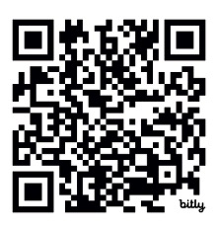
AND THANK YOU!
Please let us know how Number Talks develop in your classroom.
If you enjoyed this session, know that we are looking for partnerships with educators to advance this work.
Mathematics Education Collaborative
Jana Dean, janad@mec-math.org

Slide 15
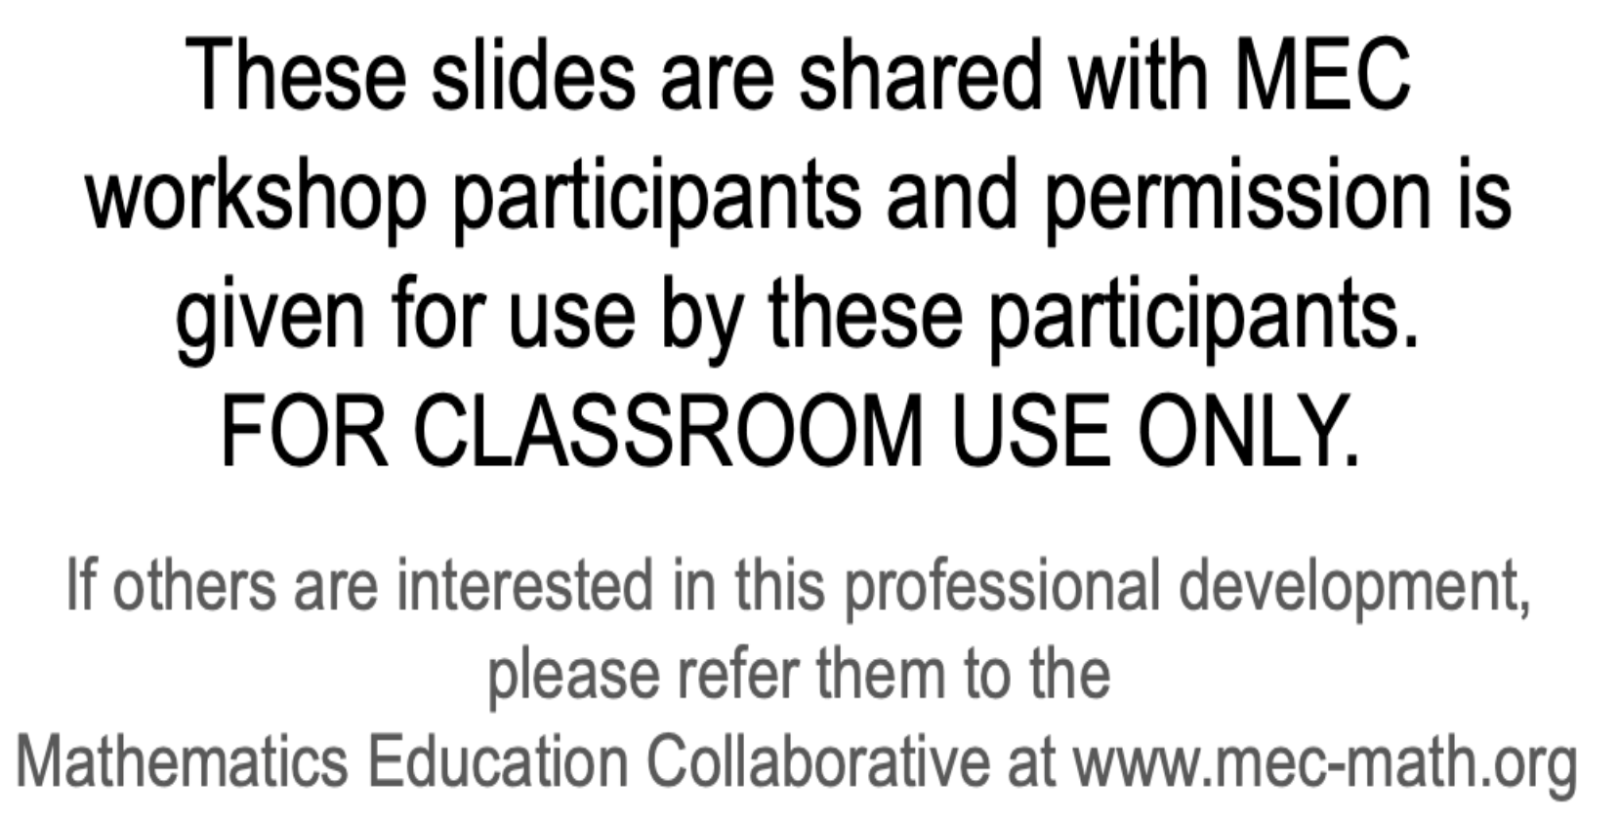
15

