Slide 1
2024 Open Washington Update & Student Publishing Projects Using Pressbooks
Boyoung Chae & Sue Wozniak
2024 BEdA Biennial Conference

Slide 2
Agenda
Statewide Open Education Initiatives: Structure & Vision
Campus Open Pedagogy Practice: Student Publishing Projects with Pressbooks

Slide 3
Statewide Open Education Initiatives: Structure & Vision

Slide 4
OER & Low-Cost Labeling Policies
It is a state law (RCW 28B.50.789) that mandates the specific labeling of courses that use
Open Educational Resources (OER)
Low-Cost Materials (LCM)

Slide 5
OER & Low-Cost Labeling Policies
During the 2022-23 academic year,
8,629 class sections were labeled as OER courses enrolling 101,186 students.
6,290 class sections were labeled as using low-cost materials enrolling 69,305 students.
Total savings for students amounted to $17,049,100 for the 2022-23 academic year

Slide 6
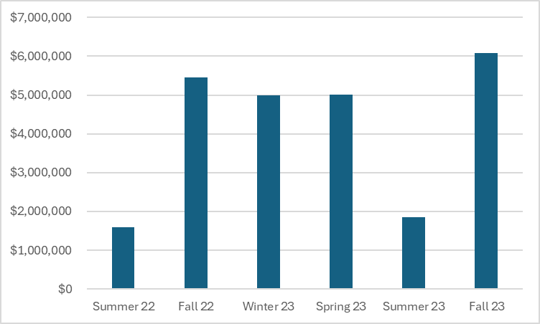
OER & Low-Cost Labeling Policies
Student Cost Saving from Summer 22 to Fall 23

Slide 7
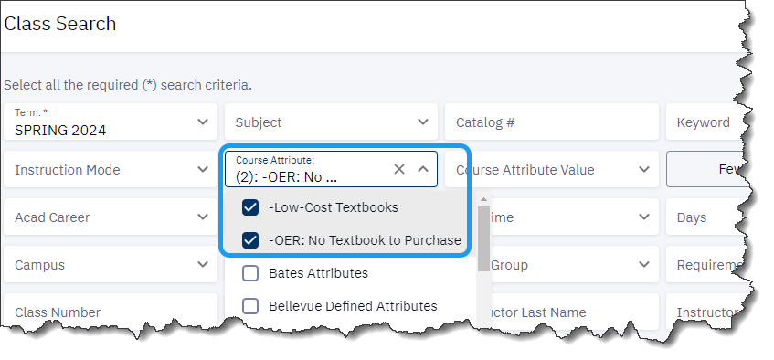
OER & Low-Cost Labeling Policies
OER and LCM appear as course attributes on the students' class search page.

Slide 8
OER & Low-Cost Labeling Policies
Where to begin & How to get help
Video Tutorial for the Beginners (Start with this!)
One-Page Overview
Complete Implementation Guide for Colleges
Labeling Decision Maker
Implementation Resource Hub

Slide 9
Washington 100
A new OER inventory for WACTC featuring selected OER for WACTC's 100 highest enrolled courses.
We invite YOU to visit Washington 100 today and
Check out the OER in your field
Join a subject group
Contribute your own works or recommend your favorite OER
Share this news with your fellow colleagues

Slide 10
Washington Open ProfTech
Funded by the U.S. Department of Education's Open Textbook Pilot grant.
Aims to produce open textbooks for high-demand professional technical programs at WACTC.

Slide 11
Washington Open ProfTech
First grant ($1.8M, 2021): Developed six textbooks, preparing for fall campus evaluation.
Introduction to Welding | Introduction to Healthcare | Introduction to Criminal Justice | Introduction to Machining | Introduction to Hospitality | Introduction to Early Childhood Education

Slide 12
Washington Open ProfTech
Second grant ($2.1M, 2023): Began in June, targeting seven new textbooks for ProfTech courses.
A Technicians handbook for CAD | Introduction to IT | Bakery and Business Math | Medical Law and Ethics | Clinical Informatics | Modern Web and Cloud Programming | Python for Cyber Security

Slide 13
OER 101
A 2-week asynchronous online course for faculty and staff new to Open Educational Resources (OER).
See the course registration page for upcoming training dates.

Slide 14
Your Campus Advocacy Plan
Establish Goals
Identify Allies
Assess Needs
Educate and Train
Spread the word
Track Progress
Feedback and Adjust
Notes:
Goals:
Set specific, measurable objectives for increasing OER use in your courses or department.
Identify Allies:
Find other faculty, students, and staff who are interested in or could benefit from OER.
Assess Needs:
Understand current OER awareness and usage, and identify obstacles to adoption.
Educate and Inform:
Share information about OER benefits, such as cost savings and access to free educational resources, through emails, meetings, or informal chats.
Training Workshops:
Organize or advocate for workshops to help faculty learn how to find, adapt, and use OER.
Advocacy Actions:
Use meetings, campus newsletters, or social media to spread the word about the benefits of OER.
Policy Change:
Encourage discussions about policies that support OER adoption, like recognition in tenure and promotion.
Track Progress:
Keep an eye on how OER usage is growing and share successes to build momentum.
Feedback and Adjust:
Get feedback from peers and adjust your advocacy approach accordingly.

Slide 15
Contact Information
Boyoung Chae, Ph.D.
Policy Associate of Open Education
Washington State Board for Community and Technical Colleges
bchae@sbctc.edu
360-628-3549

Slide 16
Student Publishing Projects with Pressbooks: Stories from Our Lives

Slide 17
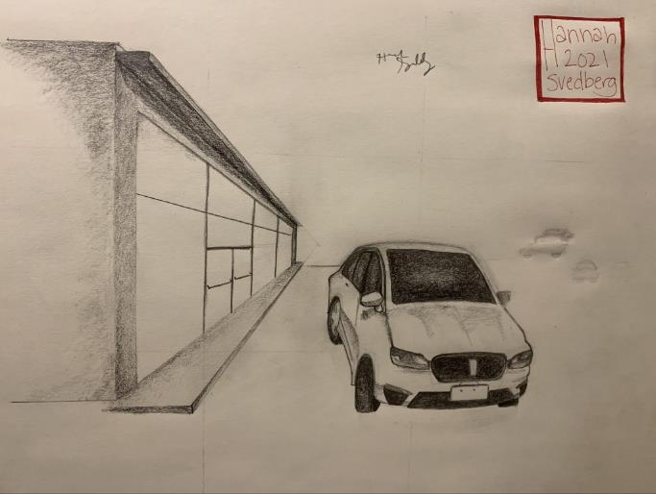
Topics
Evolution of student publishing project
Strategies to engage colleagues
Formation of regional group
Other student work publications
By Hannah Svedberg CC BY

Slide 18
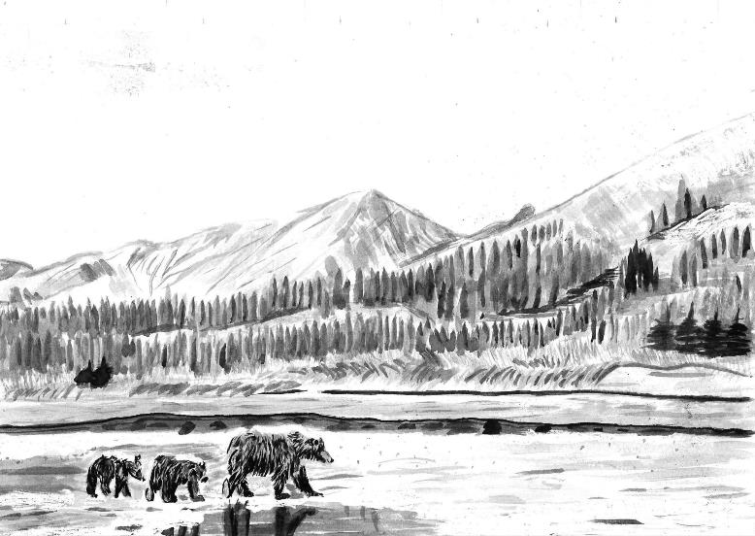
ELL-Art Collaboration
History – collection gap
Representation of student voices
Open Pedagogy
Cultural Humility
Process
Stories
Art
Pressbooks
Books
Komil Shaykhraziev CC BY

Slide 19
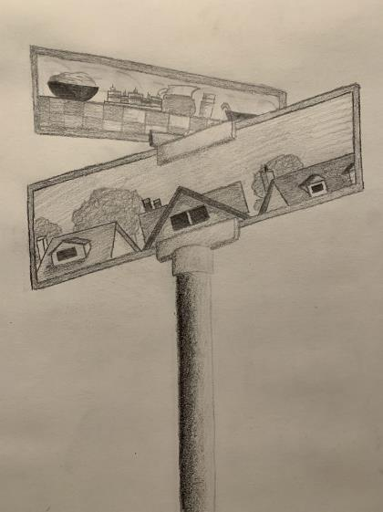
History of ELL on LWTech Campus
ELL significant program on campus
6 levels of classes
Greatest # students on campus - >600
60 countries represented, on average
Immigrant and refugee populations
Students take classes 6-15 hours/week
Strong impetus to provide relevant books
By Duncan Arnold CC BY

Slide 20
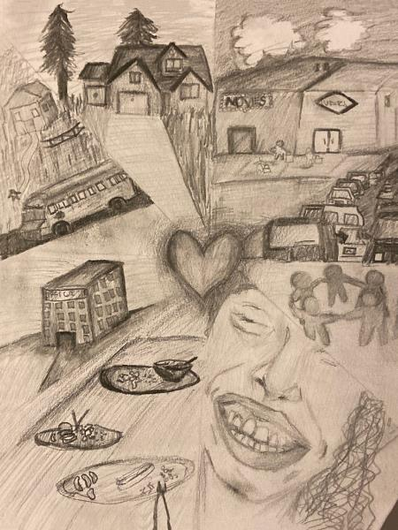
ELL Library Book Collection
State of ELL collection (2018)
Recognized needs of collection
Few books, especially for lower levels
Most lower-level ELL content child-oriented, Eurocentric
Lack of representation of LWTech populations
Greatest circulation of library collection after Course Reserves
By Eric Santaella CC BY NC

Slide 21
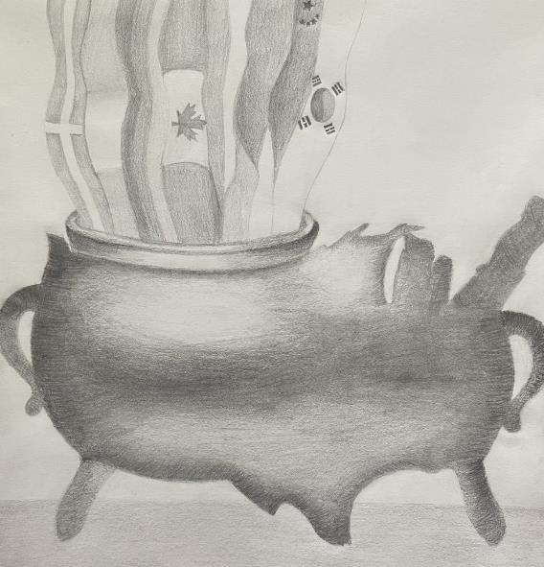
Library Support of ELL Program
Book collection
Talk Time
Hosted by library
Popular event – weekly meetings
Inspired by stories – Aha!
Have students write stories!
By Nahkari Yoeum CC BY NC

Slide 22
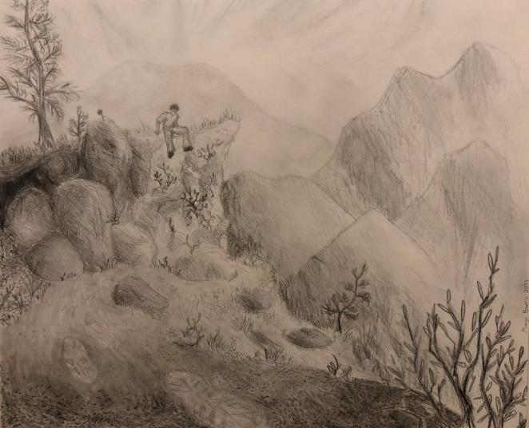
Project Initiation
Decided to try to fill gaps in ELL content with stories from our students
Now, to convince others!
Built on existing relationships
Solicited interest - ELL faculty
By Maya Burris CC BY

Slide 23
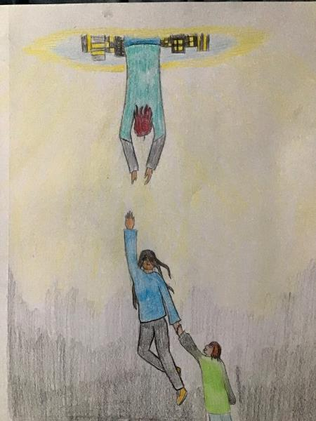
Stories
Stories collected over several quarters
Permissions and licensing
Waiver to share with LWTech
Adapted to include open licenses
By Tyler Charnholm CC BY

Slide 24
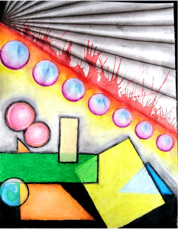
Open Pedagogy
Orientation to open pedagogy – LWTech librarians
Representing student voices
Opportunity to teach copyright, licensing, and value of open materials
Cultural humility – learning about other cultures strong college value
By Rebecca Bowers CC BY

Slide 25
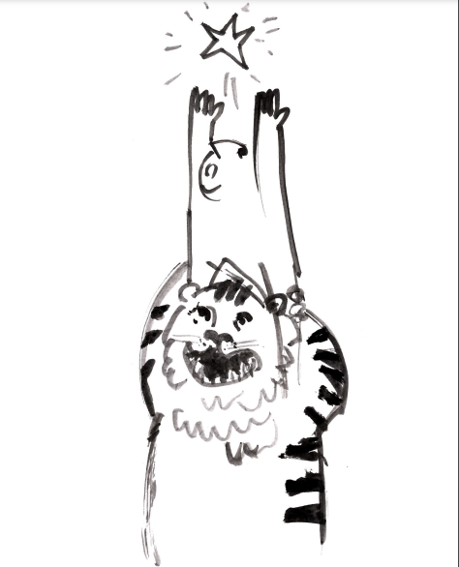
Art
Need for illustrations – more successful for lower-level ELL books
Sought help from art faculty
Drawing and painting class assignments
Read stories, create interpretive artwork
Adapted waiver with open license to share
Cultural humility – listening, response with art
By Sanhsing Yi CC BY NC

Slide 26
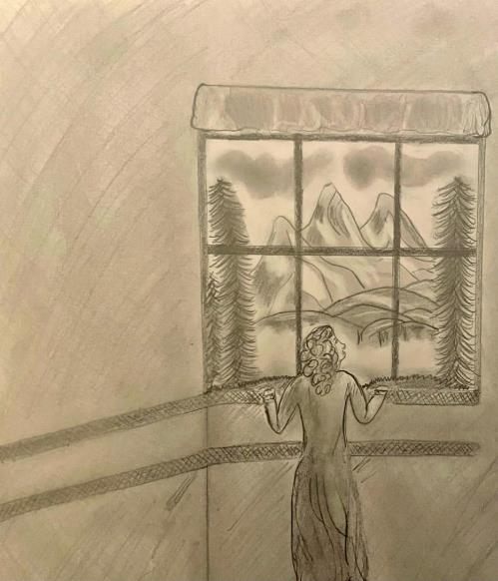
Cultural Humility
LWTech requires all students to take a Diversity and Social Justice (DSJ) class
Cultural humility is one aspect of a DSJ focus
This project falls in line with greater campus efforts
By Janice Orozoco Valencia CC BY NC

Slide 27
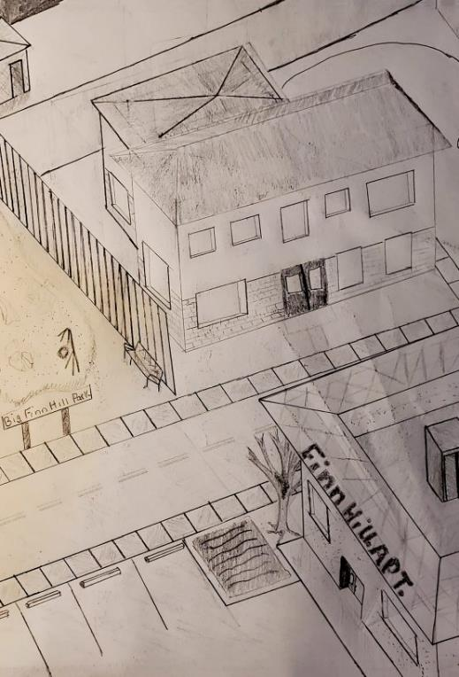
How to Make a Book?
Contemplated book format
Cost - no budget identified
Format
Stability for library book
No experience with desktop publishing
By Rebecca Bowers CC BY

Slide 28
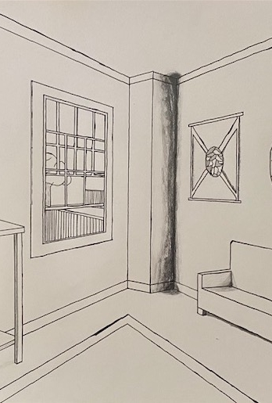
Introduction to Pressbooks
Open source publishing platform
Professional presentation
Creative Commons licensing options
Gained institutional access through faculty and OpenWA in 2021
Imported stories, integrated with art
By Jack Naig CC BY

Slide 29
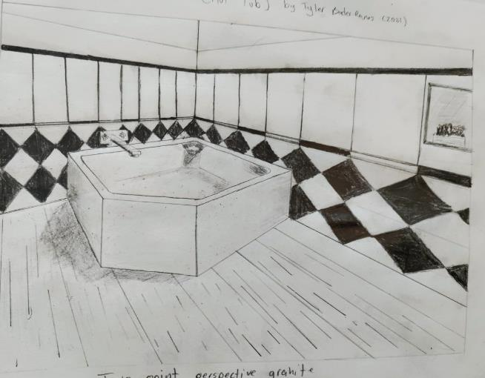
Book(s) Creation
Created eBook and print versions
Pressbooks; Open source eBook version available to share widely
Lulu.com; Self-publishing platform
2nd volume created 2021-22
3rd volume created 2022-23
Added interview and storytelling events
4th volume created in 2023-24
Storytelling event
By Tyler Baser Ramos CC BY

Slide 30
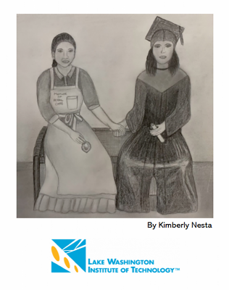
FInal Products
Stories from Our Lives: LWTech English Language Students in Words and Images, Volumes 1, 2, 3 and 4

Slide 31
Faculty Comments
It was a pleasure to watch one student create written works and see how other students could translate that into something visual.
Amber Chiozza, Art Instructor
I was very excited to join this project and to have my students contribute to the resources available for beginning English language learners. The result is a collection of beautiful stories that students wrote to honor the important people in their lives.
Kelly Cover-Tam, Professor English Language Learning and Basic Education

Slide 32
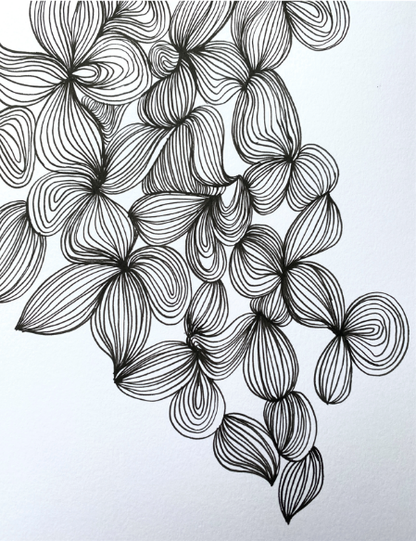
Project Evolution
First volume took 2 years to complete
Volume 2 created in one academic year (2021-22)
Worked with 3 ELL faculty, 1 new art faculty
Used library funding to print copies for each student
Volumes 3 created in fall of 2022 and 2023
Each had storytelling event in the library with projected artwork
Has become annual publication with storytelling event
By Jaida Phillips CC BY

Slide 33
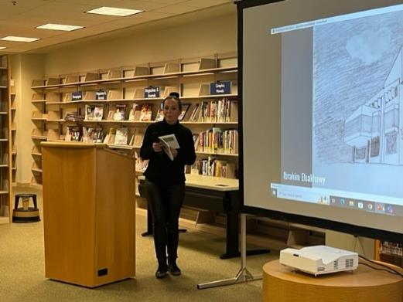
StoryTelling Event 2023
"My first publication!"
Sue Wozniak, CC BY

Slide 34
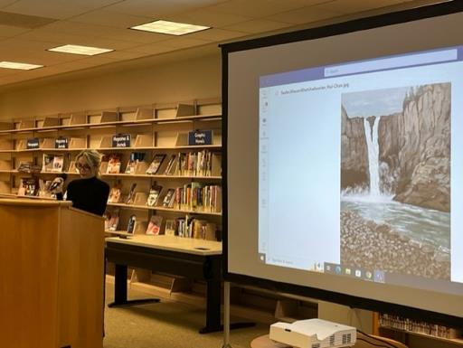
StoryTelling Event 2023
Sue Wozniak, CC BY

Slide 35
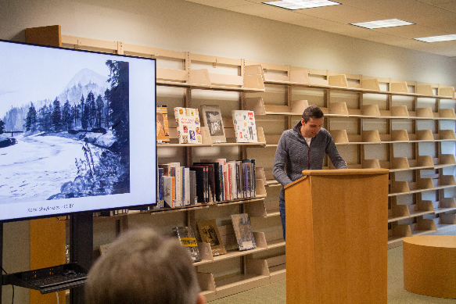
StoryTelling Event 2024
Sue Wozniak, CC BY

Slide 36
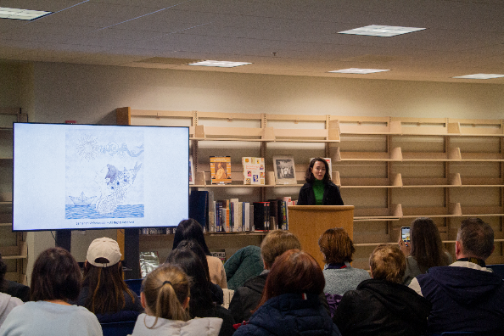
StoryTelling Event 2024
Sue Wozniak, CC BY

Slide 37
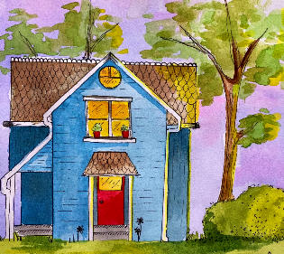
Benefits
Representation
Local cultures/stories in our library collection
Storytelling – hearing voices
Cultural humility – learning about other cultures, interpreting their stories
Open Pedagogy
Confidence-building for students to have publication,
read stories in public
Community-Building
Collaboration between students, departments, library
Fun!
By Anneli Sears CC BY

Slide 38
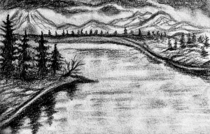
Challenges
Gaining faculty interest - convincing not extra work
Matching number of students for stories and images
Completion of student work
Completion of permissions forms
Funding source for book printing
Formatting of book for print
Talia Berner, CC BY

Slide 39
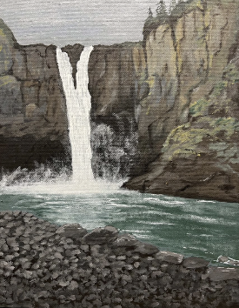
Strategies to Engage Colleagues
Build on existing relationships
Show examples of books
Use existing assignments
Storytelling events
Promote/suggest collaborations specific to your campus
Provide licensing instruction
By Sasha Khatchadourian CC BY

Slide 40
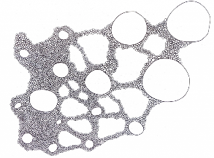
Regional Group:
Washington Open Student Publishing Collective
Interest from librarians at other CTCs; Formation of regional group to create collection of student voices in our libraries
Currently librarians/staff from 5 colleges coordinating student publishing projects. Great use of Pressbooks!
Lake Washington Institute of Technology
Highline College
UW-Bothell/Cascadia College
Yakima Valley College
Clark College
Please join us - we want to work with you!
By Seren McCall Cromer CC BY

Slide 41
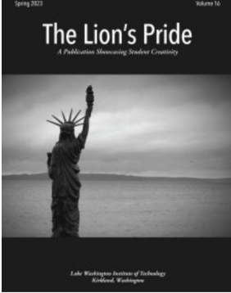
Other Student Works Publications at LWTech
Applied Research Symposium
2021, 2022, 2023
Lion’s Pride - Multidisciplinary Magazine of Student Works
Vol. 14, 15, 16
Sociological Glossary by LWTech Students
English Class Anthology of Student Work - In Solidarity
Student Art Show 2023

Slide 42
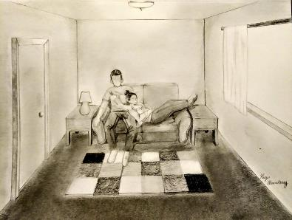
Acknowledgement
ELL/Int'l Faculty
David Fox, Kelly Cover-Tam, Anna Podnozova, Karyna Tytar, Corinne Tubbs, and Sam Brann
Art Faculty
Jason Sobottka, Amber Chiozza, Abigail Drapkin
193 Students (ELL & INTL)!
Publishing Collective Members
Chelsea Nesvig, Ryer Banta, Deborah Moore, Wendy Poteet, Zoe Spiedel, Meredith Tummeti, Leslie Potter-Henderson
By Reign Manalang CC BY

Slide 43
Contact Information
Sue Wozniak
sue.wozniak@lwtech.edu
By Caroline Morris CC BY

Slide 44
Activity: Find a Pressbook Resource
In your assigned group, search the Pressbook directory to find a resource relevant to your class/area.
Help each other identify resources within BEdA.
Questions to consider:
What do you like about the book/resource?
How might you adapt this for your class or campus?
What idea does it stimulate for creating your own student publishing project?
Come back to full group. Volunteers to share.

