Slide 1
Prioritizing Relationships OVER Transactions: Building Strong Campus Connections to Support Justice Impacted Students
Gerald Bradford
Emily Dykstra Jones

Slide 2
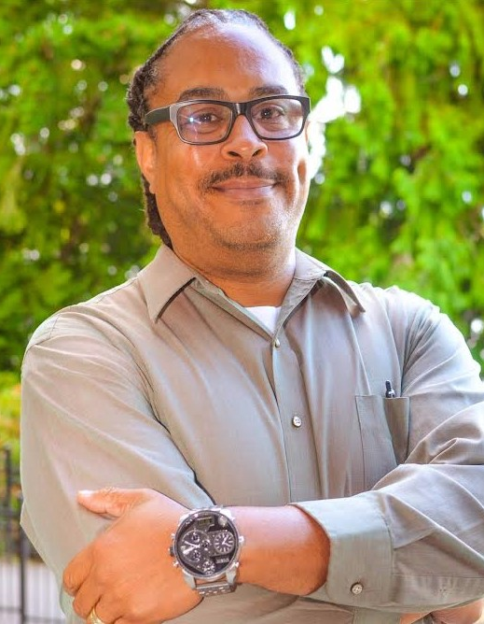
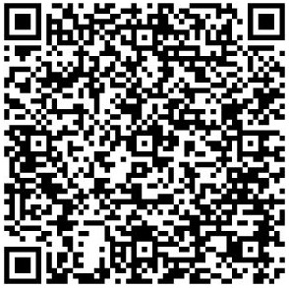
Introducing… Gerald Bradford
Re-entry Manager, Renton Technical College
Founding Member, Fresh Start PS
Board President, Central District Preservation Authority, Seattle, WA

Slide 3
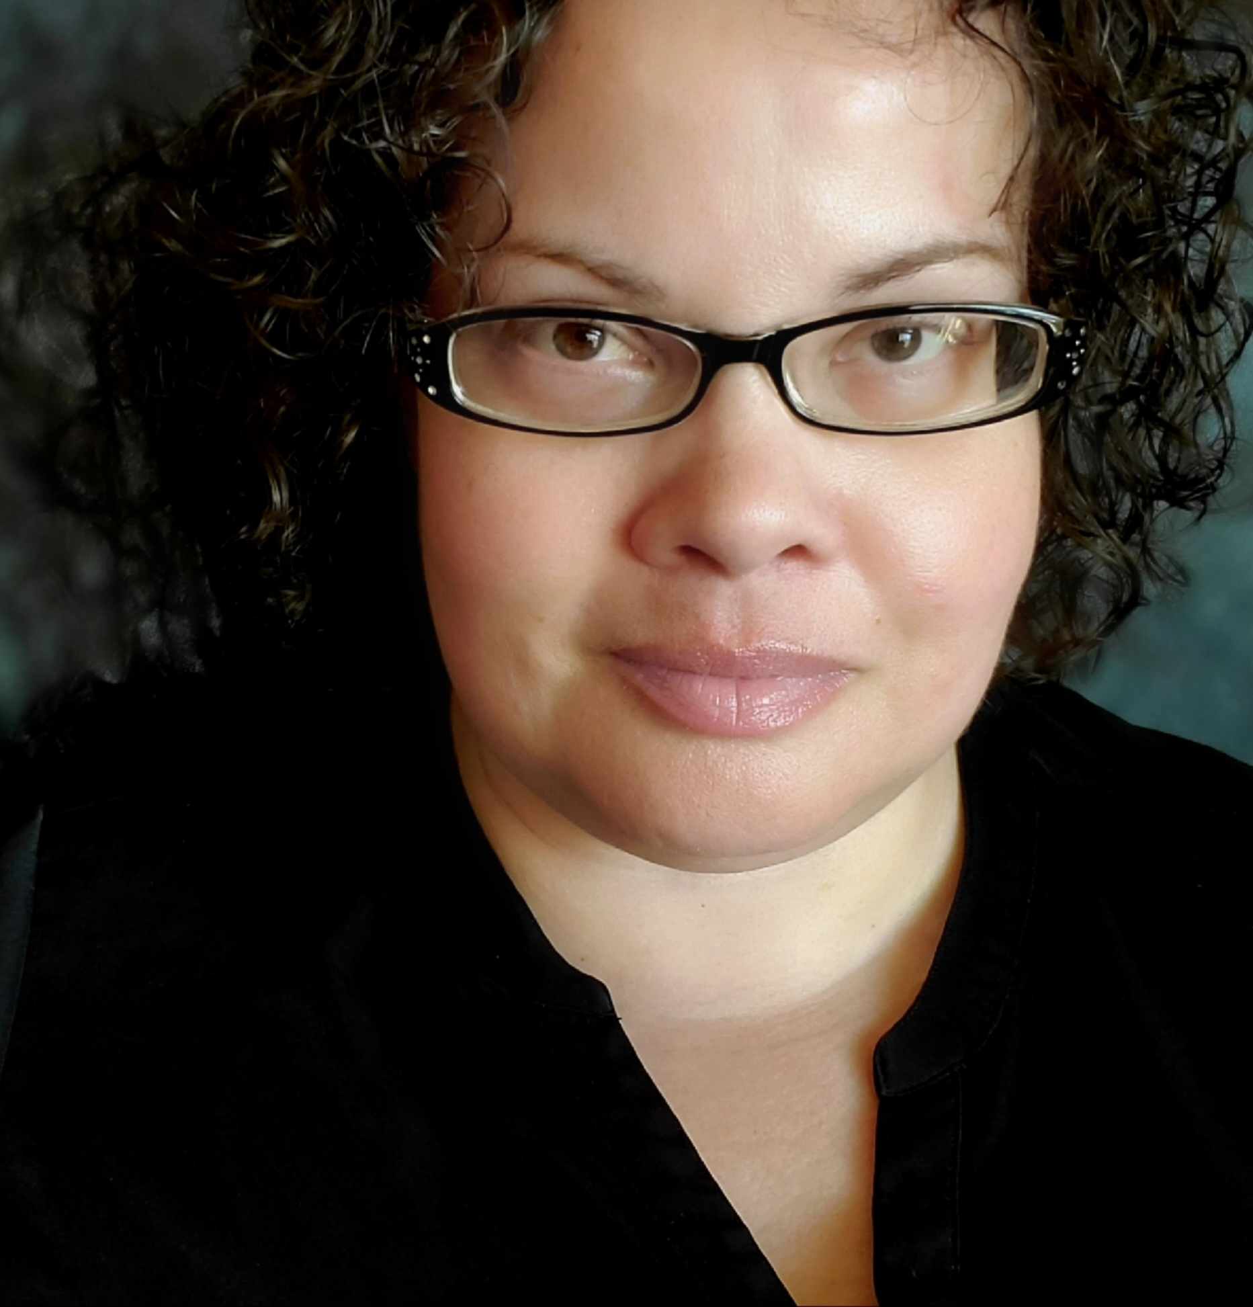
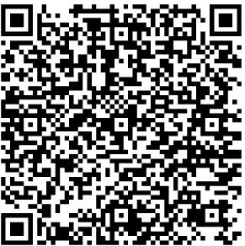
Introducing… Emily Dykstra Jones
Most recently…
Education Navigator, Tacoma Community College
Currently…
PhD Candidate, Saybrook University

Slide 4
Centering Students
Notes:
Best practices in serving people. Relationship building strategies
Strong student-centered customer service
Interpersonal interactions
Consistency
Transparency & Truth

Slide 5
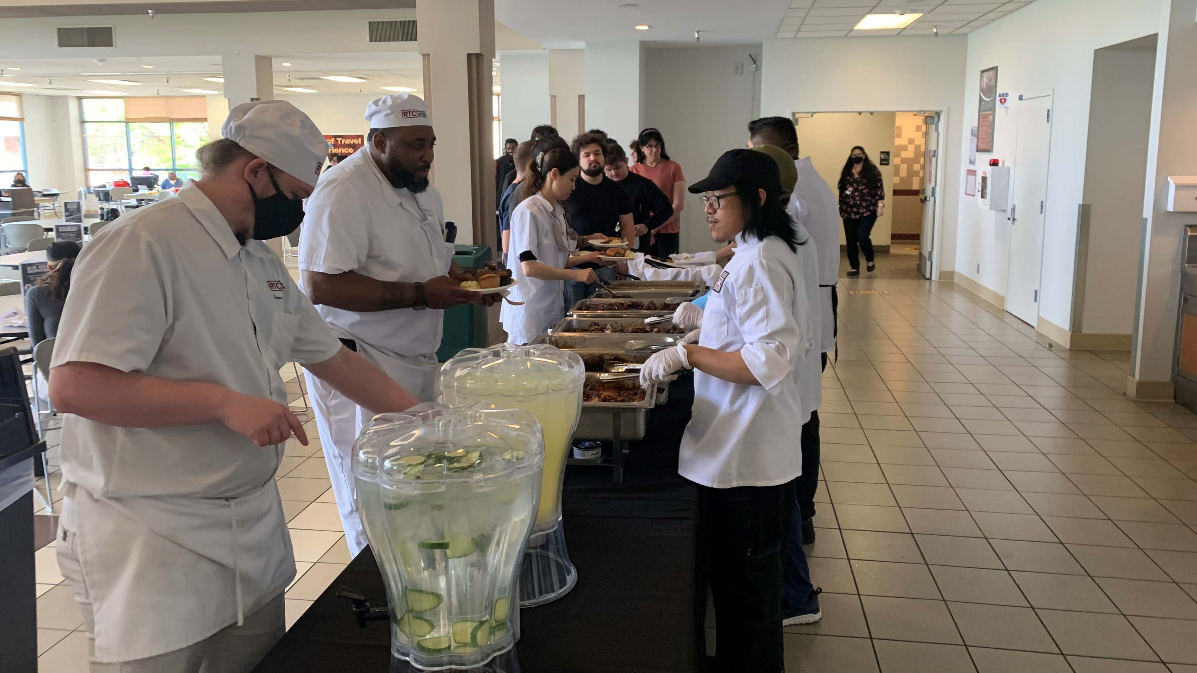
Building Community: One plate at a time
Notes:
Building Community
It’s not just about the students
Family, Friends & Community
Relationships on your college campus
You are invited to the Cookout - Building a Culture of Community
Group Discussion: How are you providing Relationships Based Customer Services

Slide 6
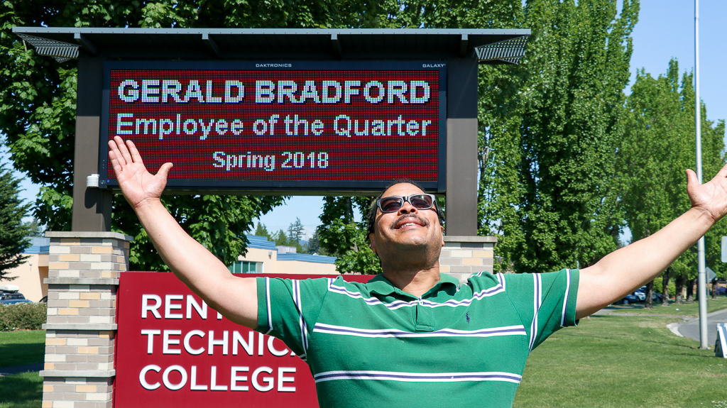
Cultivating Culture
Notes:
Cultivation An Inviting Culture on Your Campus for Justice Impacted Students
Peer Student Groups
Providing information about conviction history barriers
Transparent about barriers & collateral consequences
But we are dream killers – real about what it would take to get a “Yes”

Slide 7
Creating Healing Spaces: Starts with your WHY?
Notes:
Designated staff contact
Self-Awareness/ Healing Unpacking a person’s why (what do they want to finish their student goals) [video] Know Your Why by Michael Jr.
https://www.youtube.com/watch?v=1ytFB8TrkTo
https://www.mynextmove.org/explore/ip

Slide 8
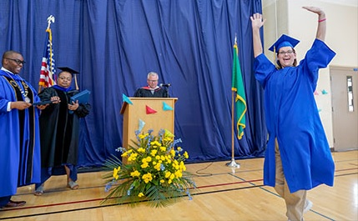
FOSTERING POSSIBILITY: Characteristics of a Collectively Healing College
More empathy - Less assumptions
Value Relationships over Transactions
Encourage people to dream and imagine!
Build critical reflection and take loving action.
Consider how environments contribute to or detract from well-being

Slide 9
Healing Centered Engagement (HCE)
Trauma Informed
Healing-Centered Engagement
“What happened to you?”
Focused on the individual symptoms & clinical treatment of trauma
Individual based
“What’s right with you?”
Focused on well-being of the environment
Interdependence based
Holistic Well-being is Liberatory & Hopeful
Community Based Solutions
HCE is based of the work of Shawn Ginwright, PhD.
Notes:
“I am more than what happened to me, I’m not just my trauma.”
– Marcus (Ginwright, 2018)

Slide 10
Environmental Characteristics of a College Engaged in Collective Healing
Counseling Services
ER Grants, Food and Hygiene Pantries
Systemic ways of informing students of barriers to higher paying jobs that give a student a chance to thrive
Housing
Technology- Please Help! Manage your expectations.
Support Groups
Impacted Student’s Group
Mental Health & Substance Use

Slide 11
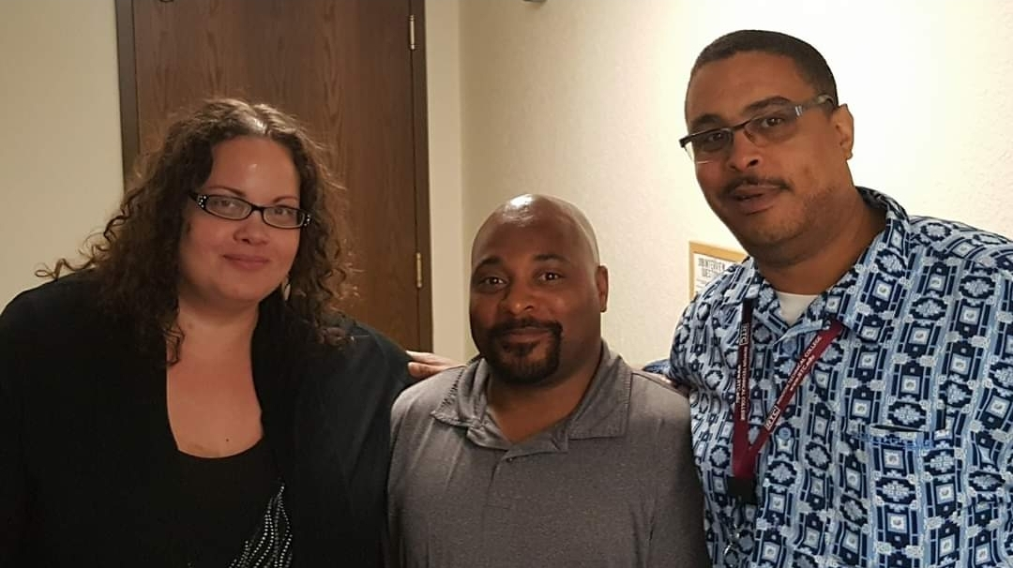
Thank you!

