Slide 1
Project Based Learning
2024 BEdA Biennial Conference
Christie Knighton, Highline College
Dawn Kroontje, Whatcom College

Slide 2
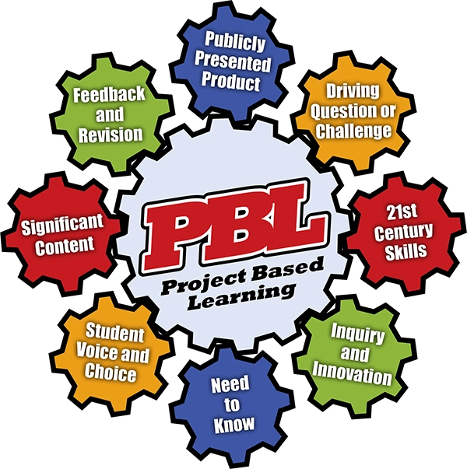
Agenda
Introductions
Overview of PjBL
Brainstorm Topics
Planning Time
Closing
pbl-graphic_3.jpg

Slide 3

Please share:
Name, school/CBO, role
Experience with Project Based Learning
Goal(s) for this session

Slide 4
Project-Based Learning (PjBL) defined:
In project-based learning (PjBL), students gain knowledge by addressing essential questions or lines of inquiry, setting and prioritizing goals, and engaging with real-world, authentic tasks.
Project-based units of instruction result in the creation of a product that demonstrates learners’ skills and content knowledge (e.g., report, presentation, video, etc.).

Slide 5
Project-Based Learning (PjBL) defined (continued):
PjBL units require an array of basic skills and soft skills including communication, collaboration, critical thinking, and creativity and are typically multidisciplinary.
The project can be related to building learners’ knowledge of community needs, careers or the workplace, or academic subjects (such as social studies, science).
Project-based learning is a rigorous and engaging approach that prepares learners for postsecondary and career transitions.

Slide 6
Brief look at PjBL research & application
Rooted in constructivist learning theory
Student centered & student voice
Teaching Skills That Matter (TSTM)
9 skills
5 topic areas
3 approaches
Notes:
Constructivist - create knowledge based on prior knowledge & experience and is mediated by new knowledge/artifacts
Student centered - addresses motivation; utilizes students strengths

Slide 7
Unpacking this Quote
Providing equitable learning experiences for students often starts with understanding how project-based learning helps students develop self-efficacy, confidence, and an eagerness to direct their own learning.
When students feel the joy of learning, they actually work harder with greater engagement and enthusiasm for the learning process. This naturally results in more significant tangible outcomes.
(State of PjBL)

Slide 8

Our lens
Reactive: What do we see?
Proactive: How do we shift our structures
and learning processes?

Slide 9

Project-based vs. Problem-based learning
2 sides of the same coin
Problem based learning:
  Real-world problems are used as a vehicle to promote learning (instead of presenting facts)
  Students work in groups and research/think through problems to propose solutions
Project based learning:
  Students gain knowledge by addressing an essential question
  Set own tasks and prioritize goals
  Create a product to share

Slide 10
Project-Based Learning (PjBL) Steps:
Identify an essential question or line of inquiry
Create project plan and schedule
Learners collaborate on tasks
Instructor facilitates and monitors progress
Learners complete project and present their work publicly
Instructor and learners assess the project outcomes
Instructor and learners reflect on project
Notes:
Here is a 6:54 video on PjBL.

Slide 11
Brainstorm
At your table, brainstorm potential projects for up to five different topics:
Digital Literacy
Civics
Health Literacy
Workplace Prep
Financial Literacy
Share out

Slide 12
Your Turn! Create an Project Based Outline
Choose an idea from the brainstorm, and flesh out a project.
Is the learning connected to shared concerns and interests of the students?
Do students have the chance to connect ideas?
Is the task based on a meaningful problem to solve or a question to answer that all learners can access and understand?
Does the task promote diverse perspectives?
Does the task have a real-world context that every student can be part of?

Slide 13


Ways To Support Students Through Process
Identify problem
Offer empathic support
Encourage risk taking
Power of collaboration
images

Slide 14

Share out
Briefly (1 minute or less) share out your outline or thoughts.

Slide 15
Resources
Rubric for PjBL
Essential Project Design Elements

Slide 16
Thank you!
Christie Knighton, Highline College: cknighton@highline.edu
Dawn Kroontje, Whatcom College, dkroontj@whatcom.edu

Slide 17
Project Based Learning As Equity
Unpacking this quote:
From the Buck Institute: “project-based learning widely used and recognized as a tool to address educational inequity and to empower students furthest from opportunity.”

