Slide 1
Supporting Justice
Impacted Students
2024 BEdA Biennial Conference
Chastity Pennington & Katelynn Orellana – SBCTC Basic Education for Adults
July 24, 2024

Slide 2

WELCOME & Intentions
Everyone works with justice impacted students.

Slide 3
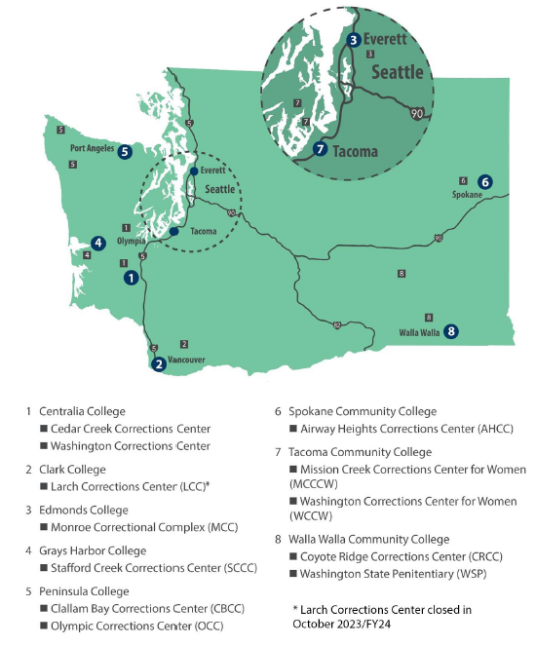
8 Community Colleges
11 Adult Prisons
PROGRAMS
High School Completion
GED
ESL/ELA
College Prep
Vocational Programs
Certificate Programs
Degree Programs

Slide 4
Wa st cORRECTIONs eDUCATION fy23
5269 Incarcerated Individuals Participated
351 students earned HS diploma
219 students earned their GED
1472 single-subject exams were passed
60 students earned associate degrees
732 justice-involved individuals continued upon reentry

Slide 5
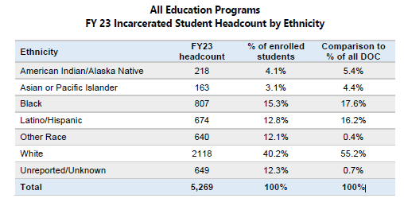
Wa st cORRECTIONs eDUCATION fy23

Slide 6

Additional Information
https://www.sbctc.edu/colleges-staff/programs-services/prisons/

Slide 7

Roleplay Activity

Slide 8
A Note On Language
Language is powerful.
When we change the language, we can change the culture.
The ask: refrain from using stigmatizing language.
People are so much more than their conviction.

Slide 9

Honoring Lived Experiences
Activity: Resume Building

Slide 10
My childhood was a mix of laughter and struggle. Raised by a single mother who worked tirelessly to make ends meet, I learned the value of hard work and resilience from a young age. Despite the challenges of growing up in a tough neighborhood, I held onto dreams of a brighter future.
As a teenager, I found myself drawn to the allure of quick money and street life. I worked part-time at a local fast-food chain. However, desperate to escape the cycle of poverty, I made some regrettable choices that led me down a path of trouble. By the time I turned 20, I found myself behind bars, facing the consequences of my actions. It was a wake-up call that shook me to my core.
In the confines of prison walls, I was forced to confront the reality of my choices. Determined to turn my life around, I immersed myself in every opportunity for growth and self-improvement.. I seized every chance to expand my horizons and build a better future for myself.
I Joined a prison-based carpentry program and helped build a mini-home, including the multi-functional furniture. I entered a prison education program to earn a Certificate in Safety in Trades. I also began coursework to continue my education towards receiving an associate's degree. This was challenging because part way through I was transferred to a different facility across the state. However, I picked up the pieces and continued my education.
I also spent time volunteering in the prison library. I would help organize the books and helped fellow inmates access resources for their own education.
After serving my time, I am emerging from prison with a newfound sense of purpose and determination. I set out to rebuild my life brick by brick. Despite the challenges of reentry, I remain steadfast in my commitment to staying on the right path.

Slide 11

Supporting Justice Impacted
(Re-entry) students
Building Trust & Authenticity
Recognizing Unique Barriers
Collaborating for Solutions

Slide 12
Small Group Discussion
Identify a note-taker and a speaker on behalf of small group
What tools, resources, approaches or philosophies do you use, or are available through your institution, to support justice impacted students?
What other unique barriers have you assisted justice impacted students with navigating?
What strengths and challenges have you identified and navigated in serving justice impacted students?
How do you honor and incorporate these students' voices?

Slide 13

Large Group Share
One volunteer to share out from each table round

Slide 14
Closing & Takeaways
Our call for supporting students furthest from justice
Additional Resources:
    Underground Scholars Language Guide
    A Note on Financial Aid (Pell Reinstatement)
Sticky Note Activity - Parting Takeaways

Slide 15


Fill out Session Evaluation
Chastity Pennington
Program Administrator
Corrections Education
cpennington@sbctc.edu
Katelynn Orellana
Program Administrator
Professional Development & EDI
korellana@sbctc.edu
THANK YOU!

