Slide 1
Promoting connectedness and relevancy With the Synectic Journey
An Eric Combs And Aaron Dahlgren Strategy
From Time To Teach! Student Engagement And Motivation
Presented by Ronanda Liberty
July 2024

Slide 2
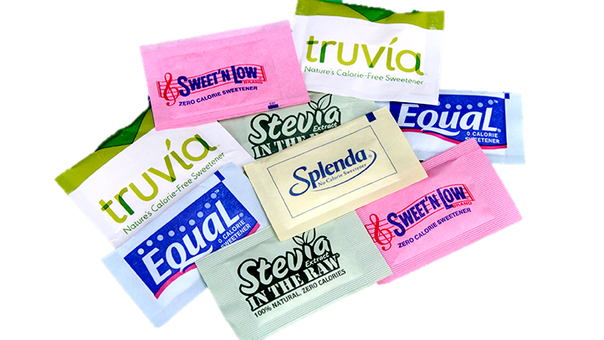
Sugar Substitutes
This Photo by Unknown Author is licensed under CC BY-SA

Slide 3

This Photo by Unknown Author is licensed under CC BY-SA-NC

Slide 4
About the presenter
Ronanda Liberty, 20 Year Educator
B.A. Elementary Ed
EdM Literacy Development
Principal-North Franklin School District; Junior High (Refreshed)
Instructor-Walla Walla Community College/Coyote Ridge Corrections & Washington State University College of Education
Speaker- Sharing cool stuff and providing tools and support to engage learners and calm classrooms
Mom-Amazing Adultlets and an animal Menagerie

Slide 5

Carrying Boxes

Slide 6

This Photo by Unknown Author is licensed under CC BY-NC-ND

Slide 7
“When creating relevancy, the hardest part for us, as teachers, is to remember that learning relevancy is not about us.”
-Eric Combs

Slide 8
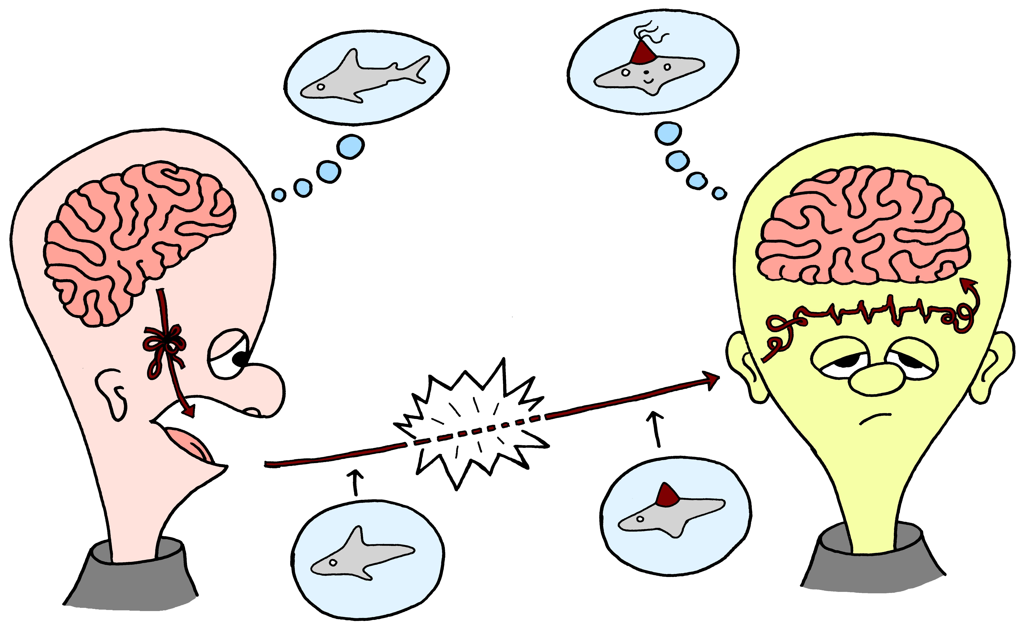
This Photo by Unknown Author is licensed under CC BY

Slide 9
Session objective
Explore a Strategy
That increases student engagement, comprehension and retention; fosters deepening of cognitive skills; offers equitable access to learners
Process and Apply
Collaborate, discuss, and apply to your own practice

Slide 10
Building Understanding from Learner Centered
Relevancy
©

Slide 11
Is like
Division
Subtraction
Thesis statement
Photosynthesis
Scientific process
……
……
……
……
a pizza party
putting toys away
an umbrella
breathing
a road map
©

Slide 12
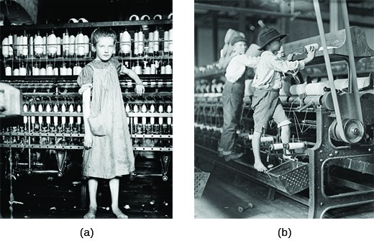
Let’s begin…The Synectic Journey
LABOR UNIONS
During the
Industrial Revolution
This Photo by Unknown Author is licensed under CC BY

Slide 13
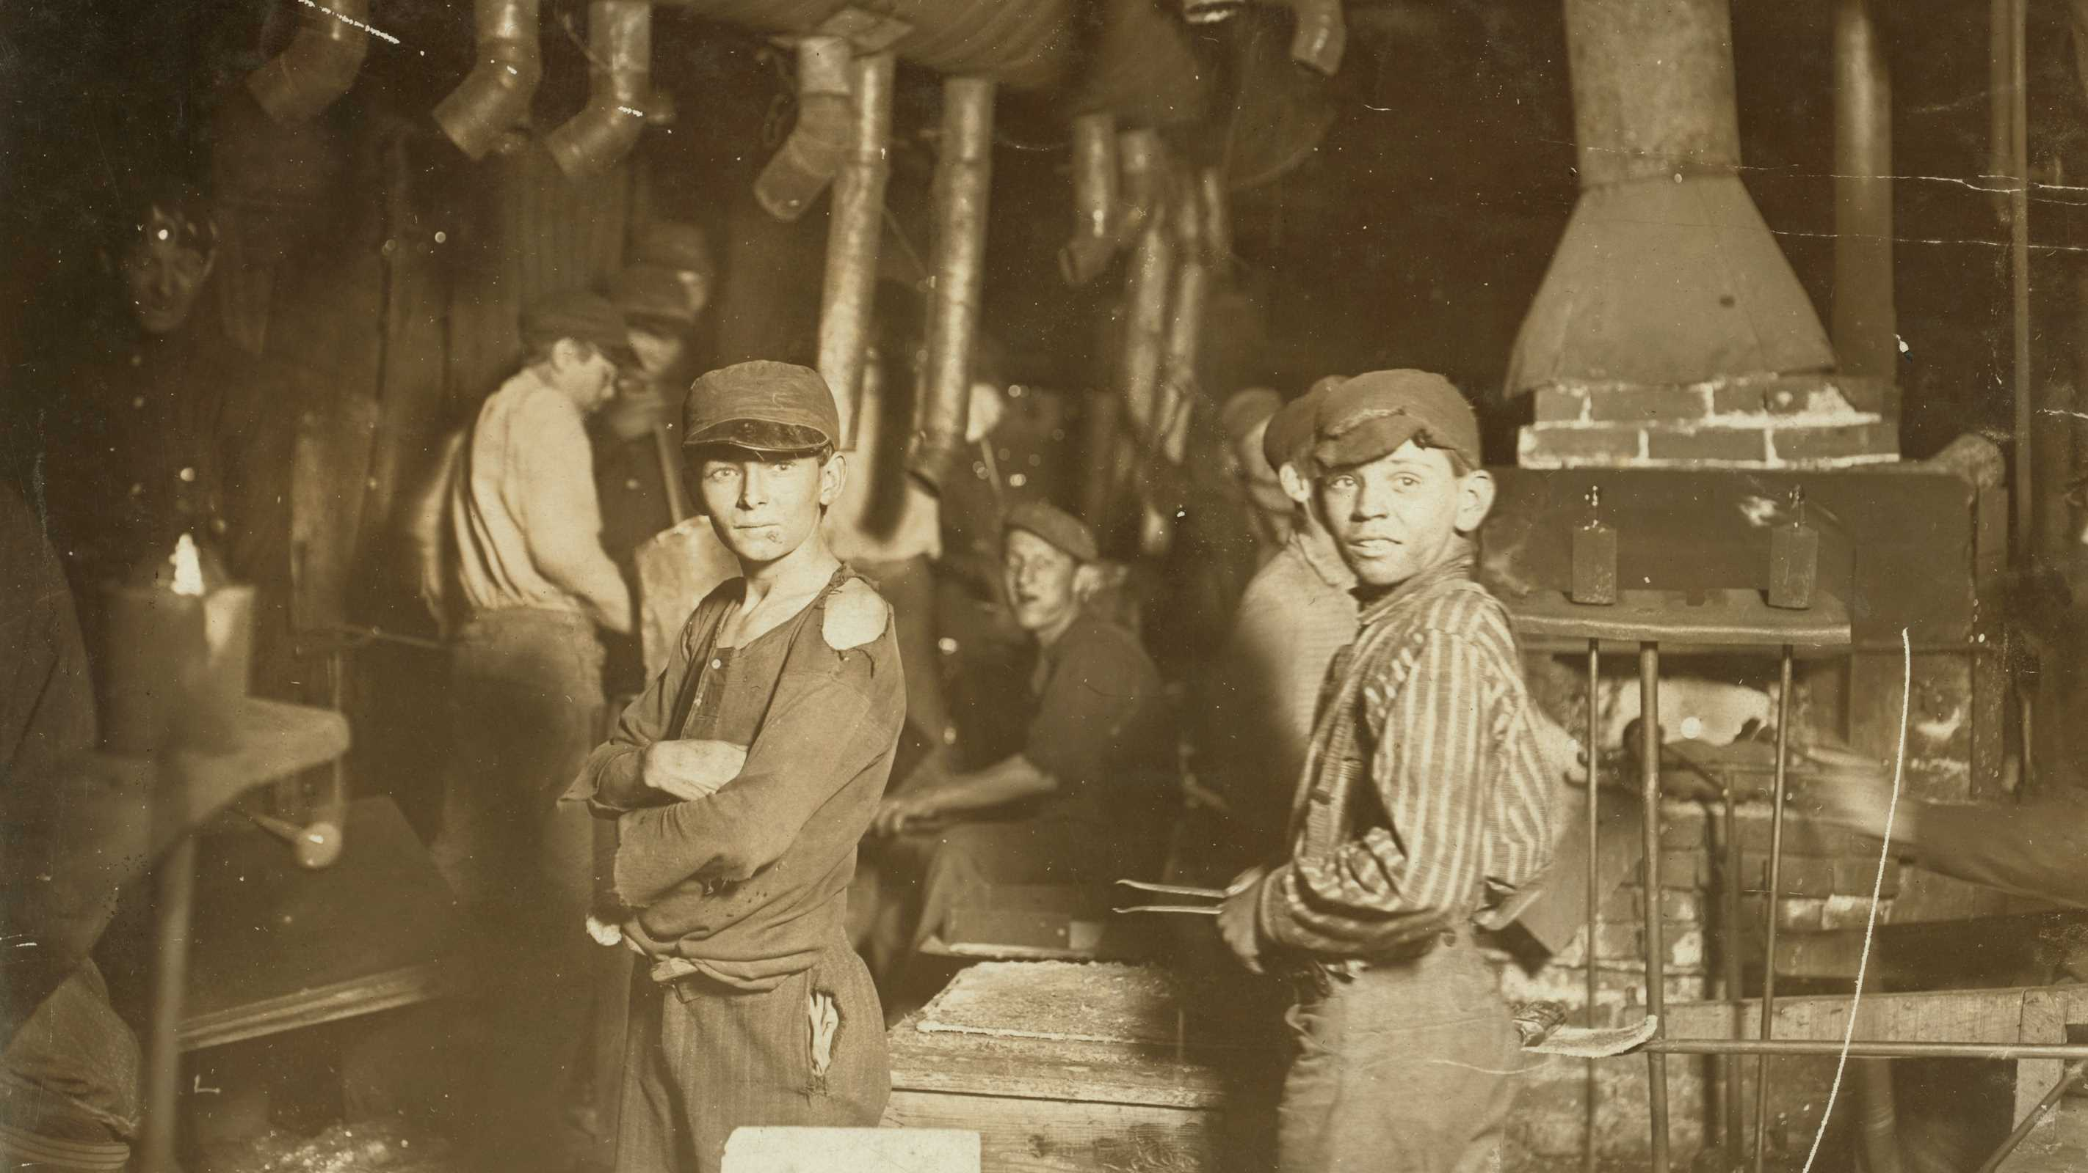
Child Laborers
This Photo by Unknown Author is licensed under CC BY-SA-NC

Slide 14
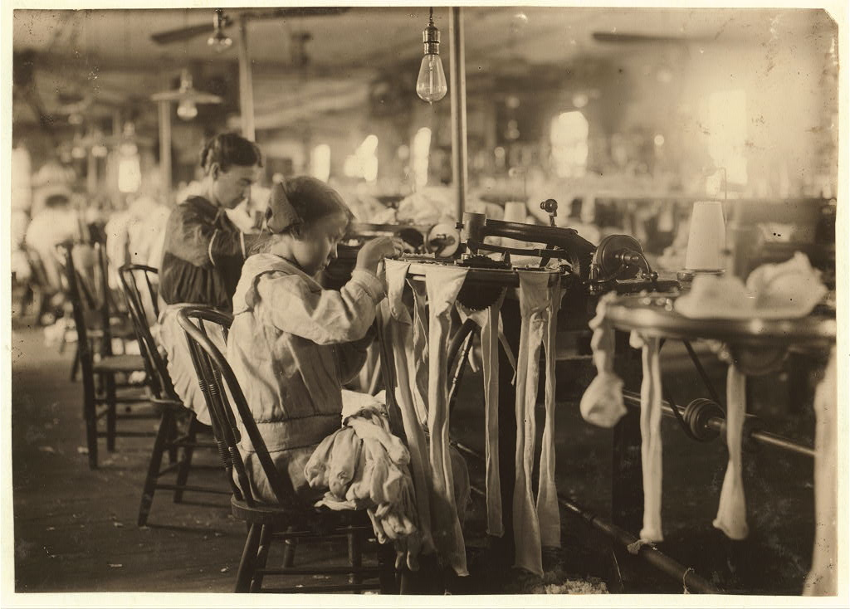
This Photo by Unknown Author is licensed under CC BY-SA-NC

Slide 15
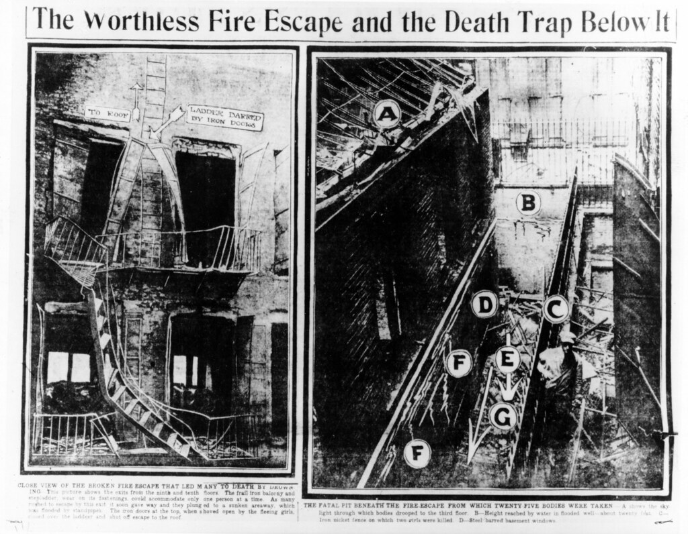
This Photo by Unknown Author is licensed under CC BY

Slide 16
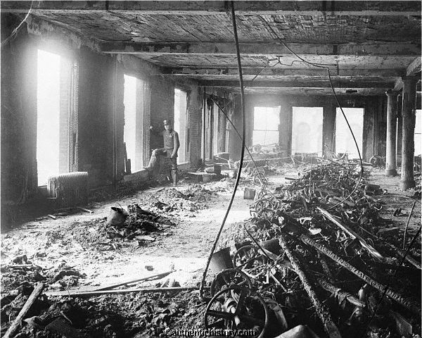
This Photo by Unknown Author is licensed under CC BY-SA-NC

Slide 17
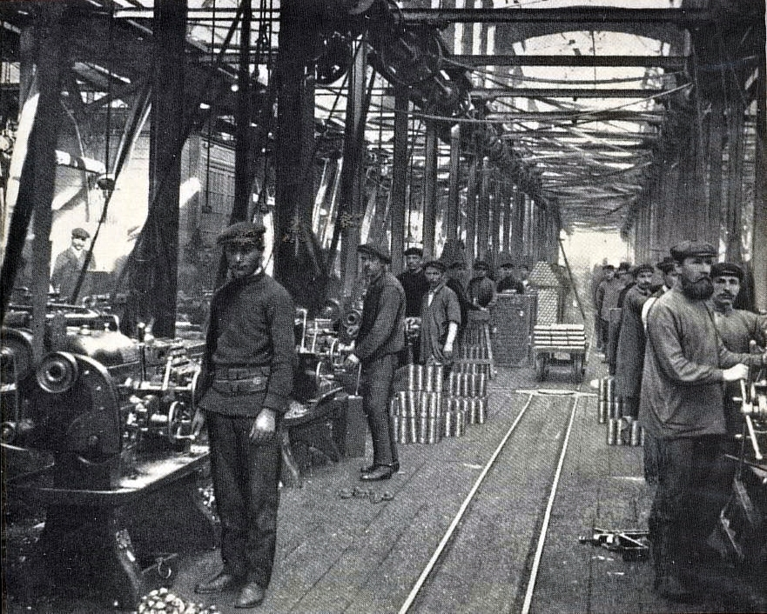
This Photo by Unknown Author is licensed under CC BY-NC-ND

Slide 18

This Photo by Unknown Author is licensed under CC BY-SA-NC

Slide 19
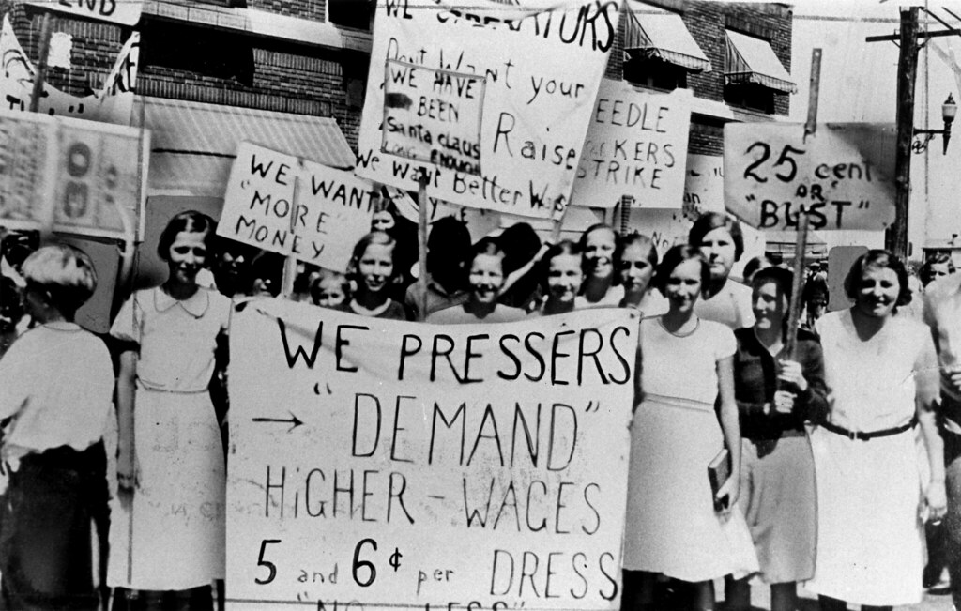
This Photo by Unknown Author is licensed under CC BY

Slide 20
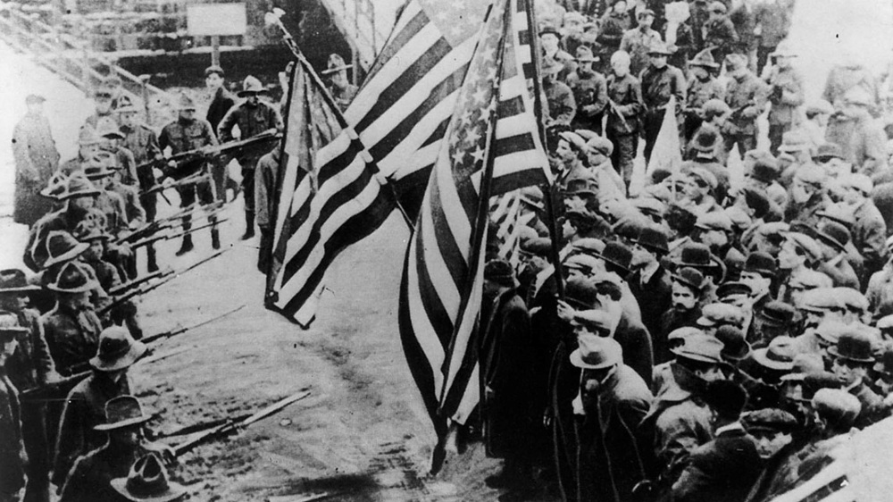
This Photo by Unknown Author is licensed under CC BY-SA

Slide 21
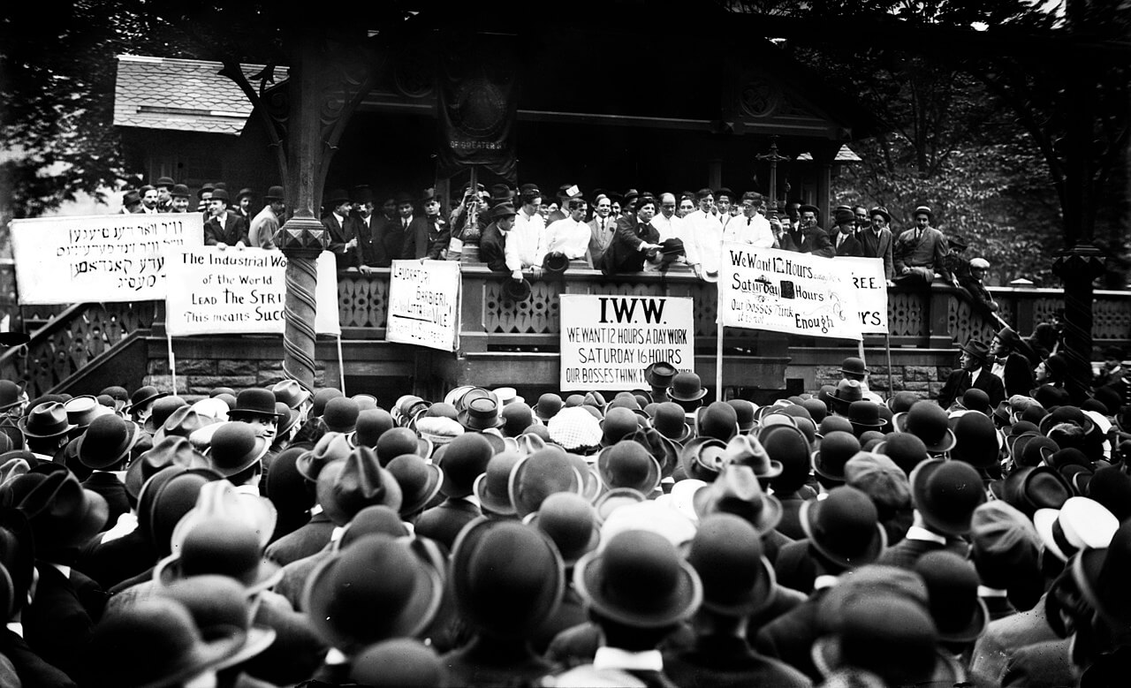
This Photo by Unknown Author is licensed under CC BY-NC-ND

Slide 22
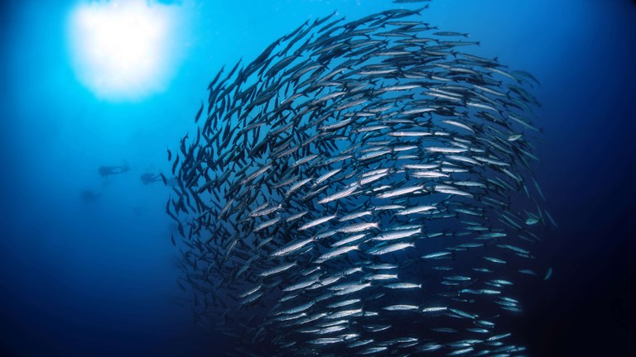
A Labor Union is LIKE: a school of fish
This Photo by Unknown Author is licensed under CC BY
©

Slide 23
A Labor Union is LIKE: a school of fish
When working together they keep things away that can harm them
because…
©

Slide 24
A Labor Union is LIKE: a school of fish
They organize themselves to stay together as they move around to achieve a common goal
because…
©

Slide 25
A Labor Union is LIKE: a school of fish
It keeps one from getting better or worse treatment from the others
because…
©

Slide 26
A Labor Union is LIKE: a school of fish
When working together they keep things away that can harm them
They organize themselves to stay together as they move around to achieve a common goal
It keeps one from getting better or worse treatment from the others
because…
©

Slide 27
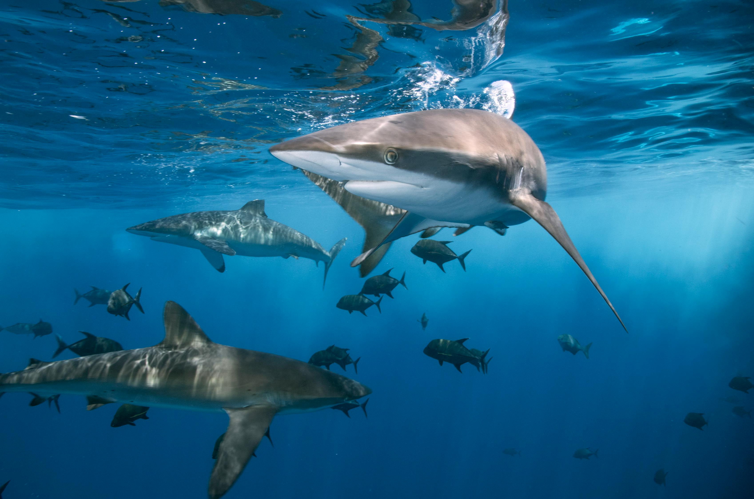

A Labor Union is NOT LIKE: a school of fish
https://www.pexels.com/photo/dangerous-sharks-swimming-in-clean-water-of-ocean-6216347/
This Photo by Unknown Author is licensed under CC BY
©

Slide 28
A Labor Union is NOT LIKE: a school of fish
The people are not eaten by the things that can harm them (employers that exploit workers/sharks eat fish)
because…
©

Slide 29
A Labor Union is NOT LIKE: a school of fish
People can choose to participate; fish follow their survival instinct
because…
©

Slide 30
A Labor Union is NOT LIKE: a school of fish
People can negotiate (give and take) with employers; fish do not negotiate with sharks
because…
©

Slide 31
A Labor Union is NOT LIKE: a school of fish
The people are not eaten by the things that can harm them (employers that exploit workers/sharks eat fish)
People can choose to participate; fish follow their survival instinct
People can negotiate (give and take) with employers; fish do not negotiate with sharks
because…
©

Slide 32
YOUR TURN!
How is a labor union
LIKE
a school of fish?
How is a labor union
NOT LIKE
a school of fish?
A labor union is LIKE a school of fish , because ________.
A labor union is NOT LIKE a school of fish, because ________.
©

Slide 33
Try creating your own example:
(can’t use school of fish)
1.
A labor union is
LIKE ___________:
Because ________
Because ________
Because ________
A labor union is
NOT LIKE ___________:
Because ________
Because ________
Because ________
©

Slide 34
In your own words
2.
What is a labor union?
_______________________________
_______________________________
_______________________________
©

Slide 35
Book definition
3.
Workers who agree to work together (organize) for the purpose of improving working conditions and wages.
©

Slide 36
Synectic journey recap
Connect from the student’s point of view before connecting
to the book’s point of view.
©

Slide 37
Simple formula
I do: Teacher Exemplar
WE do: Students make their own connections, then share
YOU do: Students come up with their own definition’
Bring it all together: Provide the “book” definition
©

Slide 38
Processing
What concepts or terms do your students find difficult to connect with or comprehend?
Examples…

Slide 39

Examples
An entrepreneur is like a stunt man
Inflation is like a tube of toothpaste
A community helper is like your family
Money/Currency is like your family
Saving money is like burying treasure
Taxes are like a group project
A bank is like a coffee can
This Photo by Unknown Author is licensed under CC BY-SA

Slide 40
Processing—Apply to your own practice
More ideas to get you started…
Interpersonal communication is like…
Metadata is like…
Civics is like…
Correlation coefficient is like…
Genetic drift is like…
Global economics is like…
Ethics is like…
Multifactorial causation is like…

Slide 41
Processing
Use the tool to create teacher exemplars for your own content.

Slide 42
Processing
Share Out

Slide 43
Keep in touch!
Share. Ask. Connect.
Ronanda Liberty
ronanda@libertytolearn.education
509-280-1212

